Slide 1

BASIC Data through an Equity Lens
BASIC Monthly Teams Call
February 21st, 2022

Slide 2
Call Overview
Face-to-Face 2022
BASIC Data Review
ILPQC Birth Equity Initiative
Integrating Equity into our Neonatal Work
Neonatal Equity Team Talk
Wrap Up
Notes:
Add Icebreaker: go-to first wordle word

Slide 3


2022 OB & Neonatal Face-to-Face Meetings
Obstetric May 25, 2022
Neonatal May 26, 2022
2022 ILPQC 10th Annual Conference
Thursday, October 27, 2022
More information coming soon!
VIRTUAL

Slide 4
Face to Face Preparation
Share the save the date with QI team NOW!
Look out for registration March 2022!
Email info@ilpqc.org if you are interested in volunteering for a role at the F2F meeting including:
  Planning committee
  Breakout Facilitators
Review data submission status and progress towards QI Recognition Awards
Information to come soon about QI team "Storyboards" for the F2F
Notes:
Dan's notes:
Planning committee recruitment open...first meeting...
Registration Open...
Continuing Education (ONA)…
Submit data for QI Awards...
Storyboard information and submission deadlines...

Slide 5

BASIC QI Recognition Awards
All structure & patient-level data entered for Baseline-March 2022 due May 1st, 2022, at Midnight
Key Structure Measures "In Place":
  Standardized Family Education Process
  EOS Risk Assessment Protocols for ≥35 and <35 Newborns
  Standardized Dosing Guidelines
  Antibiotic Discussions/Time Outs Protocol
  Standardized Automatic Stop Order Process
Achievement of process and outcome level measures (Based on Jan – March 2022 data)
  ≥80% of neonatal/pediatric providers and nurses educated
  20% reduction (or absolute rate of ≤4%) in newborns ≥35 weeks who receive antibiotics
  20% reduction in newborns with a negative blood culture who receive antibiotics for >48 hours
  ≥80% of newborns with the anticipated duration of antibiotic course discussed by clinical team (antibiotic time out)
  ≥80% of newborns with an automatic stop order entered into the medical chart
F2F Award Criteria:
Data complete
Structure measures in place
At least 3 process/outcome measures achieved
Notes:
Data complete, structure measures in place, 3 process/outcome measures achieved
Hospital has implemented a process for standardized education for healthcare team on neonatal antibiotic stewardship best practices
Hospital has provided patient standardized education and anticipatory guidance with a focus on equitable care to families on antibiotics, early onset sepsis, and treatment plan for newborn antibiotics and early onset sepsis
Hospital has developed, in coordination with IT department, an electronic reporting system from electronic medical record
Hospital has Implemented Quality Improvement strategies to ensure feedback is provided to the neonatal/pediatric clinical team through one or more of the following components: 1. monitor and share provider-level and/or unit level antibiotics prescribing data; 2. antibiotic debriefs to identify & review neonatal sepsis and antibiotic decisions for consistency with protocols and procedures; 3. report that tracks current inpatient newborns who are receiving antibiotics
Hospital has implemented standardized policies, protocols, and support tools to evaluate risk for early onset sepsis for newborns for ≥ 35 0/7 weeks gestation based on the AAP recommended risk assessment tools.
Hospital has implemented standardized risk assessment algorithm to evaluate risk of early onset sepsis for every neonate < 35 weeks gestation.
Hospital has developed partnerships with obstetric team to standardize communication with the pediatric/neonatal team about maternal risk factors for early onset sepsis.
Hospital has implemented standardized serial assessment of neonates
Hospital has implemented standardized identification of and response to neonates with worsening clinical status.
Hospital has implemented standardized policies, protocols and support tools to assist staff in properly and consistently obtaining blood cultures
Hospital has partnered with inpatient lab to optimize timely processing of blood culture results and communication with care team
Hospital has implemented standardized policies, protocols and support tools to assist staff to stop or de-escalate therapy promptly based on the culture and sensitivity results
Hospital has implemented standardized dosing guidelines and order sets to reduce intra-hospital variation of antibiotic prescribing
Hospital has implemented standardized approach for healthcare team to discuss the anticipated duration of antibiotic course at the initiation of antibiotics (antibiotic time out)
Hospital has implemented standardized automatic stop order process
Hospital has implemented a standardized process to review antibiotic data by race/ethnicity and share with providers and staff.
Hospital has implemented a social determinants of health tool and facilitates coordinated connection to community resources and follow up.

Slide 6
Update on BASIC Progress

Slide 7
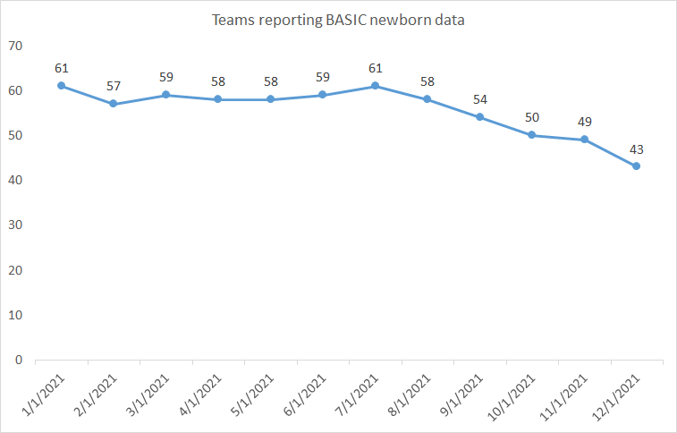
BASIC Team REDCap Reporting
73 of 82 teams have ever submitted data!

Slide 8
BASIC Data Collection Updates
We are listening to you!
Working to update the monthly newborn data form to remove questions that may be time consuming to collect and less directly tied to achievement of initiative aims including:
  Maternal risk for EOS questions
  Newborn antibiotic prescribing rationale
  Additional criteria
We will update the paper data form and hide questions on the REDCap data form starting March 1, 2022

Slide 9



2021 Data Completion Raffle Winner
All teams who entered BASIC Patient and Hospital data for all of 2021 by February 15th
Thanks to all teams – 70% of teams had complete 2021 data!
Treat your team to a pizza lunch or coffee and donuts!
And the winner is…..
Anderson Hospital!!
Notes:
WINNER: Anderson Hospital

Slide 10
Equity in our Neonatal Work
We are working to incorporate equity work into all of our initiatives on both the OB and Neonatal side of ILPQC
Huge inequities have been documented in maternal and neonatal outcomes
ILPQC launched the Birth Equity Initiative in 2021 to address these inequities and many of the great resources they have created and compiled are applicable for our neonatal teams as well
Notes:
Transition to BE

Slide 11

ILPQC Birth Equity Initiative
Ieshia Johnson, MPH
ILPQC Project Coordinator

Slide 12
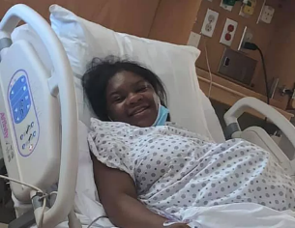
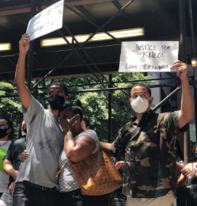
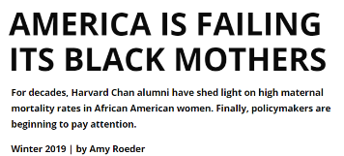



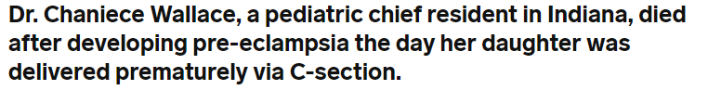
Why we do this work?
Photo credits (clockwise from upper left): Sha-asia Washington: Juwan Lopez/Facebook, Claudia Irizarry Aponte/THE CITY, Amber Rose Isaac: Bruce McIntyre, LWA/Dann Tardif/Getty Images; Anna Medaris: www.insider.com;Shalon Irving: www.hsph.harvard.edu/;

Slide 13
In 2018, compared to white infants,
Black infants were:
180% more likely to die during the first year of life
  70% more like to die from birth defects
  140% more likely to die from prematurity or fetal malnutrition
  160% more likely to die from pregnancy or delivery complications
  510% more likely to die from Sudden Unexpected Infant Death
Data Source: Illinois Death and Birth Certificates, 2018

Slide 14

ILPQC Birth Equity Initiative
Hospital teams voted on BE in 2019
86 hospital teams participating across IL
2019-2021 prep work and toolkit development
14 Wave 1 teams trial data form 1/2021-4/2021
Launch call 6/2021, have started monthly calls and data collection
Foundational work for all hospitals to address equity and improve quality of care / patient experience will support all future QI work

Slide 15





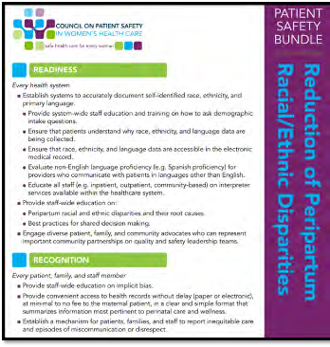




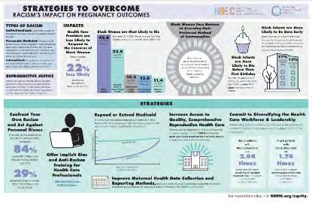
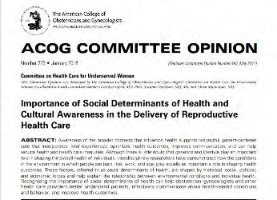


National Guidelines & PQC Partners
Illinois Perinatal Quality Collaborative
9

Slide 16

Expanded resources for engaging
patients, families and communities
Patient, Family and Community engagement pilot
Consulting Everthrive to promote community engagement
Patient focus groups and feedback
Maternal Health Task Force engagement
Patient engagement consultant: LaToshia Rouse
Infant and Maternal Mortality Among African Americans Task Force

Slide 17
BE Aims and Measures

Slide 18

What is the focus of Birth Equity (BE)?
BE AIM: By December 2023,
more than 75% of Illinois birthing hospitals will be participating in the Birth Equity Initiative and
more than 75% of participating hospitals will have the key strategies in place.
86% of Illinois birthing hospitals participating!
Promote patient- centered approach to engage patients and communities
Develop respectful care and bias education for providers, nurses, and staff
Addressing Social Determinants of Health
Review race/ethnicity medical record and quality data

Slide 19

BE Key Drivers Diagram
Strategies
By December 2023, more than 75% of Illinois birthing hospitals will be participating in the Birth Equity Initiative and more than 75% of participating hospitals will have all key strategies in place
1. Address social determinants of health during prenatal, delivery, and postpartum care to improve birth equity
1. Utilize ILPQC social determinants of health (SDoH) community resources mapping tool to assist linking patients to resources based on the social determinants of health screening and share with affiliated prenatal care sites and hospital OB units
3. Engage patients, support partners including doulas, and communities to improve birth equity
2. Utilize race/ethnicity medical record and quality data to improve birth equity
4. Implement processes and protocols for improving the collection and accuracy of patient-reported race/ethnicity data
7. Identify a patient advisor for hospital perinatal quality improvement team or other opportunities to engage patient / community members
8. Implement a strategy for sharing expected respectful care practices with delivery staff and patient (i.e. posting in L&D) including appropriately engaging support partners and/or doulas
5. Develop and implement a process to review and share maternal health quality data stratified by race/ethnicity and Medicaid status
6. Implement a Patient Reported Experience Measure (PREM) patient survey to obtain feedback from postpartum patients and a process to review and share results with providers, nurses, and staff
9. Provide patients the recommended postpartum safety patient education materials prior to hospital discharge including education on urgent maternal warning signs, postpartum safety, communication with healthcare providers and importance of early follow up
4. Engage and educate providers, nurses, & staff to improve birth equity
10. Educating providers, nurses, and staff on the importance of listening to patients, providing respectful care and addressing implicit bias
2. Screen patients for social determinants of health during prenatal care and delivery admission and appropriately link to resources
3. Implement strategy for incorporating discussion of social determinants of health and discrimination as factors in potential hospital maternal morbidity reviews
Drivers
AIM

Slide 20
Key QI Strategies
Optimize race/ethnicity data collection & review key maternal quality data by race, ethnicity & Medicaid status
Engage patients and community members for input on quality improvement efforts
Universal social determinants of health screening tool (prenatal/L&D) with system for linkage to appropriate resources
Share respectful care practices on L&D and survey patients before discharge on their care experience (using the PREM) for feedback
Standardize postpartum safety education and schedule early postpartum follow up prior to hospital discharge
Implicit Bias / Respectful Care training for providers, nurses and other staff
Notes:
Optimize race/ethnicity data collection and review key maternal quality data by race, ethnicity and Medicaid status
Universal social determinants of health screening tool (prenatal/L&D) with system for linkage to appropriate resources
Share respectful care practices on L&D and survey patients before discharge on their care experience (using the PREM tool) for feedback
Engage patients and community members for input on quality improvement efforts
Standardize postpartum safety education and schedule early postpartum follow up prior to hospital discharge
Implicit Bias / Respectful Care training for providers, nurses and other staff

Slide 21
BE Topics covered on webinars so far……
Optimizing race / ethnicity data collection for OB patients
August
Review maternal health quality data stratified by race, ethnicity, and Medicaid status
September
Data Reporting Webinars
July
Birth Equity Statewide Launch
June
Universal Social Determinants of Health Screening and mapping resources
November
Implementing Respectful Care Practices and PREM
December

Slide 22
Structure Measures:
Implementing Systems Changes

Slide 23
Structure Measures:
Implementing Systems Changes
Notes:
System to provide patients postpartum safety education, where to call, and early follow-up

Slide 24
Process Measures
Measures |  | Baseline Data
Patients screened prenatal and during delivery admission with SDoH screening documented using a SDoH screening tool | SDoH Tool Documented Prenatal | 23%
 | SDoH Tool Documented L&D | 9%
Patients linked prenatal and during delivery admission screened positive for SDoH that have documentation of patient linkage to needed resources/services | SDoH Linkage to Resources Prenatal | 6%
 | SDoH Linkage to Resources L&D | 4%

Slide 25
Process Measures:
Postpartum Safety

Slide 26
Process Measures:
Staff Training

Slide 27

BE Toolkit
Birth Equity Toolkit now available online: https://ilpqc.org/birthequity/
Created with national resources/guidance, and resources from other PQC’s

Slide 28



Strategy: Optimize race/ethnicity medical record and quality data
How to Ask the Questions Regarding Race/Ethnicity
Tools and strategies to optimize collection and accuracy of race/ethnicity data
Resources to develop a process to review hospital maternal health quality data by race, ethnicity, and Medicaid status
Hospital Guide to Stratifying Data by Patient Demographics
Assemble workgroup
Validate patient data
Identify priority metrics
Determine if stratification is possible
Stratify the data

Slide 29

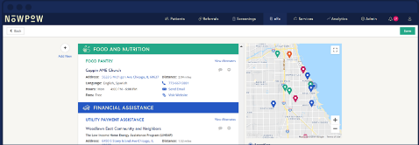
Strategy: Implement universal social determinants of health screening and linkage to appropriate resources
Sample screening tools
Community resources and mapping tool
Folders with patient and provider resources for SDoH screen positive patients
SDoH Folder
SDoH Screening Tools
SDoH Resource Mapping Tool
NowPow Access Guide
Universal SDoH Resources
SDoH Tip Sheets by Topic
Local SDoH Resources
Patient handouts on SDoH resources (ILPQC Tip Sheets and or NowPow* referral)
Create a Process Flow for patients who screen positive to confirm documentation & linked to resources
*NowPow searchable database for personalized referrals for local resources
Illinois Perinatal Quality Collaborative

Slide 30

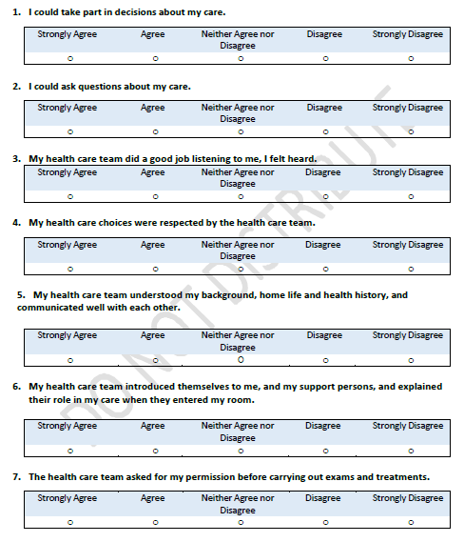



Strategy: Share Respectful Care Practices
Provided to Patients on Delivery Admission
Labor & Delivery
PREM
Respectful Care Practices
Notes:
Teams will receive patient handout with QR code reports on patient feedback will be available in the ILPQC Data System
Available in English and Spanish
Additional 7 languages coming soon

Slide 31
Strategy: Engage patients and community members for input on quality improvement efforts
LaToshia Rouse (patient advisor consultant) provided patient engagement pilot
Everthive will host community meetings in 10 perinatal regions with Birth Equity QI team leads and community organizations. Birth Equity teams will learn:
  How to identify patients/community groups, share example of people who might give feedback, how would you facilitate?
  How do you invite community members to provide feedback?
  How do get the feedback - hold special meeting, open discussion, get feedback?
  How do you integrate feedback into your work, share with your team?
  How to you follow up / make community input an ongoing process, have some group meeting regularly or / and select an individual for ongoing relationship / feedback?
  While applying examples from Birth Equity key QI strategies

Slide 32



Strategy: Standardize postpartum safety education and schedule early postpartum follow up prior to hospital discharge
Tools to improve postpartum safety patient education and support for early postpartum follow up
  Urgent maternal warnings signs handouts in up to 5 languages
  Patient conversation guide for maternal warning signs
  Healthy pregnancy spacing handout
  Benefits of early postpartum care handout

Slide 33




Strategy: Develop respectful care and bias education for providers, nurses, and staff
E-modules for provider, nurse & staff education
Grand Rounds
SPEAK UP train the trainer sponsored training
Laboring with Hope
CDC Hear Her Messaging Campaign
Tools to address diversity within healthcare hiring

Slide 34
Any Questions?

Slide 35
Neonatal Inequities in Illinois
IDPH Data

Slide 36
Illinois Infant Mortality Rate Trends by Race/Ethnicity
Racial differences have been persistent over time
We have achieved no improvement in the Black infant mortality rate in IL since 2008
Healthy People 2020 Goal
Data Source: Illinois Death Certificates, 2000-2018

Slide 37
Racial Disparities in
Illinois Infant Mortality
Infants born to Black women are nearly three times as likely to die as infants born to white women
Infant mortality among Black infants only racial group in IL for who we are not meeting the Healthy People 2020 objective
Healthy People 2020 Goal
Data Source: Illinois Death and Birth Certificates, 2018

Slide 38
In 2018, compared to white infants,
Black infants were:
180% more likely to die during the first year of life
  70% more like/y to die from birth defects
  140% more likely to die from prematurity or fetal malnutrition
  160% more likely to die from pregnancy or delivery complications
  510% more likely to die from Sudden Unexpected Infant Death
Data Source: Illinois Death and Birth Certificates, 2018

Slide 39
Applications for Equity in our BASIC Work
Ellie Suse, MSN, MPH, RN
ILPQC Project Coordinator

Slide 40
Driver 4: Equitable Care
Equitable Care Delivery: Building your capacity to identify and eliminate inequities and disparities
Inequities and disparities identification:
  Data availability
  Data reporting
  Data analysis to drive change
  Data presentation to drive change
  Family partnership
Inequities and disparities elimination:
  Standard evidence based best practice
  Identify care variation
  Decrease care variation
  Care delivery in preferred language
  Identification of SDoH needs
  Family partnership
  Physician education
  Nurse education

Slide 41
What have we discussed so far?
(Aug 2021)
Race and Ethnicity Data Collection and the importance of patient/care-giver reported data
  Patient/care-giver self-reporting of REAL data is the gold standard of data collection.
    Staff should not attempt to guess a patient’s race, ethnicity or preferred language
  Health care organizations should collect information on patients' race and ethnicity in order to measure disparities in care—-and see if they exist in the organization

Slide 42
Optimizing REAL Data Collection
Four-Step Approach to Ensure Successful REAL Data Collection
1) Determine the appropriate data categories
2) Develop a methodology for data collection
3) Train staff members on methodology for data collection
4) Assign accountability and monitor progress of data collection efforts
Source: American Hospital Association, 2013.
Notes:
Brief reminder of resources discussed in August

Slide 43
Sample Language to Request Patient Race and Ethnicity Data
Sample 1: “We want to make sure all patients are getting the best care possible, can you tell us what you consider your baby’s race, ethnicity, and your preferred language?”
(Adapted from ILPQC Focus Groups)
Sample 2: “<Insert hospital name> is committed to giving you and all of our patients the best care possible. In order to do this we ask you to tell us how you would describe your baby’s race, ethnicity and your preferred language. If you would like to tell us your country of origin, we would be interested in that, too.”
(Adapted from Health Partners)
Sample 3: "We want to make sure that all our patients get the best care possible. We would like you to tell us your baby’s racial/ethnic background so that we can review the treatment that all patients receive and make sure that everyone gets the highest quality of care.“
(Adapted from American Hospital Association)
Use PDSA cycles to test out a few versions to find the language that best fits your institution and patients' preferences.
Notes:
Brief reminder of resources discussed in August

Slide 44
Resources
VI. Utilize Race and Ethnicity Medical Record and Quality Data
  a. Improve patient-reported race/ethnicity data collection for EMR
    HPOE - Reducing health care disparities: collection and use of race, ethnicity and language data
    AHA: How to Ask the Questions Regarding Race/Ethnicity
    AHA: Staff Training and Scripts Examples
    AHA: Optimizing Real Data Collection
    AHA: Develop a Methodology for Data Collection
    ILPQC: Process Flow for Race & Ethnicity Data Collection with Staff Responses
  b. Resources to assist review of hospital maternal health quality data by race, ethnicity, and Medicaid status
    HRET: Framework for Stratifying Race, Ethnicity, and Language Data
    ILPQC: Hospital tip sheet and resource overview for developing a process to review maternal health quality data stratified by race/ethnicity and Medicaid status
Notes:
Brief reminder of resources discussed in August

Slide 45
Equity Resources
Implicit bias training for providers and staff
Share Diversity Science E-Modules with staff
Respectful care practices for providers and staff
Social determinants of health support for patients/families
Engage patients/families
Share Respectful Care practices with parents and caregivers
Implement universal social determinants of health screening and linkage to appropriate resources

Slide 46

Implicit Bias: Diversity Science e-modules
ILPQC has partnered with Diversity Science to provide simplified online access to the Dignity in Pregnancy and Childbirth online e-module training
3-module free program for perinatal providers, nurses and staff
  With resources to promote health equity in clinical practice and organizations also available
Free access to the resources and support to add e-modules to online hospital learning systems will be provided
Access at https://www.diversityscience.org/ilpqc-new/

Slide 47
Respectful Care
Treating you with dignity and respect throughout your hospital stay
Introducing ourselves and our role on your care team to you and your support persons upon entering the room
Learning your goals for delivery and postpartum: What is important to you for labor and birth? What are your concerns regarding your birth experience? How can we best support you?
Working to understand you, your background, your home life, and your health history so we can make sure you receive the care you need during your birth and recovery.
Communicating effectively across your health care team to ensure the best care for you
Partnering with you for all decisions so that you can make choices that are right for you
Practicing “active listening”—to ensure that you, and your support persons are heard
Valuing personal boundaries and respecting your dignity and modesty at all times, including asking your permission before entering a room or touching you
Recognizing your prior experiences with healthcare may affect how you feel during your birth, we will strive at all times to provide safe, equitable and respectful care
Making sure you are discharged after delivery with an understanding of postpartum warning signs, where to call with concerns, and with postpartum follow-up care visits arranged
Ensuring you are discharged with the skills, support and resources to care for yourself and your baby
Protecting your privacy and keeping your medical information confidential
Being ready to hear any concerns or ways that we can improve your care
Notes:
Using inclusive language is just one part of creating a respectful environment for patients but it can be a place for providers to start.
1 minute to read
Patti, Can I edit these to be appropriate for Neo??
Hi Ellie, great question. These were thoughtfully developed and informed by other work so I hesitate to adapt them on a short timeline. I wonder if the takeaway here for all the resources in the section can be – here are some tools your OB team may be implementing that may be well suited for your neonatal team to partner on for possible use in your work. Connect with your OB team to discuss. We are here to help. Something like that, before you introduce any of the specific tools?

Slide 48
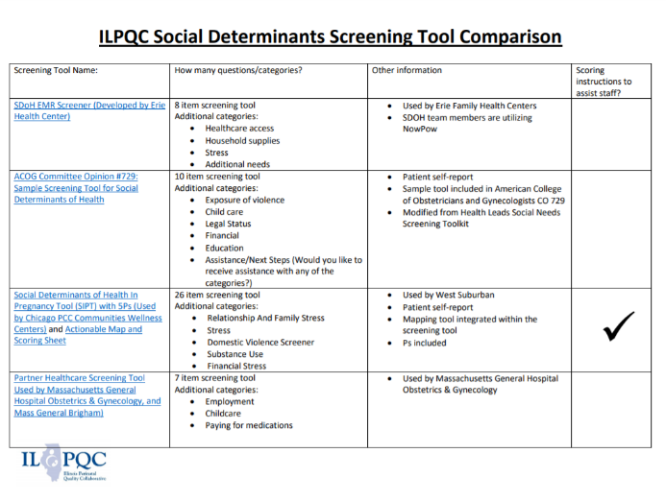
SDoH Screening
BE Team created a comparison screening tool for 4 different SDoH Screening tools

Slide 49
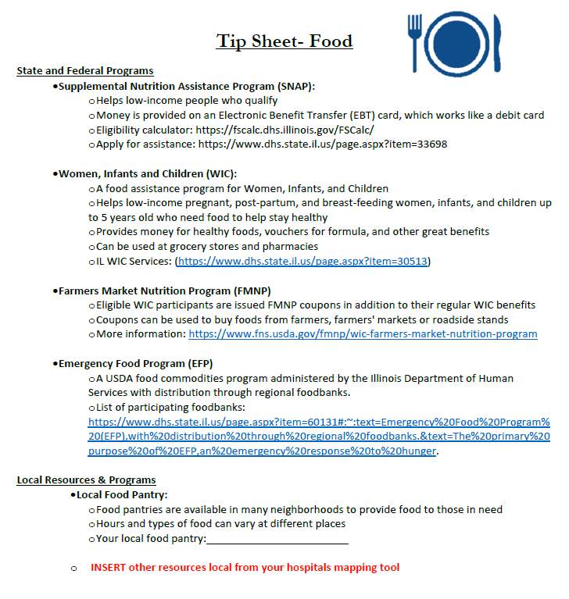
SDoH Resources: Tip Sheets

Slide 50
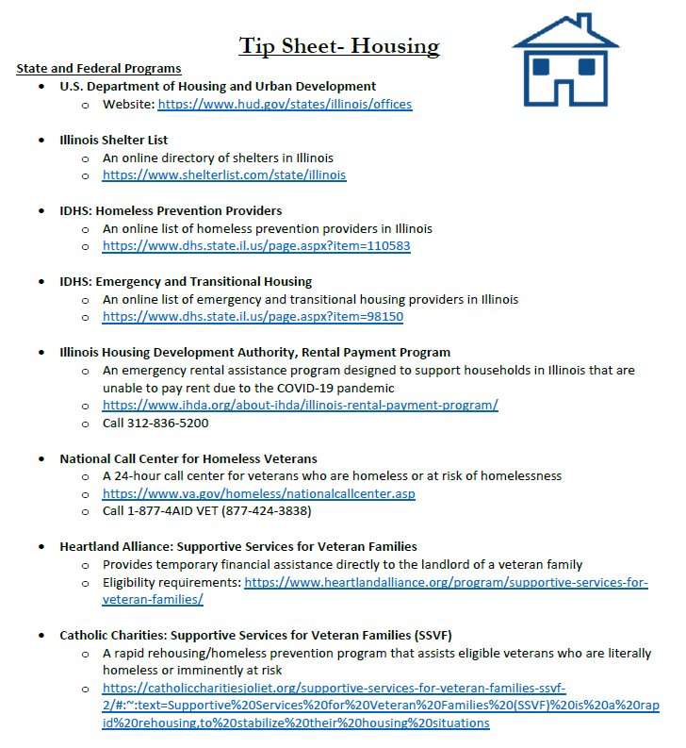
SDoH Resources: Tip Sheets

Slide 51
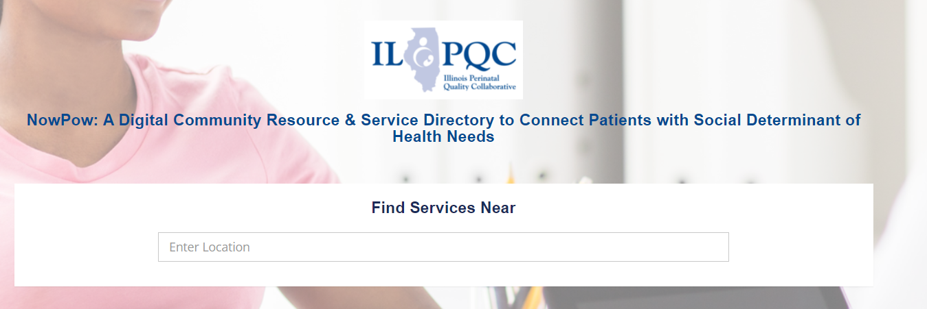
SDoH Resources: NowPow

Slide 52
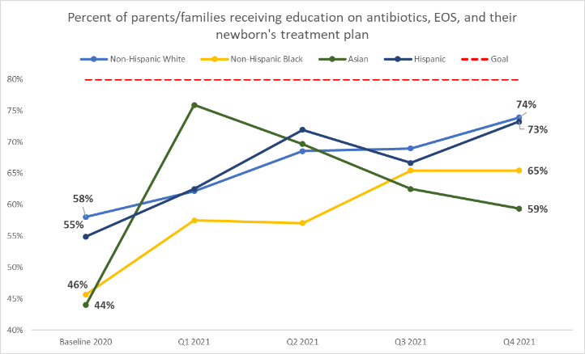
Example: BASIC Data to monitor for inequities
Differences by race in % parents/families receiving education on their newborn's treatment plan (baseline 2020)
Look at your hospital’s data and if applicable for your hospital discuss:
  WHY aren't all families equitably receiving education?
  WHO on the QI and clinical team needs to be engaged to improve this?
  WHAT changes can be implemented to ensure every family receives patient-centered education every time?
  HOW will you know if you've made an impact?

Slide 53
BASIC Data to monitor for inequities
BASIC team reviewed data for baseline 2020 and noticed that there were very small differences in the data showing newborns with a negative blood culture receiving antibiotics past 48 hours

Slide 54
BASIC Data to monitor for inequities
BASIC team reviewed data for baseline 2020 and noticed that there were very small differences in the data showing newborns with a negative blood culture receiving antibiotics past 48 hours

Slide 55
Team Talk:
Advocate Children’s Hospital

Slide 56


ADVOCATE CHILDREN’S HOSPITAL
Notes:
Advocate Children’s Hospital is a two-campus facility delivering care to the pediatric populations in the Park Ridge and the Oak Lawn communities and surrounding neighbor hoods. The NICU in Park Ridge has 54 private and open bay beds. Oak Lawn has 61 private rooms.

Slide 57
Antibiotic Stewardship
2021 | Admits | Africa American | Abx | Non- Antibiotic use | White | Abx | Non- Antibiotic use | White/ Hispanic | Abx | Non- Antibiotic use | Other/ declined | ABX | Non- Antibiotic use
Year Total | 910 | 319 |  |  | 378 |  |  | 178 |  |  | 35
 |  | 35.1% |  |  | 41.5% |  |  | 19.6% |  |  | 3.8%
Antibiotic Use Totals | 389 42.7 (57.3%) | 148 |  |  |  | 155 |  |  | 68 |  |  | 18
By census |  | 16.3% |  |  | 17% |  |  | 7.4% |  |  | 2%
By race |  |  | 46.4% | 53.6 |  | 41% | 59% |  | 38.2% | 61.8% |  | 51.4% | 48.6%

Slide 58
Understanding health care disparities
Learning modules
Vermont Oxford
Reducing Chronic Lung disease with attention to racial equities
NICU Book Club
Reproductive Injustice by Dana Ain Davis
Multidisciplinary team approach
Food
Shelter
Transportation
Interpretative Services
Document changes
QR codes meeting current technology

Slide 59
Winning
Notes:
With the actions being taken, the awareness is being brought to light. Addressing issues of disparities, we are further supporting the families of our patients. Ultimately this will drive improved outcomes for all.

Slide 60
Wrap-up and Next Steps

Slide 61
Upcoming Call Schedule
Date | Topic
March 21, 2022 2-3 PM | Private Pediatricians: Education and Communication
April 18 2022, 2-3 PM | Integrating the NEOSC into the EMR
May 26, 2022 | ILPQC 2022 Face-to-Face Meeting

Slide 62
Next Steps for BASIC
Review equity resources and determine what will be useful implementation in your hospital
Continue working towards goals to be achieved by Face-to-Face
Review Structure Measures and Face-to-Face Award Criteria
Continue with QI Team meetings and data sharing

Slide 63










Thanks to our Funders
In kind support:

