Slide 1
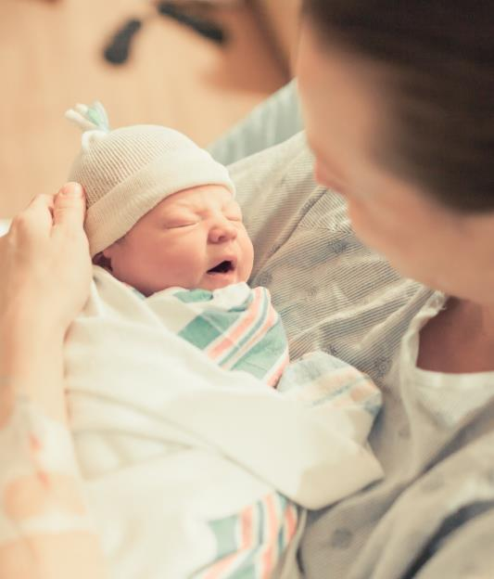
Culture Negative Sepsis
BASIC Monthly Teams Call
January 2022

Slide 2
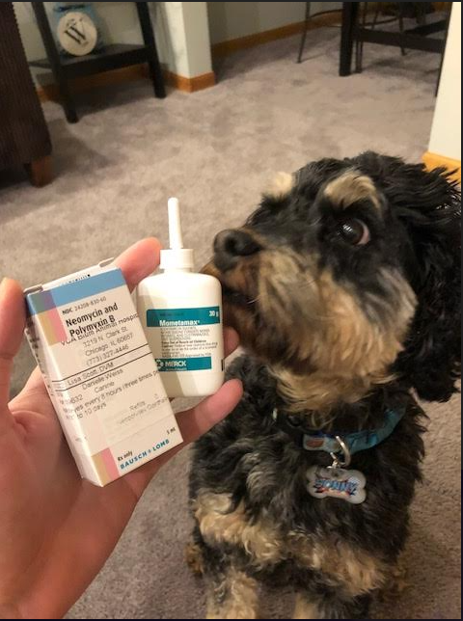
Call Overview
Updates & Housekeeping
BASIC Data Review
Culture Negative Sepsis
BASIC Team Poster Presentation
Wrap Up
Sonny on 2 antibiotics!
Ice breaker: Please share if you have a pet(s), type, and name! If you don’t have a pet, share your favorite animal!

Slide 3


2022 OB & Neonatal Face-to-Face Meetings
Obstetric May 25, 2022
Neonatal May 26, 2022
2022 ILPQC 10th Annual Conference
Thursday, October 27, 2022
More information coming soon!

Slide 4
Update on BASIC Progress

Slide 5
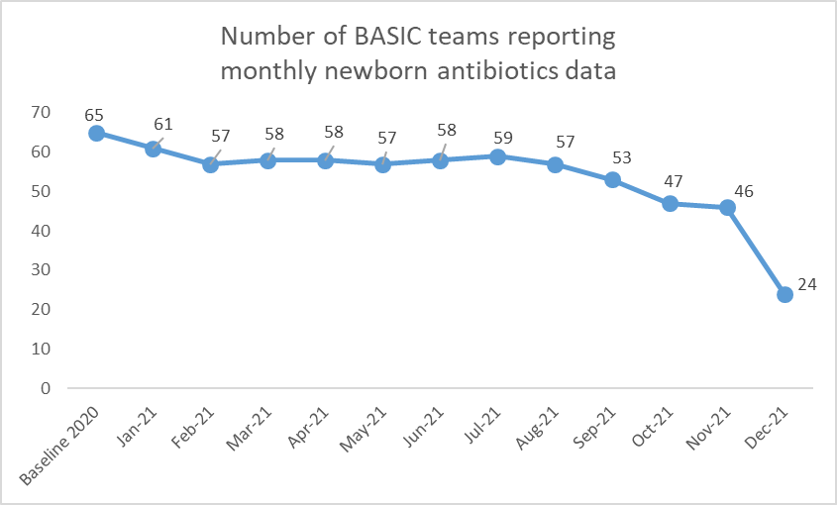
BASIC Team REDCap Reporting
December data not complete yet!

Slide 6




Enter 2021 data for a chance to win a prize!
Enter your BASIC Patient and Hospital data for all of 2021 by February 15th to be entered into a raffle!
The winning team will receive a Visa Gift Card to treat your team to a well-earned pizza lunch or coffee and donuts!

Slide 7
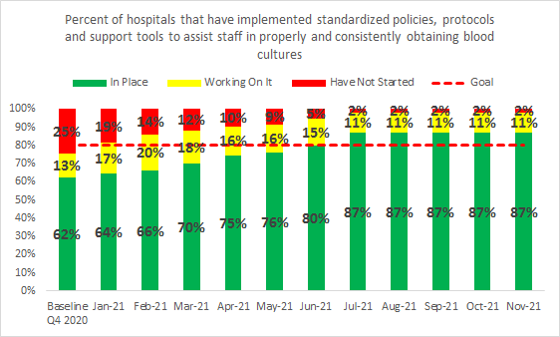
BC Collection Structure Measure

Slide 8
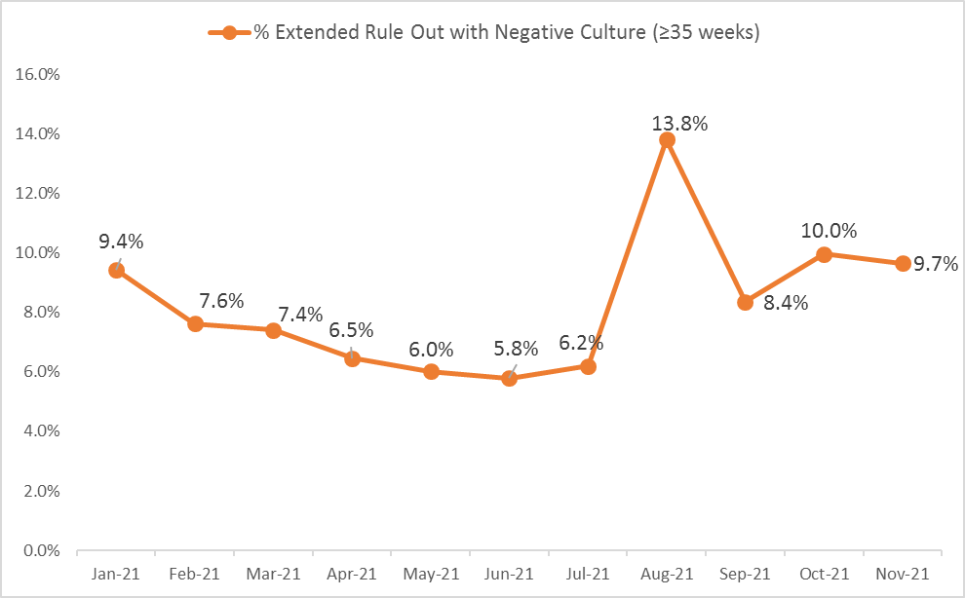
Extended Rule Out with Negative
Culture (>35 weeks):
Notes:
Put on 2 different graphs with <35 weeks data and stratify by 35-32, 31.6-28.0, <28

Slide 9
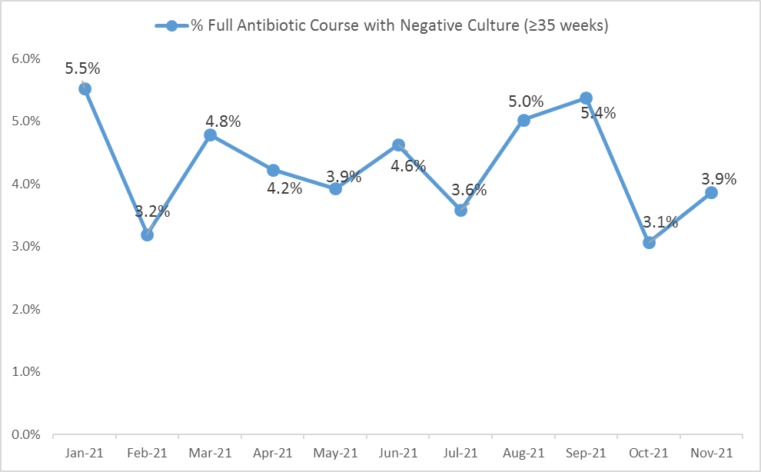
Full Antibiotic Course with Negative
Culture (>35 weeks):
Notes:
Put on 2 different graphs with <35 weeks data and stratify by 35-32, 31.6-28.0, <28

Slide 10
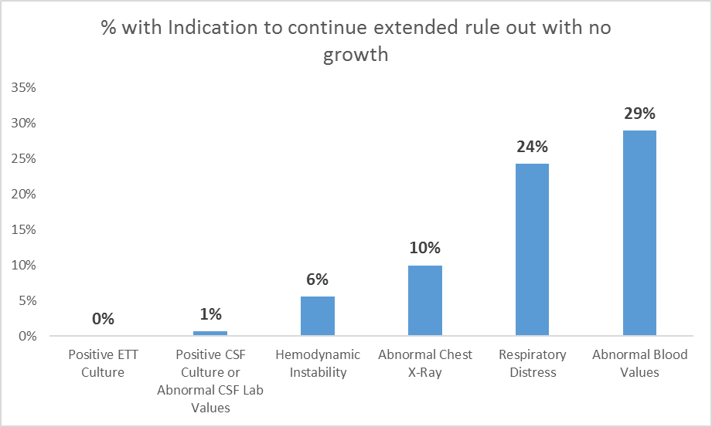
Top reasons newborns are treated for culture negative sepsis (>35 weeks):
Notes:
Delete Positive ETT culture for this graph
Dan: can you fix 2nd bar to say “Abnormal CSF Lab Values.” Leave out Positive ETT from this 3%, leaving only the percent with abnormal CSF values.

Slide 11
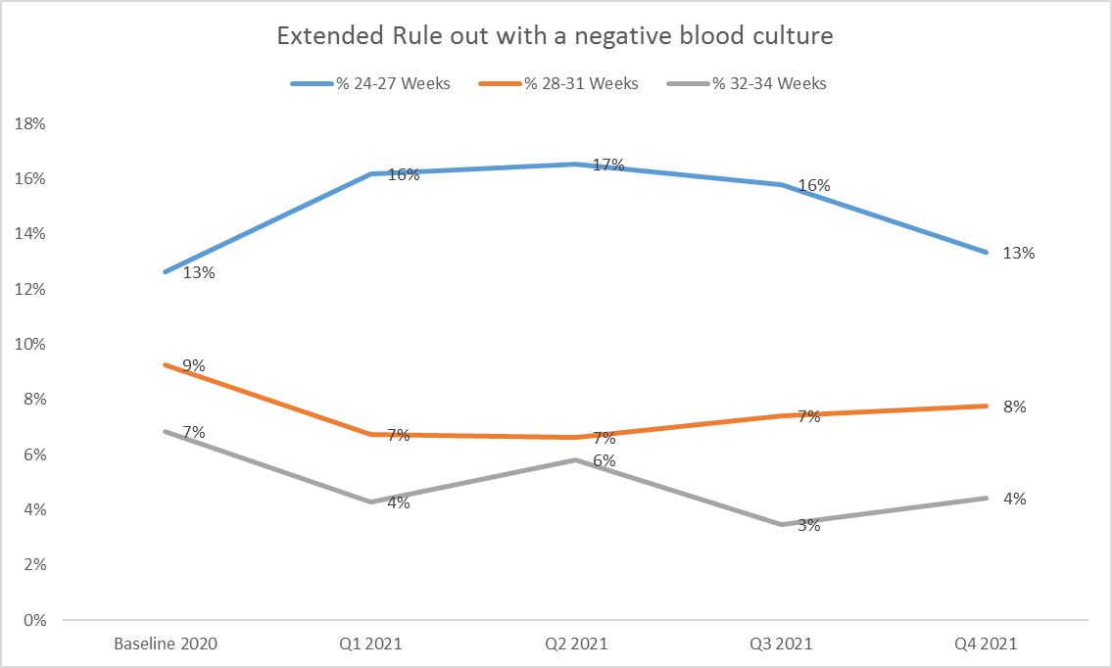
Extended Rule Out with Negative Culture

Slide 12
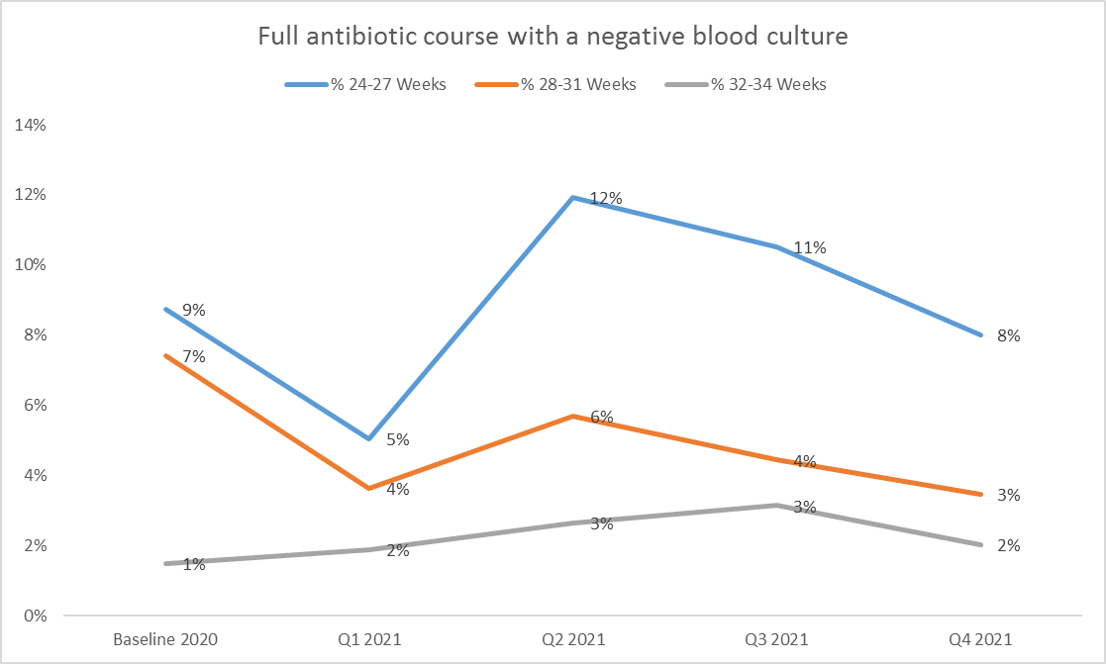
Full ABX Course with Negative Culture

Slide 13
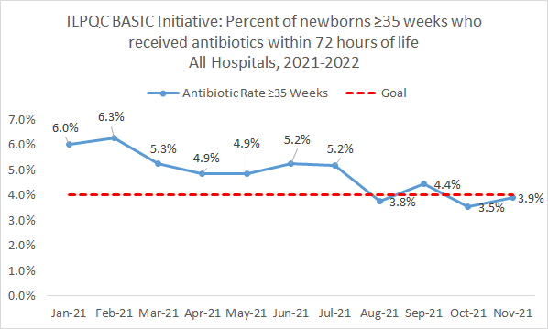
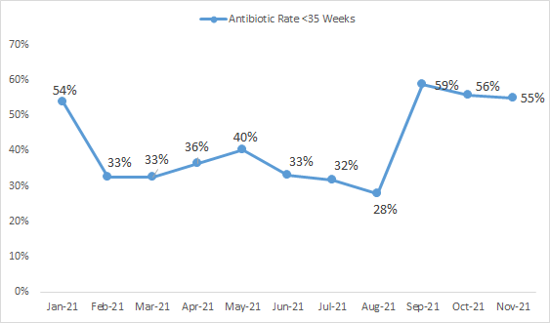
BASIC Aims: Antibiotic Prescribing
≥35 Weeks
<35 Weeks
Notes:
Can we dive deeper into this. This doesn’t make sense that it increased.
Why has the <35 increased!!!
Extended rule out slide graph from above should go on the next slide after this one.

Slide 14
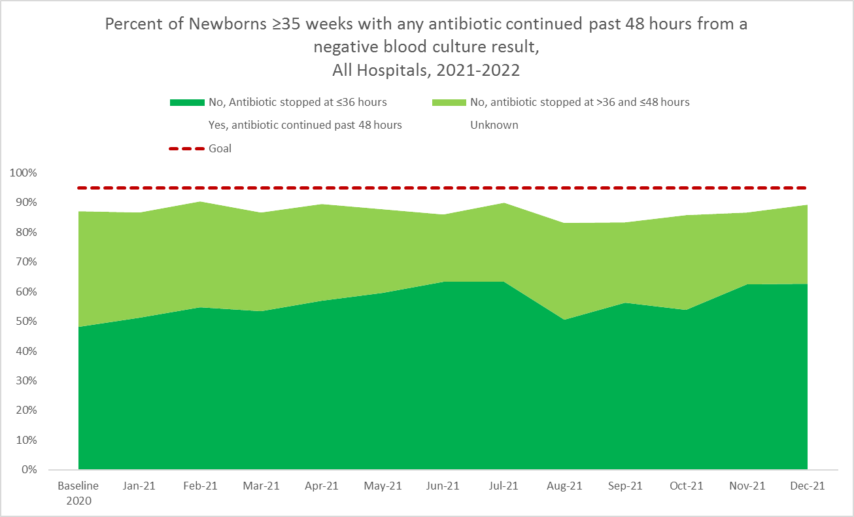
BASIC Aims: Antibiotics Discontinuation at 48 hours with negative culture (≥35 weeks)
Notes:
DAN: can you add a slide with his same information but with 48 hours instead of 36
49hrs – 5 days, 5+ day lines!
Tuesday talk: 36 vs 48 hours (time where we have a goal only talking about 36)

Slide 15
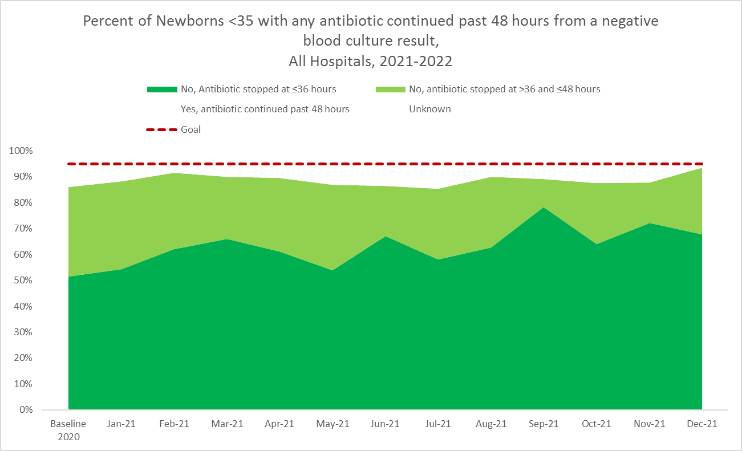
BASIC Aims: Antibiotics Discontinuation at 48 hours with negative culture (<35 weeks)
Notes:
DAN: can you add a slide with his same information but with 48 hours instead of 36
49hrs – 5 days, 5+ day lines!
Tuesday talk: 36 vs 48 hours (time where we have a goal only talking about 36)

Slide 16
Antibiotics for newborns ≥35 weeks stopped by 36 hours by hospital
Notes:
Add similar slide with 48 hours

Slide 17
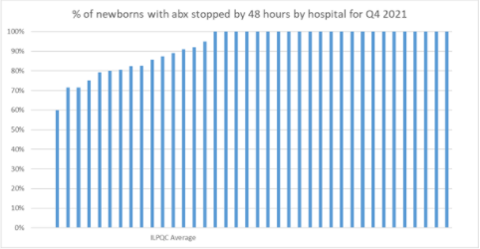
Antibiotics for newborns <35 weeks stopped by 36 hours by hospital
Notes:
Add similar slide with 48 hours

Slide 18
Culture Negative Sepsis

Slide 19
Evidence-based tools for abx stewardship
Serial observation / propensity scoring over empiric therapy
Automatic hard-stops
Shorter durations of therapy for common diagnoses
Eliminating “culture-negative” sepsis
Optimizing blood culture volumes
Reducing use of biomarkers (CBCs, C-reactive protein, etc)
Infection prevention techniques
REMINDER: Antibiotic stewardship does not mean getting to zero
Notes:
Cantey
Things we have worked on: in yellow

Slide 20
Definition of Culture Negative Sepsis
Wide variation
Essentially a clinician feels that a patient has or might have bacterial infection and that a negative blood culture is a false negative.
Notes:
o What is culture negative sepsis, does it exist (https://pubmed.ncbi.nlm.nih.gov/24751791/)
§ Definition: Culture negative sepsis definition: BC negative, baby maybe still has infection, still treating even with negative culture
§ Probable sepsis… no consensus definition?
Culture negative sepsis is signs of EOS without a culture (clinical illness category?)

Slide 21
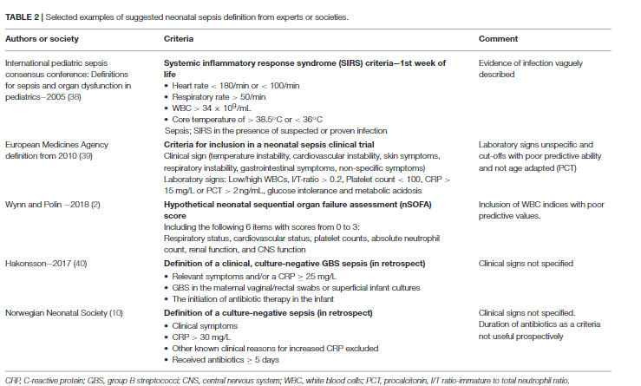
Klingberg, Frontiers in Pediatrics, 2018

Slide 22
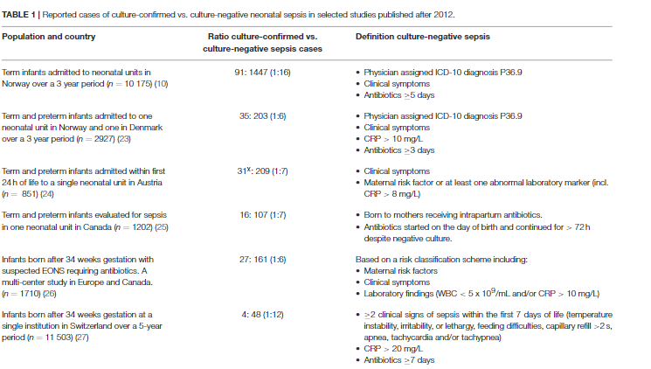
Klingberg, Frontiers in Pediatrics, 2018

Slide 23
We Are Over-treating preemies:
22-28 weeks, NRN Study
Early Onset Sepsis Incidence: 0.5% 2.5%
Low Risk:
Delivery by Cesarean
ROM at delivery
No maternal chorio
Comparison Group:
Everyone Else
Table 5 from Puopolo et al. Pediatrics. 2017
Notes:
Prolonged antibiotics defined as >/= 5days
Low risk = delivery by CD, ROM at delivery, and no documentation of maternal clinical chorioamnionitis in the obstetrical record.
Comparision group: everyone else
Dukhovny

Slide 24
Treatment of Culture Negative Sepsis
Shorter duration of therapy
Find evidence for utility of a 5-day course versus longer
Notes:
Waiting for Feedback from Cantey, Puopolo and Sagori
If you had a baby with a negative culture what would it take to continue abx? Term, late preterm, and preterm
The master punt

Slide 25
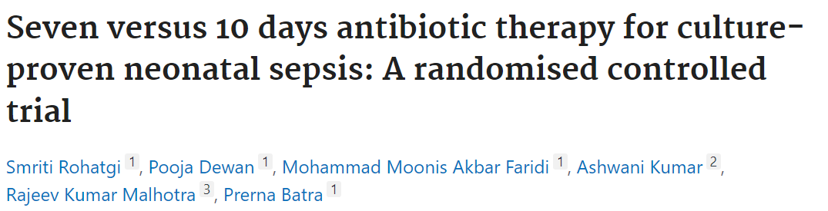
Culture POSITIVE sepsis
No differences!

Slide 26
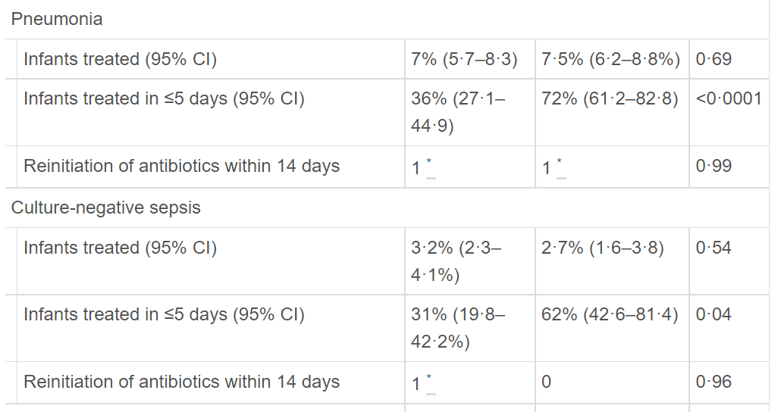
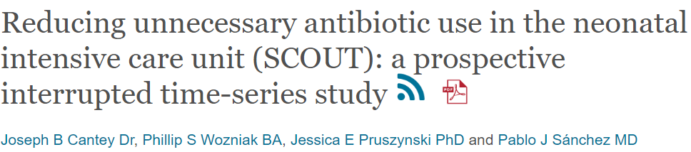
Parkland NICU (1400 admits annully)

Slide 27
AAP COFN Clinical Report: Evaluation/Treatment
When initial blood culture results are negative, antibiotics should be discontinued by 36-48 hours, unless site-specific infection
Puopolo K, Benitz W, Zaoutis T, COFN. Management of Neonates Born at ≤34 6/7 Weeks’ Gestation With Suspected or Proven Early-Onset Bacterial Sepsis, Pediatrics, 2018
Notes:
Mukhopadhyay

Slide 28
Summary
Standardize treatment duration
5 days appears to be safe and effective for pneumonia and “culture negative sepsis”

Slide 29
Trusting your Blood Culture

Slide 30
Modern Blood Culture Processing
The old-fashioned “48-hour rule-out” based on daily examination of broth culture for visual turbidity and 12-hourly reviews of plate subcultures
Current blood culture techniques rely on production of CO2 or change in gas pressure for continuous detection of bacterial growth
  Optimized to detect very low levels of bacteremia
  Neutralize antibiotics in circulation
Notes:
Puopolo

Slide 31
AAP COFN Clinical Report: Laboratory Tests
Blood culture:
  The diagnostic standard for EOS
  Reliably detect bacteremia at a level of 1 to 10 CFU with 1 mL blood
  Consider anaerobic cultures
CSF culture:
  Case by case
“Continuation . . . in the absence of culture-confirmed disease is rarely justified”
Puopolo K, Benitz W, Zaoutis T, COFN. Management of Neonates Born at ≤34 6/7 Weeks’ Gestation With Suspected or Proven Early-Onset Bacterial Sepsis, Pediatrics, 2018
Notes:
Mukhopadhyay

Slide 32
Neonatal Blood Culture Reliability
Percent detected
CFU/mL | Inoculate volume
 | 0.5 mL | 1 mL | 2 mL | 4 mL
1 | 0.39 | 0.63 | 0.87 | 0.98
2 | 0.63 | 0.87 | 0.98 | 0.99
3 | 0.78 | 0.95 | 0.99 | 0.99
4 | 0.87 | 0.98 | 0.99 | 0.99
5 | 0.92 | 0.99 | 0.99 | 0.99
10 | 0.97 | 0.99 | 0.99 | 0.99
100 | 1.0 | 1.0 | 1.0 | 1.0
How sure are you of the inoculate volume?
How frequent is low-level bacteremia?
What is adequate treatment for low-level bacteremia?
Do you think that your patient is really at risk for bacteremia?
Schelonka et al, Journal of Pediatrics, 1996; Lancaster et al, JCM, 2015
Notes:
Mukhopadhyay

Slide 33
How sure are you of the inoculate volume?
Previous studies report that only 65% blood cultures have adequate inoculate volume
Single center Prospective study:
  Weigh blood culture bottles for 1 year
  Optimal volume: 2 ml blood divided and inoculated in one aerobic and one anaerobic culture bottle
  Minimum sufficient: 1 ml inoculate in aerobic bottle
Neal et al, JCM, 1986; Connell et al, Pediatrics, 2007
Notes:
Mukhopadhyay

Slide 34
Median total inoculate: 1.96 (1.72-2.14)
Median aerobic volume: 0.98 (0.83-1.12)
Median anaerobic volume: 1.01 (0.87-1.12)
Notes:
Mukhopadhyay

Slide 35
Summary of Blood Cultures
Minimum 1 mL inoculate is met in >95% tests
Blood culture results do not have a substitute in management of sepsis currently
Auditing inoculate volumes may optimize this critical test’s output
  increase provider confidence in culture results
  improve management of true infection
Notes:
Mukhopadhyay

Slide 36
Utility of Biomarkers

Slide 37
Limited Utility of CBC
Gestational age at birth, sex, and mode of delivery affect the WBC and differential.
Fetal bone marrow depression due to maternal preeclampsia or placental insufficiency and prolonged exposure to inflammatory signals, such as those associated with the premature ROM, can result in abnormal values without infection.
None of the components of the CBC (WBC count, I/T, nor ANC) are strongly associated with culture confirmed infection.
  Extreme values (WBC<5000, I/T >0.3, ANC<2000) were associated with highest likelihood ratios, but still with poor sensitivity
  WBC>20K was not strongly associated with EOS
  (I/T)/ANC preformed the best, but still with modest sensitivity and specificity.
Puopolo KM. AAP Management of Neonates Born at ≥35 0/7 Weeks’ Gestation With Suspected or Proven Early-Onset Bacterial Sepsis. Pediatrics 2018
Newman TB. Interpreting complete blood counts soon after birth in newborns at risk for sepsis. Pediatrics. 2010
Hornik CP. Use of the complete blood cell count in early-onset neonatal sepsis. Pediatr Infect Dis J. 2012

Slide 38
Limited Utility of CRP
CRP concentrations increase in newborn infants in response to a variety of inflammatory stimuli, including infection, asphyxia, and pneumothorax.
Single values of CRP obtained after birth to assess the risk of EOS are neither sensitive nor specific to guide EOS care decisions.
Consistently normal values of CRP and procalcitonin over the first 48 hours of age are associated with the absence of EOS, but serial abnormal values alone should not be used to decide whether to administer antibiotics in the absence of culture-confirmed infection.
Serial evaluation of inflammatory markers should not be used to assess well-appearing term newborn infants for risk of EOS.
Puopolo KM. AAP Management of Neonates Born at ≥35 0/7 Weeks’ Gestation With Suspected or Proven Early-Onset Bacterial Sepsis 2018

Slide 39
White Blood Cell Count
Multiple clinical factors can affect the WBC count and differential, including gestational age at birth, sex, and mode of delivery.
Fetal bone marrow depression attributable to maternal preeclampsia or placental insufficiency and prolonged exposure to inflammatory signals, such as those associated with the premature ROM, frequently result in abnormal values in the absence of infection.
As the incidence of EOS declines, the clinical utility of the WBC count also declines.
Notes:
Grand Rounds

Slide 40
White Blood Cell Count
Two large, multicenter studies applied the likelihood ratio, a test characteristic that is independent of disease incidence, to assess the relationship between WBC count and culture-confirmed EOS among term and late-preterm infants.
  None of the components (WBC count, I/T, nor ANC) performed well.
    Extreme values (total WBC count <5000/μL [I/T >0.3; ANC <2000/μL] in one study and WBC count <1000/μL [ANC <100/μL; and I/T >0.5] in the other) were associated with the highest likelihood ratios but very low sensitivities.
  WBC count >20 000/μL and platelet counts were not associated with EOS in either study.
  The I/T squared (I/T divided by the ANC) performed better than any of the more traditional tests and was independent of age in hours but also had modest sensitivity and specificity.
Notes:
Grand Rounds

Slide 41
Other Inflammatory Markers
Multiple studies address other markers of inflammation, including C-reactive protein (CRP), procalcitonin, interleukins (ILs) (soluble IL-2 receptor, IL-6, and IL-8), tumor necrosis factor α, and CD64.
Both CRP and procalcitonin concentrations increase in newborn infants in response to a variety of inflammatory stimuli, including infection, asphyxia, and pneumothorax.
Procalcitonin concentrations also increase naturally over the first 24 to 36 hours after birth.
Single values of CRP or procalcitonin obtained after birth to assess the risk of EOS are neither sensitive nor specific to guide EOS care decisions.
Consistently normal values of CRP and procalcitonin over the first 48 hours of age are associated with the absence of EOS, but serial abnormal values alone should not be used to decide whether to administer antibiotics in the absence of culture-confirmed infection.
Notes:
Grand Rounds

Slide 42
Detrimental Effects of Antibiotics
A reminder

Slide 43
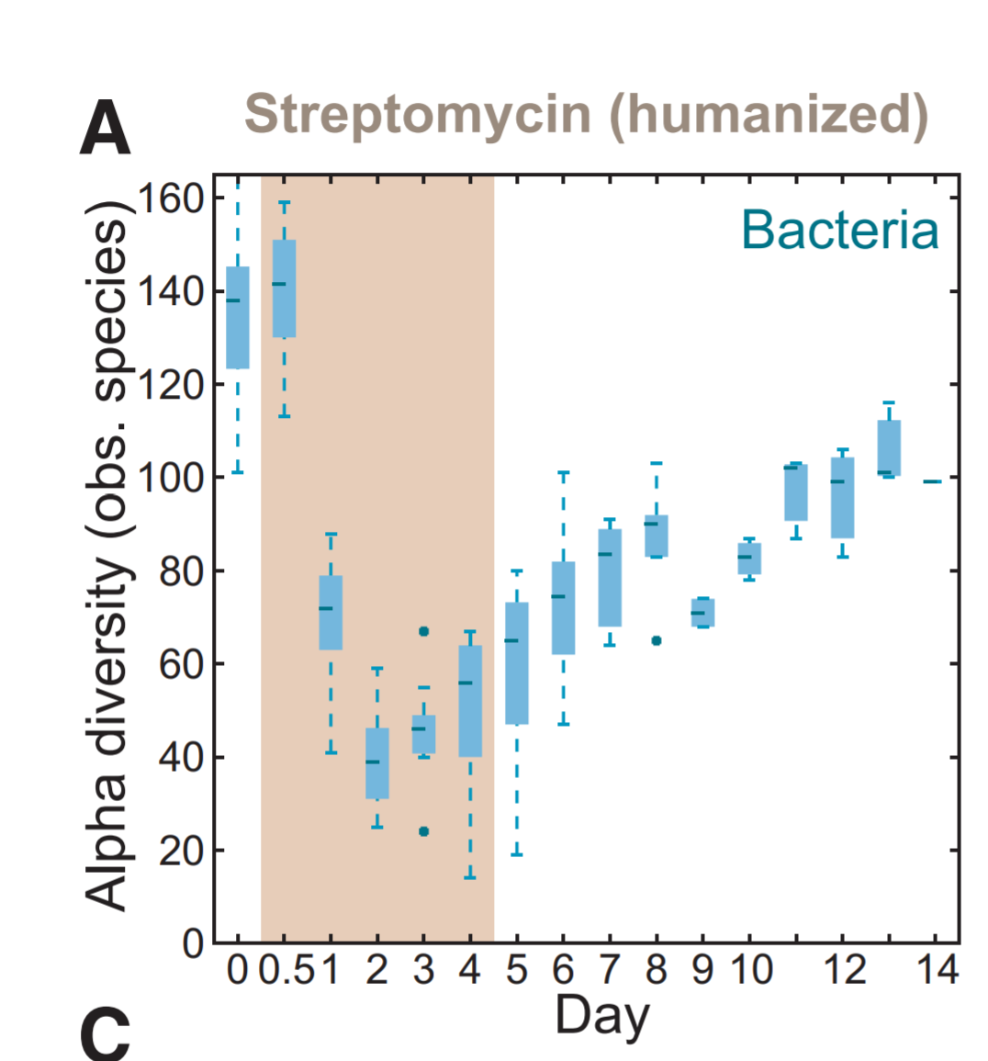
Antibiotic disruption of the microbiome
Following even a single dose of antibacterial therapy, there is a significant loss of number and diversity of bacteria in the gut
This “dysbiosis” takes weeks to months to recover from
Similar effects seen in the lung and cutaneous microbiome

Slide 44
Prolonged Empiric Antibiotic Exposure and
Risk of NEC and Death
4039 ELBW infants
1998-2001
5730 ELBW infants
2008-2014
53% early antibiotics ≥5 days
44% early antibiotics ≥5 days
49% in 2008 → 35% in 2014
NEC
61% early antibiotics ≥5 days
No NEC
51% early antibiotics ≥5 days
Death/NEC
25% among those with early antibiotics ≥5 days
20% among those without early antibiotics ≥5 days
With each additional day of antibiotics
7% increase in odds of NEC
16% increase in odds of mortality
Cotten et al (2009) Pediatrics; Greenberg et al (2019) Pediatr Res
Notes:
Puopolo
The increase with each additional day was almost doubled for NEC alone, with a 7% increase in the odds for each additional day of initial empirical antibiotic treatment. Duration of initial empirical antibiotic use was strongly associated with increased mortality rates, with a 16% increase in the adjusted odds for each additional day of initial empirical antibiotic treatment;
NEC stage 2 or greater

Slide 45
Adverse Effects on Lung Microbiome
Lohmann et al, Pediatr Res 2014
  Serial tracheal samples from infants ≤32 weeks gestation
  Reduced diversity (even on day 1) = ↑ risk for BPD
  Correlated with maternal and infant antibiotic exposure
Cantey et al, J Pediatr 2017
  Retrospective cohort of 1140 VLBW infants receiving initial empiric therapy despite sterile blood cultures; controlled for severity of illness using CRIB-II score
  In multivariate analysis, each additional antibiotic DOT was associated with:
    Increased risk for BPD (OR 1.13 [95% CI 1.09-1.16]).
    Increased severity level of BPD (OR 1.06 [95% CI 1.04-1.08])
Notes:
Cantey

Slide 46
Dysbiosis
This loss of diversity is associated with a variety of adverse outcomes even in term newborns
Increased risk for Candida colonization/infection
  Saiman et al, PIDJ 2001
  Cotten et al, Pediatrics 2006
  Lee et al, PIDJ 2012
Increased risk for colonization/infection with multi-drug resistant organisms
  de Man et al, Lancet 2000
  Carr et al, Arch Dis Child Fetal Neonatal Ed 2017
  Ramirez et al, Neoreviews 2019
Atopic disease (asthma, eczema)
  Donovan et al, Clin Infect Dis 2019
  Ni et al, BMC Pediatr 2019
  Ahmadizar et al, Ped All Immunol 2017
Obesity, Metabolic Syndrome, and Diabetes
  Block et al, Pediatrics 2018
  Bailey et al, JAMA Pediatr 2014
  Jess et al, Sci Rep 2019
  Singer-Englar et al, Expert Rev Gastro Hepatol, 2019
Primary risk factor in all these studies is duration of therapy – each day increases risk
Notes:
Cantey

Slide 47
The Right Thing for the Patient
Decreased antibiotic exposure = decreased risk for:
  Late-onset infection
  Necrotizing enterocolitis
  Death
  Colonization or infection with multi-drug resistant organisms
  Colonization or infection with Candida
  Asthma, Eczema, Food allergies
  Obesity
  Type 1 diabetes mellitus?
  Celiac disease??
Notes:
Cantey

Slide 48
BASIC Team Poster Presentation
OSF St. Francis Medical Center, Children’s Hospital of Illinois
Ashley Fischer, MD

Slide 49
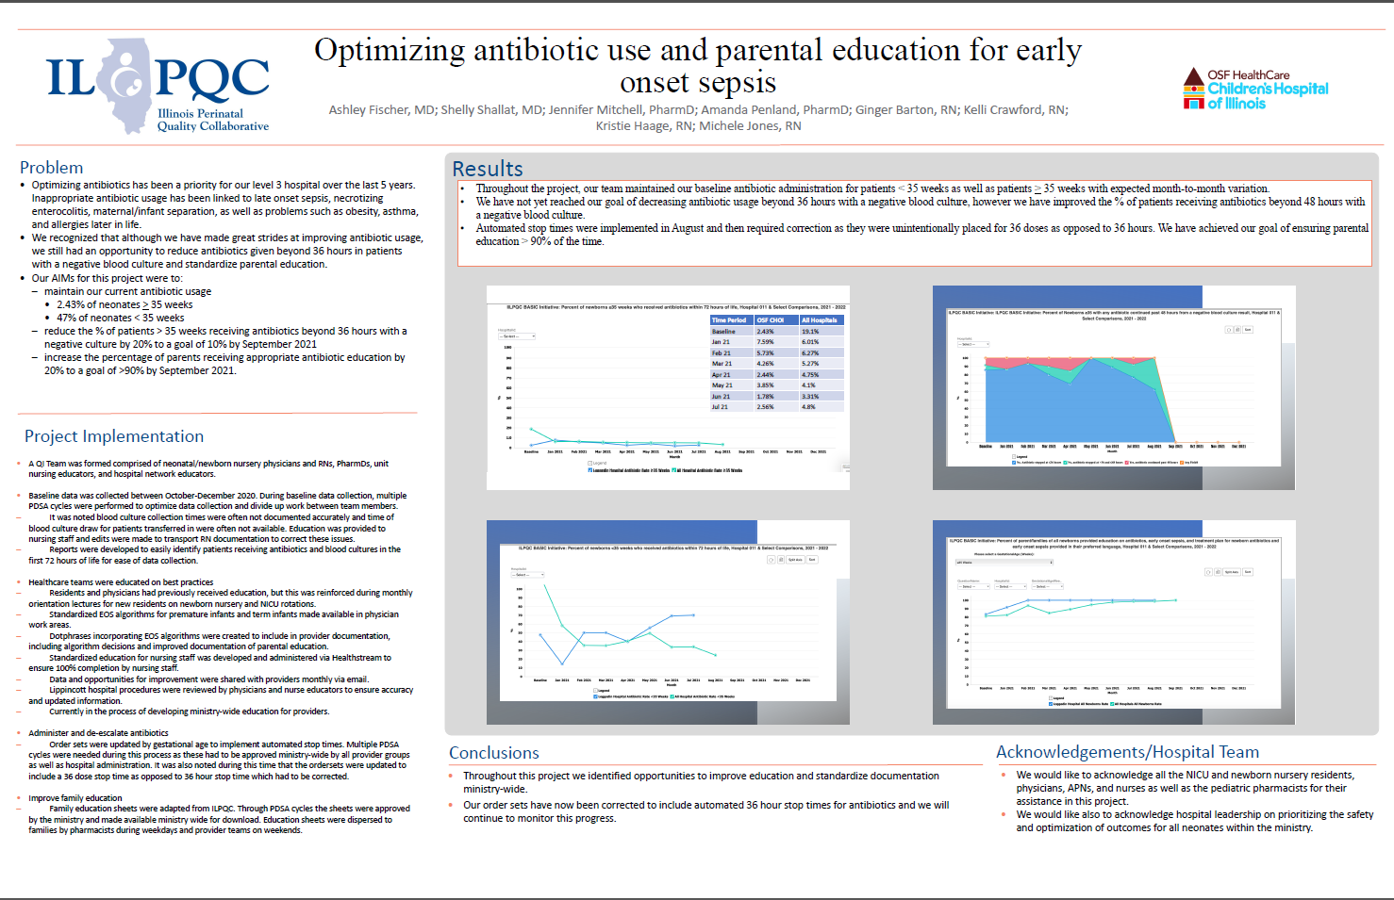

Slide 50
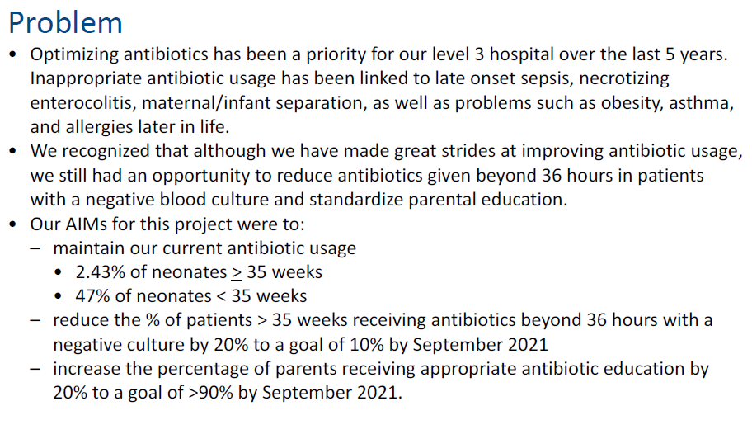
Problem

Slide 51
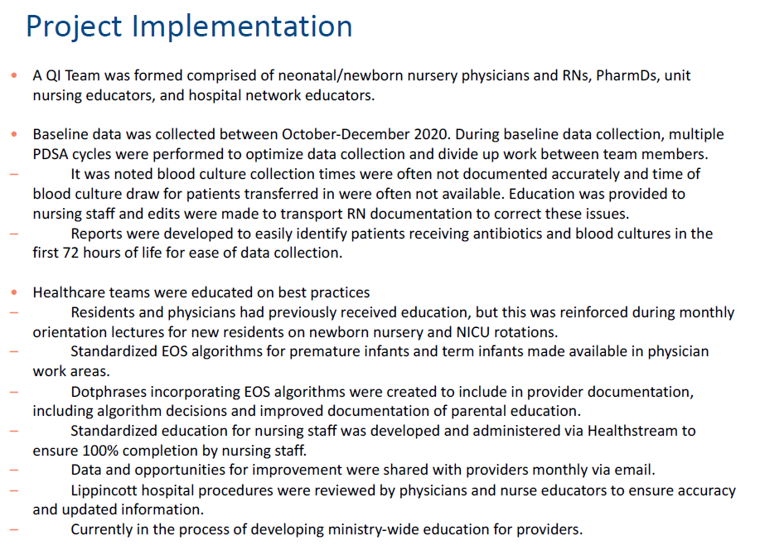
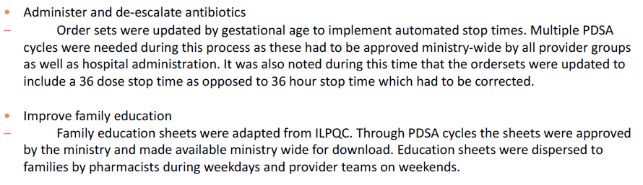
Project Implementation

Slide 52
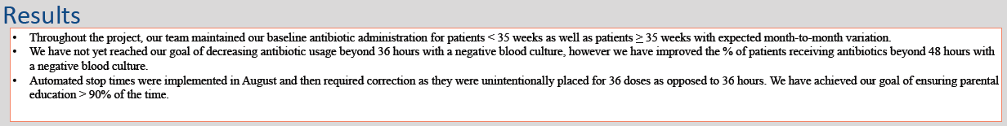
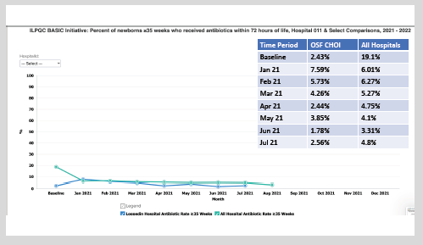
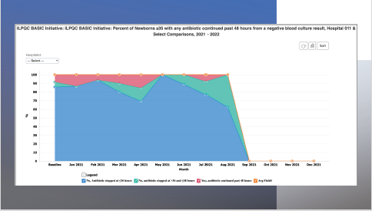
Results

Slide 53
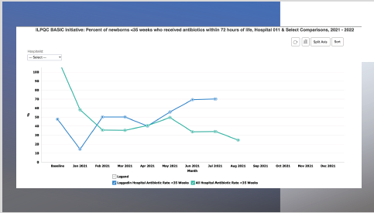
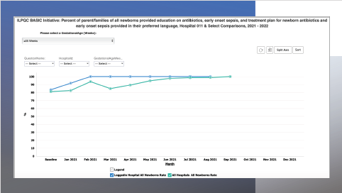
Results

Slide 54
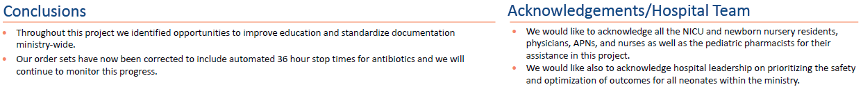
Conclusions

Slide 55
Wrapping Up

Slide 56
Key Conclusions
Culture negative sepsis is hard to define
Treatment for “culture negative sepsis” should be avoided or limited to very infrequent circumstances
Treat for fewer days (5? 7?)

Slide 57
Wrap-up and Next Steps

Slide 58
Upcoming Call Schedule
Date | Topic
February 21, 2022 2-3 PM | BASIC Teams Call: Interpreting your Data through the Lens of Equity
March 21, 2022 2-3 PM | TBD
April 18 2022, 2-3 PM | TBD
May 26, 2022 | ILPQC 2022 Face-to-Face Meeting

Slide 59
BASIC New Year’s Resolutions
Review your structure measures and determine what you can implement next
Create goals to be accomplished by Face to Face
Continue with QI Team meetings and data sharing
Create a 30/60/90 day plan for the first 3 months of 2022

Slide 60










Thanks to our Funders
In kind support:

