Slide 1

PVB Monthly Webinar: Implementing standardized protocol/processes for induction
July 26, 2021 12:30-1:30

Slide 2

Introductions
Please enter for yourself and all those in the room with you viewing the webinar into the chat box your:
  Name
  Role
  Institution
If you are only on the phone line, please be sure to let us know so we can note your attendance

Slide 3
Overview:
PVB Data Review
Protocols and Processes for Induction
Dr. Amber Watters, MD: Implementation of Outpatient Cervical Ripening for Induction of Labor
Team Talk: Amy L. Mehl, BSN, RNC-OB, from OSF St. Francis
PVB Next Steps
PVB Office Hours
  Join us after the call to ask any questions you may have
Notes:
Ellie to add in talk title

Slide 4
PVB Data Review

Slide 5
Supporting vaginal birth and reducing primary Cesareans for optimal maternal and neonatal outcomes
Aim: 70% of participating hospitals will be at or below the Healthy People goal of 24.7% cesarean delivery rate among NTSV births by December 31, 2022
Goal: Increase the percent of cesarean section deliveries among NTSV births that meet ACOG/SMFM criteria for cesarean
Goal: Increase the % of physicians/ midwives/ nurses educated on ACOG/SMFM criteria for cesarean, labor management strategies/response to labor challenges, protocol for facilitating decision huddles and/or decision debriefs

Slide 6
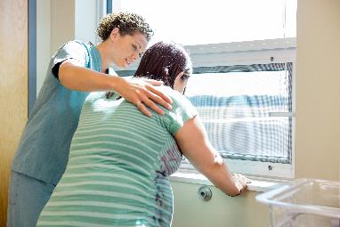
PVB Key Strategies
    Identifying NTSVs
    Education of ACOG/SMFM criteria for providers and nurses
    Implementing cesarean decision checklists and huddles with patient centered decision making
    Labor management support
    Develop standardized processes/protocols for induction, early labor and labor challenges

Slide 7
ILPQC Hospital Team
Data Submission (94 Teams Total)
Month | Teams Reporting Patient Data | Teams Reporting Hospital Data
Baseline (Q4 2019) | 89 | 85
January 2021 | 82 | 78
February 2021 | 81 | 77
March 2021 | 81 | 76
April 2021 | 72 | 67
May 2021 | 61 | 57
June 2021 | 28 | 24
Use your hospital data form as a QI team meeting roadmap to guide your efforts. Please contact us if you need help getting started with reviewing and entering your data.
If hospital data is not submitted for a given month you will not have access team’s NTSV C-Section rate over time.

Slide 8
ILPQC NTSV C-Section Rates
Goal: < 24.7%

Slide 9
NTSV C-Section Rates, by hospital
50% of teams at or below goal in May 2021
Goal: < 24.7%
All ILPQC Average: 25%
Notes:
Not enough June data to graph at this point so I am using May

Slide 10
NTSV C-sections meeting
ACOG/SMFM Criteria, across hospitals
Goal: >80%

Slide 11
Provider and Nurse Education

Slide 12
Standard protocols and processes

Slide 13
Cesarean Decision Checklist

Slide 14
Sharing Provider Level Data

Slide 15
Decision Huddles/Debriefs

Slide 16
Shared Decision Making

Slide 17
Standardized Patient Education

Slide 18
EMR Integration

Slide 19
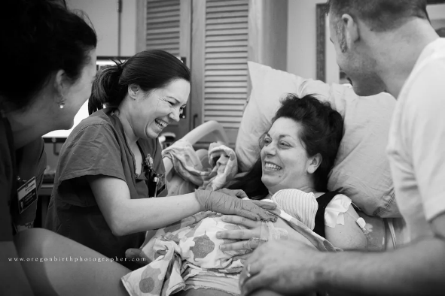
Promoting Vaginal Birth (PVB)
Key Strategies
Optimizing Labor Management and support
Protocols and Guidelines for Induction and Labor Decision Making
Provider, Nurse, Patient Education to support clinical culture change

Slide 20
Protocols and Processes for Induction

Slide 21
Induction in your PVB Work
The use of induction has increased in the US concurrently with the increase of C-sections*
Variations in the management of labor induction likely affect rates of cesarean delivery including*:
  Inconsistency in use of cervical ripening agents for the unfavorable cervix
  Inconsistency in time allowed for the latent phase before calling failed induction.
  *https://www.acog.org/clinical/clinical-guidance/obstetric-care-consensus/articles/2014/03/safe-prevention-of-the-primary-cesarean-delivery

Slide 22
What about the ARRIVE Trial?
The New England Journal of Medicine, August 8, 2018, Grobman, et al, Labor Induction versus Expectant Management in Low-Risk Nulliparous Women.
RCT compared labor induction at 39 weeks to expectant management up to 42 2/7 weeks among low risk nulliparous women.
Primary outcome was neonatal morbidity. There was no difference.
Secondary outcome: cesarean section rate which was lower in the induction group that in the expectant management group. (18.6% vs 22.2%)
Notes:
Published in 2018 was RCT in community and university hospitals that compared labor induction at 39 weeks to expectant management up to 42 2/7 weeks among low risk nulliparous women.
Primary outcome- Composite Neonatal Outcomes
No difference in groupsSecondary outcome- CD
CD rate 18.5% Induction Group
CD rate 22% Expectant Management Group

Slide 23
What about the ARRIVE Trial?
Rigorous selection process, not simply patient or physician directed request.
High degree of compliance with ACOG/SMFM recommendations for arrest of labor and those utilized in PROVIDE.
Patients undergoing elective induction of labor did experience a 30-40% increase in length of labor compared to patients who were allowed to enter labor spontaneously.
Notes:
A strict definition for failed induction related to cervical ripening, labor duration, and labor management needs to be adopted and practiced to prevent a potential spike in cesarean rates. The increase in labor time indicates that the management of labor is a critical factor for women both induced and expectantly managed.

Slide 24
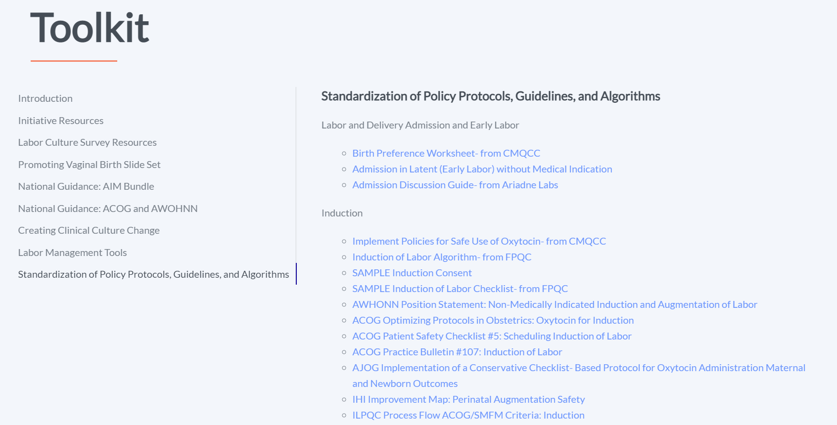
PVB Toolkit Induction Resources

Slide 25
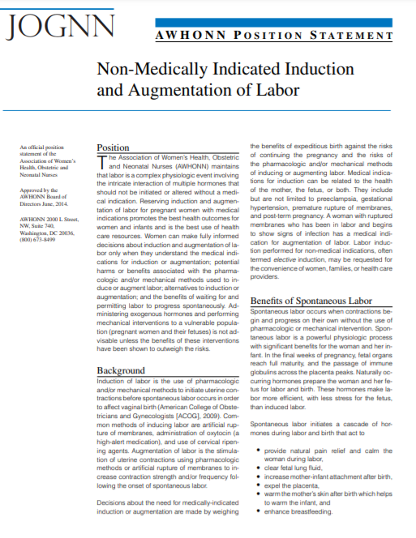
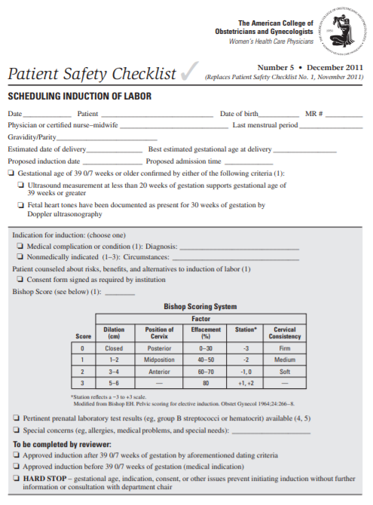
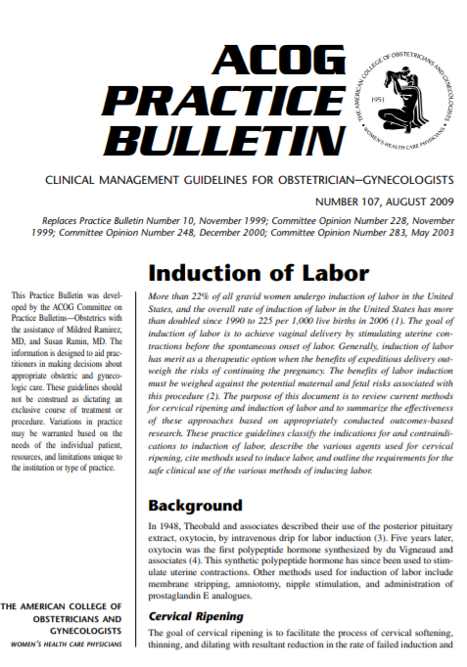
PVB Toolkit:
National Induction Resources
AWHONN Position Statement
ACOG Induction Checklist
ACOG Practice Bulletin

Slide 26
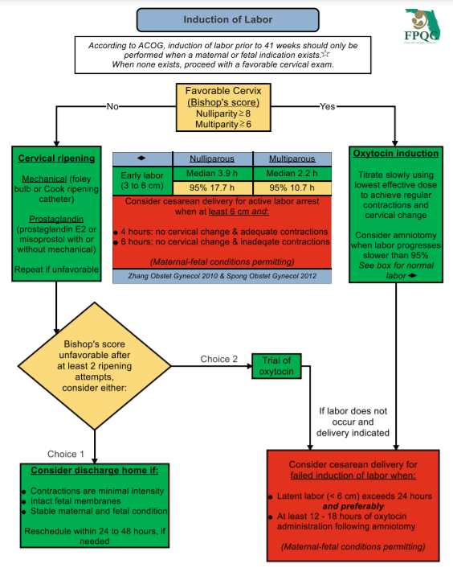
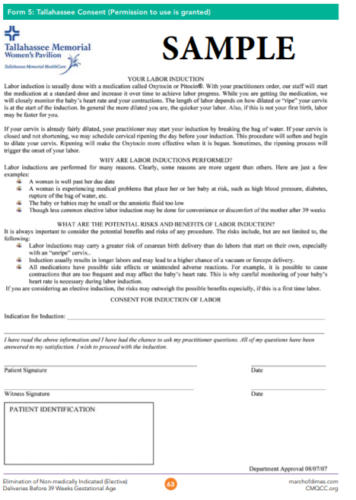
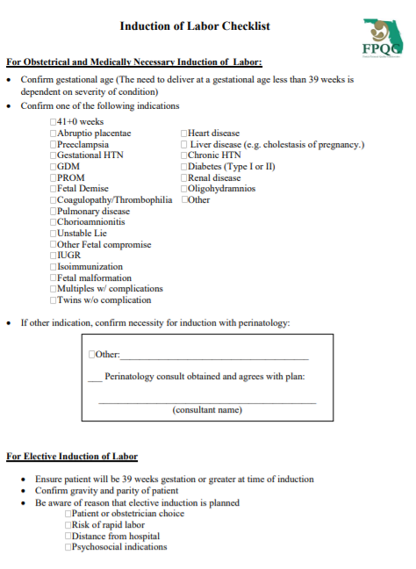
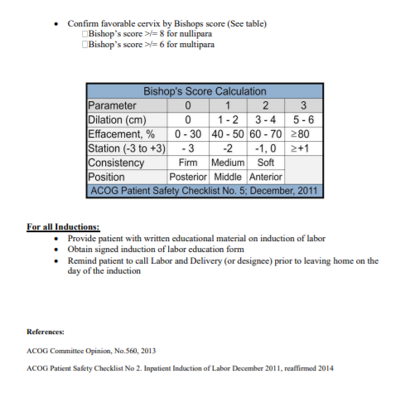
PVB Toolkit: Induction Resources
FPQC Induction Algorithm
FPQC Sample Induction Consent
FPQC Sample Induction Checklist

Slide 27
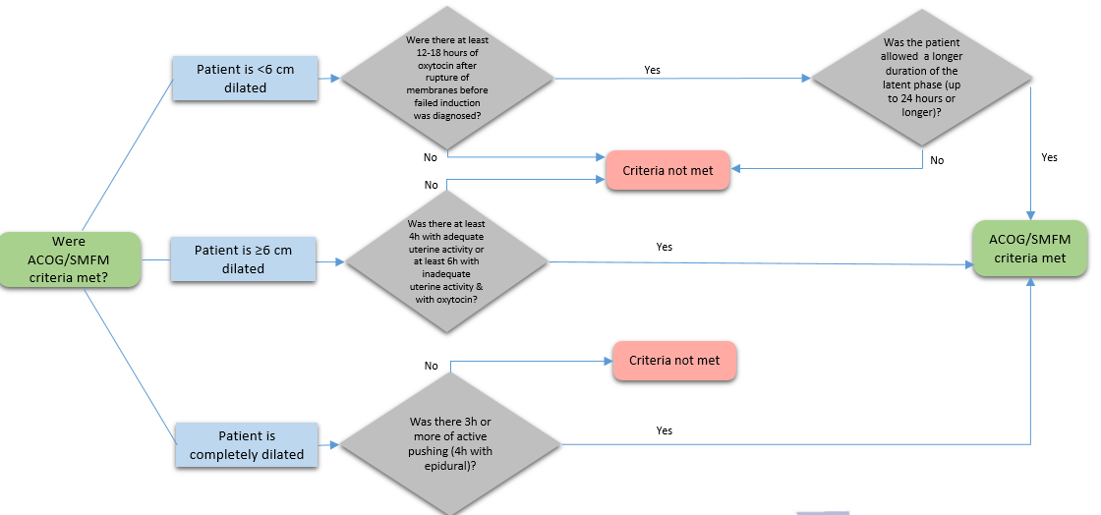
ACOG/SMFM Criteria Induction
Process Flow is located in the ILPQC PVB Toolkit and can be used to review whether ACOG/SMFM Criteria was met

Slide 28
ACOG/SMFM Guidelines for induction
Patient < 6 cm dilated
  Cervical ripening used (if unfavorable cervix: Bishop score < 8 if nullip, < 6 if multp)
  Was there at least 12-18 hours of oxytocin after rupture of membranes before failed induction was diagnosed
  Was the patient allowed a longer duration of latent phase (up to 24 hours or longer of oxytocin after membranes rupture if maternal/fetal status permits)?

Slide 29
ILPQC ACOG/SMFM
Checklist
Helps all staff determine if ACOG/SMFM c/s delivery criteria is being met
Useful communication tool for bedside RN & delivering provider
Available in the online ILPQC PVB Toolkit
Notes:
Need to determine if we will share the huddle form. AP

Slide 30
Ex:1
Dr. Borders AB
Jane Smith
DOB: 1/1/91
A Perrault AP
4/26/21 @ 2125
X
√
√
Ex:2
X

Slide 31
Dr. Amber Watters MD, Northwestern Medicine

Slide 32
Implementation of Outpatient Cervical Ripening for Induction of Labor
Amber Watters, MD
Assistant Professor, Obstetrics & Gynecology
Ambulatory Medical Director, Galter 14th Floor
Labor & Delivery Medical Director, Prentice Women’s Hospital
Northwestern University and Northwestern Medical Group

Slide 33
Disclosures
I have no financial disclosures.
I am not an expert.
Notes:
I am looking forward to sharing our experience and gaining inspiration from your ideas today.
As we’ve gone through this process, I’ve been intrigued by the number of providers who have said, oh yes, I did that as a resident/faculty/elsewhere.
Out of curiosity, how many of you have past/present experience with Outpatient Cervical Ripening?

Slide 34
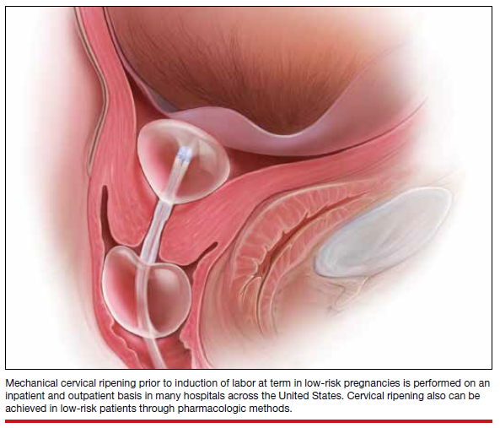
Objectives
Share our institution’s backstory and personal experience with implementation of outpatient cervical ripening.
Review the safety and efficacy of outpatient cervical ripening with an induction balloon.
Lamar et al, OBG Management
Notes:
Data regarding safety and efficacy with the use of outpatient prostaglandins for induction of labor also exists.
The practices at our institution have so far chosen not to use outpatient prostaglandins, so this talk will focus only on mechanical outpatient cervical ripening.
We chose mechanical ripening because it is not associated with tachysytole, fetal intolerance of labor, or meconium staining.
Many of the references I use today include data for pharmacologic ripening methods and detail their role in outpatient cervical ripening, so do not hesitate to refer to them for any queries regarding those methods.

Slide 35
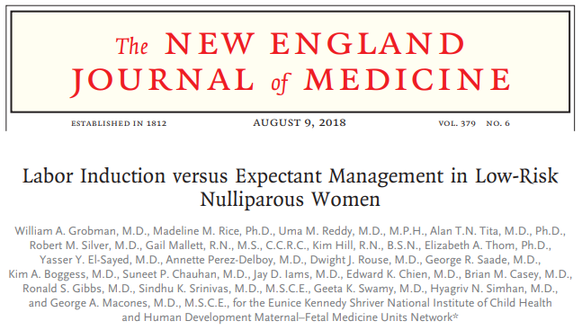
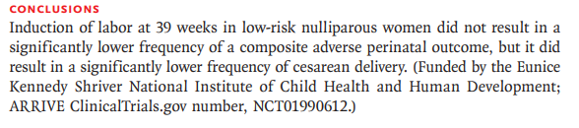
Paradigm Shift
Publication of the ARRIVE trial in August 2018
Notes:
The publication of the ARRIVE trial in 2018 laid the foundation for a paradigm shift in our field.
Just prior to publication of this paper, 2017 induction rates were noted to have risen to about 25%.
This paper concluded that induction is safe (and possibly even safer) than expectant management after 39 weeks for nulliparous women.
Nulliparous elective induction was thus transformed from a discouraged and rare occurrence to a valid option for all pregnant patients.

Slide 36
An Operations Problem
Labor and Delivery Bottleneck
Manifest as...
Induction Working Group…
Waitlist for elective induction scheduling
Prolonged LOS on L&D
Patients ‘boarding’ in OB triage or a full floor leads to cancelling inductions
Transparency/Communication
Process Improvements
What about Outpatient Cervical Ripening ?
Notes:
As obstetric providers at our institution began to more comfortably implement the change in practice permitted by the ARRIVE data, a Labor and Delivery bottleneck developed.
This manifest itself through a persistent waitlist of patients desiring induction, longer induction times on L&D leading to prolonged LOS, which in turn led to boarding of patients in OB triage or cancelled inductions.
In response to these issues, our department convened an Induction Working Group to brainstorm and implement strategies to improve our L&D access and throughput.
We increased transparency for providers and patients, streamlined our induction scheduling process and made the ‘waitlist’ more easily understood, and optimized every aspect of real-time adjustments to get patients off of the waitlists and on to L&D as efficiently as possible. Fast track slots.
Despite these efforts, we found we just needed more access on L&D, and this led us to the question, “What about Outpatient Cervical Ripening?”

Slide 37
Baseline Data
Prentice Women’s Hospital
INDUCTION VOLUME
4,071 induction episodes over 1 calendar year (6/1/19 to 5/31/20)
2,741 (67%) had ≥ one documented cervical ripening agent
  About 7.5 inductions per day require cervical ripening
  Daily waitlist for induction slots of 3-19 patients
L&D LENGTH of STAY
Inductions undergoing inpatient cervical ripening:
Average LOS of 22:13 hours
Notes:
We took a look at our baseline data to see what the potential impact of this intervention could be.
There were 4071 induction episodes over 1 calendar year at Prentice Women’s Hospital.
Of these, 67% underwent cervical ripening with at least one documented agent. This breaks down to about 7.5 inductions per day requiring cervical ripening.
A daily waitlist of 3-19 patients persisted, despite our efforts via the Induction Working Group. Our induction access is currently capped at 14 slots/day.
On our unit, inductions who underwent inpatient cervical ripening had a L&D LOS of 22:13 hours.
If we could reduce the LOS for inductions requiring cervical ripening, this could improve L&D access and throughput, potentially freeing up space for more induction slots each day.
We decided to give outpatient cervical ripening a closer look.

Slide 38
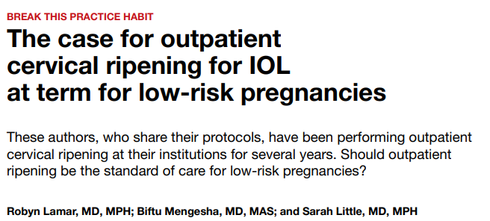
Outpatient Cervical Ripening
Dr Biftu Mengesha, UCSF
Is it safe?
Is it effective?
How do we do it?
OBG Management, Sept 2019, Vol 31 No 9
Notes:
Next we asked ourselves…is it safe? Is it effective? How do we do it?
We started by reviewing the existing literature (top 50 published articles referencing Outpatient Cervical Ripening on PubMed) and by reaching out to our friends at institutions across the country who currently perform outpatient cervical ripening.
I would like to give a special shout-out to Dr Biftu Mengesha, a Northwestern alumnus who practices at UCSF, who was especially generous with her personal experience and resources – this was invaluable to us as we began our planning.
Her article in OBG Management in September of 2019 was a helpful and approachable starting off point for us.
Since our initial literature review, there have been updated systematic reviews and an additional RCT published, and I’d like to take you through an overview of that data now.

Slide 39
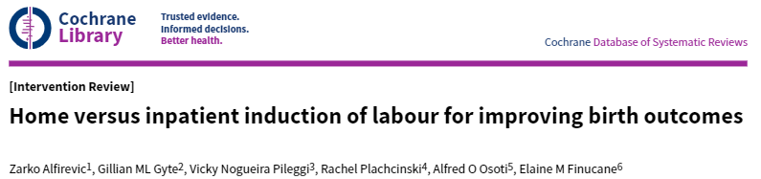
Outpatient Cervical Ripening
No significant differences
Is it safe?
Maternal Harms
Fetal Harms
Uterine hyperstimulation
Cesarean birth
Neonatal infection
Admission to NICU
Serious neonatal morbidity or mortality
4 randomized controlled trials, 3 studies (289 women and babies)
Notes:
Cochrane Review updated in 2020
4 RCTs, 3 studies (289 women and babies) – low quality evidence
Mohamad 2018 (Malaysia) – conference abstract only (60 women)
Policiano 2017 (Portugal) – RCT of 130 women – 40cc up to 24 hours
Sciscione 2001 (US) – RCT of 111 women – 30cc to ‘next morning’
Wilkinson 2015a-COPRA (Australia) – 2:1 RCT of 48 women – Cook catheter up to 80cc in both to ‘next morning’
No significant differences between groups for primary outcomes (wide conference intervals and all crossed 1)
No serious neonatal infections nor serious neonatal morbidity in the one study (48 babies) assessing those outcomes

Slide 40
Outpatient Cervical Ripening
Is it effective?
Time from induction to birth
Length of hospital stay
-3.51 hours
-0.50 days
Notes:
Showed a decrease by 3.5 hours in time from induction to birth
Length of hospital stay decreased by 0.5 days
Trends towards lower maximum and duration of Pitocin use
Author’s conclusions

Slide 41
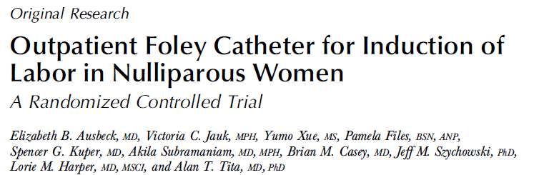
Outpatient Cervical Ripening
No significant differences
Is it safe?
Maternal Harms
Fetal Harms
Chorioamnionitis
Cesarean delivery
Postpartum hemorrhage
Heavy bleeding/placental abruption
Meconium-stained fluid
5-min Apgar <7
Admission to NICU
Is it effective?
Modified Bishop score 1->3 (vs. 1->1)
-4.3 hours from admission to delivery
Patient satisfaction similar between groups
Notes:
An additional RCT has been published since the Cochrane Review was updated.
This RCT included 126 women (bringing the total number studied in RCTs to 415) and was performed at UAB by Dr Ausbeck.
No significant differences in maternal or fetal harms between groups
30cc in foley, taped to tension, up to 24 hours
Modified bishop score changed from 1 at randomization to 3 at admission
Difference of 4.3 hours from admission to delivery (inpatient LOS 21.7 hours, so similar to our baseline)
Patient satisfaction similar between groups
22% of the outpatient group were admitted prior to scheduled induction
As a fun aside, this study and the only prior US RCT, which was included in the Cochrane Review (Sciscione), were conducted 20 years apart but with similar study designs and essentially the same findings.

Slide 42
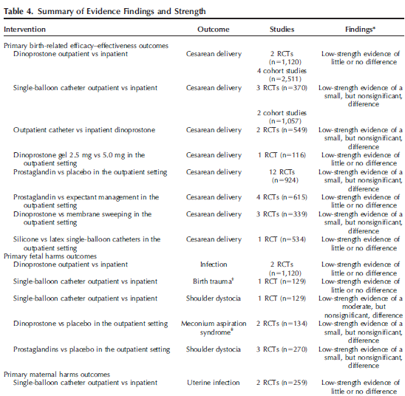
Outpatient Cervical Ripening
Is it safe?
Maternal Harms
Uterine infection
Cesarean delivery
Fetal Harms
Birth trauma
Shoulder dystocia
No significant differences
McDonagh et al Outpatient Cervical Ripening
Notes:
This table is from a recent systematic review and meta-analysis of Outpatient Cervical Ripening that included both RCTs and cohort studies (though limited to English-language only).
This review was requested by ACOG as an ‘updated review of the evidence’ to guide in revising their Practice Bulletin on Induction of Labor.
This review included 6 RCTS and 3 cohort studies in comparison of outpatient and inpatient mechanical methods, which resulted in a total ‘n’ of 2356 patients.
No outcome was found to have better than ‘low-strength’ evidence.
No significant difference was found between groups undergoing inpatient and outpatient mechanical methods, when looking at the listed maternal and fetal harms.
This review excluded pre-post studies (observational studies without a control group)
‘The findings that outpatient cervical ripening…with single-balloon catheters did not impose increased risk of cesarean delivery, with at least no strong signals of clinically important increased risk of harms, may be encouraging for women who are interested in outpatient cervical ripening’.
Call for more RCTs…however, as we’ve only had 2 RCTs in this country in the past 20 years, it may be more pragmatic to look elsewhere for reassurance of safety.

Slide 43
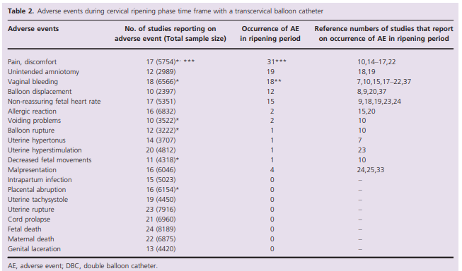
Mechanical Cervical Ripening
Estimated prevalence of adverse events 0.0-0.26%
Is it safe?
Diederen et al Safety of the balloon catheter for cervical ripening in outpatient care:
complications during the period from insertion to expulsion of a balloon catheter in the process of labour induction
Notes:
Diederen conducted a systematic review looking at patient safety between introduction and expulsion of a cervical ripening balloon.
The goal of this review was to ‘assess the complication rate during cervical ripening with balloon induction’ with the hope of being able to extrapolate this data to the likely period in which a patient will be home for outpatient cervical ripening.
They only included data able to be defined precisely by the time period in which cervical ripening occurred, and limited their data to RCTs and cohort studies with more than 400 participants, and to those studies that used balloon catheters alone.
I find this table incredibly reassuring.
The adverse events are ordered by frequency with the most common being pain/discomfort and unintended amniotomy.
This review included 26 studies (8292 women), and found the estimated prevalence of the analyzed adverse effects to be between 0% and 0.26%, the most common of which was pain or discomfort with the catheter.

Slide 44
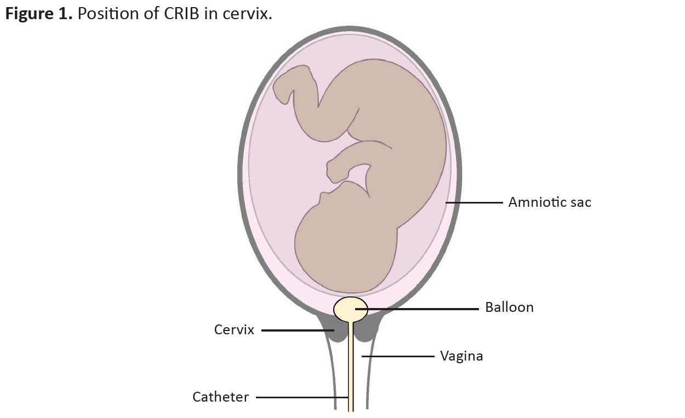
Outpatient Cervical Ripening
It is safe.
It is effective (at both ripening the cervix and decreasing LOS on L&D).
How will we do it?
Notes:
RCTs do not show outpatient cervical ripening to be ‘unsafe’, though evidence is low quality and adverse events are rare.
Extrapolations from the same time frame in an inpatient setting suggest mechanical cervical ripening is very safe.
Define CRIB

Slide 45
Induction with Cervical Ripening:
Shift to Outpatient Process
Current State
Future state
Admitted for IOL
Cervical Ripening Induction Balloon (CRIB) placed
Cervical Ripening Completed
Labor
Delivery
Outpatient CRIB placed
Cervical Ripening Completed
+
Admitted for IOL
Labor
Delivery
Average time 2:28
<24 hours
Up to 12 hours
Up to 18 hours
Up to 18 hours
Notes:
We looked at our existing process for inpatient cervical ripening, which is detailed here, on the left.
The patient is admitted to L&D at a scheduled induction time.
She can then face a delay, depending on provider and staff availability, before undergoing CRIB placement. This delay has most recently averaged 2 hours and 28 minutes.
The CRIB then remains in place for 6-12 hours, after which cervical ripening is complete. (We generally do misoprostol in conjunction with CRIB at our institution)
Once the cervix is ready for labor, it takes additional time for labor to effect cervical change and ultimately result in delivery.
On the right is our ‘future state’ process map incorporating outpatient cervical ripening.
The patient undergoes outpatient CRIB placement in her provider’s office, and she then returns to her home while the CRIB remains in place.
The patient is admitted to L&D at a scheduled induction time, which is typically 12-15 hours from the outpatient CRIB placement, although some studies allowed patients to be at home for 24 hours prior to admission.
On admission to L&D, cervical ripening is already complete, and she progresses directly to induction of labor.
It still takes additional time for labor to effect cervical change and ultimately result in delivery.

Slide 46
Outpatient Process
Development
Identify Champions (MD, RN, administrator)
Write Protocol
Prepare Materials/Assemble Supplies
Start!
Revise and Evolve Your Process
Notes:
Our development looked something like this overall. We got our champions together, wrote our protocol, prepared materials/assembled supplies, started!
Then revised and evolved based on feedback/operations.
Now, I’m going to take you through our process on a more granular level.

Slide 47
Outpatient Process - Identify an Appropriate Patient
Northwestern Memorial Group Faculty OBGYN
Inclusion criteria
1) Patient undergoing induction between 37.0-40.6
2) Requires cervical ripening (Bishop score ≤6)
Exclusion criteria
Any contraindication to vaginal delivery
TOLAC
Abnormal vitals on arrival
Preeclampsia or uncontrolled hypertension
Ruptured membranes
Suspected fetal growth restriction
Amniotic fluid volume abnormalities
Relative contraindications
Presence of hardships (transportation issues, multiple no-shows, lack of support at home)
Maternal anxiety (Consider number of telephone calls/messages sent during pregnancy)
Notes:
First, we have to identify appropriate patients.

Slide 48
Outpatient Process – Recruit the Patient
Northwestern Memorial Group Faculty OBGYN
Make Outpatient CRIB the default for appropriate patients.
TRY:
  Cervical ripening is an important part of getting your body ready for induction. We place a balloon inside the cervix here in the office. You then go home, have dinner, watch a show, and get some rest before coming in at your scheduled induction time.
  Outpatient balloons allow you to eat, drink, and move around normally in the comfort of your home.
  Reducing the number of hours on L&D can decrease stress for patients during an induction.
  An outpatient balloon is the first step towards meeting your baby.
Notes:
When we introduce elective induction (routinely at the 36 week visit with more detailed discussion at 38 weeks), we frame outpatient cervical ripening as the default.
Can use SVE (if performed) after 36 week GBS swab as practical assessment for outpatient CRIB assessment
Can use patient’s initial reaction to guide further counseling
Great news, we now allow patients to complete the cervical ripening portion of their procedure at home!
Practice scripting, as detailed above

Slide 49
Outpatient Process - Schedule
Northwestern Memorial Group Faculty OBGYN
1
Submit induction scheduling request
2
L&D Induction Date/Time confirmed
3
Schedule outpatient CRIB with provider (12-16 hr)
Schedule NST
Scheduling ‘edge’ at our institution (7d vs 5d)
Notes:
Institutional support is helpful to incentivize the process (inertia! and effort!) – Administrator who is a ‘champion’
Staff champion is critical to grease the wheels of the scheduling/office process
Ours also end up doing a fair amount of education

Slide 50
Outpatient Process – CRIB office visit
Northwestern Memorial Group Faculty OBGYN
Patient is roomed and vitals performed by office staff.
Provider performs bedside US for DVP and fetal presentation.
Provider performs SVE and places CRIB.
Patient proceeds to NST. During NST, patient receives detailed home instructions from nurse.
Patient is discharged home.
CPT 59200,
PR Insert Cervical Dilator
Notes:
Our usual process is to place a single-balloon silicone foley and inflate with 60cc sterile saline. We then tape the balloon to tension.
We bill the procedure as a subsequent OB visit with a procedure modifier code. We use the CPT code 59200, PR Insert Cervical Dilator. Our reimbursements have run at about $200 per visit, depending on managed care plans.

Slide 51
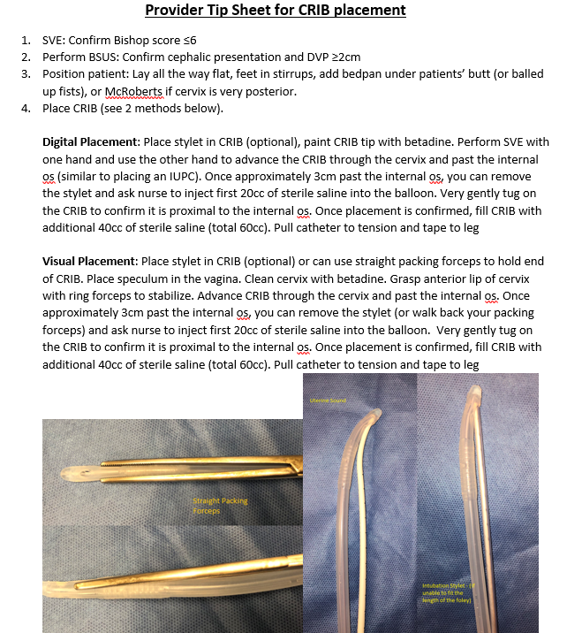
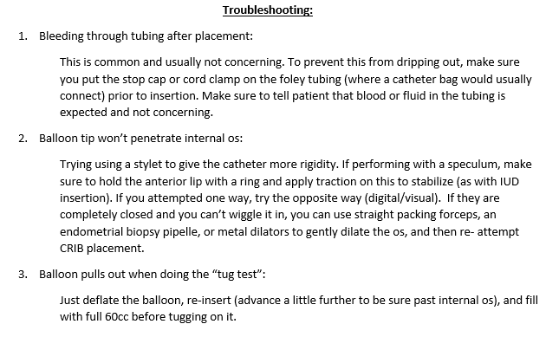
Outpatient Process – Provider Tip Sheet
Support Materials
Notes:
Our resources have been useful to refresh staff/providers in between CRIB placements.
I have included a portion of the provider tip sheet, which includes detailed instructions on placement, documentation, billing, and trouble-shooting.

Slide 52
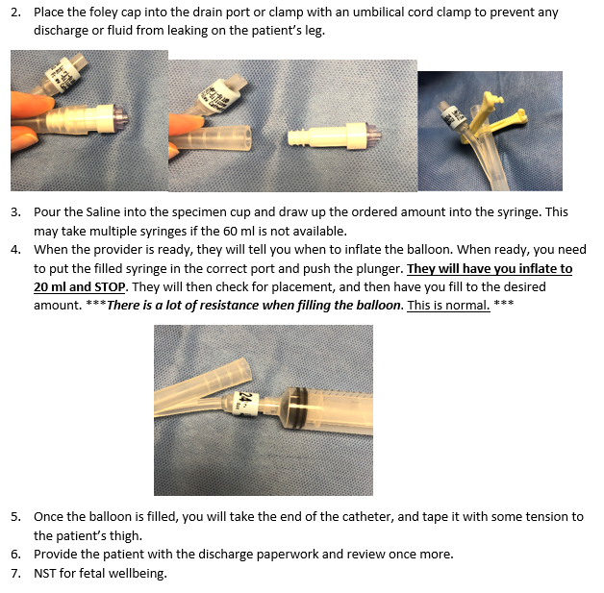
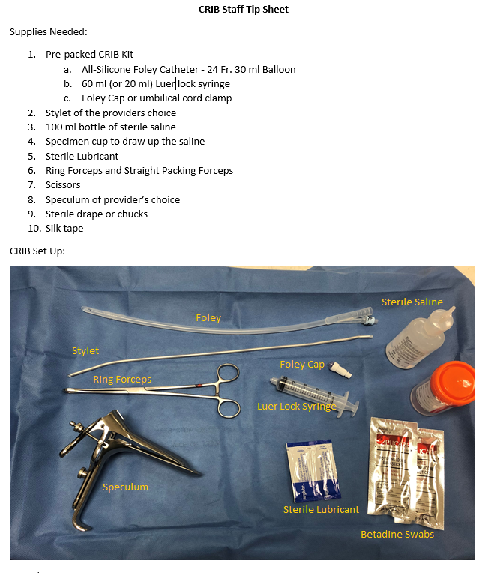
Outpatient Process – Staff Tip Sheet
Support Materials
Notes:
Our resources have been useful to refresh staff/providers in between CRIB placements.
Here is a portion of the staff tip sheet, reviewing supplies and detailing the assistant’s role.
A similar tip sheet was created for schedulers with screenshots of the order details needed when submitting the induction request.

Slide 53
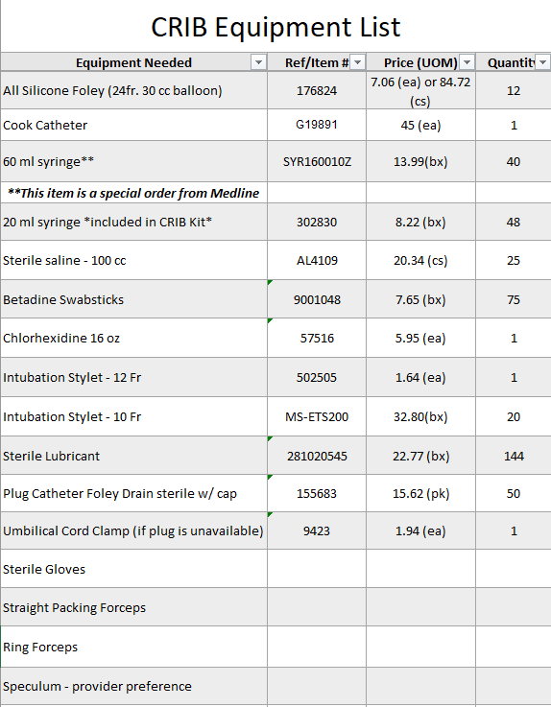
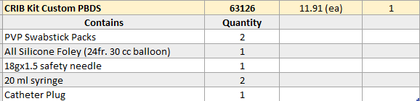
Outpatient Process – Equipment List
Support Materials
Notes:
The is the equipment list that we created, which includes ordering supplies separately, as well as the ‘CRIB kit’ which can be ordered at our institution (for $11!).

Slide 54
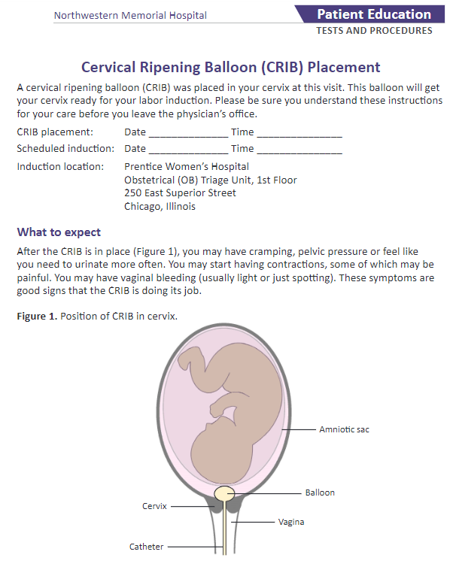
Outpatient Process – Patient Education
Northwestern Memorial Group Faculty OBGYN
Offer encouragement and support
Be transparent with expectations and precautions
Notes:
You can see a portion of our patient educational materials here.
Once the patient is discharge home, we update our partner on call overnight.

Slide 55
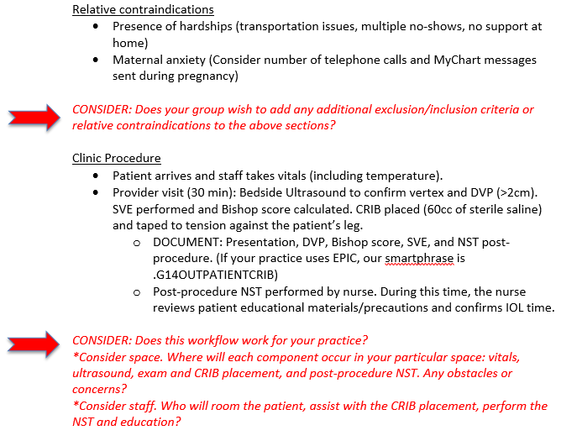
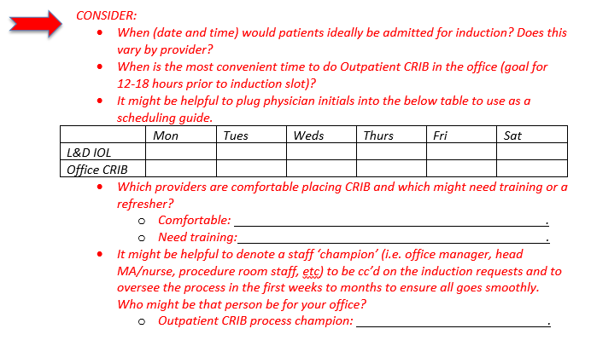
Outpatient Process – Dynamic and Personal
Notes:
I have shared our process with you but I cannot emphasize enough how incredibly dynamic and personal this process must be.
We continue to tweak as we learn from our experiences, and with that in mind and for others interested in beginning, we developed a working draft of our office protocol that has built-in prompts to allow for self-guided implementation.
You can see a portion of that document here – with an example of the prompting that is embedded throughout.

Slide 56
Academy for Quality and Safety Improvement Project
CRIB in Your Crib
Outcome Metric:
  L&D LOS for induction of labor requiring cervical ripening
Process Metrics:
  Percentage of CRIB performed Outpatient
  OBGYN Practices doing Outpatient CRIB
Association for Women's Health Care (Baum)
Chicago Women's Health Group (Kelsey)
Comprehensive Women's Health Care
Erie - All sites
Lakeshore Obstetrics & Gynecology
Near North Health Services - North Kostner Health Center
NMG G14 Faculty OBGYN
NMG PAC Clinic
NMG MFM Clinic
NMG 680 Obstetrics and Gynecology Group
NMG 680 CNM Group
Northwestern Obstetrics & Gynecology Consultants (P Katz)
Northwestern Specialists for Women (B Wise)
Northwestern Women's Health Associates (Friedell and Feldstein)
Nye Partners Women's Health
The Women's Group of Northwestern (Kamel)
The Women's Practice (Mazzullo, Tan)
Women's Health Consulting (Rubin)
In scope for AQSI project
Practice performing Outpatient CRIB
Notes:
AQSI is the Northwestern Academy for Quality and Safety Improvement, and our project focused on expanding cervical ripening with the goal of decreasing LOS on L&D. Our project goal is for 20% of cervical ripening to be done outpatient by July of this year.
L&D inpatient LOS is calculated from admission to delivery, based on EMR time stamps.
The percentage of total CRIB that are performed outpatient, which you will see depicted on the next slide.
The number of obstetric practices at PWH who perform Outpatient CRIB.
All obstetric practices whose patients currently deliver at PWH are listed in this table.
Currently, we are up to 4 practices out of the 18 who have begun performing Outpatient CRIB (These practices are highlighted in green).
The complete packet of materials needed for self implementation was shared, along with a personalized invitation and offer of support, with each private group delivering at PWH.
As a real-time motivator, we are already seeing an uptrend in volume (the post-pandemic shock babies ☺), and we have experienced boarding on our L&D. I am hopeful this will motivate additional groups to join.

Slide 57

PWH: Average Time L&D Arrival to Delivery
Comparison of Outpatient vs. Inpatient CRIB Placement
Notes:
This slide represents a summary of some of our outcome and process metrics, which we follow monthly to assess impact of outpatient cervical ripening on overall L&D LOS.
The solid bar graph reflects the numbers of total CRIBs placed.
Each bar is separated into darker purple to represent the tiny sliver currently done on an outpatient basis, and light purple which denotes those placed inpatient.
Every time I review this graph, I am struck by the degree of opportunity – 202 inductions with cervical ripening last month – if even 20% of those are done outpatient (40), saving an average of 7 hours each, that is 282 extra hours of L&D time made available. My newest selling point has become – 1 outpatient CRIB/practice/week!
The lines graphed over the bars represent the current LOS on L&D for patients undergoing IOL with cervical ripening.
The light purple again denotes those whose course is completed while inpatient. You can see that their average LOS over the past 8 months is about 20 hours (range 19:29 to 21:52).
The darker purple depicts the course for those who underwent outpatient CRIB. Their L&D LOS is much shorter averaging 13 hours (range 10:44 to 17:33).
This represents an average LOS savings of 7 hours per patient.

Slide 58
Next Steps/Lessons Learned
Increase Outpatient CRIBs!!!!
Outreach: Follow CRIB data, support efforts at additional groups, evolve processes
Outreach: Intro Materials/Self-Guided Implementation Plan for hospitals interested via ILPQC – we will share this with all of you today (though I think Dr Donelan may have already done so)
Research: Patient and Provider Satisfaction
Lesson: Behavior Change is Hard
Lesson: Team Members are Critical
  Thank you to Dr Emily Donelan, Emily Steveson RN, Juli Pritchard RN, and Jesse Meyer, department administrator.
Lesson: Progress is Success

Slide 59
References
Grobman WA, Rice MM, Reddy UM, Tita ATN, Silver RM, Mallett G, et al. Labor induction versus expectant management in low-risk nulliparous women. N Engl J Med 2018;379:513–23. DOI: 10.1056/NEJMoa1800566.
Induction of labor. ACOG Practice Bulletin No. 107. American College of Obstetricians and Gynecologists. Obstet Gynecol 2009;114:386-97. DOI: 10.1097/AOG.0b013e3181b48ef5.
Alfirevic Z, Gyte GML, Nogueira Pileggi V, Plachcinski R, Osoti AO, Finucane EM. Home versus inpatient induction of labour for improving birth outcomes. Cochrane Database of Systematic Reviews 2020, Issue 8. Art. No.: CD007372. DOI: 10.1002/14651858.CD007372.pub4.
Mohamad A, Ismail NA, Rahman RA, Kalok AH, Ahmad S. A comparison between inpatient and outpatient balloon catheter cervical ripening: a prospective randomised controlled trial in PPUKM. Medical Journal of Malaysia 2018; 73:22.
Policiano C, Pimenta M, Martins D, Clode N. Outpatient versus inpatient cervix priming with Foley catheter: a randomized trial. European Journal of Obstetrics & Gynecology and Reproductive Biology 2017;210:1-6.
Sciscione AC, Muench M, Pollock M, Jenkins TM, Tildon-Burton J, Colmorgen GH. Transcervical foley catheter for preinduction cervical ripening in an outpatient versus inpatients setting. Obstetrics & Gynecology 2001;98:751-6.
Wilkinson C, Adelson P, Turnbull D. Outpatient compared to inpatient cervical ripening with a double balloon catheter: A pilot randomised controlled trial. BJOG: an international journal of obstetrics and gynaecology 2015;122(Supp S1):231.
Ausbeck EB, Jauk VC, Xue Y, Files P, Kuper SG, Subramaniam A, et al. Outpatient Foley Catheter for Induction of Labor in Nulliparous Women: A Randomized Controlled Trial. Obstetrics & Gynecology 2020;136(3):597-605.
McDonagh M, Skelly AC, Tilden E, Brodt ED, Dana T, Hart E, et al. Outpatient Cervical Ripening: A Systematic Review and Meta-analysis. Obstet Gynecol 2021;00:1-11. DOI: 10.1097/AOG.0000000000004382.
Diederen M, Gommers JSM, Wilkinson C, Turnbull D, Mol BWJ. Safety of the balloon catheter for cervical ripening in outpatient care: complications during the period from insertion to expulsion of a balloon catheter in the process of labour induction: a systematic review. BJOG 2018; 125:1086–1095.
Kruit H, Heikinheimo O, Ulander VM, Aitokallio-Tallberg A, Nupponen I, Paavonen J, et al. Foley catheter induction of labor as an outpatient procedure. J Perinatol 2016;36:618-22. DOI: 10.1038/jp.2016.62.
Lamar R, Mengesha B, Little S. The case for outpatient cervical ripening for IOL at term for low-risk pregnancies. OBG Management Sept 2019;31(9):41-49.

Slide 60
Team Talk: Amy Mehl BSN, RNC-OB OSF St. Francis
Notes:
To be added

Slide 61
OSF HealthCare
Saint Francis Medical Center
ILPQC PROMOTING VAGINAL BIRTH
TEAM:
Clinical Outreach Coordinator Perinatologist
Perinatal Educator Private OB Attending
Perinatal Administrator OBGYN Department Chair
Data abstractor Medical Director of L&D
L&D Director Laborist
L&D Manager Midwife
L&D Supervisor Doula
L&D Educator Clinical Informatics Scholars
L&D Charge/Bedside RNs Quality and Safety Coordinator

Slide 62
BACKGROUND
2020: Process Improvement Project
  focus on impacting patient length of stay by decreasing the C-Section rate
2021: ILPQC PVB Initiative
  focus on decreasing the C-Section rate specifically on PC-02 population

Slide 63
IMPLEMENTATION
Discussions with OBGYN Department Chair and Medical Director of Labor and Delivery
PowerPoint Presentation at OBGYN Department meeting
  Process Improvement Project
  ILPQC Initiative PVB
Data Collection
Labor Culture Survey

Slide 64
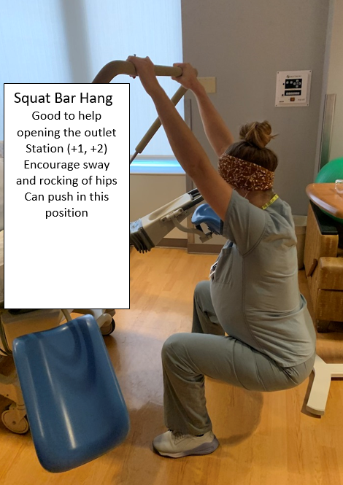
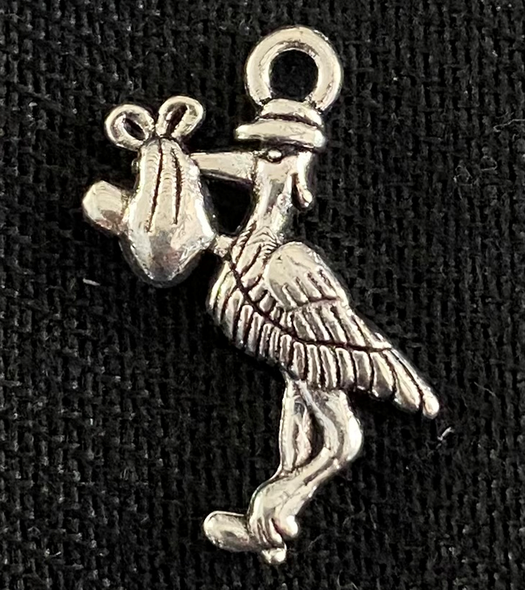
WHAT’S BEEN SUCCESSFUL?
Discussions surrounding definitions and impact
Magnets and shift report huddle
Bulletin Board
Laminated pictures – Labor position changes
Crown Down
Stork charms

Slide 65
WHAT ARE THE BARRIERS?
Provider Buy-in
  Medical Director of L&D and MFM Provider
  ILPQC Virtual Grand Rounds
Un-blinded provider level data
  Administration is supportive with the communication and implementation going forward
Staying on top of real time data

Slide 66
Data Dashboards

Slide 67
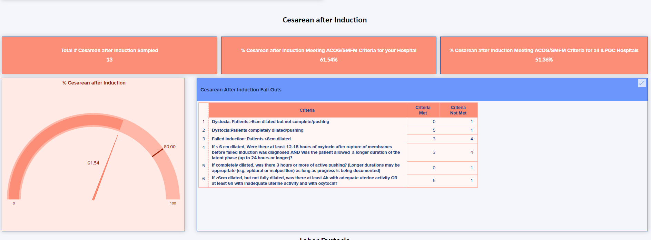

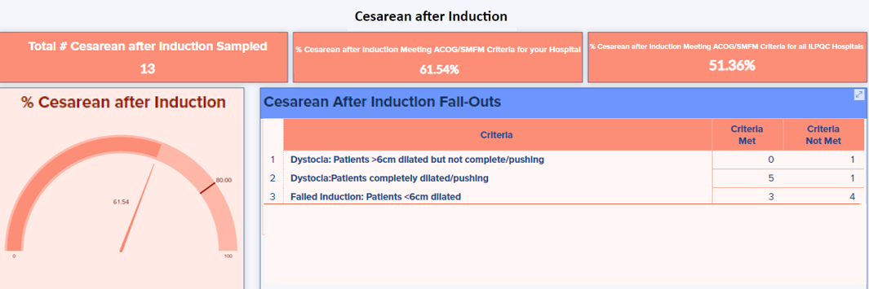



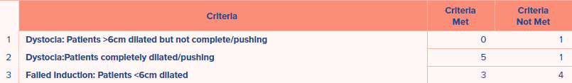
Dashboard Coming Soon!
We are excited to announce that our PVB Dashboard IS ALMOST READY!!!
The dashboard will give you a deeper look at your NTSV C-sections as well as allow you to see how your hospital compares to the rest of the state on key measures
Please join us on July 27th at 12:00 a QI Topic call:
Using the PVB Dashboard to Drive Change
Please join us Tuesday August 10 at 12:00 a QI Topic call: Using the PVB Dashboard to Drive Change
Register at the link in the chat or on the PVB webpage

Slide 68
Next Steps with PVB

Slide 69
Current Activities for your QI Team
Continue to host and attend your regular QI Team meetings
Review your LCS results with the LCS implementation guide
Determine if a PVB Grand Rounds/OB Provider Meeting to help achieve nurse and physician buy-in
Submit monthly data collection for January-June 2021
Roll-out cesarean decision checklist
Ensure your hospital had identified at least one team member to attend a virtual live Labor Support Class who can train clinicians at your hospital. Register at https://ilpqc.org/initiatives/promoting-vaginal-birth-initiative/

Slide 70
ILPQC Labor Support Classes
We are partnering with Jessica Brumley, CNM from FPQC to offer two Virtual Labor Support Classes
We invite all individuals who care for laboring patients to join us for this advanced labor support training.
The live class will consist of a virtual presentation with demonstration videos
Participants will receive a packet to take back to their institution with resources to educate their staff that were unable to attend
When? August 3 and September 28 8AM-1PM
Registration links will be in your PVB newsletter and on the PVB Webpage at ilpqc.org

Slide 71

PVB Grand Rounds
PVB Grand Rounds help facilitate buy-in and give your providers the opportunity learn more about the initiative
Hear from an expert on the ILPQC Grand Rounds Speaker’s Bureau
Email ellie.suse@northwestern.edu to schedule your grand rounds or OB provider meeting
14 Grand Rounds already scheduled for PVB

Slide 72
Upcoming Monthly Webinars:
Date | Topic
Monday, August 23 12:30-1:30 | Implementing a standard criteria for the diagnosis of labor dystocia arrest disorders
Monday, September 27 12:30-1:30 | Policies and Procedures: Pain management and early Labor
Thursday October 28th | 2021 Annual Conference
Register and Join here: https://northwestern.zoom.us/j/91684580832?pwd=eXo3U3VsTlVTOHI5QjRvUjdQeWRtdz09

Slide 73
Save the Dates!
2021 Annual Conference
October 28, 2021
2022 Face-to-Face Meeting
OB Day: May 25, 2022
Neo Day: May 26, 2022

Slide 74
Questions?
Please put your questions or comments in the chat

Slide 75










Thanks to our Funders
In kind support:

