Slide 1

PVB Monthly Webinar:
Policies and procedures for pain management and early labor
November 22, 2021 12:30-1:30

Slide 2
Overview:
2021 Annual Conference Recap
PVB Data Review
Policies and Procedures for Pain management and early Labor
Dawn Hernandez Price: Promoting Vaginal Delivery Early Labor and Pain Management
Team Talk: NM Palos Hospital
PVB Next Steps
PVB Office Hours
  Join us after the call to ask any questions you may have

Slide 3
Annual Conference Recap

Slide 4
Annual Conference By-The-Numbers
658 registered, over 500 total attendees
7 National Speakers
200 participants in the OB Breakout Session:
54 Quality Improvement Posters
Over 100 QI Awards for hospital teams for MNO-OB, MNO-Neo, BASIC, PVB, and Birth Equity
10 Collaborator Booths
If you were unable to attend or want to share any of the presentations with your colleagues, ILPQC will upload slide presentations & recordings to the conference webpage in the upcoming weeks!

Slide 5

2021 QI LEADER AWARD
ILPQC 2021 9th Annual Conference
Promoting Vaginal Birth Award Criteria
Movement on PVB Structure Measures (Red → Yellow, Yellow → Green) + All 2020 Q4 (Oct- Dec) Baseline Data Submitted
+
All Data Submitted *
Congratulations to all of the PVB QI Recognition Award Winners! If you did not receive an award reach out to Ellie (ellie.suse@gmail.com) to set up a 1-1 QI support call
*All Data Submitted
Baseline through August 2021 by October 15th

Slide 6

Promoting Vaginal Birth QI Recognition Award
Abraham Lincoln Memorial Hospital
Adventist Hinsdale Hospital
Advocate Aurora Good Shepherd Hospital
Advocate Condell
Advocate Good Samaritan
Advocate Illinois Masonic Hospital
Advocate Lutheran General Hospital
Advocate Sherman Hospital
Alton Memorial
AMITA Bolingbrook
Amita Health Resurrection Medical Center
AMITA Health Saint Alexius Medical Center
AMITA St. Mary & Elizabeth Hospital
Barnes Jewish Hospital
Carle BroMenn Medical Center
Carle Richland Memorial Hospital
Central DuPage Hospital
CGH Medical Center
Edward Hospital
Elmhurst Hospital
FHN Memorial Hospital
Gibson Hospital
HSHS St. John's Hospital
HSHS St. Joseph's Breese
Javon Bea Hospital

Slide 7
Promoting Vaginal Birth QI Recognition Award
KSB Hospital
Loyola University
MacNeal Hospital
Memorial Hospital East
Morris Hospital & Healthcare Center
NM Delnor
NM Huntley Hospital
NM Kishwaukee Hospital
NM Lake Forest Hospital
NM McHenry Hospital
NorthShore University HealthSystem
Evanston Hospital
Northwest Community Hospital
Northwestern Memorial Hospital
OSF HealthCare Saint Anthony Medical Center
OSF Healthcare Saint Francis Medical Center
OSF Heart of Mary Medical Center
OSF Little Company of Mary hospital
Palos Hospital
Riverside Medical Center
SSM Good Samaritan
SSM Health St. Mary's Hospital- St. Louis
St. Anthony Hospital
Stroger
Unity Point Methodist
University of Chicago Medicine

Slide 8
PVB Data Review

Slide 9
Month | Teams Reporting Patient Data | Teams Reporting Hospital Data
Baseline | 89 | 85
January 2021 | 86 | 80
February 2021 | 85 | 80
March 2021 | 85 | 78
April 2021 | 81 | 78
May 2021 | 78 | 70
June 2021 | 71 | 71
July 2021 | 76 | 67
August 2021 | 76 | 59
September | 64 | 48
October | 48 | 32
ILPQC Hospital Team Data Submission
(94 Teams Total)
If hospital data is not submitted for a given month you will not have access to your team’s NTSV C-Section rate over time.

Slide 10
Supporting vaginal birth and reducing primary Cesareans for optimal maternal and neonatal outcomes
Aim: 70% of participating hospitals will be at or below the Healthy People goal of 23.6% cesarean delivery rate among NTSV births by December 31, 2022
Goal: Increase the percent of cesarean section deliveries among NTSV births that meet ACOG/SMFM criteria for cesarean
Goal: Increase the % of physicians/ midwives/ nurses educated on ACOG/SMFM criteria for cesarean, labor management strategies/response to labor challenges, protocol for facilitating decision huddles and/or decision debriefs
UPDATED GOAL based in Health People 2030

Slide 11
Provider and Nurse Education

Slide 12
Standard protocols and processes

Slide 13
Sharing Provider Level Data

Slide 14
Cesarean Decision Checklist

Slide 15
Decision Huddles/Debriefs

Slide 16
Shared Decision Making

Slide 17
Standardized Patient Education

Slide 18
EMR Integration

Slide 19
NTSV C-sections meeting
ACOG/SMFM Criteria, across hospitals
Goal: >80%
67%
60%
58%
Notes:
Add numbers in a box for Total NTSV CS, C/S after induction and Labor Dystocia for baseline and for October

Slide 20
Where do we need to focus improvements for meeting ACOG/SMFM Guidelines?
ACOG/SMFM Criteria for Nullips in the Second Stage:
Allowing 3 or more hours of pushing, 4 hours with epidural​

Slide 21
NTSV C-Section Rates, by hospital
Goal: < 23.6%
All ILPQC Average: 25%

Slide 22
ILPQC NTSV C-Section Rates
26%
24%
25%
22%
Notes:
Add the number in for baseline and Aug , Sept and October.

Slide 23
Policies and procedures for pain management and early labor

Slide 24
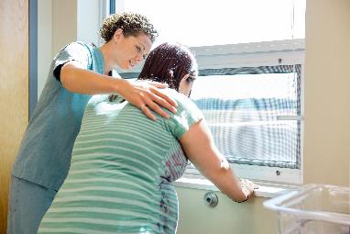
PVB Key Strategies
    Identifying NTSVs
    Education of ACOG/SMFM criteria for providers and nurses
    Implementing cesarean decision checklists and huddles with patient centered decision making
    Labor management support
    Develop standardized processes/protocols for induction, early labor and labor challenges

Slide 25
Did you know?
6 is the new 4!
FIRST STAGE OF LABOR
Zhang 2002 found that 50% of women entered active labor at 4cm, 75% at 5cm and 100% at 6cm.
Cervical dilation of 6 cm should be considered the threshold for the active phase of most women in labor. Before 6 cm dilation, standards of active phase progress should not be applied.
Safe prevention of the primary cesarean delivery. Obstetric Care Consensus No. 1. American College of Obstetricians and Gynecologists. Obstet Gynecol 2014;123:693–711.

Slide 26

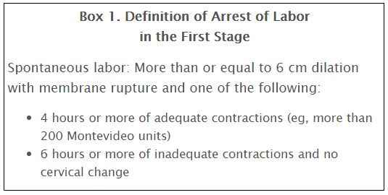
Safe prevention of the primary cesarean delivery. Obstetric Care Consensus No. 1. American College of Obstetricians and Gynecologists. Obstet Gynecol 2014;123:693–711.

Slide 27

Number 687, February 2017
Approaches to Limit Intervention During Labor and Birth
Obstetrician–gynecologists, in collaboration with midwives, nurses, patients, and those who support them in labor, can help women meet their goals for labor and birth by using techniques that are associated with minimal interventions and high rates of patient satisfaction. Many common obstetric practices are of limited or uncertain benefit for low-risk women in spontaneous labor.
For women who are in latent labor and are not admitted, a process of shared decision making is recommended.
Admission during the latent phase of labor may be necessary for a variety of reasons.
Admission to labor and delivery may be delayed for women in the latent phase of labor when their status and their fetuses’ status are reassuring. The women can be offered frequent contact and support, as well as non-pharmacologic pain management measures.
When women are observed or admitted for pain or fatigue in latent labor, techniques such as education and support, oral hydration, positions of comfort, and non-pharmacologic pain management techniques such as massage or water immersion may be beneficial.
Notes:
I think its important to note that these recommendations are coming from ACOG!

Slide 28
Implement Early Labor Supportive Care Policies and Active Labor Criteria for Admission
Translation: Early labor at home. Let labor start on its own!
Physiologic onset of labor is critical to the success in labor, and introduces moms and babies to protective hormonal pathways
Women admitted in early labor are more likely to have a cesarean, and more likely to have routine interventions e.g. oxytocin even if not clinically necessary

Slide 29
Early admission support
Recog/Prevent
Admission policy or checklist for spontaneous labor
Latent labor support and therapeutic rest policies
Patient education materials to explain rationale for delayed admission, reduce anxiety and provide guidance on when to return to the labor and delivery unit
Material with specific guidance for partners and family members as to how to best support the woman in early labor
29

Slide 30
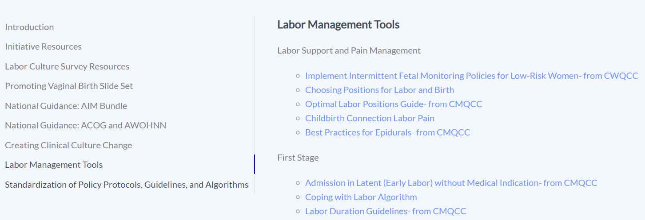
PVB Toolkit Resources

Slide 31
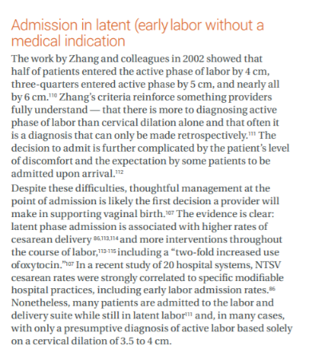
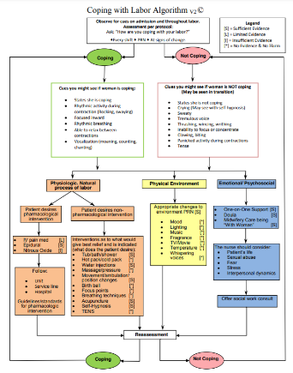
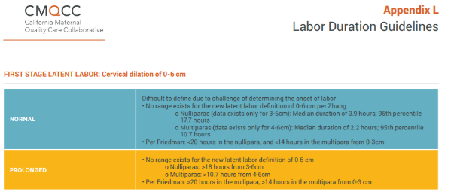
Toolkit Resources First Stage
Admission in Latent (Early Labor) without Medical Indication- from CMQCC’
Coping with Labor Algorithm
Labor Duration Guidelines- from CMQCC

Slide 32
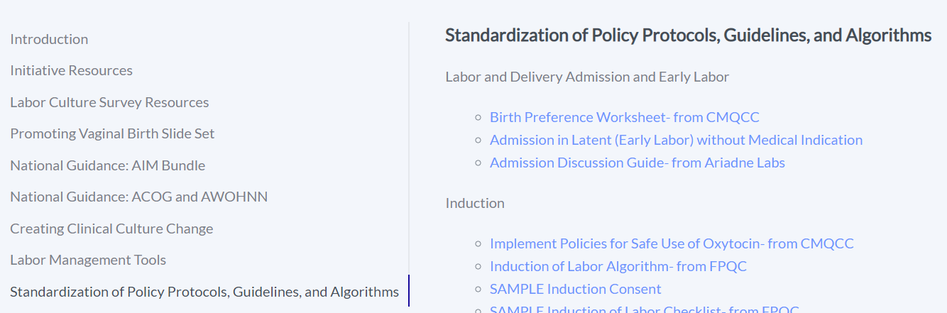
PVB Toolkit Resources

Slide 33
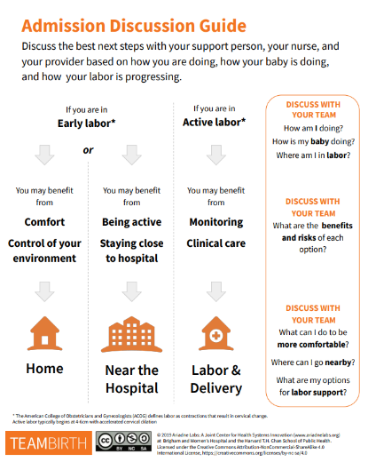
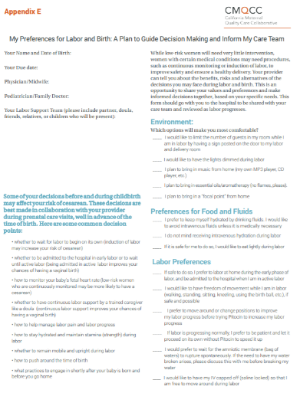
Labor and Delivery Admission and Early Labor
Birth Preference Worksheet- from CMQCC
Admission Discussion Guide- from TeamBirth, Ariadne Labs

Slide 34

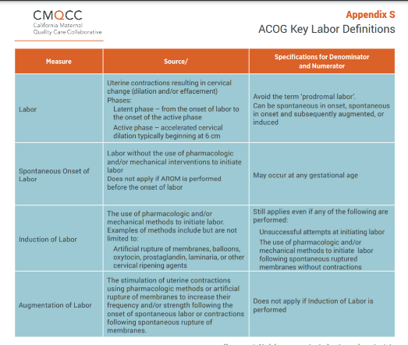
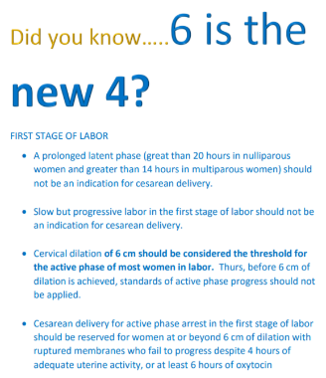
Resources: Education of ACOG/SMFM criteria for providers and nurses
CMQCC Labor Duration Guidelines
ACOG Key Labor Definitions
6 is the new 4

Slide 35
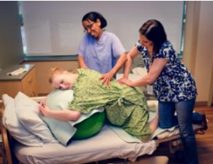
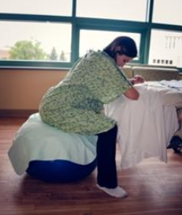
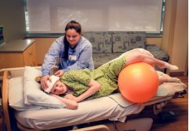
Resources: Labor management support
ILPQC held 2 labor management support workshops in partnership with Jessica Brumley, CNM from the Florida PQC
405 Attendees from 70 ILPQC hospitals
“The most applicable labor support class for an L&D nurse”
“Even better than Spinning Babies!”
COMING SOON: ILPQC Labor Management Support E-Modules for physician and nurse education adapted from Labor Management Support Workshops

Slide 36
Dawn Hernandez
California Maternal Quality Care Collaborative

Slide 37


Promoting Vaginal Delivery
Early Labor and Pain Management
Providence St Jude Medical Center
Fullerton, Ca
Dawn Hernandez Price, MSN, NE-BC, RNC-OB, C-EFM

Slide 38
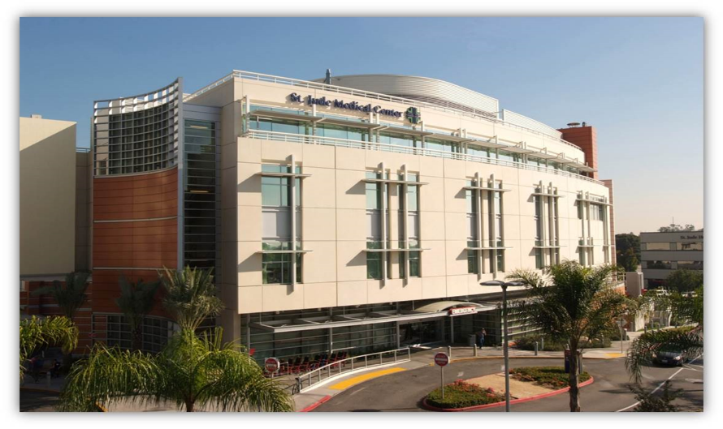
Providence St Jude Medical Center

Slide 39

Guided by our Mission, Vision, Values, and Promise

Slide 40
Providence St Jude Medical Center
Established by the Sisters of St Joseph Orange in 1957, Providence St Jude is one of Southern California’s most respected, technology advanced hospitals serving both Los Angeles and Orange County Communities.
320 Bed Hospital
2,400 Births/ Year
Magnet Designated since 2015
Baby-Friendly Designated since 2011

Slide 41
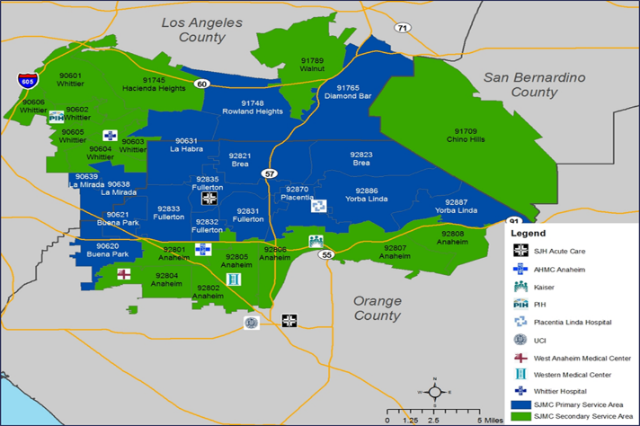
Hospital Geographic Service Area

Slide 42


Center of Excellence

Slide 43
Maternal Newborn Services
9 LDRs
2 Surgical Suites/ 2 Recovery Rooms
4 Triage Rooms
4 Antepartum Rooms
14 Bed-Level 3 CCS Community NICU
28 Bed Couplet Care

Slide 44
Goal Statement
During calendar year 2015, the baseline NTSV C/S rate was 34%, unfortunately, this rate was well above the national Healthy People 2020 goal rate of 23.9%
Goal Statement
Promoting vaginal birth and reducing the rate of first-birth cesarean birth by implementation of an early labor algorithm and therapeutic rest protocol

Slide 45
CMQCC Collaboratives
April 2016- CMQCC 1st Round Promoting Vaginal Birth and Reducing Primary Cesareans Collaborative
Administrative Support
Physician Champions
June 2016-Transparent Un-blinded Physician Data
Individual Physician Data Scorecards
NTSV Rates Review Monthly

Slide 46
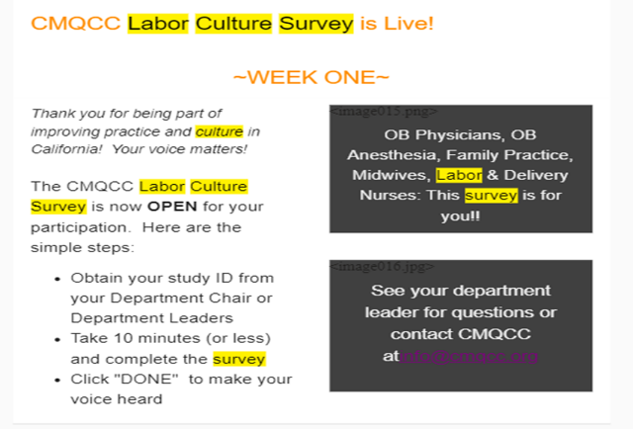
Labor Culture Survey
August 2017- Labor Culture Survey Completed

Slide 47
  CMQCC Collaboratives
L&D Champions attended CMQCC Support Vaginal Delivery Workshops
Launched Patient Resource Circle App
Early Labor Patient Education Developed
Developed Early Labor Management Algorithm
Participated 3rd Round CMQCC Promoting Vaginal Birth Collaborative Aug 2018 not only to share our great progress with other hospitals but to sustain our work!

Slide 48

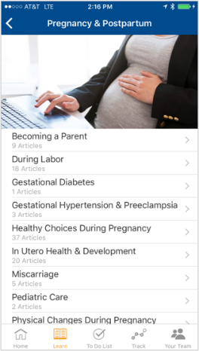
Circle App Early Labor Resource

Slide 49

Early Labor at Home

Slide 50
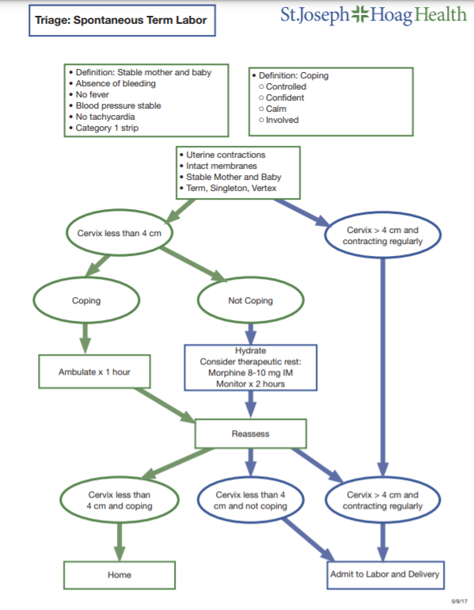
Early Labor Algorithm

Slide 51
Pain Management in Early Labor
Hydrate
Consider Morphine 8-10mg IM
Monitor 1-2 Hours
Discharge Home
Therapeutic Rest

Slide 52
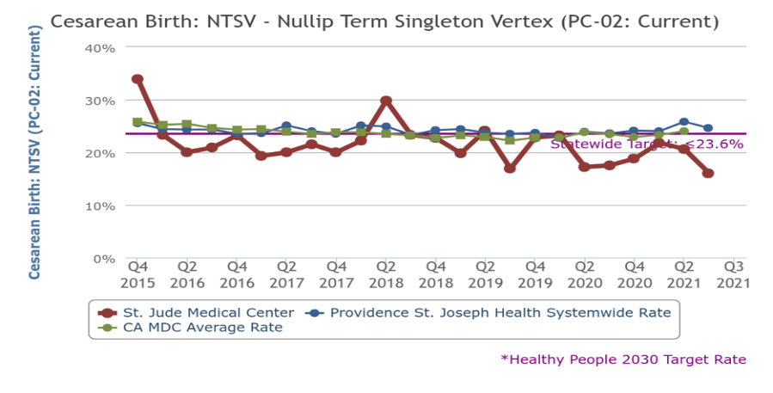
NTSV Outcome Data
1st Round CMQCC Promoting Vaginal Birth Collaborative
April 2016
3rd Round CMQCC Promoting Vaginal Birth Collaborative
Aug 2018

Slide 53
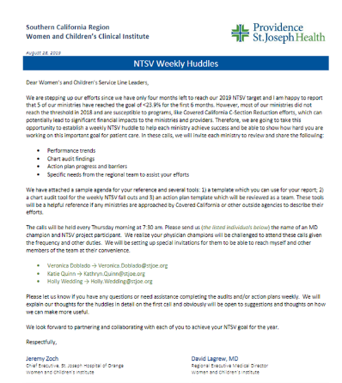
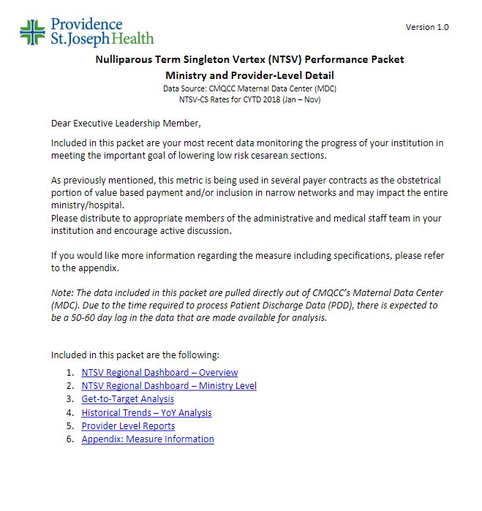
Culture Change
Organizational Culture Change

Slide 54
Sustainment
Continue Weekly NTSV Fall-Out Case Reviews
NTSV Rates Review Monthly
Labor Culture
Organizational Culture Change is a 3–5 Year Journey!

Slide 55

Can You Do It?

Slide 56

Questions?

Slide 57
Team Talk: NM Palos Hospital
Myra Pacelli

Slide 58
Northwestern Medicine Palos Hospital
Promoting Vaginal Births
ILPQC Team Call November 22, 2021

Slide 59
NM Palos Demographics
LDRP model
Approximately 600 births per year
Level II Intermediate Care Nursery
Majority private Obstetricians
OUR PROMOTING VAGINAL BIRTHS TEAM
Myra Pacelli, BSN, MS Clinical Educator, Team Lead
Karen Jaekel, RHIT, CPHQ, Quality Lead
Megan DeJong, MD Physician Champion
Lawrence Boysen, MD, Medical Director OB/GYN
Catherine Adelakun, MSN, RNC-MNN, Mgr MCH

Slide 60
NTSV Cesarean Section Rate by Month
 | # NTSV Deliveries | # C/S | % C/S
January | 20 | 4 | 20%
February | 20 | 6 | 30%
March | 18 | 7 | 30%
April | 17 | 7 | 41%
May | 18 | 9 | 50%
June | 28 | 13 | 46%
July | 25 | 6 | 24%
August | 25 | 7 | 28%
September | 10 | 4 | 40%
October | 23 | 3 | 13%

Slide 61
Data Slide
% NTSV Cesarean Section Compliance with ACOG/SMFM Guidelines
Category: | Jan | Feb | Mar | Apr | May | June | July | Aug | Sept | Oct
Failed Induction | 0% | 0% | 25% | 66.7% | 50% | 100% | 100% | 100% | N/A | N/A
Labor Dystocia | 0% | N/A | N/A | N/A | 50% | N/A | N/A | 50.8% | 100% | 0%
Fetal Heart Rate Concerns | 100% | 100% | 0% | 100% | 100% | 66.7% | 100% | 100% | 100% | 100%

Slide 62
Accomplishments
*Educated all OBs/RNs on SMFM/ACOG guidelines: included written information,
laminated pocket card & sign-off that information was received
*Adopted Pre-cesarean Huddle checklist – format has evolved over time; initially used with
one physician group and then expanded to all
*Included information on NTSV patients in morning staff huddles
*Posted laminated algorithms for guiding decision making around the unit
*Created smart phrases for ease of documentation: decision huddle, patient engagement
*Provided AJOG Opinion on Management of Category II FHR Tracings to all OBs/RNs
*Participated in Labor Culture Survey with 82% participation rate overall
*Attended the Labor Support course with ongoing information sharing
*Shared data with OB staff and providers on the ILPQC Initiative boards and at meetings

Slide 63
Ongoing efforts
Conclusions:
*Our c-section rate is variable, but is improving
*Use of the pre-csection checklist improved staff/provider communication and awareness of ACOG/SMFM guidelines
*Documentation of patient engagement improved with implementation of smart phrases in the EMR
*Guidelines for cervical ripening may decrease our csection rate for Failed Induction

Slide 64
Next Steps with PVB

Slide 65

PVB Grand Rounds
PVB Grand Rounds help facilitate buy-in and give your providers the opportunity learn more about the initiative
Hear from an expert on the ILPQC Grand Rounds Speaker’s Bureau
Email ellie.suse@northwestern.edu to schedule your grand rounds or OB provider meeting
14 Grand Rounds already scheduled for PVB

Slide 66


Provider Education Resources:
Coming Soon!
ILPQC is working on creating provider education posters to share on your Labor and Delivery Units
If you have any requests or suggestions for Provider education materials, please email ellie.suse@northwestern.edu
Examples from MNO-OB

Slide 67
Upcoming Monthly Webinars:
Date | Topic
Monday, January 23rd 12:30-1:30 | Data Transparency: Sharing provider level data
Monday February 28th 12:30-1:30 | Second Stage of Labor: Pushing
Monday, March 28th 12:30-1:30 | Dystocia Management Strategies
Monday, April 25th 12:30-1:30 | Labor Support
Wednesday, May 25th | 2022 ILPQC OB Face-to-Face
NO PVB Call in December due to the Holidays!

Slide 68
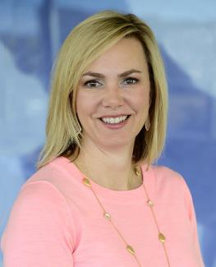
Challenges in Perinatal Marijuana Use in the Era of Legalization
Special Edition MNO-Neonatal Sustainability Call
Join us on November 29th at 1:00
Dr. Erica Wymore is a neonatologist and an expert on perinatal marijuana use and maternal/child outcomes. She was responsible for the development of the Colorado Perinatal Care Quality Collaborative (CPCQC) breastfeeding guidelines for mothers with marijuana use.

Slide 69

Save the Date!
ILPQC 2022 Face-To-Face:
  OB Day: May 25th, 2021
  Neo Day: May 26th, 2021
ILPQC 2022 Annual Conference:
  October 27th 2021

Slide 70
Next Steps
Review Early Labor and Admission Policies at your institution
Review toolkit materials for early labor and pain management
Determine which tools will be useful to share with your providers and nurses
Determine if a PVB Grand Rounds/OB Provider Meeting to help achieve nurse and physician buy-in
Submit monthly data collection for January-February 2021
Roll-out cesarean decision checklist

Slide 71
Questions?
Please put your questions or comments in the chat

Slide 72










Thanks to our Funders
In kind support:

