Slide 1
What’s My Role?
BASIC Monthly Teams Call
November 15, 2021

Slide 2
Call Overview
ILPQC Annual Conference Recap
Updates & Housekeeping
BASIC Data Review
What’s My Role?
Physicians
Nurses
Family and Caregivers
How to view the New and Improved ILPQC BASIC Online Toolkit!
Ice breaker: Please share in the chat your favorite work-friendly beverage!
Notes:
Ask people to share in the chat what their favorite NON ALCOHOLIC beverage is.

Slide 3
ABP MOC Part IV (BASIC & MNO)
Complete attestation forms if you are an ABP-certified physician seeking credit under MOC Part IV for 25 credits
Complete an attestation form and submit it to your project’s local leader or QI project leader for signature and send back to info@ilpqc.org by Friday, November 19th EOB.
Attestation of Meaningful Participation:
Intellectually engaged in planning and executing the project
Participated in implementing the project’s interventions (the changes designed to improve care)
Regularly reviewed data in keeping with the project’s measurement plan
Collaborated in the activity by attending team meetings

Slide 4
Annual Conference Recap

Slide 5
Annual Conference By-The-Numbers
658 registered, over 500 total attendees
7 National Speakers
110 participants in the Neonatal Breakout Session:
54 Quality Improvement Posters
Over 100 QI Awards for hospital teams for MNO-OB, MNO-Neo, BASIC, PVB, and Birth Equity
10 Collaborator Booths
If you were unable to attend or want to share any of the presentations with your colleagues, ILPQC will upload slide presentations & recordings to the conference webpage in the upcoming weeks!
Notes:
Ellie, Do we want to check out plus one sheets to see what our actual attendance is?
It was 37 total plus one surveys which I think puts us over 500 attendees!
10 Neo breakout
1 Patent and Family breakout
26 OB breakout

Slide 6
2021 QI Recognition
ILPQC 2021 9th Annual Conference
BASIC Hospital Recognition Criteria
All 2020 Q4 (Oct- Dec) Baseline Data Submitted
+
All monthly Hospital & Patient Data Submitted +
Movement on BASIC structure measures (Red → Yellow, Yellow → Green)
Congratulations to all of the BASIC QI Recognition Award Winners! If you did not receive an award reach out to Ellie (ellie.suse@northwestern.edu) to set up a 1-1 QI support call

Slide 7
BASIC QI Recognition Award
Advocate Aurora Good Shepherd Hospital
Advocate Aurora Sherman Hospital
Advocate Children's Hospital- Oak Lawn
Advocate Condell Medical Center
Advocate Good Samaritan Hospital
Advocate Illinois Masonic Medical Center
Advocate Lutheran General
Alton Memorial Hospital
Amita Alexian Brothers Medical Center
AMITA Health Adventist Medical Center Hinsdale
Amita Health Resurrection Medical Center
AMITA Saints Mary and Elizabeth Medical Center
AMITA St. Alexius Medical Center
Anderson Hospital
Blessing Hospital
Carle Foundation Hospital
Edward Hospital
Elmhurst Memorial Hospital
FHN Memorial Hospital
HSHS St. John's Hospital
HSHS St. Joseph's Hospital Breese
Loyola University Medical Center
MacNeal Hospital
Memorial Hospital East
Notes:
BASIC
We are excited to award our Neonatal hospital teams the Babies Antibiotic Stewardship Improvement Collabrative QI recognition Award to acknowledge their hard work during this first year of the initiative. Award recipients have submitted all hospital and patient level data for Baseline, and January 2021 through August of 2021 as well as made progress on 8 out of 15 structure measures. Please join us in congratulating all the award winners!

Slide 8
BASIC QI Recognition Award
Memorial Hospital of Carbondale
Memorial Medical Center
Morris Hospital
NM Delnor Hospital
NM Huntley Hospital
NM McHenry Hospital
NorthShore University HealthSystem
Highland Park Hospital
Northwest Community Healthcare
Northwestern Lake Forest Hospital
Northwestern Medicine Central DuPage Hospital
Northwestern Memorial Hospital
OSF Heart of Mary Medical Center
OSF Little Company Mary Medical Center
OSF St. Francis Medical Center
Palos Hospital
Riverside Medical Center
Rush Copley Medical Center
Rush University Medical Center
Silver Cross Hospital
SSM Health Good Samaritan Hospital
St. Louis Children's Hospital/Barnes Jewish Hospital
Swedish Hospital, NorthShore University HealthSystem
SwedishAmerican Hospital
West Suburban Medical Center

Slide 9
BASIC Abstracts and Posters
Reduction of Antibiotic Administration in Well Appearing Neonates Born to Mothers with Chorioamnionitis Neonatal Antimicrobial Stewardship: Baby Steps to Big Success (Advocate Lutheran General Hospital)**
Optimizing antibiotic use and parental education for early onset sepsis (OSF St. Francis Children’s Hospital of Illinois)**
Improving Newborn Antibiotic Stewardship at Silver Cross Hospital (Silver Cross Hospital)**
Neonatal Antibiotic Stewardship (AMITA Health Adventist Medical Center Hinsdale)
BASIC Quality Improvement Project (AMITA St. Alexis Medical Center)
Implementation of Early Onset Sepsis (EOS) Calculator and Reduction of Neonatal Antibiotic Exposure (Little Company of Mary Medical Center)
Down to the BASICs: Babies Antibiotic Stewardship Improvement Collaborative (Loyola University Medical Center)
BASIC Initiative (MacNeal Hospital)
BASIC Quality Improvement Project in Newborns: An Interdisciplinary Approach (Northwest Community Healthcare)
Thank you to all the teams who shared about their BASIC work at the Annual Conference Quality Improvement Poster Session! Make sure to check them out at https://ilpqc.org/2021annualconference/
Notes:
Ellie, order by level?

Slide 10
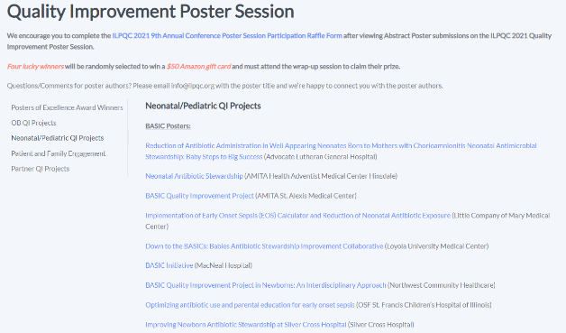
Check out the 2021 Virtual Poster Session
Visit https://ilpqc.org/2021annualconference/
and scroll down to visit the QI Poster Session to view all of the amazing posters!

Slide 11
Review of Progress on Education Strategies

Slide 12
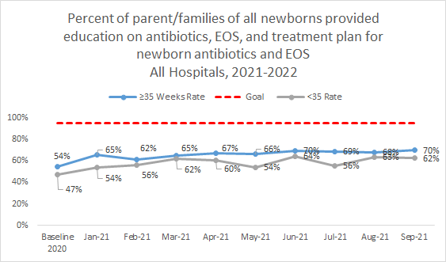
Patient Education
Notes:
Red strategy versus yellow strategy

Slide 13
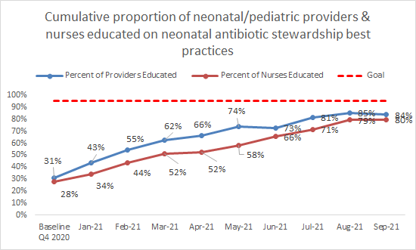
Provider and Nurse Education

Slide 14
It's Easy Being Green! Steps to have your Structure Measures "In Place"
Patient Education Structure Measure "In Place"
Review ILPQC toolkit resources for access to videos and flyers
Develop a protocol and workflow to either share print materials with patients or accessible via patient's health portal
Consider "BASIC Packets" with key provider, nurse, and patient resources in the packets!
Provider Education Structure Measure "In Place"
Sign up for an ILPQC grand rounds!
Review ILPQC toolkit for recordings from JB Cantey & Karen Puopolo
Share ILPQC Provider Education campaign resources (coming soon!)
Notes:
Made a small edit to this slide (AP)

Slide 15
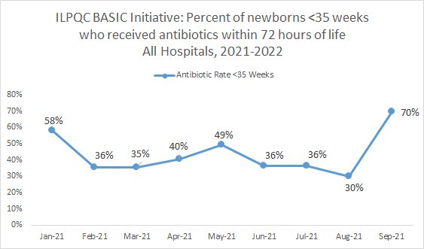
BASIC Aims: Antibiotic Prescribing

Slide 16
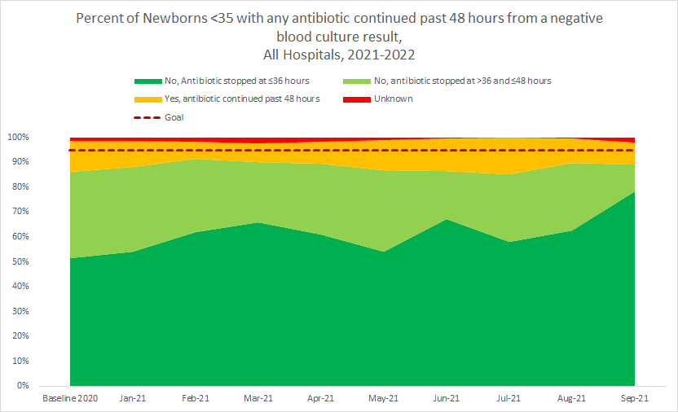
BASIC Aims: Antibiotics Discontinued
≥35 Weeks
<35 Weeks

Slide 17
Interpretation of Data and Graphs
If this is what your data looks like and your progress on patient education has reached a plateau, what can you discuss at your next QI team meeting to address this?
Notes:
1.What may be impacting progress?
2.What are reasons that antibiotics are continued for longer than 36 hours in babies with negative blood cultures?
3.What are key drivers that might improve discontinuation?
4.What are areas of focus for improvement? What processes can be put in place for improvement?
5.What tools does the team have?
6.How can we operationalize these change ideas to see a return to improvement?
7.Are there any people on the call who have experienced this?
8.How did you address it?

Slide 18
What’s My Role?
Physicians, nurses and families/caregivers

Slide 19
Role of The Labor and Delivery Nurse
Perform first assessment on Newborn
If laboring patient receives chorio diagnosis, share Understanding Chorioamnionitis handout with patient
Enter information into NEOSC if newborn is still in L&D within first hour of life and document in chart
Give a thorough report to postpartum/nursery nurse using the ILPQC Newborn Admission Report (or similar tool)

Slide 20
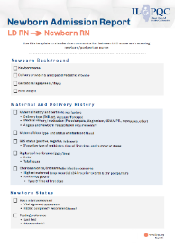
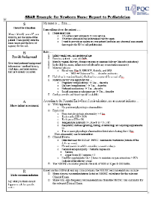
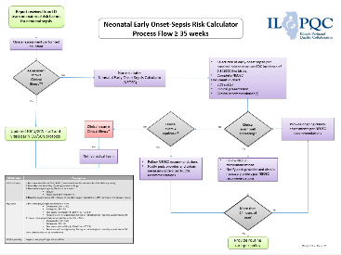
Resources for Nurses
Newborn Admission Report (LD RN to Newborn RN) May 2021; Use this template to standardize communication between L&D nurse and receiving newborn/postpartum nurse
Newborn Nurse to Pediatrician Communication Tool: Use this template to standardize communication between the newborn/postpartum nurse to the pediatrician on newborn status
ILPQC Neonatal Early Onset-Sepsis Risk Calculator Process Flow ≥ 35 weeks: Use this tool to determine the next steps for a newborn who might need antibiotics
20

Slide 21
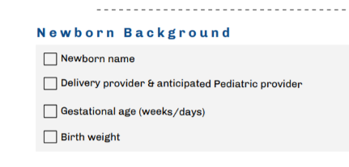
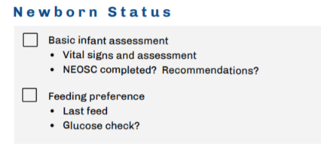
21
Notes:
https://ilpqc.org/ILPQC%202020+/BASIC20/RN_NewbornAdmissionReport_Tool_May2021.pdf

Slide 22
Role of NICU/Nursery Nurse
Receive thorough report from L&D Nurse and ask questions if information is missing
Perform admission assessment on newborn
Enter information into NEOSC if newborn has been transported within first hour of life
Notify Pediatrician of newborn status using SBAR Communication tool
Follow NEOSC Recommendations for care of newborn and inform physician of any changes in newborn status

Slide 23
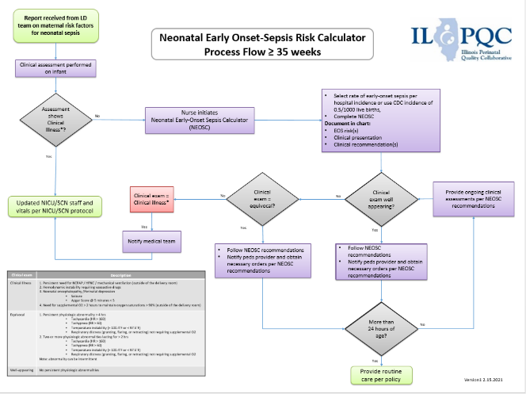
ILPQC Neonatal Early Onset-Sepsis Risk Calculator Process Flow ≥ 35 weeks:

Slide 24
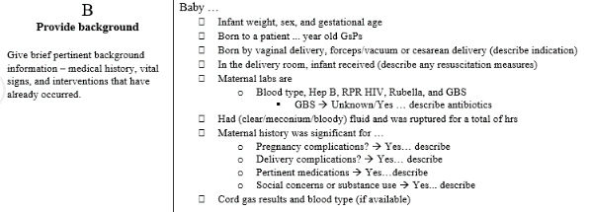
Newborn Nurse to Pediatrician Communication Tool
Situation
Background
Assessment
Recommendation
24

Slide 25
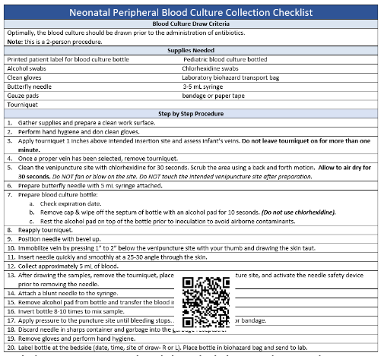
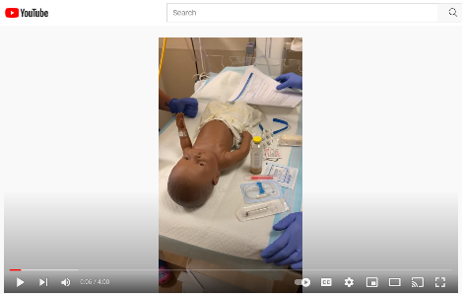
Resources for Nurses
Properly and Consistently Obtain Blood Cultures
Neonatal Peripheral Blood Culture Collection Checklist (Advocate Lutheran General Hospital)
Neonatal Peripheral Blood Culture Collection Video(Advocate Lutheran General Hospital)
25

Slide 26
Role of Provider
Be informed about current evidence-based guidelines regarding antibiotic stewardship
Know assessment tool methodology that you use at your hospital
Categorical Risk Assessment
NEOSC
Enhanced Observation
If your hospital has chosen to use the NEOSC, make sure you understand how it works and how you apply the data to the newborn you are caring for
Utilize order sets and tools, including automatic stop time, to assist in appropriate antibiotic administration

Slide 27
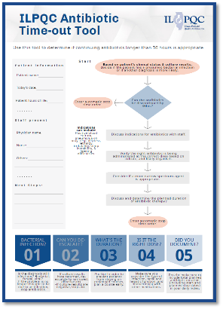
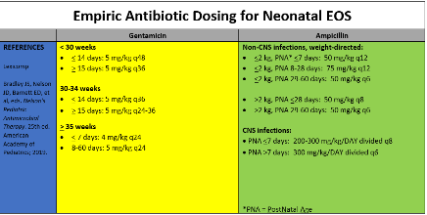
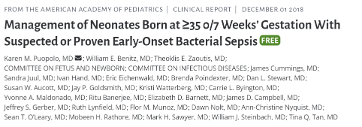
Resources for Providers
Antibiotic Timeout
ILPQC Antibiotic Time-out Tool: Use this tool to determine if continuing antibiotics longer than 36 hours is appropriate
Antibiotic time out video (PQCNC)
National Guidelines, Publications and Supportive Resources
Dosing Guidelines

Slide 28
National Guidelines, Publications and Supportive Resources

Slide 29
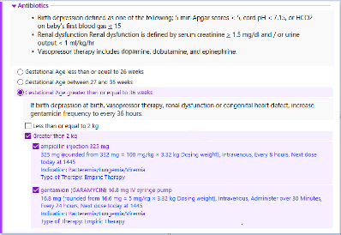
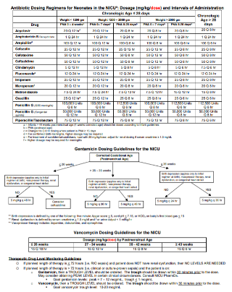
Dosing Guidelines
AAP: Empiric Antibiotic Dosing Chart for Neonatal EOS (2019)
Example Antibiotic Dosing Regimens, Intervals of Administration, and Dosing Guidelines (Shared by UIH 5.4.2020)
Example >35 weeks orderset (Shared in 2020 by UIH)
Example Gentamicin EMR automated stop time order (Shared in 2020 by UIH)

Slide 30
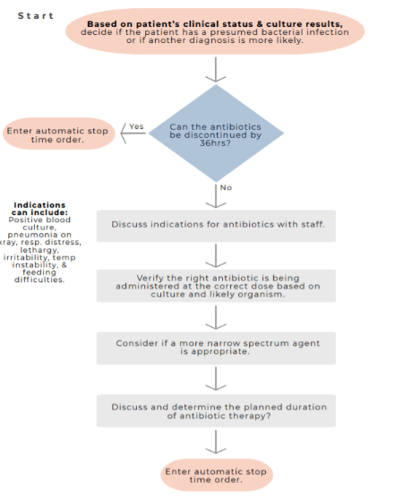
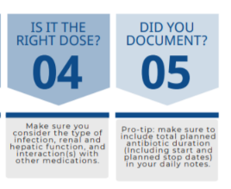

Slide 31
Role of Family and Caregivers
Understand why your baby might need antibiotics by talking to your healthcare team
Watch and review provided educational materials
Ask questions specific to your baby
Ask for clarification when needed
Continue to be a part of your baby's team
Notes:
Thoughts added (AP)

Slide 32
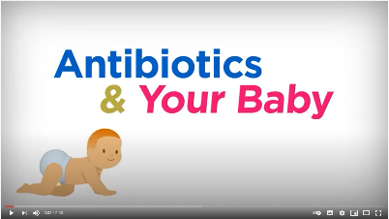
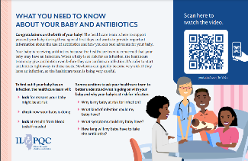
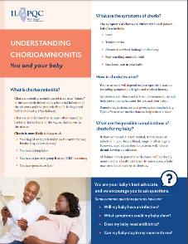
Resources for Family and Caregivers
Antibiotics & Your Baby Education Video
This education video can be shared with families/caregivers after delivery, on admission to postpartum floor/newborn nursery/NICU for newborns who have received antibiotics
English Video: https://www.youtube.com/watch?v=c0an_TmVe6o&pp=sAQA
Spanish Video: https://www.youtube.com/watch?v=sWHd2P91Fy0&pp=sAQA
Antibiotics & Your Baby Accompanying Flyer This flyer can be given to families/caregivers to supplement the education video
Understanding Chorioamnionitis This flyer can be given to patients on admission to L&D to provide important information about Chorioamnionitis

Slide 33
Antibiotics & Your Baby Education Video
Available in Spanish and English!

Slide 34
Patient Education Handout
QR Code:
Open the camera app on your
Point the camera at the QR code
Click the link that pops up t the top of your screen
Watch “Antibiotics and your Baby”

Slide 35
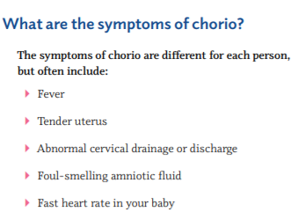
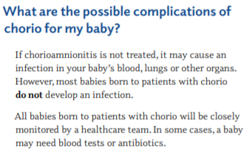
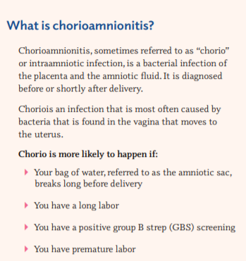
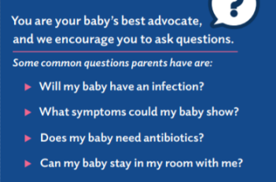
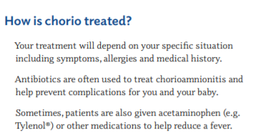

Slide 36
How to view the New and Improved ILPQC BASIC Online Toolkit

Slide 37
1. Visit ILPQC.org
Visit ilpqc.org

Slide 38
2. Click Initiatives and locate BASIC
Notes:
initiatives

Slide 39
3. Open the BASIC Webpage and Scroll down
Scroll Down!!
Notes:
Basic page, scroll down

Slide 41
Communication Tools

Slide 42
Order Sets and Dosing Guidelines

Slide 43
Helpful Initiative Tools

Slide 44
BASIC Data Collection and Tools

Slide 45
QI Resources

Slide 46
Wrap-up and Next Steps
Physicians, nurses and families/caregivers

Slide 47
REMINDER BASIC Monthly Webinar
BASIC Monthly Webinars will now be held from 2-3 PM on the 3rd Monday of the Month starting on the September 20, 2021 call

Slide 48
Upcoming Call Schedule
Date | Topic
November 29, 2021 1-2 PM | MNO-Neo Sustainability Call: Challenges in Perinatal Marijuana Use in the Era of Legalization
December 13, 2021 2-3PM | BASIC Teams Call: Automatic Stop Times
January 17, 2022 2-3PM | BASIC Teams Call: Culture Negative Sepsis
February 21, 2022 2-3 PM | BASIC Teams Call: Interpreting your data through the lens of equity

Slide 49
BASIC Next Steps
Enter Baseline and January-November 2021 patient and hospital level data
Review new and improved ILPQC Toolkit with QI team
Review roles of providers, nurses, and parents/caregivers and determine plan for education of providers and nurses
Determine plan for distribution of patient education materials
Register for upcoming MNO-Neonatal Call on 11/29 at 1:00pm

Slide 50
Challenges in Perinatal Marijuana Use in the Era of Legalization
Special Edition MNO-Neonatal Sustainability Call
Join us on November 29th at 1:00
Dr. Erica Wymore is a neonatologist and an expert on perinatal marijuana use and maternal/child outcomes. She was responsible for the development of the Colorado Perinatal Care Quality Collaborative (CPCQC) breastfeeding guidelines for mothers with marijuana use.

Slide 51
Thanks to our Funders
In kind support:

