Slide 1
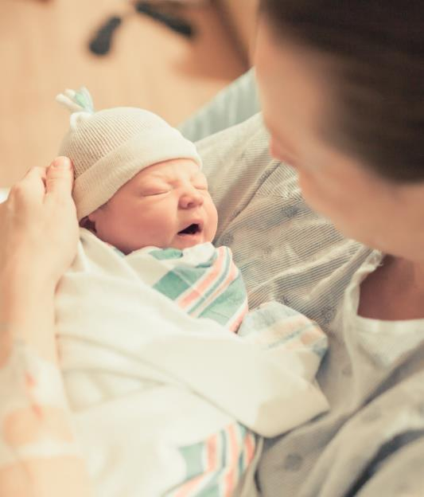
Implementation of Risk Assessments in Newborns <35 Weeks
BASIC Monthly Teams Call
September 20, 2021

Slide 2
Call Overview
ILPQC Updates & Housekeeping
BASIC Data Review
Dr. Sagori Mukhopadhyay, MD, MMSc: Evidence behind the AAP EOS preterm policy
Team Talk: HSHS St. John’s

Slide 3
ABP MOC Part IV (BASIC & MNO)
Complete attestation forms if you are an ABP-certified physician seeking credit under MOC Part IV for 25 credits
Complete an attestation form and submit it to your project’s local leader or QI project leader for signature and send back to info@ilpqc.org by October 31st.
Attestation of Meaningful Participation:
  Intellectually engaged in planning and executing the project
  Participated in implementing the project’s interventions (the changes designed to improve care)
  Regularly reviewed data in keeping with the project’s measurement plan
  Collaborated in the activity by attending team meetings
What strategies can ILPQC employ to support providers and nurses in building QI skills?

Slide 4
Annual Conference Updates

Slide 5

Now OPEN!
Calling all physicians, nurse midwives, nurse practitioners, nurses, lactation counselors, social workers, quality leaders, administrators, payers, public health professionals, & all others interested in perinatal health!
Join us for the ILPQC 9th Annual Conference held virtually on Oct. 28th from 8:00-4:15pm
New this year...education contract hours for social workers
Be sure to invite your patients / community partners to join our special patient/family, community breakout session
2021 AC education contract hours are sponsored by
SSM Health approves this live activity for a maximum of 7.5 AMA PRA Category 1 Credits™, 7.5 ANCC contact hours, 7.5 IPCE credit for learning and change and 7 continuing education credits for social workers. Physicians should claim only the credit commensurate with the extent of their participation in the activity.

Slide 6

Time | Title & Presenter(s)
8:00- 9:00am | Welcome address & Collaboration in Action: Celebrating Progress of ILPQC Initiatives - Ann Borders, MD, MSc, MPH with Leslie Caldarelli, MD and Justin Josephsen, MD
9:00- 9:45am | TeamBirth PVB Plenary- Neel Shah, MD, MPP
9:45- 9:50am | Break
9:50- 10:35am | Antibiotic Stewardship: Beyond the Sepsis Calculator- Karen Puopolo, MD, PhD
10:35- 11:30am | State PQC Leaders Panel: National Perspectives on Improving Perinatal Care- Marilyn Kacica, MD, MPH (NY), Barbara O’Brien, MS, RN (OK), & Munish Gupta MD MMSc (MA)
11:30-11:45am | ILPQC Award Ceremony
11:45- 12:45am | Lunch & Poster session
12:45- 1:30pm | Birth Equity Plenary- Marilyn Kacica, MD, MPH
1:30- 2:15pm | Bridging the Gap: Families Sharing their Experiences to Improve Care - Linda Suleiman, MD & Wanda Irving
2:15-2:30pm | Break
2:30-4:00pm | Breakout Sessions OB Session , Neonatal Session & Patient/Family & Community Session Patient & Family Engagement: Opportunities to Engage Patients, Families, and Communities
4:00- 4:15 | Evaluations & Wrap-up
Scan here
to register
Invite your patients/ community partners

Slide 7



YOU ARE ILPQC!
ILPQC wants to celebrate all of you during our virtual conference!
Enter to WIN a $100 gift card & be featured during the Annual Conference
How? Participate in the ILPQC “Flat Stanley” Project to be entered into the raffle
What? Win a $100 gift card for your QI team to enjoy a pizza party or coffee and donuts
What to do? Use the ILPQC logo and take a QI team picture holding it
When? Email you picture to info@ilpqc.org by Oct. 15th

Slide 8

Click here for the AC Survey
We want to hear from you!
Share your teams thoughts & insights on the upcoming 2021 AC Team Survey

Slide 9
2021 Call for Abstract/Poster
Submission
All hospital teams are asked to submit an Abstract/Poster on complete or in progress QI work
Abstract/Posters submitted by Oct. 1st, will be reviewed for awards:
  Top abstract(s) in OB, Neonatal, Patient/Family Engagement, First time Level I/II Hospital receive Abstract of Excellence Awards
  Two OB & two Neonatal abstracts receive special recognition, one each for (1) Best Use of Data, (2) Best Project Implementation
  Awarded abstracts will be announced at the conference and have a prize designation displayed on their poster
All Posters are due Oct 15th to be uploaded to the ILPQC Annual Conference website
A poster template and support is available from ILPQC.
9

Slide 10

ILPQC is here to help
ILPQC will be offering a variety of support services to assist with abstract/poster submissions
  Poster Template
  Mentorship Services
  “After hours office hours” (Information + Q&A Sessions after team webinars)

Slide 11


2021 QI Recognition
ILPQC 2021 9th Annual Conference
BASIC Hospital Recognition Criteria
All 2020 Q4 (Oct- Dec) Baseline Data Submitted
+
All monthly Hospital & Patient Data Submitted * +
Movement on BASIC structure measures (Red → Yellow, Yellow → Green)
*All Data Submitted
Baseline through August. 2021 by October 15th
Notes:
NOTE: updated from September to August for Data submission

Slide 12
BASIC Updates & Data Review

Slide 13
Upcoming Teams Calls
Date | Topic
September 20, 2021 2-3PM | BASIC Teams Call: Assessment for EOS in Newborns <35 Weeks
October 28, 2021 | Annual Conference
November 15, 2021 2-3PM | BASIC Teams Call
December 13, 2021 2-3PM | BASIC Teams Call

Slide 14
BASIC Hospital Team Data Submission
Month | Teams Reporting Patient Data | Teams Reporting Hospital Data
Baseline (Q4 2020) | 68 | 65
January 2021 | 66 | 65
February 2021 | 65 | 64
March 2021 | 67 | 63
April 2021 | 61 | 61
May 2021 | 61 | 57
June 2021 | 57 | 54
July 2021 | 54 | 50
August 2021 | 42 | 26

Slide 15
BASIC QI Support
ILPQC provides quarterly QI support to participating hospital teams
Upcoming QI support will focus on…
  Assisting with complete data entry
    Baseline – current
  Supporting progress and movement to GREEN on key structure measures that correlate to the topics from our monthly webinars
  Reach out to ellie.suse@northwestern.edu if you need support on data submission or structure measure progress

Slide 16
Key Structure Measure for BASIC QI Support
  Hospital has developed, in coordination with IT department, an electronic reporting system from electronic medical record
  Hospital has implemented standardized policies, protocols, and support tools to evaluate risk for early onset sepsis for newborns for ≥ 35 0/7 weeks gestation based on the AAP recommended risk assessment tools.
  Hospital has implemented standardized serial assessment of neonates
  Hospital has implemented standardized policies, protocols and support tools to assist staff in properly and consistently obtaining blood cultures
  Hospital has implemented standardized dosing guidelines and order sets to reduce intra-hospital variation of antibiotic prescribing
  Hospital has implemented standardized approach for healthcare team to discuss the anticipated duration of antibiotic course at the initiation of antibiotics (antibiotic time out)
  Hospital has implemented standardized automatic stop order process
Notes:
Justin and Leslie: Teams without at least 4 of these in place will receive QI Support from ILPQC.

Slide 17
≥ 35 EOS Risk Assessment

Slide 18
<35 EOS Risk Assessment

Slide 19
Process Measures:
EOS Risk Assessment Utilized
Notes:
>35 EOS Assessment
<35 EOS Assessment
Documentation of Maternal Risk Factors

Slide 20
Outcome Measure:
Antibiotic Prescribing Rate ≥35 weeks
Notes:
JJ: Can we add a slide of prescribing rate <35 weeks?
Done-Ellie

Slide 21
Outcome Measure:
Antibiotic Prescribing Rate <35 weeks

Slide 22
BASIC Key Drivers:
What We’ve Worked On
Driver 1: Data monitoring, transparency, and stewardship infrastructure
Driver 2: Timely and Appropriate Initiation of Antibiotics
Driver 3: Appropriate Administration and De-escalation of antibiotics
Driver 4: Equitable Care Delivery: Building your capacity to identify and eliminate inequities and disparities
  Inequities and disparities identification:
    Data availability
    Data reporting
Notes:
Can you add a slide with the deconstructred KDD that shows where today’s talk fits in? (which driver and sub driver)
Added Below

Slide 23
BASIC Key Drivers:
What we are working on now for newborns < 35 weeks
Driver 2: Timely and Appropriate Initiation of Antibiotics
Timely Initiation of Antibiotics
  EOS risk assessment
Appropriate initiation of antibiotics
  Optimal blood culture draw process
  Appropriate antibiotic selection
  Appropriate dose / interval
  Appropriate timing of administration
  Serial assessments
  Process to identify change in newborn clinical status
Driver 3: Appropriate Administration and De-escalation of antibiotics
Appropriate administration of antibiotics
  Antibiotic selection
  Antibiotic dosing
Appropriate de-escalation of antibiotics
  Blood culture results communication
  Standard antibiotic course
  Culture negative sepsis education, trusting the blood culture results

Slide 24



Evidence behind the AAP EOS preterm policy
Sagori Mukhopadhyay, MD, MMSc
Assistant Professor of Pediatrics
University of Pennsylvania Perelman School of Medicine
The Children’s Hospital of Philadelphia
Newborn Care at Pennsylvania Hospital
September 20th, 2021
Babies Antibiotic Stewardship Improvement Collaborative (BASIC)
Illinois Perinatal Quality Collaborative

Slide 25
DISCLOSURE STATEMENT
Sagori Mukhopadhyay M.D., M.M.S.c
I have no relevant financial relationships with the manufacturer(s) of any commercial product(s) and/or provider(s) of commercial services discussed in this CME activity
I do not intend to discuss an unapproved/investigative use of a commercial product/device in my presentation

Slide 26
Learning Objectives
To review the American Academy of Pediatrics (AAP), Committee of Fetus and Newborn (COFN) Recommendations for “Management of Neonates Born at ≤34 6/7 Weeks’ Gestation With Suspected or Proven Early-Onset Bacterial Sepsis”
To discuss the evidence for the recommendations
To describe implementation of the recommendations

Slide 27
AAP COFN Clinical Report
Introduces issues pertinent to preterm early-onset sepsis (EOS)
  Pathogenesis
  Current Management
  Antibiotic Stewardship
Evaluation:
  Risk categorization for preterm infants
  Laboratory testing
Treatment
Prevention strategies
Puopolo K, Benitz W, Zaoutis T, COFN. Management of Neonates Born at ≤34 6/7 Weeks’ Gestation With Suspected or Proven Early-Onset Bacterial Sepsis, Pediatrics, 2018

Slide 28
AAP COFN Clinical Report: Low EOS risk categorization
Based on delivery criteria
Preterm infants at a lower risk for EOS:
  Obstetric indications for preterm birth (such as preeclampsia)
  Birth by cesarean delivery
  Absence of labor, attempts to induce labor
  Membrane rupture at time of delivery
Management for these infants
  No laboratory evaluation, no empirical antibiotic therapy
  Or, blood culture and no empirical antibiotic therapy
Puopolo K, Benitz W, Zaoutis T, COFN. Management of Neonates Born at ≤34 6/7 Weeks’ Gestation With Suspected or Proven Early-Onset Bacterial Sepsis, Pediatrics, 2018

Slide 29
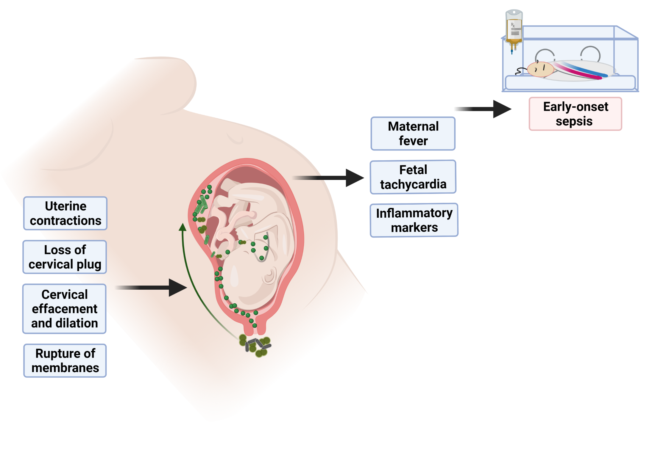
Are All Preterm Infants at Equal Risk of EOS?

Slide 30
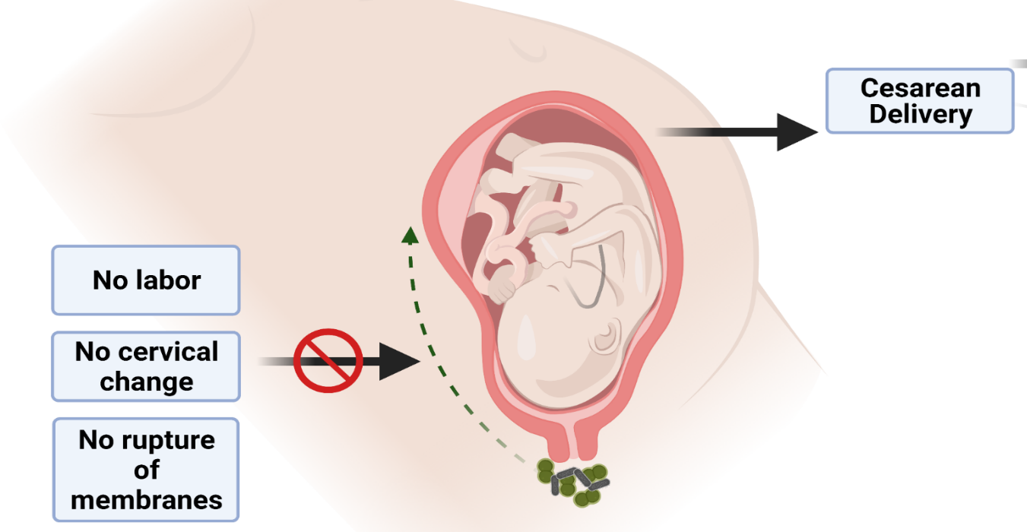
Infants at low risk for EOS

Slide 31
Identifying Infants at Low Risk of EOS
Retrospective Analysis of the Neonatal Research Network database
Infants <29 weeks, <1500 grams (2006-2014)
EOS and prolonged antibiotics among infants with
  Birth by cesarean section,
  Rupture of membranes at delivery, AND
  Absence of clinical chorioamnionitis
Puopolo K et al, Identification of extremely preterm infants at low risk for early onset sepsis, Pediatrics, 2017
Notes:
Analysis by Robust Poisson regression adjusted for center, race, antenatal steroid, multiple birth, sex, GA, BW

Slide 32
Study Population
Eligible
N = 15,544
Included Infants
N = 15,433
Low EOS risk
N = 5,759
(37%)
Others
N = 9,674
(63%)
Missing Data
N = 111

Slide 33
Low-risk infants had lower EOS
 | Low-risk n (%) N = 5,640 | Others n (%) N = 8,422 | Adjusted RR (95% CI)
EOS | 29 (0.5) | 209 (2.5) | 0.24 (0.16-0.36)
Notes:
Death more in low gestation and non lerd group; EOS plus CONS 0.8 vs 2.8

Slide 34
Low risk infants still get prolonged antibiotics
 | Low-risk n (%) N = 5,640 | Others n (%) N = 8,422 | Adjusted RR (95% CI)
EOS | 29 (0.5) | 209 (2.5) | 0.24 (0.16-0.36)
Prolonged antibiotics* | 1771/5334 (33.2) | 3649/7752 (47.1) | <0.001
# Infants w/prolonged antibiotics per EOS case | 66 | 19 | <0.001
*Antibiotics started <72 hours and continued for ≥5 days in the absence of a positive culture, necrotizing enterocolitis or spontaneous intestinal perforation
Notes:
Death more in low gestation and non lerd group; EOS plus CONS 0.8 vs 2.8

Slide 35
Conclusions
About 1 in 3 preterm infants can be categorized as low-risk for EOS by delivery criteria
EOS risk is significantly lower in these infants
Antibiotics are initiated and continued in a large proportion of low-risk infants
Mukhopadhyay S and Puopolo K, PIDJ, 2017

Slide 36
Implementation of AAP policy

Slide 37
Delivery Criteria Based Preterm EOS Guideline
Intrapartum fever or IAI
Rule out EOS
Reason for preterm delivery
Maternal indication
Mode of delivery
Preterm labor and/or rupture OR non-reassuring fetal testing
Labor present
C-Section w/o labor or rupture
“Low EOS risk”
Cardiorespiratory
support
Rule out EOS
No Antibiotics
No blood culture*
Mukhopadhyay S et al Archives of Fetal and Newborn, 2018
Notes:
*Hemodynamically unstable and refractory to volume

Slide 38
Implementation of Preterm EOS Guideline
Population: inborn VLBW infants
Study Period:
  Period 1 (Jan 2009 - Mar 2017 ), n=727
  Period 2 (Apr 2017 - Jan 2020 ), n=191
Outcome: VLBW infants with antibiotics ≤72 hours of age
Safety Measures:
  Delayed culture and antibiotic initiation in EOS cases
  Culture confirmed infection at 4-7 days of age
  Antibiotic initiation at 4-7 days of age

Slide 39
Population
 | Period 1 n=727 | Period 2 n=191 | P value
Birth weight (grams), mean (SD) | 1056 (298) | 1046 (312) | 0.70
Birth weight <1000 grams, n (%) | 297 (40.9) | 85 (44.5) | 0.36
Gestational age (weeks), median (IQR) | 28.6 (26.4 – 30.6) | 28.7 (26.4 – 30.6) | 0.98
Multiple birth, n (%) | 233 (32.1) | 41 (21.5) | 0.004
Infants meeting low-risk criteria, n (%) | 298 (41.0) | 83 (43.5) | 0.54

Slide 40
EOS evaluation in Day 0-3
 | All infants
 | Period 1 n=727 | Period 2 n=191 | P value
Blood culture, n (%) | 643 (88.5) | 117 (61.3) | <0.001
Antibiotic initiation, n (%) | 590 (81.2) | 113 (59.2) | <0.001
Culture-confirmed EOS, n (%) | 9 (1.2) | 3 (1.6) | 0.72
Antibiotic duration ≥72 hours*, n (%) | 177/587 (30.2) | 2/111 (1.8) | <0.001
*in the absence of positive culture, NEC/SIP

Slide 41
EOS evaluation in Day 0-3
 | All infants |  |  | Low EOS risk
 | Period 1 n=727 | Period 2 n=191 | P value | Period 1 n=298 | Period 2 n=83 | P value
Blood culture, n (%) | 643 (88.5) | 117 (61.3) | <0.001 | 225 (75.5) | 14 (16.9) | <0.001
Antibiotic initiation, n (%) | 590 (81.2) | 113 (59.2) | <0.001 | 184 (62.1) | 11 (13.3) | <0.001
Culture-confirmed EOS, n (%) | 9 (1.2) | 3 (1.6) | 0.72 | 0 | 0 | NA
Antibiotic duration ≥72 hours*, n (%) | 177/587 (30.2) | 2/111 (1.8) | <0.001 | 56/183 (30.6) | 0/11 (0.0) | 0.03
*in the absence of positive culture, NEC/SIP

Slide 42
Sepsis evaluation in Day 4-7
 | All infants |  |  | Low EOS risk
 | Period 1 n=727 | Period 2 n=191 | P value | Period 1 n=298 | Period 2 n=83 | P value
Blood culture, n (%) | 130 (17.9) | 25 (13.2) | 0.12 | 61 (20.5) | 9 (10.8) | 0.05
Antibiotic initiation, n (%) | 67 (9.2) | 22 (11.6) | 0.33 | 34 (11.4) | 9 (10.8) | 0.89
Culture-confirmed sepsis, n (%) | 17 (2.3) | 3 (1.6) | 0.52 | 6 (2.0) | 1 (1.2) | 0.63
No change in mortality, transfer out, NEC detection or hours from birth to first dose on antibiotics for infants with culture confirmed infection in the first week

Slide 43
Conclusion
Implementation of delivery criteria based EOS risk stratification in VLBW is feasible and effective
No case of delayed antibiotics among culture confirmed infection
No increase in antibiotic initiation >72 h

Slide 44
AAP COFN Clinical Report: Laboratory Tests
Blood culture:
  The diagnostic standard for EOS
  Reliably detect bacteremia at a level of 1 to 10 CFU with 1 mL blood
  Consider anaerobic cultures
CSF culture:
  Case by case
Continuation for persistent cardiorespiratory instability or laboratory test abnormalities in the absence of culture-confirmed disease is rarely justified
Puopolo K, Benitz W, Zaoutis T, COFN. Management of Neonates Born at ≤34 6/7 Weeks’ Gestation With Suspected or Proven Early-Onset Bacterial Sepsis, Pediatrics, 2018

Slide 45
Neonatal Blood culture Reliability
Percent detected
CFU/mL | Inoculate volume
 | 0.5 mL | 1 mL | 2 mL | 4 mL
1 | 0.39 | 0.63 | 0.87 | 0.98
2 | 0.63 | 0.87 | 0.98 | 0.99
3 | 0.78 | 0.95 | 0.99 | 0.99
4 | 0.87 | 0.98 | 0.99 | 0.99
5 | 0.92 | 0.99 | 0.99 | 0.99
10 | 0.97 | 0.99 | 0.99 | 0.99
100 | 1.0 | 1.0 | 1.0 | 1.0
Schelonka et al, Journal of Pediatrics, 1996; Lancaster et al, JCM, 2015

Slide 46
Neonatal Blood culture Reliability
Percent detected
CFU/mL | Inoculate volume
 | 0.5 mL | 1 mL | 2 mL | 4 mL
1 | 0.39 | 0.63 | 0.87 | 0.98
2 | 0.63 | 0.87 | 0.98 | 0.99
3 | 0.78 | 0.95 | 0.99 | 0.99
4 | 0.87 | 0.98 | 0.99 | 0.99
5 | 0.92 | 0.99 | 0.99 | 0.99
10 | 0.97 | 0.99 | 0.99 | 0.99
100 | 1.0 | 1.0 | 1.0 | 1.0
How sure are you of the inoculate volume?
How frequent is low-level bacteremia?
What is adequate treatment for low-level bacteremia?
Schelonka et al, Journal of Pediatrics, 1996; Lancaster et al, JCM, 2015

Slide 47
How sure are you of the inoculate volume?
Previous studies report that only 65% blood cultures have adequate inoculate volume
Single center Prospective study:
  Weigh blood culture bottles for 1 year
  Optimal volume: 2 ml blood divided and inoculated in one aerobic and one anaerobic culture bottle
  Minimum sufficient: 1 ml inoculate in aerobic bottle
Neal et al, JCM, 1986; Connell et al, Pediatrics, 2007

Slide 48
Median total inoculate: 1.96 (1.72-2.14)
Median aerobic volume: 0.98 (0.83-1.12)
Median anaerobic volume: 1.01 (0.87-1.12)

Slide 49
Conclusions
Minimum 1 mL inoculate is met in >95% tests
Blood culture results do not have a substitute in management of sepsis currently
Auditing inoculate volumes may optimize this critical test’s output
  increase provider confidence in culture results
  improve management of true infection

Slide 50
AAP COFN Clinical Report: Evaluation/Treatment
When initial blood culture results are negative, antibiotics should be discontinued by 36-48 hours, unless site-specific infection
Puopolo K, Benitz W, Zaoutis T, COFN. Management of Neonates Born at ≤34 6/7 Weeks’ Gestation With Suspected or Proven Early-Onset Bacterial Sepsis, Pediatrics, 2018

Slide 51
Empiric Antibiotic Duration
Currently determined by the time from blood culture inoculation to detectable growth, the Time to Positivity (TTP), in a reasonable majority of cases

Slide 52
Blood Culture Isolations
71,345 cultures
18 facilities
3 states
Cultures growing bacteria
N= 1626
Pathogens
N = 606 (37%)
Contaminants
N= 1018 (63%)
Fungi N=2
No TTP data
N = 12
Microorganisms that typically do not cause true invasive disease, e.g. Bacillus spp., diptheroides, Micrococcus
Cultures for TTP Measurement
N = 594
Kuzneiwicz et al, PIDJ, 2020 [Accepted, in press]
Notes:
2.3%

Slide 53
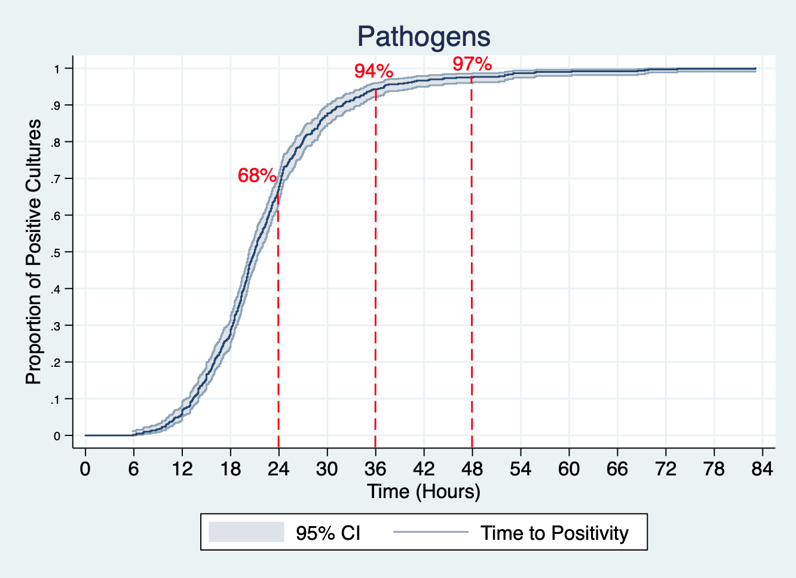

Slide 54
Thought Experiment: 25 years of EOS at BWH
VLBW admits
N = 5313
25 infants missing
TTP data
Antibiotics total=4834 (90.8%)
EOS = 84
1.7%
No EOS = 4750
98.3%
If we stopped Empiric therapy at 36 h (instead of 48 h)
Unchanged therapy in cases detected <36 h
N=76 (90% of cases)
Ampicillin delay in 8 cases
  ≤3 hours=4/8
  ≤9 hours=2/8
  >9 hours=2/8
Doses of unnecessary ampicillin avoided
N=4750
Data adapted from Brigham and Womens Hospital 1990-2014

Slide 55
AAP COFN Clinical Report: Treatment
Ampicillin and gentamicin are the 1st choice for empirical therapy.
The routine empirical use of broader-spectrum antibiotics is not warranted and may be harmful
Preterm infants who are severely ill and at the highest risk for Gram negative EOS …the empirical addition of broader-spectrum antibiotic therapy may be considered
Puopolo K, Benitz W, Zaoutis T, COFN. Management of Neonates Born at ≤34 6/7 Weeks’ Gestation With Suspected or Proven Early-Onset Bacterial Sepsis, Pediatrics, 2018

Slide 56
Choosing empiric coverage
Bacteria in EOS (% of cases) | Ampicillin susceptibility | Gentamicin susceptibility | Cephalosporin susceptibility
GBS (35.8%) | 100% | Intrinsic resistant – potential synergism | 100%
E. coli (24.8%) | ~ 22% | ~90% | Case reports of extended spectrum beta lactamase producing E .coli
Viridans spp. (18.9%) | Variable. Population surveillance susceptibility, 67% | Added for synergy in endocarditis | Majority (87% found susceptible to cefepime)
H. influenzae (4.5%) | Worldwide ~82% | Susceptible at baseline but acquired resistance with use reported. | Worldwide high (100% to ceftriaxone)
S. aureus (3.5%) | Most strains resistant due to production of beta lactamases | Susceptible at baseline. Better alternates. | Variable
Enterococcus spp. (3.1%) | E. fecalis sensitive (more frequent). E. faecium resistant | Intrinsic resistance (synergistically in endocarditis. | Intrinsically resistant
Group D streptococcus (1.4%) | Universally susceptible | Maybe used for synergy | Susceptible
L. monocytogenes (1.3%) | Susceptible (bacteriostatic) | Intracellular form of listeria resistant | Intrinsically resistant
K. pneumoniae (<1%) and Enterobacteriaceae | Increasingly resistant | Susceptible at baseline. Acquired resistance has been describe. | Susceptible. Acquired ESBL producers reported
S. pneumonia (<1%) and other GPC | Increasing penicillin resistance nationally | Intrinsic resistant | Variable susceptibility
9.8% resistant to both ampicillin and gentamicin
4.5% resistant to piperacillin-tazobactum
Mukhopadhyay S et al, Clinics in Perinatology, 2019; Schrag et al, Pediatrics, 2016; Flannery D et al, Unpublished data

Slide 57
Minimizing harm
Risk of invasive candidiasis in 137/1515 ELBW infants
Risk factor | Adjusted odds ratio (95% CI) | P value
Broadly acting antibiotics | 1.98 (1.37, 2.86) | <0.001
Central catheter | 1.94 (1.17, 3.21) | 0.01
IV lipid emulsion | 1.66 (0.98, 2.81) | 0.06
Endotracheal tube | 1.58 (1.07, 2.35) | 0.02
Antenatal antibiotics | 1.40 (0.97, 2.03) | 0.08
Benjamin D, et al. Pediatrics. 2010

Slide 58
Minimizing harm
Adjusted mortality odds: n=111,000
Ampicillin/Cefotaxim vs. Ampicillin/Gentamicin
Clark R, et al. Pediatrics. 2006

Slide 59
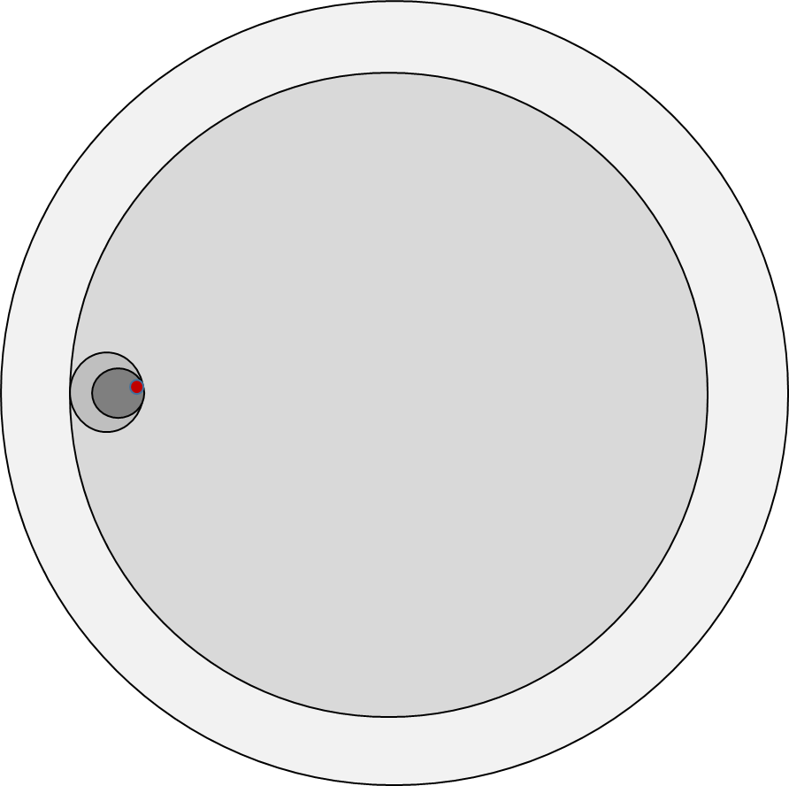
Balancing Risk
All VLBW infants
Will receive empiric Rx = 66%
“Preterm infants who are severely ill and at the highest risk for Gram negative EOS …the empirical addition of broader-spectrum antibiotic therapy may be considered”
Culture-confirmed infection = 1%
E. coli 0.5%
Resistant to both = 0.05%

Slide 60



Acknowledgements
Karen M Puopolo, MD, PhD
Research Team
  Miren Dhudasia, MBBS, MPH
  Emily Woodford, BA
Collaborators:
  Dustin Flannery, DO, MSCE
  Jeff Gerber, MD, PhD
  Lauren Skerritt, MSIII
  Michael Kuzniewicz, MD, MPH
  Samuel Garber, MD
  David Rub, MD
Supporting Institutes
  Eric Eichenwald, MD, Division Chief, Neonatology, CHOP
  Soraya Abbasi, MD - Research Director PAH, Site PI Neonatal Research Network, NICHD
  Penn Data Store, University of Pennsylvania
  Center of Pediatric Clinical Effectiveness, CHOP
  Brigham and Women’s Clinical Centers of Excellence
  Neonatal Research Network, NICHD
Sponsors
  NICHD - K23HD088753-01A1
  Society of Pediatric Research
  Institute of Translational Medicine
Pennsylvania Hospital, Newborn Care staff and patients

Slide 61
Questions

Slide 62


‘A commitment to always use antibiotics appropriately and safely’
Expected benefit and acceptable risk
Resistance
R
Dysbiosis→?
Asthma, eczema, food allergy, obesity
NEC, Sepsis, Death
Intravenous access
Increased resources utilized
Potential drug toxicity
Escalated monitoring
Mother-infant separation
Breastfeeding impact
Mukhopadhyay et al, 2015 & 2014; Murk et al, 2011; Tsasok et al, 2013; Metsala et al, 2014; Vangay et al, 2015; Cotten et al, 2009; Kuppala et al, 2013; Deshmukh et al, 2014; CDC 2013

Slide 63
Resources for < 35 newborns at risk for EOS
Check the ILPQC BASIC Toolkit for Resources

Slide 64


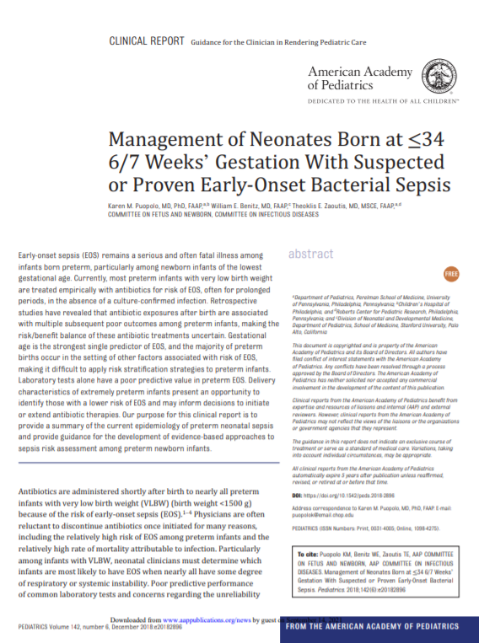
AAP Management of Neonates Born ≤34 6/7 Weeks with EOS
Pediatrics: Management of Neonates Born at ≤34 6/7 Weeks’ Gestation With Suspected or Proven Early-Onset Bacterial Sepsis (2018)
  See key takeaways from this document that Dr. Mukhopadhyay outlines in her presentation

Slide 65
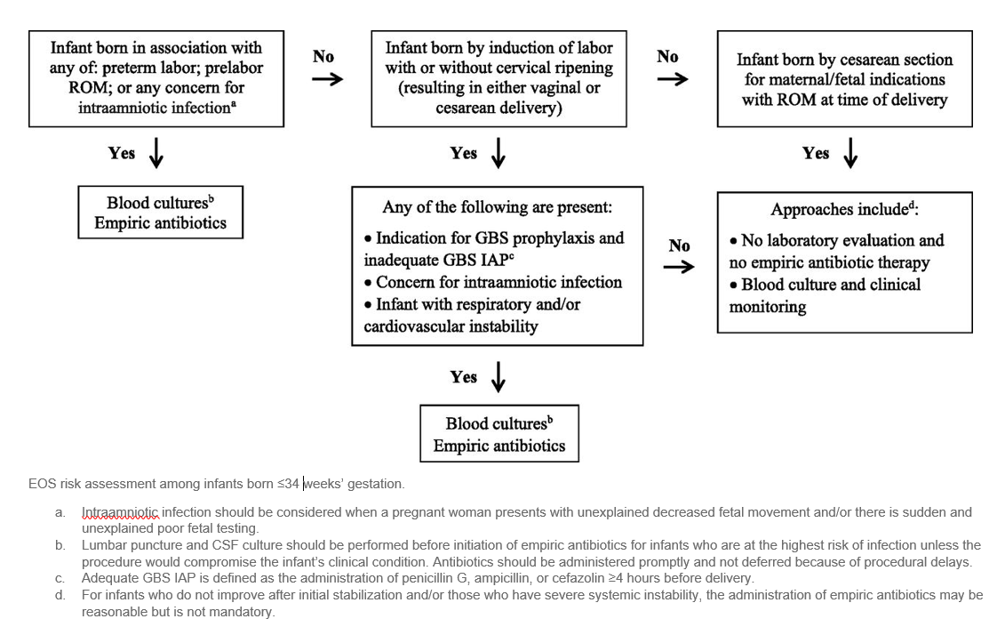
< 35 Week AAP Risk Assessment Workflow
Notes:
<35 weeks AAP Risk Assessment Workflow

Slide 66
Team Talk: HSHS St. John’s
Dr. Pele Dina

Slide 67
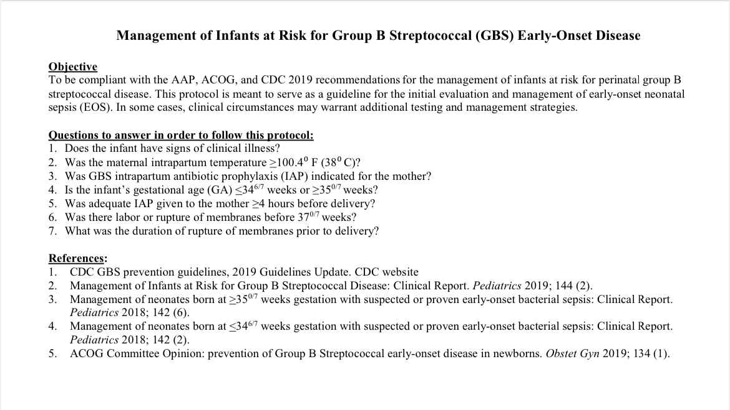
Early Onset Sepsis Risk Assessment

Slide 68
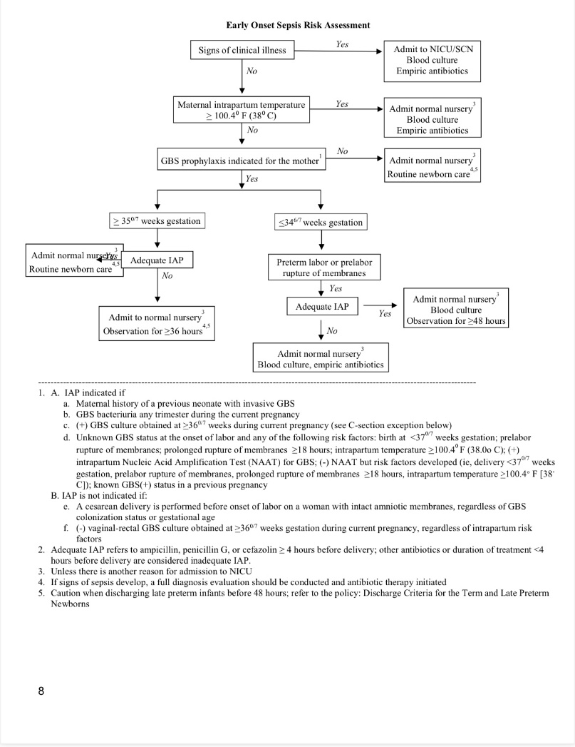
Early Onset Sepsis Risk Assessment

Slide 69
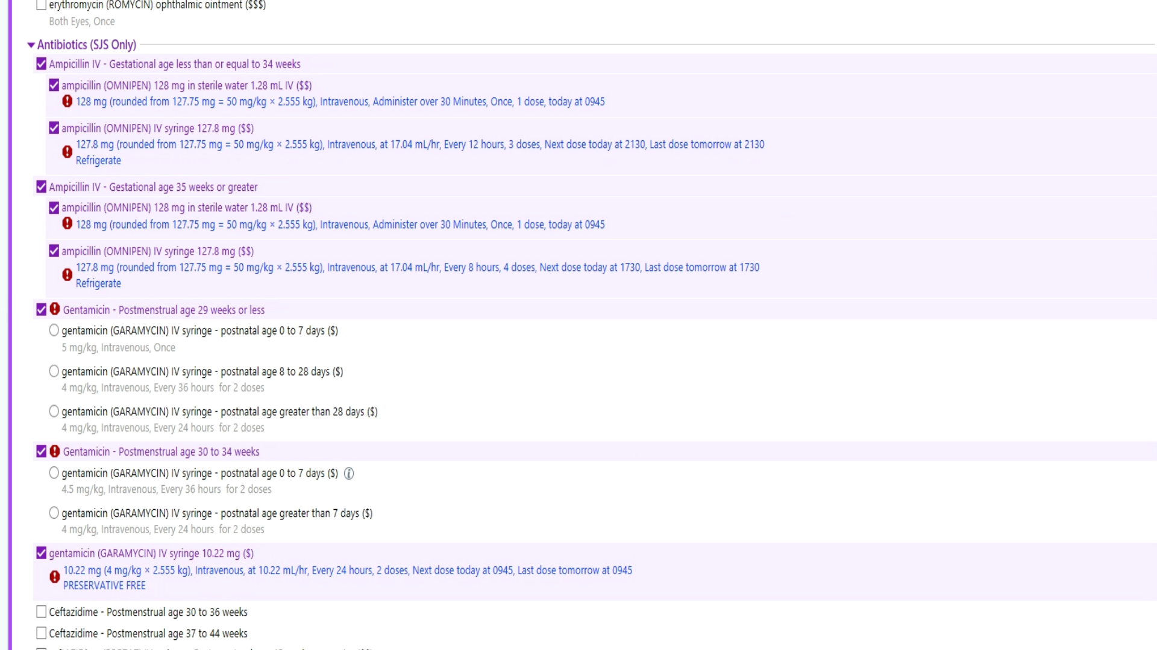

Slide 70
ILPQC Resources

Slide 71
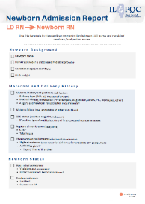
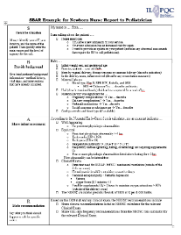
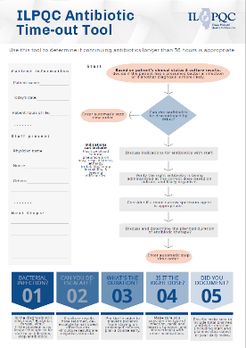
Summer BASIC Resources
Newborn Admission Report (LD RN to Newborn RN) May 2021; Use this template to standardize communication between L&D nurse and receiving newborn/postpartum nurse
Newborn Nurse to Pediatrician Communication Tool: Use this template to standardize communication between the newborn/postpartum nurse to the pediatrician on newborn status
ILPQC Antibiotic Time-Out Tool- use the tool to determine if continuing antibiotics longer than 36 hours is appropriate
71

Slide 72
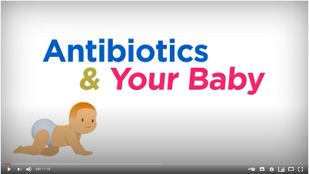

BASIC Family Education Resources
Antibiotics & Your Baby Education Video
  This education video can be shared with families/caregivers after delivery, on admission to postpartum floor/newborn nursery/NICU for newborns who have received antibiotics
  English Video: https://www.youtube.com/watch?v=c0an_TmVe6o&pp=sAQA
  oSpanish Video: https://www.youtube.com/watch?v=sWHd2P91Fy0&pp=sAQA
Understanding Chorioamnionitis This flyer can be given to patients on admission to L&D to provide important information about Chorioamnionitis
Antibiotics & Your Baby Accompanying Flyer This flyer can be given to families/caregivers to supplement the education video

Slide 73
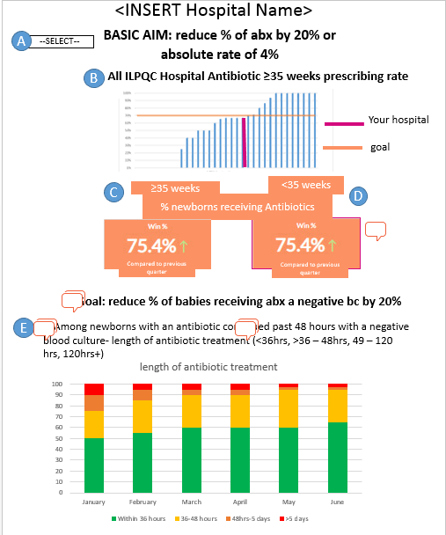
BASIC QI Strategies Resources
BASIC Dashboard for your monthly QI meetings coming October 2021
BASIC Grand Rounds- reach out to info@ilpqc.org for scheduling, teams are already signing up!
DRAFT!!!
73

Slide 74
Get ready for Annual Conference
Register online
Abstract /Posters
AC Team Survey
Flat Stanley
Submit Data
FREE conference, held VIRTUALLY Thursday, October 28th, 2021 from 8am-4:15pm
Click here and register today! Be sure to invite all your colleagues including social workers and your patients
All teams are encouraged to participate & submit a poster to be displayed online
To be considered for an award, submit an abstract via REDCap by Oct. 1st online here
All poster are due Oct. 15th to be displayed by emailing your poster to info@ilpqc.org. Poster template can he found here.
Coordinate with your colleagues working across initiatives to have one person from your hospital submit the survey due Oct. 15th AC Survey can be found here
Please submit all outstanding data by Oct. 15th
Please upload your team photo via email to info@ilpqc.org by Oct. 15th to be feature in the Annual Conference slide show
Notes:
Registration link: https://www.eeds.com/live/330984
Survey: https://redcap.healthlnk.org/surveys/?s=7XEFMA7N9J
Abstracts: https://redcap.healthlnk.org/surveys/?s=K8L84877AJ
Poster template: https://ilpqc.org/ILPQC%202020+/Annual%20Conferences/2020%20Annual%20Conference/ILPQC%20Annual%20Conference%20Abstract%20Template_2020_FINAL.ppt

Slide 75
Next Steps
Get ready for the 2021 Annual Conference
  Save the date 10/28/2021
  Coordinate with your QI team who will be submitting out the AC Teams survey by 10/15
  Submit Abstracts for award submit abstract by 10/1, final poster due for all teams by 10/15
  Connect with your team to submit data & structure measure progress data by 10/15 for BASIC Recognition
Review the new ILPQC resources in the BASIC toolkit and look for opportunities for integration
Review your team’s current process for <35 week Risk Assessments and determine areas for improvement

Slide 76
REMINDER
BASIC Monthly Webinar
BASIC Monthly Webinars will now be held from 2-3 PM on the 3rd Monday of the Month starting on the September 20, 2021 call

Slide 77










Thanks to our Funders
In kind support:

Slide 78
Annual Conference Abstract/Poster Information and Q&A

