Slide 1

PVB Monthly Webinar: Implementing standard criteria for the diagnosis of labor dystocia arrest disorders
September 27th, 2021 12:30-1:30

Slide 2

Introductions
Please enter for yourself and all those in the room with you viewing the webinar into the chat box your:
  Name
  Role
  Institution
If you are only on the phone line, please be sure to let us know so we can note your attendance

Slide 3
Overview:
ILPQC Updates: 2021 Annual Conference
PVB Data Review
Protocols and Processes for Induction
Supporting Vaginal Birth Initiative: Roles of Teamwork, Labor Support, Inductions, and Patience: Dr. Elliott Main, CMQCC
Team Talk: Cristy Shafer, OSF HealthCare Heart of Mary Medical Center
PVB Q&A
PVB Next Steps
PVB Office Hours
  Join us after the call to ask any questions you may have

Slide 4
ILPQC Labor Support Class
TOMORROW 9/28!
Don’t miss this opportunity to attend this FREE and IMPACTFUL event tomorrow 9/28 from 8am-1pm
250 people already registered!
Check out the Labor Support Toolkit on the PVB webpage for resources to educate your staff that were unable to attend
Registration still open! See Link in chat or visit the PVB webpage at ilpqc.org
See comments from past participants:
“The most applicable labor support class for an L&D nurse”
“Even better than Spinning Babies!”
Notes:
Ellie,

Slide 5
Annual Conference Updates

Slide 6

Now OPEN!
Calling all physicians, nurse midwives, nurse practitioners, nurses, lactation counselors, social workers, quality leaders, administrators, payers, public health professionals, & all others interested in perinatal health!
Join us for the ILPQC 9th Annual Conference held virtually on Oct. 28th from 8:00-4:15pm
New this year...education contract hours for social workers
Be sure to invite your patients / community partners to join our special patient/family, community breakout session
2021 AC education contract hours are sponsored by
SSM Health approves this live activity for a maximum of 7.5 AMA PRA Category 1 Credits™, 7.5 ANCC contact hours, 7.5 IPCE credit for learning and change and 7 continuing education credits for social workers. Physicians should claim only the credit commensurate with the extent of their participation in the activity.

Slide 7

Time | Title & Presenter(s)
8:00- 9:00am | Welcome address & Collaboration in Action: Celebrating Progress of ILPQC Initiatives - Ann Borders, MD, MSc, MPH with Leslie Caldarelli, MD and Justin Josephsen, MD
9:00- 9:45am | TeamBirth PVB Plenary- Neel Shah, MD, MPP
9:45- 9:50am | Break
9:50- 10:35am | Antibiotic Stewardship: Beyond the Sepsis Calculator- Karen Puopolo, MD, PhD
10:35- 11:30am | State PQC Leaders Panel: National Perspectives on Improving Perinatal Care- Marilyn Kacica, MD, MPH (NY), Barbara O’Brien, MS, RN (OK), & Munish Gupta MD MMSc (MA)
11:30-11:45am | ILPQC Award Ceremony
11:45- 12:45am | Lunch & Poster session
12:45- 1:30pm | Birth Equity Plenary- Marilyn Kacica, MD, MPH
1:30- 2:15pm | Bridging the Gap: Families Sharing their Experiences to Improve Care - Linda Suleiman, MD & Wanda Irving
2:15-2:30pm | Break
2:30-4:00pm | Breakout Sessions OB Session , Neonatal Session & Patient/Family & Community Session Patient & Family Engagement: Opportunities to Engage Patients, Families, and Communities
4:00- 4:15 | Evaluations & Wrap-up
Scan here
to register
Invite your patients/ community partners

Slide 8



YOU ARE ILPQC!
ILPQC wants to celebrate all of you during our virtual conference!
Enter to WIN a $100 gift card & be featured during the Annual Conference
How? Participate in the ILPQC “Flat Stanley” Project to be entered into the raffle
What? Win a $100 gift card for your QI team to enjoy a pizza party or coffee and donuts
What to do? Use the ILPQC logo and take a QI team picture holding it
When? Email you picture to info@ilpqc.org by Oct. 15th

Slide 9

Click here for the AC Survey
We want to hear from you!
Share your teams thoughts & insights on the upcoming 2021 AC Team Survey

Slide 10
2021 Call for Abstract/Poster
Submission
All hospital teams are asked to submit an Abstract/Poster on complete or in progress QI work
Abstract/Posters submitted by Oct. 1st, will be reviewed for awards:
  Top abstract(s) in OB, Neonatal, Patient/Family Engagement, First time Level I/II Hospital receive Abstract of Excellence Awards
  Two OB & two Neonatal abstracts receive special recognition, one each for (1) Best Use of Data, (2) Best Project Implementation
  Awarded abstracts will be announced at the conference and have a prize designation displayed on their poster
All Posters are due Oct 15th to be uploaded to the ILPQC Annual Conference website
A poster template and support is available from ILPQC.
10

Slide 11

ILPQC is here to help
ILPQC will be offering a variety of support services to assist with abstract/poster submissions
  Poster Template
  Mentorship Services
  “After hours office hours” (Information + Q&A Sessions after team webinars)

Slide 12

2021 QI LEADER AWARD
ILPQC 2021 9th Annual Conference
Promoting Vaginal Birth Award Criteria
Movement on PVB Structure Measures (Red → Yellow, Yellow → Green) + All 2020 Q4 (Oct- Dec) Baseline Data Submitted
+
All Data Submitted *
*All Data Submitted
Baseline through August 2021 by October 15th
Notes:
Note: updated from September to August

Slide 13
PVB Data Review

Slide 14
Supporting vaginal birth and reducing primary Cesareans for optimal maternal and neonatal outcomes
Aim: 70% of participating hospitals will be at or below the Healthy People goal of 24.7% cesarean delivery rate among NTSV births by December 31, 2022
Goal: Increase the percent of cesarean section deliveries among NTSV births that meet ACOG/SMFM criteria for cesarean
Goal: Increase the % of physicians/ midwives/ nurses educated on ACOG/SMFM criteria for cesarean, labor management strategies/response to labor challenges, protocol for facilitating decision huddles and/or decision debriefs

Slide 15
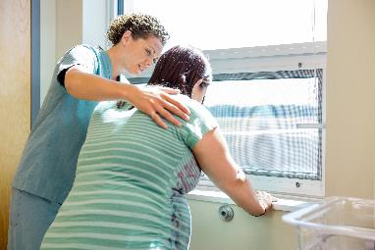
PVB Key Strategies
    Identifying NTSVs
    Education of ACOG/SMFM criteria for providers and nurses
    Implementing cesarean decision checklists and huddles with patient centered decision making
    Labor management support
    Develop standardized processes/protocols for induction, early labor and labor challenges

Slide 16
ILPQC Hospital Team
Data Submission (94 Teams Total)
Month | Teams Reporting Patient Data | Teams Reporting Hospital Data
Baseline (Q4 2019) | 88 | 79
January 2021 | 82 | 76
February 2021 | 82 | 77
March 2021 | 80 | 76
April 2021 | 78 | 73
May 2021 | 75 | 66
June 2021 | 68 | 65
July 2021 | 67 | 53
August 2021 | 55 | 38
If hospital data is not submitted for a given month you will not have access to your team’s NTSV C-Section rate over time.
Use your hospital data form as a QI team meeting roadmap to guide your efforts. Please contact us if you need help getting started with reviewing and entering your data.
Notes:
Ellie please update

Slide 17
ILPQC NTSV C-Section Rates
Goal: < 24.7%
Notes:
Ellie please update

Slide 18
NTSV C-Section Rates, by hospital
60% of teams at or below goal in June 2021
Goal: < 24.7%
All ILPQC Average: 24%
Notes:
Ellie, please update

Slide 19
NTSV C-sections meeting
ACOG/SMFM Criteria, across hospitals
Goal: >80%
FHR
Total
IOL
LD

Slide 20
Provider and Nurse Education

Slide 21
Standard protocols and processes

Slide 22
Sharing Provider Level Data

Slide 23
Cesarean Decision Checklist

Slide 24
Decision Huddles/Debriefs

Slide 25
Shared Decision Making

Slide 26
Standardized Patient Education

Slide 27
EMR Integration

Slide 28
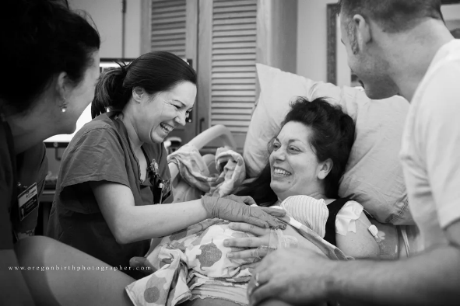
Promoting Vaginal Birth (PVB)
Key Strategies
Optimizing Labor Management and support
Protocols and Guidelines for Induction and Labor Decision Making
Provider, Nurse, Patient Education to support clinical culture change

Slide 29
Protocols and Processes for Diagnosis of Labor Dystocia Arrest Disorders

Slide 30
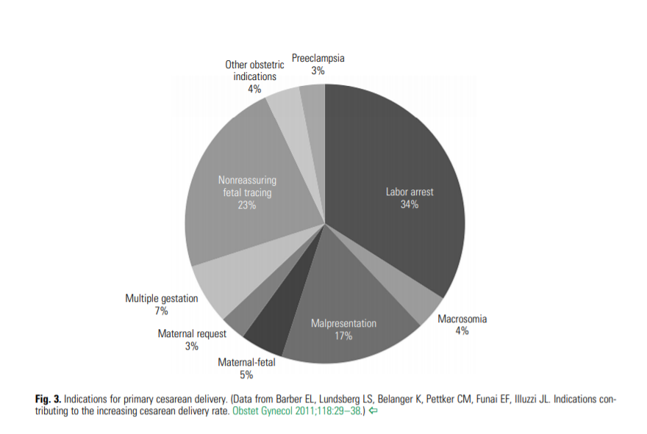
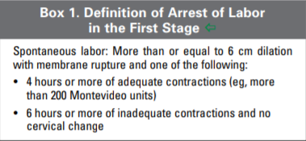
Arrest of Labor
Notes:
https://www.acog.org/-/media/project/acog/acogorg/clinical/files/obstetric-care-consensus/articles/2014/03/safe-prevention-of-the-primary-cesarean-delivery.pdf

Slide 31
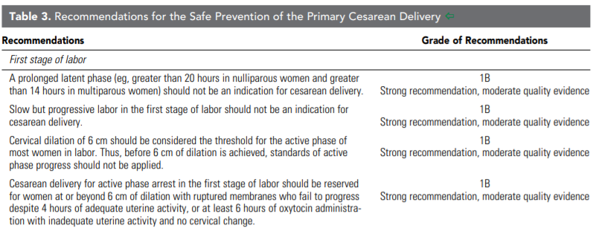
Recommendations for Safe
Prevention of Primary Cesarean Delivery
Notes:
https://www.acog.org/-/media/project/acog/acogorg/clinical/files/obstetric-care-consensus/articles/2014/03/safe-prevention-of-the-primary-cesarean-delivery.pdf

Slide 32
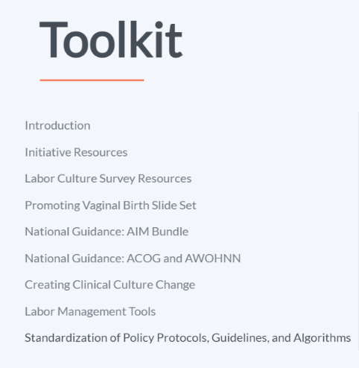
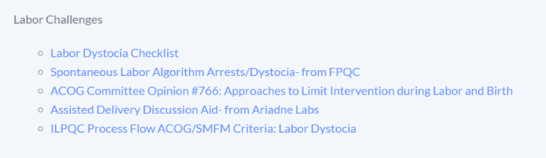
PVB Toolkit Induction Resources

Slide 33
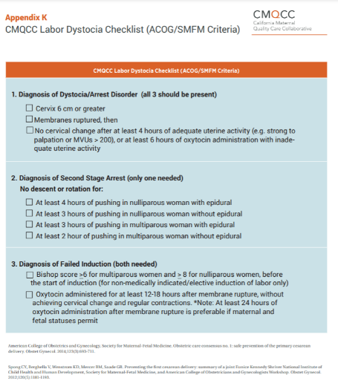
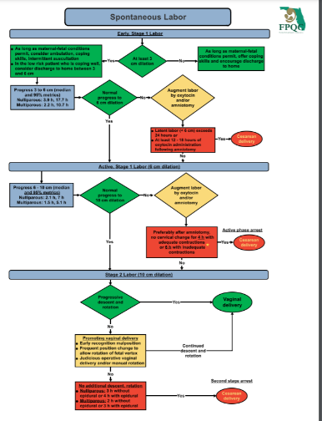
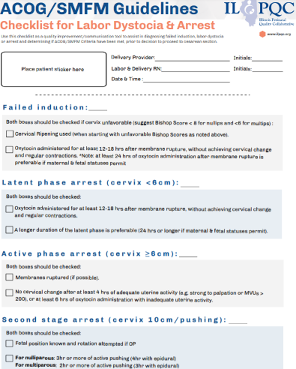
Toolkit Resources
CMQCC Labor Dystocia Checklist
FPQC Spontaneous Labor Algorithm Arrests/Dystocia-
ILPQC ACOG/SMFM Guidelines

Slide 34
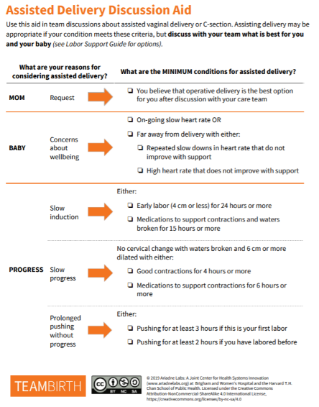
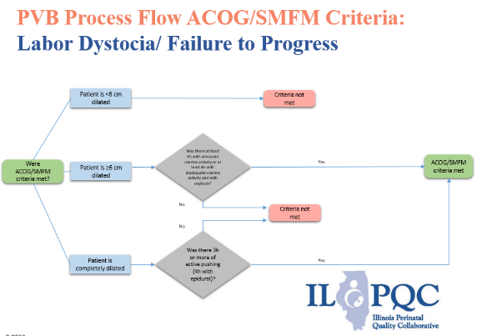
Toolkit Resources
Assisted Delivery Discussion Aid- from Ariadne Labs
ILPQC Process Flow ACOG/SMFM Criteria: Labor Dystocia

Slide 35
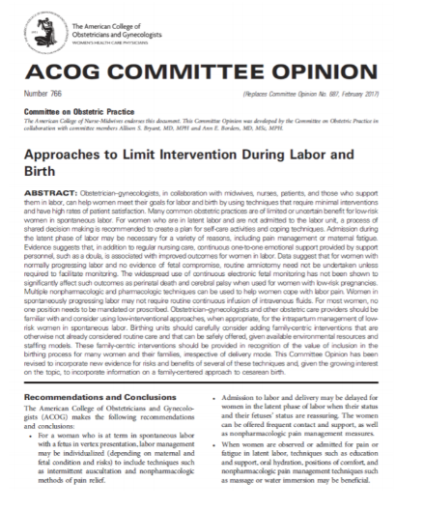
Toolkit Resources
ACOG Committee Opinion #766: Approaches to Limit Intervention during Labor and Birth

Slide 36
Dr. Elliott Main
California Maternal Quality Care Collaborative

Slide 37
Supporting Vaginal Birth Initiative:
Roles of Teamwork, Labor Support, Inductions, and Patience
Elliott Main, MD
Medical Director, CMQCC
Clinical Professor, OB/GYN
Stanford University
Notes:
37

Slide 38
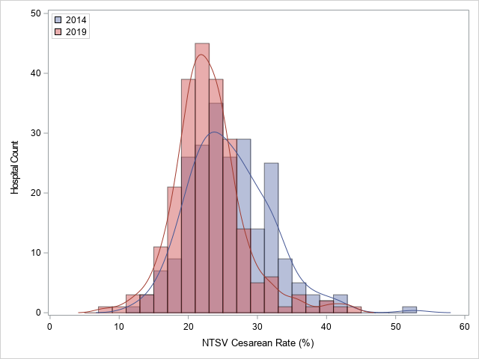
CMQCC Collaborative to Reduce Primary Cesarean Birth
First Birth Low-Risk Cesarean Rate
Meets 3 Goals of a Large-scale QI Initiative
• Significant reduction in Mean CS rates
• Significant reduction in rate variation (narrowing of the distribution curves)
• Reduction of outliers (hospitals with rates >29%)
Rosenstein MG, Chang S-C, Sakowski C, Markow C, Teleki S, Lang L, Logan J, Cape V, Main EK. Hospital Quality Improvement Interventions and Statewide Policy Initiatives and Rates of Nulliparous Term Singleton Vertex Cesarean Deliveries in California. JAMA 2021. Apr 27;325(16):1631-1639.

Slide 39

A Wide Variety of Specific Interventions Were Used by Hospitals
Specific Interventions by Hospitals (n=91) | Implementation (%)
Provider Education | 90 (99%)
Physician/Nurse Education on Labor | 90 (98%)
Manual Rotation of Occiput Posterior | 41 (45%)
Operative Vaginal Deliveries | 2 (2%)
Labor Support Activities | 82 (90%)
Peanut Balls* | 48 (53%)
Doula program | 30 (33%)
Coping with Labor Algorithm | 9 (10%)
Nitrous Oxide | 4 (4%)
Labor Management | 78 (86%)
Labor Dystocia Checklist | 59 (65%)
Active Phase Huddle | 41 (45%)
Latent Labor Management | 41 (45%)
2nd Stage Management | 16 (18%)
Electronic Medical Record Order Sets | 22 (24%)
Specific Interventions by Hospitals (n=91) | Implementation (%)
Sharing Unblinded Provider NTSV CS Rates | 77 (85%)
Labor Induction | 48 (53%)
Induction Scheduling Form | 31 (34%)
Induction Algorithm | 20 (22%)
Outpatient Cervical Ripening | 17 (19%)
Patient Education | 43 (47%)
Prenatal Childbirth Education | 7 (8%)
Patient Education During Triage/Labor | 41 (45%)
Patient Support after Traumatic Birth Experience | 24 (26%)
L&D Staff Model | 12 (13%)
Addition of Laborists | 8 (9%)
Addition of Midwives | 4 (4%)
*Peanut ball is an inflated exercise ball shaped like a large peanut used between
the thighs during late labor to help open the pelvis

Slide 40
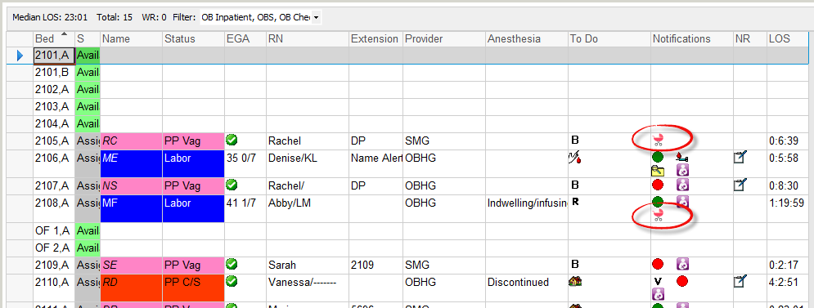

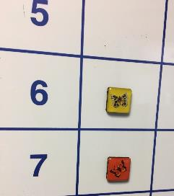
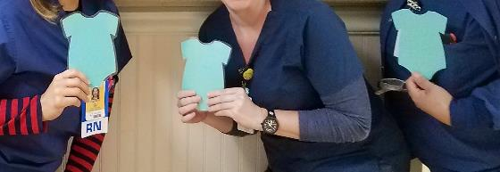
Identify NTSV Patients—Support Team Efforts

Slide 41
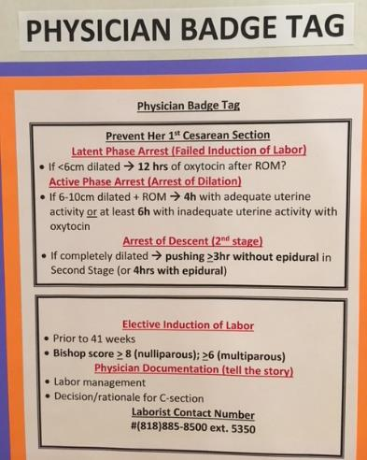
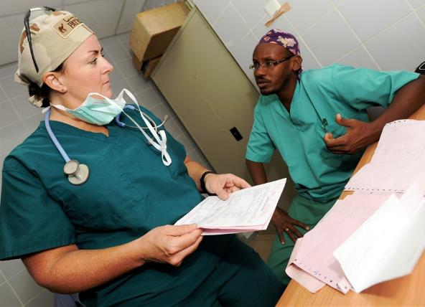
Wide Dissemination of
ACOG/SMFM Guidelines and Education

Slide 42

Example Case Review Checklist:
Can be used prior to CS as shown here or in a revised format as post-hoc case review. Cases get a “pass” if criteria met, otherwise more review and discussion would be in order.
Criteria taken from:

Slide 43

Can I apply the Arrive Trial to my Hospital?
Can I “induce my way”
out of a high Cesarean rate??

Slide 44
Population Analysis of CS Rates After Induction
Arrive Trial was limited to University and University-affiliated hospitals
Are their numbers comparable to community hospitals where >90% of US birth occur?
DO YOU HAVE THE SAME RESULTS WITH NULIP INDUCTIONS AS THE ARRIVE TRIAL?
Analysis of all ~240 California hospitals
Main EK, Chang SC, Cheng YW, Rosenstein M, Lagrew DC. Hospital-Level variation in the frequency of cesarean delivery among nulliparous women who undergo labor induction. Obstet Gynecol 2020, Dec;136(6):1179-1189.

Slide 45
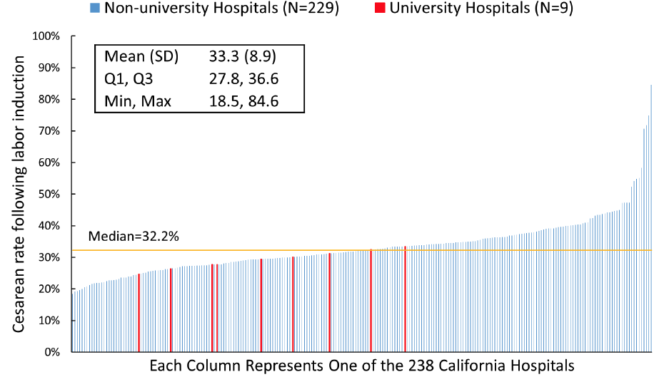
Cesarean Rate Following Labor Induction in Nulliparas: Large Variation Among Hospitals
Rates Reported in Protocol-driven RCTs

Slide 46
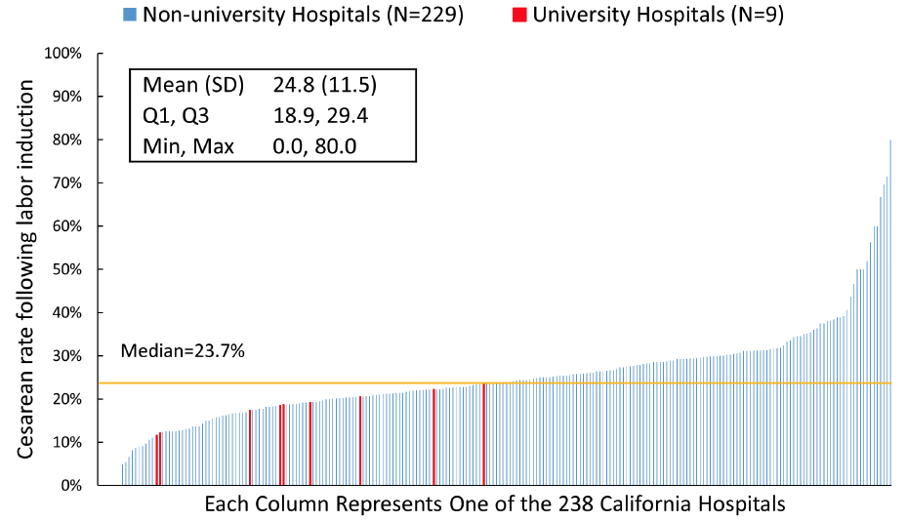
CS Rate Following Labor Induction in Lowest-Risk* Nulliparas: Large Variation Among Hospitals
*Lowest-risk=NTSV excluding mothers with age over 35 years, BMI over 35, gestational age over 40 weeks or medical complications
Rates Reported in Protocol-driven RCTs

Slide 47
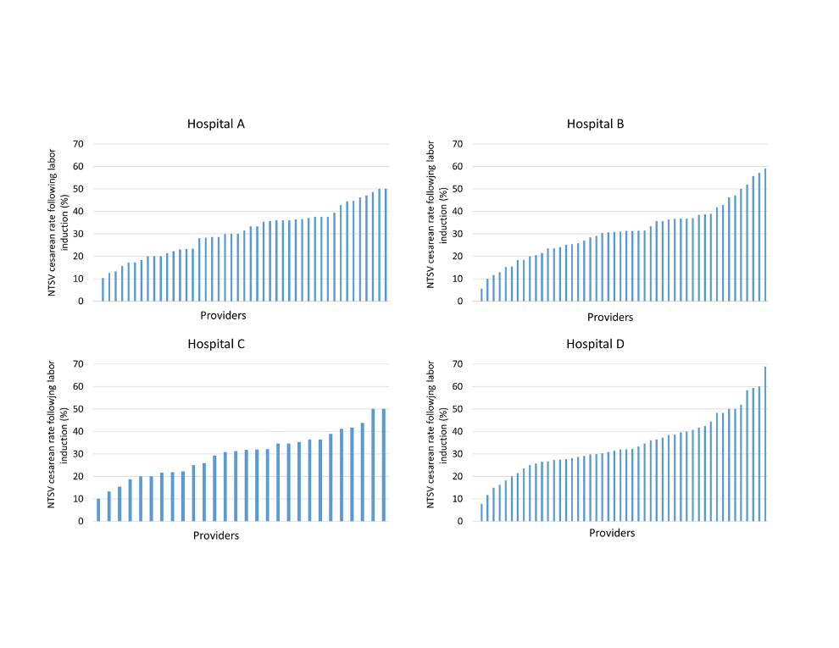
Variation in Provider Cesarean Rate After Nullip Induction
(4 hospitals without CNM or FP, only providers with >10 nullip inductions)

Slide 48
Defining Failed Induction of Labor
Grobman et al Am J Obstet Gynecol 2018;218:122.e1-8.
MFMU Network: 10,677 women who were induced
  96% of women entered active phase when:
  Cervical ripening complete
  ROM
  And,15 hours of oxytocin
No clinical fetal or maternal harm with this length of latent phase
Limitation: Analysis not limited to nullips or term

Slide 49
3 Keys for Induction Success
Who you choose
  Parity and cervical ripeness
  Do I really need to induce?
How you perform the induction
Follow your success rates!

Slide 50
Outpatient Foley Balloons Lessons Learned From Experience: Providence Health
Majority of patients can have balloon placed/ stenosis rare
Proper placement above internal os has very good success
No fetal monitoring needed since no tachysystole risk, monitoring only for other indications
If inpatient for monitoring, you can use misoprostol or oxytocin and Foley balloon concurrently
Only about 5% come in labor before morning
Balloon usually sitting in vagina in the morning, can have induction started if balloon not expelled
Patients much happier with the process and less tired since slept at home
Relieves significant burden on L&D Staff and Physicians

Slide 51
We should not focus on
“To Induce or Not To Induce”
(‘tis not the question)
BUT rather it is
How you actually do the Induction!

Slide 52
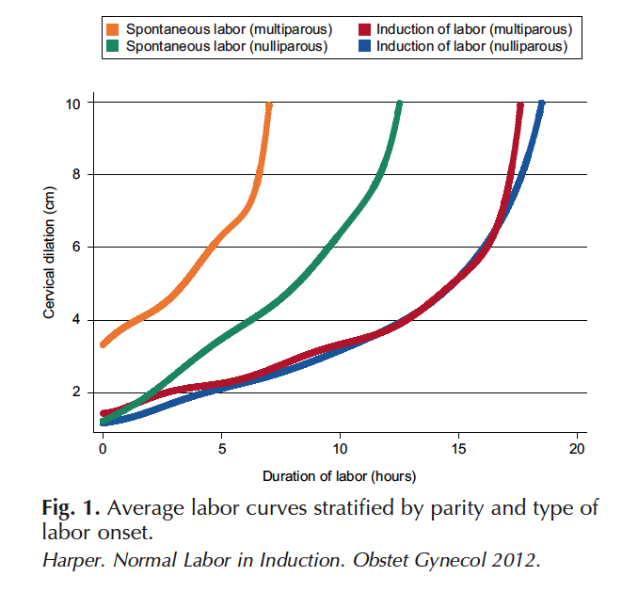
Striking Differences in Latent Phase

Slide 53
Case Study… What is the Definition of Failed Induction?¹
33 yo G1 P0 at 40+6wks; Bishop score: 3
Tues 10pm: FT/50/-3: Admit--Miso 50ug x3
+12hr: no change -- Cervidil
+24hr: no change -- Foley balloon+oxytocin
+36hr: no change -- Foley still snug, continue
+46hr: 4/40%/-3 -- Foley expelled, oxytocin
¹Grobman etal: AJOG 2018; 218:122.e1-8 --MFMU: 15hr after oxytocin and ROM

Slide 54
Modern Induction Labor Curve…
46hr
50hr
55hr
10
9
8
7
6
5
4
3
2
1
0
Oxytocin 20mIU
Oxytocin 22mIU
24mIU
Dilation (cm)
AROM
6pm
8pm
10pm
12am
2am
4am
6am
Eff.
40%
50%
50%
100%
100%
Station
-3
-3
-2
-1
+1
Too high for ROM

Slide 55
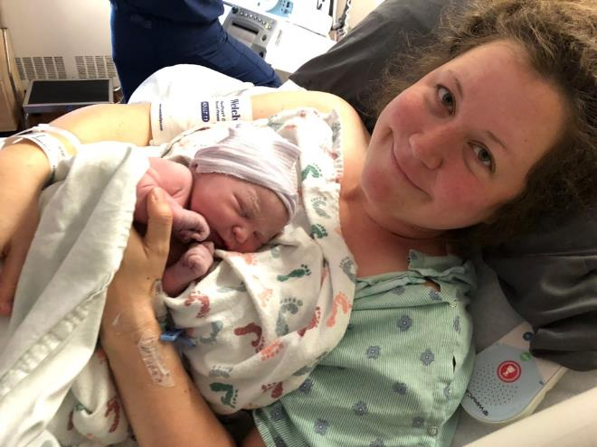
After 1 hour of pushing, NSVD
Apgars 8 & 9, 8lb 10oz Baby Boy
Used with permission of Galen Main

Slide 56
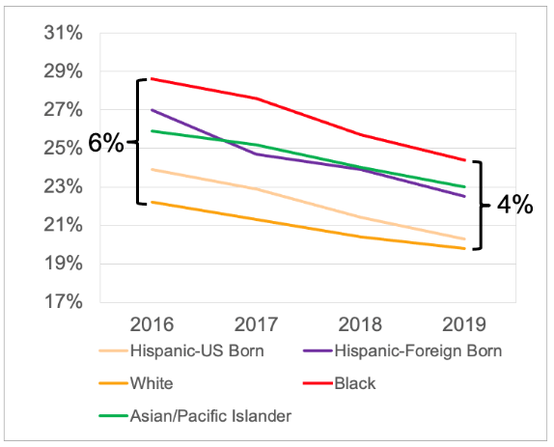
U.S. Cesarean Birth Rates by Race
(NCHS-NVR Report)
NTSV Cesarean Birth Rates by Race and Ethnicity
Adjusted for Comorbidities (Age and BMI)
NTSV Cesarean Birth Rate
• Until 1995 Black women had lower Cesarean rates than White women
• The Black:White Cesarean rate disparity is actually worsening since 2010
• All races demonstrated significant improvement
• Black mothers decreased more than others, narrowing the difference
• Can standardized care reduce the subjectivity (and bias) in labor decisions?

Slide 57
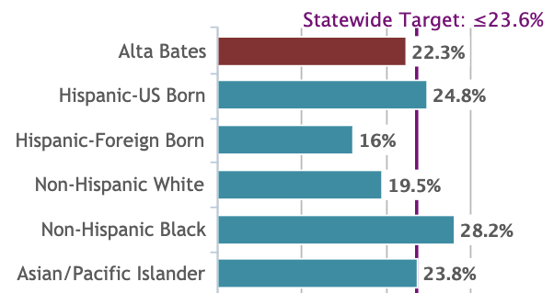
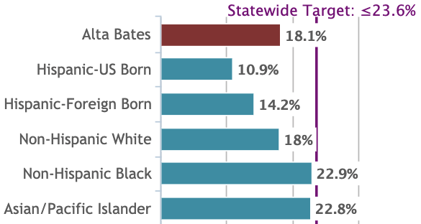


Importance of Stratification of Outcomes by Race: NTSV CS
Hospital A
Hospital A
Year--2017
6 Mos--2020

Slide 58
Questions?
I trust my presentation was clearer than fog…

Slide 59
Team Talk: OSF Little Company of Mary
Cristy Shafer

Slide 60
OSF Heart of Mary Medical Center, Urbana Il.
Rolling, Rolling, rolling…Keep those mom’s Rolling to their Sides!!!!
ILPQC Promoting Vaginal Birth Initative

Slide 61


Cha..Cha..cha..Changes…..
Created team of 6 staff, 1 physician and 1 CNM
Four nurses attended Spinning Babies course
worked with physician to create education on ACOG key labor definitions, labor duration and create C/S pre huddle form using ILPQC resources and physician group input for improved buy in rates from group
Physician and midwife provided education during staff meeting on the unit and via Facebook live for those unable to attend, the same education was presented to provider group to ensure all were on the same page.
C/S huddle sheet introduced, met with issues
Nurse buy in: They were “charmed”
Telemetry monitoring
Labor management webinar…PIZZA!
Monthly poster board update on data
Intermittent Fetal Monitoring and Care of Cesarean Section policies
2021 | Jan | Feb | March | April | May | June | July | August
Total ILPQC deliveries | 9 | 3 | 11 | 13 | 11 | 11 | 10 | 15
Vaginal ILPQC | 2 | 2 | 10 | 12 | 11 | 5 | 7 | 13
C/S ILPQC | 7 | 1 | 1 | 1 | 0 | 6 | 3 | 2
CS meeting ACOG criteria | 6 | 1 | 1 | 1 | 0 | 5 | 2 | 1
% of C/S | 77% | 33% | 9% | 7% | 0% | 54% | 30% | 15%

Slide 62
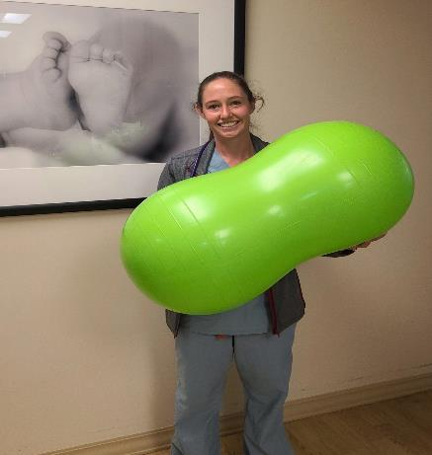
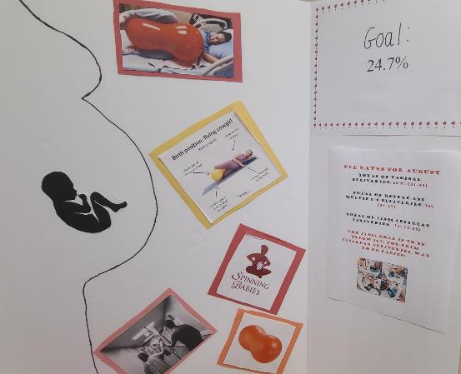
What’s Next…… FINDING A NEW COLABORATING DOCTOR, MAINTAINING OUR REDUCTION RATES, AND FURTHER EDUCATION AND POLICY CHANGE

Slide 63
PVB Q&A

Slide 64
Discussion
“I don’t want to use the ACOG/SMFM Checklist because I am worried about the liability and legal ramifications”
“Our hospitals patient population is very high risk and that is why our c-section rate is so high”
“Rupturing membranes is not "safe" because head is too high, but the only alternative is cesarean (all other things having been tried). Why is ROM a criteria for diagnosing failed induction?”

Slide 65
Next Steps with PVB

Slide 66

PVB Grand Rounds
PVB Grand Rounds help facilitate buy-in and give your providers the opportunity learn more about the initiative
Hear from an expert on the ILPQC Grand Rounds Speaker’s Bureau
Email ellie.suse@northwestern.edu to schedule your grand rounds or OB provider meeting
14 Grand Rounds already scheduled for PVB

Slide 67
Upcoming Monthly Webinars:
Date | Topic
Thursday October 28th | 2021 Annual Conference
Monday, November 22nd 12:30-1:30 | Policies and Procedures: Pain management and early Labor
Monday, January 23rd 12:30-1:30 | Data Transparency: Sharing provider level data
Monday February 28th 12:30-1:30 | Dystocia Management Strategies
Register and Join here: https://northwestern.zoom.us/j/91684580832?pwd=eXo3U3VsTlVTOHI5QjRvUjdQeWRtdz09

Slide 68
Get ready for Annual Conference
Register online
Abstract /Posters
AC Team Survey
Flat Stanley
Submit Data
FREE conference, held VIRTUALLY Thursday, October 28th, 2021 from 8am-4:15pm
Click here and register today! Be sure to invite all your colleagues including social workers and your patients
All teams are encouraged to participate & submit a poster to be displayed online
To be considered for an award, submit an abstract via REDCap by Oct. 1st online here
All poster are due Oct. 15th to be displayed by emailing your poster to info@ilpqc.org. Poster template can he found here.
Coordinate with your colleagues working across initiatives to have one person from your hospital submit the survey due Oct. 15th AC Survey can be found here
Please submit all outstanding data by Oct. 15th
Please upload your team photo via email to info@ilpqc.org by Oct. 15th to be feature in the Annual Conference slide show
Notes:
Registration link: https://www.eeds.com/live/330984
Survey: https://redcap.healthlnk.org/surveys/?s=7XEFMA7N9J
Abstracts: https://redcap.healthlnk.org/surveys/?s=K8L84877AJ
Poster template: https://ilpqc.org/ILPQC%202020+/Annual%20Conferences/2020%20Annual%20Conference/ILPQC%20Annual%20Conference%20Abstract%20Template_2020_FINAL.ppt

Slide 69
Next Steps
Get ready for the 2021 Annual Conference
  Save the date 10/28/2021
  Coordinate with your QI team who will be submitting out the AC Teams survey by 10/15
  Submit Abstracts for award submit abstract by 10/1, final poster due for all teams by 10/15
  Connect with your team to submit data & structure measure progress data by 10/15 for BASIC Recognition
Determine if a PVB Grand Rounds/OB Provider Meeting to help achieve nurse and physician buy-in
Submit monthly data collection for January-August 2021
Roll-out cesarean decision checklist
Ensure your hospital had identified at least one team member to attend a virtual live Labor Support Class who can train clinicians at your hospital. Register at https://ilpqc.org/initiatives/promoting-vaginal-birth-initiative/

Slide 70
Questions?
Please put your questions or comments in the chat

Slide 71










Thanks to our Funders
In kind support:

