Slide 1

PVB Monthly Webinar: Systems changes for induction processes and protocols
July 26, 2021 12:30-1:30

Slide 2

Introductions
Please enter for yourself and all those in the room with you viewing the webinar into the chat box your:
  Name
  Role
  Institution
If you are only on the phone line, please be sure to let us know so we can note your attendance

Slide 3
Overview:
ILPQC Updates: 2021 Annual Conference
PVB Data Review
Protocols and Processes for Induction
Safe Reduction of Primary Cesarean Sections-
Induction Strategies: Nancy Travis and Dr. Carol Lawrence at Lee Health, Fort Myers, FL
Team Talk: Jennifer Behrens, CGH Medical Center
PVB Next Steps
PVB Office Hours
  Join us after the call to ask any questions you may have

Slide 4


ILPQC Updates
14

Slide 5
Annual Conference Updates
ILPQC 2021 9th Annual Conference will be held virtually
OB Speakers confirmed
  PVB- Neel Shah, MD, MPP
  BE- Marilyn Kacica, MD, MPH
  Patient Stories- Wanda Irving
  State PQC Panel- New York, Oklahoma, Massachusetts
Currently recruiting 2021 AC Planning Committee members- email aperrault@northshore.org if interested.

Slide 6

We want to hear from you!
Share your teams thoughts & insights on the upcoming 2021 AC Team Survey

Slide 7
2021 Call for Abstract/Poster
Submission
All hospital teams are asked to submit an abstract on complete or in progress QI work
Abstracts submitted by Oct. 1st, will be reviewed for awards:
  Top abstract(s) in OB, Neonatal, Patient/Family Engagement, First time Level I/II Hospital receive Abstract of Excellence Awards
  Two OB & two Neonatal abstracts receive special recognition, one each for (1) Best Use of Data, (2) Best Project Implementation
Awarded abstracts will be announced at the conference and have a prize designation displayed on their poster
Late breaking abstracts (not eligible for awards) are due Oct 15th
Submission link coming soon!
A poster template will be provided and support is available from ILPQC.
7

Slide 8

ILPQC is here to help
ILPQC will be offering a variety of support services to assist with abstract/poster submissions
  Poster Template
  Mentorship Services
  FAQ Tool- to be released in initiative newsletters
  “After hours office hours” (Information + Q&A Sessions after team webinars)

Slide 9

2021 QI LEADER AWARD
ILPQC 2021 9th Annual Conference
Promoting Vaginal Birth Award Criteria
Movement on PVB Structure Measures (Red → Yellow, Yellow → Green) + All 2020 Q4 (Oct- Dec) Baseline Data Submitted
+
All Data Submitted *
*All Data Submitted
Baseline through Sept. 2021 by October 15th

Slide 10
PVB Data Review

Slide 11
Supporting vaginal birth and reducing primary Cesareans for optimal maternal and neonatal outcomes
Aim: 70% of participating hospitals will be at or below the Healthy People goal of 24.7% cesarean delivery rate among NTSV births by December 31, 2022
Goal: Increase the percent of cesarean section deliveries among NTSV births that meet ACOG/SMFM criteria for cesarean
Goal: Increase the % of physicians/ midwives/ nurses educated on ACOG/SMFM criteria for cesarean, labor management strategies/response to labor challenges, protocol for facilitating decision huddles and/or decision debriefs

Slide 12
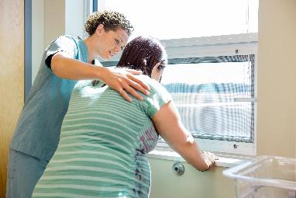
PVB Key Strategies
    Identifying NTSVs
    Education of ACOG/SMFM criteria for providers and nurses
    Implementing cesarean decision checklists and huddles with patient centered decision making
    Labor management support
    Develop standardized processes/protocols for induction, early labor and labor challenges

Slide 13
ILPQC Hospital Team
Data Submission (94 Teams Total)
Month | Teams Reporting Patient Data | Teams Reporting Hospital Data
Baseline (Q4 2019) | 89 | 85
January 2021 | 82 | 78
February 2021 | 81 | 77
March 2021 | 82 | 76
April 2021 | 79 | 67
May 2021 | 69 | 60
June 2021 | 57 | 56
Use your hospital data form as a QI team meeting roadmap to guide your efforts. Please contact us if you need help getting started with reviewing and entering your data.
If hospital data is not submitted for a given month you will not have access to your team’s NTSV C-Section rate over time.

Slide 14
ILPQC NTSV C-Section Rates
Goal: < 24.7%

Slide 15
NTSV C-Section Rates, by hospital
45% of teams at or below goal in June 2021
All ILPQC Average: 24%
Goal: < 24.7%

Slide 16
NTSV C-sections meeting
ACOG/SMFM Criteria, across hospitals
Goal: >80%

Slide 17
Provider and Nurse Education

Slide 18
Standard protocols and processes

Slide 19
Sharing Provider Level Data

Slide 20
Cesarean Decision Checklist

Slide 21
Decision Huddles/Debriefs

Slide 22
Shared Decision Making

Slide 23
Standardized Patient Education

Slide 24
EMR Integration

Slide 25
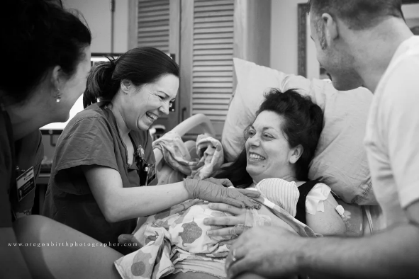
Promoting Vaginal Birth (PVB)
Key Strategies
Optimizing Labor Management and support
Protocols and Guidelines for Induction and Labor Decision Making
Provider, Nurse, Patient Education to support clinical culture change

Slide 26
Protocols and Processes for Induction

Slide 27
Policies and Procedures
Policies are Systems Changes that can help lead to clinical culture change.
Steps to implementing or updating policies and procedures include…
  Creating a learning environment by developing a culture that welcomes change
  Finding your champions. These are the stakeholders who believe in evidence-based practice and want to improve outcomes by testing change.
  Prioritizing QI science, such as PDSA cycles. The QI strategies test change on a small scale, which offers an opportunity for staff and patient input and encourages buy-in, while providing concrete steps for applying the strategy to the broader patient population
Notes:
https://www.nichq.org/insight/what-comes-first-policy-or-change-0

Slide 28
How can your induction protocols and procedures be improved?
Induction scheduling
Use of an induction checklist
Reporting of bishop score in the EMR
Physician buy-in
Team education on criteria for failed induction
Patient education on induction process
Consider outpatient Foley induction protocol
Identify potential areas for improvement:
Find your Induction Champions
Conduct a PDSA Cycle

Slide 29
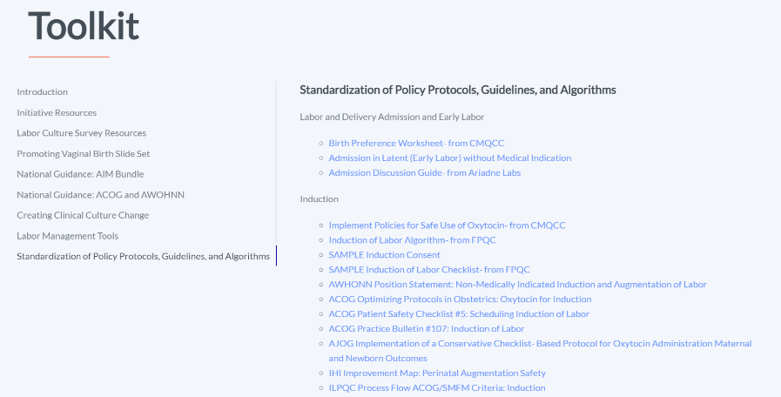
PVB Toolkit Induction Resources

Slide 30

ACOG Optimizing Protocols in Obstetrics: Oxytocin for Induction
Your go-to ACOG Resource for inductions
Includes:
  Letter to ACOG District II Members
  Executive Summary
  Key Elements for the Use of Oxytocin
  Sample Protocols
  ACOG publications
  Other Resources
Notes:
https://ilpqc.org/ILPQC%202020%2B/PVB/Toolkit/Induc/ACOG%20Bulletin%20Management%20of%20Intrapartum%20FHR%20Tracing%20Oxytocin%20for%20Induction.pdf

Slide 31

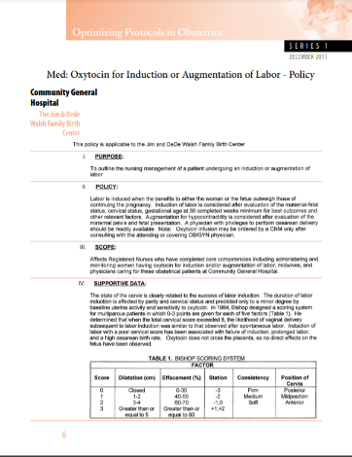
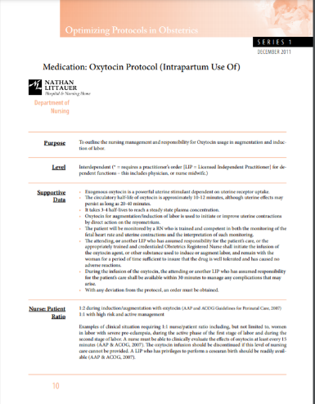
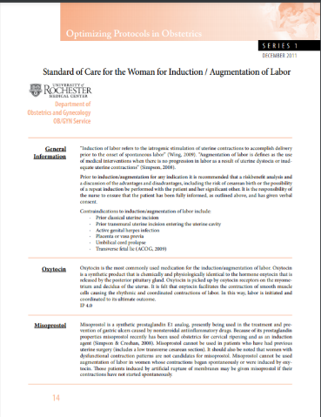
Sample Protocols
Med: Oxytocin for Induction or Augmentation of Labor - Policy Community General Hospital
Medication: Oxytocin Protocol (Intrapartum Use Of)
Standard of Care for the Woman for Induction / Augmentation of Labor University of Rochester Medical Center
Notes:
https://ilpqc.org/ILPQC%202020%2B/PVB/Toolkit/Induc/ACOG%20Bulletin%20Management%20of%20Intrapartum%20FHR%20Tracing%20Oxytocin%20for%20Induction.pdf

Slide 32

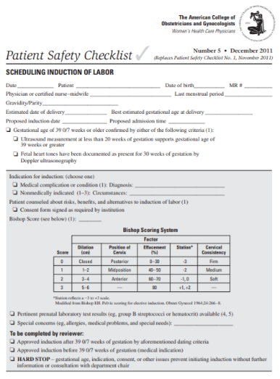
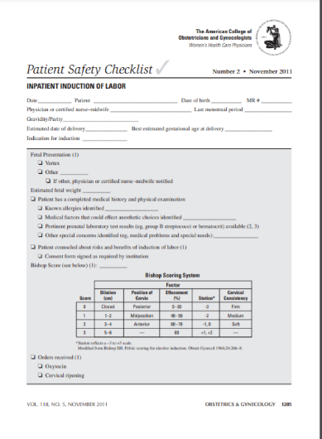
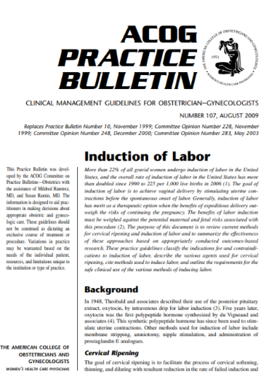
ACOG Publications
ACOG Patient Safety Checklist -Scheduling Induction of Labor
ACOG Patient Safety Checklist - Inpatient Induction of Labor
ACOG Practice Bulletin #107 - Induction of Labor

Slide 33
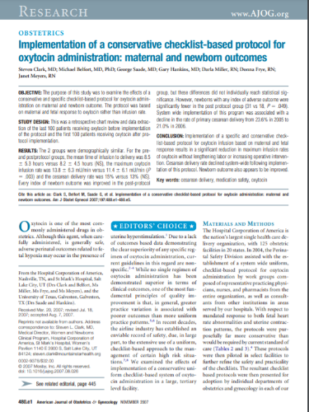
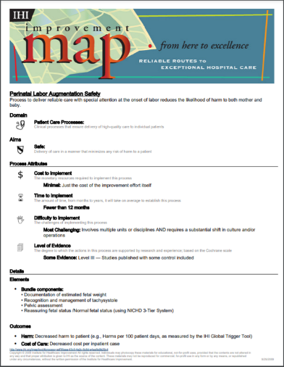
Other Resources
AJOG Implementation of a conservative checklist-based protocol for oxytocin administration: material and newborn outcomes
ACOG Patient Safety Checklist - Inpatient Induction of Labor
Notes:
https://ilpqc.org/ILPQC%202020%2B/PVB/Toolkit/Induc/ACOG%20Bulletin%20Management%20of%20Intrapartum%20FHR%20Tracing%20Oxytocin%20for%20Induction.pdf

Slide 34
Nancy Travis and Dr. Carol Lawrence
Florida Perinatal Quality Collaborative: Lee Health

Slide 35
Safe Reduction of Primary Cesarean Sections-
Induction Strategies
Nancy Travis, MS, RN, BC-PED, CBC
Carol Lawrence, PhD, MS, BSN, RNC-CBC
8/23/21

Slide 36

Florida Perinatal Quality Collaborative
Promoting Primary Vaginal Deliveries (PROVIDE) Initiative
https://health.usf.edu/publichealth/chiles/fpqc/provide

Slide 37

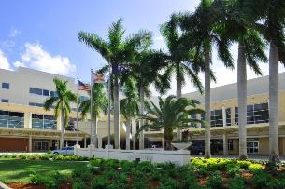


6-hospital system in SW Florida
Community, Non-profit
OB Services at 2 hospitals. March 2019 Consolidated from 3 hospitals to 2 hospitals
Perform ~6,600 deliveries per year
I RIPCC center
Level II And III nursery

Slide 38
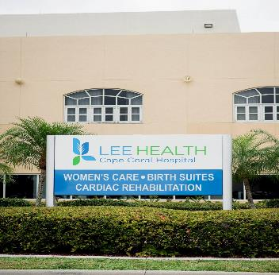
Lee Health Cape Coral Hospital
Part of the Lee Health System in SW Florida
Level 1 Obstetrical Service
1500 annual deliveries
LDRP Single Room Maternity Care
Model of Care

Slide 39
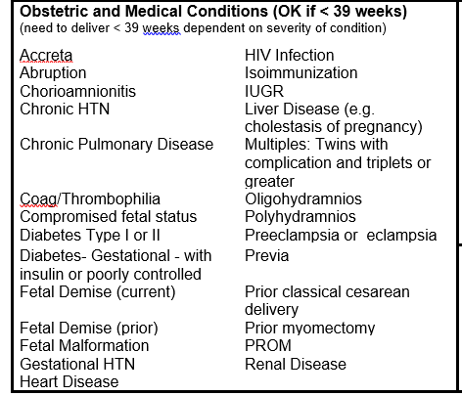
First Steps
Induction Scheduling Policy
Decision to limit inductions
Starting point- March of Dimes/ FPQC Early Elective Delivery indications for <39 weeks
Already had scheduling form & process

Slide 40
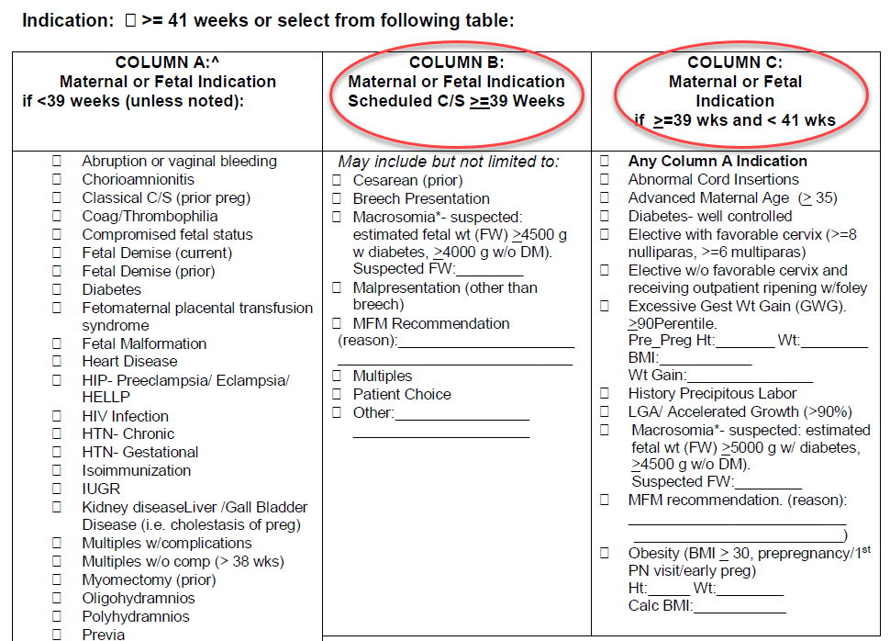
First Steps
Induction Scheduling Policy
Decision to limit inductions
Starting point- March of Dimes/ FPQC Early Elective Delivery indications for <39 weeks

Slide 41
First Steps
Induction Scheduling Policy
Non-medically indicated (elective) induction of labor at or beyond 39 weeks of gestation will only be scheduled and performed on women with favorable cervix (> = 8 for nulliparas or > = 6 for multiparas).
For non-medically indicated (elective) inductions, a vaginal exam will be performed at admission. If the vaginal exam does not confirm a favorable Bishop score:
The charge nurse will be notified to confirm with a second vaginal exam.
The OB Hospitalist or other OB provider may also be notified to perform or confirm the Bishop Score.
If the Bishop score is not favorable, the provider will be notified and the patient will be discharged.

Slide 42
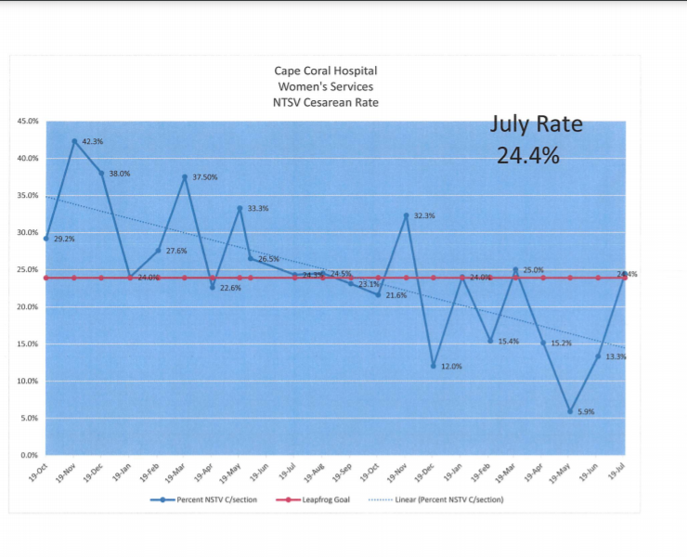
We Have Come a Long Way!

Slide 43
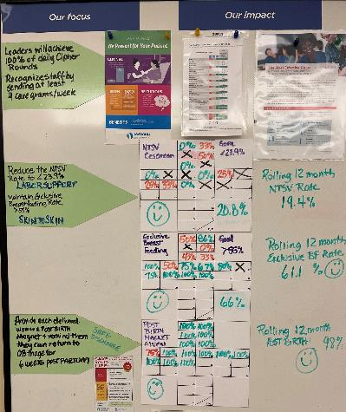
Daily Attention to NTSV Rate

Slide 44
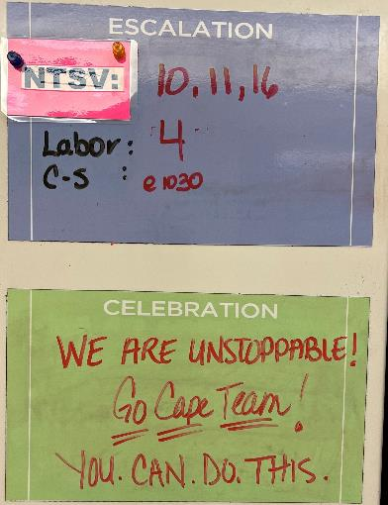

Where Are the NTSV Laboring Patients?

Slide 45
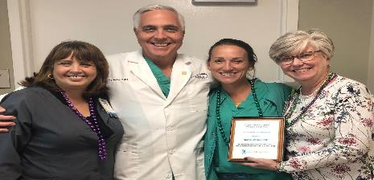

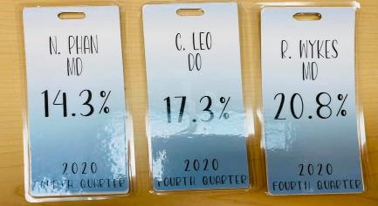
Do Your Providers Know their Rates?

Slide 46



6 is the New 4

Slide 47
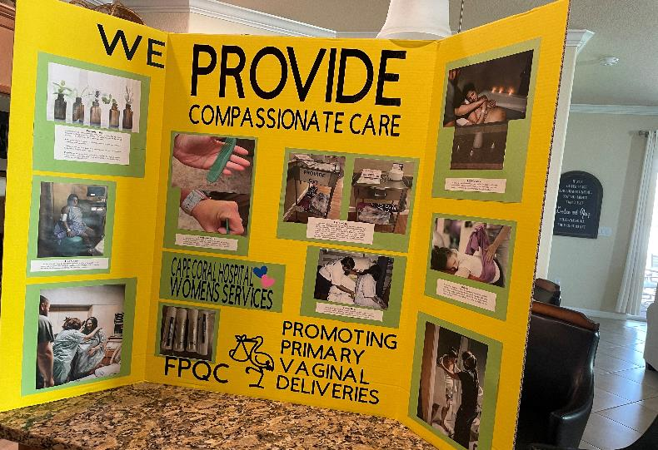
Labor Support increases Patient Satisfaction

Slide 48
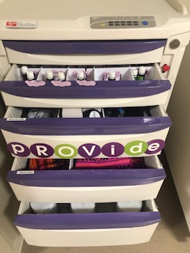
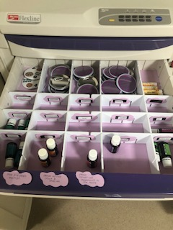
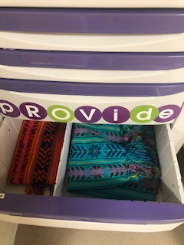
PROVIDE CART Puts Tools in One Place

Slide 49

Spinning Babies Course

Slide 50
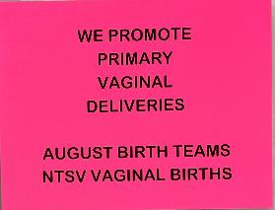
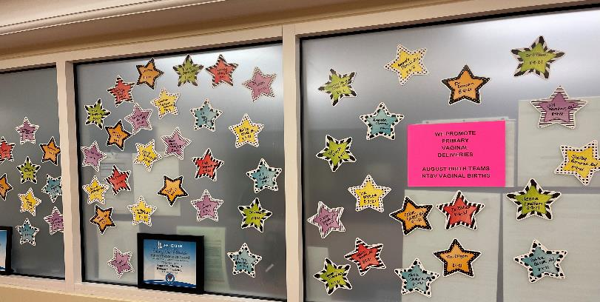
Celebrate When Things Go Well!

Slide 51
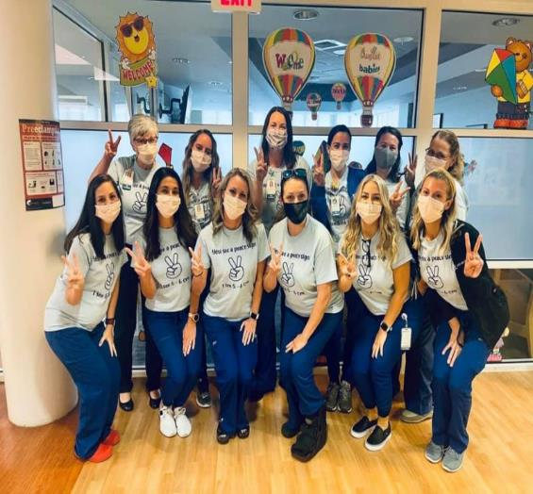
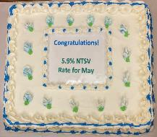
Celebrate!

Slide 52
Next Steps!
Labor Walking Path!
An Early-Labor Walking Path Tool to Reduce Early Admission and Decrease Primary Cesarean Birth Rates
Erin Morelli, MSN, CNM
Maria MacKeil, MSN, RN, CNML
DOI:https://doi.org/10.1016/j.jogn.2018.04.005

Slide 53
Nancy Travis nancy.travis@leehealth.org
239-424-2308 office
Linked In: linkedin.com/in/nancy-travis-8b089919
Twitter: nancy_njtravis

Slide 55
Team Talk: CGH Medical Center
Jennifer Behrens RN, BSN Assistant Nurse Manager

Slide 56




Slide 57
CGH Medical Center is a 99-bed hospital in northwest Illinois
Approximately 550 deliveries per year
3 Full-time and 1 part-time OB
1 CNM
30 RN’s
3 HUC/ CNA’s

Slide 58
PVB Team
Team Lead- Jennifer Behrens RN, BSN (Assistant Nurse Manager)
Annette VanLanduit RN, MSN (Nurse Educator)
Emily Mills RNC, (Day shift staff nurse)
Marcela Sproul RN, IBCLC (Day shift staff nurse)
Liz Austin RN, (Night shift staff nurse)
Nataly Jones LPN, (Office Nurse)
Dr. Debra Bowman OB, GYN
Laurie Buckman, APN, CNM

Slide 59
Induction Consent and Checklist Development
March- Reviewed samples from tool kit. Group members decided what they liked and disliked. A checklist and consent were developed for the providers on the PVB team to trial.
April- Providers and staff provided feedback. Providers and office staff requested a single form.
May- Providers on the team trialed the combined checklist and consent with separate education sheet for patient.
June- All providers began using the new consent.

Slide 60
Development Continued
July- Consent with checklist sent to the Forms Committee to be barcoded and was refused. Stated we needed to use the IMed induction consent.
July- Sent a request to the IMed vendor to incorporate the checklist into the consent.
August- The final combined consent and induction checklist was rolled out with a separate education sheet for the patient. This is completed in the office then sent to the Birthing Center.

Slide 61
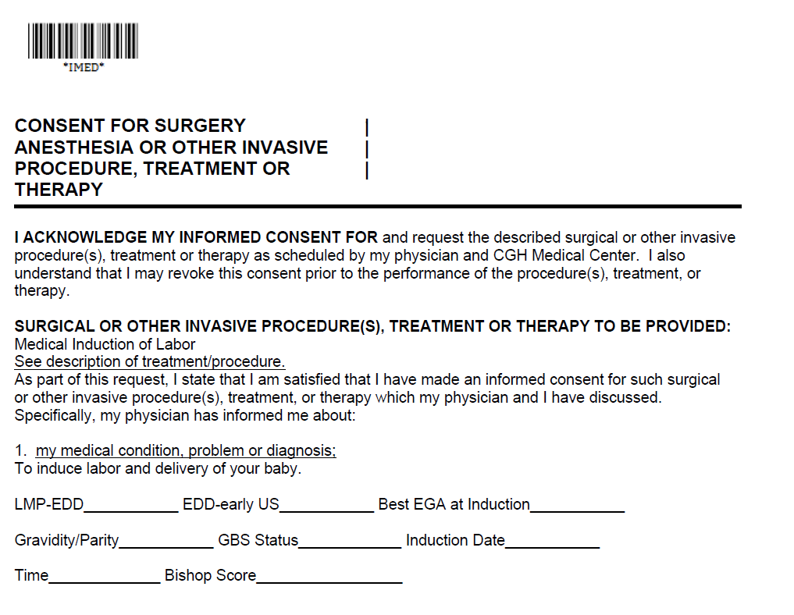
Induction Consent

Slide 62
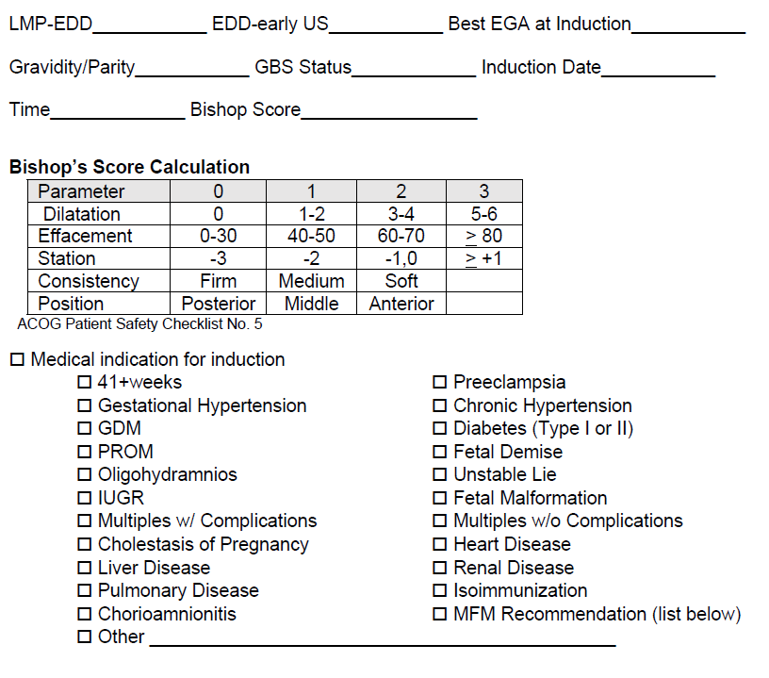
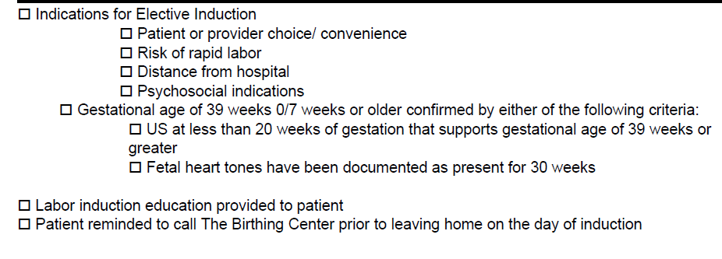
Induction Checklist

Slide 63
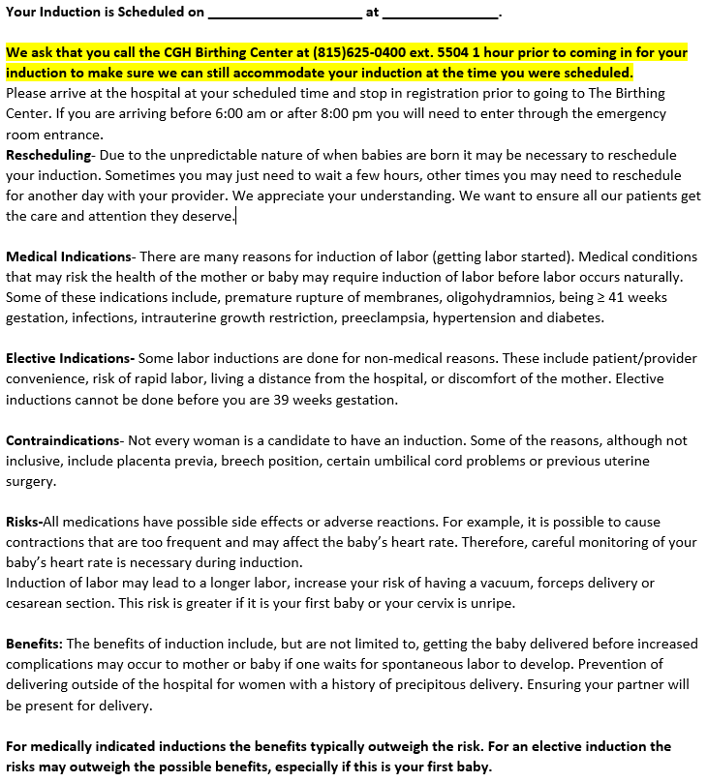
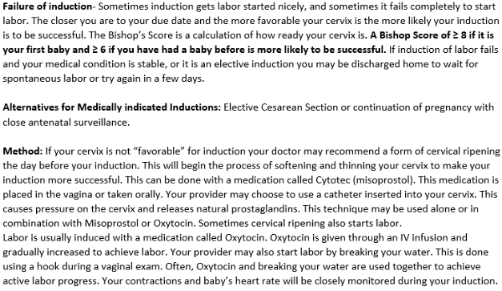

Slide 64
Data Dashboards

Slide 65
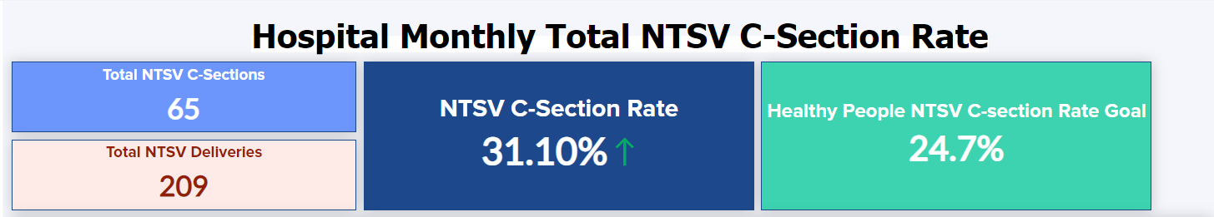
PVB Dashboard!
We are excited to announce that our PVB Dashboard is here!!!
The dashboard will give you a deeper look at your NTSV C-sections as well as allow you to see how your hospital compares to the rest of the state on key measures
Would you be interested in another offering of the QI Topic call: Using the PVB Dashboard to Drive Change?

Slide 66
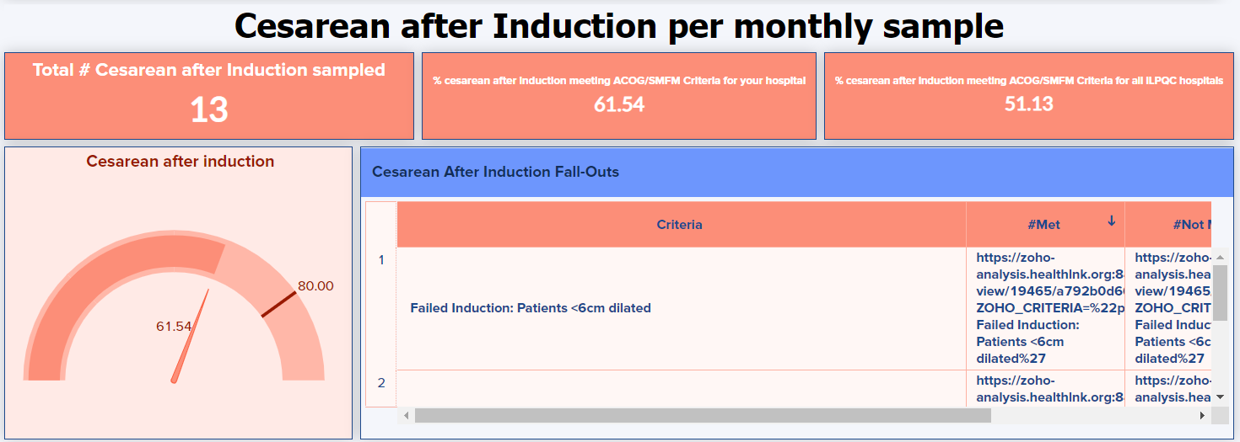
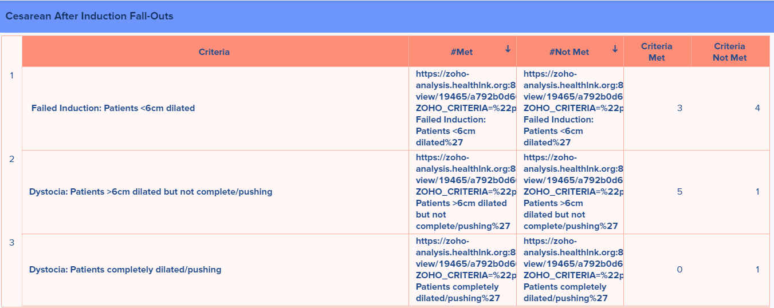
Cesarean after Induction

Slide 67
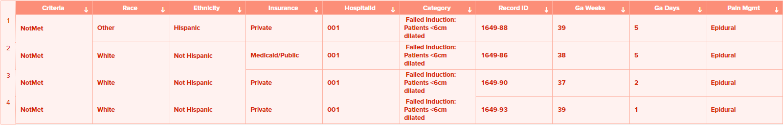
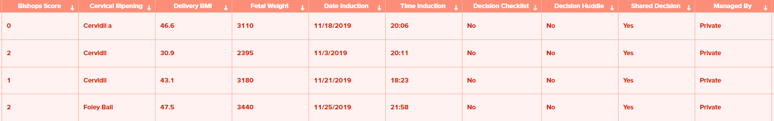
Induction Fallouts

Slide 68
Next Steps with PVB

Slide 69
Current Activities for your QI Team
Continue to host and attend your regular QI Team meetings
Determine if a PVB Grand Rounds/OB Provider Meeting to help achieve nurse and physician buy-in
Submit monthly data collection for January-July 2021
Roll-out cesarean decision checklist
Ensure your hospital had identified at least one team member to attend a virtual live Labor Support Class who can train clinicians at your hospital. Register at https://ilpqc.org/initiatives/promoting-vaginal-birth-initiative/

Slide 70
ILPQC Labor Support Classes
We are partnering with Jessica Brumley, CNM from FPQC to offer two Virtual Labor Support Classes
We invite all individuals who care for laboring patients to join us for this advanced labor support training
The live class will consist of a virtual presentation with demonstration videos
Participants will receive a packet to take back to their institution with resources to educate their staff that were unable to attend
When? September 28 8AM-1PM
Registration links will be in your PVB newsletter and on the PVB Webpage at ilpqc.org

Slide 71

PVB Grand Rounds
PVB Grand Rounds help facilitate buy-in and give your providers the opportunity learn more about the initiative
Hear from an expert on the ILPQC Grand Rounds Speaker’s Bureau
Email ellie.suse@northwestern.edu to schedule your grand rounds or OB provider meeting
14 Grand Rounds already scheduled for PVB

Slide 72
Upcoming Monthly Webinars:
Date | Topic
Monday, September 27 12:30-1:30 | Implementing a standard criteria for the diagnosis of labor dystocia arrest disorders
Thursday October 28th | 2021 Annual Conference
Monday, November 22nd 12:30-1:30 | Policies and Procedures: Pain management and early Labor
Monday, January 23rd 12:30-1:30 | Data Transparency: Sharing provider level data
Monday February 28th 12:30-1:30 | Dystocia Management Strategies
Register and Join here: https://northwestern.zoom.us/j/91684580832?pwd=eXo3U3VsTlVTOHI5QjRvUjdQeWRtdz09

Slide 73
Questions?
Please put your questions or comments in the chat

Slide 74










Thanks to our Funders
In kind support:

