Slide 1

Stop, Collaborate, and Listen: ABX Debriefs, Time Outs, and Stop Orders
BASIC Monthly Teams Call
July 19, 2021

Slide 2
Call Overview
ILPQC Updates & Housekeeping
BASIC Data Review
STOP: Automatic Stop Orders
COLLABORATE & LISTEN: Antibiotic Debriefs / Time Outs
QI Corner
Team Talk: Kenny Kronforst, MD; Humboldt Park Health
Partnership with Families: Launch of family engagement materials
Office Hours (2-2:30pm): Blood Culture Process Mapping & Communication Optimization

Slide 3


Obtain a Certificate in
Quality Improvement Science!
ILPQC is offering hospital teams access to IHI Open School, a free opportunity to asynchronously complete over 13 continuing education hours!
Access starting July 2021 and available for two years providing ample time to complete certificate.
Please complete the IHI Open School inquiry form to designate a specific number of members across OB & Neonatal QI initiatives at your hospital.
Pump up your Quality Improvement skills!

Slide 4
IHI Open School Access Sign up for your hospital’s slots TODAY
Current status of hospital team sign up by perinatal network:
Loyola Network: 5/5 (100%)
U Chicago Network: 9/12 (75%)
Stroger Network: 2/3 (66%)
Rush Network: 5/11 (45%)
Northwestern Network: 5/13 (38%)
UIC Network: 3/9 (33%)
Cardinal Glennon Network: 3/11 (27%)
Rockford Network: 2/10 (20%)
St. John’s Network: 3/15 (20%)
St. Francis Network: 3/16 (18%)
Only 40 of 105 (38%) Illinois Birthing/Children’s Hospitals have signed up… do not miss this opportunity!
Fill out this link with your team TODAY!
https://redcap.healthlnk.org/surveys/?s=RN9D4H9AMD

Slide 5
BASIC & Birth Equity Teams Call
Timing: We want your feedback
The BASIC and Birth Equity Teams calls are both held on the 3rd Monday of the month from 12-1pm (BE) and 1-2pm (BASIC)
ILPQC Central is having discussions regarding creating more time between the BASIC and Birth Equity Teams call to make sure teams can participate in both as needed
If the monthly BASIC teams call timing needed to be updated, which of the following would work for you and your team:
  3rd Monday of the month, 2-3pm
  3rd Tuesday of the month, 1-2pm
  3rd Tuesday of the month, 2-3pm
  Keep the same, 3rd Monday of the month from 1-2pm

Slide 6
BASIC Updates & Data Review

Slide 7
Upcoming Teams Calls
Date | Topic
July 2021 | BASIC Teams Call: Evaluate Antibiotic Appropriateness (Antibiotic Discussion/Time Outs) + Office Hours with Micro lab discussion
August 2021 | BASIC Teams Call: Equitable Care in BASIC: Equity Data, Dashboards, Strategies to Collect Race/Ethnicity Data
September 2021 | BASIC Teams Call: Assessment for EOS in Newborns <35 Weeks
October 2021 | Annual Conference
November 2021 | BASIC Teams Call
December 2021 | BASIC Teams Call

Slide 8
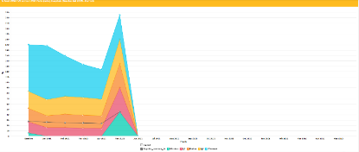
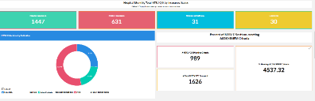
BASIC QI Strategies Resources
BASIC Dashboard for your monthly QI meetings coming September 2021
BASIC Grand Rounds- reach out to info@ilpqc.org for scheduling, teams are already signing up!
Example Dashboard
8

Slide 9
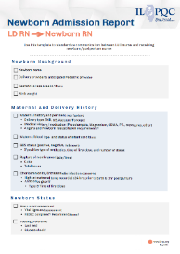
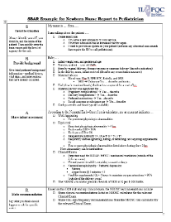
NEW BASIC Resources
Newborn Admission Report (LD RN to Newborn RN) May 2021; Use this template to standardize communication between L&D nurse and receiving newborn/postpartum nurse
Newborn Nurse to Pediatrician Communication Tool: Use this template to standardize communication between the newborn/postpartum nurse to the pediatrician on newborn status
9

Slide 10
BASIC Hospital Team Data Submission
Month | Teams Reporting Patient Data | Teams Reporting Hospital Data
Baseline (Q4 2020) | 65 | 58
January 2021 | 58 | 65
February 2021 | 54 | 64
March 2021 | 56 | 63
April 2021 | 55 | 58
May 2021 | 51 | 44
June 2021 | 33 | 22

Slide 11
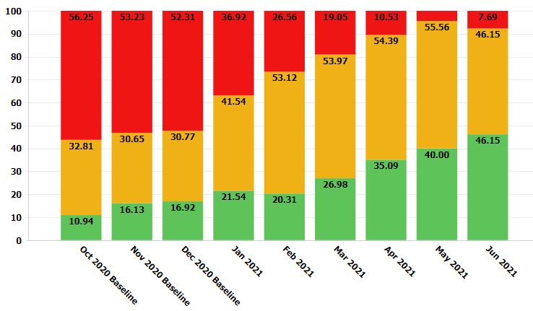
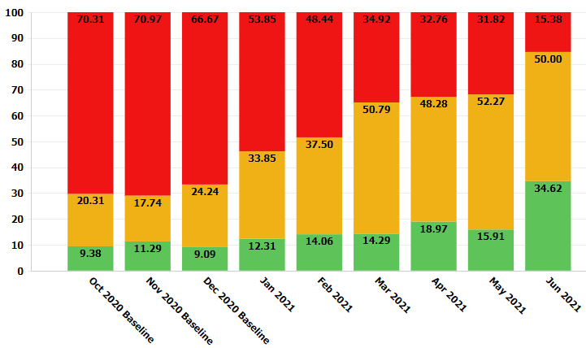
Structure Measures:
Health Care Team and Family Education
Provider and Nurse Education
Patient Education

Slide 12
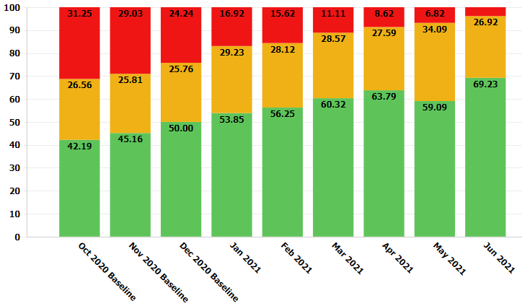
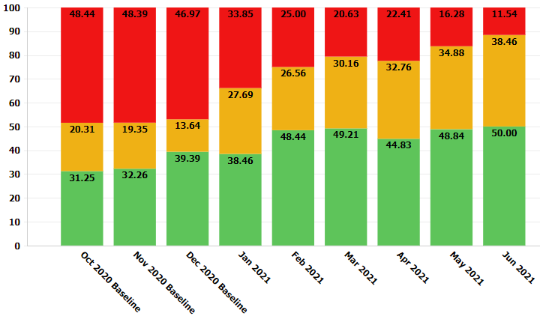
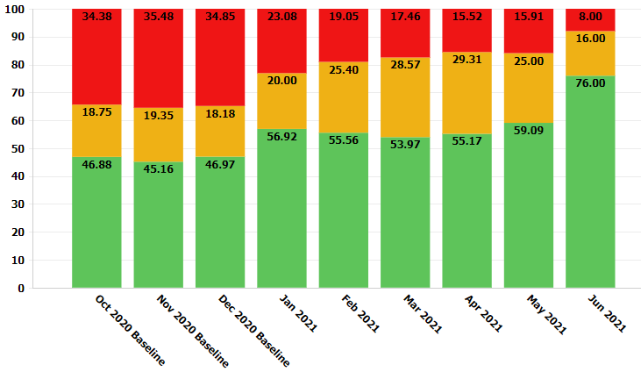
Assessment and Communication Strategies
≥35 EOS Risk Assessment
<35 EOS Risk Assessment
OB Communication

Slide 13
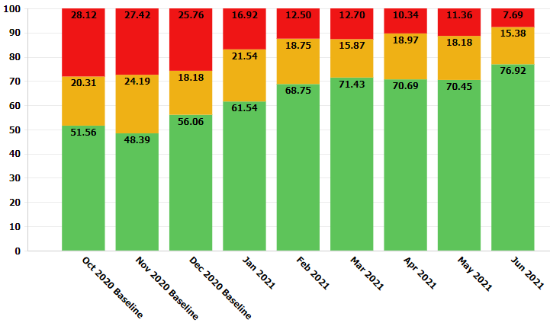
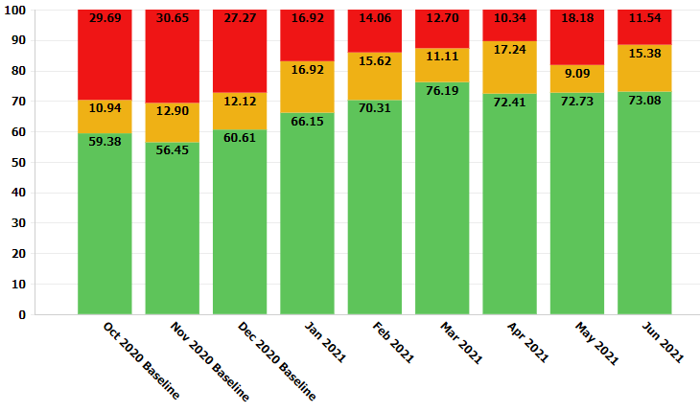
Structure Measures:
Assessment & Initiation
Serial Assessment
Identification & Response to Worsening Status
Notes:
Serial Assessment
Reaction to Worsening Clinical Status

Slide 14
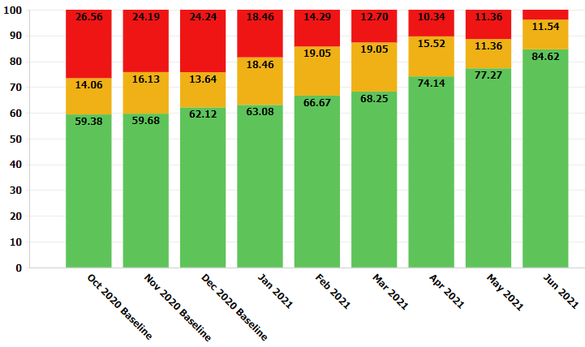
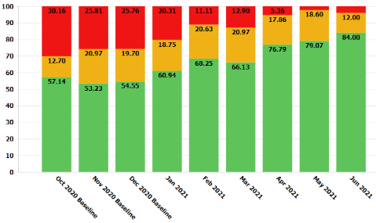
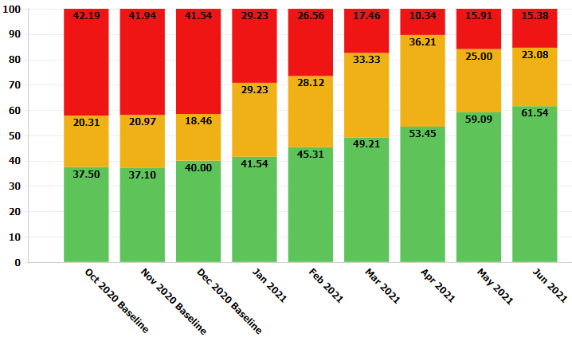
Blood Cultures &
De-Escalation Protocols
Blood Culture Collection
Blood Culture Result Processing & Communication
Protocol to De-escalate Antibiotics

Slide 15
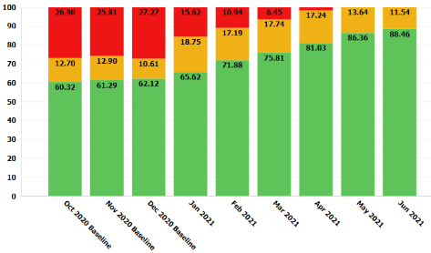
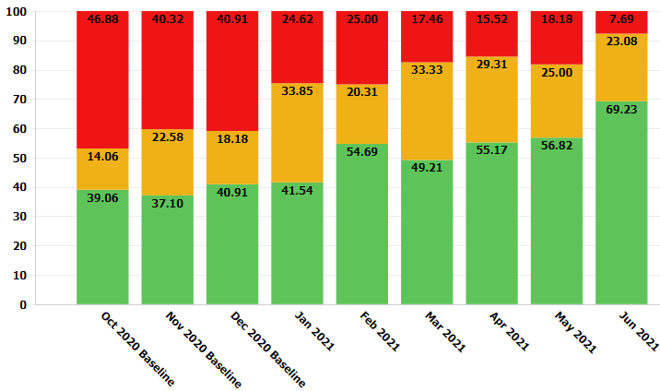
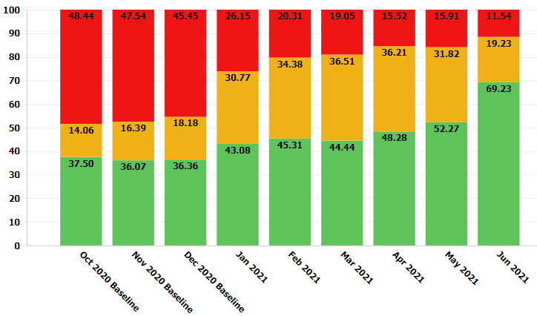
Antibiotic Time Outs, Stop-Times, and Dosing Guidelines
Dosing Guidelines
Discussions/Time Outs
Automatic Stop Times

Slide 16
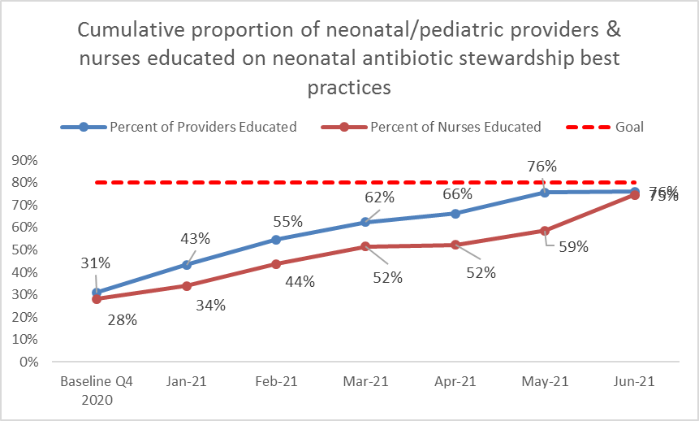
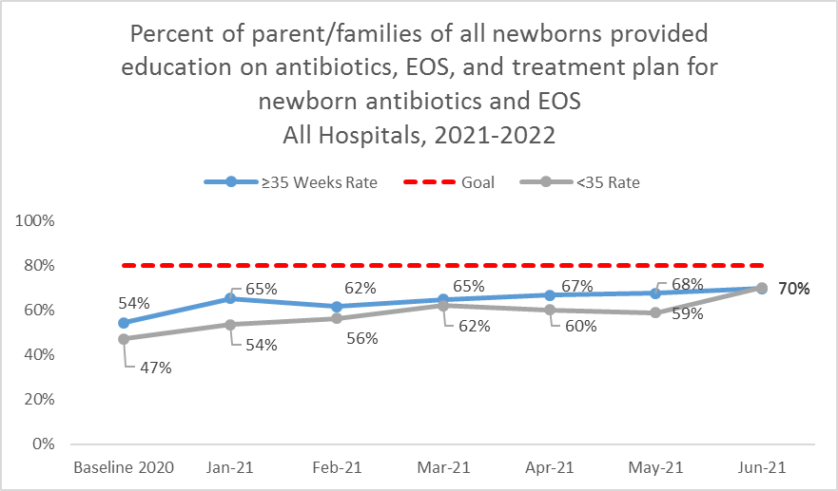
Process Measures:
Health Care Team & Family Education
Provider & Nurse Education
Parent/Family Education
Notes:
Family Education
Family Ed, preferred language
Provider Education (Process)
Nurse Education (Process)

Slide 17
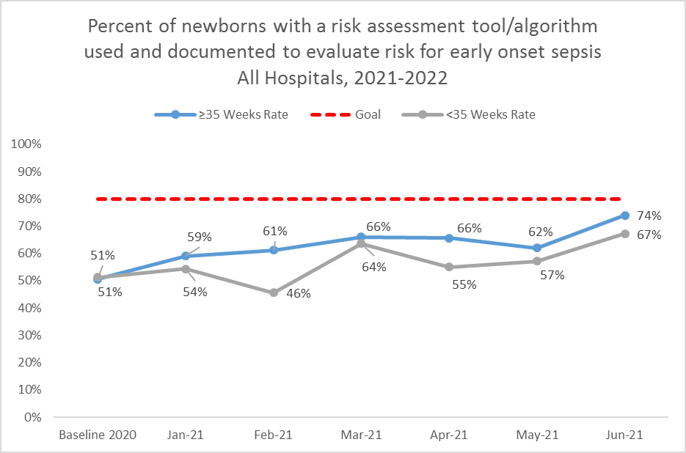
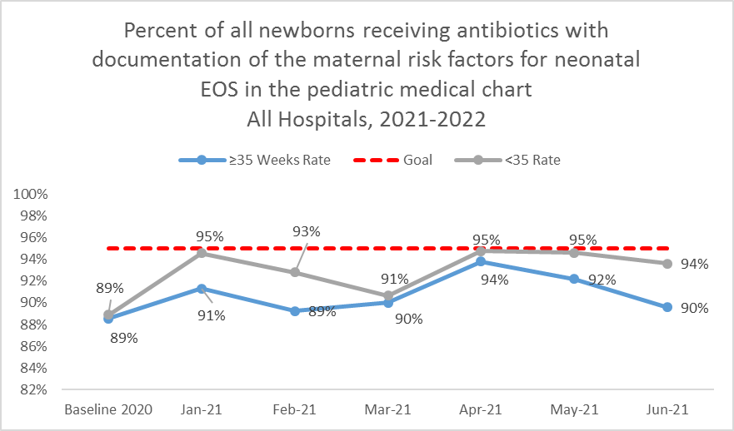
Process Measures:
Assessment & Initiation
EOS Risk Assessment Utilized
Maternal Risk Factors for Neonatal EOS Documented
Notes:
>35 EOS Assessment
<35 EOS Assessment
Documentation of Maternal Risk Factors

Slide 18
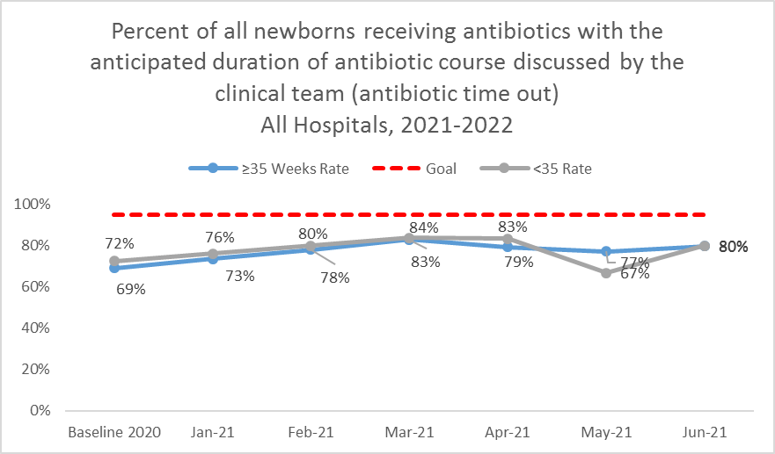
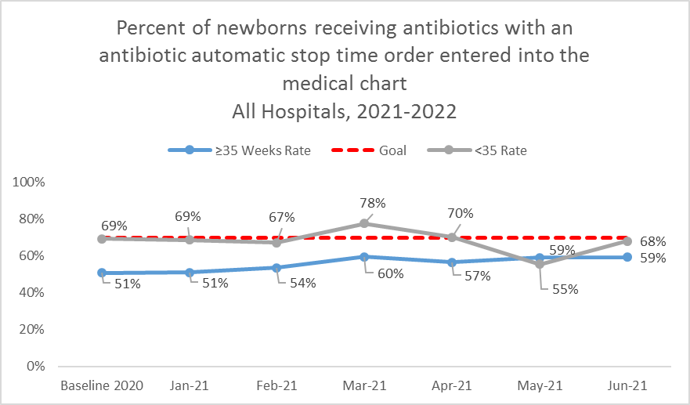
Process Measures:
Antibiotic De-escalation
ABX Course Discussed by Clinical Team (Time Out)
ABX Automatic Stop Order Entered
Notes:
Note for discussion – do we want to move up our goal on some of these process measures that look like they could hit 90%. We can discuss with the team, but reasonable

Slide 19
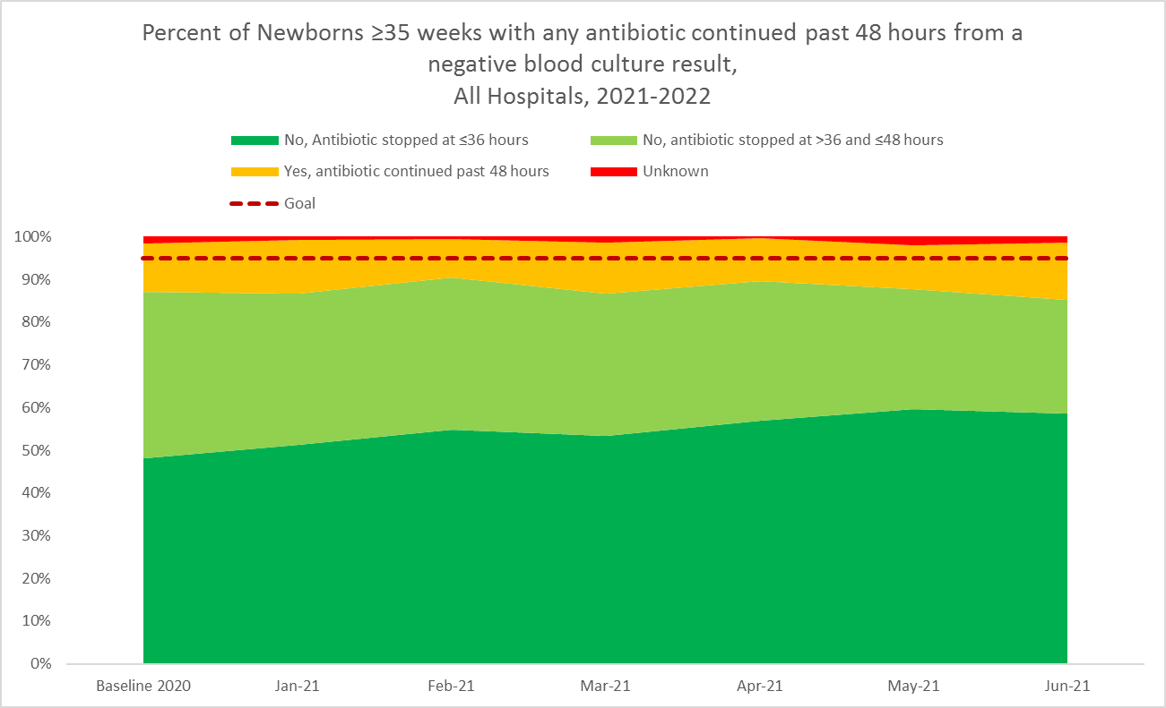
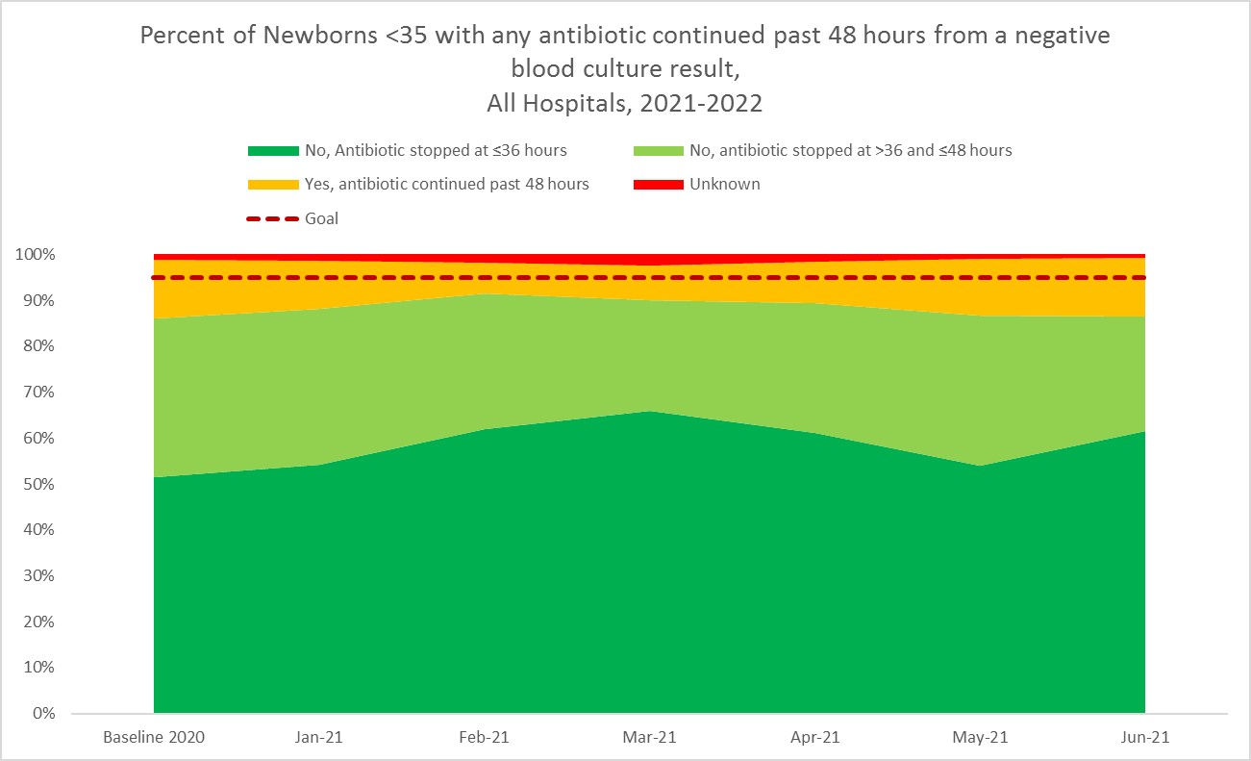
Outcome Measures:
Antibiotics Continued Past Negative
Blood Culture Result
≥35 ABX Continued Past Negative Blood Culture
<35 ABX Continued Past Negative Blood Culture
Notes:
Goal- as dark green as possible, light green is ok
Key Messages:
- % of newborns antibiotics stopped by 36 & 48 hours (change formula?)
Babies treated for 5 days or more in the absence of a positive blood culture, positive CSF culture, pneumonia
Culture negative sepsis… talk with Justin & Leslie about this criteria

Slide 20
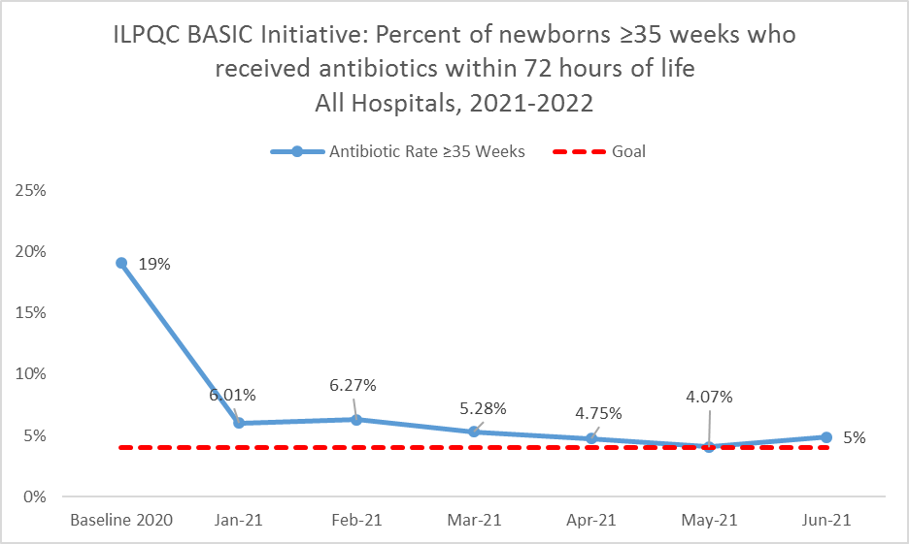
Outcome Measure:
Antibiotic Prescribing Rate

Slide 21
BASIC Key Drivers:
What We’ve Worked On
Data monitoring, transparency, and stewardship infrastructure
Timely and Appropriate Initiation of Antibiotics
  Apply EOS risk assessment
  Ensure optimal blood culture draw process
  Select appropriate antibiotic, dose and interval
  Operationalize serial assessments & process to identify change in newborn clinical status
  Facilitate PP to Peds communication
  Facilitate Ob to Peds communication

Slide 22
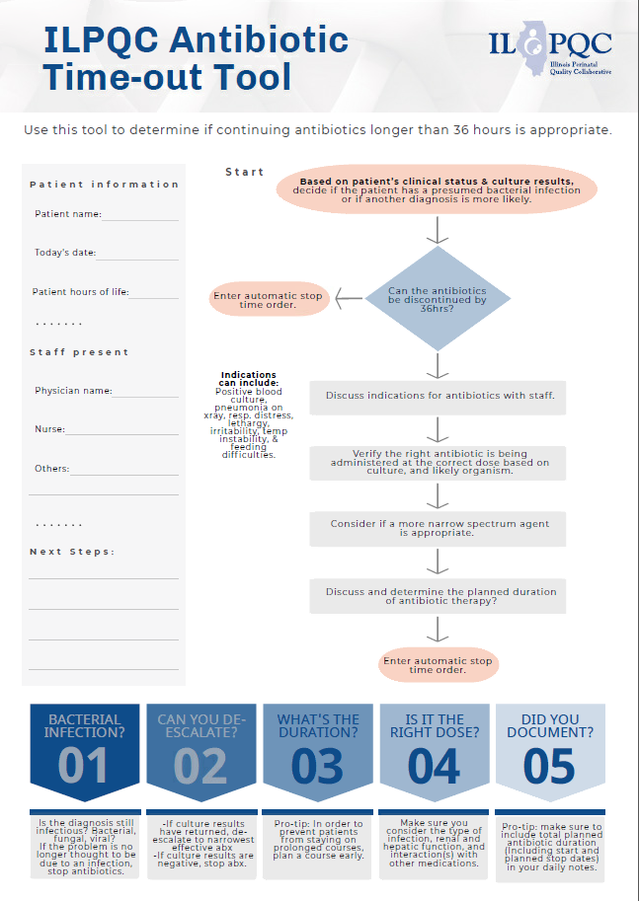
Driver 3: Appropriate Administration and De-escalation
NEW TOOL!
Appropriate administration of antibiotics:
Foster Family Education and Partnership
Appropriate de-escalation of antibiotics
Understand microbiology lab workflow & blood culture results communication
Reevaluate antibiotic appropriateness (antibiotic discussion/time out)
Implement antibiotic stop time
Disseminate culture negative sepsis education (coming soon)
Notes:
Highlight with a call out, “new tool coming” for abx time out tool

Slide 23
STOP: Implement Antibiotic Stop Times

Slide 24
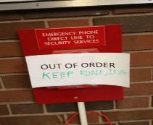
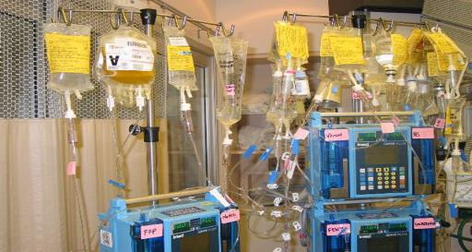


Error Reduction Strategies

Slide 25

Designing Systems to Reduce Errors
Make the easiest thing to do the safest thing to do
Reduce reliance on memory and vigilance
Improve access to complete and timely information
“Error proof” through fail-safe systems and forcing functions
Standardize and simplify processes
Design systems to be resistant to psychological and environmental precursors to error

Slide 26
Most Effective
  Forcing functions, constraints
  Automation, computerization
  Standardization, protocols
  Checklists, double-check systems
  Rules, policies
  Education, information
  “Be more careful. Be vigilant.”
Least Effective
Source: Gosbee JW, Gosbee LL, eds. Human Human Factors Engineering
to Improve Patient Safety. Oakbrook IL: Joint Commission Resources 2005
Also: Institute for Safe Medication Practice, 2007

Slide 27

Antibiotic Automatic Stop Times
What: Pharmacy-driven implementation of an electronic 36 (or 48)-hour automatic stop on all antibiotic orders within the newborn order set
Why: Using the electronic health record as a tool for antibiotic stewardship can be effective for achieving the goal of decreasing unnecessary antibiotic use
  Incorporating additional interventions, such as NEOSC and time outs can decrease exposure too

Slide 28
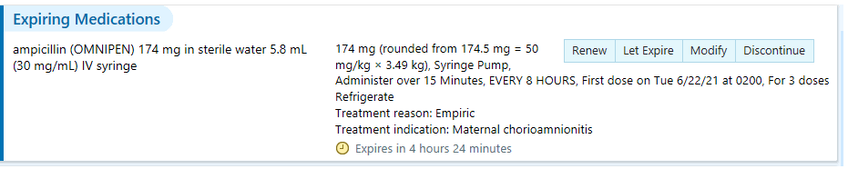

Automatic Stop Times:
Toolkit Resources
Example EHR Automatic Stop Time (Lurie Children’s Hospital)

Slide 29
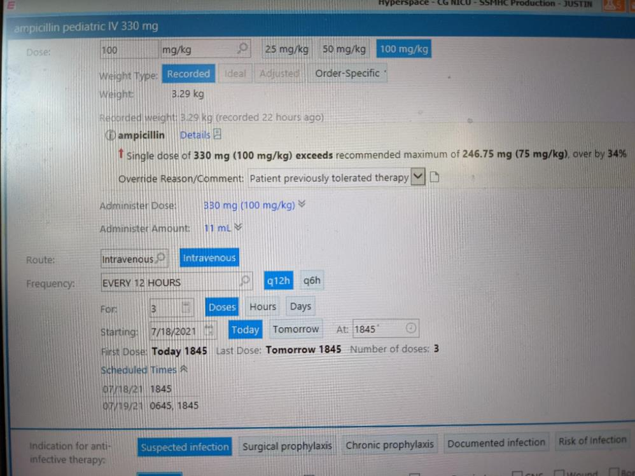
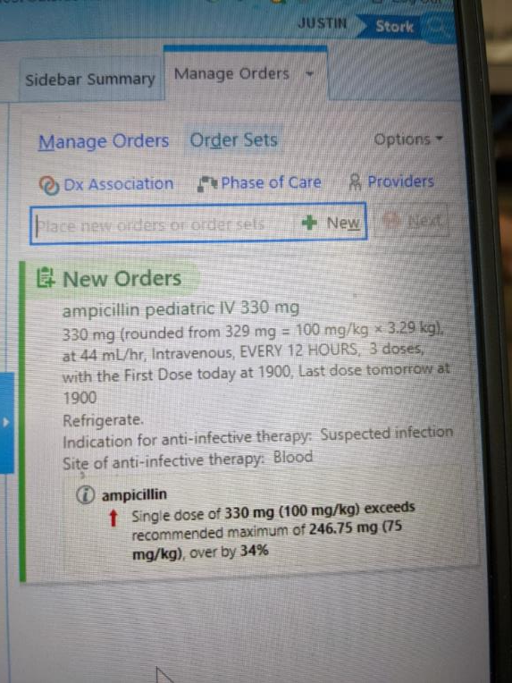
Alternative Approach

Slide 30
COLLABORATE & LISTEN:
Reevaluate antibiotic appropriateness (discussion/time out)

Slide 31

Antibiotic Discussions/Time Outs
What: The selection of the antibiotic is not always revisited after more clinical and laboratory data (including culture results) become available
An antibiotic “time out” prompts a reassessment of the continuing need and choice of antibiotics when the clinical picture is clearer.
When: All clinicians should perform a review of antibiotic indications with the interprofessional team:
Review the need for antibiotics on each patient daily
Evaluate new information, such as clinical improvement and new culture results, to update your treatment plan.
At a minimum, there are two key times to review antibiotic treatment: daily and at 36-48 hrs.
Other useful times include at transitions of care, change in clinical status, or handoff between providers.
Notes:
ASOs can be put into an order set
ASOs can be put in with the antibiotic order
ASOs can be put in once there is more data for decision making

Slide 32
Sample ABX Time Out Checklist
Do we still think patient has a bacterial infection or is another diagnosis more likely?
Have we documented dose, duration and indication for all antibiotics?
If the patient has a bacterial infection, can we de-escalate?
How long should the patient receive antibiotics?
Is the antibiotic prescribed at the right dose?
Is the diagnosis still infectious? Bacterial, fungal, viral?
If the problem is no longer thought to be due to an infection, stop antibiotics.
If culture results have returned, de-escalate to the narrowest effective antibiotic.
If culture results are negative, stop antibiotics.
Pro-tip: In order to prevent patients from staying on prolonged courses, plan a course early.
Make sure you consider the type of infection, renal and hepatic function, and interaction(s) with other medications.
Pro-tip: make sure to include total planned antibiotic duration (Including start and planned stop dates) in your daily notes.
Notes:
Can we put our new tool in here?

Slide 33
Decisions, decisions, decisions
When will they put them in?
How will they put them in?
Who will put them in?
What is the process if the culture turns positive?

Slide 34
Resources to Support ABX
Discussions/Time Outs
ILPQC Antibiotic Time-Out Tool- use the tool to determine if continuing antibiotics longer than 36 hours is appropriate
PQCNC ASNS Antibiotic Time Out Video (https://vimeo.com/214084083)
Notes:
Autumn add time-out

Slide 35
QI Corner

Slide 36
PDSA Cycles
Take your QI skills to the next level
Quality Improvement work is NOT just education or large roll outs of one idea

Slide 37
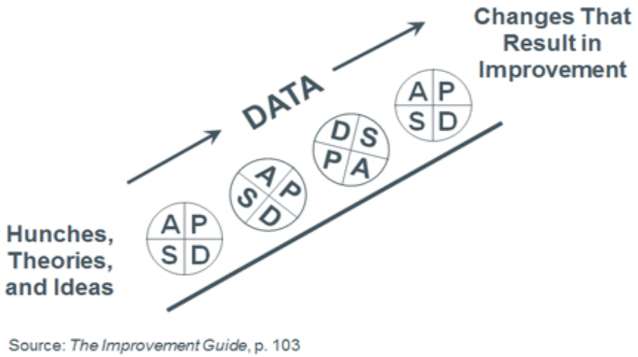
Small tests of change
Try the abx time out tool with 1 RN, & 1 provider for the entire shift
Try the abx time out tool with 1 RN, 1 patient & 1 provider on night shift
Try the abx time out tool with 1 RN, 1 patient & 1 provider on day shift
Remember DON’T overthink it- start small
Notes:
Dan to lead QI corner

Slide 38

PDSA Cycle- useful tools
ILPQC is here to help!
PDSA Cycle Worksheet- use this tool to help outline your upcoming small test of change and to organize feedback
ILPQC QI Leader Call recording- listen to this recording to learn more about being a QI leader in an ILPQC initiative
IHI Open School with QI Certification- free opportunity to asynchronously complete over 13 continuing education hours and obtain a certificate in QI
Always feel free to reach out to ILPQC to talk through your PDSA ideas or for help in determining next steps

Slide 39
Team Talk
Kenny Kronforst, MD; Humbold Park Health, Lurie Children’s Hospital

Slide 40

Communication Strategies
Huddles
  The 8/8 Huddle
    Occurs daily and involves key clinical staff- OB, Peds, L&D/PP nurses, 1 ICN nurse, SW
    Nursing driving (FM residents)
    Aim is to share important information of patients in the unit and discuss staffing (floats and shortages)
      Quick review of postpartum mothers and babies (non-routine monitoring/needs), ICN babies (census), and potential social issues
      High risk mothers (triage/L&D)
        Strip review and concerns
        Comorbidities- IDM, IUGR, abnormal fetal findings
        Deliveries where Peds hospitalist or Neonatologist needs to be present (policy)
Notes:
every morning and evening, captures both shifts

Slide 41

Neonatal Conditions Requiring Pediatric Hospitalist/Neonatologist Attendance
Definition: Level 2 conditions
  Intermediate problems anticipated
  Possibility that the neonate will require resuscitation
Attendants:
  Intermediate Care Registered Nurse
  Pediatrics Hospitalist
Indications:
  All non-routine, unscheduled cesarean deliveries
  35 weeks estimated gestational age (EGA) or above
  Estimated fetal weight (EFW) is 1500 – 2000 grams
  Unregistered patient with no prenatal care
  Maternal substance abuse
  Maternal chorioamnionitis
  Meconium-stained amniotic fluid
  Diabetic mothers on an insulin drip during labor
  Inadequate intra-partum antibiotic prophylaxis (less than 4 hours from the time of administration of the first dose of antibiotics to delivery) in mothers who are GBS positive
  Group B Streptococcus (GBS) unknown with risk factors (ruptured membranes greater than 18 hours or gestational age less than 37 weeks)
  History of a previous newborn with invasive GBS disease
  Concern for shoulder dystocia
  Instrumentation with vacuum or forceps
  Unstable maternal medical condition
  Twin pregnancy (Call Neonatologist if less than 37 weeks)
  Oligohydramnios/polyhydramnios
  Category II or concerning fetal heart rate tracing
  Mothers with high serum levels of magnesium sulfate
  Mothers who have received narcotics within two hours of delivery
  Mothers with OB hemorrhage
  Newborn infant having trouble with transition (abnormal vital signs, etc.)
  Any concerns or problems identified by OBs, Family practitioners, advance level practitioners, or nursing staff
Definition: Level 3 conditions
  Maximum problems anticipated
  Highly likely the baby will need resuscitation
  Most likely an admission to the ICN
Attendants:
  Intermediate Care Registered Nurse
  Pediatric hospitalist
  Neonatologist
  Respiratory Therapist (on-call to ICN)
Indications:
  EFW < 1500 grams
  EGA < 35 weeks
  Category III fetal heart rate tracing
  Known major fetal anomalies
  Cord prolapse
  Placental abruption
  Maternal cardiopulmonary arrest
  Any concerns or problems identified by OBs, Family practitioners, advance level practitioners, or nursing staff

Slide 42
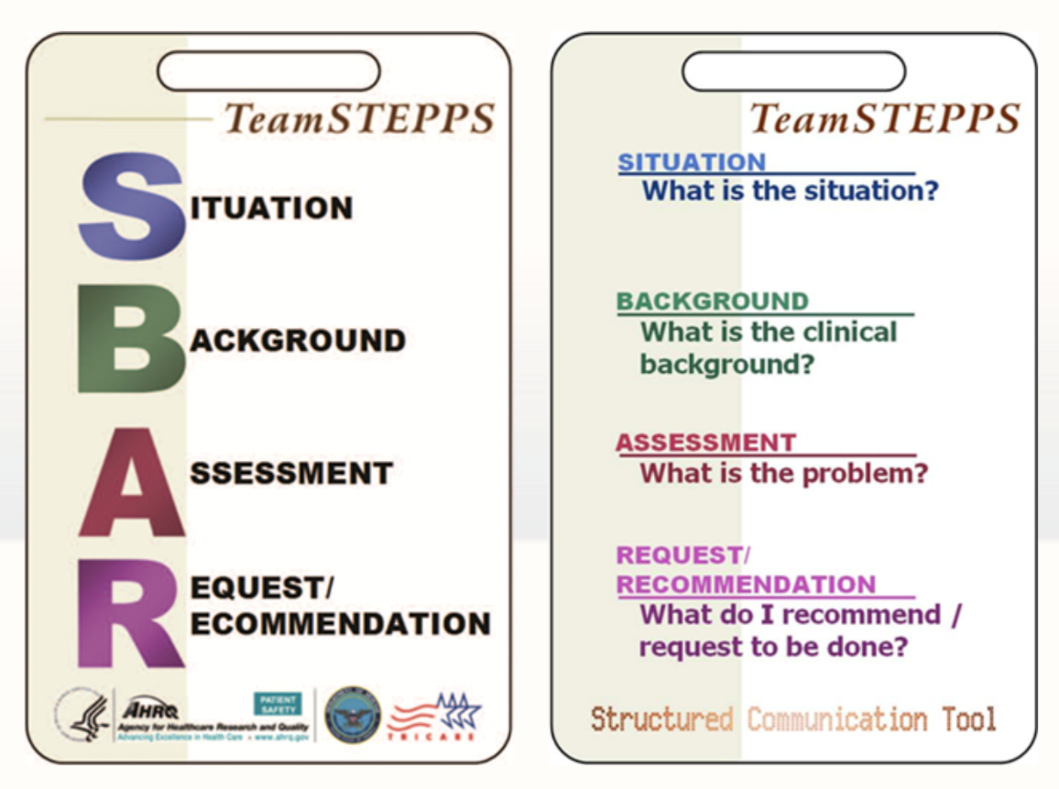
Content of Information

Slide 43
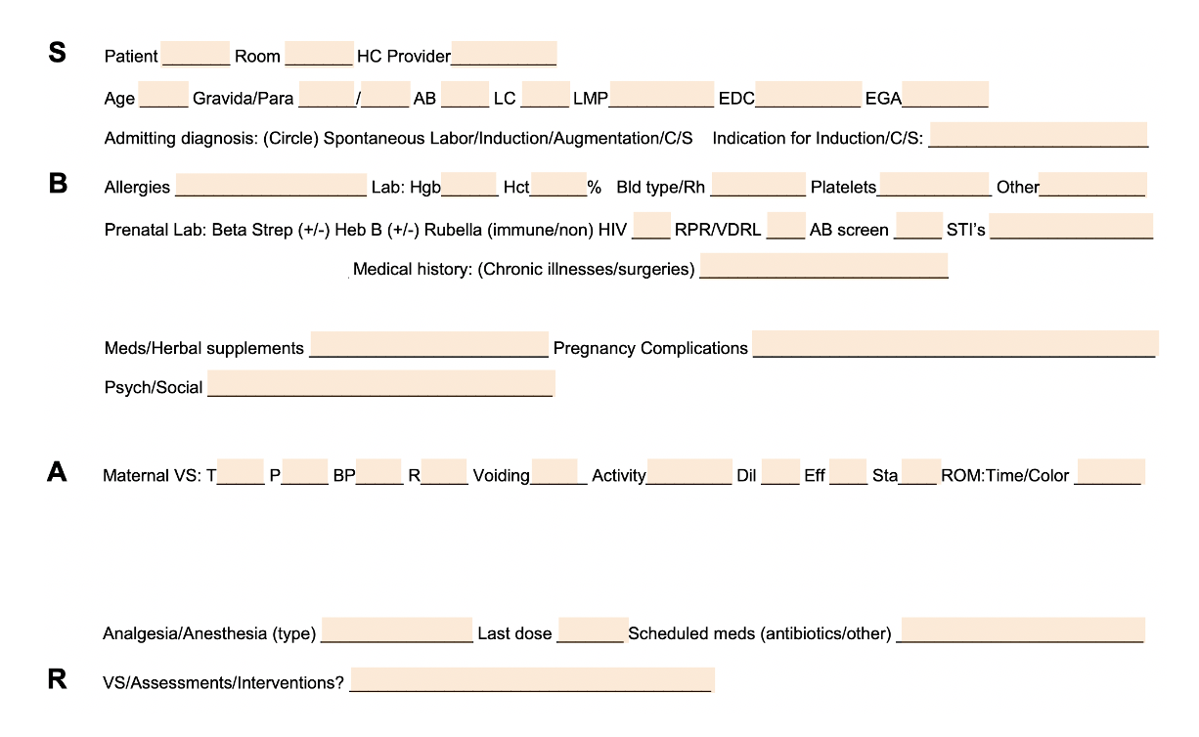
SBAR Example
Notes:
GBS status? Antibiotics? Number of doses prior to delivery? Time of last dose?
ROM at (time) or number of hours? Presence of meconium?
Highest maternal antepartum temperature?

Slide 44
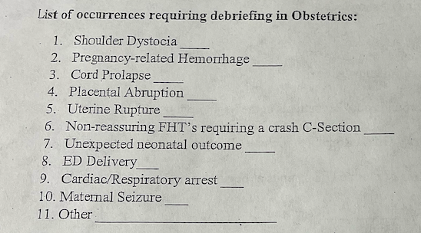
OB Debrief Huddle
Initiated by physicians, ad hoc
Used as an improvement tool when an unexpected occurrence/complication occurs
Provides another opportunity to discuss EOS
  Work in progress
What went well?
What didn’t go well?
Opportunities for improvement (list)
Functionality of Resources (list)

Slide 45
Foster Family Education & Partnership

Slide 46
BASIC Family Education Resources
Understanding Chorioamnionitis – Patient Education Flyer
  This flyer can be given to patients on admission to L&D to provide important information about Chorioamnionitis
Antibiotics & Your Baby Education Video
  This education video can be shared with families/caregivers after delivery, on admission to postpartum floor/newborn nursery/NICU for newborns who have received antibiotics
Antibiotics & Your Baby Accompanying Flyer
  This flyer can be given to families/caregivers to supplement the education video

Slide 47

Family Education Video Premiere!
Coming NOW to a unit near you

Slide 48
Next Steps
Meet with your BASIC QI team to review your hospital’s monthly reports for Hospital & Newborn measures and determine measures to focus on for improvement in the upcoming months – plan your next PDSA!
Review with your QI team your hospital’s policies, protocols, strategies, and the ILPQC BASIC toolkit. Make updates as appropriate regarding:
  Family education & partnership
  Understand microbiology lab workflow & blood culture results communication
  Antibiotic discussions/time outs
  Automatic stop orders
Fill out IHI Open School access list for your hospital
Notes:
Check last bullets

Slide 49
Office Hours: Blood Culture Process Mapping & Communication Optimization
2:00 – 2:30pm

Slide 50
BASIC After Hours
Blood Cultures
SSM Health Illinois

Slide 51
SSM Health Illinois
Good Samaritan Hospital Mt. Vernon, Illinois
Good Samaritan is a 134 bed facility in Jefferson County serving a 12 county area
1092 deliveries in 2020
2 OB physician groups and 1 Pediatric group
24 bed LDR/PP/GYN unit
Level 2 facility
Telemedicine available with Cardinal Glennon

Slide 52


SSM Health Illinois
St. Mary’s Hospital Centralia, Illinois
St. Mary’s is a 125 bed facility in Marion County serving a 7 county area
268 deliveries in 2020
1 OB physician group with 1 hospital employed pediatrician and 2 private pediatricians
9 bed LDRP unit
Level 2 facility
Baby Friendly Designation 2018

Slide 53
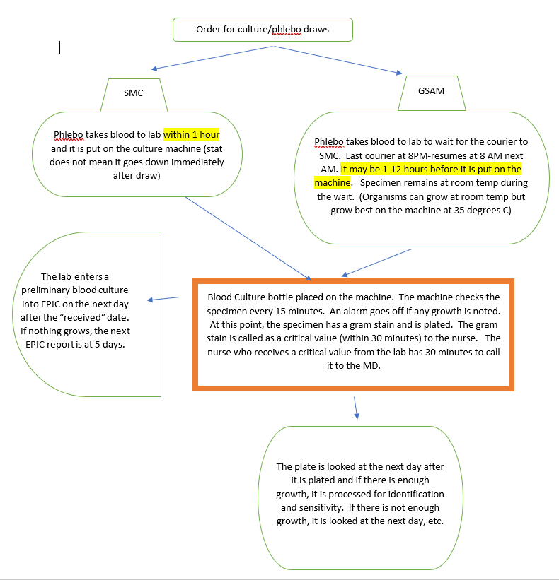
At our first meeting, the nursery staff on our team related that they had concerns about the blood culture collection. A member of the lab was on our call. She walked us through the policy for blood culture collection (posted in the nursery so nurses are aware) and through the lab process once blood is received. We then realized that all blood cultures were done at SMC and GSAM had to send blood cultures there per a courier.
After auditing charts, we realized that there could be quite a delay in getting GSAM cultures on the machine.
This led to the chart to the left which spoke to each facilities process/timing/reporting.
MDs had concerns about the delay and how it affected the goal for evaluating antibiotics based on culture results at 36 hours from culture COLLECTION.
We spoke to the lab again about time frames-best and worst- for getting GSAM cultures on the machine. We sought advice from ILPQC on how to proceed when a culture may have only been on the machine for 24 hours at the 36 hour mark after culture collection.
We were assured that 24 hours was sufficient to start seeing growth and decisions could be based on this timing.

Slide 54
Next Steps
Audit Blood Culture collection in the nursery. Use a tool adapted to match hospital policy and monitor the procedure as well as the volume of blood collected.
Consider having nursing draw the blood cultures
Use the BASIC audits to monitor collect time vs received time for trends/opportunities.

Slide 55
Thank You
Pat Baker OB Team Lead
SSM Health Illinois
Patricia.baker@ssmhealth.com

Slide 56
Steps to investigate at your hospital
Identify the steps in your hospital’s process.
Identify how long it usually takes for a culture bottle to get to the lab
Identify time 0.
Identify the process for positive or negative report
Identify how and to who a positive culture is reported
Identify if the lab can report a status at 36 hours or is no news good news.

Slide 57










Thanks to our Funders
In kind support:

Slide 58
Appendix

Slide 59
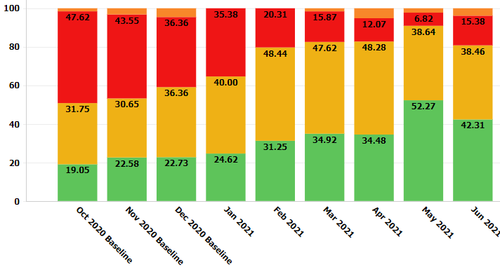
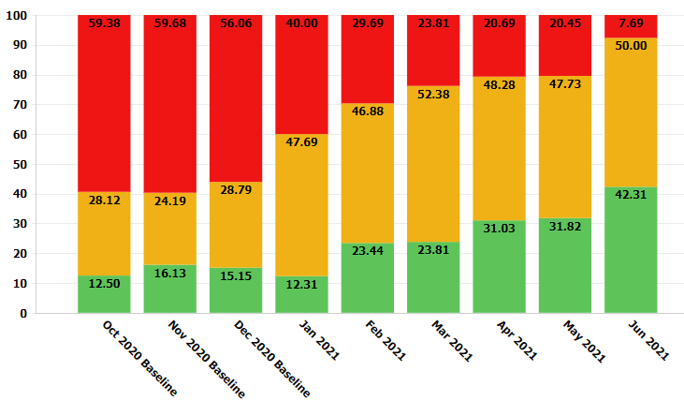
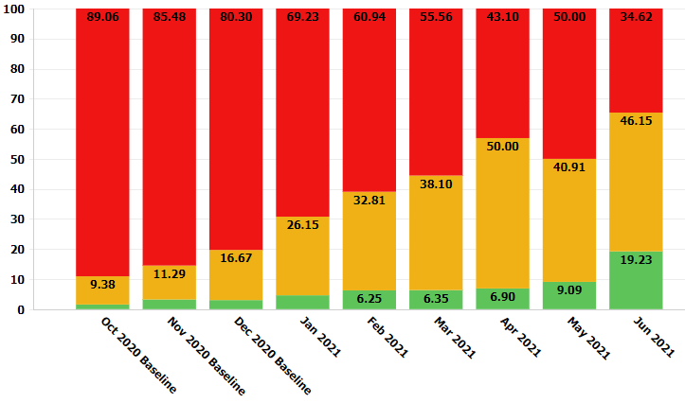
IT Partnership
QI Strategies for Provider Feedback
Review Data by Race & Ethnicity
Notes:
Structure Measures:
QI Strategies & Equitable Care

