Slide 1

Equitable Care in BASIC: Equity Data, Dashboards, Strategies to Collect Race/Ethnicity Data
BASIC Monthly Teams Call
August 16, 2021

Slide 2
Call Overview
ILPQC Updates & Housekeeping
BASIC Data Review
QI Corner
Team Talk: Rita Brennan

Slide 3


Obtain a Certificate in
Quality Improvement Science!
ILPQC is offering hospital teams access to IHI Open School, a free opportunity to asynchronously complete over 17.75 continuing education hours!
Access starting July 2021 and available for two years providing ample time to complete certificate.
Please complete the IHI Open School inquiry form to designate a specific number of members across OB & Neonatal QI initiatives at your hospital.
Pump up your resume and skills!

Slide 4
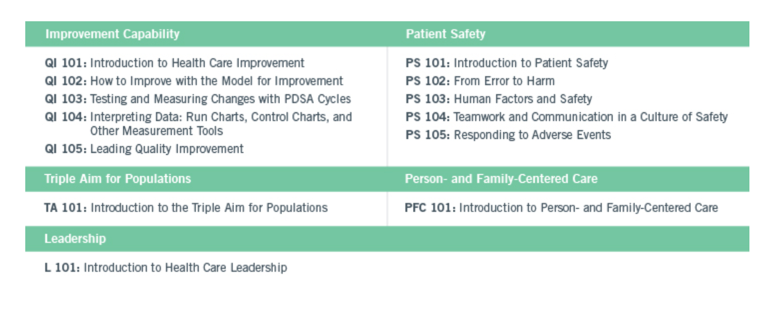
IHI Certificate in Quality & Safety
Course Track

Slide 5
IHI Open School Access Sign up for your hospital’s slots TODAY
Current status of hospital team sign up by perinatal network:
Loyola Network: 5/5 (100%)
U Chicago Network: 9/12 (75%)
Stroger Network: 2/3 (66%)
Rush Network: 5/11 (45%)
Northwestern Network: 5/13 (38%)
UIC Network: 3/9 (33%)
Cardinal Glennon Network: 3/11 (27%)
Rockford Network: 2/10 (20%)
St. John’s Network: 3/15 (20%)
St. Francis Network: 3/16 (18%)
Only 40 of 105 (38%) Illinois Birthing/Children’s Hospitals have signed up… do not miss this opportunity!
Fill out this link with your team TODAY!
https://redcap.healthlnk.org/surveys/?s=RN9D4H9AMD

Slide 6
UPDATED TIME
BASIC Monthly Webinar
BASIC Monthly Webinars will now be held from 2-3 PM on the 3rd Monday of the Month starting on the September 20, 2021 call

Slide 7
Annual Conference Updates
ILPQC 2021 9th Annual Conference will be held virtually
Welcome Session
PVB Plenary: Dr. Neel Shah
BASIC Plenary: Dr. Karen Puopolo
PQC Panel:
  NYSPQC: Marilyn Kacica
  OKPQC: Barbara O’Brien
  PNQIN: Dr. Munish Gupta
BE Plenary: Marilyn Kacica
Patient Plenary: Wanda Irving, Dr. Linda Suleiman
OB, Neo, and Family Engagement Breakout Sessions
Currently recruiting 2021 AC Planning Committee members- email aperrault@northshore.org if interested.

Slide 8

We want to hear from you!
Share your team’s thoughts & insights on the upcoming 2021 AC Team Survey

Slide 9
2021 Call for Abstract/Poster
Submission
All hospital teams are asked to submit an abstract on complete or in progress QI work
Abstracts submitted by Oct. 1, will be reviewed for awards:
  Top abstract(s) in OB, Neonatal, Patient/Family Engagement, First time Level I/II Hospital receive Abstract of Excellence Awards
  Two OB & two Neonatal abstracts receive special recognition, one each for
    (1) Best Use of Data
    (2) Best Project Implementation
Awarded abstracts will be announced at the conference and have a prize designation displayed on their poster
Late breaking abstracts (not eligible for awards) are due Oct 15th
Submission link coming soon!
A poster template will be provided and support is available from ILPQC.
9

Slide 10
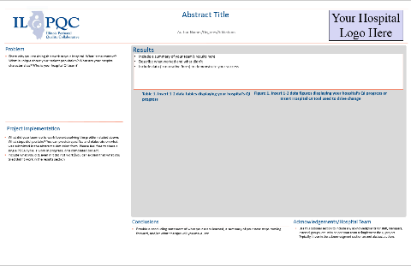
ILPQC is here to help
ILPQC will be offering a variety of support services to assist with abstract/poster submissions
  Poster Template coming soon
  Mentorship Services
  FAQ Tool- to be released in initiative newsletters
  “After hours office hours” (Information + Q&A Sessions after team webinars)
Notes:
-

Slide 11


2021 QI Recognition
ILPQC 2021 9th Annual Conference
BASIC Hospital Recognition Criteria
All 2020 Q4 (Oct- Dec) Baseline Data Submitted
+
All monthly Hospital & Patient Data Submitted * +
Movement on BASIC structure measures (Red → Yellow, Yellow → Green)
*All Data Submitted
Baseline through Sept. 2021 by October 15th

Slide 12
BASIC Updates & Data Review

Slide 13
Upcoming Teams Calls
Date | Topic
September 20, 2021 2-3PM | BASIC Teams Call: Assessment for EOS in Newborns <35 Weeks
October 28, 2021 | Annual Conference
November 15, 2021 2-3PM | BASIC Teams Call
December 13, 2021 2-3PM | BASIC Teams Call

Slide 14
BASIC Hospital Team Data Submission
Month | Teams Reporting Patient Data | Teams Reporting Hospital Data
Baseline (Q4 2020) | 66 | 64
January 2021 | 64 | 64
February 2021 | 65 | 64
March 2021 | 67 | 63
April 2021 | 61 | 58
May 2021 | 61 | 52
June 2021 | 57 | 46

Slide 15
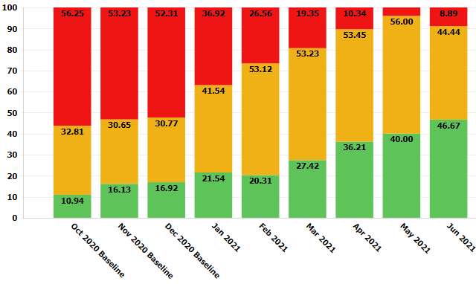
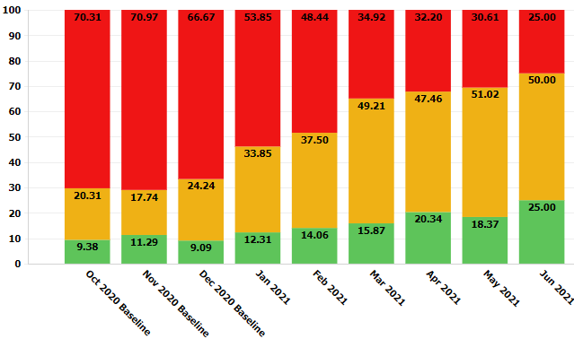
Structure Measures:
Health Care Team and Family Education
Provider and Nurse Education
Patient Education
BASIC Grand Rounds can help standardize care team education!
New family education materials can be used to standardize family education

Slide 16
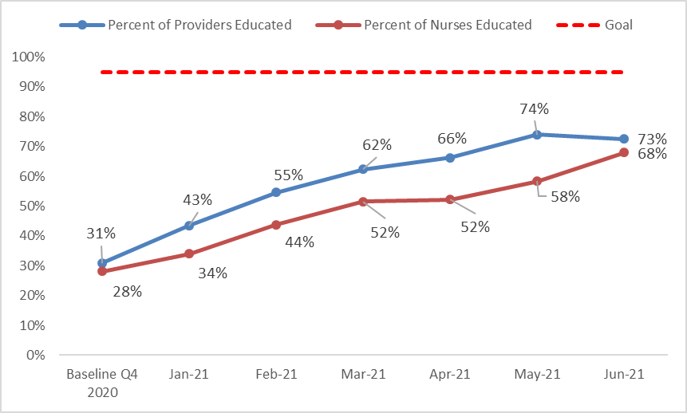
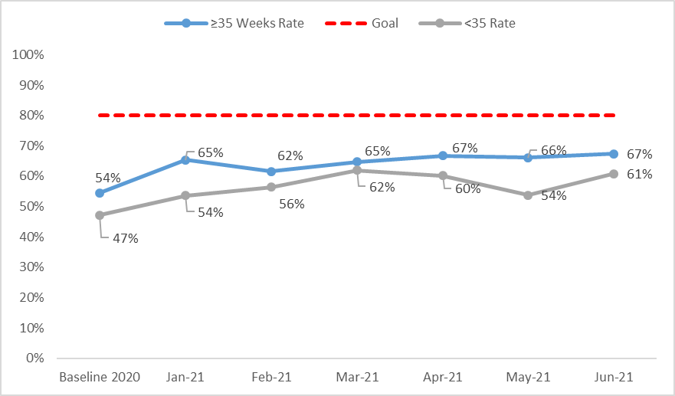
Process Measures:
Health Care Team & Family Education
Provider & Nurse Education
Parent/Family Education
BASIC Grand Rounds can help standardize care team education!
Notes:
Family Education
Family Ed, preferred language
Provider Education (Process)
Nurse Education (Process)

Slide 17
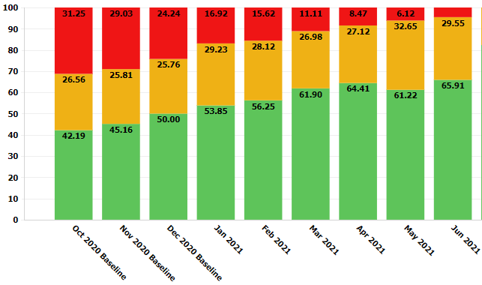
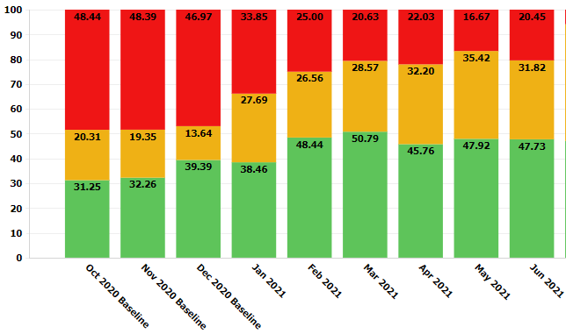
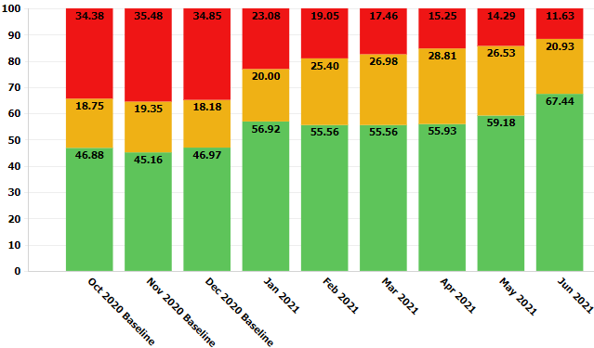
Assessment and Communication Strategies
≥35 EOS Risk Assessment
<35 EOS Risk Assessment
Sept 2021 webinar topic
OB Communication
Strategies launched in past months

Slide 18
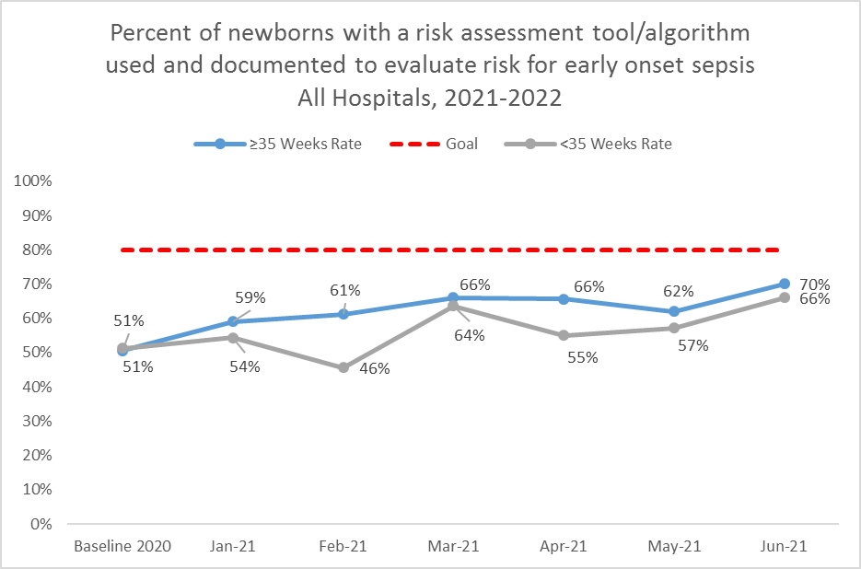
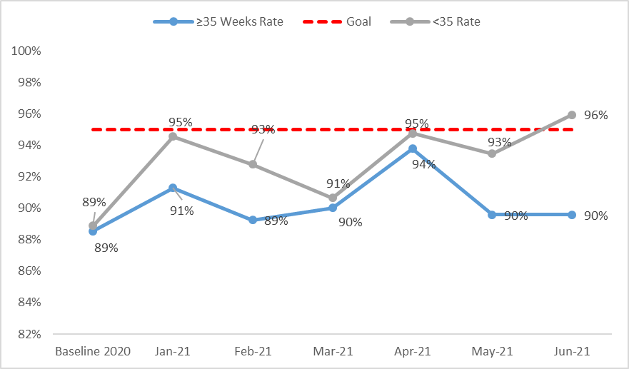
Process Measures:
Assessment & Initiation
EOS Risk Assessment Utilized
Maternal Risk Factors for Neonatal EOS Documented
Notes:
>35 EOS Assessment
<35 EOS Assessment
Documentation of Maternal Risk Factors

Slide 19
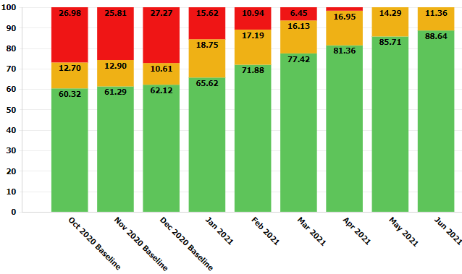
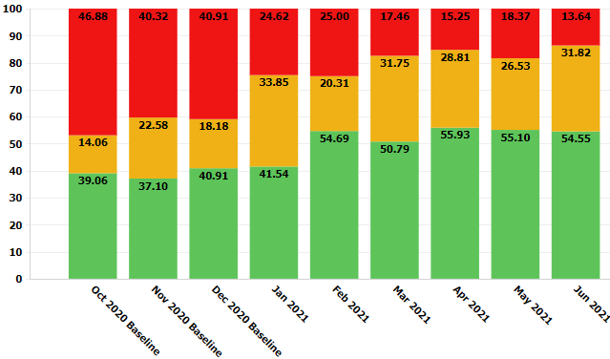
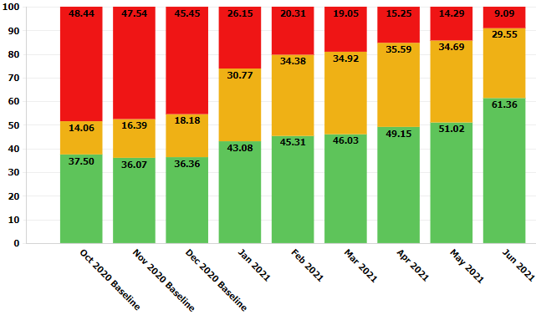
Antibiotic Time Outs, Stop-Times, and Dosing Guidelines
Dosing Guidelines
Discussions/Time Outs
Strategies rolled out in July!
June 2021 focus
Automatic Stop Times
Strategies rolled out in July!

Slide 20
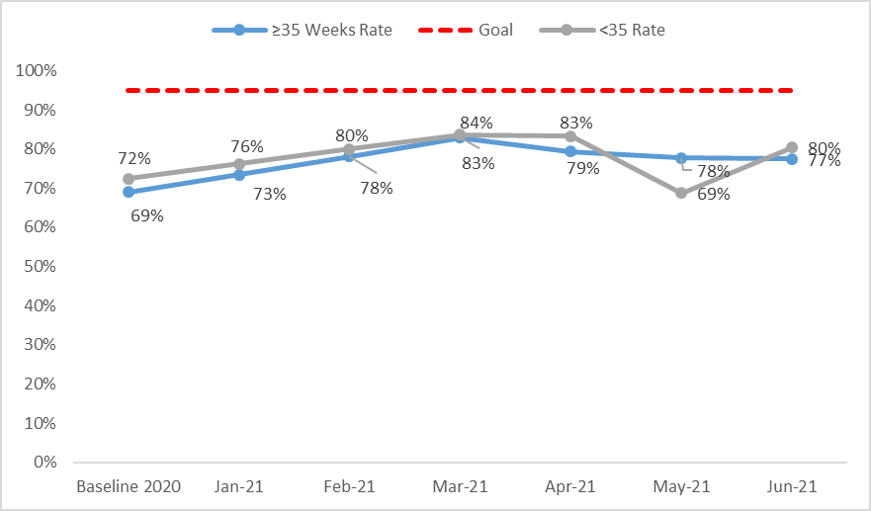
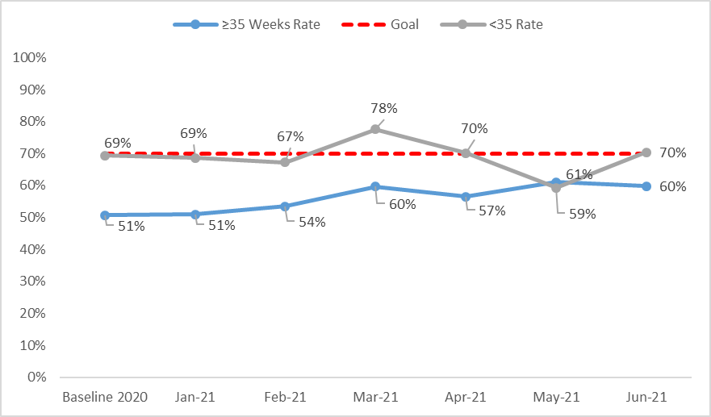
Process Measures:
Antibiotic De-escalation
ABX Course Discussed by Clinical Team (Time Out)
ABX Automatic Stop Order Entered
Notes:
Note for discussion – do we want to move up our goal on some of these process measures that look like they could hit 90%. We can discuss with the team, but reasonable
JJ: yes on stop order. Let’s do this by Sept call.

Slide 21
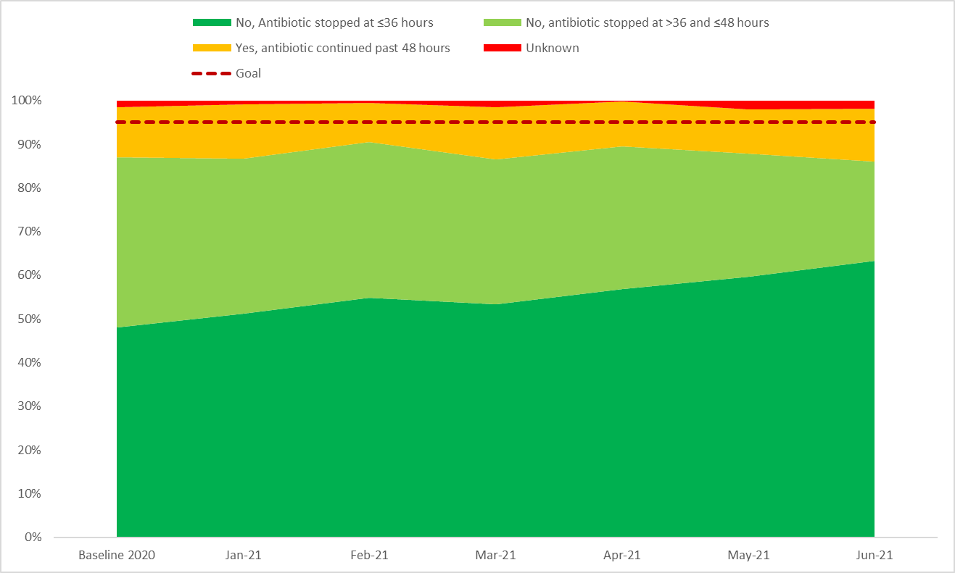
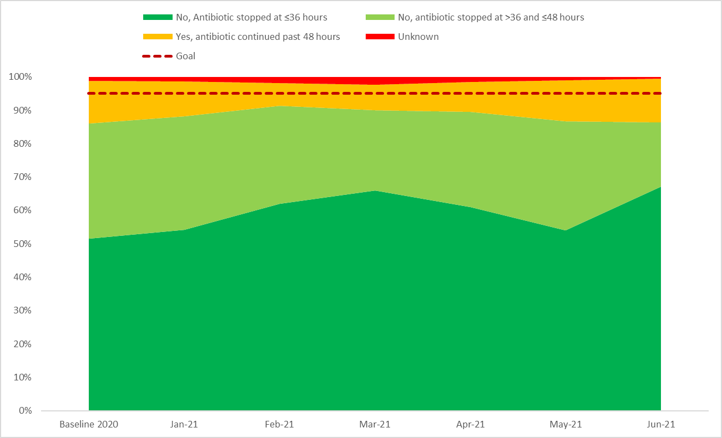
Outcome Measures:
Antibiotics Continued Past Negative
Blood Culture Result
≥35 ABX Continued Past Negative Blood Culture
<35 ABX Continued Past Negative Blood Culture
Notes:
Goal- as dark green as possible, light green is ok
Key Messages:
- % of newborns antibiotics stopped by 36 & 48 hours (change formula?)
Babies treated for 5 days or more in the absence of a positive blood culture, positive CSF culture, pneumonia
Culture negative sepsis… talk with Justin & Leslie about this criteria
JJ: let’s talk about this on call today 8/13, need to highlight > in green and < in yellow

Slide 22
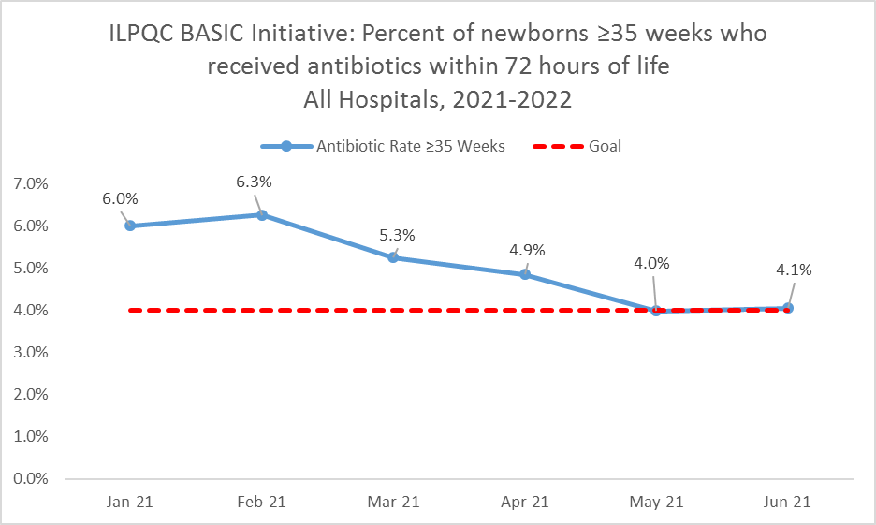
Outcome Measure:
Antibiotic Prescribing Rate
Notes:
Somewhere we need a quick, but nice slide that is a reminder that all positive blood cultures should be reported to APORS. Can we find out exactly what should be reported? -JJ
Dan, do you know how to find this information? - Ellie

Slide 23
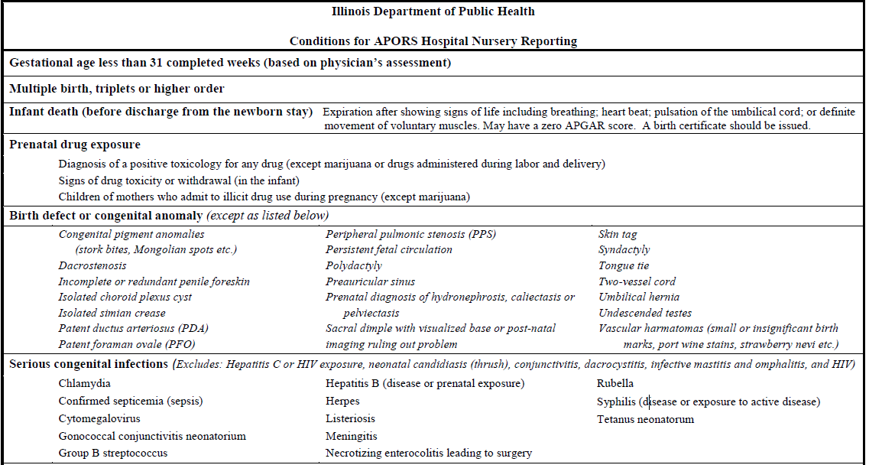
Reporting Confirmed Septicemia to
APORS

Slide 24
BASIC QI Support
ILPQC provides quarterly QI support to participating hospital teams
Upcoming QI support will focus on…
  Assisting with complete data entry
    Baseline – current
  Supporting progress and movement to GREEN on key structure measures that correlate to the topics from our monthly webinars

Slide 25
BASIC Key Drivers:
What We’ve Worked On
Driver 1: Data monitoring, transparency, and stewardship infrastructure
Driver 2: Timely and Appropriate Initiation of Antibiotics
Driver 3: Appropriate Administration and De-escalation of antibiotics
  Understand microbiology lab workflow & blood culture results communication
  Reevaluate antibiotic appropriateness (antibiotic discussion/time out)
  Implement antibiotic stop time
  Disseminate culture negative sepsis education (coming soon)

Slide 26
Driver 4: Equitable Care
Equitable Care Delivery: Building your capacity to identify and eliminate inequities and disparities
Inequities and disparities identification:
  Data availability
  Data reporting
  Data analysis to drive change
  Data presentation to drive change
  Family partnership
Inequities and disparities elimination:
  Standard evidence based best practice
  Identify care variation
  Decrease care variation
  Care delivery in preferred language
  Identification of SDOH needs
  Family partnership
  Physician education
  Nurse education

Slide 27


Why focus on patient-reported race/ethnicity data?
Goal is to collect and use Race, Ethnicity And Language (REAL) data in a meaningful way to understand and address health care disparities
Patient/care-giver self-reporting of REAL data is the gold standard of data collection.
  Staff should not attempt to guess a patient’s race, ethnicity or preferred language
Health care organizations should collect information on patients' race and ethnicity in order to measure disparities in care—-and see if they exist in the organization.
Collecting accurate data helps evaluate the population trends and ensure nondiscrimination on the basis of race and national origin are addressed through a quality of care framework
Organizations that collect accurate data can use this information to ensure they have sufficient language assistance services, to develop appropriate patient education materials, and to track quality indicators and health outcomes for specific groups to inform improvements in quality of care
Source: American Hospital Association, 2013.

Slide 28
Optimizing REAL Data Collection
Four-Step Approach to Ensure Successful REAL Data Collection
1) Determine the appropriate data categories
2) Develop a methodology for data collection
3) Train staff members on methodology for data collection
4) Assign accountability and monitor progress of data collection efforts
Source: American Hospital Association, 2013.

Slide 29
Optimizing REAL Data Collection
Step 1: Determine the appropriate data categories:
Race
  Black
  White
  Asian
  Other
  Unknown/declined
Ethnicity
  Hispanic
  Non-Hispanic
  Unknown/decline
Notes:
Is this from BE too? JJ
Where are they going to put this data? JJ
- This is how we ask the question on the BASIC data form - Ellie

Slide 30
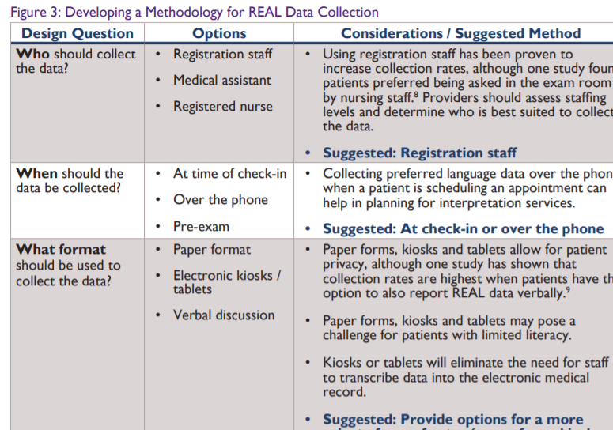
Optimizing REAL
Data Collection
Step 2: Develop a methodology for data collection
Source: American Hospital Association, 2013.

Slide 31
Optimizing REAL
Data Collection
Step 3: Train staff members on methodology for data collection:
Once a methodology for data collection is defined, hospitals and care systems should provide training to appropriate staff members. Training on standardized processes can increase compliance, ensure data integrity and improve patient buy-in.
Source: American Hospital Association, 2013.

Slide 32
Optimizing REAL
Data Collection
Step 4: Assign accountability and monitor progress of data collection efforts:
Hospital leadership should assign accountability and monitor data collection efforts to ensure processes are working as planned. For example, registration staff can be held accountable for achieving certain metrics against a baseline, such as a decrease in the number of patients reported as “unknown” for race or ethnicity. Leveraging existing processes can save time and resources
Source: American Hospital Association, 2013.

Slide 33
Sample Language to Request Patient Race and Ethnicity Data
Sample 1: “We want to make sure all patients are getting the best care possible, can you tell us what you consider you baby’s race, ethnicity, and your preferred language?”
(Adapted from ILPQC Focus Groups)
Sample 2: “<Insert hospital name> is committed to giving you and all of our patients the best care possible. In order to do this we ask you to tell us how you would describe your baby’s race, ethnicity and your preferred language. If you would like to tell us your country of origin, we would be interested in that, too.”
(Adapted from Health Partners)
Sample 3: "We want to make sure that all our patients get the best care possible. We would like you to tell us your baby’s racial/ethnic background so that we can review the treatment that all patients receive and make sure that everyone gets the highest quality of care.“
(Adapted from American Hospital Association)
Use PDSA cycles to test out a few versions to find the language that best fits your institution and patients' preferences.

Slide 34
Key Considerations for
Team Discussion
Determine who will ask the questions and collect the parental/caregiver self-report newborn’s race & ethnicity (e.g. 1 birth certificate local coordinator, staff nurse, etc.)
  Discuss considerations regarding infant transports, infants discharged with incomplete birth certificate
Determine where they will be able to document the information until EMR edits are made
  Start process of EMR integration to allow for streamlined data collection and documentation
These strategies can be done as small tests of change (Plan-Do-Study-Act Cycles) to determine the best possible fit for your hospital!

Slide 35

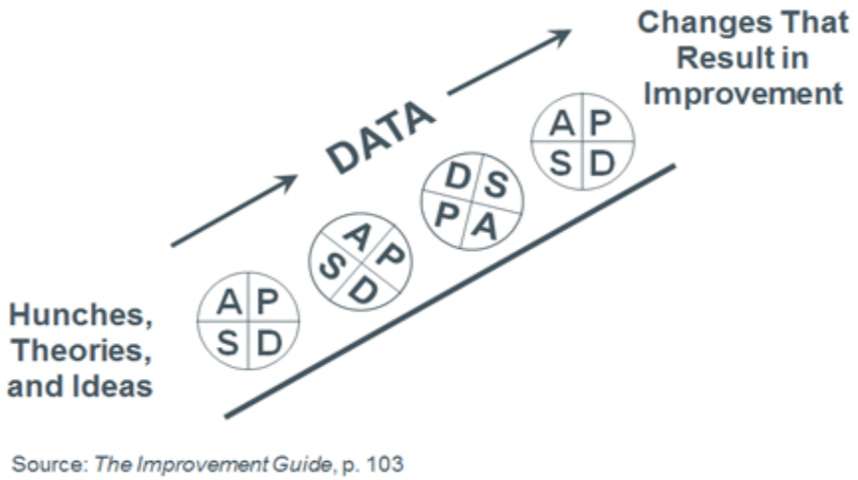
Small tests of change
Try the R/E script tool with 1 birth certificate local coordinator, 1 patient for the entire shift
Repeat as needed
Collect data & insights
Try the R/E script tool with 1 birth certificate local coordinator, 1 patient on night shift
Collect data & insights
Try the R/E script tool with 1 birth certificate local coordinator, 1 patient on day shift
Ask, Don’t Assume:
The baby’s race & ethnicity may not be the same as what is listed the birthing person’s chart

Slide 36
Addressing Concerns from
Patients regarding race/ethnicity
We have found that when you explain why you are asking people to report their race/ethnicity/sex/primary language/disability status and do so in a nonthreatening and polite manner, resistance to providing this information is minimized. There may be individuals who do not understand the question or do not want to respond to it. It is very important to remember that if someone does not want to answer these questions, simply record "declined" and move on with the registration process.
If people express concern about confidentiality or who will see this information, state the following:
"The only people who see this information are registration staff, administrators for the hospital, and the people involved in quality improvement and oversight, and the confidentiality of what you say is protected by law."
Source: American Hospital Association, 2021

Slide 37
Resources for Buy-in
VI. Utilize Race and Ethnicity Medical Record and Quality Data
  a. Improve patient-reported race/ethnicity data collection for EMR
    HPOE - Reducing health care disparities: collection and use of race, ethnicity and language data
    AHA: How to Ask the Questions Regarding Race/Ethnicity
    AHA: Staff Training and Scripts Examples
    AHA: Optimizing Real Data Collection
    AHA: Develop a Methodology for Data Collection
    ILPQC: Process Flow for Race & Ethnicity Data Collection with Staff Responses
  b. Resources to assist review of hospital maternal health quality data by race, ethnicity, and Medicaid status
    HRET: Framework for Stratifying Race, Ethnicity, and Language Data
    ILPQC: Hospital tip sheet and resource overview for developing a process to review maternal health quality data stratified by race/ethnicity and Medicaid status
Notes:
I am finishing updating the Resources and will update this slide - Ellie

Slide 38
QI Corner
Accessing your BASIC Reports & PSDA for Patient Education Rollout
Notes:
Autumn to insert QI Corner

Slide 39
Accessing BASIC Data Reports
Did you know you have real-time data reports available in REDCap?
  % of newborns ≥35 weeks who received abx within 72 hrs of life
  % of newborns <35 weeks who received abxs within 72 hrs of life
  % of newborns ≥35 with a risk assessment tool used and documented to evaluate risk for EOS
  % of Newborns <35 with the AAP recommended risk assessment algorithm used and documented to evaluate risk of EOS
  % of parent/families of all newborns provided education on abx, early onset sepsis, and treatment plan for newborn abx and EOS
  % of all newborns receiving abx with documentation of the maternal risk factors for neonatal EOS in the pediatric medical chart
  % of all newborns receiving abx with documentation of the maternal risk factors for neonatal EOS in the pediatric medical chart
  % of all newborns receiving abx with the anticipated duration of abx course discussed by the clinical team
  % of all newborns receiving abx with an abx automatic stop time order entered into the medical chart
  % of Newborns ≥35 with any abx continued past 48 hrs from a negative blood culture result
  % of Newborns <35 with any abx continued past 48 hrs from a negative blood culture result

Slide 40
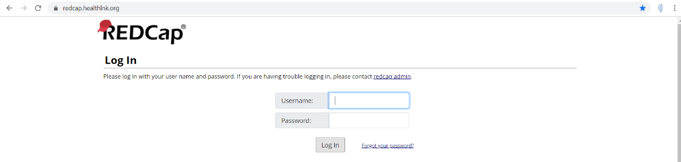
How to Access Reports
Log into REDCap (https://www.redcap.healthlnk.org)
Don’t have access, email DWeiss@northshore.org!
Notes:
I would include 3-4 slides that walks them through step by step with the layout that you can see.
Done-Ellie

Slide 41
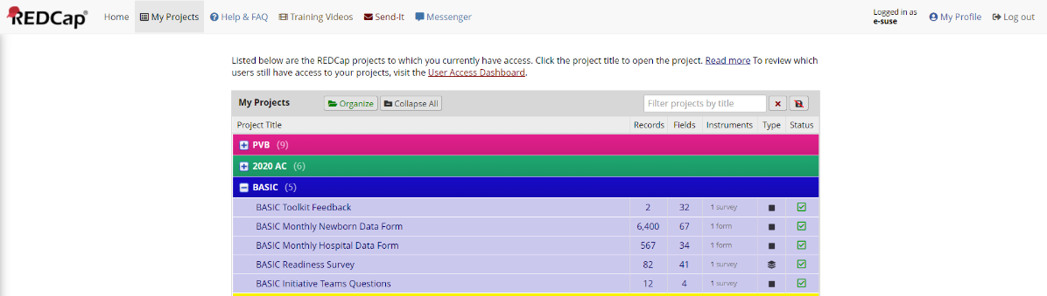
How to Access Reports
Click “BASIC Monthly Newborn Data Form” and “BASIC Monthly Hospital Data Form” under “My Projects”
Notes:
I would include 3-4 slides that walks them through step by step with the layout that you can see.

Slide 42
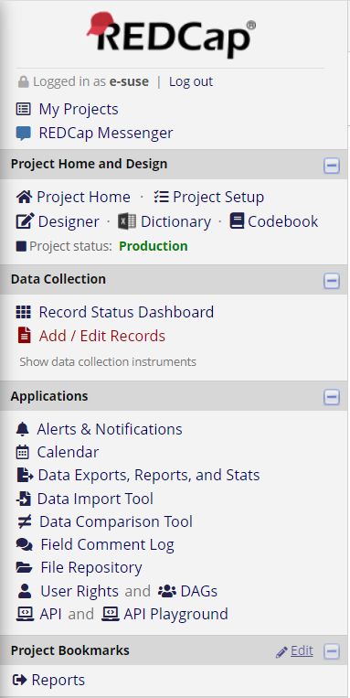
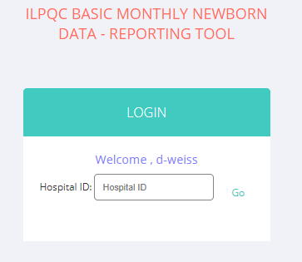
How to Access Reports
Type your hospital 3-digit ID into the webpage to access your reports!
Email Dweiss@northshore.org if you don’t know your ID
Click “Reports” under project bookmarks on left side of webpage- opens a new webpage
Notes:
I would include 3-4 slides that walks them through step by step with the layout that you can see.

Slide 43
Using your data reports
Review your reports during your monthly QI team meetings to guide your improvement efforts so you can…
  Understand the current status of your work
  Assess whether the changes are leading to improvement
  Discover key information to help guide future work
Things to ask during your review…
  What trends are we seeing?
  What is meaningful about this data and why does it matter?
  Knowing this, what should we focus on next?

Slide 44

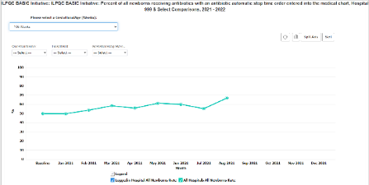
Example:
Successes
  Percent of all newborns receiving antibiotics with an antibiotic automatic stop time order entered into the medical chart
Opportunities
  Standardized Patient Education

Slide 45
BASIC Education Resources
Rollout Suggestions
Connect with OB colleagues to share new resources
Draft the current process flow for abx pt education materials
Discuss and determine where new ed materials could fit in process flow
Create and implement PDSA cycle for feedback
Adapt, adopt or abandon based on PDSA cycle
Finalize the education process flow
Large roll-out of new materials

Slide 46
Example:
Act
PLAN
Do
Study
QI team met with the pediatrician & realized they need to adapt the current process for documentation
QI team reviews patient education resources and create draft process flow for new material
Patient provided feedback about the video and the new chorio worksheet
Implemented new pt education process flow with 1 pediatrician & 1 patient
Plan to implement patient education
  Team decided that peds would provide education material during the treatment discussion plan
  After the 1st PDSA cycle the team discovered:
    Need to identify pathway for documentation
    Need to work with OB team to complete 1 PDSA

Slide 47
Connect with OB colleagues to share new resources
Draft the current process flow for abx pt education materials
Discuss and determine where new ed materials could fit in process flow
Create and implement PDSA cycle for feedback
Adapt, adopt or abandon based on PDSA cycle
Finalize the education process flow
Large roll-out of new materials
Summary of lessons learned…
Team discovered that it was a patient satisfier and worked well to have the RN provide the resource to patient to assist with QR code troubleshooting
After 1st round, the team decided that education resources could be provided by RN and documented in flow sheets for tracking

Slide 48
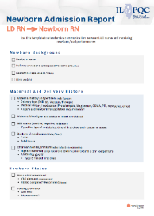
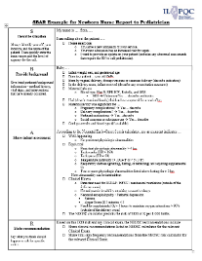
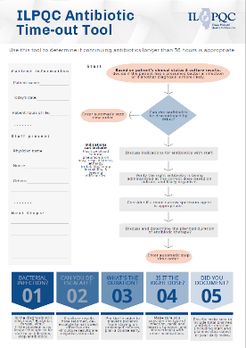
Summer BASIC Resources
Newborn Admission Report (LD RN to Newborn RN) May 2021; Use this template to standardize communication between L&D nurse and receiving newborn/postpartum nurse
Newborn Nurse to Pediatrician Communication Tool: Use this template to standardize communication between the newborn/postpartum nurse to the pediatrician on newborn status
ILPQC Antibiotic Time-Out Tool- use the tool to determine if continuing antibiotics longer than 36 hours is appropriate
48

Slide 49


BASIC Family Education Resources
Antibiotics & Your Baby Education Video
  This education video can be shared with families/caregivers after delivery, on admission to postpartum floor/newborn nursery/NICU for newborns who have received antibiotics
  English Video: https://www.youtube.com/watch?v=c0an_TmVe6o&pp=sAQA
  oSpanish Video: https://www.youtube.com/watch?v=sWHd2P91Fy0&pp=sAQA
Understanding Chorioamnionitis (Coming August 2021)
  This flyer can be given to patients on admission to L&D to provide important information about Chorioamnionitis
Antibiotics & Your Baby Accompanying Flyer (Coming August 2021)
  This flyer can be given to families/caregivers to supplement the education video

Slide 50
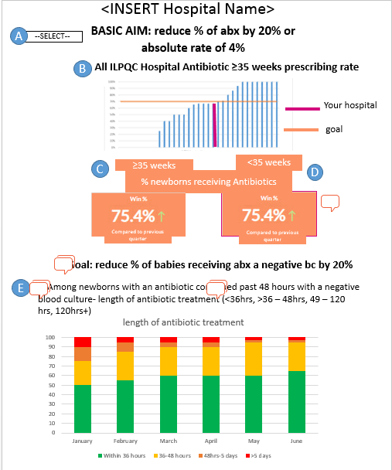
BASIC QI Strategies Resources
BASIC Dashboard for your monthly QI meetings coming September 2021
BASIC Grand Rounds- reach out to info@ilpqc.org for scheduling, teams are already signing up!
Coming SOON
DRAFT!!!
50

Slide 51
Team Talk
Rita Allen Brennan, DNP, RNC-NIC, APRN, CNS, CPHQ
Outcomes Manager, Women’s & Children’s Services
Northwestern Medicine Central DuPage Hospital

Slide 52
Baby’s Antibiotic Stewardship Improvement Collaborative (BASIC)
Central DuPage Hospital
Rita Allen Brennan, DNP, RNC-NIC, APRN, CPHQ

Slide 53
BASIC- Initial Identification
Report for first time antibiotic administration
  DOB
  Medication
  Date/time of administration
  Determine if meet criteria
Blood culture report
  Newborns who had culture done
  Date/time drawn
  Result
If you have transports into your hospital- check for transports in the 1st 72 hrs. life.
  Meet criteria?
  Received antibiotics?

Slide 54
BASIC
Maternal data-Sources for data (inborn)
EMR delivery record -data used from report for maternal data
    Maternal MRN, Name, GA at birth, date & time delivery, delivery method, ROM length of time
    Newborn MRN, Name, BW, Newborn sex
    GBS status
    Antibiotics
Face sheet
    Demographics- insurance & zip code
Flowsheet- maternal temperature
Labor/ chorioamnionitis – manual chart review (progress/delivery note)

Slide 55
BASIC
Newborn Data
Race & ethnicity- birth certificate (mother completes worksheet).
  The birth certificate clerk uses a worksheet that includes race/ethnicity and asks the patient the question.
  Mother chooses race and ethnicity.
  Sometime declines to answer or says other.
  If translator needed, language line is used.
  Example scenario: mother state they are “other” race and add Hispanic and then also choose Hispanic for ethnicity.

Slide 56
BASIC
Newborn Data
Risk factors/ EOS score – H&P or progress notes
Antibiotic information- MAR
Duration of antibiotics discussed with clinical team ????
Antibiotic automatic stop time- orders
Rational for starting/continuing antibiotics- H&P or progress notes
Parent education- progress notes Physician/ Nursing or Pharmacist education???

Slide 57
BASIC
Tips & Trials
Issues: Incomplete documentation, report not consistent with documentation, does not capture newborns transported into hospital
Question along the way…
  When entering data we had questions that came up
Conclusions thus far
  Clear definitions needed; staff and provider education on definitions
  Accurate and complete documentation needed
Interested in hearing your experiences!

Slide 58
BASIC
Use of data
How are you using race/ethnicity data for quality improvement?
Potential ideas:
  Stratify outcomes by race/ethnicity
  % of newborns who receive antibiotics by race and ethnicity/all newborns born
Broader implications for SDH of health data

Slide 59
Questions?

Slide 60
Next Steps
Get ready for the 2021 Annual Conference
  Save the date 10/28/2021
  Be on the lookout for the AC Teams survey launching 9/1/2021
  Discuss with your team what initiatives you’ll submit for the call for abstracts
  Connect with your team to submit data & structure measure progress for BASIC Recognition
Review the new ILPQC resources in the BASIC toolkit and look for opportunities for integration
Review your team’s current process for collecting parental/caregiver self-report of newborn’s race & ethnicity- implement small tests of change to improve processes and collection

Slide 61
REMINDER
BASIC Monthly Webinar
BASIC Monthly Webinars will now be held from 2-3 PM on the 3rd Monday of the Month starting on the September 20, 2021 call

Slide 62










Thanks to our Funders
In kind support:

