Slide 1
Second Stage
Push it real good

Slide 2
Session Outline
ACOG/SMFM/ACNM/AWHONN Recommendations/data on second stage and demonstrate relationship between fetal position/maternal pelvis and maternal pushing positions
Evidence for second stage management
Appropriate second stage positions for specific clinical presentations and review techniques for rotating a baby in second stage
Practice supporting the patient in different positions with and without epidural
Practice scenarios (patient care communication and nurse-provider communication)
Patient and Family Education on 2nd stage

Slide 3
Organization Recommendations

Slide 4
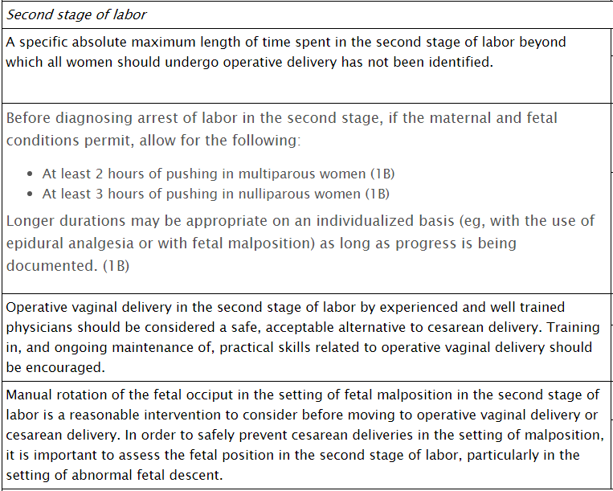

Slide 7
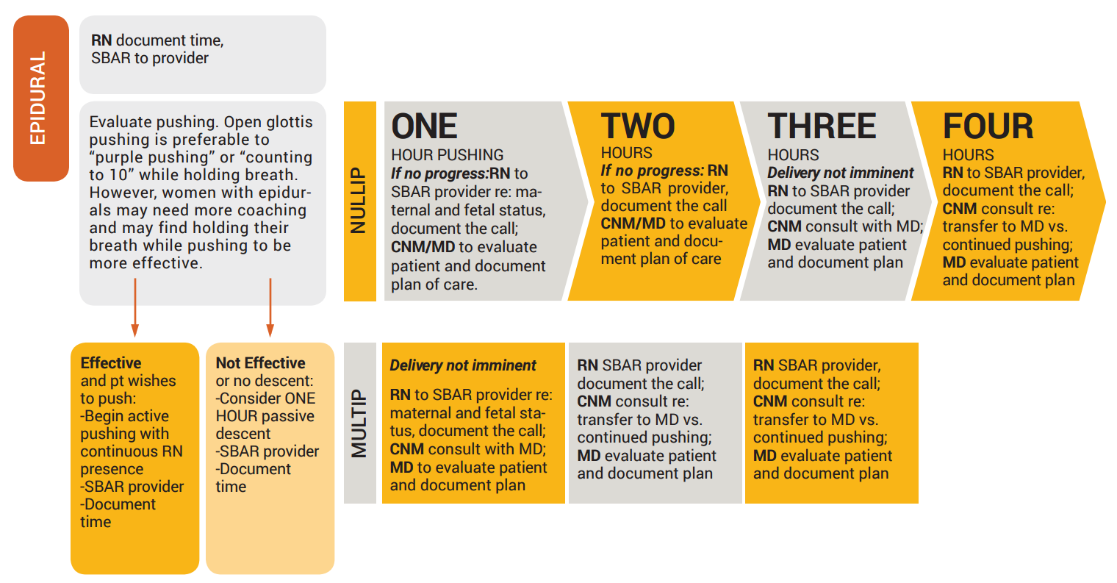
Epidural

Slide 8
CMQCC Labor Dystocia Checklist

Slide 9
Delayed Pushing / Laboring Down / Passive Descent

Slide 10
Delayed Pushing Laboring Down
Delayed pushing is a period of rest between full dilation and the active urge to bear down.
Facilitates passive descent and rotation.
Has previously been recommended by ACOG, ACNM and AWHONN.

Slide 12
Is Laboring Down for Everyone?
October 2018 Cahill et al.
RCT comparing immediate versus delayed pushing (1 hour)
N= 2414 nulliparous women at term with an epidural

Slide 13
No difference were found in:
Rate of spontaneous vaginal delivery.
In sub analyses, the spontaneous delivery rate was not affected by fetal station, position of the vertex, or study site.
Rate of operative vaginal delivery
Rate of Cesarean sections
Composite outcome of neonatal morbidity (7.3% immediate vs 8.9% delayed; RR, 0.8; 95% CI, 0.6 to 1.1). Variables in this composite outcome included neonatal death, birth injury, umbilical cord arterial pH < 7.1, respiratory distress, transient tachypnea, meconium aspiration with pulmonary hypertension, hypoxic- ischemic encephalopathy, hypoglycemia, hypothermia treatment, or suspected neonatal sepsis.

Slide 14
Immediate pushing group
Lower rates of chorioamnionitis (6.7% vs. 9.1%; RR, 0.7; 95% CI 0.6 – 0.9; P=0.005)
Lower rates of postpartum hemorrhage (2.3% vs. 4.0%; RR, 0.6; 95% CI 0.3 – 0.9; P=0.03)
Shorter second stage (102.4 vs 134.2 minutes; P<0.001)
Longer mean duration of pushing (83.7 vs 74.5 minutes; P=0.005)
Increased 3rd or 4th degree lacerations (5.7% vs. 4.6% respectively; P=0.01)
Lower rate of neonatal acidemia (0.8% vs. 1.2%; RR, 0.7; 95% CI, 0.6 – 0.9; P=0.01).

Slide 15
What now?
ACOG released a Practice Advisory that recommends that women begin pushing once cervical dilation is complete.
ACNM endorses this Practice Advisory but acknowledges that more research is needed and that this is not a recommendation for a new standard of care and cannot replace individual clinical judgment.

Slide 16
THE EVIDENCE

Slide 17
Changing Positions Is Best Practice
For women without an epidural, pushing in an upright position is associated with a decrease in the risk of episiotomies, vacuum and forceps-assisted deliveries, and fetal heart rate abnormalities, an increase in the risk of second-degree tears, and a possible increase in the risk of having blood loss more than 500 mL
Women with epidurals who push in upright positions may experience a shortened labor and pushing phase. More evidence is needed to evaluate pushing positions in women with traditional (non-walking) epidurals

Slide 18
Non-Supine Positions
Standing, kneeling, and squatting take advantage of gravity to help the baby move down into the pelvis.
Additionally, squatting increases the size of the pelvis (Johnson, 1991; Ancheta, 2011), providing more room for the baby to maneuver and descend.
Birthing in the side-lying position has been shown to reduce perineal tearing by allowing the presenting part to descend more slowly (Shorten, 2002).

Slide 19
Non-Supine Positions
Like squatting and standing, the dimensions of the pelvis can be maximized by the hands-and-knees position that is often used to relieve the back pain that may occur when the infant remains in a persistent occiput posterior presentation (Stremler, 2005).
Throughout the course of labor, including the second stage, women benefit from frequent position changes and ideally, should be free to select or reject them at will

Slide 20
Which type of pushing do you encourage your patients to do?
Open Glottis
Closed Glottis
Push when you feel the urge to bear down and don’t hold your breath
Hold your breath and pushing for as long as it takes to count to 10

Slide 21
Non-Directed Pushing
Research does not support the widespread practice of directed pushing, which has been shown to stress the maternal cardiovascular system, reduce circulating oxygen, and trigger changes in the fetal heart rate.
Women who are encouraged to push in coordination with a self-perceived urge consistently limit efforts to short bursts of 5 to 7 seconds and often grunt, groan, or moan, releasing air through an open glottis. This practice improves oxygenation through synchronized efforts of the uterus and respiratory systems (Osborne, 2014).

Slide 22
Non-Directed Pushing
Directed, forceful pushing had the potential to increase pressure on the baby and the umbilical cord, and the tissues of the perineum, resulting in more tears and a weaker pelvic floor musculature which can result in urinary incontinence (Goer and Romano 2012)
One study (Bloom, 2006) showed that directed pushing shortened the second stage of labor by an average of 13 minutes, which is not considered a significant difference.
Open-Glottis pushing results in better maternal-fetal circulation, less maternal fatigue, and less chance of bladder, pelvis floor, and perineal damage (CMQCC)

Slide 25
How to Do Open Glottis Pushing
A health care provider and/or support person is there to encourage you to trust your body and support you as you push.
You push when you feel the urge to bear down or when you feel like having a bowel movement.
Most women take several breaths between pushes.
You probably will push for about 5 seconds 3-5 times during each contraction.
You may grunt or make a deep noise when you are pushing. Th is is a sign that you are pushing well.

Slide 26
Supporting the Patient in 2nd Stage

Slide 27
Change Positions
Changing pushing positions at least every 15-20 minutes allows for optimal fetal descent into the pelvis.
Position changes during pushing are essential if the patient is pushing but not making progress.

Slide 28
Lithotomy and semi-­‐reclined positions with legs pulled back may decrease comfort/coping in the 2nd stage, may prevent fetal descent, and denies the benefit of gravity.
Use upright, forward-leaning, and/or squatting positions as much as possible (based on what feels comfortable to woman at that time)

Slide 29
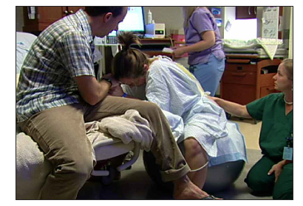
Pushing without an Epidural
Squatting (with or without the bar)
Sitting or Semi-seated (with or without tug-o-war)

Slide 30
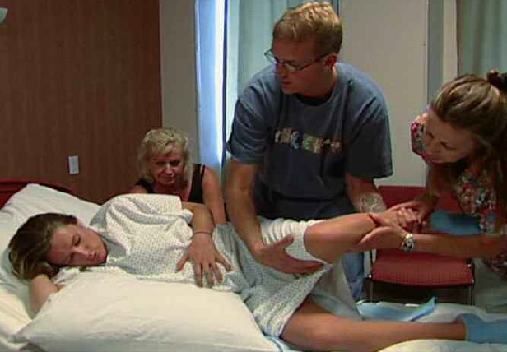
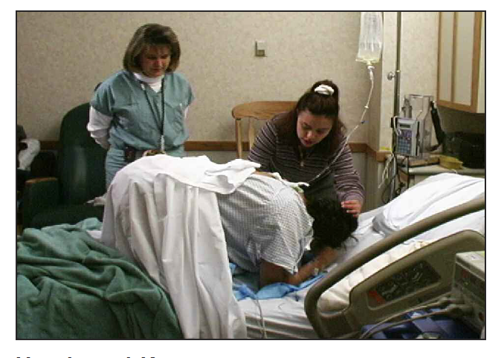
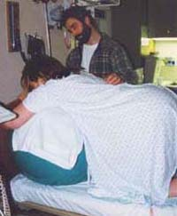
Positions without an Epidural
Side-lying
Hands-and-knees
Standing

Slide 31
Pushing with an Epidural
Side-lying, supine, semi-sitting, supported squat, tug-o-war, full lithotomy

Slide 32
Inlet Openers: When the head is high
Walchers Technique
Flying Cow-person
https://www.youtube.com/watch?v=JuvGhVyHJTk

Slide 33
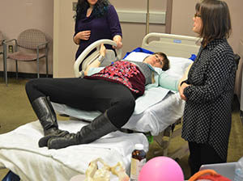
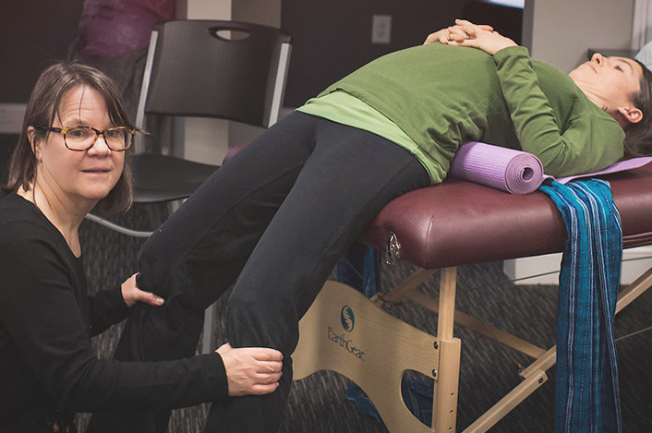
Walcher’s Technique
Can be use during the late first stage or second stage when the baby remains high.
May open the inlet up to 1cm.
Usually effective within 3 contractions.

Slide 34
Close Knees Pushing
https://www.youtube.com/watch?v=sw8wR-2LRgo

Slide 35
The laboring woman’s legs hang off the bed into the air. The legs are NOT supported. The weight of the hanging legs pulls the pelvis open more at the inlet. The edge of the bed is at the lower border of the buttocks.
Keep close eye contact with her face and speak soothingly to her through the approximately 15 minutes that it takes for 3 contractions to come and go.
The mother lays back like that, almost a backbend, through three contractions. She remains there in between the contractions, too.

Slide 36
Rotating a Baby in Second Stage

Slide 37
Epidurals and Malposition
While there is no evidence that epidurals cause malposition, women with epidurals are up to 4 times more likely to have an OP fetus than women without an epidural.
Women with OP fetus are 2 - 6 times more likely to have a cesarean.
Avoid malposition:
avoid routine early amniotomy
position changes in 1st and 2nd stage every 20 minutes

Slide 41
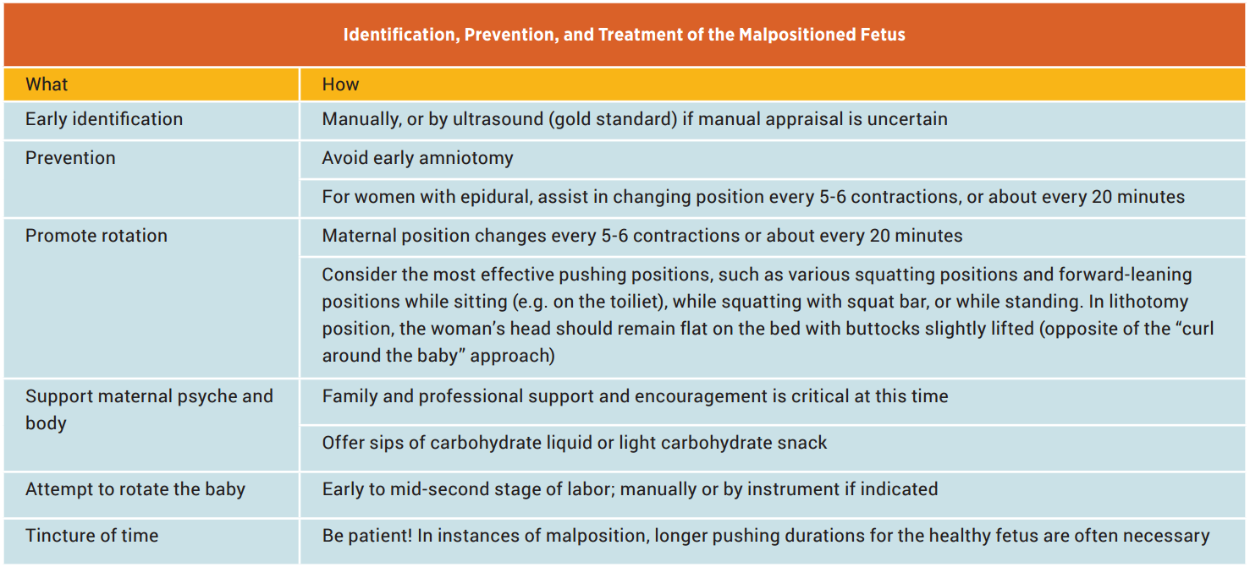

Slide 42
Practice Scenario

Slide 43
Maggie is a G1P0 at 39w3d. She was admitted for labor at 5/70/-2 with SROM two hours ago (clear fluid). She complained of significant lower back pain, and received an epidural with good relief. You suspect an LOP presentation. She was started on Pitocin after the epidural, and is now 10/100/-1. FHTs are Cat 1. UC's q3-4m. Maggie feels some rectal pressure but not a strong urge to push.
Notes:
Begin the conversation by asking the RN to notify MD of second stage.
Utilize SBAR to advocate for appropriate patient care.
Request non-role playing learner to demonstrate fetal position in maternal pelvis utilizing manequins.
What interventions could you do to help facilitate the descent of the fetus?
Empty Bladder
Position Changes – discuss appropriate maternal positions to facilitate rotation of fetal presenting part.
Continue/titrate oxytocin PRN
Consider epidural bolus
How often should you change patient positions?
every 30 minutes
How long should you allow for passive descent of the fetus?
No longer than 2 hours

Slide 44
It’s 1 hour later and Maggie now states that she feels the urge to push. SVE is 10/100/0 and position is LOT.
Notes:
Request RN 3 learner to demonstrate fetal position in maternal pelvis utilizing manikins.
What position is appropriate for Maggie now?
Consider hands and knees position to facilitate rotation to LOA.
What is the next plan for patient care?
Continue with interventions as above.

Slide 45
Maggie’s SVE is 10/100/+1, fetal position is LOA. The MD calls and has dinner plans and is wondering why she is taking so long.
Notes:
Request non-role playing learner to demonstrate fetal position in maternal pelvis utilizing manikins.
Ask RN to role play conversation with MD regarding Maggie’s progress.
Utilize SBAR to advocate for appropriate patient care.
Value of patient in patient care outcomes.
You start pushing with Maggie, she c/o being tired. What pushing positions might be most useful now?
Assist patient with assuming different position changes in bed.
Birth bed bar or other supported positions
How often should we change our patient's position during the pushing phase?
at least every 30 minutes (8-10 UC’s)

Slide 46
Maggie pushes for 90 mins and delivers a baby boy. :)

Slide 47
Patient and Family Education

Slide 48
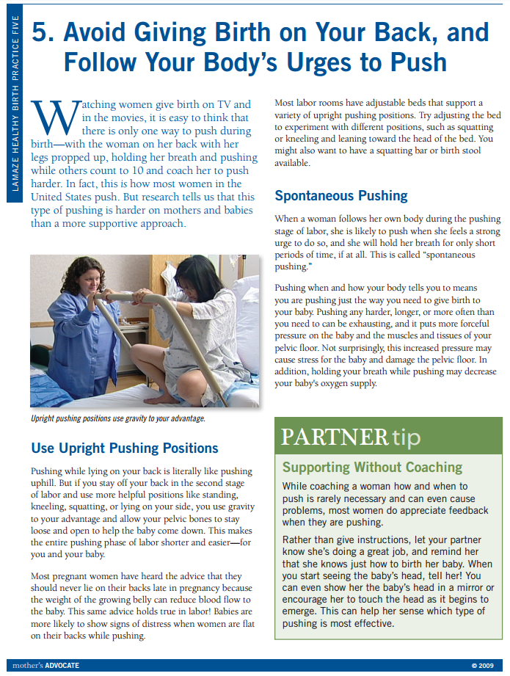
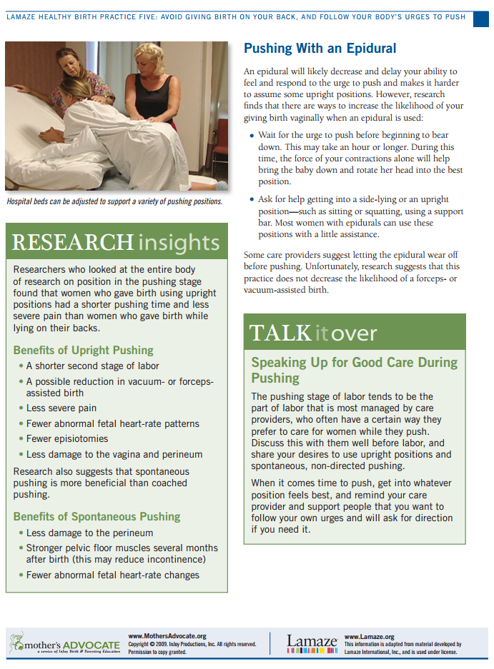
MothersAdvocate.org

Slide 49
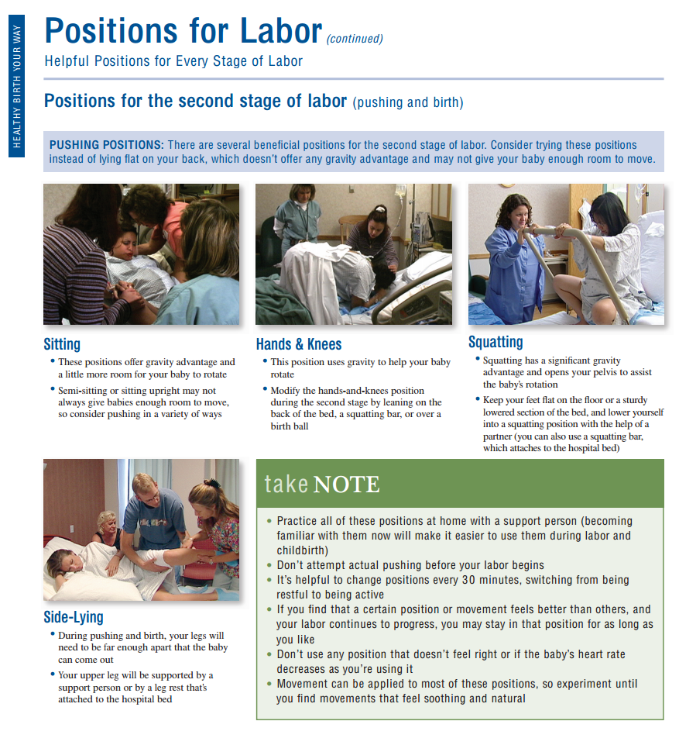

Slide 50
Videos
Second Stage Positions Video on YouTube
Positions for Pushing, Natural - https://youtu.be/r2al2WtHJ_0
Positions for Pushing, Epidural - https://youtu.be/tn8H5JV3lec
Lamaze: Get Upright and Follow your Body’s Urges to Push
http://mothersadvocate.org/videos.pushing.html

Slide 51
Take Home Points
Recommended longer pushing time than previously practiced
Try open glottis pushing, especially with non-epidural patients
All patients can change position while pushing to help with fetal descent and rotation

