Slide 1

PVB Monthly Webinar: Unpacking your Labor Culture Survey Results
June 28, 2021 12:30-1:30

Slide 2

Introductions
Please enter for yourself and all those in the room with you viewing the webinar into the chat box your:
  Name
  Role
  Institution
If you are only on the phone line, please be sure to let us know so we can note your attendance

Slide 3
Overview: Unpacking your Labor Culture Survey
Face-to-Face 2021 Recap
PVB Data Review
Dr. Emily White VanGompel: Labor Culture Survey Results
Team Talk: Michaela Crotty, MSN, RNC-OB
NorthShore Swedish Hospital
PVB Next Steps
PVB Office Hours
  Join us after the call to ask any questions you may have
Notes:
Ellie to add in talk title

Slide 4
ILPQC Face to Face Recap
Share your thoughts and comments about the meeting!

Slide 5



To obtain your AMA PRA Category 1 Credits™ certificate
www.cme.northwestern.edu
*NOTE* Credits must be claimed by June 30th, 2021
Email to follow at the conclusion of the OB meeting
In order to obtain your AMA PRA Category 1 Credit(s)™, at the completion of this activity please follow these steps:
Sign in to Northwestern University Feinberg School of Medicine’s Office of CME website: www.cme.northwestern.edu
using the email and password used to register for this activity.
After logging into Cloud CME, go to My CME and click on Evaluations & Certificates. You will see the activity ILPQC OB & Neonatal Face-to-Face Meeting listed. Click on "Complete Evaluation.
Once you complete the evaluation form, your certificate will auto-generate. Please print a copy for your records. A copy of your credits will be saved on your transcript that can be found under “My CME” then click “Transcript.”
For additional questions or assistance, please email cme@northwestern.edu
Illinois Perinatal Quality Collaborative
5

Slide 6

Face-to-Face Debrief
ILPQC Virtual Face-to-Face Recap
  By the numbers:
    503 providers, nurses, allied health professionals, public health professionals and more attended the online meeting- record attendance!
    3 national speakers participated in the conference speaking to topics including Birth Equity, Illinois Maternal Mortality, Patient/Family Advisors Strategies, and other state perinatal quality collaborative work.
    37 ILPQC hospital teams submitted storyboards
    64 ILPQC hospital teams won PVB Outstanding Launch Award
    4 ILPQC hospital teams achieved the MNO-OB QI Award of Excellence in Optimal OUD Care (adding to the 11 teams who have already won this award)
6

Slide 7
Post Face-to-Face Information
ILPQC will have recordings from the Face-to-Face Meeting available by the end of June, all slides available here
  Linked here: https://ilpqc.org/ilpqc-2021-virtual-ob-face-to-face/
  Password: OBF2F21
Don’t forget to complete the evaluation to receive CMEs credit, if you attended the conference and are still interested
  Linked Here: www.cme.northwestern.edu
Storyboards are still available on the conference webpage as well
  Linked here: https://ilpqc.org/ilpqc-2021-virtual-ob-face-to-face/
7

Slide 8
PVB Data Review

Slide 9
Supporting vaginal birth and reducing primary Cesareans for optimal maternal and neonatal outcomes
Aim: 70% of participating hospitals will be at or below the Healthy People goal of 24.7% cesarean delivery rate among NTSV births by December 31, 2022
Goal: Increase the percent of cesarean section deliveries among NTSV births that meet ACOG/SMFM criteria for cesarean
Goal: Increase the % of physicians/ midwives/ nurses educated on ACOG/SMFM criteria for cesarean, labor management strategies/response to labor challenges, protocol for facilitating decision huddles and/or decision debriefs

Slide 10
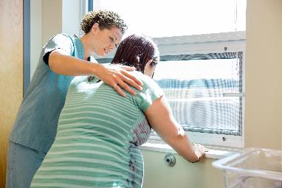
PVB Key Strategies
    Identifying NTSVs
    Education of ACOG/SMFM criteria for providers and nurses
    Implementing cesarean decision checklists and huddles with patient centered decision making
    Labor management support
    Develop standardized processes/protocols for induction, early labor and labor challenges

Slide 11
ILPQC Hospital Team
Data Submission (95 Teams Total)
Month | Teams Reporting Patient Data | Teams Reporting Hospital Data
Baseline (Q4 2019) | 89 | 85
January 2021 | 82 | 74
February 2021 | 81 | 73
March 2021 | 81 | 73
April 2021 | 72 | 63
May 2021 | 61 | 50
Use your hospital data form as a QI team meeting roadmap to guide your efforts. Please contact us if you need help getting started with reviewing and entering your data.
If hospital data is not submitted for a given month you will not have access team’s NTSV C-Section rate over time.

Slide 12
ILPQC NTSV C-Section Rates
Goal: < 24.7%

Slide 13
NTSV C-Section Rates, by hospital
55% of teams at or above goal in May 2021
Goal: < 24.7%
All ILPQC Average: 24%

Slide 14
NTSV C-sections meeting
ACOG/SMFM Criteria, across hospitals
Goal: >80%

Slide 15
Sharing Provider Level Data

Slide 16
Provider and Nurse Education

Slide 17
Standard protocols and processes

Slide 18
Cesarean Decision Checklist

Slide 19
Decision Huddles/Debriefs

Slide 20
Shared Decision Making

Slide 21
Standardized Patient Education

Slide 22
EMR Integration

Slide 23
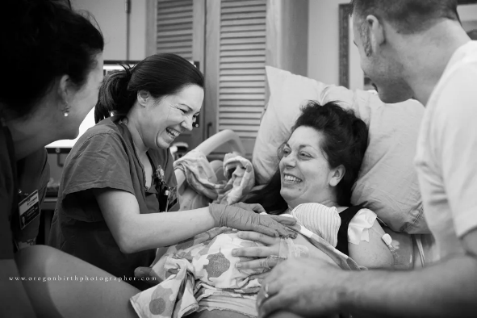
Promoting Vaginal Birth (PVB)
Key Strategies
Optimizing Labor Management and support
Protocols and Guidelines for Induction and Labor Decision Making
Provider, Nurse, Patient Education to support clinical culture change

Slide 24
Labor Culture Survey
Individual Attitudes
Unit Subjective Norms
Clinical Culture
The Labor Culture Survey is an opportunity to gain a deeper understanding of your current L&D culture and inform your PVB work
A tool to understand an individual hospital’s existing culture in regards to supporting vaginal birth

Slide 25
Labor Culture Survey
Developed in partnership with CMQCC, used in both California and Michigan birthing hospitals
Gives hospitals the ability to identify opportunities to influence individual attitudes and unit norms around supporting vaginal birth
Individual Hospital Reports:
  Provide hospitals with specific and actionable areas to target for improvement
Notes:
Across the US, hospital cesarean rates vary tenfold – from 6 to 69%. This variation is not explainable by clinical case-mix or hospital or patient demographics. The evidence continues to point to the hospital at which a woman chooses to give birth as the strongest determinant of whether she delivers vaginally or by cesarean. This NPR article featured an interview with the chief administrator of Covered California, who was discussing the decision to require all birthing hospitals to achieve the HealthyPeople 2020 goal for cesarean delivery rates or lose in-network status for all ACA-based plans. At the time, California’s data was showing some hospitals with NTSV cesarean rates >70%. There have been many similar calls to address culture, but how do you measure culture?

Slide 26
Labor Culture Survey Results:
Individual Hospital Reports to Hospital Liaisons sent Monday June 21st
Next step review results and Culture Change Implementation Guide

Slide 27
Dr. Emily White VanGompel:

Slide 28

Labor Culture Survey in Illinois: Results and Application
June 28th, 2021
Emily White VanGompel, MD, MPH
Notes:
Hospital, name, email, phone number, date , who gave talk and notes

Slide 29
Labor Culture Survey
Developed in partnership with CMQCC, used in both California and Michigan birthing hospitals (and now Louisiana, Iowa, and Illinois)
Gives hospitals the ability to identify opportunities to influence individual attitudes and unit norms around supporting vaginal birth
Individual Hospital Reports:
  Provide hospitals with specific and actionable areas to target for improvement

Slide 30
Labor Culture in Illinois: Participants
54 Hospitals Achieved Target Response Rate of >=30% and including both nurses and physicians
Top Quartile No. of hospitals Percent
22.7% and above 40 74.1
Less than 22.7% 14 25.9
Top Quartile No. of participants Percent
22.7% and above 1689 68.7
Less than 22.7% 768 31.3

Slide 31
Labor Culture in Illinois: Participants

Slide 32
Labor Culture in Illinois: Participants

Slide 33
Labor Culture in Illinois: Overall
When compared to Top Quartile IL Hospitals, our hospitals are:
  Less likely to endorse unit microculture is supportive of vaginal birth (p<.0001)
  Less likely to endorse patient safety culture (p<.001)

Slide 34
Labor Culture in Illinois: Providers (FM/OB/CNM)
Compared to Top Quartile Hospitals, Physicians in IL Hospitals are:
  Less likely to endorse evidence-based strategies to reduce cesarean delivery (p<.016)
  Less likely to endorse unit has a strong patient safety culture (p<.006)

Slide 35
Labor Culture in Illinois: L&D Nurses
Compared to Top Quartile Hospitals, IL Nurses are:
  Less likely to endorse their unit has a microculture supportive of vaginal birth (<.0001)
  Less likely to endorse their unit has a strong patient safety culture (p<.0001)
  LESS likely to endorse personal fears of vaginal birth (p<.04) → surprise!

Slide 36
Labor Culture in Illinois compared with Michigan
Notes:
Unfortunately no places where Illinois started off ahead…but that means more opportunity for growth!

Slide 37

Labor Culture in Illinois compared with Michigan
Compared to Hospitals in Michigan at the Start of their Initiative, IL Hospitals were:
  Less supportive of best practices to reduce cesarean (p<.0001)
  Less likely to endorse their unit microculture is supportive of vaginal birth (p<.001)
  Less likely to endorse importance of maternal role in birth (p<.003)
N=2,457 Clinicians
54 out of 71 Hospitals
Notes:
Unfortunately no places where Illinois started off ahead…but that means more opportunity for growth!

Slide 38
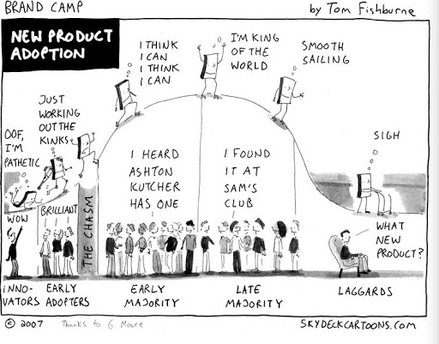
LCS Basics: How to Use it as a Tool to Guide Change
Every hospital is unique, and interpreting and using your results depends on local knowledge.
Main goals:
Uncover uncomfortable truths and bring them out into open discussion
Bring forward voices that are usually not the loudest, but may make up the majority
Identify “low hanging fruit” to target for early wins
Identify where you will have to invest more time in changing attitudes before making protocol/practice changes

Slide 39
LCS Basics: Reading Your Report

Slide 40
LCS Basics: Reading Your Report

Slide 41
LCS Basics: Reading Your Report
Top Quartile = Lowest NTSV Cesarean Rates

Slide 42
LCS Basics: Reading Your Report
Lower is Better!

Slide 43
LCS Basics: Reading Your Report

Slide 44
LCS Basics: Reading Your Report
Look for areas where everyone agrees → A good place to start making immediate changes
Look for areas where everyone is uncomfortable → Put these at the end of your list, because they will be hard
Look for areas where there is a discrepancy between RNs and MDs → Start your interprofessional education and teambuilding activities here

Slide 45
LCS Basics: Use the Implementation Guide
https://www.cmqcc.org/resource/3432/download
Resources are linked to CMQCC Toolkit
Illinois-specific ILPQC Resources can be found here

Slide 46
LCS Basics: Reading Your Report
Look for areas where everyone agrees → A good place to start making immediate changes
Look for areas where everyone is uncomfortable → Put these at the end of your list, because they will be hard
Look for areas where there is a discrepancy between RNs and MDs → Start your interprofessional education and teambuilding activities here

Slide 47
Team Talk: Michaela Crotty, MSN, RNC-OB
NorthShore Swedish Hospital
Notes:
To be added

Slide 48
Data Dashboards

Slide 49
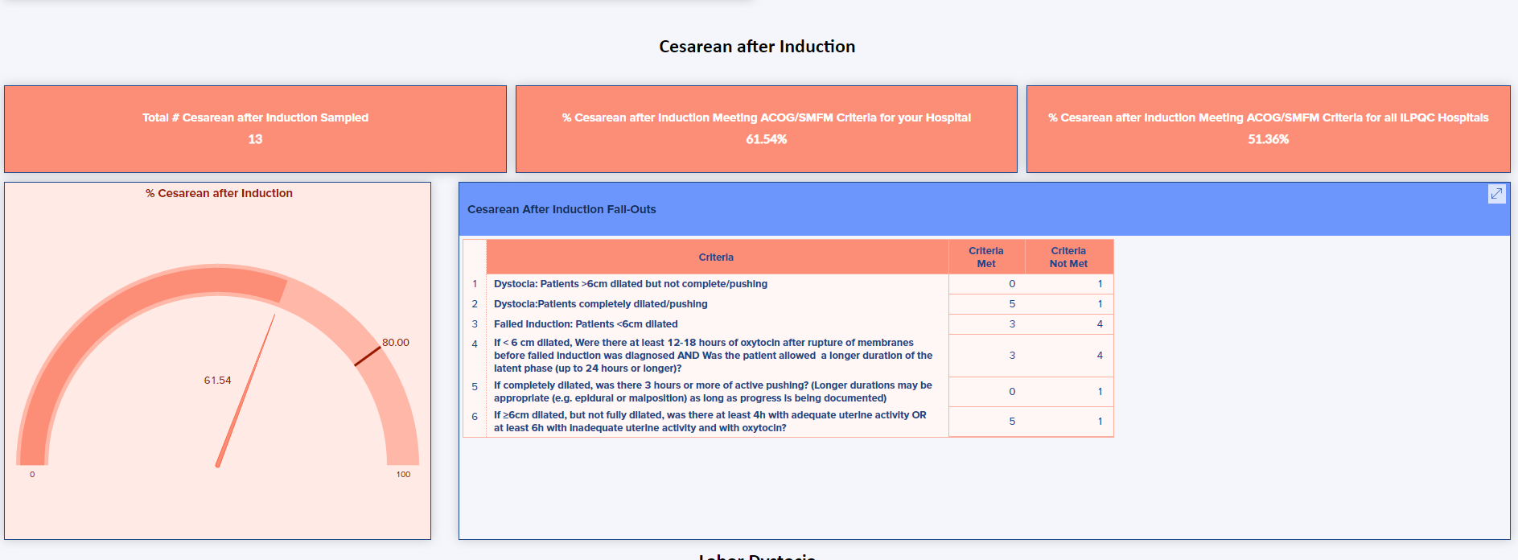

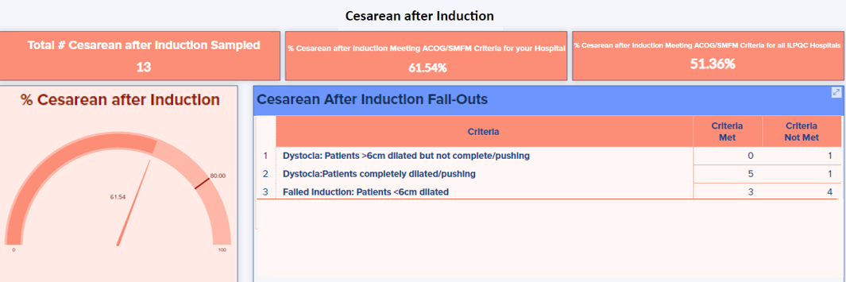



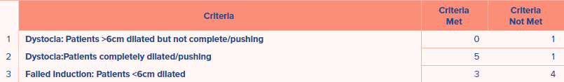
Dashboard Coming Soon!
We are excited to announce that our PVB Dashboard will be ready next month!!
The dashboard will give you a deeper look at your NTSV C-sections as well as allow you to see how your hospital compares to the rest of the state on key measures
Please join us on July 27th at 12:00 a QI Topic call:
Using the PVB Dashboard to Drive Change
Please join us on July 27th at 12:00 a QI Topic call:
Using the PVB Dashboard to Drive Change

Slide 50
Next Steps with PVB

Slide 51
Current Activities for your QI Team
Continue to host and attend your regular QI Team meetings
Review your LCS results with the LCS implementation guide
Determine if a PVB Grand Rounds/OB Provider Meeting to help achieve nurse and physician buy-in
Submit monthly data collection for January-June 2021
Roll-out cesarean decision checklist
Register for Labor Support Classes

Slide 52

PVB Grand Rounds
PVB Grand Rounds help facilitate buy-in and give your providers the opportunity learn more about the initiative
Hear from an expert on the ILPQC Grand Rounds Speaker’s Bureau
Email ellie.suse@northwestern.edu to schedule your grand rounds or OB provider meeting
14 Grand Rounds already scheduled for PVB

Slide 53
ILPQC Labor Support Classes
We are partnering with Jessica Brumley, CNM from FPQC to offer two Virtual Labor Support Classes
We invite all individuals who care for laboring patients to join us for this advanced labor support training.
The live class will consist of a virtual presentation with demonstration videos
Participants will receive a packet to take back to their institution with resources to educate their staff that were unable to attend
When? August 3 and September 28 8AM-1PM
Registration links will be in your PVB newsletter and on the PVB Webpage at ilpqc.org
Notes:
We need the dates and link to register in the text as the dates in the image aren’t big enough to see

Slide 54
QI Topic Calls by Perinatal Level
Per your request we will be offering PVB QI Topic Calls by Perinatal Level
We welcome all teams to join the calls and collaborate and learn from other hospitals based on perinatal level.
PVB teams will share PVB strategies, barriers and success on each call with plenty of time for Q&A.
Level III Hospitals
Tuesday June 29th at 12:00 PM
Level II/II+Hospitals
Thursday July 1st at 12:00 PM

Slide 55
Upcoming Monthly Webinars:
Date | Topic
Monday, July 26 12:30-1:30 | Implementing standardized protocol/processes for induction
Monday, August 23 12:30-1:30 | Implementing a standard criteria for the diagnosis of labor dystocia arrest disorders
Monday, September 27 12:30-1:30 | Policies and Procedures: Pain management and early Labor
Thursday October 28th | 2021 Annual Conference
Register and Join here: https://northwestern.zoom.us/j/91684580832?pwd=eXo3U3VsTlVTOHI5QjRvUjdQeWRtdz09

Slide 56
Save the Dates!
2021 Annual Conference
October 28, 2021
2022 Face-to-Face Meeting
OB Day: May 25, 2022
Neo Day: May 26, 2022

Slide 57
Questions?
Please put your questions or comments in the chat

Slide 58










Thanks to our Funders
In kind support:

