Slide 1

BASIC Teams Call:
Implementation Strategies for NEOSC for newborns ≥35 Weeks
March 15, 2021
1:00 – 2:00pm

Slide 2
Call Overview
Housekeeping Items
BASIC Data Overview & FAQs
NEOSC Implementation Strategies, Resources & Live Demonstration
TEAM TALK: Jessica Mossman from Alton Memorial
Designated time for questions & answers
BASIC Data Question Office Hours (After Call)

Slide 3
Objectives from Today’s Call
Provide live demonstrations of the Neonatal Early Onset Sepsis Calculator (NEOSC) for a variety of cases
Review strategies and resources for implementing NEOSC
Learn from teams about standardizing serial assessment for well-appearing newborns
Notes:
Learning objectives from teams?

Slide 4
Housekeeping Items

Slide 5

Build Your Teams QI Capacity!
Are you or a member of your hospital QI team looking to learn and build quality improvement skills and strategies?
What is IHI and why does it matter to me?
  IHI stands for the Institute for Healthcare Improvement
  Helps leaders use improvement science to advance and sustain outcomes in healthcare
We are granting a few volunteers per hospital access to the IHI Open School.
This FREE opportunity allows participates to asynchronously complete up to 13 continuing education hours leading to a Certificate in Quality Improvement Science.
Members will have access for two years to complete the open school training.
Details coming Summer 2021!

Slide 6

2021 Virtual Face-to-Face
Registration Opens 4/1/2021

Slide 7
2021 Face-to-Face Agenda
Time | Session/Speaker
8:15 – 8:40 am | Welcome & overview- Celebrating Our Accomplishments in a Virtual World with a Look to 2021 and Beyond- Justin Josephsen & Leslie Caldarelli
8:40-9:00 am | An overview of infant mortality in Illinois- Amanda Bennett
9:00 – 9:45 am | Understanding inequities in maternal and child health as a moral imperative- Russell Kirby
9:45 – 9:55 am | Break
9:55 – 10:40 am | Neonatal Antibiotic Stewardship and related QI strategies for newborns - Joseph B. Cantey
10:40 – 11:00am | QI Awards
11:00 – 12:30 pm | Virtual Storyboard Review & Lunch
12:30 – 1:15 pm | BASIC Hospital Team Panel: Sharing Strategies for a Successful Launch- ILPQC BASIC Hospital teams
1:15 – 1:25pm | Break
1:25 – 2:00 pm | Breakout Session 1: Small Group Key Topic Discussions on Implementation Strategies
2:00 – 2:05 pm | Break
2:05 – 2:40 pm | Breakout Session 2: Small Group Key Topic Discussions on Implementation Strategies
2:40 – 2:45 pm | Break
2:45 – 3:00 pm | Where do we go from here? Wrap-up, evaluation and raffle
Hospital Measures are critical to track your overall ABX rate and facilitate your systems changes for improvement!

Slide 8
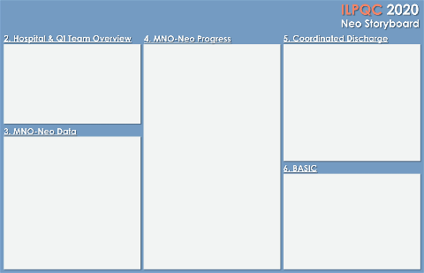
Neo F2F Storyboard Session
All teams will be asked to create a story board for the May 2021 “Face to Face” to share their QI teams progress on ILPQC initiatives
Storyboard should focus on…
  Launching the BASIC initiative including sharing their 30/60/90day achievements, prioritization matrix, data collection strategies
  MNO-Neo Sustainability including compliance monitoring, education for new hires and continued education.
Check out your BASIC newsletter for more info!

Slide 9

2021
Annual Conference
October 28, 2021

Slide 10
BASIC Data Overview and FAQs

Slide 11
ILPQC BASIC Vision & AIMS
Vision: ILPQC hospitals, regardless of perinatal level or past experience with implementing newborn antibiotics initiatives, will implement best practices to provide: the right antibiotics to the right babies for the right duration
Measures:
% of newborns with EOS risk assessment tool used and documented
% of parents/families provided education on antibiotics, EOS, and treatment plan for their newborn
% of parents/families provided education in their preferred language
% of newborns receiving abx with documentation of maternal risk factors for EOS in their chart
% of newborns with anticipated duration of abx course discussed by clinical team
% of newborns with antibiotic automatic stop order in medical chart
AIMs:
Decrease by 20% (or absolute rate of 4%) the number of newborns, born at ≥35 weeks who receive antibiotics
Decrease by 20% the number of newborns with a negative blood culture who receive antibiotics for longer than 36 hours

Slide 12
Structure Measures
Data Monitoring, Transparency, and Stewardship Infrastructure
Provider and nurse education on abx stewardship & equitable care
Patient education
Electronic reporting system in EMR
Quality Improvement Strategies to ensure feedback is provided to clinical team
Timely and Appropriate Initiation of Antibiotics
Standardized risk assessment for early onset sepsis
Partnership with obstetric team to standardize communication about maternal risk factors for early onset sepsis
Standardized serial assessment of neonates
Standardized identification and response to neonates with worsening clinical status

Slide 13

Structure Measures
Appropriate Administration and De-escalation
Standardized protocols to properly and consistently obtain blood cultures
Partnership with inpatient lab to optimize timely processing of blood culture results and communication with care team
Protocols to assist staff to stop or de-escalate therapy based on culture and sensitivity results
Standardized dosing guidelines
Standardized team approach to discuss anticipated duration of abx course at initiation of abx
Standardized automatic stop order process

Slide 14
Structure Measures
Equitable Care Delivery
Standardized process to review antibiotic data by race/ethnicity and share with providers and staff
Implementation of social determinants of health tool and facilitate coordinated connection to community resources and follow up
Provide information at the appropriate health literacy level
Provide communication in preferred language

Slide 15



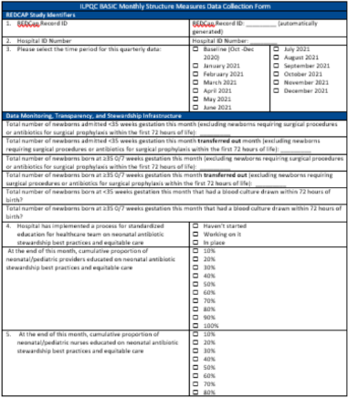
BASIC Data Collection
Patient-level Data
Hospital-level Data
Submitted for every individual newborn receiving antibiotics in a month
Submitted once per month

Slide 16

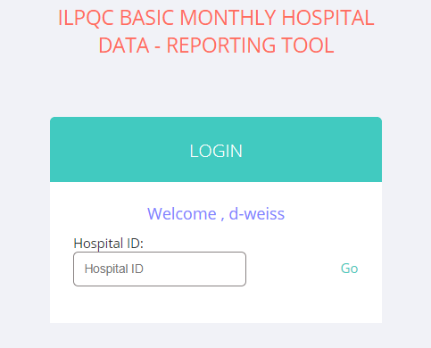
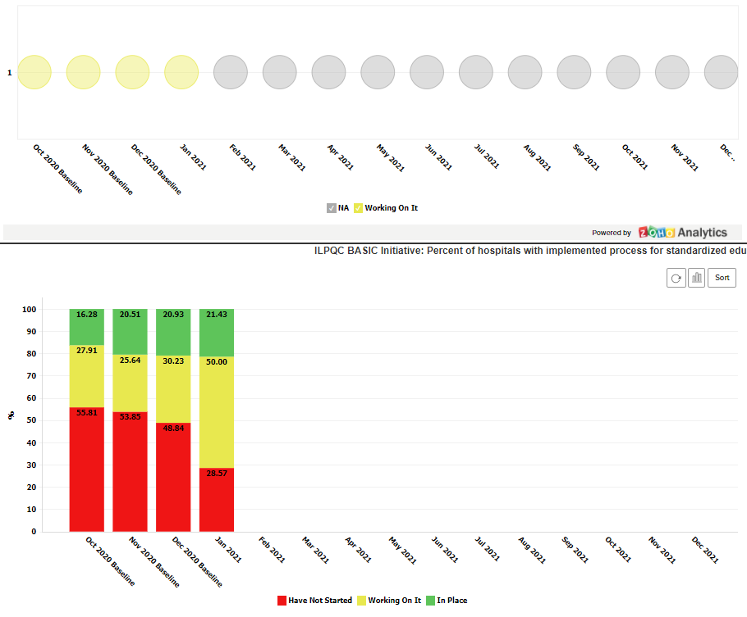
Hospital Measure Reports Live!
Under the Hospital Measures Project, click Reports and type in your 3-digit hospital ID
Use these to track your hospital’s monthly system changes towards achieving BASIC

Slide 17
BASIC Hospital Team
Data Submission (79 Teams Total)
Month | Teams Reporting Patient Data | Teams Reporting Hospital Data
Baseline (Q4 2020) | 59 teams (1668 newborns) | 54 teams
January 2021 | 48 teams (491 newborns) | 53 teams
February 2021 | 24 teams (186 newborns) | 14 teams
Use your hospital data form as a QI team meeting roadmap to guide your efforts. Please contact us if you need help getting started with reviewing and entering your data.
If hospital data is not submitted for a given month you will not have access team’s Antibiotic Prescribing Rate over time.

Slide 18
Supporting ILPQC teams
ILPQC is here to help!
ILPQC is working to connect with Hospital Teams who are working to submit data.
Opportunity for one-on-one calls to discuss data collection strategies and answer question
Reach out to ellie.suse@northwestern.edu and schedule your QI Support call today!

Slide 19
Get recognition for your QI work!
Data helps you facilitate your QI effort.
ILPQC will award teams at the Face to Face meeting for Successful BASIC QI Team Launch. To be recognized, please make sure these key steps to start BASIC are complete by Friday, April 30th:
BASIC Team Roster Submitted
BASIC Readiness Survey Submitted
BASIC Monthly Newborn Data Submitted for Baseline (Q4 2020) and January – March 2021
BASIC Monthly Hospital Level Data Submitted for Baseline (Q4 2020) and January – March 2021
Hospital Measures are critical to track your overall ABX rate and facilitate your systems changes for improvement!

Slide 20
What we learned about BASIC Teams’ readiness
towards Implementing ≥35 EOS Risk Tools
52% of teams currently use the NEOSC for infants ≥35 weeks
  16% have NEOSC data automatically entered/populated in EMR
  19% have data input into NEOSC by nursing
  65% have data input into NEOSC by provider
Current utilization of NEOSC:
  52% uses a consistent, standardized process to use the Neonatal Early-Onset Sepsis Calculator for every infant
  48% only uses the NEOSC when there are known risk factors for early-onset sepsis

Slide 21
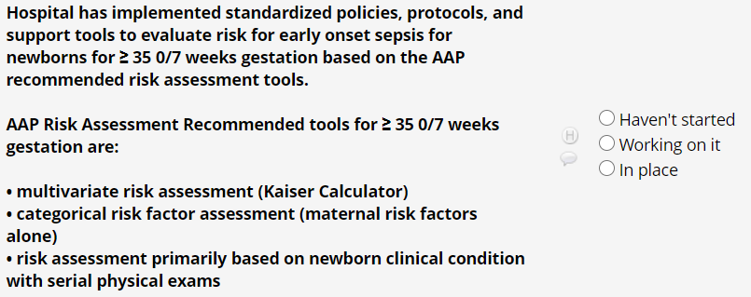
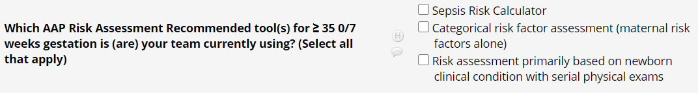
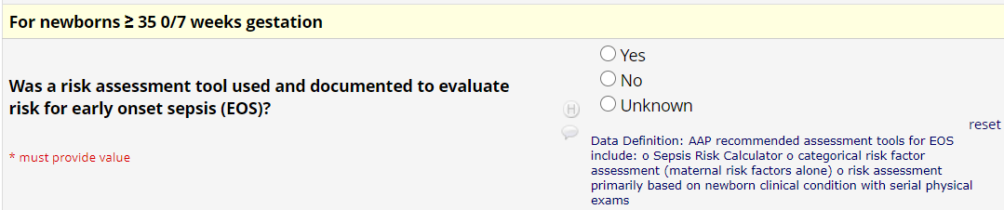
NEOSC in ILQPC Data System
Monthly Hospital Data Form Questions:
Monthly Newborn Data Form Question:

Slide 22
Get to Green:
Standardized ≥35 EOS Risk Tools
WHAT DOES IT MEAN TO BE AT GREEN WITH IMPLEMENTATION OF A >35 ASSESSMENT Structure Measure?
Guideline written and in use
Education completed with nurses and providers
Systematic process for documentation of sepsis risk

Slide 23
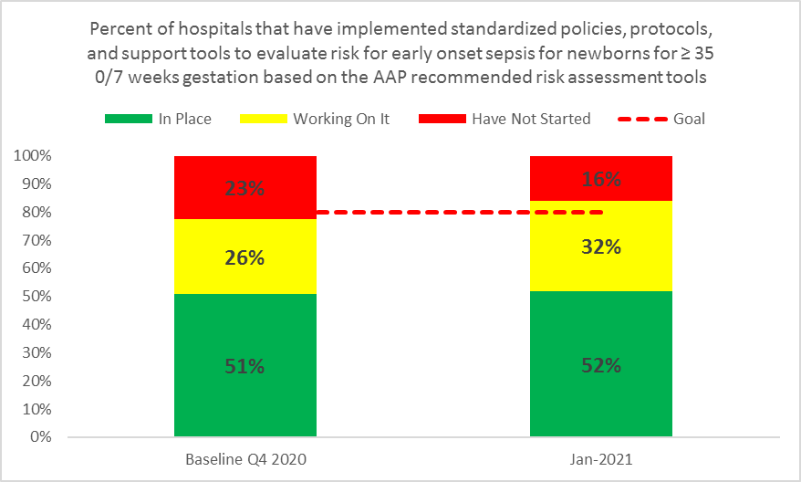
BASIC Monthly Hospital Data:
Standardized Protocol for ≥35 weeks EOS Risk Assessment

Slide 24
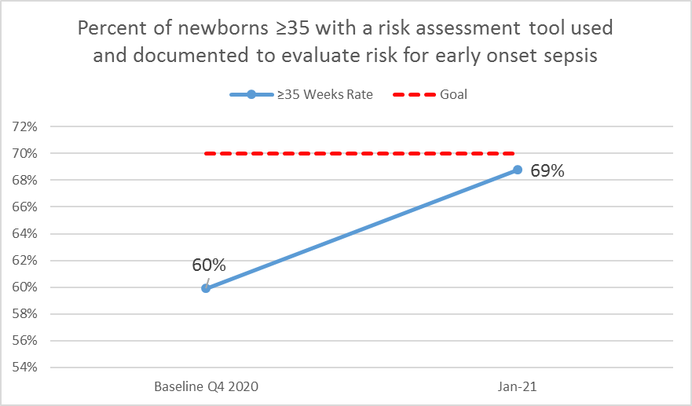
BASIC Monthly Newborn Data:
Documentation of Use of ≥35 weeks EOS Risk Assessment

Slide 25
NEOSC Implementation Strategies, Resources & Live Demonstration

Slide 26
BASIC Key Driver Diagram
AIMS
Primary Drivers
Change Ideas
Create multidisciplinary antibiotic stewardship QI team
Educate healthcare team on best practices
Provide standardized education and anticipatory guidance with focus on equitable care to families on EOS and treatment plan
By June 2022, ILPQC Hospitals will:
Implement QI infrastructure
Monitor & share transparent antibiotic data
A. Decrease by 20% (or absolute rate of 4%) the number of newborns, born at ≥35 weeks who receive antibiotics
B. Decrease by 20% the number of newborns with a negative blood culture who receive antibiotics for longer than 36 hours
Coordinate with IT to implement reporting system from EMR
Review transparent data and debrief with providers
Initiate timely and appropriate antibiotics
Standardize risk assessment for early onset sepsis (EOS)
Communicate with OBs to share maternal risk for EOS
Implement protocols for serial assessment with response to worsening status
Consistently obtain blood cultures
Partner with inpatient lab to process blood culture results
De-escalate therapy based on culture and sensitivity results
Implement pharmacy protocols to assure appropriate use
Standardize dosing guidelines and order sets
Implement process to discuss antibiotic duration and course
Implement automatic stop order processes
Administer and de-escalate antibiotics
Deliver equitable care
Review health quality data stratified by race, ethnicity, and Medicaid status to identify disparities and address opportunities for improvement
Version 2.12.2021

Slide 27

NEOSC Calculator
The RIGHT antibiotics for the RIGHT babies for RIGHT amount of time

Slide 28
LIVE DEMO
NEOSC Calculator
Cases 1-4 were all diagnosed with chorioamnionitis during labor
Case 5 was a repeat C-section
Notes:
See document with cases

Slide 29



Monday Afternoon LIVE!
  “Quality Collaborative Hospital”
    Level 2 hospital
    300 births/month
    QI Team Members:
      Patti: L&D Nurse
      Ellie: Admission Nursey Nurse
      Justin: Pediatrician/Neonatologist
Monday
Afternoon
Live
MAL
Notes:
Live from Illinois is Monday afternoon LIVE

Slide 30
Scenario 1:
G2 P2 31 year old patient
36.3 weeks
GBBS: positive
ROM: 8 hours
Last Maternal Temp: 100.7 3 hours before delivery
Baby dried stimulated and place on mother’s chest
Nb exam: Well-appearing

Slide 31

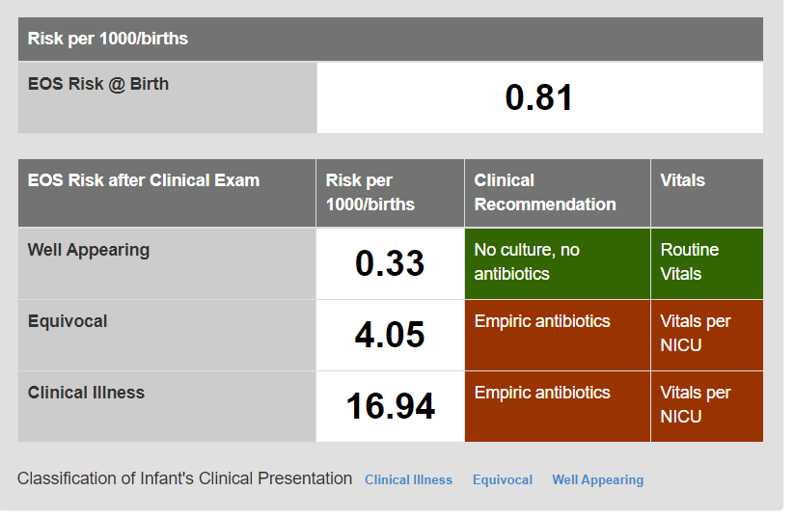
Report received from LD team on maternal risk factors for neonatal sepsis
Neonatal Early Onset-Sepsis Risk Calculator
Process Flow ≥ 35 weeks
Clinical assessment performed on infant
Assessment shows Clinical Illness*?
Select rate of early-onset sepsis per hospital incidence or use CDC incidence of 0.5/1000 live births,
Complete NEOSC
Document in chart:
EOS risk(s)
Clinical presentation
Clinical recommendation(s)
No
Nurse initiates
Neonatal Early-Onset Sepsis Calculator (NEOSC)
Yes
Clinical exam = equivocal?
Clinical exam well appearing?
Clinical exam well appearing?
Clinical exam = Clinical illness*
Provide ongoing clinical assessments per NEOSC recommendations
Updated NICU/SCN staff and vitals per NICU/SCN protocol
No
No
Notify medical team
Yes
Yes
Follow NEOSC recommendations
Notify peds provider and obtain necessary orders per NEOSC recommendations
Follow NEOSC recommendations
Notify peds provider and obtain necessary orders per NEOSC recommendations
Follow NEOSC recommendations
Notify peds provider and obtain necessary orders per NEOSC recommendations
Clinical exam | Description
Clinical Illness | 1. Persistent need for NCPAP / HFNC / mechanical ventilation (outside of the delivery room) 2. Hemodynamic instability requiring vasoactive drugs 3. Neonatal encephalopathy /Perinatal depression Seizure Apgar Score @ 5 minutes < 5 4. Need for supplemental O2 > 2 hours to maintain oxygen saturations > 90% (outside of the delivery room)
Equivocal | 1. Persistent physiologic abnormality > 4 hrs Tachycardia (HR > 160) Tachypnea (RR > 60) Temperature instability (> 100.4˚F or < 97.5˚F) Respiratory distress (grunting, flaring, or retracting) not requiring supplemental O2 2. Two or more physiologic abnormalities lasting for > 2 hrs Tachycardia (HR > 160) Tachypnea (RR > 60) Temperature instability (> 100.4˚F or < 97.5˚F) Respiratory distress (grunting, flaring, or retracting) not requiring supplemental O2 Note: abnormality can be intermittent
Well-appearing | No persistent physiologic abnormalities
More than 24 hours of age?
More than 24 hours of age?
No
Yes
Provide routine care per policy
DRAFT 2.15.2021

Slide 32
Scenario:
Maternal History:
21 Year old patient
G1 P0 40.2 weeks
Incomplete prenatal care
Elevated GTT but never completed 3 hour test
History of elevated BP that did not require medication
Induction with pitocin
Delivery info:
NSVD
Peds present at delivery due to chorio
GBS+ in urine treated with Macrobid
Negative swab
Broad spectrum abx per protocol
ROM 26.5 hours
Temp 101
Newborn:
Infant placed on overheard warmer
Initial pulse-ox 71 at 5 min
CPAP for 6 min then weaned to room air
O2 over 90% and well appearing
Notes:
Justin, feel free to edit whatever information you want to share about out this case

Slide 33
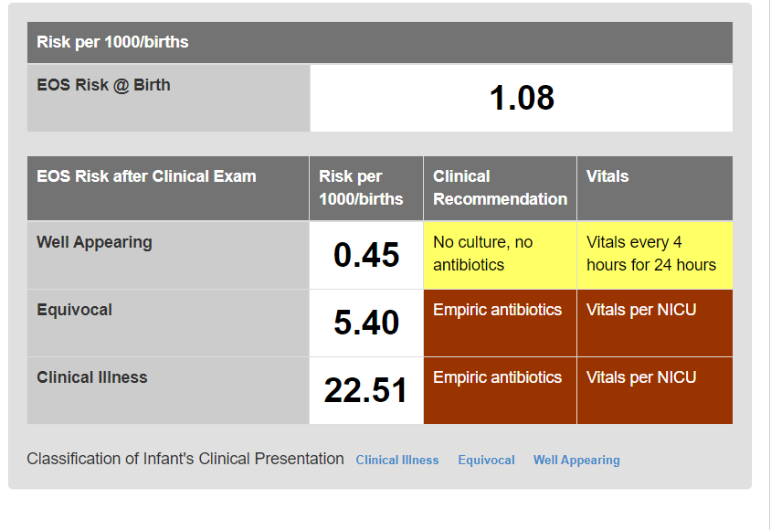
Report received from LD team on maternal risk factors for neonatal sepsis
Neonatal Early Onset-Sepsis Risk Calculator
Process Flow ≥ 35 weeks
Clinical assessment performed on infant
Assessment shows Clinical Illness*?
Select rate of early-onset sepsis per hospital incidence or use CDC incidence of 0.5/1000 live births,
Complete NEOSC
Document in chart:
EOS risk(s)
Clinical presentation
Clinical recommendation(s)
No
Nurse initiates
Neonatal Early-Onset Sepsis Calculator (NEOSC)
Yes
Clinical exam = equivocal?
Clinical exam well appearing?
Clinical exam well appearing?
Clinical exam = Clinical illness*
Provide ongoing clinical assessments per NEOSC recommendations
Updated NICU/SCN staff and vitals per NICU/SCN protocol
No
No
Notify medical team
Yes
Yes
Follow NEOSC recommendations
Notify peds provider and obtain necessary orders per NEOSC and/or pediatrician/.neonatologist
Follow NEOSC recommendations
Notify peds provider and obtain necessary orders per NEOSC recommendations
Follow NEOSC recommendations
Notify peds provider and obtain necessary orders per NEOSC recommendations
More than 24 hours of age?
More than 24 hours of age?
No
Yes
Provide routine care per policy
Notes:
INSERT REPORT Try to get the green into the yellow. Is now equivocal→ grunting and
21 Year old
40.2 weeks
Incomplete prenatal care
Elevated GTT but never completed 3 hour test
History of elevated BP that did not require Meds
G1 P0
NSVD
Peds present at delivery due to chorio
Induction with Pit
GBS+ in urine treated with Macrobid
- Negative swab
PCN x 5: broad spectrum abx per protocol
ROM 26.5 hours prior to delivery
Temp 100.6 within 24 hours
Nb placed on overheard warmer
Initial pulse-ox 71 at 5 min
CPAP for 6 min then weaned to room air
O2 over 90% and well appearing
To normal newborn
Q4 hours for 24 hours
Serial assessment

Slide 34
Report received from LD team on maternal risk factors for neonatal sepsis
Neonatal Early Onset-Sepsis Risk Calculator
Process Flow ≥ 35 weeks
Clinical assessment performed on infant
Assessment shows Clinical Illness*?
Select rate of early-onset sepsis per hospital incidence or use CDC incidence of 0.5/1000 live births,
Complete NEOSC
Document in chart:
EOS risk(s)
Clinical presentation
Clinical recommendation(s)
No
Nurse initiates
Neonatal Early-Onset Sepsis Calculator (NEOSC)
Yes
Clinical exam = equivocal?
Clinical exam well appearing?
Clinical exam well appearing?
Clinical exam = Clinical illness*
Provide ongoing clinical assessments per NEOSC recommendations
Updated NICU/SCN staff and vitals per NICU/SCN protocol
No
No
Notify medical team
Yes
Yes
Follow NEOSC recommendations
Notify peds provider and obtain necessary orders per NEOSC and/or pediatrician/.neonatologist
Follow NEOSC recommendations
Notify peds provider and obtain necessary orders per NEOSC recommendations
Follow NEOSC recommendations
Notify peds provider and obtain necessary orders per NEOSC recommendations
Clinical Exam:
Newborn is now grunting and tachypneic
More than 24 hours of age?
More than 24 hours of age?
No
Yes
Provide routine care per policy
Notes:
Tahcynpnea, grunting, provider notified and orders obtained

Slide 35
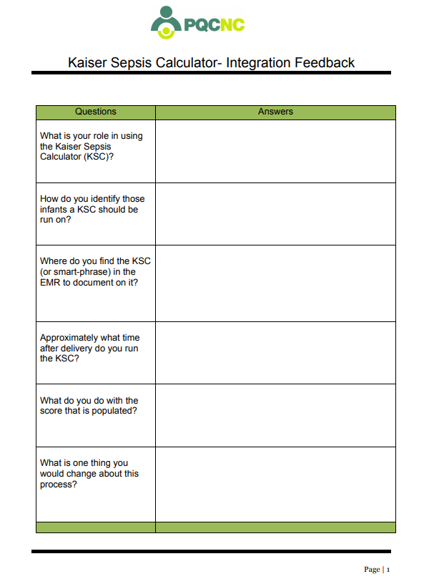
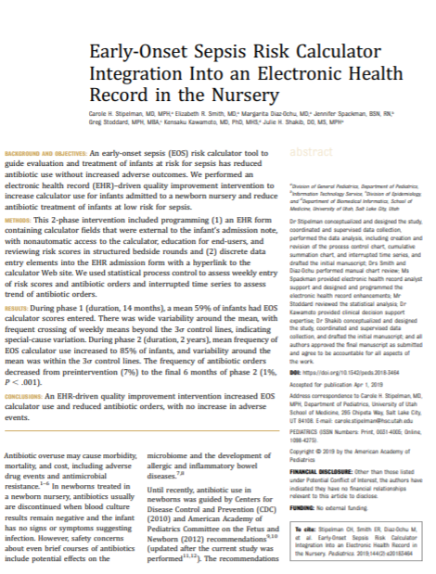
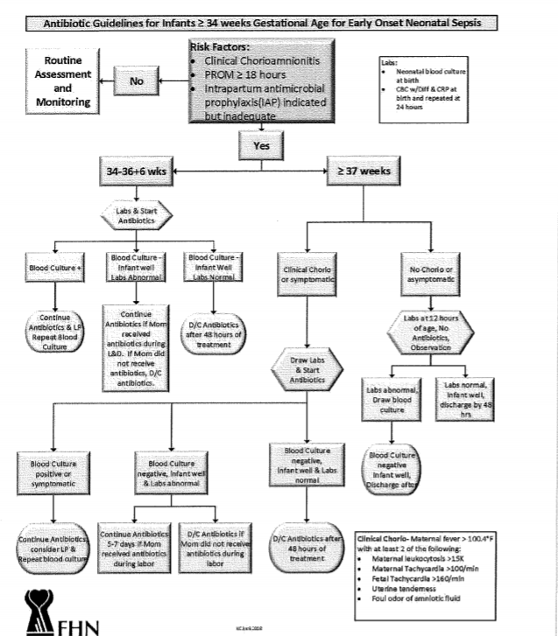
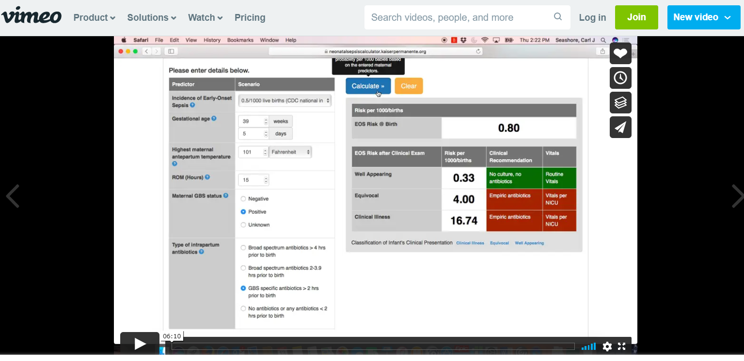
Resources in ILPQC Toolkit
Kaiser Sepsis Integration feedback tool
  Helps QI team identify key players in the implementation process
Kaiser NEOSC EMR Integration Tool
  Article to assist with buy-in to support EMR integration
Sample Algorithm from ILPQC Hospital
  FHN shares integration algorithm
Risk Calculator Training Video
  Can be used for provider & nurse training

Slide 36
Team Talk:

Slide 37


2019 Statistics
Employees
871
Physicians
362
Staffed Beds
150
Inpatient admissions
7,022
Outpatient Surgery Visits
2,894
Emergency Room Visits
37,018
Deliveries
843
(Level 2a Nursery Member Southern Illinois Perinatal Network )
Alton Memorial is a member of BJC Healthcare, one of the nations largest non-profit healthcare organizations. BJC serves patients in St. Louis, Southern Illinois and Mid-Missouri in its 15 hospitals and multiple outpatient locations. Since 1937, Alton Memorial has served the greater Alton community and five surrounding counties.

Slide 38
BJC- Pediatric Clinical Quality Council
Goal of Our BJC Team:
  Our pediatric and newborn patients will receive the same standard of care in all our facilities
Past Projects Newborn Medicine:
  Maternal/Neonatal NAS Screening/Management Guidelines(2018)
  Neonatal Hypoglycemic Management Guideline (2019)
  Newborn Sepsis Guidelines (2019)
    BJC Preterm Newborn Sepsis Risk Assessment <35 weeks
    BJC Newborn Sepsis Risk Assessment Guideline> 35 weeks
    BJC Sick Neonate Sepsis Treatment Guideline
Current Project :
  Safe sleep(2020-Present)
ILPQC Projects:
  PVB
  BASIC ---(Team Members Kathie Wuellner MD, Jessica Mossman RN, Renee Strowmatt RN)
AMH Projects:
  Baby Friendly(2016-2021) Redesignation(2021)

Slide 39
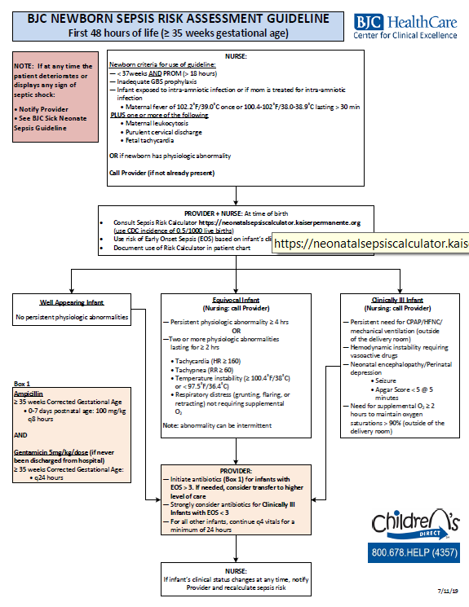
BJC Newborn Sepsis Risk Assessment Guideline:
First 48 hours of life (≥ 35 weeks gestational age)

Slide 40
Case Study:
Infant born @39.2weeks
Repeat C-Section-scheduled
Maternal Hx: HSV on suppressive Valtrex, Positive GBS, GDM diet controlled.
Male Infant
Born at 808 am, 5-6-8- APGAR
4020 Grams
Infant received < 1 minute bag mask ventilation, then spontaneous respirations.
O2 sats at 10 min of life were 64, CPAP intermittently with improvement.
Infant moved to Nursery for further evaluation

Slide 41

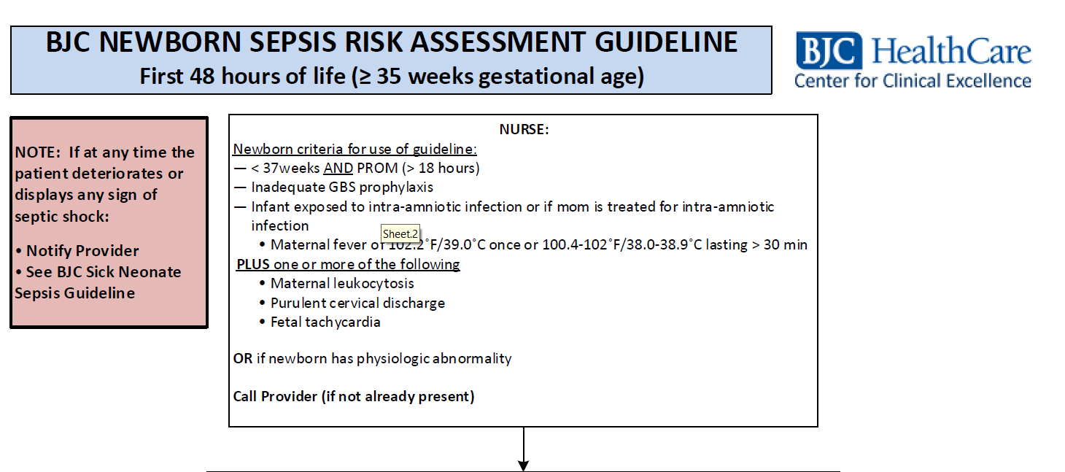
DAY
30
DAY
DAY
1

Slide 42
Case Study Continued
Initial Nursery Assessment within First hour of life:
Started on 4L of nasal cannula at 70% FIO2. O2 sats improved to 96.
Mild tachypnea RR >60, CXR suggestive of TTN-
Initially EOS score 0.6 Equivocal infant will continue to observe closely for signs of improvement.
HFNC was started at 0930 by Dr. Hill after receiving blood gas results of 7.18, 72, 52, 26 BE -6, CBC and Blood culture drawn.
Continued Assessment > 2 hours of age
Infant continued to require HFNC, would not tolerate weaning
RN re-entered data into Sepsis Risk calculator, EOS after exam 2.53 meeting clinical illness
Called physician with recommendation to start empiric antibiotics
Amp and Gent Initiated
Consult to SLCH, plan with tertiary facility will continue to observe infant over next few hours will initiate transfer if condition deteriorates or does not improve.

Slide 43
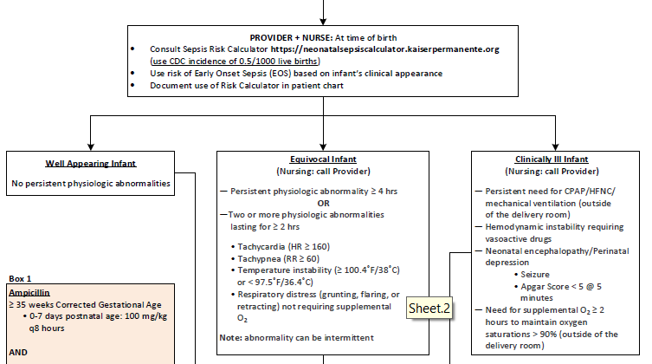

Slide 44
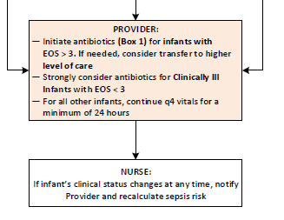
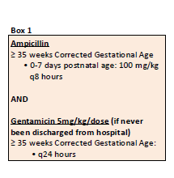

Slide 45
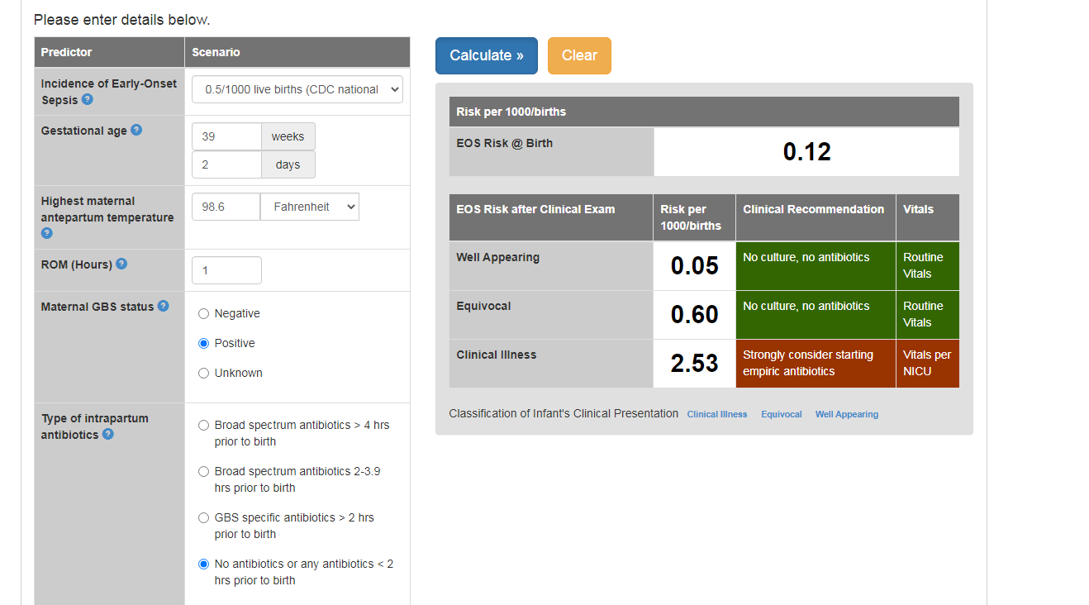

Slide 46
Case study Continued
Decision to transfer to higher level of care at 7 hours of age after re-consult with Tertiary Care facility. Infant respiratory status not improving.
Antibiotics discontinued at tertiary facility at 48 hours of age with negative Blood culture results at that time

Slide 47
Summary of our Progress
Working well:
Adaption by our providers and nurses
Visual aid for staff
Started with relatively low antibiotic use
Opportunities for Improvement:
Education for parents
Automatic stop date in orders
Documentation of tool use and EOS score
Questions?
Jessica Mossman RN, MSN
Manager Woman and Infants
Alton Memorial Hospital
Jessica.Mossman@bjc.org

Slide 48
QI Data Corner

Slide 49
BASIC Data FAQS
Maternal GBS Status Question in Newborn data form: This is for the GBS status at the time of delivery. If the GBS status is unknown at delivery but later GBS positive, the question should designate “GBS Unknown”
Change in infant IV antibiotic regimen within the first 72 hours of life Question in Newborn data form: A change in IVB antibioitics is…
When does the 36 (48) hour count start for negative blood culture results? If a blood culture result is negative after 36 (48) hours from the plating of the blood culture
Highest maternal temperature: Based on 24 hours prior to delivery through 1 hour post delivery
Notes:
Justin + Leslie review/cut

Slide 50
Next Steps
Work with your team to:
  Submit a BASIC Readiness Survey if you haven’t yet
  Work with your team to submit Baseline (Q4 2020) newborn & hospital data if you haven’t yet
Continue collecting and reporting February and March 2021 newborn and hospital data to inform your QI work
Log into your REDCap account to view your hospital’s structure measures to select your focus for the coming month
Work with your team to complete a Prioritization Matrix to make a 30-60-90 day plan and PDSA

Slide 51
2021 BASIC Webinars
Date | Topic
March 15 | Implementation Strategies for the NEOSC for Newborns ≥35 Weeks
April 19 | Using EMR for Data & Clinical Support
May 29 | Neonatal Face to Face Meeting (Virtual)
June 21 | Topic TBD
July 19 | Topic TBD
August 16 | Topic TBD
September 20 | Topic TBD
October | Annual Conference
November 15 | Topic TBD
December 20 | Topic TBD
Register for all upcoming webinars here:
https://northwestern.zoom.us/meeting/register/tJcpc-qppjMpHdWBNEO8WJsLjfDDUz9ucmt2
Notes:
Anticipate Physician Barriers
Other Topics:
Energizing teams & Tools for teams
Neonatal Early Onset Sepsis Calculator
Using the EMR
Trusting the Blood Culture
Antibiotic Stop Times
Culture Negative Sepsis
Clinical Assessments
Partnering with OB teams
Provider Education
Patient Education
Disparities in Neonatal EOS Care

Slide 52
Office hours
2-2:30pm

Slide 53










THANKS TO OUR
FUNDERS
In Kind Support

Slide 54
Appendix

