Slide 1

MNO-Neonatal Sustainability
June 7, 2021 1:00 – 2:00 PM

Slide 2
Call Overview
Face-to-Face Recap & Awards Recognition
MNO-Neo Data
MNO-Neo Teams Panel
  Humboldt Park Health
  Central DuPage Hospital
  SSM Health St. Mary’s and Cardinal Glennon St. Louis
2

Slide 3
Face-to-Face by the Numbers
>250 attendees on the Neonatal day
21 Neonatal Team Storyboards submitted
58 Stealing Shamelessly/Sharing Seamlessly submissions
6 MNO-Neonatal Teams received the QI Excellence Award!
Put 1 thing that you liked about F2F, followed by 1 thing that you wish we would improve for next time in the Chat!

Slide 4



MNO-Neonatal Excellence Award
Criteria for Optimal OEN Care
All Data Submitted
+
4 Structure Measures In Place (Prenatal Consult, Pharmacologic Care, Non- Pharmacologic Care, Coordinated Discharge)
+
All Process Measure goals met >70% Breastfeeding; <20% Pharmacologic Treatment; >95% Coordinated Discharge

Slide 5
MNO-Neo QI Excellence Award Criteria for Optimal OEN Care
New MNO-Neo QI Excellence Award Winners
Advocate Condell Medical Center
NM McHenry Hospital
Memorial Hospital East
Memorial Hospital of Carbondale
AMITA Resurrection Medical Center
AMITA Health Saint Joseph Hospital- Chicago
Previous MNO-Neo QI Excellence Award Winners:
Advocate Children's Hospital - Park Ridge
Advocate Children's Hospital - Oak Lawn
Advocate Good Samaritan Hospital
Advocate Sherman Hospital
AMITA Alexian Brothers Medical Center
AMITA St. Mary's Hospital - Kankakee
AMITA St. Alexius Medical Center
Carle BroMenn Medical Center
Edward Hospital
Illinois Valley Community Hospital
Little Company of Mary Hospital
Loyola University Medical Center
NM Central DuPage Hospital
Northwestern Memorial Hospital
OSF St. Francis Medical Center
Palos Hospital
SSM Health Cardinal Glennon Children's Hospital
St. Louis Children's Hospital
Swedish Hospital
West Suburban Medical Center

Slide 6
MNO-Neonatal Optimal OUD Care Honorable Mentions
These teams are very close to receiving the QI Excellence Award (2 of 3 measures achieved)
Morris Hospital
Northwest Community Hospital
Rush-Copley Medical Center
SSM Health St Mary's – St. Louis

Slide 7
MNO-Neonatal Data

Slide 8
Pharmacologic Treatment
75% ESC utilized in 2021
16% utilized ESC in 2017
11% used PRN dosing in 2017
55% used PRN dosing in 2021
Notes:
The proportion OENs receiving PRN pharmacologic treatment increased from 11% at Baseline to 55% in 2021
More babies received more compassionate care and fewer babies received pharmacologic treatment!

Slide 9
Receiving Breastmilk at Infant Discharge
Notes:
Inequities in providing maternal breastmilk at infant discharge existed at baseline. By the end of the initiative the initiative aim was achieved by both groups
We have seen that standardzing best practices and working together and working together as a collaborative leads to better care, improves outcomes, and decreases disparities.
At baseline, Non-Hispanic Black patients were less likely to have a coordinated discharge, however across the initiative improvements in discharge rates were seen for all patients with the greatest improvement for Non-Hispanic Black patients.

Slide 10
Discharge with a Coordinated Plan
Great improvements in coordinating discharge for OENs
Clinical readiness, family preparedness, and optimized transfer of care for 1,059 mothers and babies!

Slide 11

MNO’s Impact:
Length of Stay
Length of Stay for OENs with NAS Symptoms
Teams have cared for over 2,034 Opioid-Exposed Newborns
Average Length of Stay for OENs with NAS symptoms is 3.8 days shorter
15.5 Days
11.7 Days
2018
2021
Notes:
LOS (NAS Symptoms)- remove NICU Admits
Baseline: 15.5
2018: 13.14
2019: 10.66
2020: 12.17
2021: 11.7
LOPharm Tx (NAS Symptoms)- Remove NICU Admits
Baseline: 17.8
2018: 14.14
2019: 13.5
2020: 13.4
2021: 13.3

Slide 12
MNO’s Impact:
Length of SEPARATION
Length of Stay for OENs with NAS Symptoms
Teams have cared for over 2,034 Opioid-Exposed Newborns
Average Length of Stay for OENs with NAS symptoms is 3.8 days shorter
15.5 Days
11.7 Days
2018
2021
Notes:
LOS (NAS Symptoms)- remove NICU Admits
Baseline: 15.5
2018: 13.14
2019: 10.66
2020: 12.17
2021: 11.7
LOPharm Tx (NAS Symptoms)- Remove NICU Admits
Baseline: 17.8
2018: 14.14
2019: 13.5
2020: 13.4
2021: 13.3

Slide 13



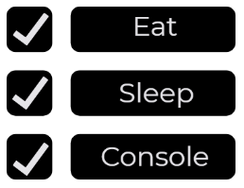



Key Component of
Optimal OEN Care

Slide 14
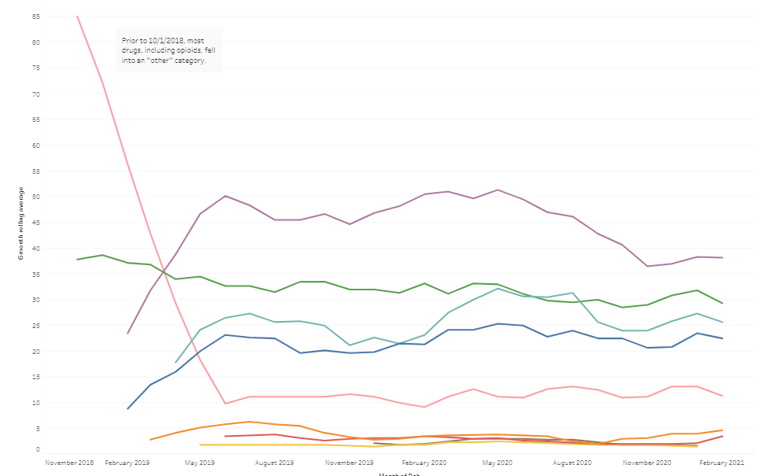
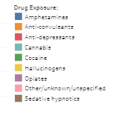
Substance by Type since Nov. 2018

Slide 15
MNO-Neonatal: What has changed?
Adapting to the changing landscape in 2021

Slide 16
What has changed?
As we enter sustainability for MNO, the landscape of substance use continues to change:
  Shift in leading causes of maternal mortality/morbidity
  Legalization of recreational marijuana in Illinois
  Adaptation of healthcare practices to Covid-19 pandemic needs
Notes:
NAS/NAS symptom reporting has also increased.

Slide 17
Important Definitions
Pregnancy-Associated Deaths: death while pregnant or within one year of pregnancy from ANY cause
Pregnancy-Related Deaths: death while pregnant or within one year of pregnancy from a cause related to a pregnancy
  Pregnancy complication
  Chain of events initiated by pregnancy
  Aggravation of underlying condition by physiologic effects of pregnancy
Notes:
Illinois Maternal Morbidity
& Mortality Report
April 2021 Release
IDPH Office of Women’s Health and Family Services
ILPQC Face-to-Face Obstetric Meeting
May 26, 2021

Slide 18
Trend in Pregnancy-Associated Mortality
Illinois averaged 75 pregnancy-associated deaths each year during 2008-2017
The highest number of deaths occurred during 2017
Notes:
Illinois Maternal Morbidity
& Mortality Report
April 2021 Release
IDPH Office of Women’s Health and Family Services
ILPQC Face-to-Face Obstetric Meeting
May 26, 2021

Slide 19
Underlying Cause of Death for Pregnancy-Associated Deaths
Medical causes made up 46% of deaths
Violent causes combined made up 43% of deaths
Other injuries (mostly motor vehicle accidents) made up 12% of deaths
Data Sources: IDPH Death Certificate Data, 2016-2017
Due to rounding, percentages do not add up to 100%
Notes:
Illinois Maternal Morbidity
& Mortality Report
April 2021 Release
IDPH Office of Women’s Health and Family Services
ILPQC Face-to-Face Obstetric Meeting
May 26, 2021

Slide 20
Pregnancy-Related Mortality Ratio by Race/Ethnicity
Black women were nearly three times as likely as White women to die from a pregnancy-related cause
  In the first report, the Black-White disparity in pregnancy-related mortality was wider
  The narrowing of the disparity is due to worsening mortality among white women, not improvements for black women
Notes:
Illinois Maternal Morbidity
& Mortality Report
April 2021 Release
IDPH Office of Women’s Health and Family Services
ILPQC Face-to-Face Obstetric Meeting
May 26, 2021

Slide 21
Top Four Underlying Causes of
Pregnancy-Related Deaths
Cause of Death Category | # Pregnancy-Related Deaths | % Pregnancy-Related Deaths
Mental Health Conditions (including substance use disorder) | 24 | 40%
Pre-existing Chronic Medical Condition | 5 | 8%
Hemorrhage | 5 | 8%
Hypertensive Disorders of Pregnancy | 5 | 8%
All Other Causes Combined | 21 | 35%
Due to rounding, percentages do not add up to 100%
Notes:
Illinois Maternal Morbidity
& Mortality Report
April 2021 Release
IDPH Office of Women’s Health and Family Services
ILPQC Face-to-Face Obstetric Meeting
May 26, 2021

Slide 22
Types of Substances Involved in Drug Overdose Pregnancy-Associated Deaths
Data Sources: IDPH MMRC-V Data, 2016-2017

Slide 23
MNO-Neonatal Teams Panel
Adapting to the changing landscape in 2021

Slide 24
MNO-Neonatal Teams Panel
Kenny Kronforst MD, MPH, MS from Humboldt Park Health
Rita Brennan DNP, RNC-NIC, APN/CNS from Central DuPage Hospital
Becky Boedeker MSN, Jessica Engel MSW, and Emily Johnson MSW from SSM St. Mary’s and Cardinal Glennon St. Louis
DNP, RNC-NIC, APN/CNS
Notes:
Can someone add in Jessica and Emily’s credentials?

Slide 25
Questions
Type your questions for the panelists in the Chat Box
We will ask them to respond when all 3 of the panels have presented

Slide 26

HPH MNO Initiative
The Marijuana Dilemma: What to do when everybody is doing it…
Kenny D. Kronforst, MD, MPH, MS

Slide 27
2019 MNO Activities
Nurse/provider training on ESC approach
  Transition out of using Finnegan scoring tool
Re-focus on non-pharmacologic care
Participation in bedside huddles for escalation of care
Pharmacologic therapy approach
  Prn’s versus continuous infusion
  Standardizing medical management
Maternal involvement in cares/breastmilk provision
Proper documentation of infant needs and medical team response

Slide 28
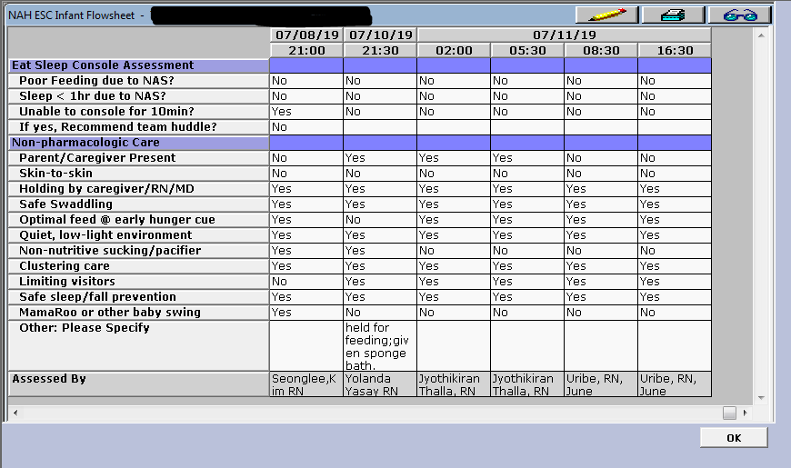
MNO at HPH
3 babies met criteria (P96.1 Neonatal withdrawal symptoms from maternal use of drugs of addiction and P04.49 Newborn affected by maternal use of other drugs of addiction) in 2019 and 2020 (thru June) of 505 possible newborns.
Screening tool created in CPN

Slide 29
MNO at HPH
All babies were high-risk per maternal reporting
  One tested positive for opioid exposure, 2 for cocaine exposure
All were treated using ESC methodology
None required medical management
All were placed into DCFS custody
Notes:
LOS1- 12/17-12/27
LOS2- 7/29-8/15
LOS3- 6/25-7/12

Slide 30
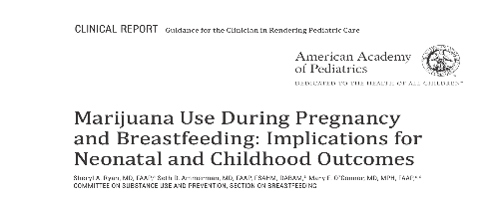
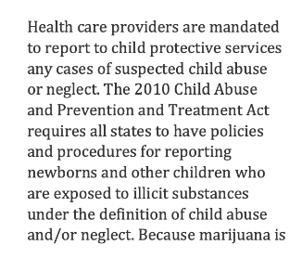
MNO Sustainability and Beyond-
The Marijuana Issue
Tackling universal screening versus targeting high-risk mothers
  ACOG 2017- early universal screening with brief intervention/referral; urine drug screening only with consent and compliance with state laws
Anecdotal increase in (+) marijuana cases
Reporting to DCFS
  Variable engagement with patient, unclear criteria
  Unclear consequences (short and long term)
  Unclear follow-up
Supporting our moms and babies
  Care note, education (not standard)
  Referrals for treatment, therapy
    New outpatient behavioral health clinic
Notes:
High-risk testing at HPH:
Prior usage of reportable substance
Maternal self-report of current or prior illicit or unprescribed drugs
No or unknown/undocumented prenatal care, late prenatal care, and/or poor prenatal care
Prematurity
At the discretion of the OB team
(+) mom triggers baby utox and mec tox
New behavioral health clinic services- psychiatric evaluation and assessment, substance abuse evaluation and assessment, individual counseling, group counseling, family counseling, medication education and management, and case management

Slide 31
Mother & Newborns Affected by Opioids Update
Sponsored by Illinois Perinatal Quality Committee
Presented to: ILPQC Neonatal Team
Date: June 7, 2021
Presenter: Rita Brennan, DNP, RNC, APN/CNS, CPHQ

Slide 32
MNO
LOS & Charges per case
CY 21, 3 infants met criteria. 2 infants remained on Mother-Baby with LOS 5 days. 1 infant > 35 wks. gestation required NICU care unrelated to withdrawal

Slide 33
MNO Newborn
Define √
OEN ≥ 35 weeks
Measure √
# OEN/Yr.
Analyze √
Establish baseline data
Control
Improve √
Decrease LOS & pharmacologic treatment by use of ESC
Enhance resources & processes
Continue to monitor results
Submit data to ILPQC
Unit huddles
Report to stakeholders
Compare CDH to state metrics
Days on pharmacological treatment
Safe discharge
Avg. LOS
Mother-Baby & NICU admits
Include inborn & transported infants
Cost avoidance
Create dashboard for all metrics to be reviewed monthly
Keep mother & baby together
Summary
Continued challenges:
Timely turn-around time for cord toxicology
Ensuring adequate LOS to observe for withdrawal- challenge with COVID 19
Finding more women use other substances than opioid during perinatal period. Seeing marijuana use. We are evaluating the need for an initiative to address marijuana use.

Slide 34
Perinatal Marijuana Use
Problem
S: Marijuana is one of most widely used substances during pregnancy in US¹
B: Illegal at the federal level, but legal in several states such as Illinois. Growing number of women view as safe and effective way to treat nausea and vomiting in pregnancy. ² ACOG and AAP both recommend advising against marijuana use in pregnancy.
A: Unknown the number of women delivering at CDH who used marijuana during pregnancy. May not disclose to OB or on 5 P’s screening. When a woman does disclose there may be lack of consistency in recommendations and what to expect during delivery at CDH. Is reportable to DCFS. Need for provider, staff, and patient education
R: Explore further the interest and need to implement a perinatal marijuana project jointly with the Pediatric Quality & Safety Committee and the Child Protection Team
1 Ryan, S.A., Ammerman, S.D., O’Connor, M.E. & Committee on Substance Use, Prevention, and AAP Section on Breastfeeding. (2018). Marijuana use during pregnancy and breastfeeding: Implications for neonatal and childhood outcomes. Pediatrics, 142 (3) e20181889; DOI: 10.1542/peds.2018-1889
2. Substance Abuse and Mental Health Services Administration. (2020, September 11). Marijuana and pregnancy. Retrieved from https://www.samhsa.gov/marijuana/marijuana-pregnancy

Slide 35
Perinatal Marijuana Use
Background
Marijuana can:
  Can cross placenta
  Concerns for both pregnancy outcomes and fetal development
  Long-term consequences for infants or children
Little reliable education is provided to pregnant women on use of marijuana
Providers as well as patients may believe marijuana is not harmful
Long-term consequences can result from use in pregnancy and beyond
Women who report marijuana have a higher risk of additional illicit substance use and have greater ACE scores.
Substance use increases risk for child maltreatment.
AAP and ACOG both provide recommendations to counsel against use of marijuana during pregnancy
More education related to marijuana is needed both for women and providers.

Slide 36

Cardinal Glennon Children’s Hospital/St. Mary’s Hospital
Located St. Louis, MO
Significant number of patients from Southern Illinois and the Metro East
Partnership with SSM Health and Saint Louis University Physicians

Slide 37
Level IV NICU
Within 195-bed, freestanding children's hospital
65 bed, private NICU room model (twin rooms)
>700 admissions / year
Serve 150-mile radius of patients from rural and urban combination
Quaternary referral center for subspeciality patients in including cardiothoracic surgery and ECMO

Slide 38
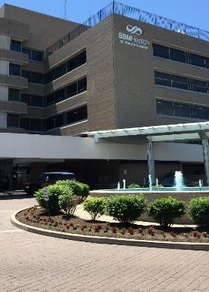
SSM Health St. Mary’s Hospital - St. Louis
The Family Birthplace at SSM Health St. Mary’s Hospital - St. Louis is home to the Saint Louis University School of Medicine’s Department of Obstetrics, Gynecology and Women’s Health residency program and supported by neonatologists from SSM Health Cardinal Glennon Children's Hospital.
Designated Administrative Perinatal Center for the Southern Illinois Perinatal Network
Approx 3000 births
Labor & Delivery Unit
  13 LDR rooms, 6 Triage rooms, 2 OR
Antepartum Unit
  28 Antepartum rooms, 10 Perinatal Special Care Unit rooms
Mother/Baby Unit
  30 Postpartum rooms
Level III NICU
  42 beds

Slide 39
MNO Comparisons to Pre-COVID
Number of Births Decreased
February 2019 – January 2020
February 2020 – January 2021
Total volume – 133
WISH participant – 73%
MAT (stable/not stable) – 70%
Substance use during pregnancy – 86%
Stayed with baby – 78%
Total volume – 105 (- 21%)
WISH participant – 76%
MAT (stable/not stable) – 67%
Substance use during pregnancy – 83%
Stayed with baby – 84.5%
Notes:
The only really significant difference was the total volume of SUD mom/baby couplets.
Where were they going? Maybe to other hospitals? Were the missing moms getting PNC and/or MAT?

Slide 40
Why did it feel so much worse?
Visitor Restrictions
Use of Cuddlers
Pre – COVID
Allowed two people to stay, but could switch out as needed.
COVID
Allowed 2 people to stay, but could not leave and reenter.
Pre – COVID
Cuddlers were present many shifts, and also on-call.
COVID
No cuddlers – burden fell to the nurses.
Notes:
Parents/caregivers more tired and frazzled. Nurses more stressed in an already stressful time

Slide 41
Ultimately reinforced what we already knew – Maximizing SIMPLE Non-Pharm Measures is the Key
How did we manage? Not Great
Kept babies at the Nurses’ station at times.
All nurses held babies when at the desk.
Lobbied for more formal help.
Recruited from other units and within hospital administration to hold babies.
Continued to ask for loosening of restrictions when reasonable.
Notes:
We know the nurses’ station is not ideal – but made the best of it.

Slide 42
Q&A
Type your questions for the panelists in the Chat Box

Slide 43

MNO Work: A QI Triathlon
Work with your team to complete and implement your sustainability plan:
  Compliance Monitoring
  New Hire & Continuing Education
  Systems Changes
Attend MNO Sustainability Webinars in 2021 to learn and share strategies with other ILPQC hospitals
ILPQC will provide QI support to help you cross finish line
Systems Changes
Clinical Culture Changes
Sustain Changes
Don’t forget to submit your sustainability plan! Only 25% of MNO-Neonatal teams have submitted a plan thus far!

Slide 44
MNO-Neonatal Next Steps
OUD Systems
Continue to cross the finish line and ensure all systems are in place to provide optimal OEN care
Provider Education
Ensure all clinical team members receive education and know how to activate the OEN Systems and provide stigma free care
Sustainability Plan
Begin preparing for sustainability and work with your QI team to complete & submit your sustainability plan
23

Slide 45
MNO-Neonatal Sustainability
2021 | Calls
September | 1st Monday: 1-2pm MNO Sustainability
October | No Calls- Annual Conference
December | 1st Monday: 1-2pm MNO Sustainability
Sustainability topics to include:
Cannabis
Multi-substance exposure
Respectful care
Other ideas? What are pressing MNO-Neo topics you would like covered in chat box.
22

Slide 46


Obtain a Certificate in
Quality Improvement Science!
IHI Open School, a free opportunity to asynchronously complete up to 13 continuing education hours
Access starting June 2021 for two years
ILPQC will send out an inquiry form to designate a specific number of members across OB & Neonatal QI initiatives at your hospital access to the training!
Pump up your Quality Improvement skills!

Slide 47










Thanks to our Funders
In kind support:

