Slide 1
BASIC Teams Call: Timely & Appropriate Initiation of Antibiotics
June 21st, 2021

Slide 2
Call Overview
ILPQC Updates & Housekeeping
BASIC Data Review
Timely & Appropriate Initiation of Antibiotics
Communication Strategies
Optimal Blood Culture Collection
Selecting the Appropriate Antibiotic Dose
Standardizing Serial Assessments & Response to Worsening Clinical Status
Team Talk

Slide 3
Obtain a Certificate in Quality Improvement Science!
ILPQC is offering hospital teams access to IHI Open School, a free opportunity to asynchronously complete over 13 continuing education hours!
Access starting June 2021 but people can complete the certificate over two years.
Please complete the IHI Open School inquiry form to designate a specific number of members across OB & Neonatal QI initiatives at your hospital. Access to the training begins by Wednesday, June 30th https://redcap.healthlnk.org/surveys/?s=RN9D4H9AMD
Pump up your Quality Improvement skills!
Notes:
Hi team, I feel like the email communication Ariel drafted and our questions from Sara provide us insight to update this slide to be more relevant to now. Would you please update with the what we are offering and what they have to do to request it info from more recent communications? See my updates please! (DW)

Slide 4
2021 Virtual Face-to-Face Meeting Recap
>250 attendees on the Neonatal Day (over 500 across both days)
21 Neonatal Team Storyboards with 58 Stealing Shamelessly/Sharing Seamlessly submissions
53 BASIC Outstanding Launch & 6 MNO-Neonatal QI Excellence Award Winners!
10 total breakout sessions covering Infant Mortality, MNO, BASIC
3 national speakers
3 amazing panelists
25 Provider & Nurse breakout facilitators and discussants
Thank you for all of your work to make this successful!
Notes:
Can we add the count of breakout facilitators and discussants. Multiple doesn’t capture the extent of this volunteer energy.

Slide 5
BASIC Updates & Data Review

Slide 6
Upcoming Teams Calls
Date | Topic
June 2021 | BASIC Teams Call: Timely and Appropriate Initiation of Antibiotics
July 2021 | BASIC Teams Call: Evaluate Antibiotic Appropriateness (Antibiotic Discussion/Time Outs) + Office Hours with Micro lab discussion
August 2021 | BASIC Teams Call: Equitable Care in BASIC: Equity Data, Dashboards, Strategies to Collect Race/Ethnicity Data
September 2021 | BASIC Teams Call: Assessment for EOS in Newborns <35 Weeks
October 2021 | Annual Conference
November 2021 | BASIC Teams Call
December 2021 | BASIC Teams Call

Slide 7
BASIC Outstanding Launch Award Winners
Abraham Lincoln Memorial Hospital
Advocate Aurora Sherman Hospital
Advocate Children's- Oak Lawn
Advocate Condell Medical Center
Advocate Good Samaritan Hospital
Advocate Good Shepherd Hospital
Advocate Illinois Masonic Medical Center
Alton Memorial Hospital
AMITA Alexian Brothers Womens and Childrens Hospital at St. Alexius
AMITA Health Adventist Medical Center - Bolingbrook
AMITA Health Adventist Medical Center Hinsdale
AMITA Health Alexian Brothers Medical Center
AMITA Health Saints Mary and Elizabeth Medical Center
AMITA Health St. Joseph Hospital - Chicago
AMITA Health St. Mary's Hospital- Kankakee
AMITA Resurrection Medical Center
Anderson Hospital
Blessing Hospital
Carle Foundation Hospital
Edward Hospital
Elmhurst Memorial Hospital
FHN Memorial Hospital
Highland Park Hospital
HSHS St. John's Hospital
Katherine Shaw Bethea (KSB) Hospital
Loyola University Medical Center
MacNeal Hospital

Slide 8
BASIC Outstanding Launch Award Winners
Memorial Hospital East
Memorial Hospital of Carbondale
Memorial Medical Center
Mercyhealth Javon Bea Hospital
Morris Hospital and Health Care Centers
NM Central DuPage Hospital
NM Delnor Hospital
NM Huntley Hospital
NM McHenry Hospital
NorthShore Evanston Hospital
Northwest Community Hospital
OSF Heart of Mary Medical Center
OSF Little Company of Mary Hospital
Palos Community Hospital
OSF St. Francis Medical Center
Riverside Medical Center
Rush University Medical Center
Rush-Copley Medical Center
Silver Cross Hospital
SSM Health Good Samaritan
SSM Health St. Mary's Hospital- Centralia
St. Joseph Hospital - Breese
St. Louis Children's Hospital
Stroger Hospital of Cook County
Swedish Hospital
University of Illinois Hospital (UIC)
West Suburban Medical Center

Slide 9
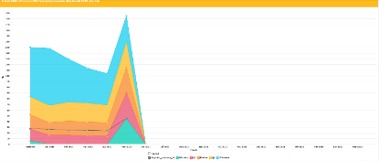
NEW BASIC Resources - Coming Soon
Patient education video with flyers
BASIC Dashboard for your monthly QI meetings
BASIC Grand Rounds- reach out to info@ilpqc.org for scheduling
Example Dashboard
Education Video Concept Art
9

Slide 10
BASIC Hospital Team Data Submission
Month | Teams Reporting Patient Data | Teams Reporting Hospital Data
Baseline (Q4 2020) | 65 | 58
January 2021 | 58 | 64
February 2021 | 54 | 53
March 2021 | 56 | 60
April 2021 | 54 | 55
May 2021 | 43 | 34

Slide 11
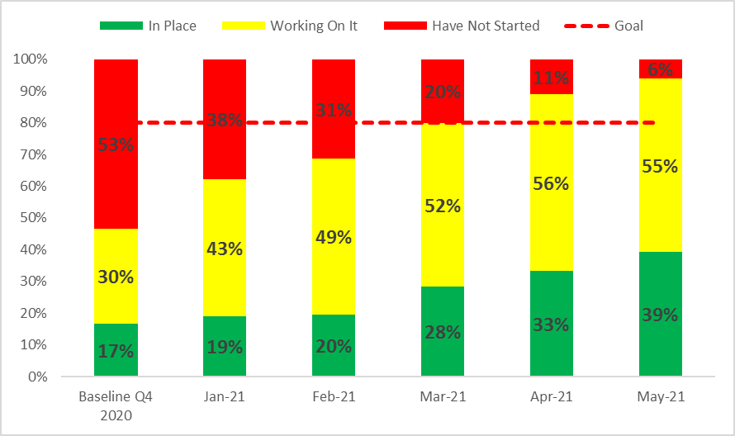
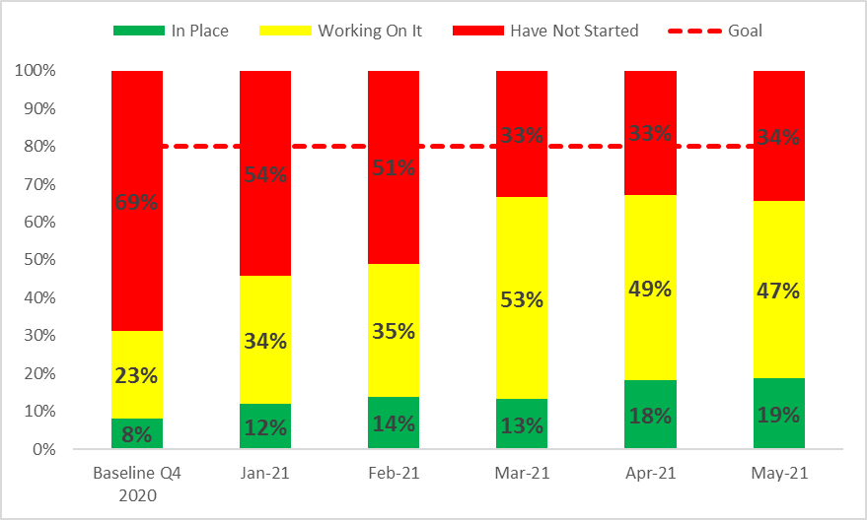
Structure Measures: Health Care Team and Family Education
Provider and Nurse Education
Patient Education

Slide 12
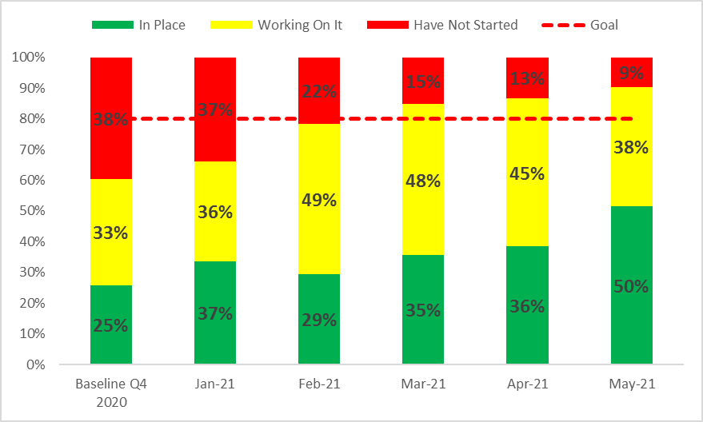
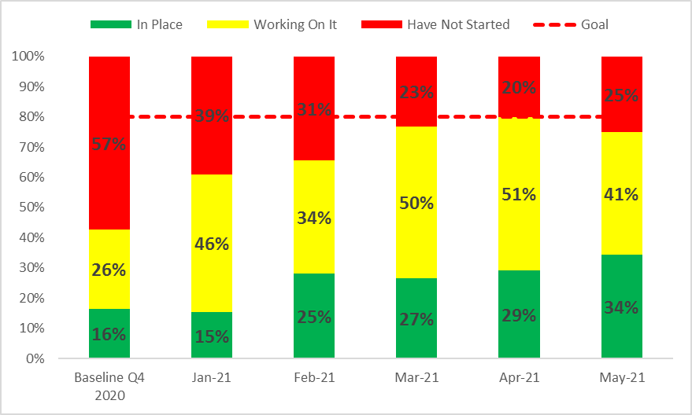
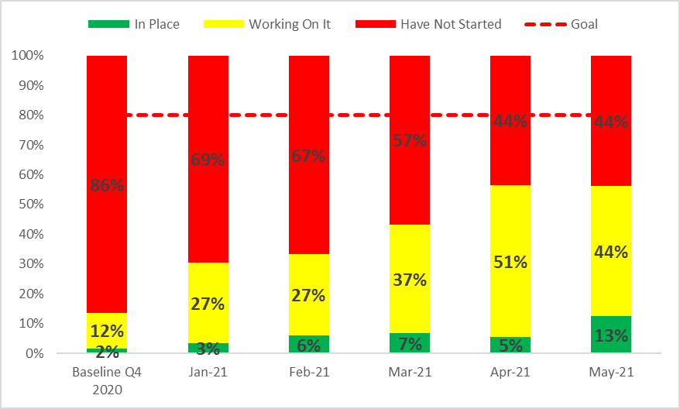
IT Partnership
QI Strategies for Provider Feedback
Review Data by Race & Ethnicity
Notes:
Structure Measures: QI Strategies & Equitable Care

Slide 13
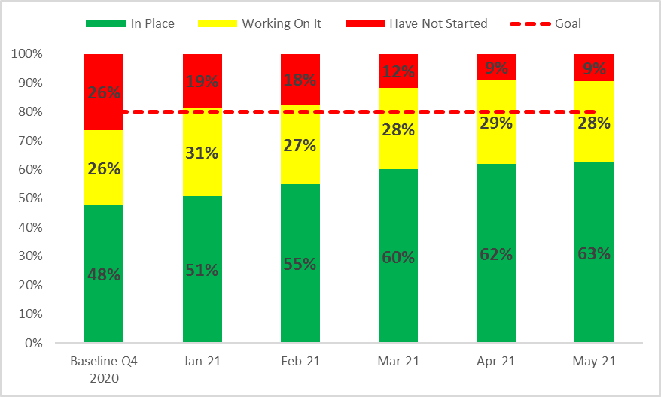
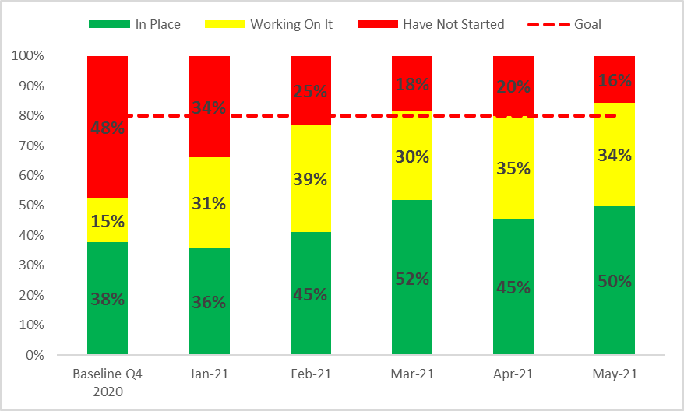
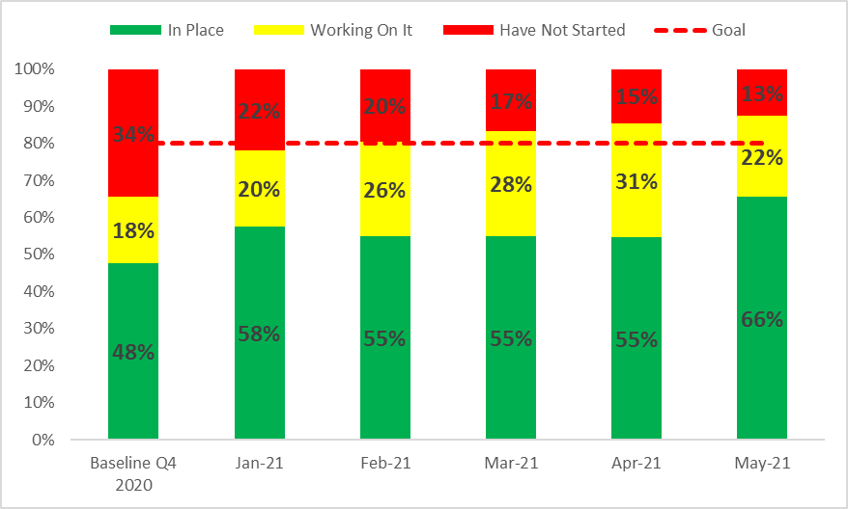
≥35 EOS Risk Assessment
<35 EOS Risk Assessment
OB Communication

Slide 14
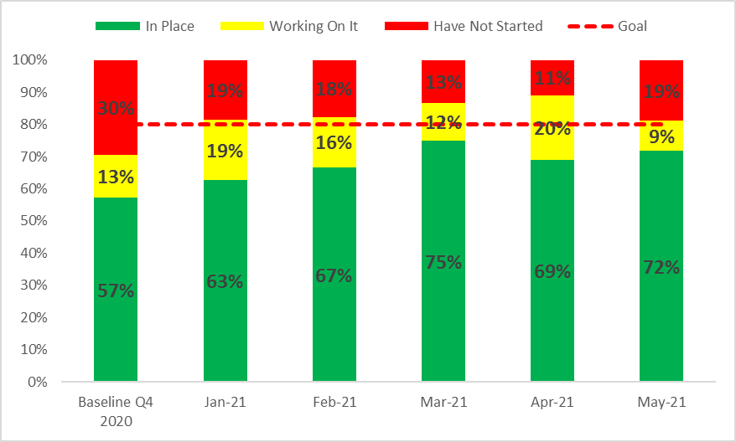
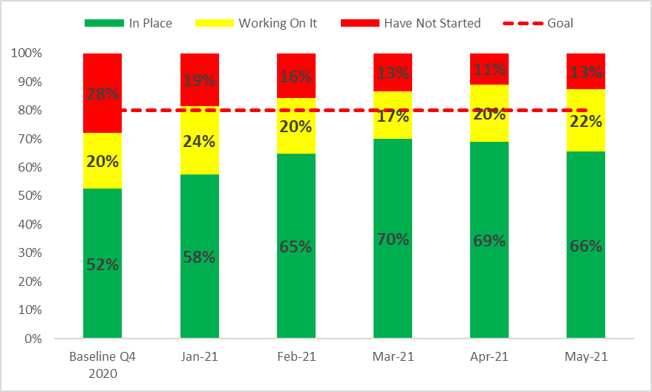
Structure Measures: Assessment & Initiation
Serial Assessment
Identification & Response to Worsening Status
Notes:
Serial Assessment
Reaction to Worsening Clinical Status

Slide 15
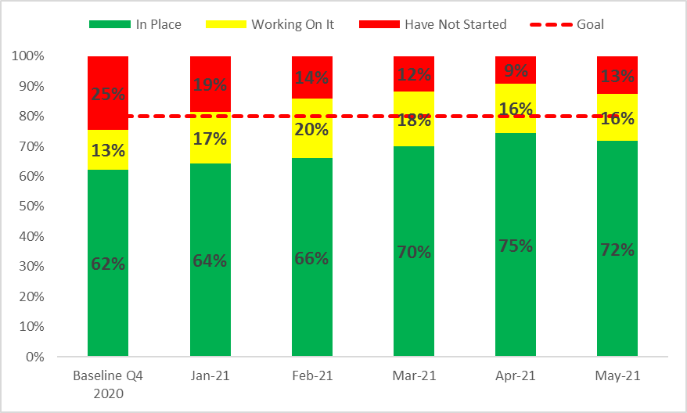
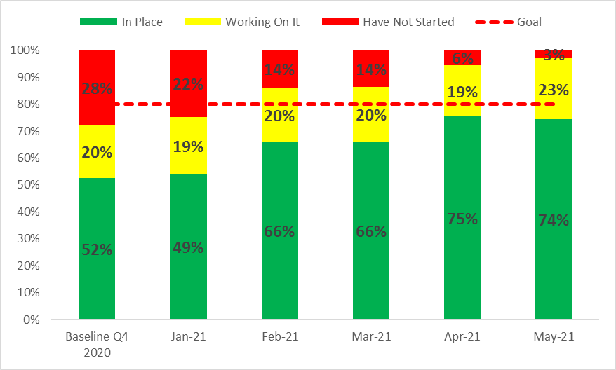
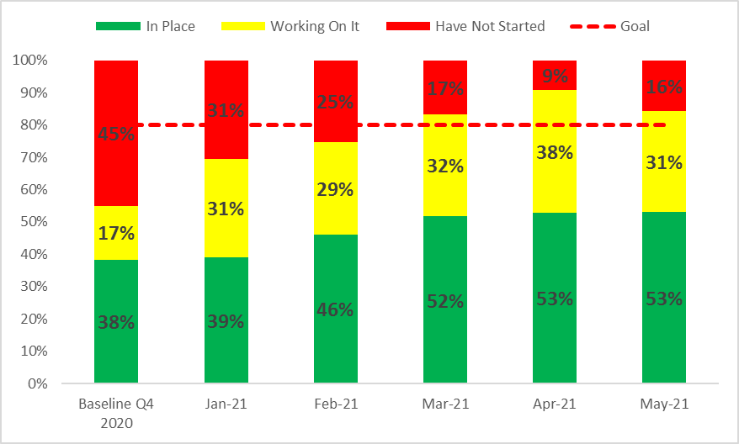
Blood Culture Collection
Blood Culture Result Processing & Communication
Protocol to De-escalate Antibiotics
Notes:
BC Collection
Communication with Lab re BCs
De-escalate

Slide 16
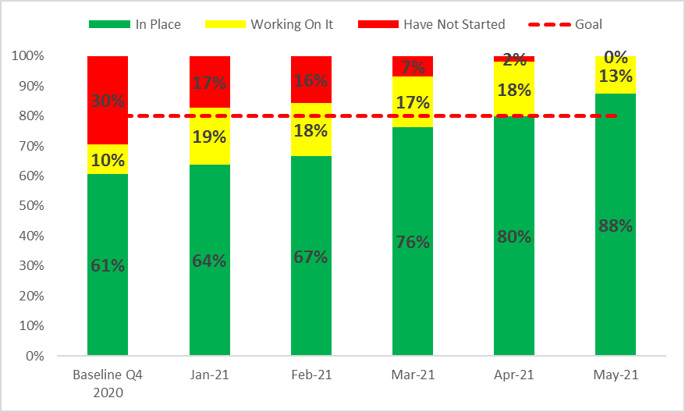
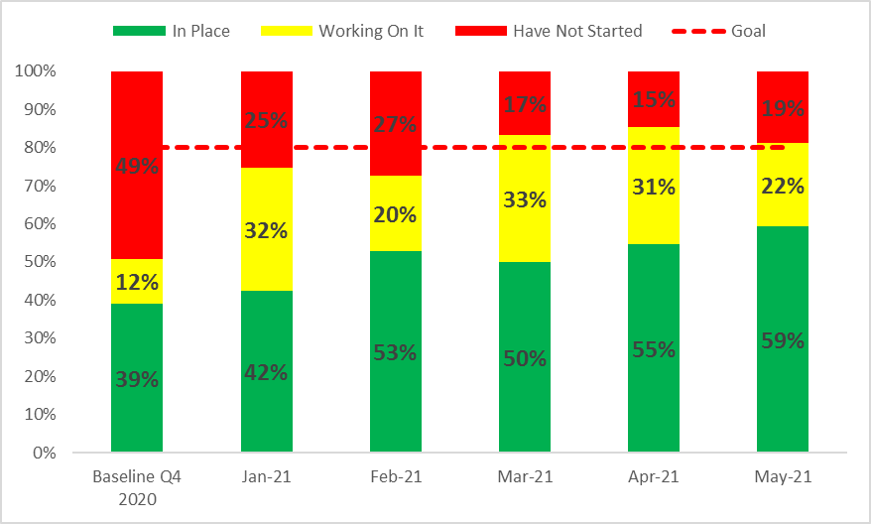
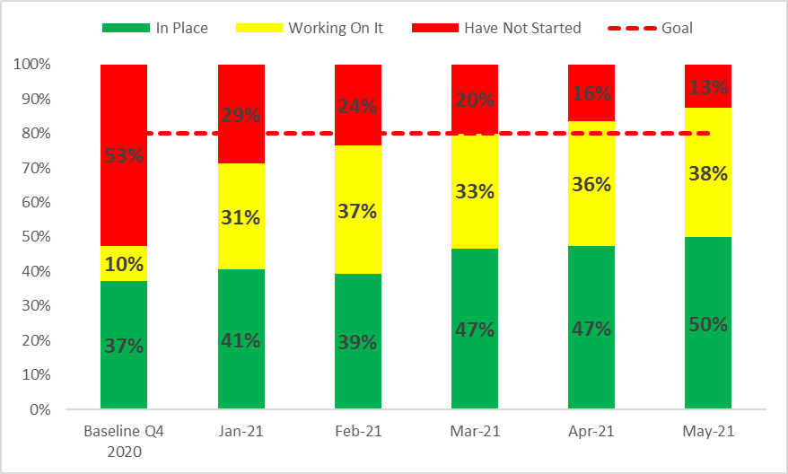
Dosing Guidelines
Discussions/Time Outs
Automatic Stop Times
Notes:
Standard dosing guidelines
“Antibiotic Time Out”
Automatic stop order

Slide 17
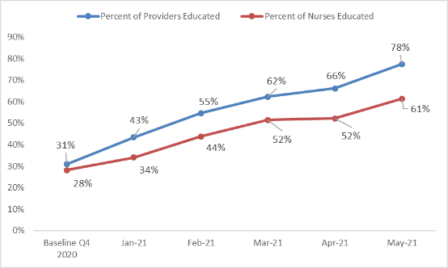
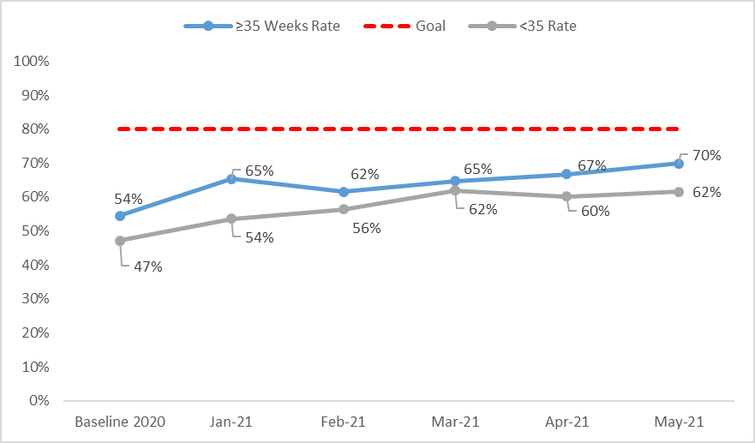
Process Measures: Health Care Team & Family Education
Provider & Nurse Education
Parent/Family Education
Notes:
Family Education
Family Ed, preferred language
Provider Education (Process)
Nurse Education (Process)

Slide 18
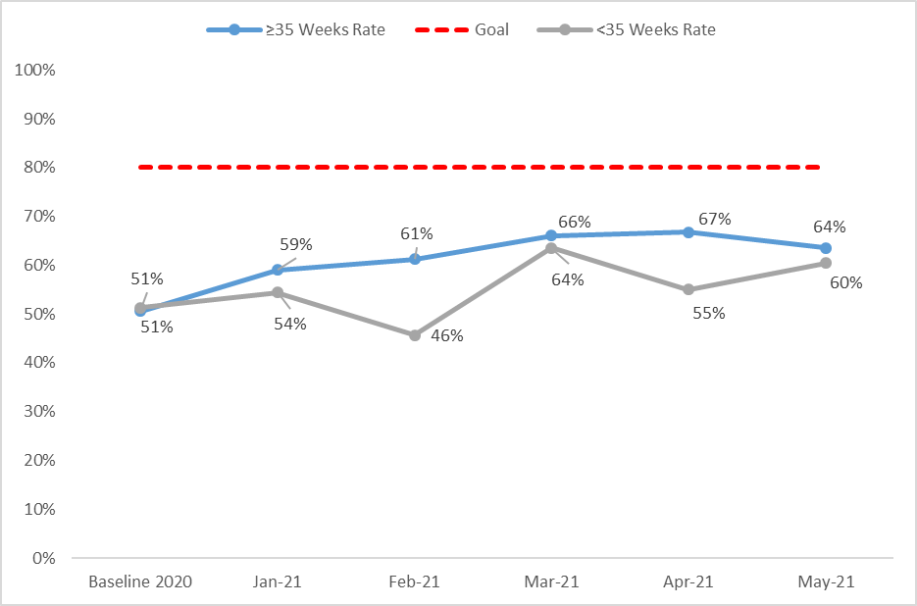
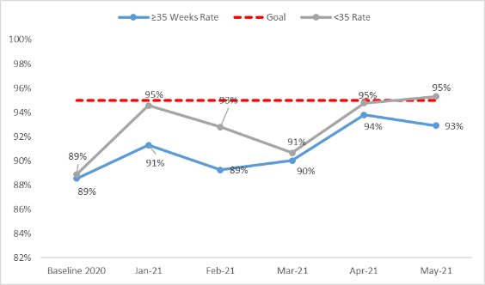
Process Measures: Assessment & Initiation
EOS Risk Assessment Utilized
Maternal Risk Factors for Neonatal EOS Documented
Notes:
>35 EOS Assessment
<35 EOS Assessment
Documentation of Maternal Risk Factors

Slide 19
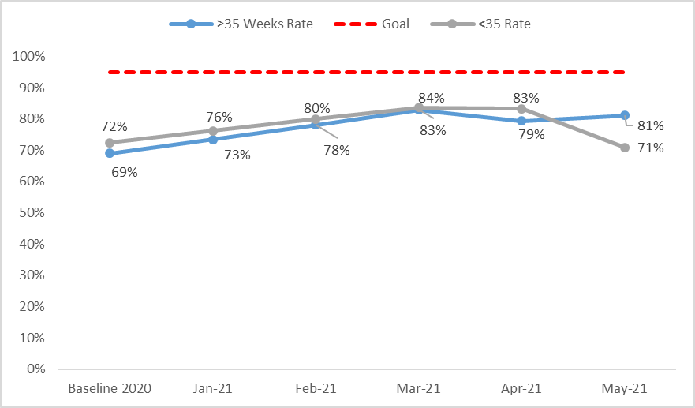
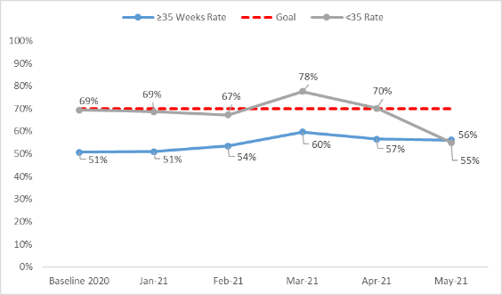
Process Measures: Antibiotic De-escalation
ABX Course Discussed by Clinical Team (Time Out)
ABX Automatic Stop Order Entered
Notes:
Abx time out
Abx stop order

Slide 20
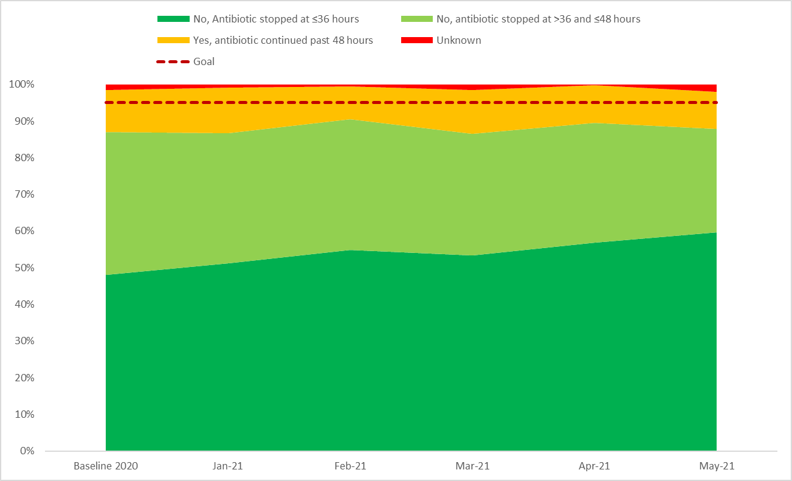
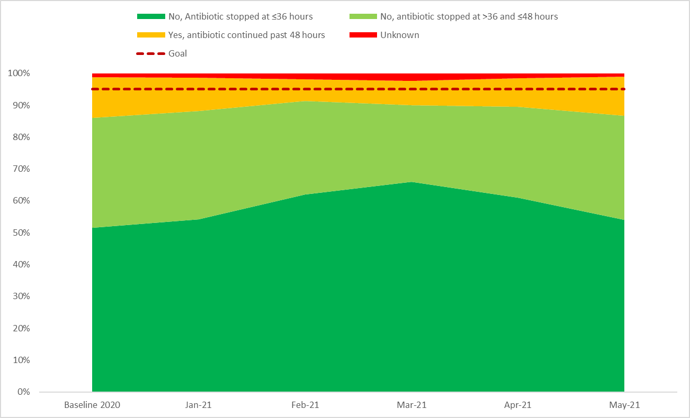
Outcome Measures: Antibiotics Continued Past Negative Blood Culture Result
≥35 ABX Continued Past Negative Blood Culture
<35 ABX Continued Past Negative Blood Culture

Slide 21
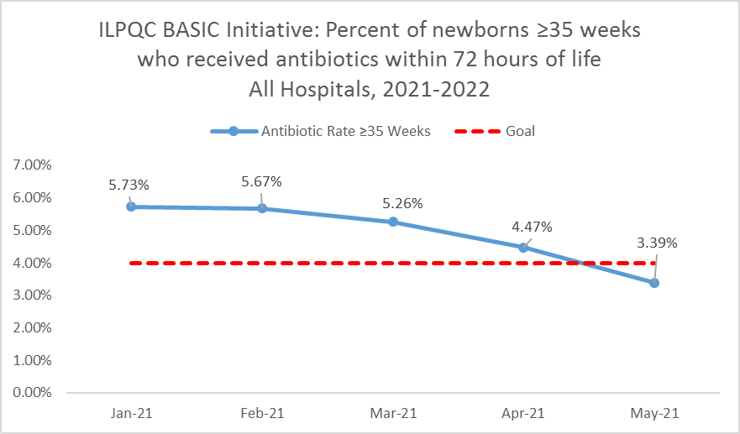
Outcome Measure: Antibiotic Prescribing Rate

Slide 22
BASIC Key Drivers
Data monitoring, transparency, and stewardship infrastructure
Timely and Appropriate Initiation of Antibiotics
Appropriate Administration and De-escalation
Equitable Care Delivery

Slide 23
Driver 2: Timely & Appropriate Initiation of Antibiotics
Timely Initiation of Antibiotics:
Facilitate Ob to Peds communication
Apply EOS risk assessment ☺
Facilitate PP to Peds communication
Appropriate Initiation of antibiotics:
Ensure optimal blood culture draw process
Select appropriate antibiotic, dose and interval
Operationalize serial assessments & process to identify change in newborn clinical status

Slide 24
Communication Strategies

Slide 25
Communications & Handoffs
What: A handoff is the transfer of patient information and responsibility from one nurse or provider to another nurse or provider
Why: Accurate communication of information about a patient from one member of the health care team to another is a critical element of patient care and safety. Handoffs ensure a seamless transition of critical information that results in continuity of patient care.

Slide 26
Communication & Handoffs: Where they happen
Communication between L&D nurse and receiving newborn/postpartum nurse for newborn risk of EOS:
Newborn background
Maternal & delivery history
Newborn status
Communication between newborn/postpartum nurse and pediatrician:
Maternal & Newborn history and assessment
Results of NEOSC
NEOSC recommendations

Slide 27
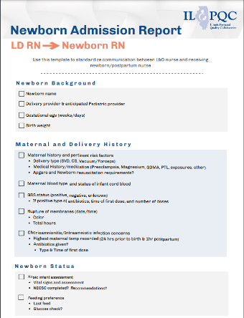
Communication & Handoffs: Toolkit Resources
Newborn Admission Report
Use this template to standardize communication between L&D nurse and receiving Newborn/Postpartum nurse
Newborn Nurse to Pediatrician Communication Tool
Use this template to standardize communication between the newborn/postpartum nurse to the pediatrician on newborn status
Notes:
Need the other communication tool

Slide 28
Optimal Blood Culture Collection

Slide 29
Optimal Blood Culture Collection
When:
Should be collected prior to the initiation of antibiotics.
What:
The definitive diagnosis of neonatal sepsis is established by a positive blood culture.
A minimum blood volume of 1mL per bottle is desirable.
The optimal recovery of bacteria and fungi from blood depends on culturing an adequate volume of blood- this improves detection of pathogenic bacteria or fungi in low quantities!

Slide 30
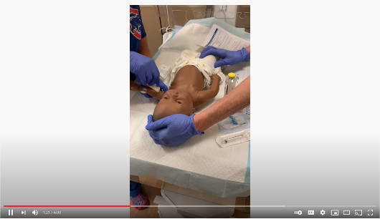
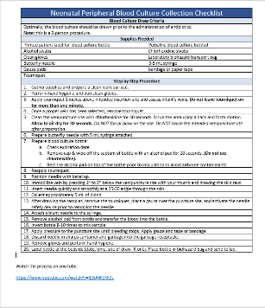
Resources to Support Optimal BC Collection
Example Neonatal Peripheral Blood Culture Collection Checklist & accompanying YouTube instructional video from Catherine Bennett, Advocate Lutheran General Hospital: https://www.youtube.com/watch?v=IL3jAW1Kk9c

Slide 31
Selecting the Appropriate Antibiotic Dose

Slide 32
Antibiotic Dosing for Neonatal EOS

Slide 33
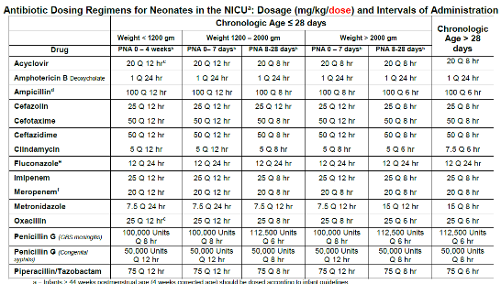
Example Dosing Guidelines & Order Sets in Toolkit
Example Antibiotic Dosing Regimens, Intervals of Administration, and Gentamicin/Vancomycin Dosing Guidelines (Shared by UIH 5.4.2020)
Example >35 weeks orderset (Shared in 2020 by UIH)
Example Gentamicin 10.4mg IV EMR Order (Shared in 2020 by UIH)
Example Gentamicin 13.6mg and Ampicilin 170mg EMR Order (Shared in 2020)
Does your hospital have example guidelines/order sets and want to share with the collaborative?
Email them to info@ilpqc.org!

Slide 34
Standardizing Serial Assessments & Response to Worsening Clinical Status

Slide 35
Early Onset Sepsis
Early Identification for Infants at risk for developing infection
Presented to: Insert relevant presenter information Calibri 16pt
Presented on: Month day, Year
Presented by: Insert relevant presenter information here
Presented to: ILPQC BASIC Committee
Presented on: June 21st, 2021
Presented by: Rachel Varghese and Genni Field NWR

Slide 36
Risk factors for neonatal sepsis
Group B Streptococcus positive or unknown status of mother
Maternal temperature >100.4
Rupture of membranes > 18 hours
Chorioamnionitis
Premature labor ≥ 34 weeks gestation
Intrapartum antibiotics
Fetal tachycardia
Symptomatic Infant

Slide 37
KAISER PERMANENTE PROBABILITY TOOL
Based on Maternal risks and Infant’s Clinical Presentation

Slide 38
Kaiser Permanente

Slide 39
Classification of infant’s clinical presentation
Clinical Exam and Description

Slide 40
Standardized Serial Assessments
Well Appearing | Equivocal | Clinical Illness
Infant’s ≥ 37 weeks gestation and ROM <18 hours require a minimum observation of 48 hours in the hospital | Follow recommendations as outlined in the EOS calculator or at the discretion of the physician | Infant’s with clinical illness or worsening symptoms are admitted to the ICN/SCN for the management as ordered by the physician
Infant’s <37 weeks gestation or ROM ≥ 18 hours should have diagnostic testing ordered by physician and observed for 48 hours |  | Obtain orders for CBC with differential and Blood culture prior to starting Empiric antibiotics
All infant’s screened for EOS have serial assessments of their vital signs and I&O every 4 hours for the first 48 hours |  | Antibiotics are discontinued if blood cultures results are negative at 36 hours
Well appearing infants who’s mothers received full antibiotic prophylaxis prior to delivery may be discharged as early as 24 hours at the discretion of the physician

Slide 41
Questions?

Slide 42
Thank You

Slide 43
Next Steps
Meet with your BASIC QI team to review your hospital’s monthly reports for Hospital & Newborn measures and determine measures to focus on for improvement in the upcoming months
Review with your QI team your hospital’s policies, protocols, strategies, and the ILPQC BASIC toolkit. Make updates as appropriate regarding:
Communication Strategies
Optimal Blood Culture Collection
Selecting the Appropriate Antibiotic Dose
Standardizing Serial Assessments & Response to Worsening Clinical Status

Slide 44
Questions?

Slide 45
Thanks to our Funders
In kind support:

