Slide 1

BASIC Hospital
Teams Panel:
Sharing Strategies for a Successful Launch
2021 Virtual Neonatal
Face to Face Meeting

Slide 2
BASIC Vision
ILPQC hospitals, regardless of perinatal level or experience with newborn antibiotics initiatives, will implement best practices to provide:
the right antibiotics
for the right babies
for the right duration

Slide 3
BASIC by the Numbers
August –
October 2020
22 Wave 1 teams met monthly to review and provide feedback to data form & collection strategies
December 2020
Successfully launched BASIC with 82 hospital teams
200 attendees at launch call
January 2021 –
April 2021
4 monthly teams calls held, average attendance over 100
Teams have submitted data on over 4,000 newborns so far!
Teams working to complete readiness surveys
2 QI Leader calls held
June 2021 →
BASIC Dashboards Live
Updated toolkit resources
Patient education materials live

Slide 4
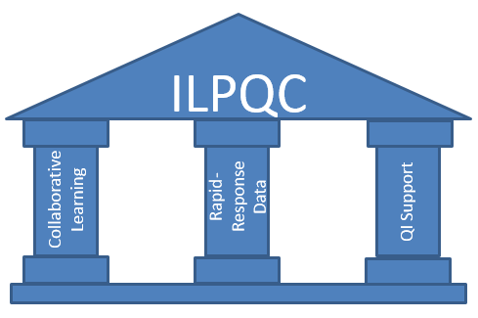
Core Pillars of ILPQC

Slide 5
BASIC Teams Panel
BASIC Initiative Data Collection: Strategies & Successes
  Susan McCarty, MSN, RNC-LRN; Memorial Medical Center, Springfield
Antibiotic Stewardship QI Initiative, Facilitating Buy-In
  Preetha Prazad, MD; Advocate Children’s Hospital- Park Ridge
Strategies to Improve Communication
  Rajeev Kumar, MD; John H Stroger Hospital of Cook County, Chicago
Notes:
JJ: Do we have a brief intro sentence for each one?

Slide 6
BASIC Initiative Data Collection: Strategies & Successes
Susan McCarty MSN RNC-LRN

Slide 7
Strategies:
Cerner
Documentation is unit specific
Collaborative working relationship
Result copy
Identification of required data
What is already built?

Slide 8
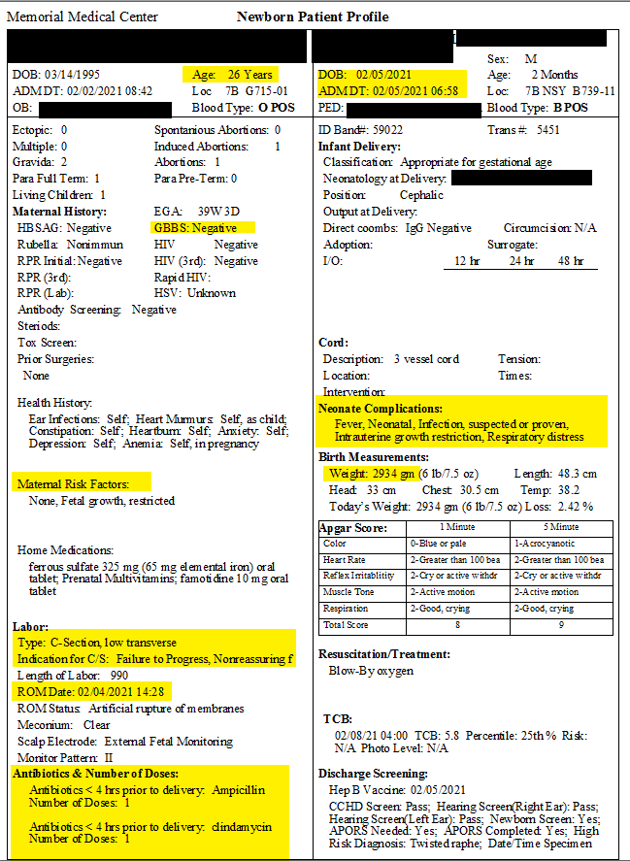
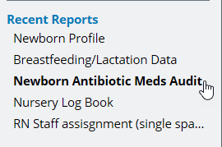
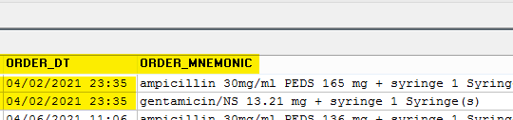
Some Old and some New………
Notes:
Remove if slide doesn’t apply

Slide 9
Success!
Now only 2 sources with all of our data collection information!!

Slide 10
Antibiotic Stewardship QI Initiative, Facilitating Buy-In
Preetha Prazad, MD, Advocate Children’s Hospital- Park Ridge

Slide 11
Antibiotic Stewardship QI Initiative
ACH-PR NICU
QI team development
1. Interdisciplinary Team
Neonatologists and NPM fellows
NICU nursing leaders and staff
Pediatric infectious disease physician
Infection prevention expert
Neonatal clinical pharmacists
Pharmacist dedicated to antibiotic stewardship
Health informatics and Technology personnel
2. Biweekly Team meetings
Phases:
QI team development
Planning and selection of intervention
Staff education
Intervention implementation
Pre-/post-analysis
Planning and selection of intervention
1. Developed an EOS guidelines
2. Baseline data

Slide 12
Antibiotic Stewardship QI Initiative
ACH-PR NICU
Staff education
1. Educational sessions with providers and nursing staff
Shared baseline data
Discussed new EOS guidelines
SRC and use in various clinical scenarios
2. Shortcut to SRC link installed in all NICU computers
3. EMR modified to record SRC scores in progress notes
Reinforced provider use of SRC Document rationale if EOS guideline was not followed
Phases:
QI team development
Planning and selection of intervention
Staff education
Intervention implementation
Pre-/post-analysis
Intervention implementation
Weekly review of progress notes to monitor
Accuracy of SRC scores
Documentation completeness
EOS guideline compliance
2. Review compiled into compliance report that included provider names, compliance with guidelines, and reason for deviation, if applicable
3. Report shared with all providers & leadership staff on a weekly basis
4. Quarterly antibiotic usage reports
Concomitant hospital antibiotic stewardship initiative

Slide 13
Strategies to improve communication
Rajeev Kumar, MD
John H Stroger hospital of Cook County
Chicago, IL.

Slide 14
IMPROVING COMMUNICATION
Before Delivery- Maternal risk factors- Who is going to provide the information (Doctor vs Nurse vs Automatic from EMR).
At Birth- Neonatal Sepsis Calculator- Who is going to do it (Doctor vs Nurse or Automatic EMR).
EMR- does everybody knows where to look for information.
Newborn Nursery/NICU.

Slide 15
Neonatal Sepsis Calculator
Newborn
Well Appearing
Equivocal
Clinical illness
Work flow changes
Evaluation and antibiotics
Routine care

Slide 16
Work flow changes
Identify which babies to monitor- who is identifying.
What to monitor – Vitals (RR, HR, Temp, Feeding difficulties).
What is normal or abnormal.
What to do with information.
Day vs Night
Order sets

Slide 17
Results

Slide 18
Thanks

Slide 19
Questions?

Slide 20
Breakout Sessions
Continuing to share in small groups: the core of ILPQC efforts

Slide 21
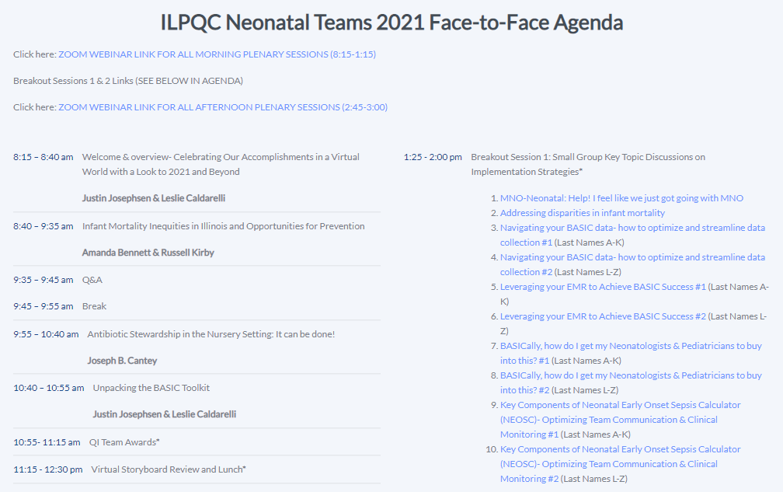

Slide 22
Get ready to start your video and unmute those mics!
Join us in the Breakout Sessions to:
  Share your experiences and ideas
  Review your lessons learned
  Collaborate with your colleagues across the state
  Starts at 1:25 pm

Slide 23
Breakout Sessions
Select the breakout sessions you selected during registration:
Each attendee can attend a total of 2 sessions
  Session #1: 1:25pm - 2:00pm
  Session #2: 2:05pm - 2:40pm
MNO-Neonatal: Help! I feel like we just got going with MNO
Addressing disparities in infant mortality
Navigating your BASIC data- how to optimize and streamline data collection #1 (Last Names A-K)
Navigating your BASIC data- how to optimize and streamline data collection #2 (Last Names L-Z)
Leveraging your EMR to Achieve BASIC Success #1 (Last Names A-K)
Leveraging your EMR to Achieve BASIC Success #2 (Last Names L-Z)
BASICally, how do I get my Neonatologists & Pediatricians to buy into this? #1 (Last Names A-K)
BASICally, how do I get my Neonatologists & Pediatricians to buy into this? #2 (Last Names L-Z)
Key Components of Neonatal Early Onset Sepsis Calculator (NEOSC)- Optimizing Team Communication & Clinical Monitoring #1 (Last Names A-K)
Key Components of Neonatal Early Onset Sepsis Calculator (NEOSC)- Optimizing Team Communication & Clinical Monitoring #2 (Last Names L-Z)

Slide 24
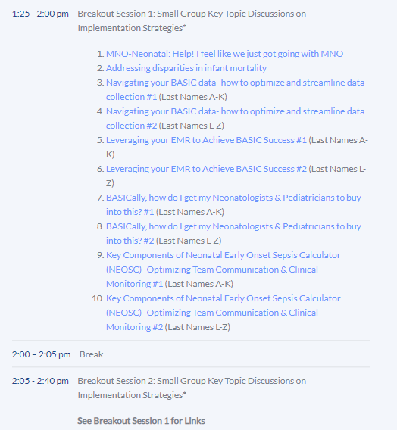
Breakout Session Details
How to get to your Zoom Breakout Session:
  Click the link in the ILPQC online agenda
  Select the appropriate link based on the first letter of your last name
Simply click the link to join the session!

Slide 26

10-Minute Break,
Transition to Breakout #1
1:15 – 1:25 PM

Slide 27










Thanks to our Funders
In kind support:

