Slide 1
BASIC: Unpacking the Toolkit
10:40 am – 10:55 am

Slide 2

What is a toolkit?
What is a toolkit?
  A toolkit is a living document based on national and local best practices
What is in a toolkit?
  Example protocols
  Workflows
  Policies
  QI resources
How is it used?
  Facilitate buy-in at your hospital
  Implement systems and clinical culture change
  Implement QI Processes

Slide 3
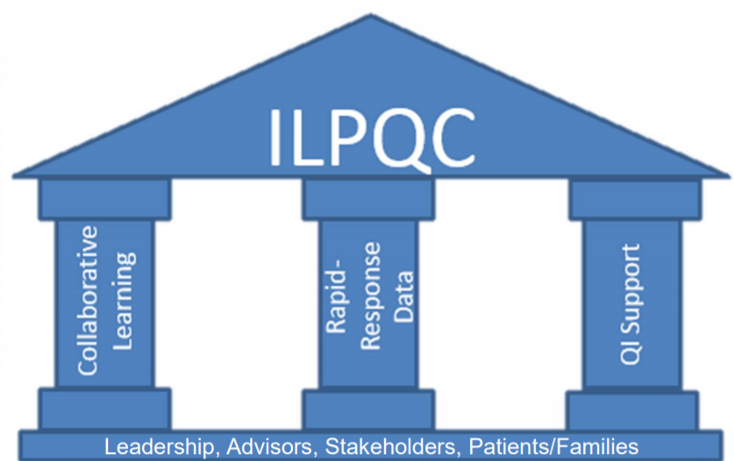
How does a toolkit fit into your QI work?
Collaborative Learning
QI Support
Toolkit
Rapid Response Data

Slide 4
ILPQC BASIC Vision and AIMs
Measures:
% of newborns with EOS risk assessment tool used and documented
% of parents/families provided education on antibiotics, EOS, and treatment plan for their newborn
% of parents/families provided education in their preferred language
% of newborns receiving abx with documentation of maternal risk factors for EOS in their chart
% of newborns with anticipated duration of abx course discussed by clinical team
% of newborns with antibiotic automatic stop order in medical chart
Vision: ILPQC hospitals, regardless of perinatal level or past experience with implementing newborn antibiotics initiatives, will implement best practices to provide: the right antibiotics to the right babies for the right duration
AIMs:
Decrease by 20% (or absolute rate of 4%) the number of newborns, born at ≥35 weeks who receive antibiotics
Decrease by 20% the number of newborns with a negative blood culture who receive antibiotics for longer than 36 hours

Slide 5
Two versions of BASIC Toolkit
2 versions of the toolkit that contain same tools
Links directly to Key Driver Diagram
Coming soon: User-friendly version of the BASIC Toolkit
  Family Communication and Education
  Provider and Nursing Education
  National Guidelines and Recommendations
  EMR Related Tools
Version currently on Webpage

Slide 6
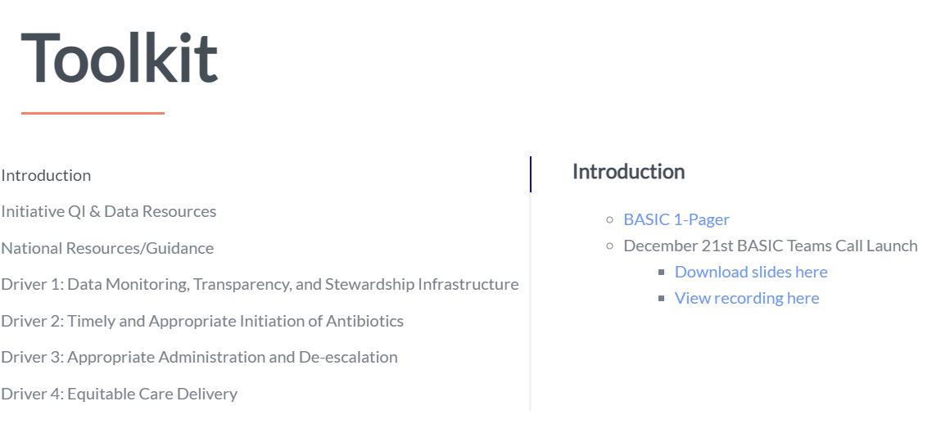
BASIC Toolkit Sections:
Introduction
Initiative QI and Data Resources
National Resources/Guidance
Driver 1: Data Monitoring, Transparency, and Stewardship Infrastructure
Driver 2: Timely and Appropriate Initiation of Antibiotics
Driver 3: Appropriate Administration and De-escalation
Driver 4: Equitable Care Delivery
Find The BASIC Toolkit at ILPQC.org/basic2021/

Slide 7
Driver 1
Data Monitoring Transparency and Stewardship Infrastructure

Slide 8

Interdisciplinary QI team & Infrastructure
Form an interdisciplinary QI team, identify champions, and meet regularly
Ensure leadership commitment
Develop a project roadmap
Monitor and share data to create transparency
Coordinate communication with all interdisciplinary members

Slide 9
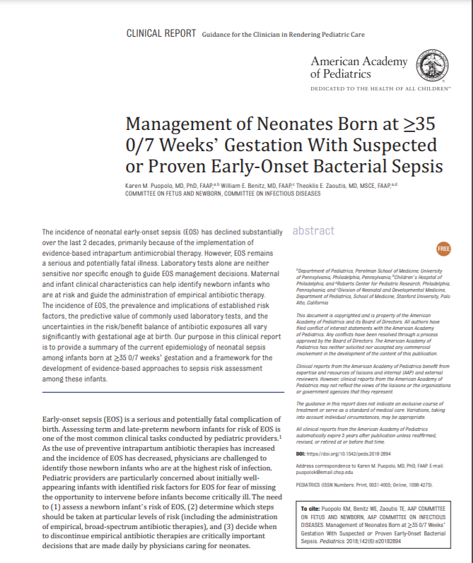
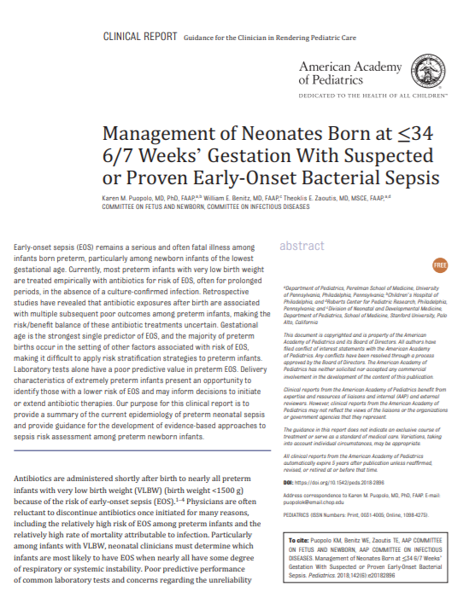
National Guidance: AAP

Slide 10
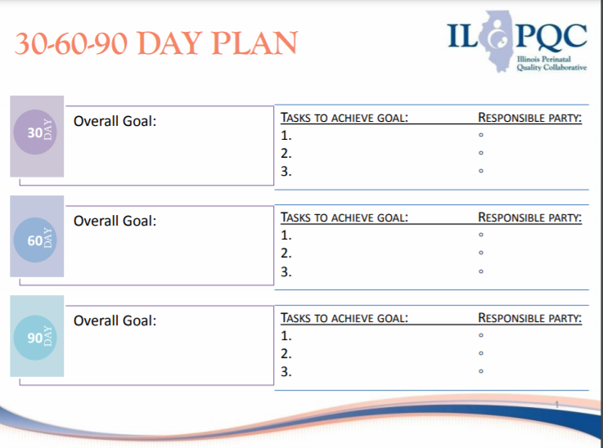
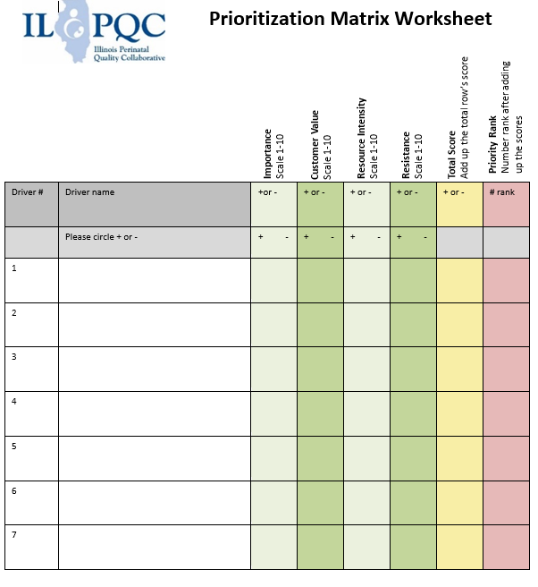
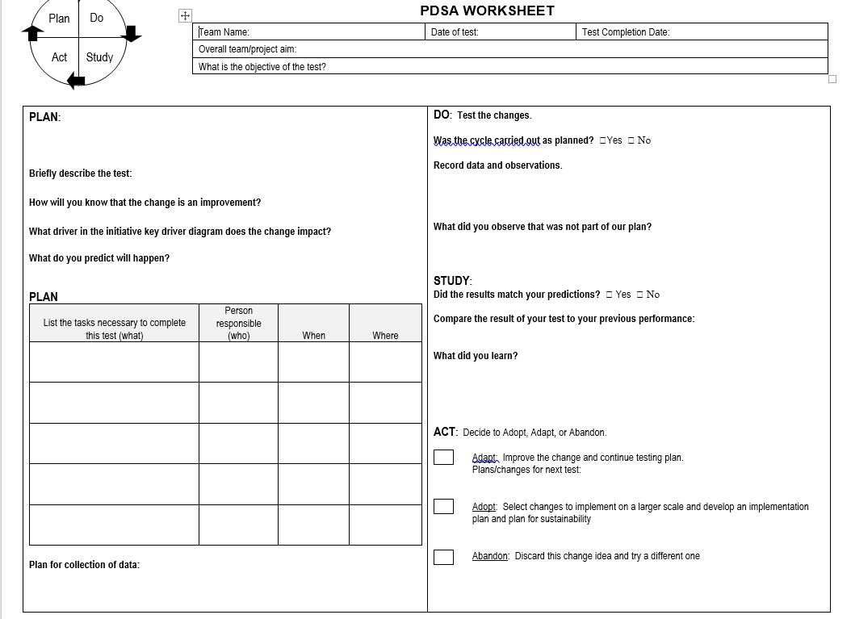

Slide 11

Data systems & team capacity to review and evaluate data
Coordinate with HIT to develop EMR data structure including collection and reporting
Review Dr. Patrick Lyon’s webinar on Leveraging your EMR

Slide 12
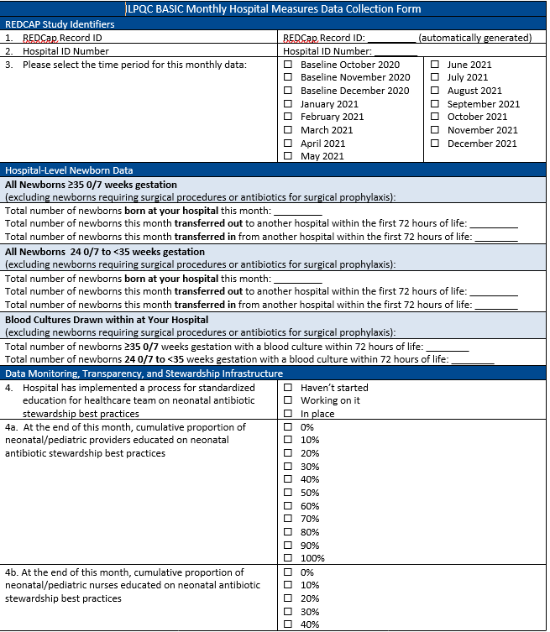
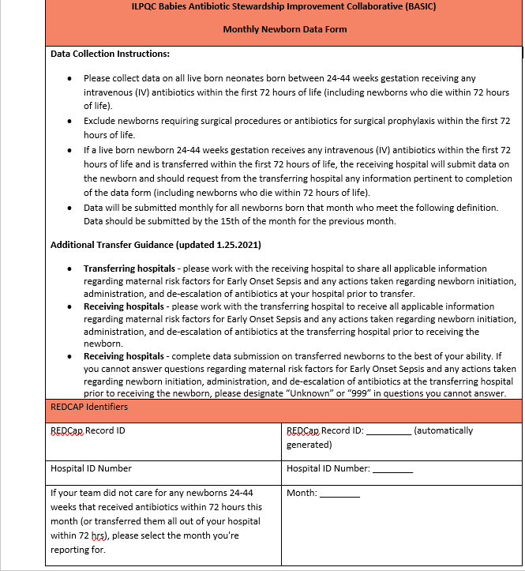

Data systems & team capacity to review and evaluate data
Monthly Hospital Data Form
Submit/Analyze monthly hospital and newborn data into ILPQC Data System
Track progress to key improvement goals and identify priority areas
Monthly Newborn Data Form

Slide 13
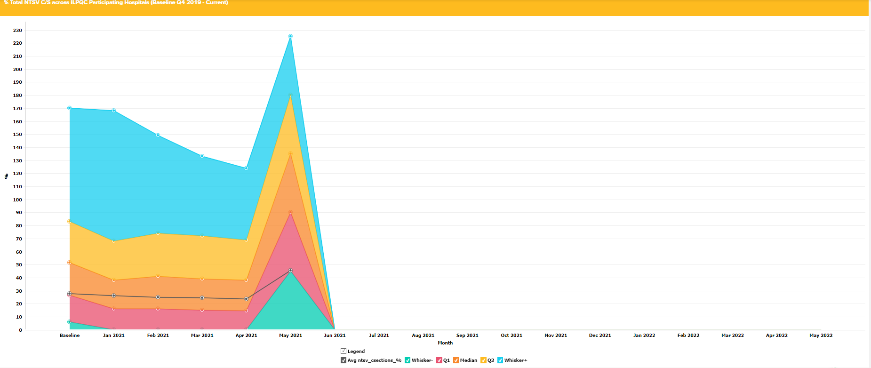
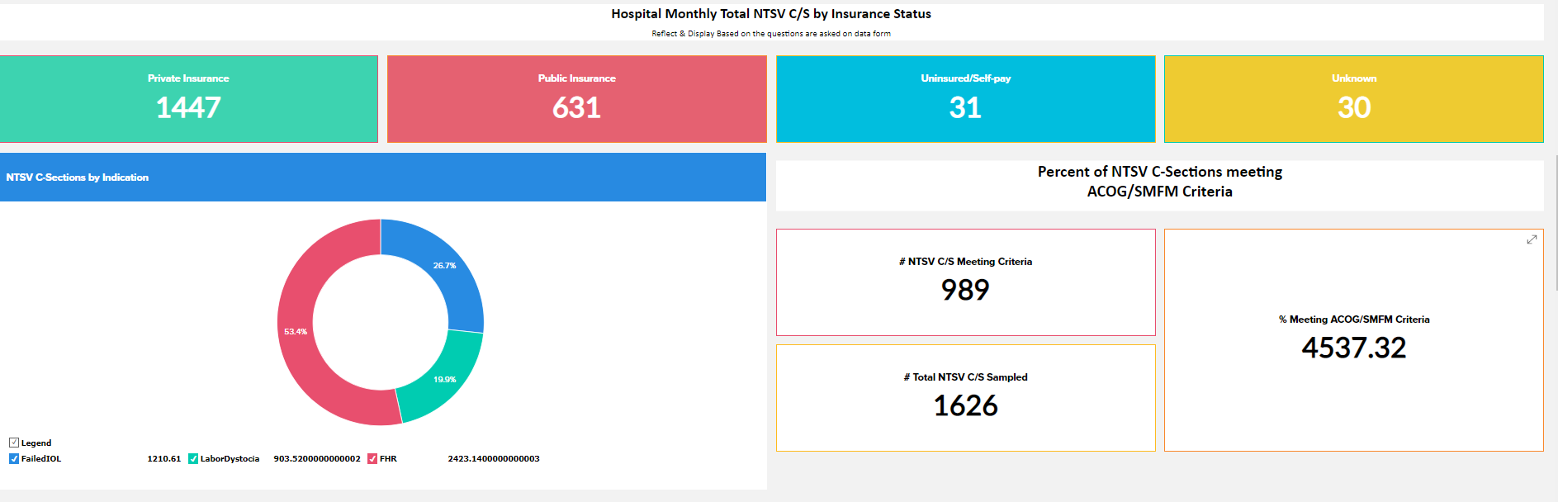
Build capacity to effectively share data
Display the hospital and newborn data in a meaningful way for various stakeholders
COMING SOON:
  BASIC Dashboard
Example Dashboard from Promoting Vaginal Birth Initiative

Slide 14
Capacity building for antibiotic stewardship
Build an interdisciplinary clinical antibiotic stewardship team to include representatives from ID, Pharmacy, Microbiology
Foster clinical leadership commitment
Identify evidence based best practices
Review metrics and benchmarks regularly
Develop a structure of accountability with feedback and compliance monitoring
Disseminate nursing/provider/physician education
Use EMR clinical decision support to provide optimal care

Slide 15
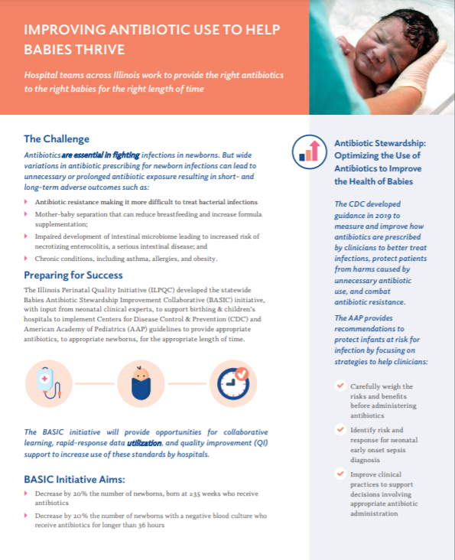
BASIC Grand Rounds (coming this summer)
Nursing Education Resources
BASIC One-pager
Notes:
Other resources we can add here???

Slide 16
Driver 2
Timely and Appropriate Initiation of Antibiotics

Slide 17
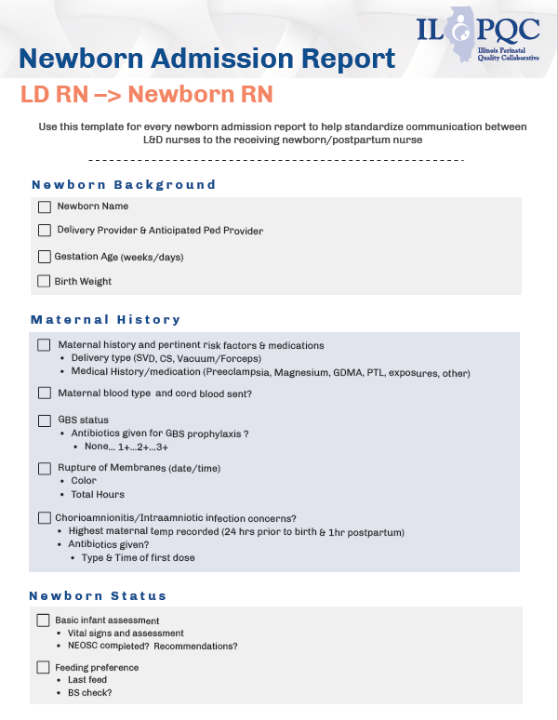
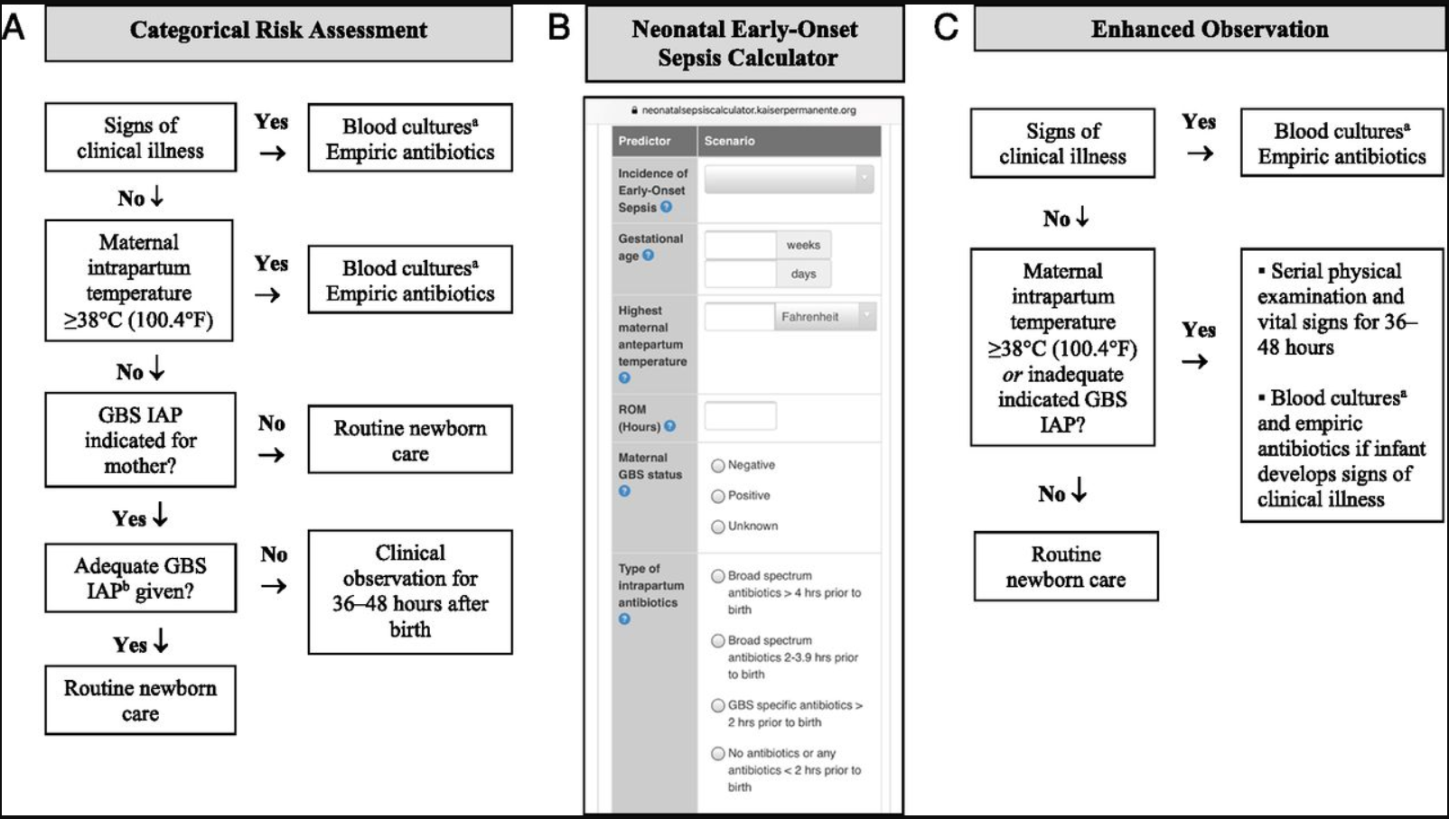
Timely Initiation of Antibiotics:
Facilitate OB to Peds communication
Apply EOS risk assessment
Facilitate PP to Peds communication
AAP Recommended Risk Assessment Tools- 3 Types

Slide 18
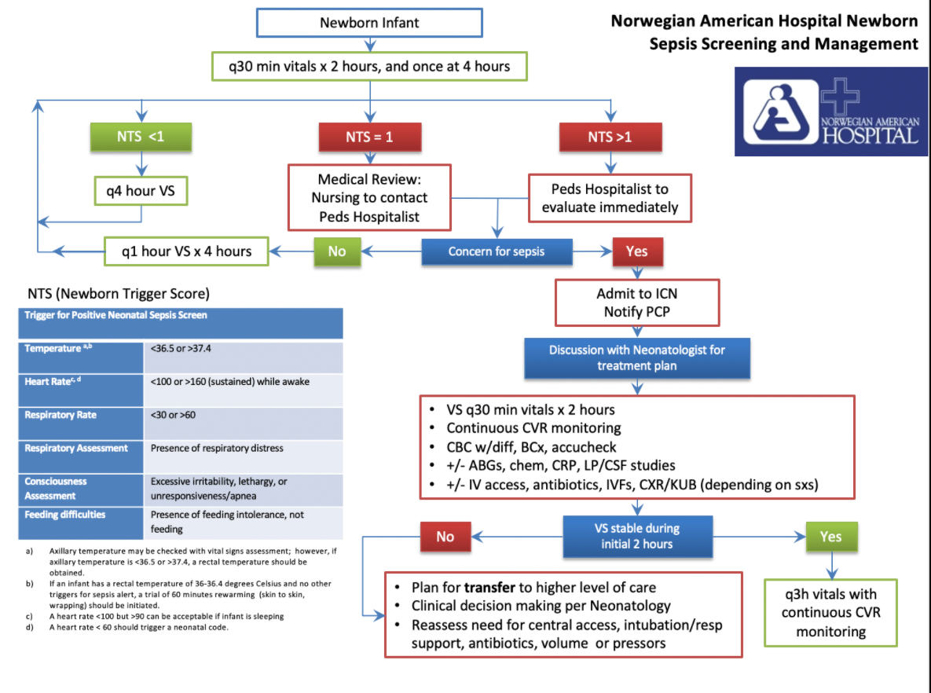
Appropriate initiation of antibiotics
Norwegian American Hospital (Humboldt Park Health) Example Newborn Sepsis Screen and Management
Ensure optimal blood culture draw process (right volume)
Select appropriate antibiotic, dose and interval
Operationalize serial assessments & process to identify change in newborn clinical status

Slide 19
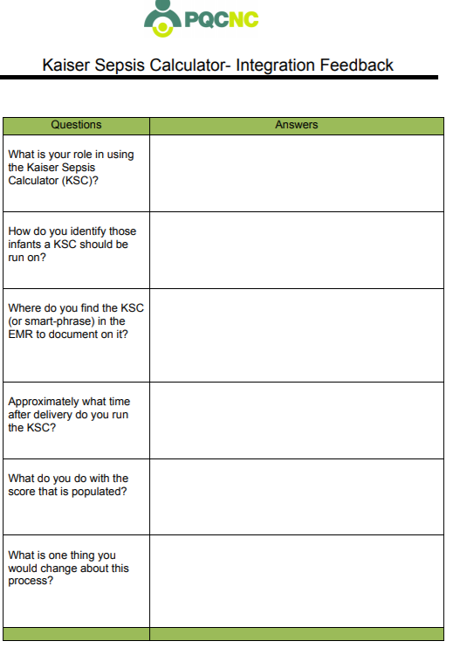
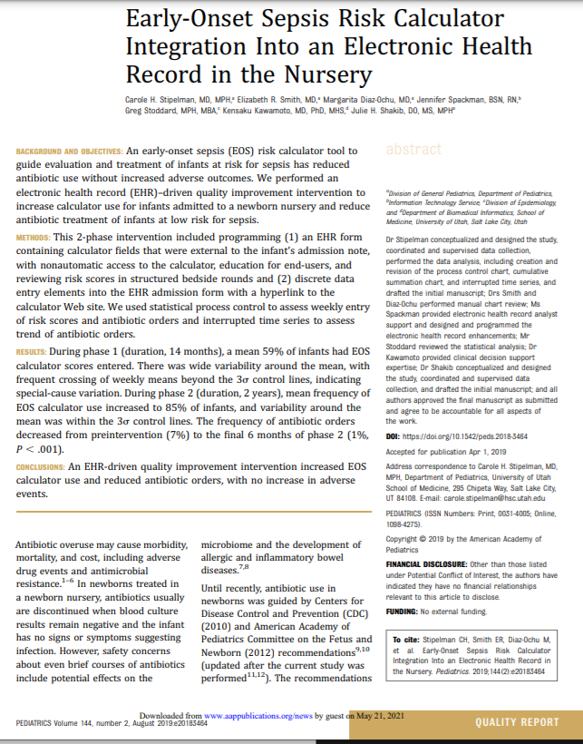
Resources for Implementation of Standardized Risk Assessment for ≥ 35
Publication to support EMR integration
Kaiser Calculator Integration Check Tool

Slide 20
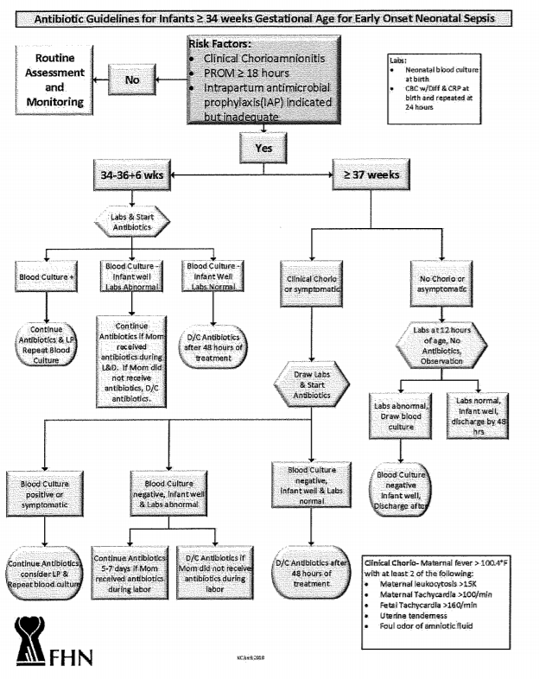
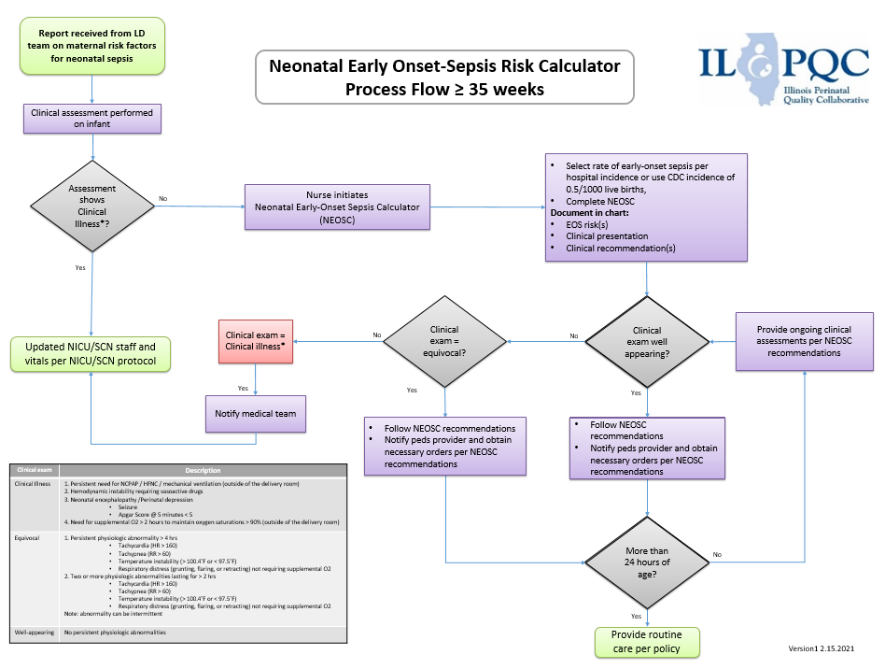
Resources for Implementation of Standardized Risk Assessment for ≥ 35
ILPQC Neonatal Early Onset-Sepsis Risk Calculator Process Flow ≥ 35 weeks
FHN Example ABX Guidelines for Newborns >34 weeks for EOS

Slide 21
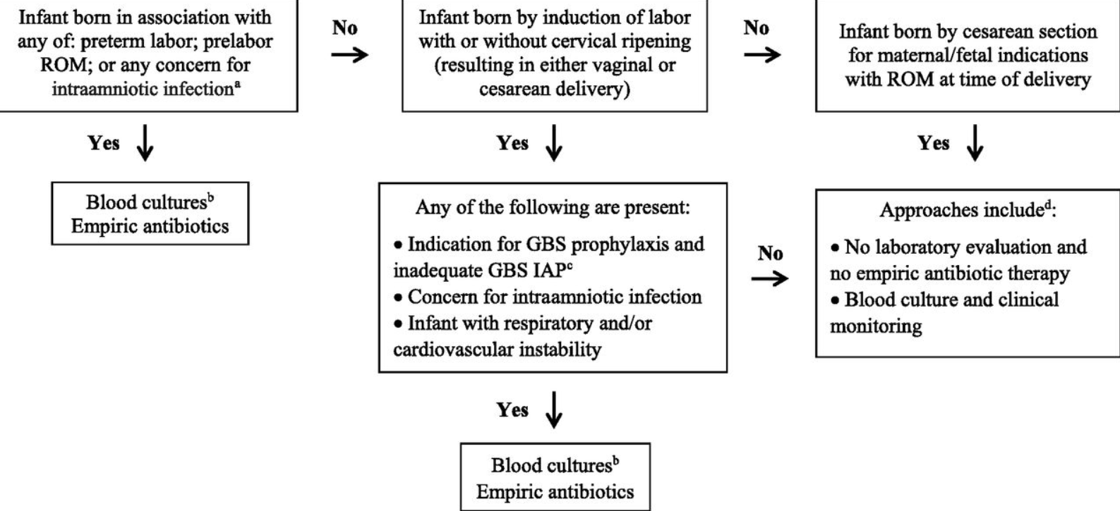
Resources for Implementation of Standardized Risk Assessment for <35
AAP Risk Assessment Workflow

Slide 22
Driver 3
Appropriate Administration and De-escalation

Slide 23
Appropriate administration of antibiotics
Foster family education and partnership
  Patient education video with flyer coming early Summer
Notes:
Will we have a screenshot or something for telestration?

Slide 24
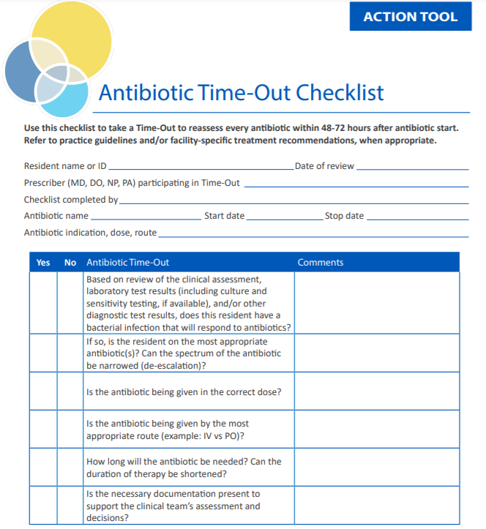
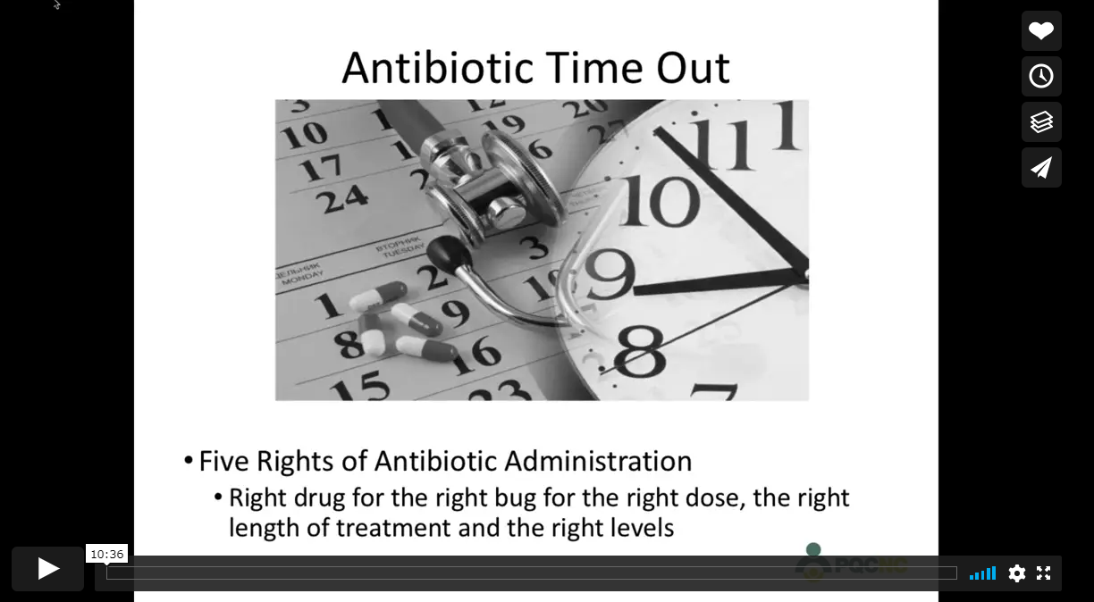
Appropriate de-escalation of antibiotics:
Example Antibiotic Timeout Checklist
Understand microbiology lab workflow & blood culture results communication
Reevaluate antibiotic appropriateness (antibiotic discussion/time out)
Implement antibiotic stop time
Disseminate culture negative sepsis education
Antibiotic time out video (PQCNC)

Slide 25
Driver 4
Equitable Care Delivery: Building your capacity to identify and eliminate inequities and disparities

Slide 26
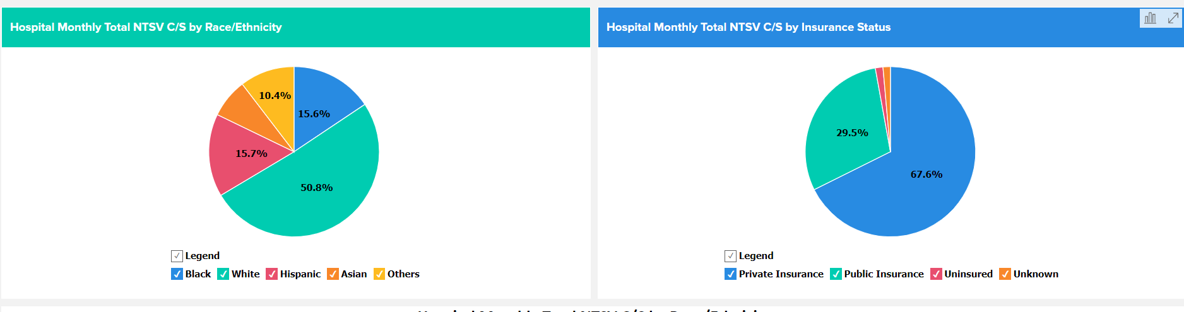
Inequities and disparities identification:
Ensure data availability
Develop data reports
Analyze data to drive change
Present data to drive change
Foster family partnership
Example Dashboard from Promoting Vaginal Birth Initiative

Slide 27
Inequities and disparities elimination:
Utilize standard evidence based best practice
Identify care variation
Decrease care variation
Communicate healthcare information in preferred language
Identify of family SDOH needs
Foster family partnership
Disseminate physician education
Disseminate nurse education
Notes:
Telestration in English and Spanish

Slide 28
What’s next?
Now that we have reviewed the BASIC toolkit…What’s next?
Meet with your QI team to discuss which tools will be useful for your team
Determine where buy-in is needed for implementing new tools or processes/protocols
Create a 30-60-90 day implementation plan for those tools
Conduct PDSA Cycles as you implement changes

Slide 29
ILPQC QI Excellence Awards
Virtual Storyboard Session
10:55 am – 11:15 am

Slide 30
Recognizing QI Excellence
10:55 am – 11:15 am
Quality Improvement Excellence Awards:
MNO-Neo
Storyboard Awards of Excellence
Outstanding Launch Award:
BASIC

Slide 31

ILPQC QI Awards
If your hospital is recognized, please use the chat box to celebrate your team members!
Everyone please help us celebrate our award winners, CONGRATULATIONS!
ILPQC will follow up with award winners to request contact & shipping information to send awards
If you have any questions, comments, or concerns about your award status, please email Dweiss@northshore.org or info@ilpqc.org

Slide 32
Red Carpet Awards

Slide 33
Virtual Team Storyboard Session & Lunch Break
11:15am – 12:30pm

Slide 34
Thank you to all who shared Storyboards
Advocate Sherman Hospital
AMITA Resurrection Medical Center
Advocate Lutheran General /Advocate Children’s
FHN
Loyola University Medical Center
MacNeal
Memorial Hospital Shiloh
Memorial Medical Center
Northwest Community Hospital
NM McHenry
NM Lake Forest
OSF Little Company of Mary
Palos Hospital
Riverside Hospital
Rush Copley
Rush University
Saint Alexius Medical Center
OSF St. Francis/Children’s Hospital of Illinois
Memorial Hospital of Carbondale
AMITA Alexian Brothers Medical Center
HSHS St. John’s

Slide 35


Storyboards Awards
The winners of the QI Coffee and Donuts are…..
Riverside Medical Center
OSF Little Company of Mary Hospital
OSF St. Francis Medical Center

Slide 36
Neonatal Storyboards
Who: All participants
What: Neonatal Storyboards
Where: There are two ways
  Neo Face to Face link in your conference registration email
  Face to Face button on ilpcq.org
When: Storyboard Lunch session from 11:15 - 12:30 pm
Why: Collaboration and exchange of ideas – Share your excellent work across the state!
Visit the ILPQC OB/Neonatal
Storyboards to check out
other hospital’s strategies for
success and lessons learned
from their QI initiatives.

Slide 37

Storyboard Raffle
How to win:
Review the storyboards on the ILPQC Neo Face to Face website
Complete the Stealing Shamelessly / Sharing Seamlessly online form (available in your email or on the event website)
Attend the Wrap-up session from 2:45 - 3:00 pm
Winners must be present to win one of 3 prizes
If a specific storyboard sparks your interest and you want to connect to a hospital to learn more about their work, email info@ilpqc.org and we’ll facilitate a warm hand off

Slide 38
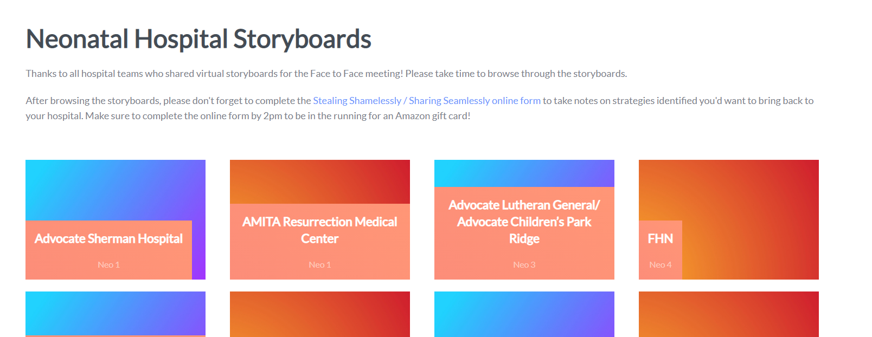

Slide 39
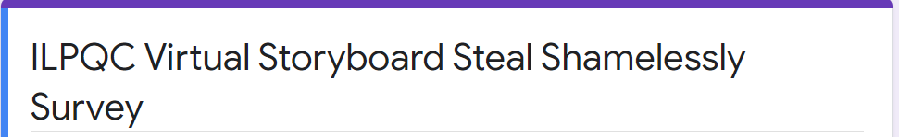
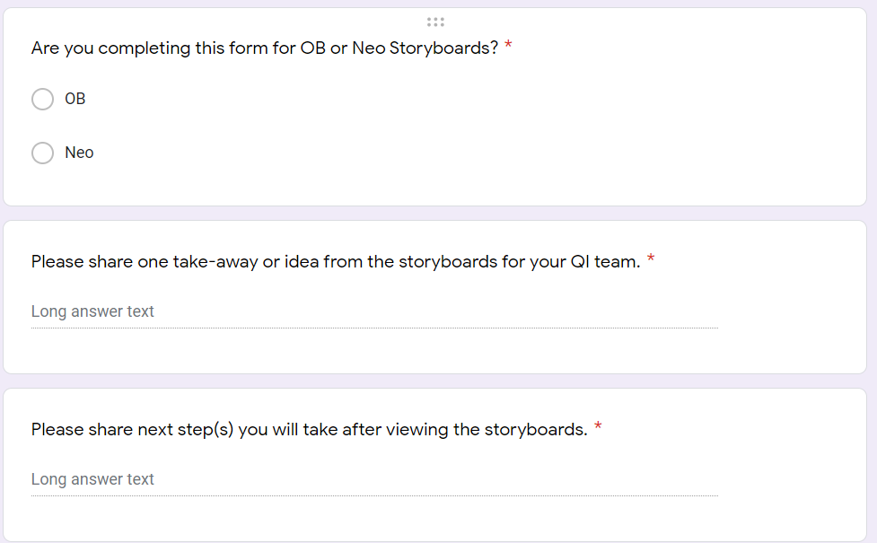
Steal Shamelessly Survey

Slide 40

Submit Steal Shamelessly Share Seamlessly online worksheet
This Photo by Unknown Author is licensed under CC BY-SA
Submit by 2pm!

Slide 41
Next Steps (11:15 – 12:30pm)
Go enjoy lunch!
Take time to browse the Neonatal Storyboards
Submit a Steal Shamelessly/Share Seamlessly form online by 2pm to be in the running for an Amazon gift card
At 12:30pm after Lunch/Storyboard Review please come back to the same Zoom webinar link you used for the AM sessions for the BASIC Hospital Team Panel
After the panel concludes, there will be a 10-minute break (1:15-1:25) to transition to Breakout Session #1

Slide 42
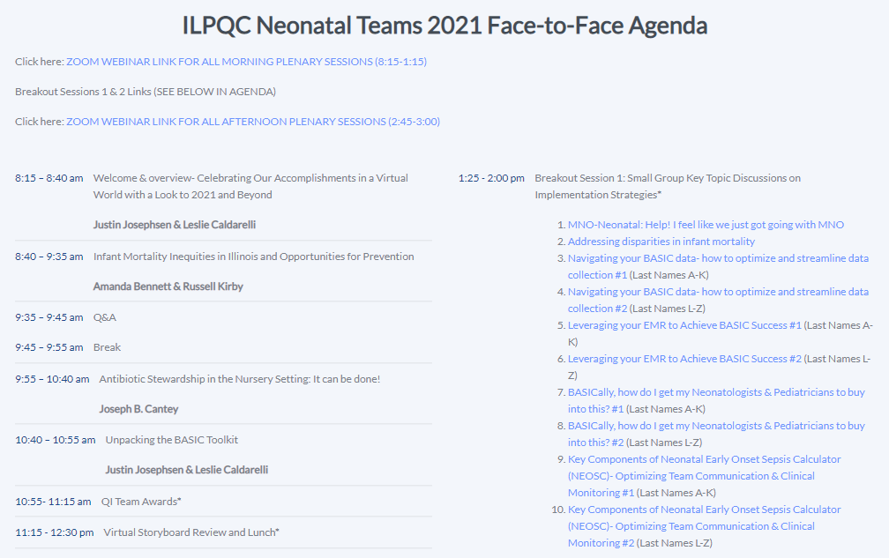

Slide 43










Thanks to our Funders
In kind support:
Notes:
Update new funder slide

