Slide 1
Antimicrobial stewardship in the nursery: It can be done!
J.B. Cantey, MD, MPH
Illinois Perinatal Quality Collaborative
Annual Face-to-Face Meeting
May 27, 2021

Slide 2
Outline
The evolution of nursery stewardship
Where were we?
Where are we now?
Where are we going?
Implementation science
How do you get buy-in for change?

Slide 3
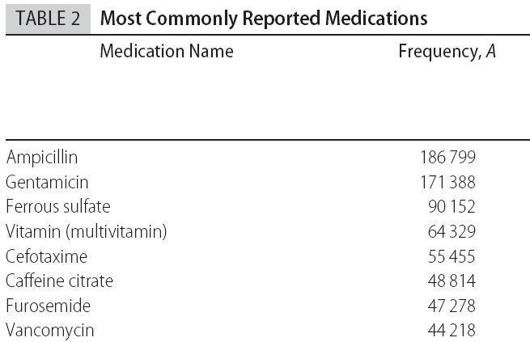
History of Nursery Stewardship
Number receiving at least one dose out of 208,459 patients
Clark et al. Pediatrics 2006

Slide 4
History of Nursery Stewardship

Slide 5
Adverse Effects in Premature Infants
Cotten et al, Pediatrics 2009
Retrospective cohort study of 4,039 extremely-low-birthweight (≤1000 g) infants
Found that for infants receiving initial empiric therapy who had sterile blood cultures, 5 or more days of therapy (53% of cohort) was associated with:
Higher risk of necrotizing enterocolitis ([NEC]; OR 1.3 [1.10-1.54])
Higher mortality (OR 1.46 [1.19 – 1.78])
Kuppala et al, J Pediatr 2011
Retrospective cohort of 365 very-low-birthweight (≤1500 g) infants receiving initial empiric therapy despite sterile blood cultures; 43% received ≥ 5 days of therapy
Found an association between receipt of 5 or more days of initial antibiotics and:
Late-onset sepsis (OR 2.45 [1.28 – 4.67])
Composite of late-onset sepsis, NEC, or death (OR 2.66 [1.12 – 6.3])

Slide 6
Adverse Effects in Premature Infants
Cantey et al, J Pediatr 2018
Retrospective cohort of 374 VLBW infants receiving initial empiric therapy despite sterile blood cultures; controlled for severity of illness using Clinical Risk Index in Babies – II (CRIB-II) score
In multivariate analysis, each additional antibiotic day of therapy (DOT) was associated with increased risk for late-onset sepsis, NEC, or death (OR 1.24 [95% CI 1.17-1.31]).
Ting et al, Pediatrics 2019
Retrospective cohort of 14,207 VLBW infants in Canadian Neonatal Network
In multivariate analysis, each additional antibiotic DOT was associated with increased risk for late-onset sepsis, NEC, or death (OR 1.05 [95% CI 1.03-1.11]).

Slide 7
Antibiotic disruption of the microbiome
Following even a single dose of antibacterial therapy, there is a significant loss of number and diversity of bacteria in the gut
This “dysbiosis” takes weeks to months to recover from
Similar effects seen in the lung and cutaneous microbiome

Slide 8
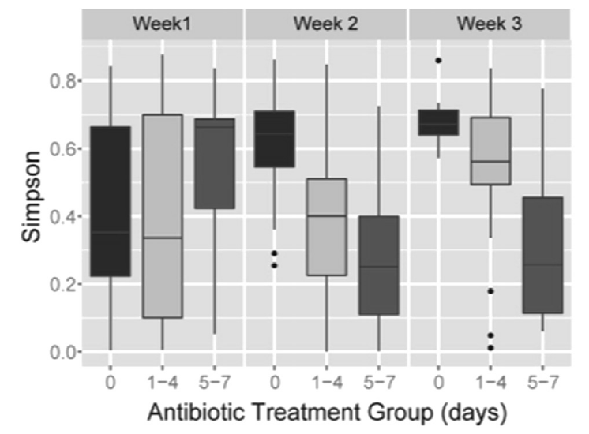
Antibiotic Effects on Gut Microbiome
Greenwood et al, J Pediatr 2014
Stool samples collected from 74 infants ≤32 weeks gestation
Infants stratified by initial antibiotic duration (0, 1-4, ≥5 days)
Higher proportion of Proteobacteria and less microbiome diversity (Simpson index) in infants who received antibiotics

Slide 9
Antibiotic Effects on Gut Microbiome
Rooney et al, Clin Infect Dis 2019
16S rRNA sequencing of stool swabs collected from 72 NICU infants after completing antimicrobial therapy
Most infants received ampicillin and an aminoglycoside
Each additional day of antibiotics reduced richness and diversity of anaerobes (RR 0.84 [95% CI 0.73-0.95])

Slide 10
Adverse Effects on Lung Microbiome
Lohmann et al, Pediatr Res 2014
Serial tracheal samples from infants ≤32 weeks gestation
Reduced diversity (even on day 1) = ↑ risk for BPD
Correlated with maternal and infant antibiotic exposure
Cantey et al, J Pediatr 2017
Retrospective cohort of 1140 VLBW infants receiving initial empiric therapy despite sterile blood cultures; controlled for severity of illness using CRIB-II score
In multivariate analysis, each additional antibiotic DOT was associated with:
Increased risk for BPD (OR 1.13 [95% CI 1.09-1.16]).
Increased severity level of BPD (OR 1.06 [95% CI 1.04-1.08])

Slide 11
Dysbiosis
This loss of diversity is associated with a variety of adverse outcomes even in term newborns
Increased risk for Candida colonization/infection
Saiman et al, PIDJ 2001
Cotten et al, Pediatrics 2006
Lee et al, PIDJ 2012
Increased risk for colonization/infection with multi-drug resistant organisms
de Man et al, Lancet 2000
Carr et al, Arch Dis Child Fetal Neonatal Ed 2017
Ramirez et al, Neoreviews 2019
Atopic disease (asthma, eczema)
Donovan et al, Clin Infect Dis 2019
Ni et al, BMC Pediatr 2019
Ahmadizar et al, Ped All Immunol 2017
Obesity, Metabolic Syndrome, and Diabetes
Block et al, Pediatrics 2018
Bailey et al, JAMA Pediatr 2014
Jess et al, Sci Rep 2019
Singer-Englar et al, Expert Rev Gastro Hepatol, 2019
Primary risk factor in all these studies is duration of therapy – each day increases risk

Slide 12
Where are we now?

Slide 13
Evidence-based tools
Serial observation / propensity scoring over empiric therapy
Automatic hard-stops
Shorter durations of therapy for common diagnoses
Eliminating “culture-negative” sepsis
Optimizing blood culture volumes
Reducing use of biomarkers (CBCs, C-reactive protein, etc)
Infection prevention techniques

Slide 14
Observation > Antibiotics
Kuzniewicz MW, et al. JAMA Pediatr. 2017; 171(4): 365
Prospective pre/post cohort during the rollout of the Kaiser sepsis calculator in Kaiser system nurseries from 2010-2015
204,485 infants ≥35 weeks gestation included
Primary outcome = number of sepsis evaluations
Safety outcomes = positive cultures, NICU admissions, readmissions, death
Calculator reduced blood cultures by 70%, antibiotics by 50%
No increase in sepsis, NICU admission, readmissions, or death

Slide 15
Observation > Antibiotics
Numerous other studies have evaluated the sepsis calculator prospectively and retrospectively
Safe and effective for chorioamnionitis-exposed infants
Safe for late preterm infants cared for in level 1 nurseries (35-36 weeks)
Safe for post-dates infants (41-43 weeks)
Included as an official recommendation in the 2018 American Academy of Pediatrics neonatal sepsis guidelines AND the 2019 group B streptococcal guidelines

Slide 16
Observation > Antibiotics
Cantoni et al, J Pediatr 2013
2 year study in northeastern Italy, 5,239 infants
Year 1 – CBC with differential and blood culture for all infants with at least 1 early-onset sepsis risk factor
Year 2 – Physical examination alone; blood culture only if clinical signs developed
No difference in time from onset of symptoms to antibiotic initiation, sepsis incidence, or mortality
Significantly fewer infants treated with antibiotics in year 2 (RR 0.42; ARR 1.2% → 0.5%)

Slide 17
Antibiotic hard stops
Can set up electronic order entry system to make antibiotics automatically discontinue after a set time
48 hours
36 hours
24 hours for early onset sepsis?!
Just like TPN, restraints, chemotherapy, etc…
Cantey Lancet ID 2016

Slide 18
Automatic hard stops
Meyers et al, Pediatrics 2020 (Rochester, NY)
Astorga et al, JPIDS 2019 (Madison, WI)
Grant et al, Clin Pediatr 2018 (Glasgow/Edinburgh, Scotland)
Tolia et al, Am J Perinatol 2017 (Mednax) – and Dr. Karna Murthy at Northwestern!
Hard stops are safe and effective.
We should be talking about antibiotics every day on rounds, just like central venous catheters or bladder catheters.

Slide 19
Where are we going?
Things we still don’t know about nursery stewardship
Paucity of granular detail in Level 1 and 2 nurseries – who is using which drugs for what indications?
Optimal metrics for stewardship – calendar days? Days of therapy? Antibiotic utilization rate? Something else?
What other outcomes should we be studying? Balancing measures?
Duration of therapy – How long is too long? How short is too short?
Provider perceptions of stewardship in the nursery setting – nurses, physicians, APPs?
Family perceptions of stewardship?

Slide 20
Stewardship NIMBYism

Slide 21
Getting buy-in
Make it easy for me to do the right thing for the patient

Slide 22
Getting buy-in
Make it easy for me to do the right thing for the patient
BENEFICENCE
NONMALEFICENCE

Slide 23
The Right Thing for the Patient
Decreased antibiotic exposure = decreased risk for:
Late-onset infection
Necrotizing enterocolitis
Death
Colonization or infection with multi-drug resistant organisms
Colonization or infection with Candida
Asthma, Eczema, Food allergies
Obesity
Type 1 diabetes mellitus?
Celiac disease??

Slide 24
The WRONG Thing for the Patient
Providers will not tolerate a missed case of sepsis
Education plays a major role here:
Old CDC/AAP guidelines “missed” kids too
Data from centers that implemented sepsis calculator have not seen delays in diagnosis or increases in “missed” cases
Serial observation means serial observation
Antibiotic stewardship does not mean getting to zero

Slide 25
Resistance - Clinicians
Szymczak J, et al. ICHE 2019.
Single-center survey of 394 providers at CHOP
92% of surveyed providers believed that ASPs improved quality of care, but… 69% had engaged in workarounds at least occasionally
Reasons included:
Not wanting to change therapy that was working for the patient
Desire to do everything possible for the patient

Slide 26
Resistance - Clinicians
Cantey JB, et al. JPIDS 2017.
Survey of 147 nurseries across the US in all 50 states
71% had a favorable impression of the nursery ASP
Common themes:
Unnecessary
Unwanted (time-consuming, not valuable, no pediatric or nursery expertise)
Lack of champion representation
Patient-level outcomes
“We want different things… they’re looking at cost and we’re looking at the patient.” “At the end of the day, it’s about what’s best for the baby. I think that’s ultimately why our group bought in, because if we can improve our practice without adding to the busywork, then everyone can support that.”

Slide 27
Education

Slide 28
Getting buy-in
Make it easy for me to do the right thing for the patient
AUTONOMY

Slide 29
Autonomy
Perozziello A, et al. J Antimicrob Chemother 2019
Survey of 27 regional hospitals in France, 920 providers
Approval much higher for education (74%) than for hard stops* (27%) or preauthorization (29%)
Audit and feedback also unpopular (37%)
Stach LM et al, JPIDS 2012
Single-center survey of 205 providers at Mercy Children’s (KC)
82-91% positive responses for education, improvement in care
11% felt loss of autonomy
6% felt that ASP interfered with decision making

Slide 30
Autonomy
Education → providers would rather make the right decision themselves than have someone else correct them
Empowerment → Recruit champions, get interdisciplinary input
Antibiotic “time-outs” at 36-48 hours are more popular than prior authorization
Feedback delivered in person (handshake rounds) is more popular than report cards or emails
Hard stops are more popular in practice than they are in theory

Slide 31
Getting buy-in
Make it easy for me to do the right thing for the patient
JUSTICE

Slide 32
Initial focus: Cost

Slide 33
Shift from cost to patient outcomes

Slide 34
Stewardship outcomes in the nursery
Amount of blood draws
Antibiotic exposure
Length of stay
Nonseparation
Breastfeeding
Readmission
Subsequent infections
Cost
EASY
A LITTLE HARDER
SHHHHH

Slide 35
Getting buy-in
Make it easy for me to do the right thing for the patient

Slide 36
Making it easy
Automate whatever you can – EMR is your friend (really)
Hard stops (again, more popular in practice than in theory)
Default antibiotic selection/dosing for given indications
Protocols and guidelines built in to EMR
Sepsis calculator integrated into nursery H&P
Don’t make it hard to start – but make it easy to stop

Slide 37
Finally
All stewardship is local
Well-baby nurseries ≠ NICUs
Delivery hospitals ≠ Referral centers
Can antibiotics be given in your Level 1? Do antibiotics require a transfer to another center?
Patient mix, surgical services, ECMO all predict antibiotic consumption but do not explain much of the variability between centers
Make it easy for me to do the right thing for the patients at my center

Slide 38
So what can your nursery do?
Intensive:
Pharmacists, nursery champion(s), stewardship program working together
Prospective audit to characterize antibiotic use
Design of interventions
Monitoring of impact, safety
Intermediate:
One or two people monitor antibiotic use during a set time period
Can even be cross-sectional sampling if needed
Focus on 1 or 2 achievable goals
Monitor outcomes
Single:
Pick one target (number of sepsis evaluations, duration of empiric antibiotics) and improve it!

Slide 39
Email: cantey@uthscsa.edu
Twitter: @InfectiousNeo
@OKAPIprogram

