Slide 1
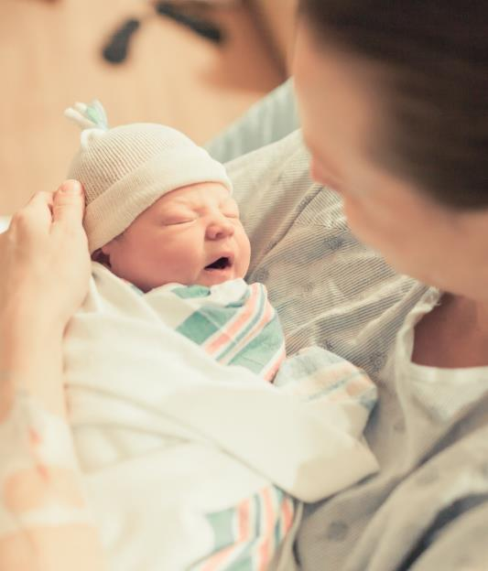
Infant Mortality Inequities in Illinois and Opportunities for Prevention
Neonatal Face to Face Meeting
May 27, 2021

Slide 2

Do Race/Ethnic Disparities in Maternal and Infant Outcomes Constitute an Ethical Dilemma?
Russell S. Kirby, PhD, MS, FACE
Distinguished University Professor, Marrell Endowed Chair
Strategic Area Faculty Lead for Population Health Science College of Public Health
University of South Florida

Slide 3
Disclosure
This presentation does not mention specific drugs, medications, or medical devices.
The presenter has no disclosures relating to the content of this presentation.
No laboratory animals, family pets or wildlife were harmed in the development of this presentation.

Slide 4
Summary for the Sleep Impaired*
Differences may or may not be disparities.
Race/ethnic disparities are present for most maternal and child health outcomes.
Focusing on black-white, or non-Hispanic black -non-Hispanic white disparities, two-fold or greater differences in adverse outcome are common.
Black-white disparities result from differences in life course experiences, access to health care and quality of health care, and socioeconomic inequalities.
The quest for health equity should be near the top of the leaderboard of the national political agenda.
*or Those Distracted by the Latest COVID-19 Reports

Slide 5
TOP TEN LIST
TEN BEST WAYS TO MISUSE INFANT MORTALITY STATISTICS
With apologies to David Letterman, and thanks for editorial assistance to
Elizabeth Kirby and for their insights to the following Internet contributors:
Pat Guhleman, WI Dept. of Health and Family Services
Phil Klein, WI Dept. of Workforce Development
Greg R. Alexander, University of Alabama at Birmingham
Kate Kvale, Wisconsin Div. of Public Health
Jeff Gould, Stanford University
Charlotte Druschel, NY State Congenital Malformations Registry
Paul Buescher, NC State Center for Health Statistics
Russel Rickard, CO Responds to Children with Special Health Care Needs
Wendy Hellerstedt, University of Minnesota
R.S. Kirby, October 2003, revised March 2014

Slide 6
Top Ten List: Ten Best Ways to Misuse Infant Mortality Statistics
Number 10
The Shell Game
Need to highlight a specific infant health issue? Just regroup the conditions in the “leading cause of death” categories.
This is especially useful when providing data to advocacy organizations: one year they might want birth defects to be the leading cause of death, and the next year the focus is prematurity.

Slide 7
Top Ten List: Ten Best Ways to Misuse Infant Mortality Statistics
Number 9
Cry Wolf!
Infant mortality statistics are real. If the rate (or number of deaths) rises from one year to the next, however small the change, it is a political crisis. Year to year variations are never random fluctuations around a stable long-term trend.
Here’s an example:

Slide 8
Infant Mortality (Deaths per 1,000 Live Births) for
U.S. and Wisconsin Whites and Blacks, 1975 to 1997
30.0
25.0
20.0
Rate per 1,000 Live Births
15.0
10.0
5.0
0.0
1975
1977
1979
1981
1983
1985
1987
1989
1991
1993
1995
1997
U.S. Black
U.S. White
Wisconsin Black
Wisconsin White

Slide 9
Infant Mortality (Five-Year Running Average)
U.S. and Wisconsin Whites and Blacks, 1975 to 1997
30.0
25.0
U.S. Black
20.0
U.S. White
Rate per 1,000 Live Births
15.0
Wisconsin Black
10.0
Wisconsin White
5.0
0.0
1975-79
1977-81
1979-83
1981-85
1983-87
1985-89
1987-91
1989-93
1991-95
1993-97

Slide 10
Top Ten List: Ten Best Ways to Misuse Infant Mortality Statistics
Number 8
Paint by Number
Always quote statistics based on death cohort numerators. This is especially important for subgroup analyses with small cell sizes. Also, these statistics are available faster.
So, the numerator is larger than the denominator? Just round off to 100% - no one will know the difference.

Slide 11
Top Ten List: Ten Best Ways to Misuse Infant Mortality Statistics
Number 7
Is a Kia the Same as a Porsche?
Now that most hospitals in the United States have 24/7 perinatology service and Level II or higher NICUs, analyses of infant or perinatal mortality by characteristics of hospital of birth are irrelevant and should not be performed.

Slide 12
Top Ten List: Ten Best Ways to Misuse Infant Mortality Statistics
Number 6
Keeping up with the Jones . . .
In justifying emphasis on the state infant mortality rate, always make the claim that it is an excellent indicator of socioeconomic status and health care in countries.
And remember:

Slide 13
The Political Purpose of Infant Mortality Statistics
“The first lesson that you must learn is, when I call for statistics about the rate of infant mortality, what I want is proof that fewer babies died when I was Prime Minister than when anyone else was Prime Minister. That is a political statistic.”
- Winston Churchill

Slide 14
Top Ten List: Ten Best Ways to Misuse Infant Mortality Statistics
Number 5
Close Enough for Government Work
All demographic and clinical data reported on birth, fetal and infant death certificates are accurate, valid, and reliable. After all, these are ‘official’ legal documents.
So go ahead! Use all the variables in the statistical file in your analyses, including:
alcohol use, weight gain, prenatal care utilization, maternal health conditions, congenital anomalies, and especially, underlying cause of fetal or infant death.

Slide 15
Top Ten List: Ten Best Ways to Misuse Infant Mortality Statistics
Number 4
Don’t Color Outside the Lines
The distinction between neonatal and postneonatal mortality is sacrosanct, and must be observed in all tabulations – especially for analyses of perinatal periods of risk.
Endogenous causes of infant death always occur within the first month after birth.

Slide 16
Top Ten List: Ten Best Ways to Misuse Infant Mortality Statistics
Number 3
Do I See What I See
The infant deaths are the only observations that matter. Those other babies didn’t die, so why study them or include their data in the analysis?
Example: if 10 out of 50 mothers with infant deaths used illicit substances during their pregnancies, this is an important ‘risk factor’ and a recommendation should be made by the FIMR committee.

Slide 17
Top Ten List: Ten Best Ways to Misuse Infant Mortality Statistics
Number 2
Spring Cleaning
Don’t store any documentation or metadata. No one will want to use your datasets in the future, and if they wish to, lack of clarity works in your favor because it allows for re-interpretation of the data to fit the current needs.
And why waste money updating storage technology?

Slide 18
Top Ten List: Ten Best Ways to Misuse Infant Mortality Statistics
Number 1
Blame the Victim, Shoot the Messenger
All statistical ‘associations’ revealed in epidemiologic analyses of infant mortality are causal.
This is especially true of observed associations by ‘race’ or ‘ethnicity’. These are both “risk factors”, and at least in the case of ethnicity, a modifiable risk factor.

Slide 19
Top Ten List: Ten Best Ways to Misuse Infant Mortality Statistics
A Final Thought
All the News That’s Fit, We Print
No one is interested in infant mortality data before the annual vital statistics report is published.
Wait until the ‘statistical year’ closes out on March 31 following, and only then begin the process of linking infant deaths to their birth certificates and cleaning the datasets.

Slide 20
Disparity or Difference?
Health disparities:
  preventable differences in the burden of disease, injury, violence, or opportunities to achieve optimal health that are experienced by socially disadvantaged populations.
Health differences:
  occur when there is a measurable difference in outcome between two or more groups.
What’s the difference?
  The difference between health disparities and health differences lies in inequity and injustice. We might see differences in mobility between elderly individuals and teenagers as a normal difference in age, not related to ageism, though certainly elderly individuals face issues of ageism. However, differences in mortality rates between people of different social classes can be directly related to social and economic inequity. Hence, a health disparity is a health difference that results from inequity and injustice.

Slide 21
Maternal and Child Health Outcomes
Preterm Birth
Infant Mortality
Birth Defects
Survival with Specific Birth Defects
Maternal Mortality
Severe Maternal Morbidity

Slide 22
Preterm Birth and Infant Mortality
For 2017, the US preterm birth rate (<37 wks gestation) was 9.9%.
By race/ethnicity, among births to non-Hispanic black women, the rate was 13.9%, compared to 9.1% among births to non-Hispanic white women.

Slide 23
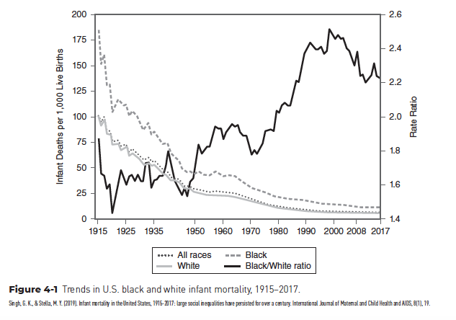
U.S. Black and White Infant Mortality, 1915–2017

Slide 24
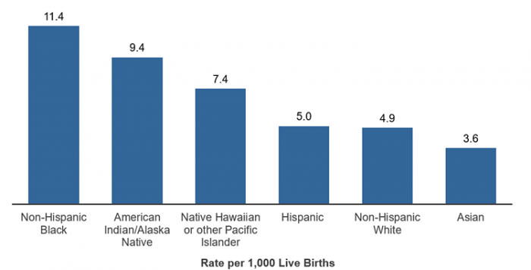
Infant Mortality Rate by Race/Ethnicity, US, 2016
*Source: p. 80 of the User Guide to the 2016 Period Linked Birth/Infant Death Public Use File

Slide 25
Each column adjusted for more sociodemographic, maternal, and neonatal factors.
Source: Janevic T., et al. JAMA Pediatrics, 2018;172:1061-1069.

Slide 26
Each column adjusted for more sociodemographic, and maternal factors.
Source: Janevic T., et al. JAMA Pediatrics, 2018;172:1061-1069.

Slide 27
Birth Defects

Slide 28
Race/Ethnicity-Specific Prevalence Rates for Selected Birth Defects, U.S., 1999-2007
Source: Canfield, et al, “The Association between Race/Ethnicity and Major Birth Defects in the United States, 1999–2007”. American Journal of Public Health, 2014;104,9:e14-e23.

Slide 29
Survival Rates for Selected Birth Defects, U.S., 1999-2007
Source: Wang et al, “Racial/Ethnic Differences in Survival of US Children with Birth Defects: A Population-based Study”, Journal of Pediatrics, 2015;166,4:819-826.

Slide 30
Survival Rates for Selected Birth Defects, by Race/Ethnicity
Source: Wang et al, “Racial/Ethnic Differences in Survival of US Children with Birth Defects: A Population-based Study”, Journal of Pediatrics, 2015;166,4:819-826.

Slide 31
Maternal Mortality

Slide 32
Source: Creanga A., et al, Ob Gyn 2017

Slide 33
Maternal Mortality by Race, U.S. 2000-2009

Slide 34
Severe Maternal Morbidity

Slide 35
Source: Creanga et al., AJOG 2014;210:435.e1-8

Slide 37
Disparity in Severe Maternal Morbidity
Source: Leonard et al., Ann Epidemiol. 2019 May;33:30-36

Slide 38
Source: Leonard et al., Ann Epidemiol. 2019 May;33:30-36

Slide 39
Source: HCUP Statistical Brief No. 243, September 2018

Slide 40
The Life Course Paradigm

Slide 41
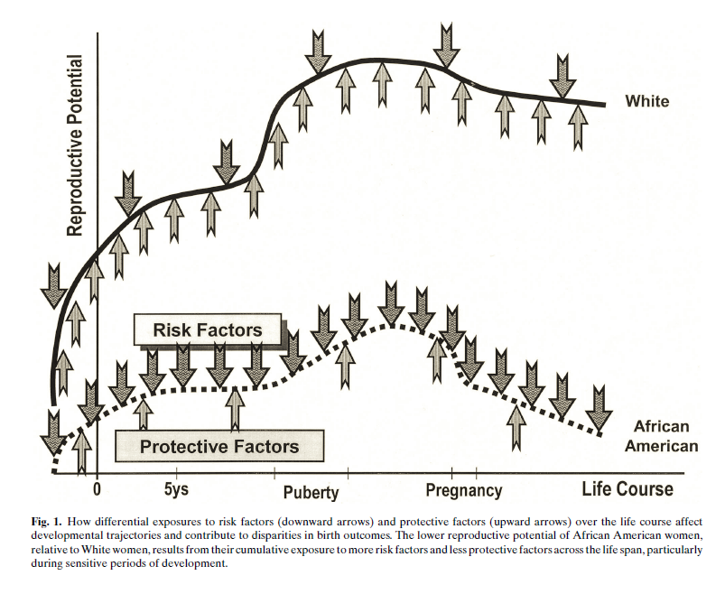
Source: Halfon and Lu, MCH Journal 2003;7:13-30.

Slide 42
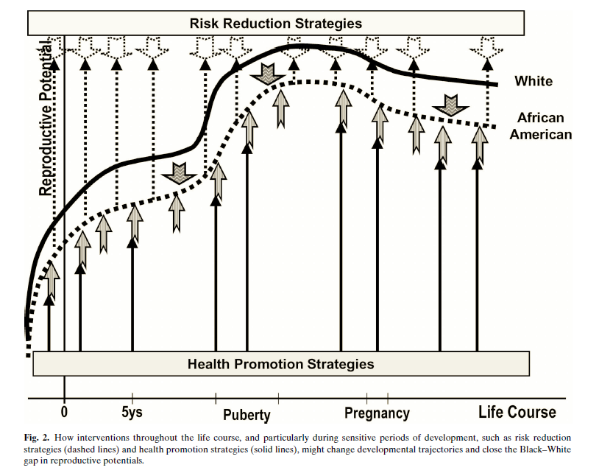
Source: Halfon and Lu, MCH Journal 2003;7:13-30.

Slide 43
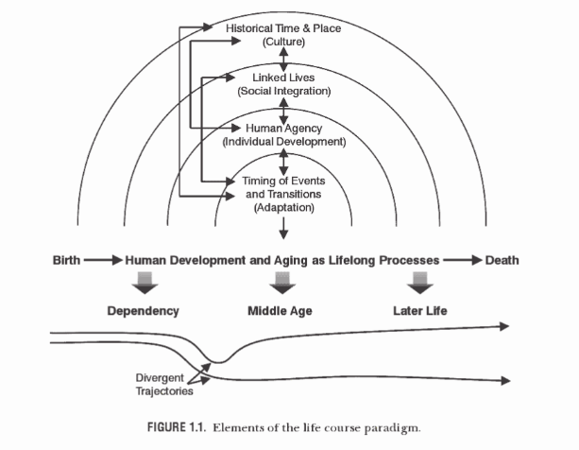
The Life Course Paradigm
Adapted from: Elder, G. H., & Giele, J. Z. (Eds.). (2009). The Craft of Life Course Research. New York, US: The Guilford Press.

Slide 44
Prather et al., J Women’s Health, 2016;25:664-671.

Slide 45
Is This An Ethical Dilemma?
One of the core ethical principles governing delivery of health services is justice.
The concept of distributive justice definitely applies – all in our society have the right to quality health care and to health equity in terms of outcomes.
Race is not a ‘risk factor’ – Racism is.
As clinicians, patients and families are treated one at a time. As a society, we owe it to all of our members to resolve the circumstances that prevent any member from achieving the best possible outcomes.
Resolving this dilemma requires that, even as we strive to do our best for our patients, we must also strive to make the changes to our society and political economy that reduce or eliminate these unjust health disparities.

Slide 46
E-mail Address and Phone Number
For additional information, suggestions, comments, and constructive criticism, and advice, please contact me at:
  kirbyr@usf.edu
  1-813-396-2347

Slide 47
Infant Mortality In Illinois:
Key Findings & Prevention Opportunities
IDPH Office of Women’s Health and Family Services
ILPQC Face-to-Face Neonatal Meeting
May 27, 2021

Slide 48
Infant Mortality…
Is “the most sensitive index we possess of social welfare” (Julia Lathrop, 1913)
Reflects a society’s commitment to the provision of: (SACIM report, 2013)
  High quality healthcare
  Adequate food and good nutrition
  Safe and stable housing
  Healthy psychosocial and physical environment
  Sufficient income to prevent impoverishment

Slide 49
Definitions
Infant Death: any live-born infant who dies within the first year of life
  Neonatal Death: any live-born infant who dies during days 0-27 of life
  Post-Neonatal Death: any live-born infant who dies during days 28-364 of life
  Mortality Rates: expressed as the number of deaths for every 1,000 births
$$\frac{\# deaths}{\# births}∗1,000=IMR$$
Notes:
Many of you are probably already aware that there are standard definitions of infant mortality and some sub-classes of infant mortality. Just to make sure we are all on the same page, I have included these definitions here.
An infant death is when any live-born infant dies before their first birthday. If the infant dies during days 0-27 of life, it is considered a “neonatal” death, and if it is during day 28 through 364, it is a “post-neonatal” death. This distinction is important, as we will talk later about how there are very different forces and causes driving neonatal and post-neonatal deaths.
If you add the neonatal deaths and the post-neonatal deaths, you get the total number of infant deaths.

Slide 50
Data Sources: Vital Records Overview
Birth Certificates
  Provide total number births for denominator in rates
  Any infant with any signs of life receives a birth certificate
  National gestational age cutoffs are 17-47 weeks
Death Certificates
  Cause of death = ICD-10 code assigned based on text fields for cause of death
  Any live-born infant who subsequently dies receives death certificate
Fetal deaths (stillbirths) do not receive a birth and death certificate, thus are not included in infant mortality rate
  Stillbirths do receive a “fetal death certificate”
Note: IDPH does not obtain medical records

Slide 51
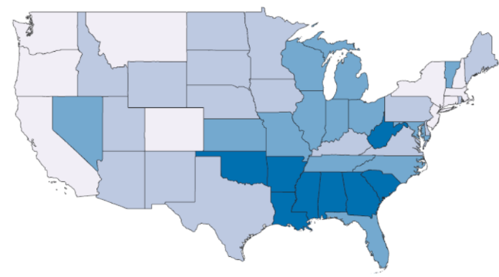
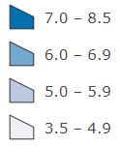


Illinois’ Infant Mortality in Context
Infant Mortality Rate, by State (2018)
About 950 Illinois infants die each year before their first birthday
  38 empty kindergarten classrooms
  7 airplanes of empty seats
  6.5 infant deaths for every 1,000 births
Among the states, Illinois ranks 36th in infant mortality
Infant Mortality Rate (per 1,000 live births)
https://www.cdc.gov/nchs/pressroom/sosmap/infant_mortality_rates/infant_mortality.htm

Slide 52
Illinois Infant Mortality Rate Trend
Between 2000 and 2018, Illinois’ infant mortality rate decreased by 22%
Healthy People 2020 Goal
Data Source: Illinois Death Certificates, 2000-2018

Slide 53
Illinois Infant Mortality Rate Trends by Timing of Death
About 2/3 of infant deaths occur during the neonatal period
Both neonatal and post-neonatal mortality rates decreased since 2000
Data Source: Illinois Death Certificates, 2000-2018

Slide 54
Illinois Infant Mortality Rate Trends by Race/Ethnicity
Racial differences have been persistent over time
The Black infant mortality rate in IL has not significantly changed since 2008
Healthy People 2020 Goal
Data Source: Illinois Death Certificates, 2000-2018

Slide 55
Racial Disparities in Illinois Infant Mortality
Infants born to Black women are nearly three times as likely to die as infants born to White women
Black infants are the only racial group in IL not meeting the Healthy People 2020 objective for infant mortality
Healthy People 2020 Goal
Data Source: Illinois Death and Birth Certificates, 2018

Slide 56
Leading Causes of Infant Death* in Illinois
Leading causes of death include:
  Prematurity or fetal malnutrition
  Birth defects
  Sudden Unexpected Infant Death (SUID)
    Sudden Infant Death Syndrome (SIDS), accidental suffocation, other unknown causes
  Pregnancy or delivery complications
These four causes account for 7 out of 10 infant deaths
*Data Source: Illinois Death Certificates, 2018

Slide 57
In 2018, compared to White infants,
Black infants were:
180% more likely to die during the first year of life
  70% more like to die from birth defects
  140% more likely to die from prematurity or fetal malnutrition
  160% more likely to die from pregnancy or delivery complications
  510% more likely to die from Sudden Unexpected Infant Death (sleep-related deaths)
Data Source: Illinois Death and Birth Certificates, 2018

Slide 58
Illinois Sudden Unexpected Infant Death (SUID) Rate Trends, by Race/Ethnicity
SUID is the cause of death with the widest racial disparity
The SUID rate among Black infants decreased during 2000-2009, but INCREASED during 2009-2018
Data Source: Illinois Death Certificates, 2000-2018

Slide 59
What is Contributing to Racial Disparities in Infant Mortality?
IDPH used “Perinatal Periods of Risk” analysis to examine underlying issues in racial disparities
  Assesses disparities between high-risk group and a low-risk group
    Equity approach: If the low-risk population can reach a certain infant mortality rate, we should strive for the higher-risk population to reach that same rate.
  Focuses on opportunities to improve population-level outcomes
  Includes both fetal and infant deaths
  Limits analysis to fetuses/infants at least 24 completed weeks gestation

Slide 60
Reference Population
(Best Outcomes)
Target Population
(Worst Outcomes)
Non-Hispanic White
Age ≥ 20 years old
Education ≥ 13 years
Non-Hispanic Black
4 Periods of Risk
Age at death
Fetal death
Neonatal death
Post-neonatal death
500-1499 g
Maternal Health / Prematurity
Birthweight
1500+ g
Maternal Care
Newborn Care
Infant Health

Slide 61
Illinois Perinatal Periods of Risk Analysis
Mortality Rates for Low-Risk White Fetuses/Infants
1.1
1.0
0.9
0.6
Excess Deaths among Black Fetuses/Infants:
8.6 deaths
per 1,000
Mortality Rates for Black Fetuses/Infants
4.1
3.0
1.5
3.5
Note: All rates expressed per 1,000 live births + fetal deaths
Data Source: Illinois Death, Birth, and Fetal Death Certificates, 2017-2018
* Some numbers may not exactly add up due to rounding errors
Notes:
We can then compare our two groups of women with the best and worst fetal-infant mortality rates to determine which of these periods of risk contributes most to the disparity. This slide shows the rates of fetal-infant mortality for each of the four periods of risk, and you can see that the rates are higher for Black women in each box.
In total, the fetal-infant mortality among low-risk white women was 4.2 deaths per 1,000. In contrast, the total fetal-infant mortality rate among black women was nearly 3 times higher: 12.2. deaths per 1,000. This is an EXCESS mortality rate of 8.0 deaths per 1,000 among the children of Black women.
In total, this translates to a total of 418 EXCESS black fetal and infant deaths during 2014-2015. This means that if the infants of black women had the same mortality rate as low-risk white women, 418 deaths would have been prevented during the two year period.

Slide 62
Illinois Perinatal Periods of Risk Analysis
Mortality Rates for Low-Risk White Fetuses/Infants
1.1
3.6
deaths per 1,000
1.0
0.9
0.6
Excess Deaths among Black Fetuses/Infants:
8.6 deaths
per 1,000
Mortality Rates for Black Fetuses/Infants
4.1
12.1 deaths per 1,000
3.0
1.5
3.5
Note: All rates expressed per 1,000 live births + fetal deaths
Data Source: Illinois Death, Birth, and Fetal Death Certificates, 2017-2018
* Some numbers may not exactly add up due to rounding errors
Notes:
In total, the mortality among low-risk white fetuses/infants was 3.6 deaths per 1,000. In contrast, the total mortality rate among black fetuses/infants was 3 times higher: 12.1. deaths per 1,000.

Slide 63
Illinois Perinatal Periods of Risk Analysis
Mortality Rates for Low-Risk White Fetuses/Infants
1.1
3.6
deaths per 1,000
1.0
0.9
0.6
Excess Deaths among Black Fetuses/Infants:
8.6 deaths
per 1,000
Mortality Rates for Black Fetuses/Infants
4.1
12.1 deaths per 1,000
3.0
1.5
3.5
Note: All rates expressed per 1,000 live births + fetal deaths
Data Source: Illinois Death, Birth, and Fetal Death Certificates, 2017-2018
* Some numbers may not exactly add up due to rounding errors
Notes:
This translates to an EXCESS mortality rate of 8.6 deaths per 1,000 among Black fetuses/infants.

Slide 64
If Black infants had the same mortality rates as low-risk White infants, 212 deaths would have been prevented each year
Period of Risk | Maternal Health & Prematurity | Maternal Care | Newborn Care | Infant Health
Excess Death Rate for Black Infants | 3.0 per 1,000 | 2.0 per 1,000 | 0.6 per 1,000 | 2.9 per 1,000
# Excess Deaths for Black Infants | 75 | 50 | 14 | 73
Targets for Action | Pre-conception health Prenatal smoking Risk-appropriate care | Prenatal care High risk referral Obstetric care | Neonatal care NICU quality Pediatric surgery | Safe Sleep Breastfeeding Injury prevention
Data Source: Illinois Death, Birth, and Fetal Death Certificates, 2017-2018
Notes:
In total, this translates to a total of 212 EXCESS black fetal and infant deaths per year. This means that if the infants of black women had the same mortality rate as low-risk white women, 212 deaths would have been prevented each year.
Two red boxes account for nearly 70% of excess deaths among Black infants

Slide 65
If Black infants had the same mortality rates as low-risk White infants, 212 deaths would have been prevented each year
Period of Risk | Maternal Health & Prematurity | Maternal Care | Newborn Care | Infant Health
Excess Death Rate for Black Infants | 3.0 per 1,000 | 2.0 per 1,000 | 0.6 per 1,000 | 2.9 per 1,000
# Excess Deaths for Black Infants | 75 | 50 | 14 | 73
Targets for Action | Pre-conception health Prenatal smoking Risk-appropriate care | Prenatal care High risk referral Obstetric care | Neonatal care NICU quality Pediatric surgery | Safe Sleep Breastfeeding Injury prevention
Data Source: Illinois Death, Birth, and Fetal Death Certificates, 2017-2018
Notes:
In total, this translates to a total of 212 EXCESS black fetal and infant deaths per year. This means that if the infants of black women had the same mortality rate as low-risk white women, 212 deaths would have been prevented each year.
Two red boxes account for nearly 70% of excess deaths among Black infants

Slide 66
Potential Steps for Infant Mortality Prevention
Prematurity Prevention
  Pre-/Inter-conception health
  Pregnancy spacing
  Early & adequate prenatal care
  No smoking during pregnancy
  Educating women on signs of early labor
  Risk-appropriate care for early labor
SUID Prevention
  Place infants to sleep on back
  Safe sleep environment
    Alone, in a crib, firm mattress with no pillows, blankets or toys
  No cigarette smoke exposure
  Breastfeeding

Slide 67
Striving for Infant Health Equity in Illinois
Black infants have higher rates of infant mortality across all causes of death, but the inequities are worst for SUID deaths
SUID deaths among Black infants have been increasing over the last 10 years, in contrast to trends in other racial groups
The periods of risk with the most opportunity to reduce racial inequities are related to:
  Maternal health & prematurity
  Infant Health (post-neonatal)

Slide 68
DISCUSSION
&
Questions
For more information about infant mortality in Illinois,
View the latest state Infant Mortality Report at:
http://www.dph.illinois.gov/sites/default/files/publications/illinois-infant-mortality-data-report-2020-december.pdf

Slide 69


10-Minute Break
9:45 – 9:55 am

Slide 70










Thanks to our Funders
In kind support:
Notes:
Update new funder slide

