Slide 1
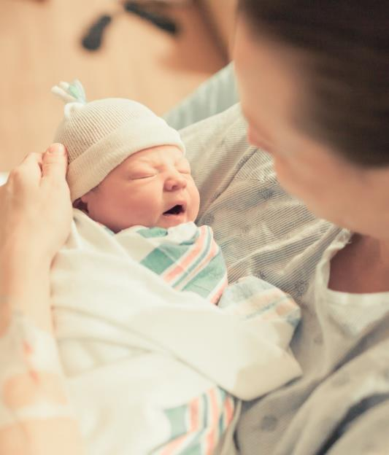
Illinois Perinatal Quality Collaborative
Neonatal Face to Face Meeting
May 27, 2021

Slide 2









ILPQC Central Team
Ann Borders: ILPQC Executive Director, OB Lead
Leslie Caldarelli & Justin Josephsen: Neonatal Leads
Patricia Lee King: State Project Director, Quality Lead
Daniel Weiss & Autumn Perrault: Project Manager, Nurse Quality Manager
Kalyan Juvvadi: Data System Developer
Ieshia Johnson & Ellie Suse: Project Coordinators
Special thanks to our ILPQC Interns: Preeya Waite, Ariel Dotts, Rayne Peerenboom, Megan Wyatt, Jessica Lamberson

Slide 3
Neonatal Disclosures
Course Director – nothing to disclose
Patricia Lee King, PhD
Planning Committee Members & Speakers – nothing to disclose
Planning Committee Member – disclosures reported
Amanda Bennett, PhD, MPH
Ann E B Borders, MD
Leslie A Caldarelli, MD
Joseph Cantey, MD, MPH
Peggy Cowling, APN,
Mary Jarvis, BSN
Ieshia Johnson, MPH
Sherry Jones, MD
Justin Josephsen, MD
Cecilia Lopez, MSN
Deborah Miller, MPH, BSN, RN, CPHQ
Xiaver Pombar, MD
Shawn O'Connor, MD
LaToshia Rouse, CD (DONA)
Karie Stewart, CNM
Ellie Suse, MSN
C. Susie Swain, BSN, RNC, C-EFM
Dan Weiss, MPH
Joseph R Hageman, MD discloses contracted role with Owlet
Russell Kirby, PhD discloses he receives funding through the CDC, NIH and Florida Dept of Health
Audra Meadows, MD, MPH discloses a consultant role with the PNQIN Birth Equity Journey
Panelists – provide implementation examples, not clinical guidance, and are therefore not required to disclose financial relationships
Susan McCarty, MSN, RNC-LRN
Preetha Prazad, MD
Rajeev Kumar, MD
Notes:
Updated 5.25.2021

Slide 4

Obtain AMA PRA Category 1 Credits™ certificate www.cme.northwestern.edu
*NOTE* Credits must be claimed by June 30, 2021
Email to follow at the conclusion of the neonatal meeting
In order to obtain your AMA PRA Category 1 Credit(s)™, at the completion of this activity please follow these steps:
1. Sign in to Northwestern University Feinberg School of Medicine’s Office of CME website: www.cme.northwestern.edu using the email and password used to register for this activity.
2. After logging into Cloud CME, go to My CME and click on Evaluations & Certificates. You will see the activity ILPQC OB & Neonatal Face-to-Face Meeting listed. Click on "Complete Evaluation.
3. Once you complete the evaluation form, your certificate will auto-generate. Please print a copy for your records. A copy of your credits will be saved on your transcript that can be found under “My CME” then click “Transcript.”
4. For additional questions or assistance, please email cme@northwestern.edu

Slide 5
Overall Learning Objectives
Define strategies to engage Obstetric/Neonatal providers and staff to optimize care and improve outcomes for mothers and newborns through the implementation of quality improvement initiatives
List key strategies for one or more of the following quality improvement initiatives: Promoting Vaginal Birth, Birth Equity and/or Babies Antibiotic Stewardship Improvement Collaborative

Slide 6
Schedule
8:15 – 8:40 am | Welcome & Overview – Celebrating our Accomplishments in a Virtual World with a Look to 2021 and beyond Leslie Caldarelli, MD & Justin Josephsen, MD
8:40 – 9:35 am | Infant Mortality Inequities in Illinois and Opportunities for Prevention Amanda Bennett, PhD, MPH & Russell Kirby, PhD, MS
9:35 – 9:45 am | Brief Discussion
9:45 – 9:55 am | Break
9:55 – 10:40 am | Antibiotic Stewardship in the Nursery Setting: It can be done! Joseph B. Cantey, MD
10:40 – 10:55 am | Unpacking the BASIC Toolkit Leslie Caldarelli, MD & Justin Josephsen, MD
10:55 – 11:15 am | QI Awards
11:15 – 12:30 pm | Virtual Storyboard Review & Lunch

Slide 7
Schedule
12:30 – 1:15 pm | BASIC Hospital Team Panel: Sharing Strategies for a Successful Launch Susan McCarty, MSN, RNC-LRN; Memorial Medical Center Preetha Prazad, MD; Advocate Children’s Hospital – Park Ridge Rajeev Kumar, MD; John H Stroger Hospital of Cook County
1:15 – 1:25 pm | Break
1:25 – 2:00 pm | Breakout Session 1: Small Group Key Topic Discussions Facilitated by IL perinatal networks and neonatal providers
2:00 – 2:05 pm | Break
2:05 – 2:40 pm | Breakout Session 2: Small Group Key Topic Discussions Facilitated by IL perinatal network and neonatal providers
2:40 – 2:45 pm | Break
2:45 – 3:00 pm | Where do we go from here? Wrap-up, evaluation, and raffle Leslie Caldarelli, MD & Justin Josephsen, MD

Slide 8
Navigating the Virtual Meeting

Slide 9
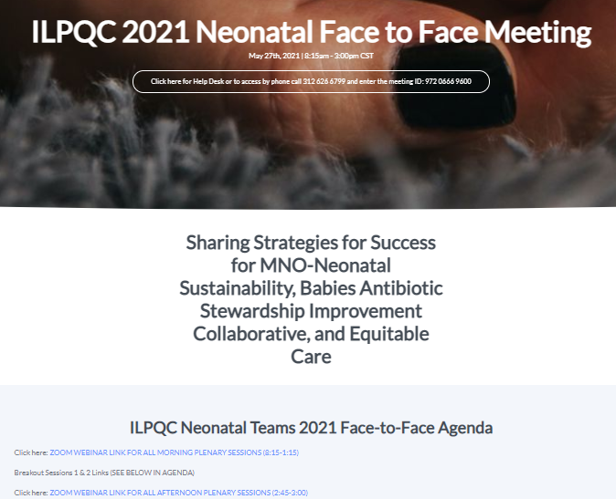
ILPQC Neo Face to Face Webpage
Your Home Base for all the meeting information you should need including:
Main session Zoom link
Breakout session Zoom links
Help-desk Zoom link
Participant e-folder
Storyboards
CME information
Face to Face website and password in the chat
Notes:
Have your neo Face to Face open in the background

Slide 10

Pro Tip

Slide 11
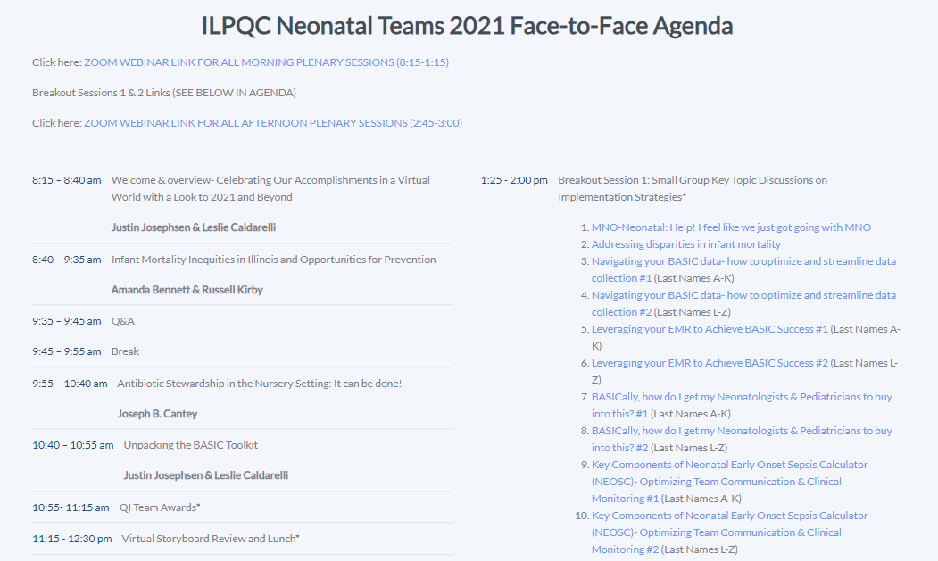

Slide 12
Engage with each other: Neonatal Storyboards
Who: All participants
What: Neonatal Storyboards
Where: There are two ways
  Neonatal Face to Face link in your conference registration email
  Face to Face button on ilpcq.org
When: Storyboard Lunch session from 11:15 - 12:30 pm
Why: Collaboration and exchange of ideas – Share your excellent work across the state!

Slide 13

Storyboard Raffle
How to win:
Review the storyboards on the ILPQC Neo Face to Face website
Complete the Stealing Shamelessly / Sharing Seamlessly online form (available in your email or on the event website)
Attend the Wrap-up session from 2:45 - 3:00 pm
Winners must be present to win one of 3 prizes
If a specific storyboard sparks your interest and you want to connect to a hospital to learn more about their work, email info@ilpqc.org and we’ll facilitate a connection

Slide 14
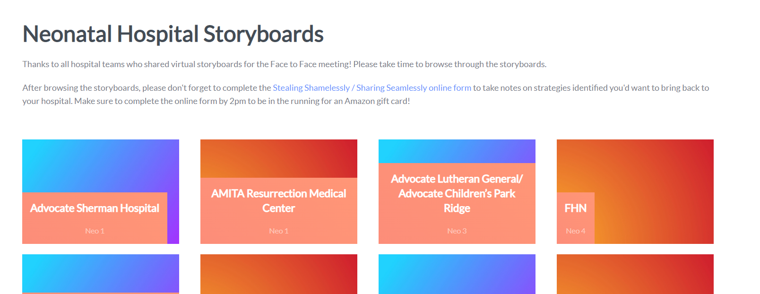

Slide 15

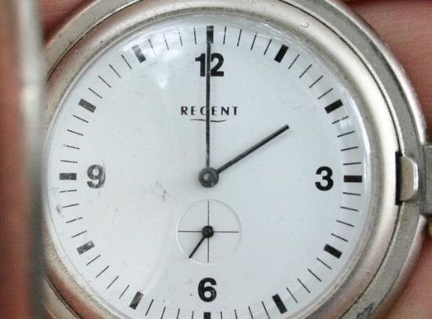
Submit Steal Shamelessly Share Seamlessly online worksheet
This Photo by Unknown Author is licensed under CC BY-SA
Submit by 2pm!

Slide 16
Engage with each other:
Breakout Sessions
Select the breakout sessions you selected during registration:
Each attendee can attend a total of 2 sessions
  Session #1: 1:25pm - 2:00pm
  Session #2: 2:05pm - 2:40pm
MNO-Neonatal: Help! I feel like we just got going with MNO
Addressing disparities in infant mortality
Navigating your BASIC data: How to optimize and streamline data collection
Leveraging your EMR to achieve BASIC success
BASICally, how do I get my Neonatologists & Pediatricians to buy into this?
Key Components of Neonatal Early Onset Sepsis Calculator (NEOSC): Optimizing team communication & clinical monitoring

Slide 17
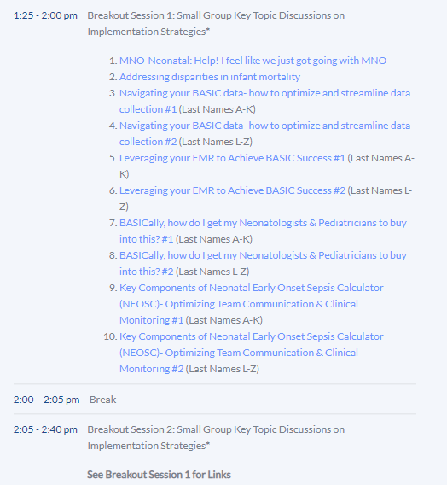
Breakout Session Details
How to get to your Zoom Breakout Session:
  Click the link in the ILPQC online agenda
  Select the appropriate link based on the first letter of your last name
Simply click the link to join the session!
Notes:
JJ:

Slide 18
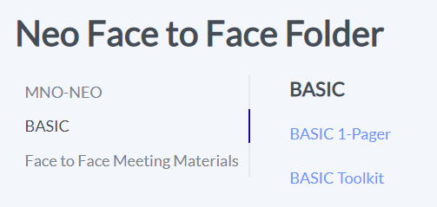
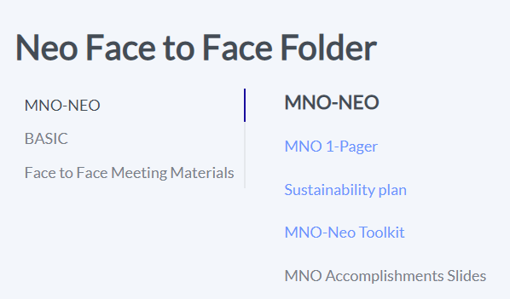
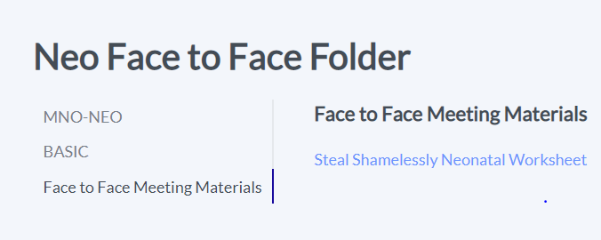
Participant e-Folder

Slide 19
Welcome Address
Congresswoman Lauren Underwood
Serves Illinois’ 14th Congressional District in the U.S. House of Representatives
Notes:
Likely we'll have Dir. Ezike on board so may need to update at the last min.
Laruen's video here
Add bio to internal agenda: https://underwood.house.gov/about/biography
JJ: is ilpqc logo the vector one?

Slide 20
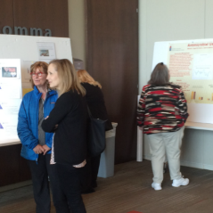
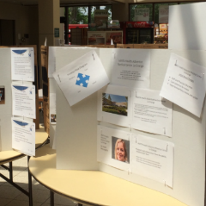
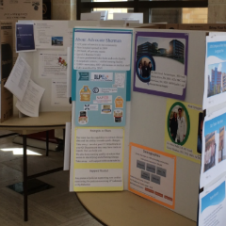
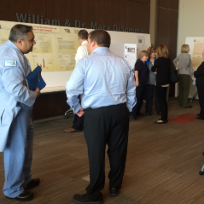
We have come a long way…
Our first in-person Neonatal meeting was held on May 13, 2016 in Peoria with about 40 attendees representing nearly 20 hospitals
The first Face-to-Face Neonatal meeting was held on May 22, 2017 in Urbana with about 77 participants representing nearly 30 hospitals
. . .as we continue to grow with nearly 90 hospitals here today, our goal remains the same
  To provide opportunities for teams to share and learn from one another
Notes:
2016
First Face to Face equivalent meeting under the ILPQC umbrella - The Golden Hour in person meeting is scheduled for Friday, May 13, 2016 from 12 – 4 pm in Peoria, IL. Best estimate to my memory was about 40 people from about 15-20 hospitals.
2017
First meeting called a Face to Face on Neo - 77 participants from 30 hospitals participated in the Neo face to face on May 22, 2017 in Urbana IL.
Today
Compare this to our numbers for this meeting (you could use the estimate of number of teams attending this year’s participant numbers and last year’s hospitals attending):
264 attendees
28 providers registered
92% participating hospitals in attendance (N=88)
25 (~28%) hospitals with virtual storyboard submitted.

Slide 21

Celebrating our Accomplishments in a Virtual World
A look to 2021 and beyond
Notes:
We have seen that standardizing best practices and working together as a collaborative leads to better care, improves outcomes, and decreases disparities.

Slide 22
MNO-Neonatal Successes
Strategies to sustain optimal OEN care through 2021

Slide 23
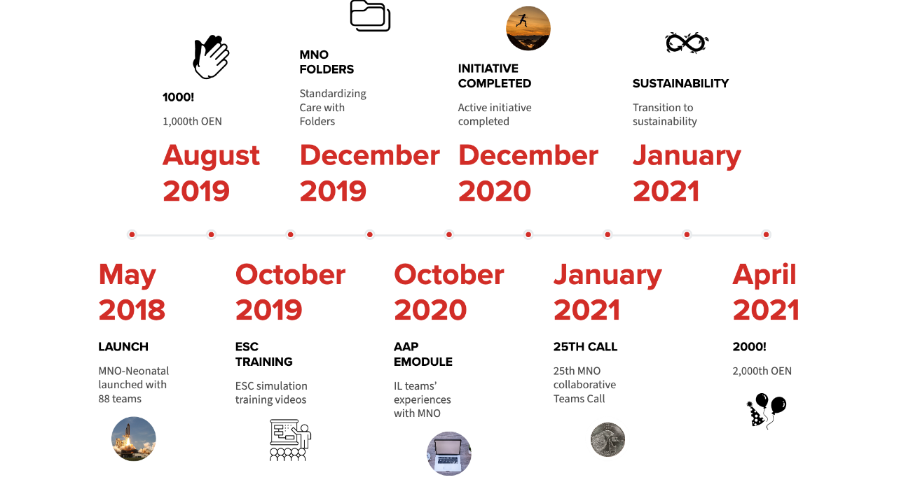

Slide 24
Changing the Landscape of NAS:
Assessment & Pharmacologic Care
75% ESC utilized in 2021
16% utilized ESC in 2017
11% used PRN dosing in 2017
55% used PRN dosing in 2021
Notes:
The proportion OENs receiving PRN pharmacologic treatment increased from 11% at Baseline to 55% in 2021
More babies received more compassionate care and fewer babies received pharmacologic treatment!

Slide 25

MNO’s Impact:
Length of Stay
Length of Stay for OENs with NAS Symptoms
Teams have cared for over 2,034 Opioid-Exposed Newborns
Average Length of Stay for OENs with NAS symptoms is 3.8 days shorter
15.5 Days
11.7 Days
2018
2021
Notes:
LOS (NAS Symptoms)- remove NICU Admits
Baseline: 15.5
2018: 13.14
2019: 10.66
2020: 12.17
2021: 11.7
LOPharm Tx (NAS Symptoms)- Remove NICU Admits
Baseline: 17.8
2018: 14.14
2019: 13.5
2020: 13.4
2021: 13.3

Slide 26
MNO’s Impact:
Coordinated Discharge
Great improvements in coordinating discharge for OENs
YOU mapped community resources to facilitate connections for your families
YOU improved partnership with mothers and caregivers
YOU ensured clinical readiness, family preparedness, and optimized transfer of care for 1,059 mothers and babies!

Slide 27



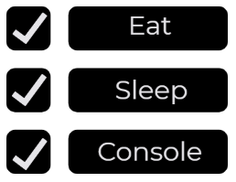



Key Strategies to Provide
Optimal OEN Care

Slide 28
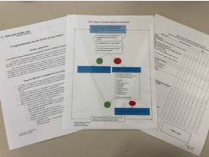
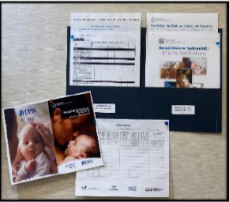
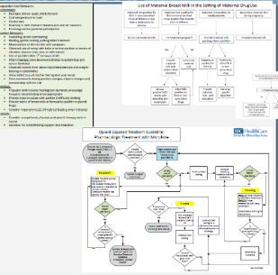
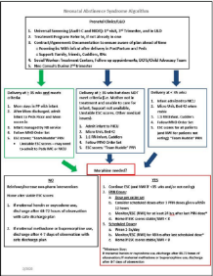
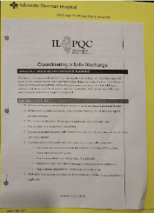
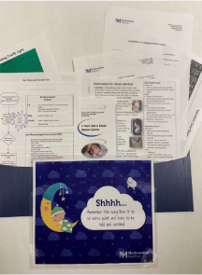
Shared Strategies to
Sustain Optimal OEN Care
Alexian Brothers Medical Center MNO-Neo Folders & Patient Education
Memorial Hospital East (Shiloh) Non-Pharmacologic, Pharmacologic, and Breastfeeding protocols
Loyola University Medical Center NAS Algorithm
Advocate Sherman NAS Assessment Tools and Coordinated Discharge Checklist
NM Central DuPage MNO-Neo Folders

Slide 29
Working Towards Equity by
Standardizing Care
Notes:
Inequities in providing maternal breastmilk at infant discharge existed at baseline. By the end of the initiative the initiative aim was achieved by both groups
We have seen that standardzing best practices and working together and working together as a collaborative leads to better care, improves outcomes, and decreases disparities.
At baseline, Non-Hispanic Black patients were less likely to have a coordinated discharge, however across the initiative improvements in discharge rates were seen for all patients with the greatest improvement for Non-Hispanic Black patients.

Slide 30
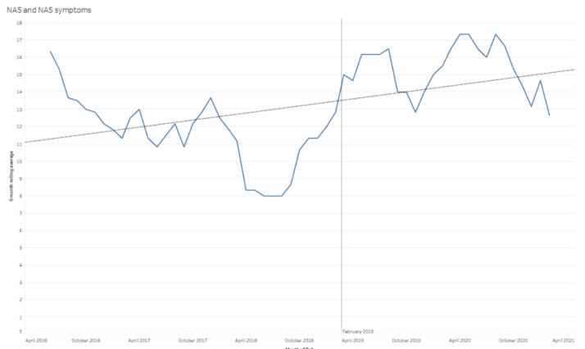
NAS Data from APORS
Adverse Pregnancy Outcomes Reporting System Data from April 2016 – February 2021, 6 month rolling averages
Notes:
NAS/NAS symptom reporting has also increased.

Slide 31

MNO Work: A QI Triathlon
Work with your team to complete and implement your sustainability plan:
  Compliance Monitoring
  New Hire & Continuing Education
  Systems Changes
Attend MNO Sustainability Webinars in 2021 to learn and share strategies with other ILPQC hospitals
ILPQC will provide QI support to help you cross finish line
Systems Changes
Clinical Culture Changes
Sustain Changes

Slide 32

Successful Launch of BASIC
Babies Antibiotic Stewardship Improvement Collaborative

Slide 33
BASIC Vision
ILPQC hospitals, regardless of perinatal level or experience with newborn antibiotics initiatives, will implement best practices to provide:
the right antibiotics
for the right babies
for the right duration

Slide 34
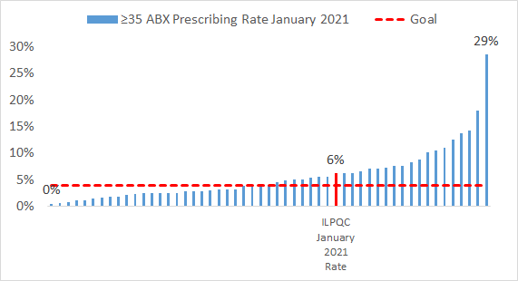
BASIC Variation in Care:
Antibiotic initiation ≥35 weeks

Slide 35
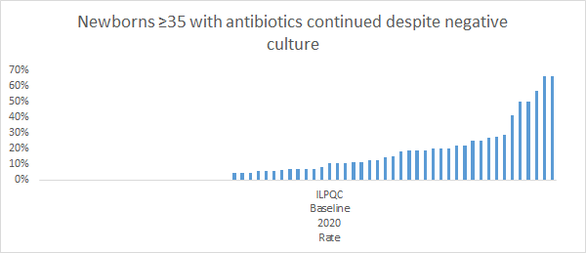
BASIC Variation in Care
Notes:
Analysis of NEGATIVE blood cultures that ABX continued past 48 hours
Need to change this, I think. Need to know how long they were on antibotics.
Need to add slide about number of positive cultures in ILPQC datasets.

Slide 36



BASIC Aims: What we want to achieve
Decrease by 20% (or absolute rate of 4%) the number of newborns born at ≥35 weeks who receive antibiotics
Decrease by 20% the number of newborns who receive antibiotics for longer than 36 hours
36hrs
No Growth to Date

Slide 37
BASIC Variation in Care:
Antibiotic initiation ≥35 weeks

Slide 38
Newborn Sepsis Data from APORS
Adverse Pregnancy Outcomes Reporting System Data from 2014 – 2020
Newborn confirmed sepsis rate gestational ages 33+ weeks: 0.7 per 1,000 live births

Slide 39



What are your Summer 2021
Pit Stops on the BASIC Road Trip!
What BASIC teams have been working on since December 2020…
We’re hungry!
Change the radio station!
Are we there yet?
Formed QI Team, Attended Data Training & QI Team webinars
Completed Readiness Survey to Identify Opportunities
Applied QI Tools like Prioritization Matrices and PDSAs
Submitted and Tracked Data

