Slide 1
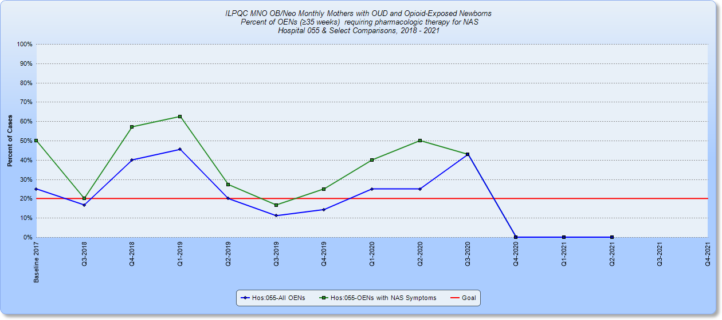
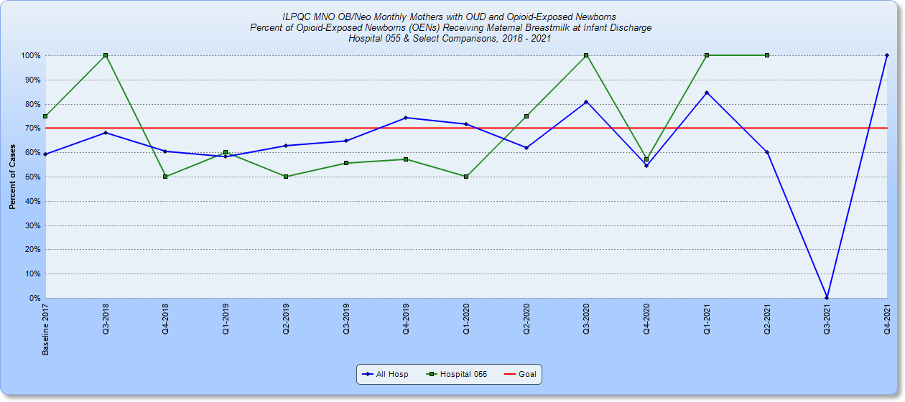
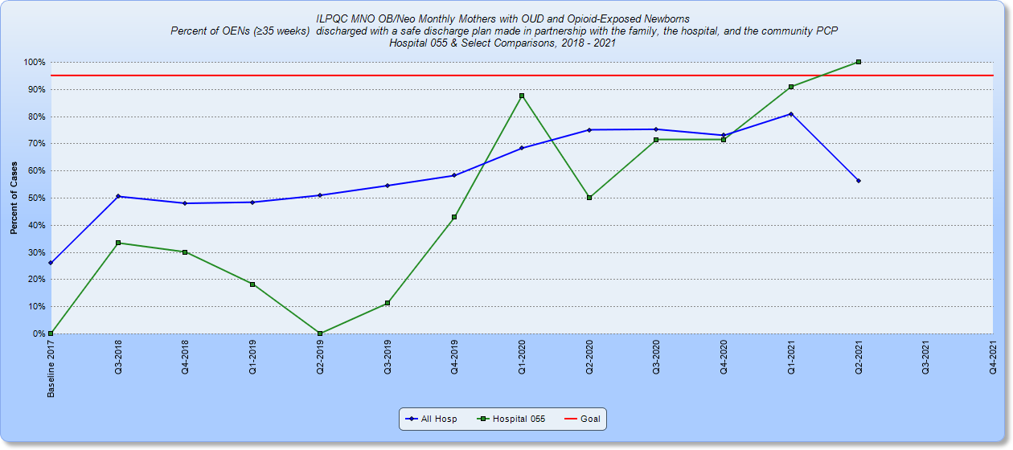
SIH – Memorial Hospital of Carbondale
MNO-Neo Data
Baseline Data
Readiness Survey
Was a good tool to help provide MHC SCN with specific 30/60/90 day goals.
EMR implementation
Neonatal Sepsis Calculator for all infants for >34 weeks
Implemented AAP Serial Assessment protocol for infants
Standardize notes for nurses & providers
Automatic stop times for Antibiotics
Changed Antibiotics dose guidelines
Created Antibiotic Report
Standardized Education for Parents
QI Tools being used
Sepsis calculator
EMR Antibiotic Report
Designated Level II+, SIH Women and Children center delivers over 2100 births per year. Due to a local birthing center closing their doors, we have increased our deliveries by 30%. Baby Friendly Designated since 2015.
7 LDR, 2 C-section ORs, 13 SCN beds, 8 Antepartum beds, 6 Triage rooms, 21 Mother Baby beds, 13 Pediatric beds
Southern Illinois’ largest and most spacious birthing center with Level II+ Special Care Nursery
Only dedicated pediatric unit in the region
Dedicated Anesthesia 24/7
24/7 Lactation support
MNO-Sustainability Plan
Continue to meet monthly with QI team to review missed opportunities
Biannual education of staff on ESC, NAS policy, and stigma training
Targeted education of nurses using missed opportunities form
Add coordinated discharge checklist to EMR
Lactation support for mothers on MAT
Anticipated Barriers/Opportunities
QI /System Changes tools being used
Eat Sleep and Console flowsheet in EMR
NAS policy in place with PRN pharmacology option
Notes:
Folders, coordinated discharge worksheet,

Slide 2
<Hospital Logo>
<Hospital Name>

