Slide 1
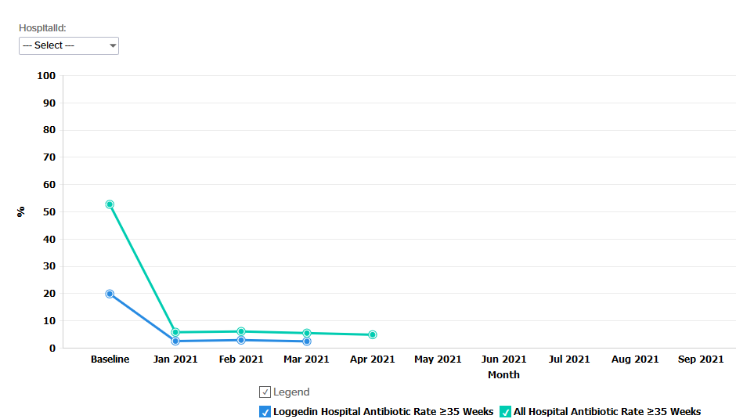
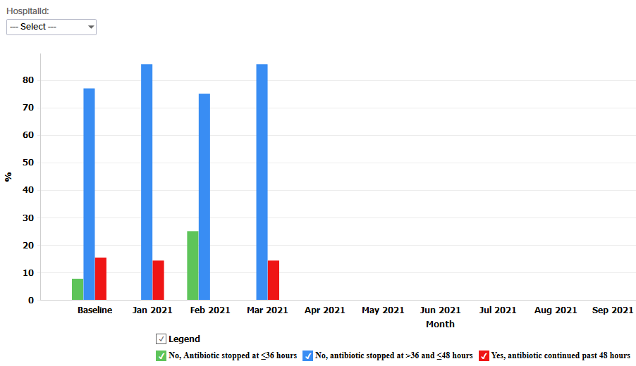
St John’s Children’s Hospital
BASIC QI team members
Kimberly Lawrence – Neonatal Intensive Care Unit (NICU) data collector
Sara Catalano – newborn nursery data collector
Vicky Cave – NICU assistant nurse manager
Diedra Stewart – NICU nurse manager
Natalie Tucker – Pharm D
Jessica Zitzke – Pharm D
Julie Livingston – Neonatal Nurse Practitioner (NNP)
Sheref Unal – newborn nursery physician champion
Marcella Rodriguez – pediatric infectious disease physician
Magali Jean-louis – neonatologist
Venkata Majjiga – neonatologist
Pele Dina – NICU physician champion
Beau Batton – director of NICU
Readiness Survey
Multiple meetings were held
Antibiotics orders are part of the NICU admission order set
Antibiotics orders have stop date and time between 36 and 48 hours from blood culture
Blood culture processed within our hospital
A protocol was made to guide the initial evaluation and management of neonatal early-onset sepsis (EOS) based on the American Academy of Pediatrics (AAP), Center of Disease Control and Prevention (CDC) and American College of Obstetricians and Gynecologists (ACOG) recommendations
Parents are verbally guided about the antibiotics
Verbal communication between Labor & Delivery (L&D) and NICU team is very efficient
EMR Implementation
For an easy data collection, we worked with IT to create a report by extracting maternal and neonatal required information from EPIC
Working on creating an newborn nursery antibiotics order set
Anticipated Barriers/Opportunities
Compliance between providers to use the antibiotic order set that has stop date and time for less than 36 hours
Compliance in documenting EOS risk assessment in the chart
Change the ampicillin stop date and time to less than 36 hours
Reviewing EOS and Late Onset Sepsis (LOS) time of positivity to make the changes on gentamicin and on antibiotics for infants less than 35 weeks
QI tools
EPIC report
Adjusted data form
Form for collecting monthly hospital data
Contact list from referring hospital
Baseline Data
Collected data between October and December 2020
19.76 % of infant ≥ 35 weeks received antibiotics within 72 hours
Data
Majority of the infants ≥ 35 weeks received antibiotics between 36 and 48 hours
Notes:
Folders, coordinated discharge worksheet,

Slide 2
<Hospital Logo>
<Hospital Name>

