Slide 1
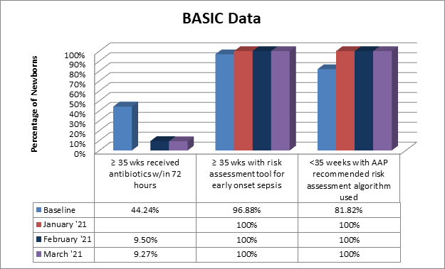
Northwest Community Healthcare
MNO-Neonatal
MNO-Neo Data
Current and up to date with the data. One baby was admitted in 2021. No pharmacologic interventions needed.
Baseline Data
Readiness Survey:
The NICU is already utilizing the Kaiser tool. Integrating, replicating, and having a structured process in Women and Infants are key to improve outcomes for all the newborns.
Key stakeholders identified.
EMR implementation:
As of April we are currently working with our IT application analyst to integrate the Kaiser Tool into the EMR.
Anticipated Barriers/Opportunities :
Provide education to the Community Pediatricians to understand the initiative
Staff buy-in is important. Training and educating the nurses are paramount
OB providers to appropriately identify the high risk mothers
QI Tools being used
Basic Data Newborn Form
Basic Hospital Data Form
Rochelle Sowa BSN, RN
Joel Fisher MD
Chris Pykett MSN, RN-NIC, RN-ELBW
Ashley Lange Pharm D
BASIC Team
Team Leads:
Nenette Cacal DNP, MSN, RN, CNML, RNC-OB, C-EFM
(Clinical Nurse Manager Women and Infants)
Chris Pykett MSN, RN-NIC, RN-ELBW
(Clinical Practice Specialist for NICU)
Physician Leads:
Anita Gupta MD & Joel Fisher MD
(Neonatologists)
Clinical Practice Specialist for Women and Infants:
Jaime Kelly MSN, RNC-OB
Clinical Nurse Manager (NICU)
Rochelle Sowa BSN, RN
QI Representative:
Elizabeth Schuett CPHQ
IT Application Analyst:
Shiny Shibu BSN, RN
Pediatric/Neonatal Pharmacist Representative:
Ashley Lange Pharm D.
Nurse Champions:
Janice Breitman BSN, RN (Staff RN NICU)
Barbara Diwisch RN, BSN, RNC-MNN (Staff RN W&I)
Agatha Sowizral BSN, RN (Staff RN W&I)
MNO-Sustainability Plan
Tracking admissions and pharmacological needs of the NICU babies
QI /System Changes tools being used
ILPQC educational information given to families as well as checklists used as a validation tool.
ESC scoring integrated into EMR.
Notes:
Folders, coordinated discharge worksheet,

Slide 2
Northwest Community Healthcare

