Slide 1
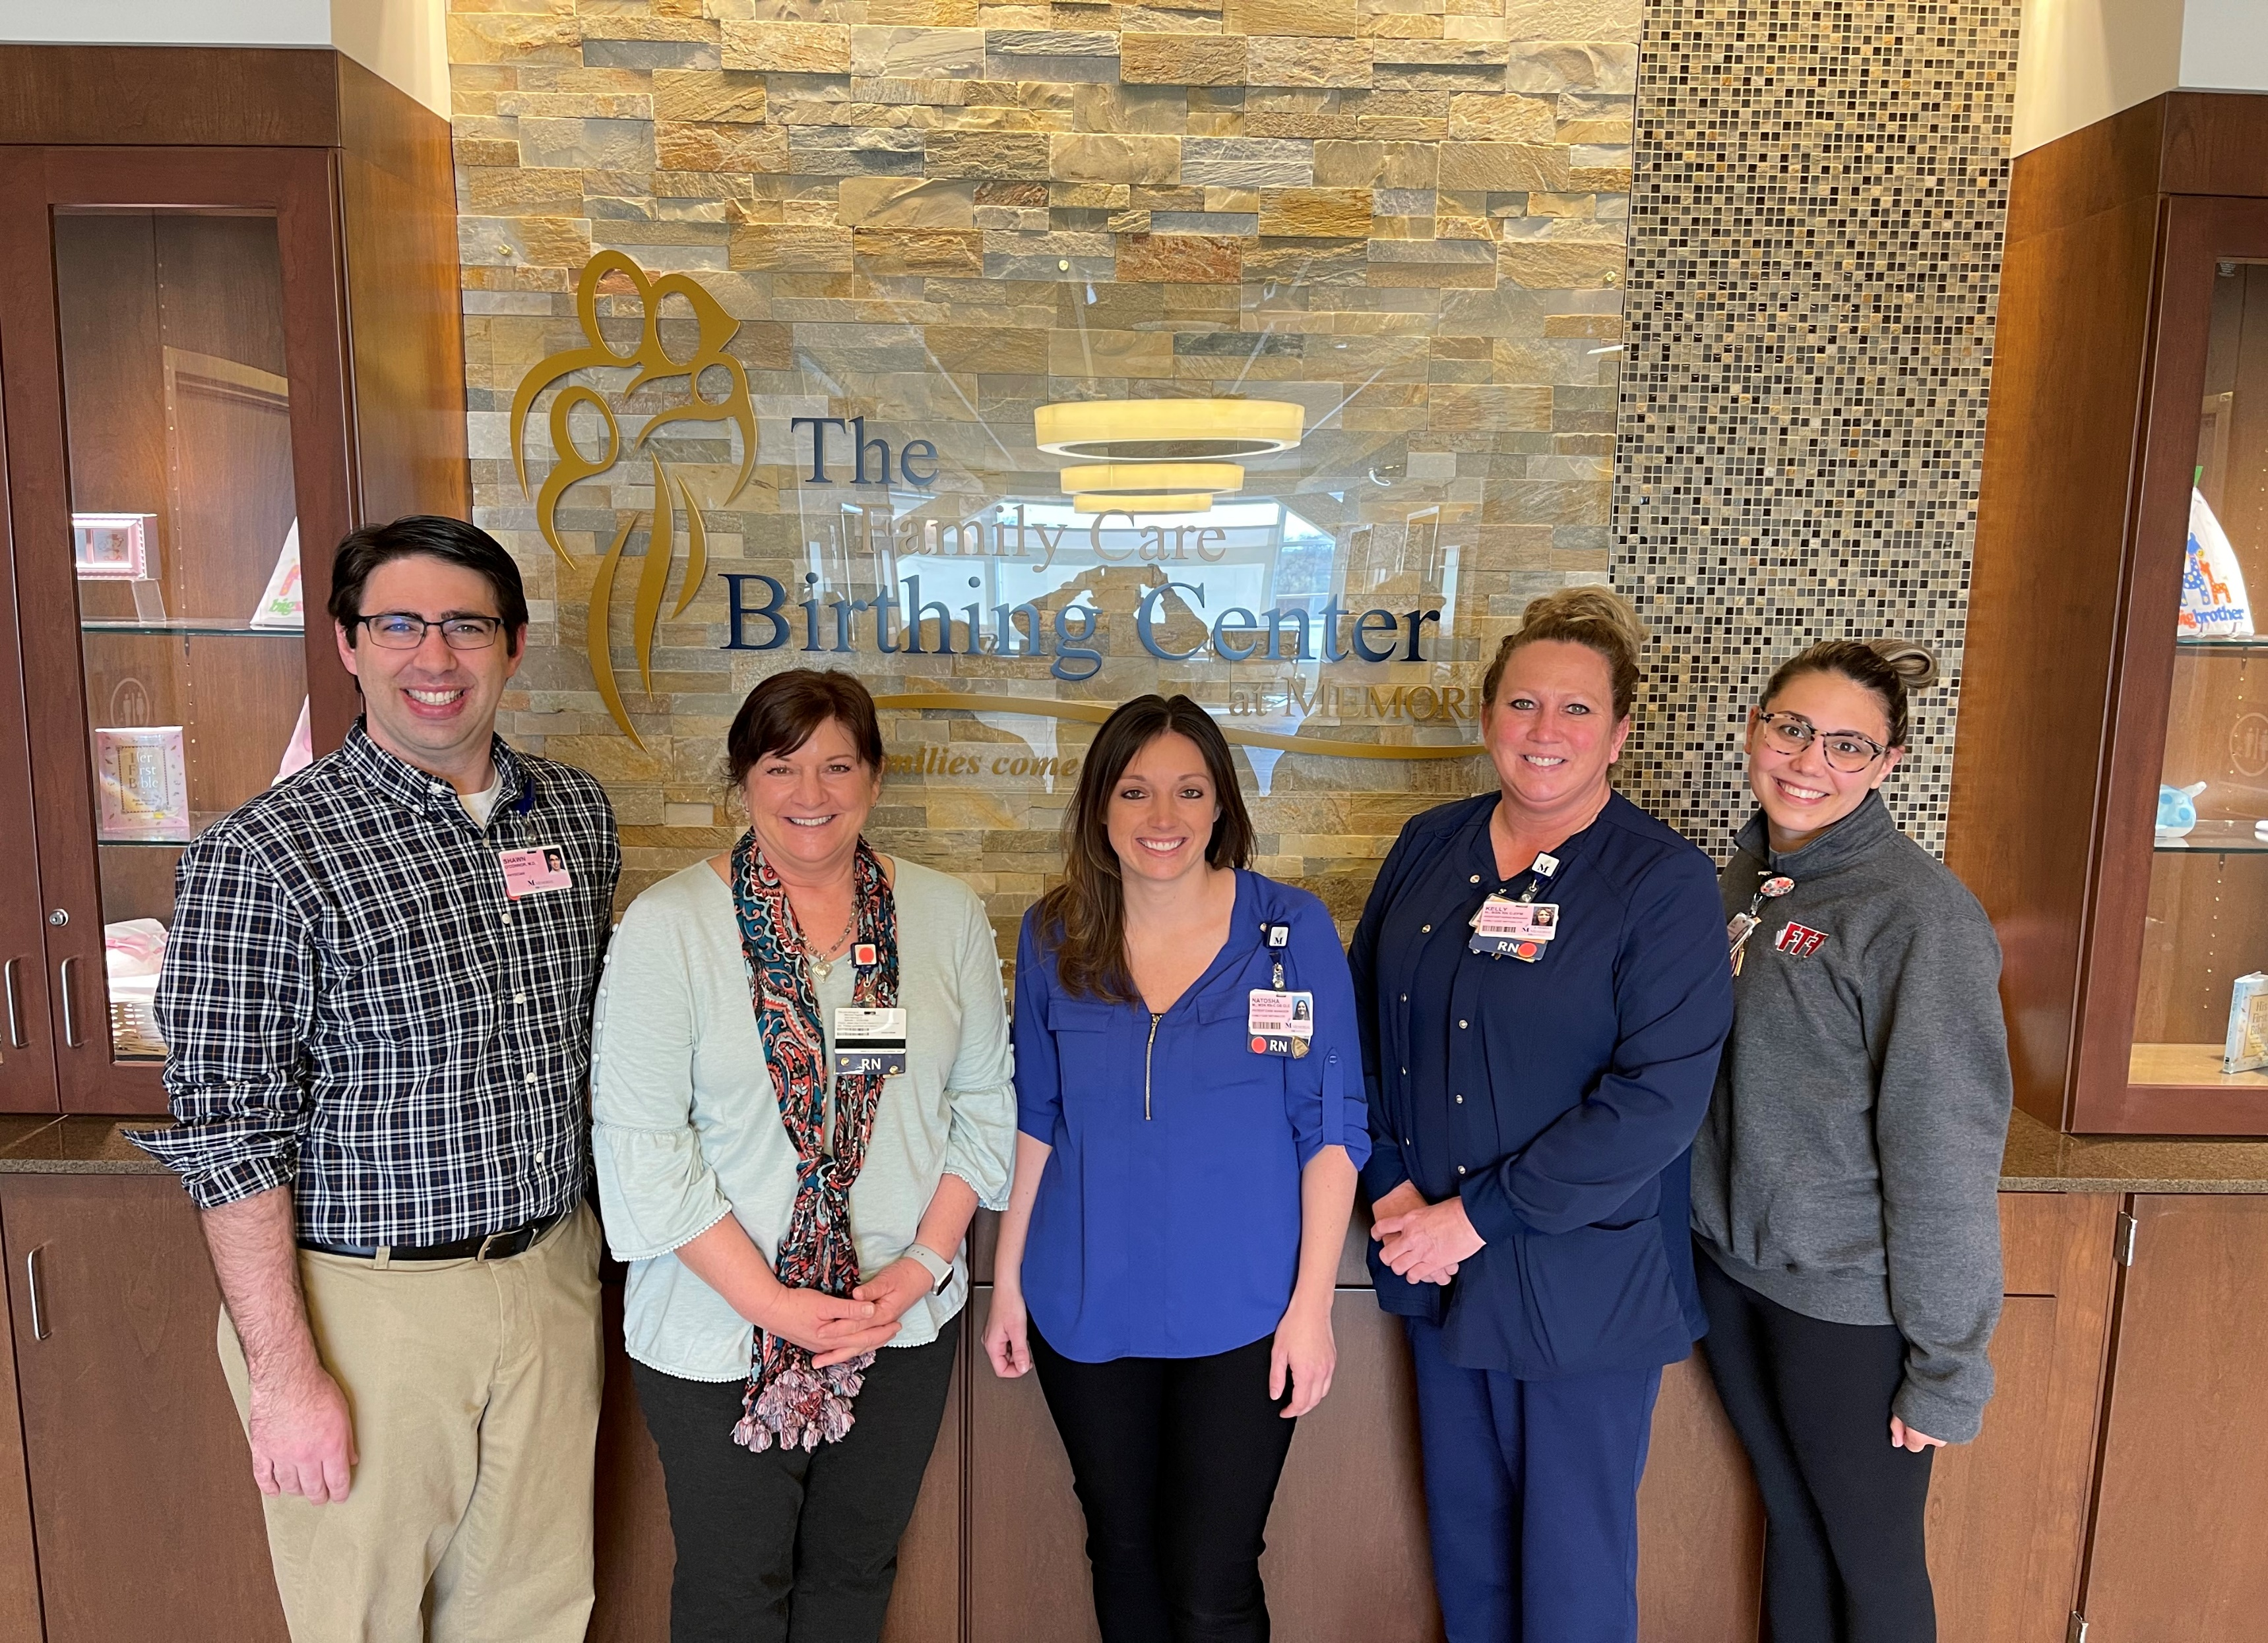
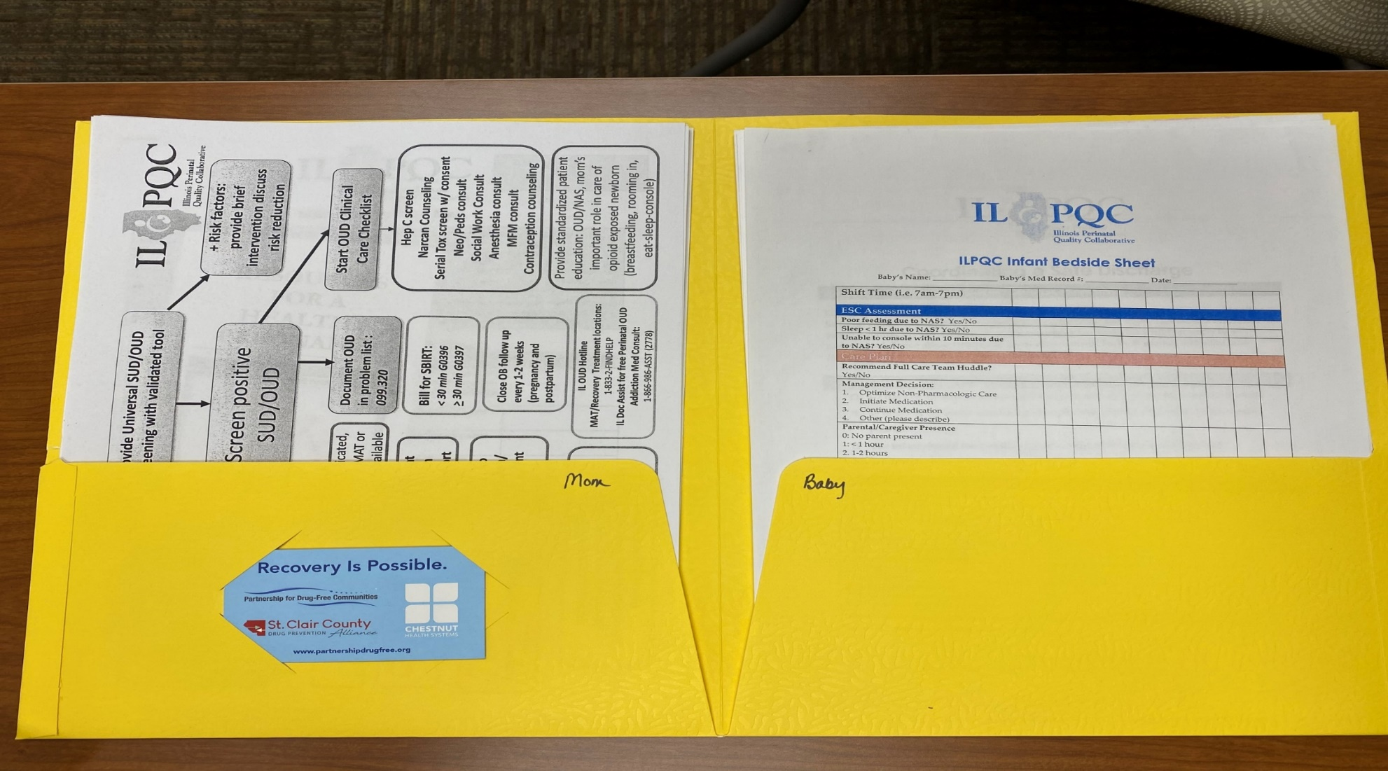
Memorial Hospital Shiloh
Neonatal Team and Roles:
Neonatology Medical Director: Dr. Shawn O’Connor
Director: Donna Stephens
Manager: Natosha McEvers
ANMs: Kelly Harre & Alexis Deutsch
QI: Kelly Harre, Natosha McEvers
& Dr. O’Connor
MNO-Neo Data
Opioid exposed newborn average length of stay: 10.8 days
Percentage with Pharm Treatment: 31.25%
Percentage who roomed in: 50%
Safe discharge plan: 100%
Baseline Data
Oct-Dec 2020:
Total Newborns < 35wks: 8
Total Newborns > 35wks: 374
< 35wks rcv’d abx: 4 = 50% absolute rate
> 35weeks rcv’d abx: 25 = 5.61% absolute rate
100% antibiotics dc’d within 36hrs of negative blood culture result.
Readiness Survey
EMR implementation
Transitioning from Meditech to Epic on June 5th
MNO-Neonatal
Physician Lead: Dr. Shawn O’Connor
ANM & QI: Kelly Harre
BASIC
Physician Lead: Dr. Shawn O’Connor
Nurse Manager & QI: Natosha McEvers
Pharmacy/Monthly Reports: Ryan Massey
MNO-Sustainability Plan
Continued use of folders/checklists
Missed Opportunities Form
Education incorporated in annual training and new hire education.
Anticipated Barriers/Opportunities
Meditech does not allow automatic stop time on abx orders; Epic will allow this and will be an opportunity of improvement.
Labeling of blood cx specimen in real time to reflect true timing of specimen collection vs. abx administration timing.
Notes:
Folders, coordinated discharge worksheet,

Slide 2
<Hospital Logo>
<Hospital Name>

