Slide 1
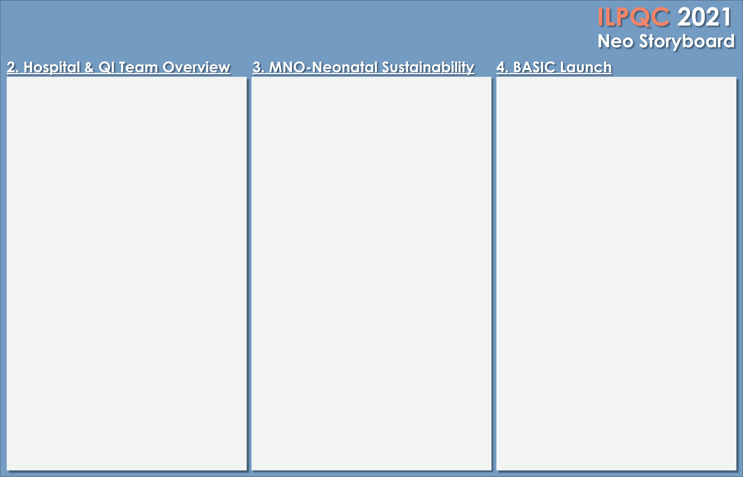

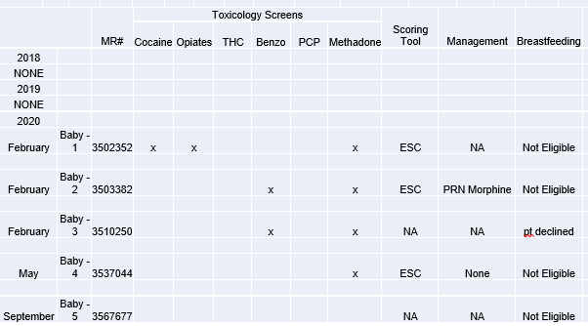
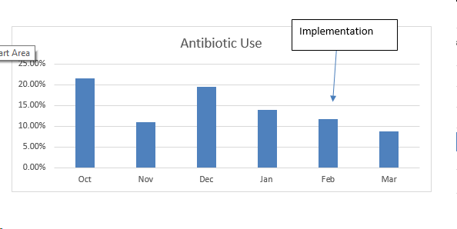
Loyola Medicine - MacNeal
MNO – Neonatal and BASIC Team
Danielle Felty, Manager
Aisha Jameel, Pediatric Hospitalist/ Pediatric Department Chief
Maggie Tyler, Clinical Nurse Specialist
Maria Lotesto, LD Supervisor/ Prenatal Educator
Heather Chavez, Special Care Nursery Supervisor
MNO-Neo Data
Baseline Data
Implementation, February 1st:
Kaiser Sepsis Scale implemented for every delivery
Standard dot phrase for physician notes with all elements of the Kaiser Scale and antibiotic course.
Discontinuation of antibiotics at 36 HOL with a negative blood culture
MNO-Sustainability Plan
Nurse champions will reinforce education to staff on a biannual basis
MNO Folders provide consistent education to parents
ESC tool will be monitored for compliance and educational needs
Debrief after each OUD patient to determine opportunities
Anticipated Barriers/Opportunities
Standardized patient education
Nursing documentation of education
Notes:
Folders, coordinated discharge worksheet,

Slide 2
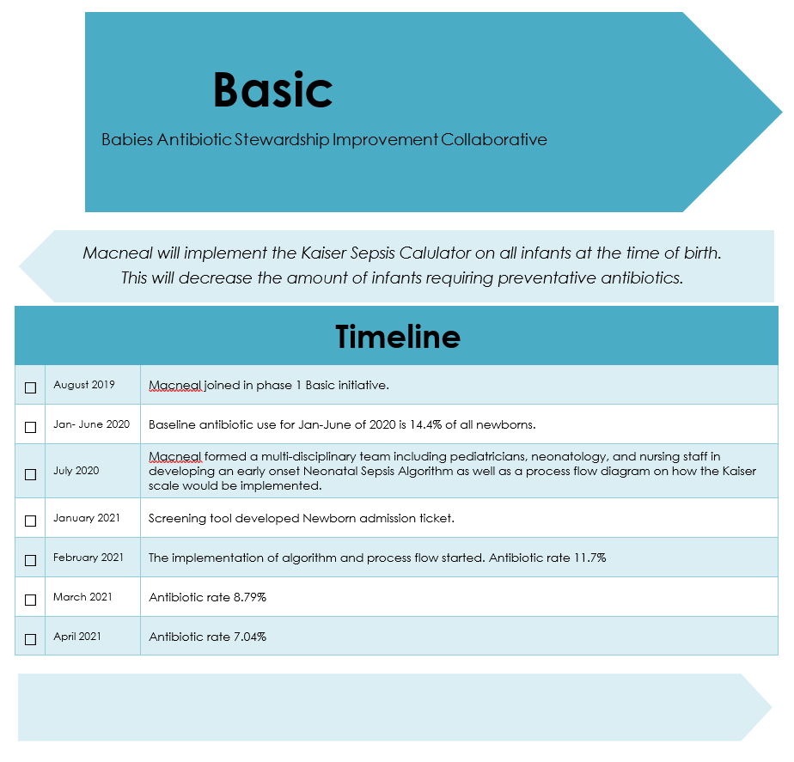
<Hospital Logo>
Loyola Medicine-MacNeal

