Slide 1
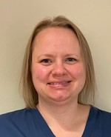
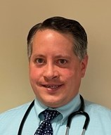
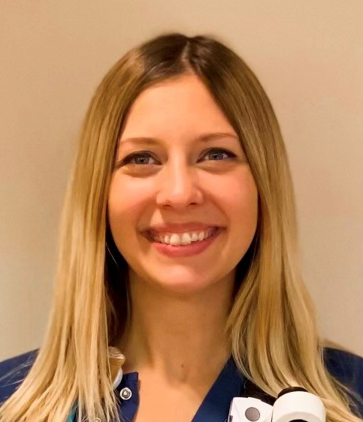
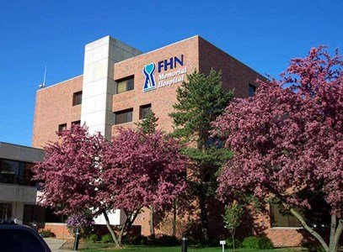
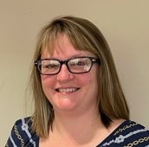
FHN Memorial Hospital
3.
BASIC Team Members
Team Leader: Carmen Kemp, BSN, RN, RNC-MNN, CPST
Pediatric Provider Champion: Dr. Adam Angelilli, MD
Peds/Neonatal Nurse Champion: Abbigail Schneiderman, BSN, RN
Team Member/Educator: Keri Schubert, BSN, RN, RNC-MNN
Team Member/IT: Laurie Williams
Hospital Information
Rural, community hospital serving northwestern Illinois
7 LDRP beds and 2 Triage beds
Average 300 deliveries per year
Level 2 Nursery
Team Pictures
Baseline Data (Oct-Dec 2020)
77 newborns
2 blood cultures
0 antibiotics administered
EMR Implementation
Enhanced Observation checklist already in place
Neonatal Sepsis order set (medications, lab tests) already in place
Incorporation NEOSC score into Meditech EMR in process
Addition of Antibiotic Timeout to newborn EMR in process
Anticipated Barriers/Opportunities
Technological – ability to format EMR programs to do what we want/need
Smaller number of staff = less difficulty in getting staff on board with changes
QI Tools being used
ILPQC templates
Data reported out monthly at unit staff meetings and unit council meetings
Data reported out quarterly at pediatric provider meetings
Notes:
Folders, coordinated discharge worksheet,
1

Slide 2
<Hospital Logo>
<Hospital Name>
Notes:
2

