Slide 1
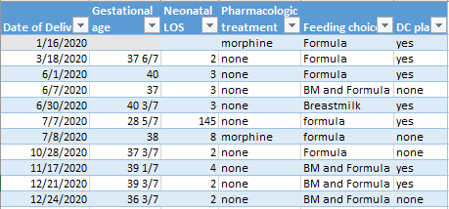
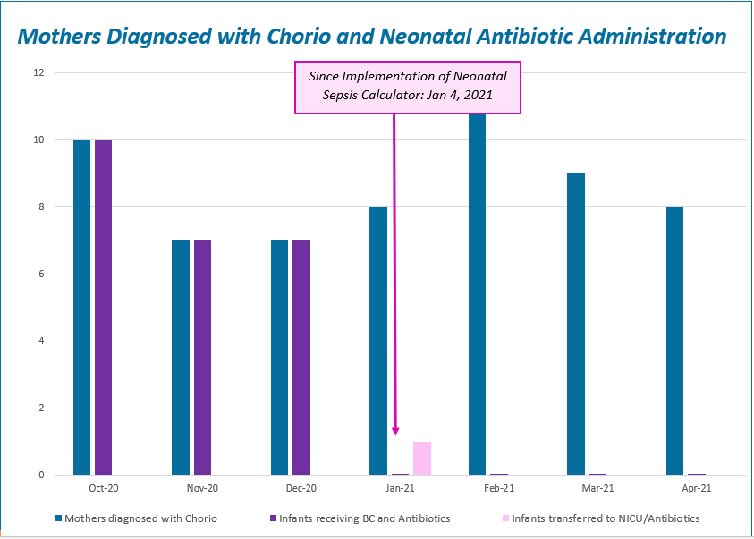
Advocate Lutheran General
Advocate Children’s Hospital Park Ridge
MNO-OB and Neonatal
MNO-OB Neo Data
ALGH ACH-PR Basic Team
Dr Jeff George, DO, FAAP, Director of Neonatology
Dr Iannucci, MD, CPE, FACOG Chair Maternal Fetal Medicine
Cindy Hartwig, Executive Director Women’s Services
Meg Behm, APRN Developmental Care RN Specialist
Debbie Schy, RNC, MSN, APN, IBCLC, Perinatal Outreach Ed
Catherine Bennett, APRN, Perinatal Clinical Nurse Specialist
Kat Bulthuis, APRN, Clinical Nurse Specialist NICU
Katie Kurnick, MSN, RNC-NIC Clinical Practice Specialist NICU
Kim Vuckovich, RN, MSN, CNL RNC-NIC Clinical Practice Specialist NICU
MNO-Sustainability Plan:
Monthly Meetings to review sustainability data and review opportunities
Continuing education via Case Studies
BASIC
ALGH ACH-PR Basic Team
Dr Prazad, MD Neonatologist
Dr Madalina Mindrut, MD, FAAP, Pediatric Hospitalist
Dr Jeff George, DO, FAAP, Director of Neonatology
Catherine Bennett, APRN, Perinatal Clinical Nurse Specialist
Laurie Lang RNC, Labor & Deliver Nurse
Kat Bulthuis, APRN, Clinical Nurse Specialist NICU
Katie Kurnick, MSN, RNC-NIC Clinical Practice Specialist NICU
Kim Vuckovich, RN, MSN, CNL RNC-NIC Clinical Practice Specialist NICU
QI /System Changes tools
ESC incorporated into EMR
MNO folders available in L&D, NICU and Mother baby
Future Opportunities: Keep infants needing pharmacologic treatment on Mother Baby or the Pediatric unit
Anticipated Barriers/Opportunities
Resources for data collection
Ongoing education
Need for EMR reports
Notes:
Folders, coordinated discharge worksheet,

Slide 2
<Hospital Logo>
<Hospital Name>

