Slide 1
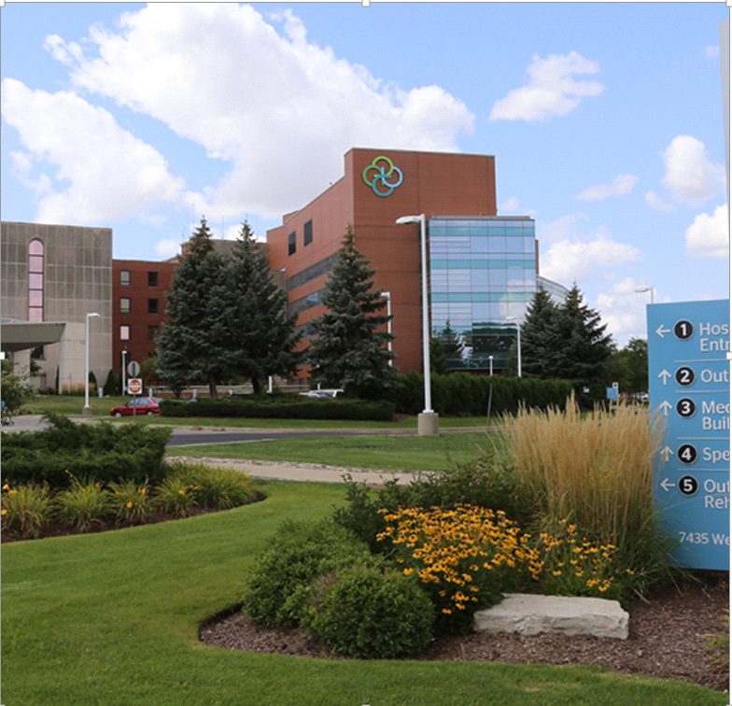
<Hospital Logo>
AMITA Resurrection Medical Center Chicago
A comprehensive 337 bed academic medical center located on Chicago’s northwest side, inclusive of O’Hare International Airport.
The Family Birthplace | Quality Initiatives
~1,000 annual deliveries 17 LDRs 2 ORs 1 RR 22 PP/Gyne Beds Loyola Perinatal Network Level 2E | Obstetric Hemorrhage Severe Maternal Hypertension Improving Postpartum Access to Care Mothers and Newborns Affected by Opioids Babies Antibiotic Stewardship Improvement Collaborative Promoting Vaginal Birth Birth Equity Enhanced Recovery After Surgery
Jo Ann Dominick Meigs, RN, BSN, MBA Nurse Manager Family Birthplace
7435 West Talcott Ave. | Chicago, IL 60631
joann.meigs@amitahealth.org
Office: 773.990.5087

Slide 2
<Hospital Logo>
AMITA Resurrection Medical Center Chicago
MNO-Neonatal
Jo Ann Meigs-Manager
Connie Wedmore-Team Lead
Kara Calhoun-Clinical Nurse Educator
Rose Molepske-SCN Level II RNC
Dr. Aldana-Attending Neonatologist
MNO-Neo Data 2020-2021
Baseline Data
Goal (1): Decrease by 20% or absolute rate of 4% the number of newborns that receive antibiotics.
Baseline data: 9.4% Goal: 4%
Goal (2): Decrease by 20% the number of newborns with a negative blood culture who receive antibiotics for longer than 36-48 hours.
Baseline data: 13% Goal: 10.4%
EMR implementation
-Building in EOS calculator
-Building in hard stop
-Modifying order set
QI Tools
-Reviewing each case of neonatal antibiotic use
-Implementing EOS calculator
-Scheduling grand rounds/educating staff
BASIC
Jo Ann Meigs-Manager
Connie Wedmore-Team Lead
Kara Calhoun-Clinical Nurse Educator
Rose Molepske-SCN Level II RNC
Emily Magiera-SCN RN
Dr. Anwar-Attending Neonatologist
MNO Sustainability Plan
-Continued education via eModules and participation in the Vermont Oxford Network NAS program
-Compliance is monitored via team huddles, chart review and patient care conferences
-ESC built into the EMR
Anticipated Barriers/Opportunities
Barriers: sepsis calculator is not currently in the EMR, there is not a hard stop on antibiotics, postpartum RNs are not trained to administer IV antibiotics to neonates
Opportunities: staff Neonatologist completed fellowship in antibiotic stewardship, ability to add hard stop and sepsis calculator to EMR, can provide training to PP RNs for antibiotic administration at maternal bedside when applicable
QI/System Tools
-Patient care folders
-Clinical Care Checklists
-Newborn Care Diary
-Patient Care Conferences
-ESC Tool
Notes:
Folders, coordinated discharge worksheet,

