Slide 1
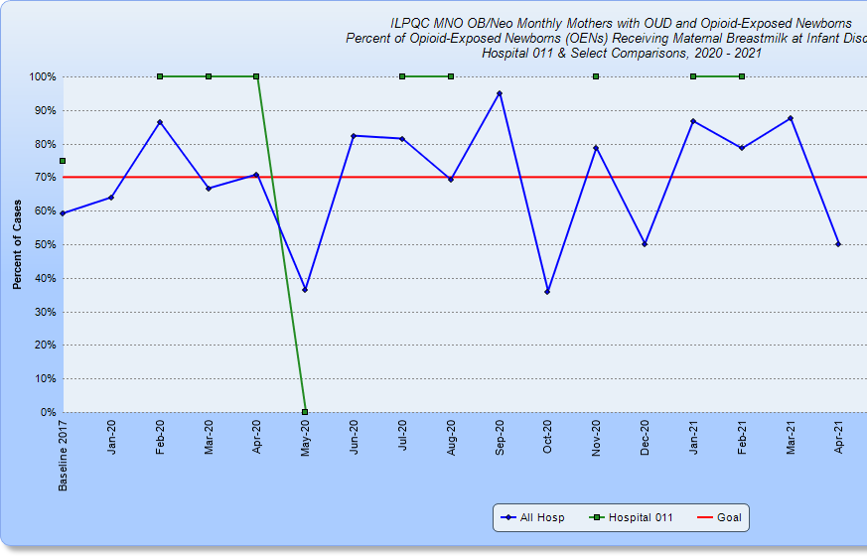
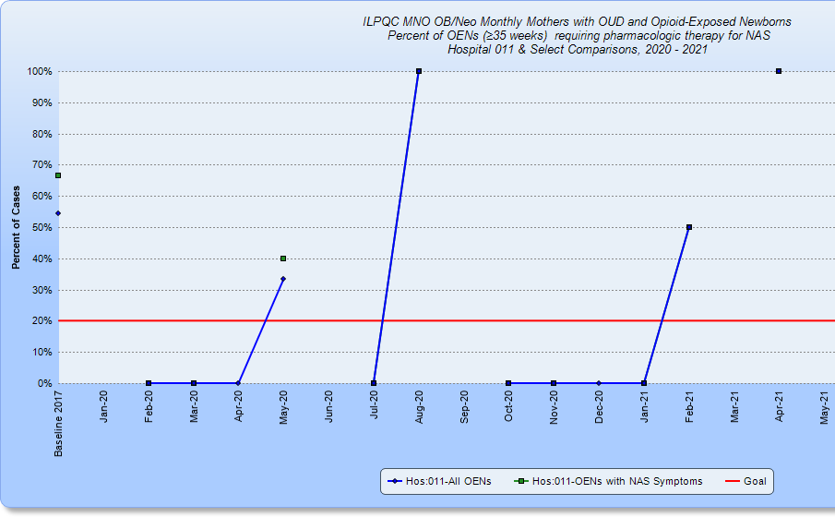
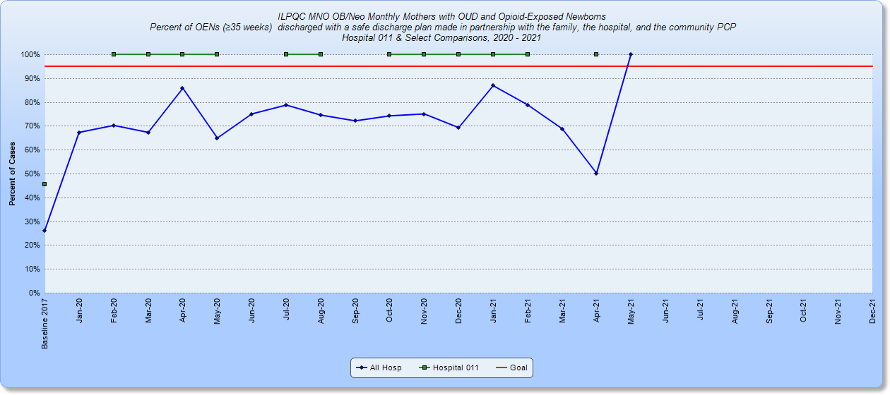
OSF St Francis Medical Center and OSF Children’s Hospital of Illinois
Peoria, IL
MNO-Neonatal
Newborn Hospitalist - Shelly Shallat, MD
Neonatologist - Juanita Corrales, MD
OB Acute Nurse Manager – Kristi Haage, RN
Perinatal Outreach Services Manager-Mildred Shafer,RN
Nursery Clinical Educator – Kelli Crawford, RN
Perinatal Outreach Coordinator - Deborah Wenell, RN
Case Manager – Christine Crumrine
Case Manager - Sherry Keyser, RN
NIC Clinical Educator – Michele Jones, RN
Lactation Consultant – Katie Madigan, CLC RN
Pharmacist – Jen Mitchell PharmD
MNO-Neo Data 1/18-4/21 – #102 total NBs
Baseline Data
18.9% neonates > 35 weeks received antibiotics
14.3% neonates > 35 weeks received antibiotics > 36 hours with a negative blood culture
Readiness Survey – opportunities for improvement
Protocol for identification and response to newborns with a worsening clinical status. One is in place but not automated in the EMR
Automated antibiotic stop orders
Patient standardized education and anticipatory guidance with a focus on equitable care to families on antibiotics, EOS, and treatment plan for newborn antibiotics and EOS
Standardize process to review antibiotic data by race/ethnicity and share with providers and staff
Standardized RN and newborn nursery resident education on Early Onset Sepsis
EMR implementation
Report already in place for antibiotics given to neonates
Report made for blood cultures during first 72 hours of life and reports adapted to include race and ethnicity data
Automated stop orders for admission order sets in process
Dot phrases and smart lists created in Epic
QI/Systems Tools being used
Prioritization Matrix
30-60-90 Day plans in place
PDSA cycles from data – found nursing education is not standardized as initially thought – created education and will be uploaded in Healthstream for ongoing use
Breastfeeding >70%
Pharm Tx <20%
Safe DC >95%
1/21-4/21 – 1/11 NBs started on Pharm Tx = 9%
BASIC
Neonatologist – Ashley Fischer, MD
Newborn Hospitalist – Shelly Shallat, MD
OB Acute Nurse Managers – Kristi Haage, RN and Cristy Shafer, RN
Perinatal Outreach Services Manager-Mildred Shafer, RN
Nursery Clinical Educator – Kelli Crawford, RN
NIC Clinical Educator – Michele Jones, RN
Director Women’s and Children’s Birthing Center – Robyn Lindenmeyer, RN
Pharmacists – Jen Mitchell PharmD and Amanda Penland PharmD
Clinical Coordinator Children’s Service Line – Ginger Barton MSN RN
Neonatal Nurse Practioner – Janessa Jenkins APN
MNO-Neo Sustainability
Compliance Monitoring
Continue Redcap entry of cases IDed via maternal ID, ESC EPIC report, toxicology testing, word of mouth
Quarterly workgroup team review of cases/data
Case Debriefs and provider feedback
Education
MNO Healthstream for new hires
June 2021 MNO staff education/celebration week - Monthly Nursery Pediatric resident MNO education
Anticipated Barriers/Opportunities
Takes longer for EMR builds as needs to be approved by all hospitals within the OSF system
Hospitals in the OSF system working with different perinatal networks – local algorithm has been in place since 2018 and working well in Peoria; other perinatal networks utilizing sepsis calculator more
QI /System Changes tools
Folders with OB/Neo provided to moms on admission
Prenatal consults by Pediatric team with NAS Booklet
MNO Collaborative Discharge Plan smart phrase in use
Continue to map resources – collaborate with Family Connects Home Nursing in Peoria County
MNO OB and Neo combined workgroups
Notes:
Folders, coordinated discharge worksheet,

Slide 2
OSF St Francis Medical Center and OSF Children’s Hospital of Illinois
Peoria, IL
Reduction of antibiotics for Infants < 35 weeks
Local algorithm put into place in fall 2016 for EOS
2018 – Late onset sepsis and surgical guidelines developed
Regular feedback and education provided during Vermont Oxford Initiative
Continued improvement with regular feedback and monitoring of all blood and urine cultures to ensure safety
Opportunities for improvement
Automated stop times – most cases of non-compliance due to 1 or 2 extra doses of antibiotics
Method of continued feedback and education of providers – new providers, residents. and nurses
Continued work on reducing preventable cases of late onset sepsis in the NICU (CLABSI, pneumonia, etc)

