Slide 1
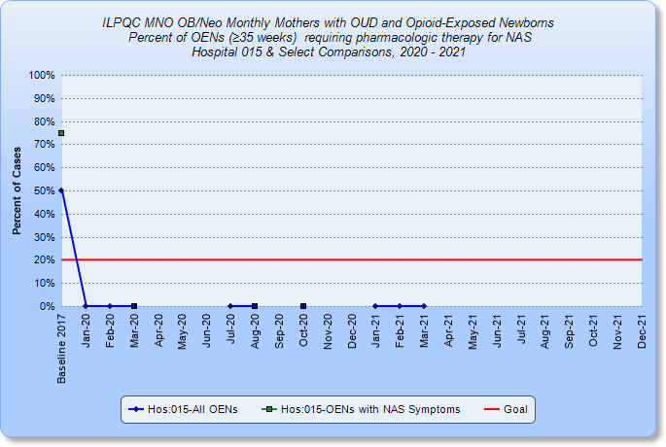
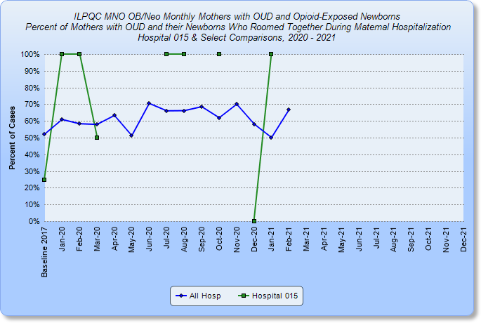
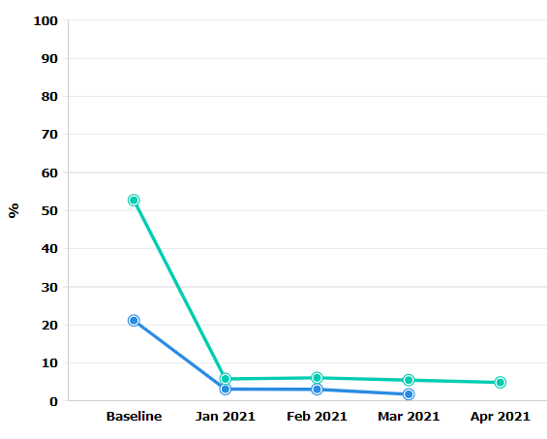
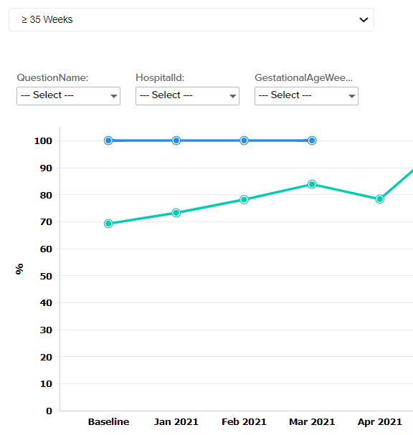
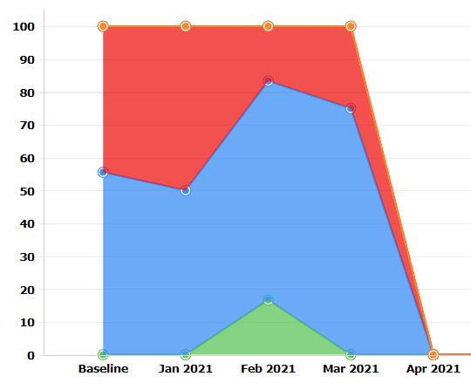
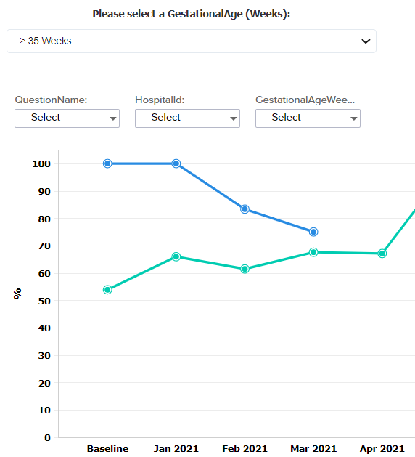
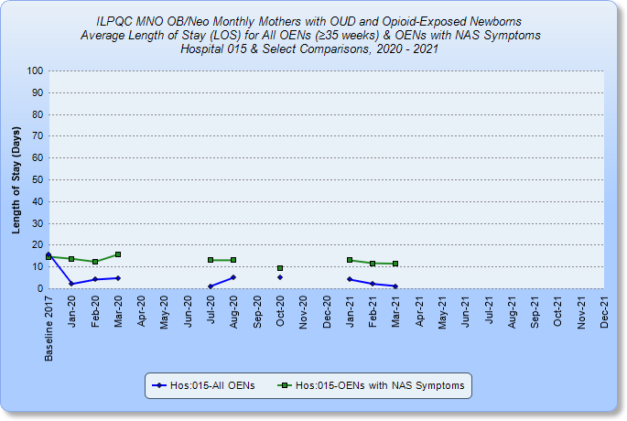
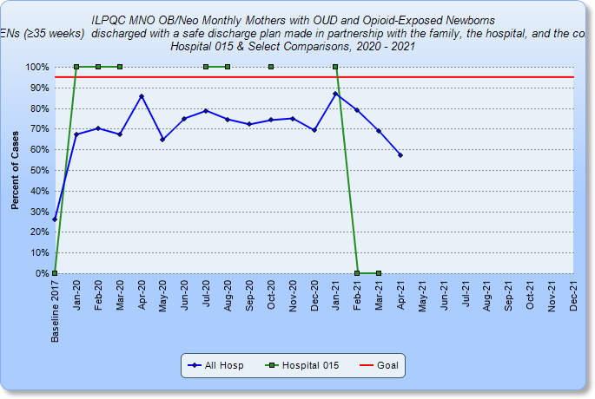
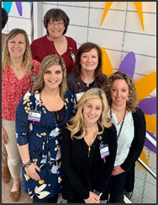
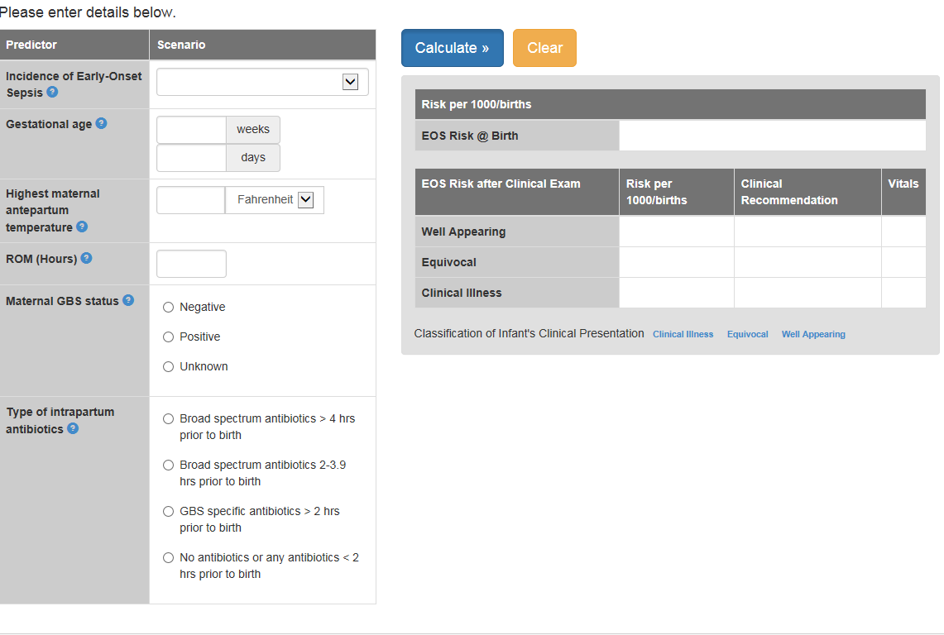
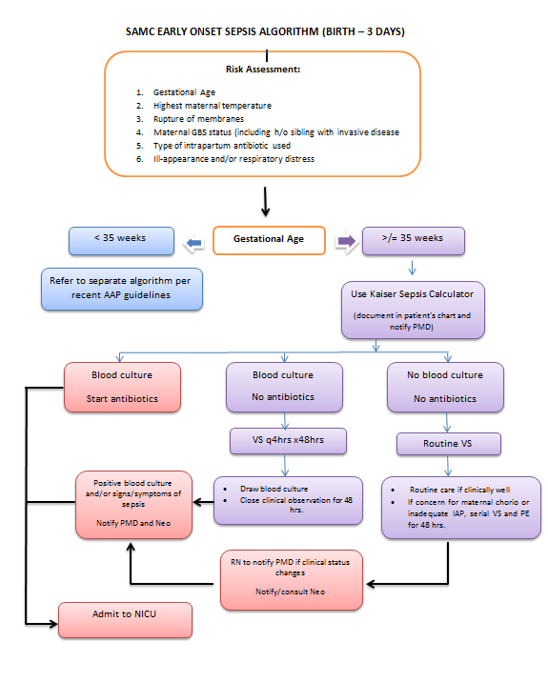
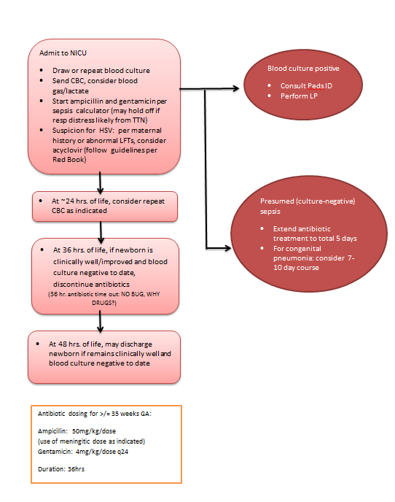
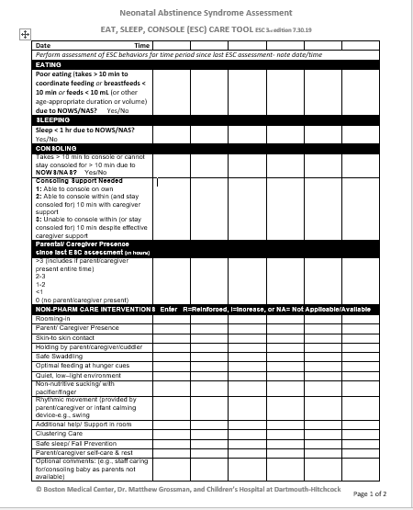
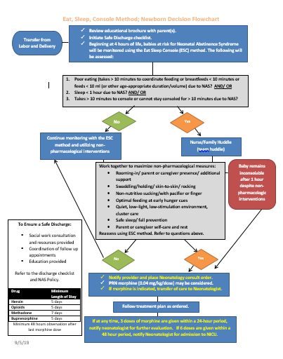
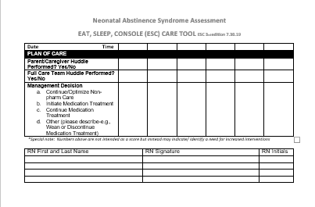
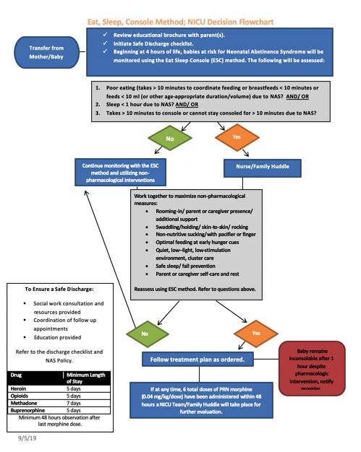
St. Alexius Medical Center
MNO-Neo Data
Pharm Treatment Length of Stay
Roomed-In Safe Discharge
Hospital 015
Other Hospitals
Baseline Data
Readiness Survey
EMR implementation
Working on integration of the Kaiser Sepsis Calculator into our EMR to facilitate an increased percentage of newborns with a documented use of EOS risk assessment tool at delivery.
QI Tools being used
Key identified opportunities:
Increase percentage of newborns with documented use of EOS risk assessment tools at delivery
Increase percentage of newborns with documentation of parent/family education about antibiotics and EOS.
Development of an electronic reporting system from EMR in collaboration with IT department.
Percent ≥35 wks who received antibiotics within 72 hours of life
Percent of all newborns
with antibiotic timeout
Percent of all newborns ≥35
wks with antibiotic continued
with negative blood culture
St. Alexius Medical Center, Hoffman Estates, IL
Comprehensive care for women experiencing complicated or high-risk pregnancies
Family-centered level III Neonatal Intensive Care Unit and Special Care Nursery
Access to maternal fetal medicine specialists
All-private rooms with family sleep accommodations
Expert lactation consultants
On- site treatment for mood and anxiety disorders, both during and after pregnancy
MNO-Neonatal Team
Maliha Shareef, MD, MS, MBA, FAAP
Ellyn Hausl, RN
Allison Henke-Schotke, RN, MSN, FNP-BC
Kristy Amore, MSN, APN
Kellie Smith, BSN, RNC-OB, C-EFM
Crystal Antos, RN, BSN
Tori Hanson, RN
Percent of parents/families of all newborns provided education
MNO-Sustainability Plan
Monthly multidisciplinary review of anticipated cases.
Utilization of the MNO-Neonatal Clinical Debrief Form to review all NAS cases and provide feedback to the clinical care team.
New hire staff education modules on use of the ESC tool.
Annual competencies/on-going education as needed.
Figure 2. EOS Algorithm
QI /System Changes tools being used
Anticipated Barriers/Opportunities
Figure 2. Newborn & NICU NAS Decision Flowcharts
Figure 1. Kaiser EOS Calculator
BASIC Team
Candy Salvador-Tolentino, MD
Courtney Camp, NNP
Carly Zirkin, PharmD
Allison Henke-Schotke, RN, MSN, FNP-BC
Kim Laarveld, MSN, RNC-NIC
Debbie Romine, RN
Jil Collins, RN-BSN
Figure 1. Eat, Sleep, & Console (ESC) Care Tool

Slide 2
<Hospital Logo>
<Hospital Name>

