Slide 1
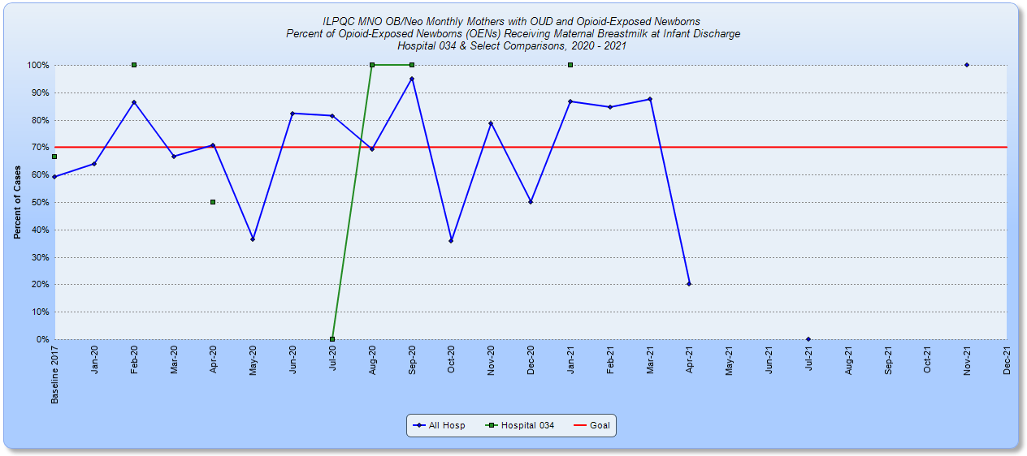
Rush Copley Medical Center
MNO-Neo Team
Director of Women's Health- Karen Werrbach
Director of Neonatology - Dr. Lina Sapiegiene
Maternal Fetal Medicine Specialist- Dr. Barbara Parilla
NICU Clinical Manager- Louise Fazio
OB Clinical Manager- Andrea Grzyb L&D Clinical Manager- Peggy Mikkelsen
NICU Clinical Educator- Sharon Colin
Women’s Health Clinical Educator- Meg Puente
Care Management- Celeste Emrich
Women’s Health Coordinator- Melissa Knapik
NICU Staff RN- Madi Tassone and Carol Heinz
OB Staff RN- Tita Cozzoni and Katherine Mueller
L&D Staff RN- Tracie New and Melissa Acton
Lactation and Childbirth Education Coordinator- Gina Becker-Espinoza
Lactation Consultant- Susan McCormack
MFM and Pelvic Medicine Coordinator- Mary Antongiorgi
BASIC Team
Team Leader- Dr. Amy Hoyme
Director of Women's Health- Karen Werrbach
Director of Neonatology - Dr. Lina Sapiegiene
Neonatologist- Dr. Chirag Talati
Pediatrician- Dr. Pricilla Sarmiento-Gupana
NICU Clinical Manager- Louise Fazio
NICU Clinical Educator- Sharon Colin
Women’s Health Clinical Educator- Meg Puente
NICU Clinical Pharmacist- Joette Miller
Women’s Health Coordinator- Melissa Knapik
NICU Staff RN- Paige Cizek, Meg Bachman, and Carol Heinz
Infection Prevention Manger-Kristi Walker
MNO-Neo Data
Since implementing the initiative, all babies were successfully managed using Eat, Sleep, and Console and no one required pharmacologic treatment.
The average length of stay for infants exposed to opioids was 4 days.
Challenges included exclusive breast milk feeding at discharge and now have the Lactation consultant meet with every MNO patient on admission regardless of their feeding intention.
MNO-Sustainability Plan
Continue to collect and submit data into REDcap.
Develop care plans prenatally when patients identified through MFM.
Initiate a patient care team huddle which includes the Managers, Care managers, staff and providers taking care of the patient when patient is admitted to or identified in L&D.
Switched from meconium toxicology to cord toxicology.
QI /System Changes tools being used
Early on in the initiative we did a small PDSA, one patient, one nurse, utilizing the ESC care tool. We have since replaced the modified Finnegan tool with ESC tool.
Education folders are located in MFM, L&D, OB and NICU to be handed out whenever a patient is identified.
During huddle the missed opportunity worksheet is reviewed to help prevent missed opportunities.
Baseline Data
Antibiotic stewardship was implemented in Fall of 2019.
Percent of newborns >/= 35 weeks who received antibiotics within 72 hours of life 25/622 = 4.02%
During that time an automatic stop time of 36 hours for antibiotics was added to the order set.
Readiness Survey
The readiness survey was completed in collaboration with the entire BASIC team.
EMR implementation
A report from EPIC lists the babies who received antibiotics within 72 hours of birth.
An IT member attended the QI topic call.
The team is reviewing EPIC to modify note templates
Anticipated Barriers/Opportunities
The Kaiser calculator was launched in Epic in February 2021. However, there were problems with the data flowing into the tool. The EPIC team is currently working on this issue.
An opportunity to further antibiotic stewardship in babies born to mother’s diagnosed with chorioamnionitis was identified. Currently, instead of automatically admitting the baby and starting antibiotics the neonatologist will evaluate the baby using the sepsis calculator and determine the need for antibiotics. Some of these babies now room-in!
QI Tools being used
Run charts, flow charts, PDSA cycles
Notes:
Folders, coordinated discharge worksheet,

Slide 2
<Hospital Logo>
<Hospital Name>

