Slide 1
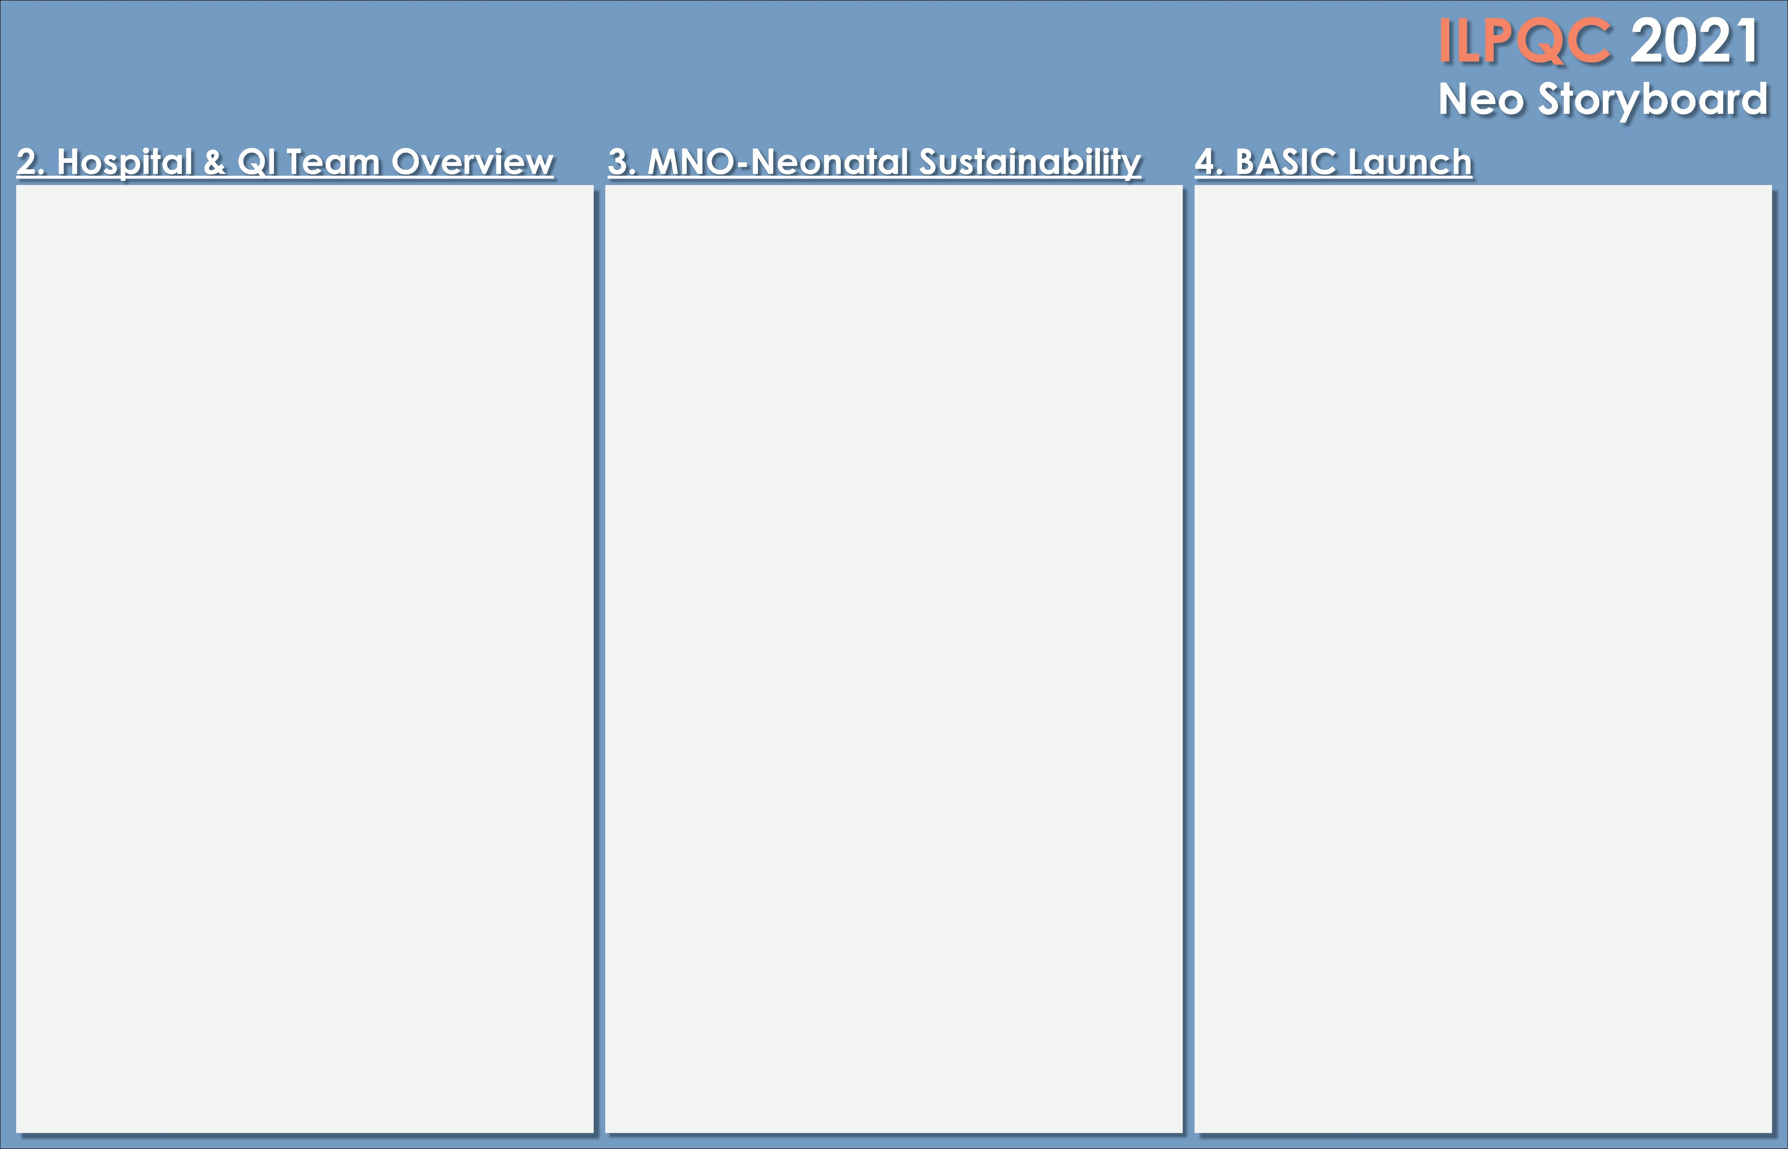

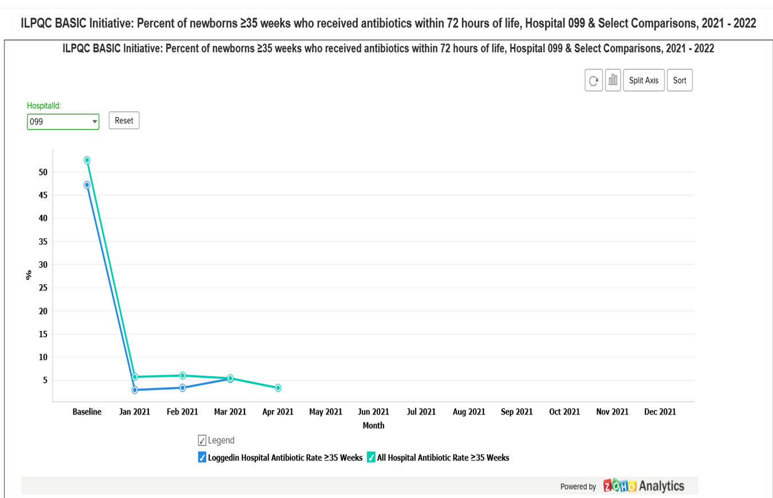
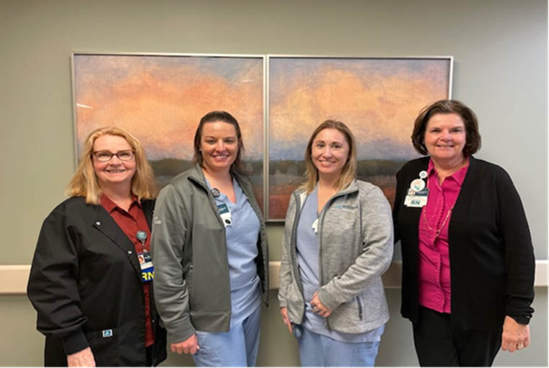
<Hospital Logo>
Riverside Medical Center
Kankakee, Illinois
Fill in QI Team & Roles Here
MNO-Neo Data
Baseline Data
Readiness Survey
Submitted in December of 2020
EMR implementation
Working with IT team to Create build and report in EPIC
QI Tools being used
MNO-Neonatal
Barbara Schuch, Director Women & Newborn Services
Mary Ellen Arrington, Perinatal Quality Coordinator
Kaylee Gray & Laura Snow Team Leaders
Dr. Jeanmarie Schied, U of C Pediatric Hospitalist
MNO-Sustainability Plan
BASIC
Barbara Schuch, Director Women & Newborn Services
Mary Ellen Arrington, Perinatal Quality Coordinator
Kaylee Gray & Laura Snow Team Leaders
Dr. Jeanmarie Schied, U of C Pediatric Hospitalist
Whitney Pelletier, Pharmacy Clinical Coordinator
Anticipated Barriers/Opportunities
B-Limited IT resources > time constraint
O-Pediatric Hospitalists and Pharmacy Clinical Coordinator on our Quality Team
QI /System Changes tools being used
Notes:
Folders, coordinated discharge worksheet,

Slide 2
<Hospital Logo>
<Hospital Name>

