Slide 1
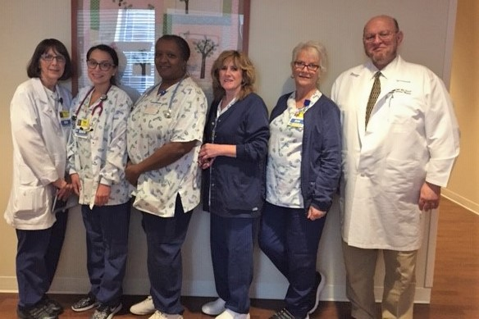
OSF Little Company of Mary
Medical Center
MNO-Neonatal:
Mary P. Grimm- Team Lead
Dr. O. Itani- Physician Champion
Mary Ward-Mayster- SCU Primary Charge RN
Cheryl A. Chemers- SCU Educator
Sonia Ramirez- SCU Staff RN
Carol Banks- M/B Staff RN
MNO-Neo Data
Urine for toxicology: 89%, now 95%
Percentage of women rec. education: 100%
Mothers rooming in: Baseline 52%, now 66%
Breastfeeding goal: 80%
Breastfed with supplementation: 100%
Prenatal Neo Consults: 100% of referred pts.
Parental Support and ESC intervention: 100%
Safe discharge plan: Baseline 26%, now 75%
Baseline Data
-Baseline Data completed prior to deadline.
-Reviewed at Department of Pediatrics meeting with providers and shared at monthly RN staff meetings
Readiness Survey:
Completed in collaboration with team members. Reviewed and submitted 01/15/2021.
EMR Implementation
-Currently there is no EOS Calculator integrated into the EMR.
-Formal request for the addition of a calculator was written and submitted to Ministry
QI Tools Being Used
-All cases reviewed at weekly Multidisciplinary Discharge Rounds
-Ongoing discussion at Pediatric Departmental and Nursing Staff Meetings
MNO-Sustainability Plan
-Maintain open communication between providers and staff
-Consistent education and support of MNO couplets
-Continue collaboration with Case Management and weekly Multidisciplinary Discharge Rounds
BASIC:
Cheryl A. Chemers-Team Lead
Dr. O. Itani- Physician Champion
Mary P. Grimm- M/C Manager
Mary War-Mayster- SCU Primary Charge RN
Jillian Hassan- Pharmacist
Regina Wan- NNP
Camille DiCostanzo-NNP
Kimberly Reule- FNP-C
Anticipated Barriers/Opportunities
-Approval and integration of EOS into EMR
-Consistent use of EOS calculator by all Neo/Peds providers
QI /System Changes Tools Being Used
-MNO OB/Neo folders for identified mothers reviewed at all stages of treatment plan
-Team review of all NAS cases
-ESC modeled and encouraged for all identified cases
-Nesting Room offered to identified mothers
-Case Studies being developed for staff review
Notes:
Folders, coordinated discharge worksheet,

Slide 2
<Hospital Logo>
OSF Little Company of Mary Medical Center
OSF Little Company of Mary Medical Center
Evergreen Park, Illinois
Proud Metro-Region Hospital of OSF HealthCare. Owned and operated by The Sisters of the Third Order of St. Francis, Peoria, Illinois.
OSF LCMMC is a 274 bed Catholic Hospital serving the Southwest Chicago community
10 Bed Level 2e within the University of Chicago Perinatal Network

