Slide 1
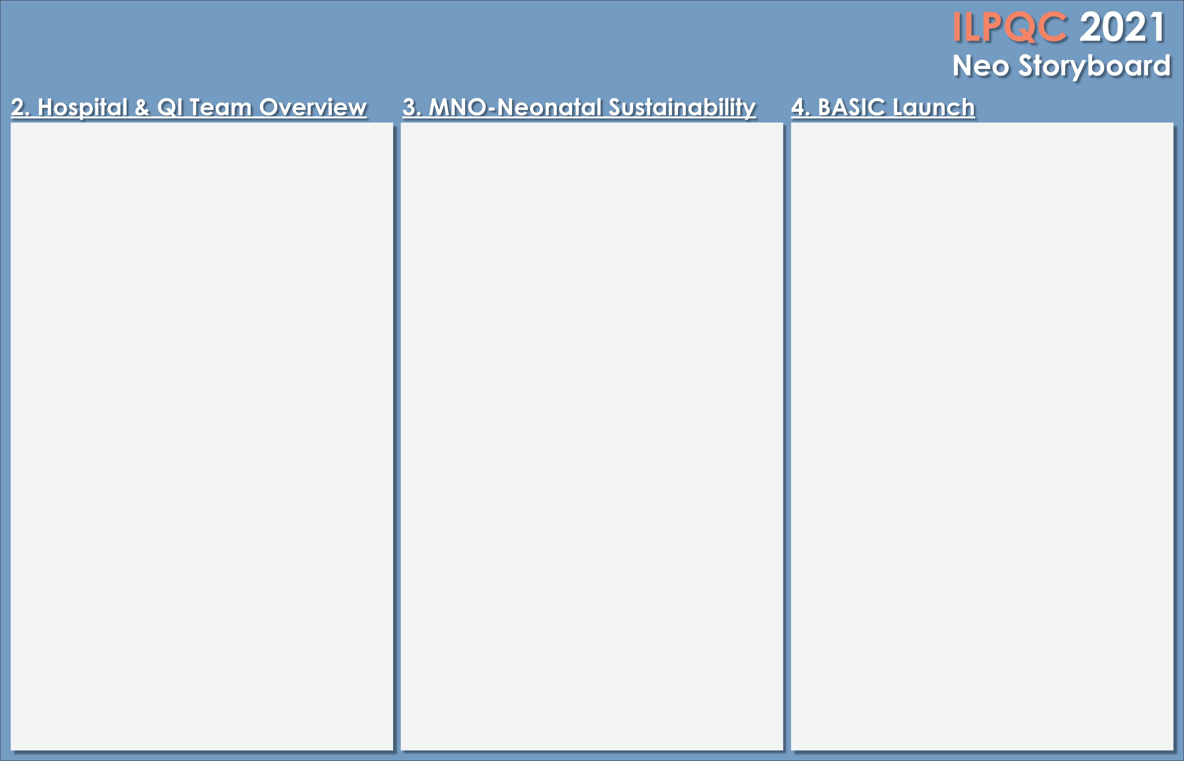

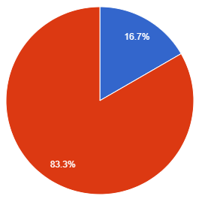
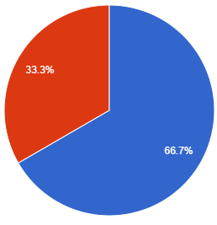
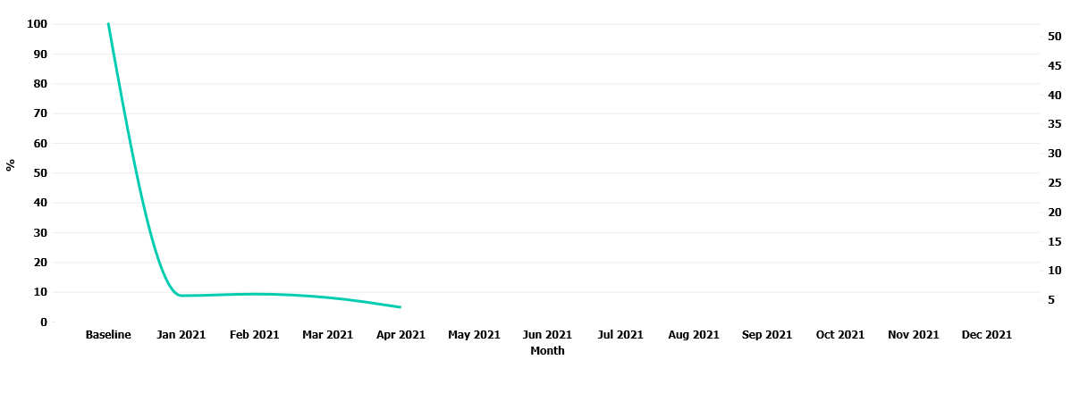

Advocate Aurora Health Hospital
Intermediate Care Nursery:
Dana Jones-MNO
Marilee Ellis-BASIC
Erin Pinaire-BASIC
Mother/Baby:
Jessica Contreras-MNO
MNO-Neo Data
Baseline Data
Readiness Survey:
EMR implementation:
Sepsis Calculator implemented in EPIC on January 18th 2021, and initiated on every newborn 35 weeks gestation and greater.
QI Tools being used:
*Monthly Newborn Data Form
*Monthly Hospital Measures Data Collection Form
*Newborn Sepsis Calculator
*Monthly meetings with whole BASIC team to review current progress and give updates.
Infants requiring pharm intervention
Infant eligible for breastfeeding at discharge
MNO-Sustainability Plan:
*Data collected monthly and entered into REDCap
*QI team meeting monthly
*Ongoing education provided to staff via
-NAS Clinical debriefs
-MNO-Neonatal toolkit materials
-monthly emails on changes
-Use of Donna Wright competency model
*MNO folders to be replenished on the units weekly
*Community resources updated bi-annually with Social worker.
MNO-Neonatal:
Improvement Tracking of Sustained Key Measures:
1. Opiod-Exposed newborns receiving Pharmacologic Treatment.
2. Opiod-Exposed newborns receiving breastmilk
3. Opiod-Exposed newborns discharged with a coordinated plan.
Anticipated Barriers/Opportunities:
Staff possibly forgetting to initiate and/or
complete Monthly Newborn Data form when
caring for infant’s undergoing antibiotic therapy.
QI /System Changes tools being used:
*Neonatal Monthly Sustainability Collection form
*Eat, Sleep, Console charting in EPIC
*Quarterly meetings with whole QI team to review any changes that need to be addressed for better outcomes or staff education.
BASIC:
Babies Antibiotic Stewardship Improvement Collaborative
*Intermediate Care Nursery RNs collecting data on neonates born between 24-44wks gestation receiving antibiotics within the first 72 hours of life.
Notes:
Folders, coordinated discharge worksheet,

Slide 2
<Hospital Logo>
<Hospital Name>

