Slide 1

COVID-19 Strategies for OB & Neonatal Units
May 29, 2020
12:00 – 1:15pm

Slide 2

Welcome
Please be certain you are on “mute” when not speaking to avoid background noise.
Whether you have joined by phone or computer audio, you can mute and unmute yourself by clicking on the microphone icon.
The following shortcuts can also be used
For PC: Alt + A : Mute or Unmute
For Mac: Shift + Command + A: Mute or Unmute
For telephone: *6 : Mute or Unmute

Slide 3
Housekeeping:
We Are Recording Now

Slide 4
ILPQC Covid 19 webinars
The strategies shared today are examples from individual institutions not IDPH or ILPQC recommendations.
This is our 8th COVID-19 strategies for OB/Neonatal Units webinars, Friday’s at noon since April 3rd. Please see https://ilpqc.org/covid-19-information/ for future webinar registration, prior recorded webinars and Q/A’s from those webinars.
We need to determine ongoing frequency of webinars, every other week to monthly, please share your opinion.
Please let us know if your hospital would like to share on an upcoming webinar, please put questions/comments into the chatbox or email directly to info@ilpqc.org

Slide 5
Overview
Introduction
Discussion of OB Unit Strategies
  Leticia Setrini-Best, MD – Obstetrics & Gynecology, Morris Hospital, Morris, IL
  Kim Kocur, MSN, RNC-OB, CNS-APN - Perinatal Outreach Coordinator, Women and Infant's Services, Advocate Christ Medical Center, Oak Lawn, IL
  Ashley Vincent, BSN, RNC-OB, HSHS - Manager, Women and Infant Services/Pediatrics, St. Anthony’s Memorial Hospital, Effingham, IL
  Fidel Abrego, MD, MBA – Obstetrics & Gynecology, John H. Stroger, Jr. Hospital,
  Emily Miller, MD – Maternal-Fetal Medicine, Northwestern University
  Rob Abrams, MD, Executive Director - SIU Center for Maternal - Fetal Medicine, HSHS St. John's Hospital, Springfield
Discussion of Neonatal Unit Strategies
  Leslie Caldarelli, MD, NICU Director, Prentice Women's Hospital, Chicago
  Justin Josephsen, MD, Medical Director – St. Mary’s Hospital NICU, Neonatologist Cardinal Glennon Children’s Hospital, St. Louis

Slide 6
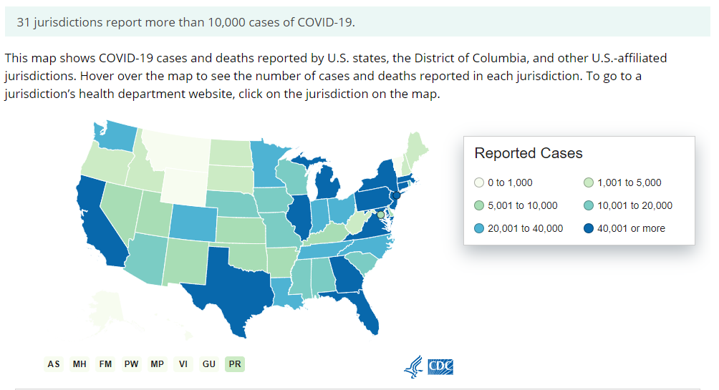
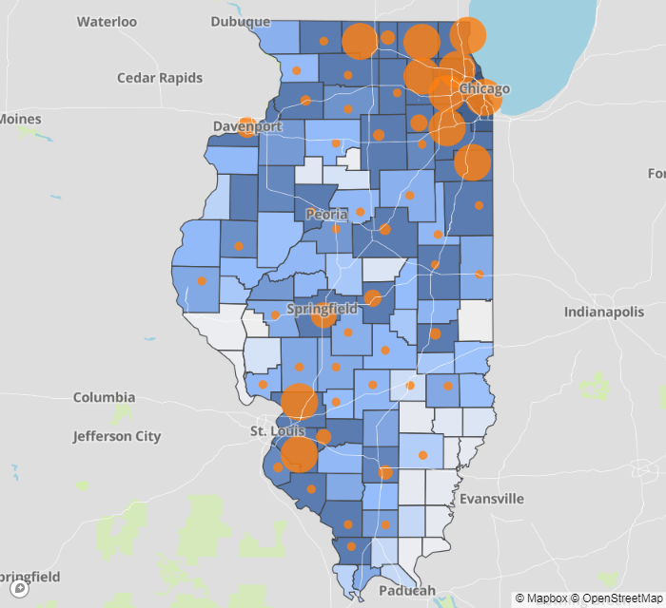
Data Update May 28, 2020
CDC/IDPH: COVID-19 Outbreak
CDC (5.14.2020) https://www.cdc.gov/coronavirus/2019-ncov/cases-updates/cases-in-us.html | IDPH https://www.dph.illinois.gov/covid19
Total cases: 1,698,523 confirmed Total deaths: 100,446 confirmed | 115,833 Confirmed Positive Cases 5,186 Deaths
Notes:
Dan to update

Slide 7
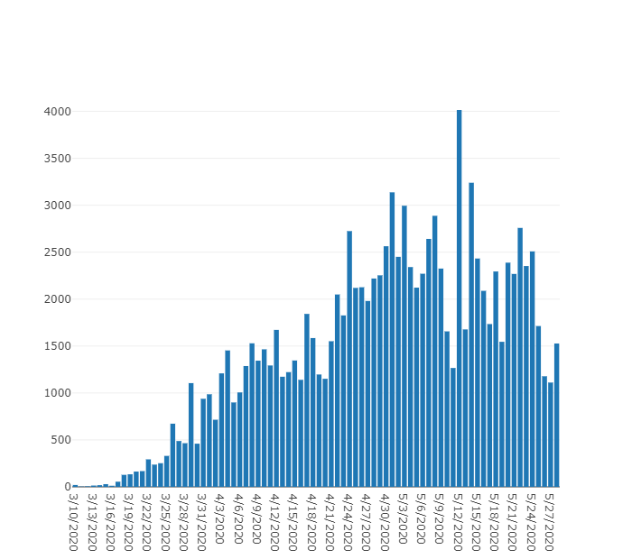
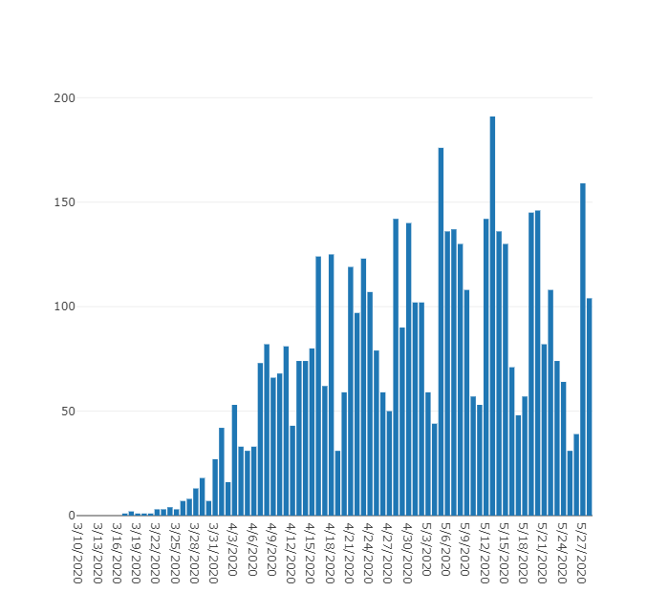
Data Update May 28, 2020
IDPH: COVID-19 Outbreak
https://www.dph.illinois.gov/covid19
IL Positive Cases Over Time
IL Deaths Over Time
Total: 5,186
Total: 115,833
87,937
3,928
3,111
70,873
Notes:
http://www.dph.illinois.gov/covid19/covid19-statistics
Dan to update

Slide 8
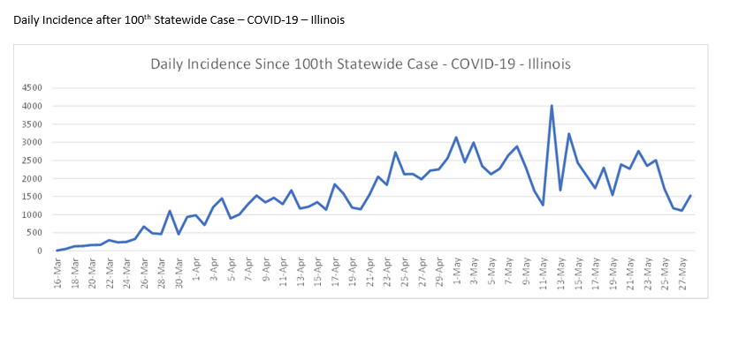
Illinois Daily Incidence
IDPH daily data summary

Slide 9
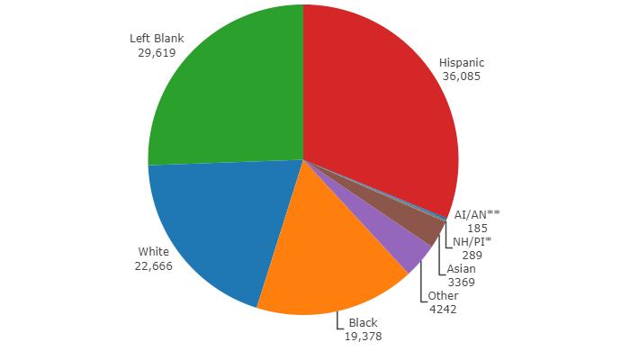
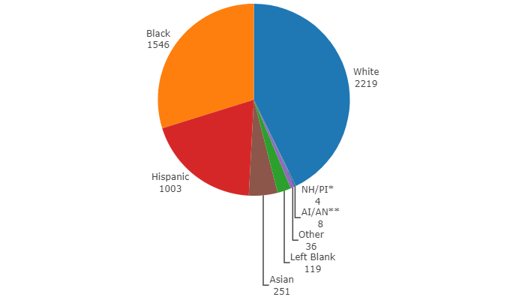
Data Update May 28, 2020
IDPH: COVID-19 Outbreak
Race Demographics
https://www.dph.illinois.gov/covid19
Confirmed Cases
Deaths
Notes:
http://www.dph.illinois.gov/covid19/covid19-statistics
Dan to update

Slide 10
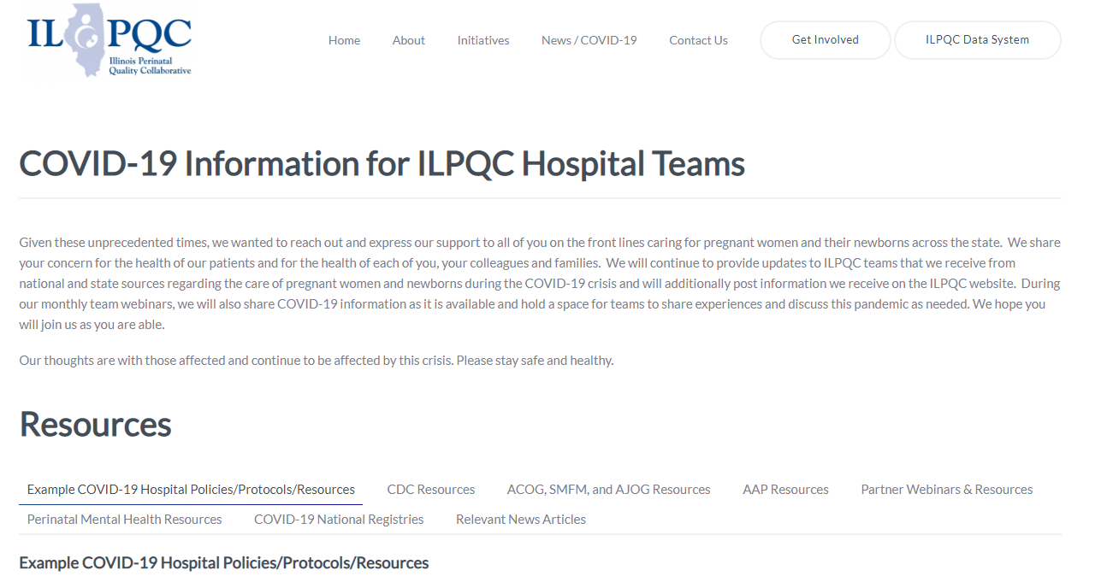
ILPQC COVID-19 Webpage www.ilpqc.org
ILPQC posts national guidelines and OB & Neonatal COVID-19 example hospital protocols & resources
please note dates as guidelines are changing rapidly
https://ilpqc.org/covid-19-information/

Slide 11
IDPH Communications
IDPH - Coronavirus Disease 2019 (COVID-19)
IDPH - Coronavirus Disease 2019 (COVID-19): Press Releases / Briefings
IDPH - Coronavirus Disease 2019 (COVID-19): Frequently Asked Questions
Coronavirus COVID-19 Global Cases by Johns Hopkins CSSE
CDC Homepage for Coronavirus Disease 2019 (COVID-19)
IDPH: COVID-19 Considerations for Healthcare Providers in ANY Healthcare Setting (4.26.2020)
CDC: Symptom-Based Strategy to Discontinue Isolation for Persons with COVID-19 (5.3.2020)
IDPH: Changes to Isolation Period for COVID-19 Cases (5.7.2020)
IDPH PAC: Obstetrical & neonatal care during the COVID-19 pandemic (5.14.2020)
IDPH: COVID-19 Elective Surgeries & Procedures (4.24.2020)
For purposes of this policy guidance, an elective inpatient procedure is defined as an elective procedure in which the patient being considered for that procedure is likely to remain in the hospital for more than 23 hours, starting from the time of registration and ending at the time of departure. For a hospital to perform inpatient procedures, all criteria listed in both Section (C) and Section (D) below must be satisfied.
Preoperative Testing for COVID-19. Facilities must test each patient within 72 hours of a scheduled procedure with a preoperative COVID-19 RT-PCR test and ensure COVID-19 negative status. Patients must self-quarantine until the day of surgery after being tested. A temperature check must also be completed on the day of arrival at the facility with results of less than 100.4 degrees prior to proceeding with an elective procedure. When clinically acceptable, providers should consider using telemedicine for preoperative visits. In such cases, face-to-face components of the exam can happen after the result of the preoperative COVID-19 test result is known to be negative

Slide 12
Updated OB Resources
ACOG & SMFM: COVID-19 Algorithm (Shared 4.23.2020)
SMFM: Management Considerations for Pregnant Patients With COVID-19 (4.29.2020)
ACOG: Early Acute Respiratory Support for Pregnant Patients With Coronavirus Disease 2019 (COVID-19) Infection (4.29.2020)
ACOG reopening women’s health: https://www.acog.org/clinical-information/policy-and-position-statements/position-statements/2020/resumption-of-comprehensive-womens-health-care-policies-and-processes (5.06.20)
ACOG Health Equity in Covid 19: https://www.acog.org/clinical-information/policy-and-position-statements/position-statements/2020/addressing-health-equity-during-the-covid-19-pandemic (5.11.20)
AJOG MFM: Coronovirus Guidance - https://www.ajog.org/coronavirus_guidance_ajog_mfm
ACOG: Step-by-Step Guide: How Ob-Gyn Practices Can Access HHS Federal Relief Funds (5.19.20)
ACOG: Practice Advisory: Novel Coronavirus 2019 (COVID-19) (updated 5.19.2020)
ACOG: COVID-19 FAQs for Obstetrician-Gynecologists, Obstetrics (updated 5.20.2020)
SMFM: Practical Guidance for Treating Pregnant Persons with COVID-19 in Resource Limited Settings: Early Lessons from the US Epidemic (5.20.20)
ACOG: FAQs for Practices: Financial Relief Provisions in the Coronavirus Aid, Relief and Economics Security (CARES) Act (updated 5.27.20)

Slide 13
Updated AAP Neonatal Guidance
Newborn Care (5/21/20): Guidance for the care of infants whose mothers have suspected or confirmed COVID-19. Includes precautions for birth attendants, rooming-in, breastfeeding, testing, neonatal intensive care, visitation and hospital discharge.
  https://services.aap.org/en/pages/2019-novel-coronavirus-covid-19-infections/faqs-management-of-infants-born-to-covid-19-mothers/
  Newborn Screening During the COVID-19 Pandemic (4/15/20): Guidance recommending that pediatricians continue to follow federal and state guidelines on newborn bloodspot screening, newborn hearing screening, and critical congenital heart disease screening.
    https://services.aap.org/en/pages/2019-novel-coronavirus-covid-19-infections/guidance-on-newborn-screening-during-covid-19/
Breastfeeding Guidance Post Hospital Discharge for Mothers or Infants with Suspected or Confirmed SARS-Co V-2 Infection (4/23/20): Guidance developed to support pediatricians providing direct care for breastfeeding families after discharge from the newborn hospital stay. Post-discharge guidance and education are essential to support families, ensure the health of mothers and infants, and ensure mothers are able to reach their breastfeeding goals.
  https://services.aap.org/en/pages/2019-novel-coronavirus-covid-19-infections/breastfeeding-guidance-post-hospital-discharge/

Slide 14
Updated OB/Neo Covid Publications
AJOG: Universal testing of patients and their support persons for COVID-19 when presenting for admission to Labor and Delivery within the Mount Sinai Health System (5.22.20)
AJCP: Placental pathology in COVID-19 (5.22.20)
AJOG MFM: Preeclampsia Treatment in SARS-CoV-2 (5.20.20)
AJOG MFM: COVID-19 antibody testing in pregnancy (5.18.20)
AJOG MFM: Vertical transmission of COVID-19 SARS-CoV-2 RNA on the fetal side of the placenta in pregnancies with COVID-19 positive mothers and neonates at birth (5.18.20)
AJOG MFM: Maternal fetal surgery during the COVID-19 pandemic (5.18.20)
AJOG MFM: Laboring alone?: Brief thoughts on ethics and practical answers during the COVID-19 pandemic (5.15.20)
CMAJ: Probable congenital SARS-CoV-2 infection in a neonate born to a woman with active SARS-CoV-2 infection (5.14.2020)
Nature: Coronovirus Blood Clot Mysteries Intensifies: https://www.nature.com/articles/d41586-020-01403-8 (5.13.20)
AJOG MFM: Detection of SARS-COV-2 in placental and fetal membrane samples (5.8.20)
AJOG MFM: Clinical course of severe and critical COVID-19 in hospitalized pregnancies: a US cohort study (5.8.20)
AJOG MFM: Placental abruption in a twin pregnancy at 32 weeks' gestation complicated by COVID-10 without vertical transmission to the babies (5.8.20)
JACC: Association of Treatment Dose Anticoagulation with In-Hospital Survival Among Hospitalized Patients with COVID-19 (5.6.2020)
JAMA: Second-Trimester Miscarriage in a Pregnant Woman With SARS-CoV-2 Infection (4.30.2020)
ACOG: Early Acute Respiratory Support for Pregnant Patients With Coronavirus Disease 2019 (COVID-19) Infection (4.29.2020)
AJOG: False-Negative COVID-19 Testing: Considerations in Obstetrical Care (4.28.2020)

Slide 15
Updated “Recovered” Definition
CDC and IDPH have aligned to the following recommendations for both healthcare and non-healthcare workers
For asymptomatic individuals: Isolation should be maintained for 10 days from the positive COVID-19 diagnostic test as long as the patient remains asymptomatic during that period of time
For symptomatic individuals: Isolation should be maintained for at least 10 days after illness onset and at least 72 hours after recovery
  Illness onset: date symptoms began
  Recovery: resolution of fever without the use of fever-reducing medications with progressive improvement or resolution of other symptoms
Exposed family members / contacts should quarantine for 14 days
These time periods may be adjusted for individuals who are immunocompromised, work in high risk environments or other special populations

Slide 16
Example:
Managing “Recovered” Patients
Considerations of how to manage isolation requirements for “recovered” patients
Example of strategy from NorthShore University HealthSystem
All hospitalized COVID-19 patients will remain in isolation until discharged from the hospital. The EPIC COVID-19 banner will be removed 14 days after discharge from hospital and they will be noted to be “COVID recovered”.
  If a patient is re-admitted 14 days after discharge, they are considered recovered and do not need to be admitted to the COVID unit or re-tested.
  If a patient is re-admitted within 14 days of discharge, they should be placed in isolation and admitted to the COVID unit.
  If an ambulatory patient (never hospitalized) needs hospitalization for any reason 14 days after symptom onset, they are considered COVID recovered and do not need to be admitted to the COVID unit or re-tested.
  If an ambulatory patient (never hospitalized) needs hospitalization for any reason within 14 days of symptom onset, they should be placed in isolation and in general will be admitted to a COVID unit unless they fall into a special population such as an obstetric patient.

Slide 17
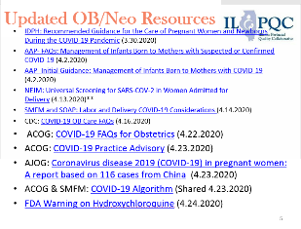
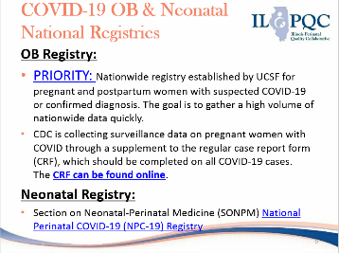
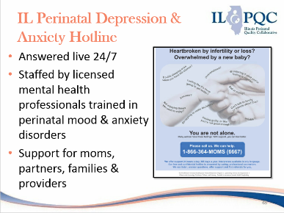
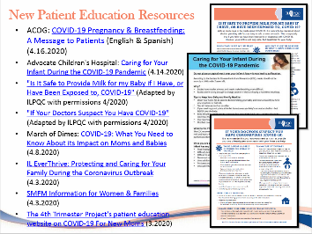
ILPQC COVID-19 Webpage Resources
Please click here for COVID-19 resource webpage

Slide 18
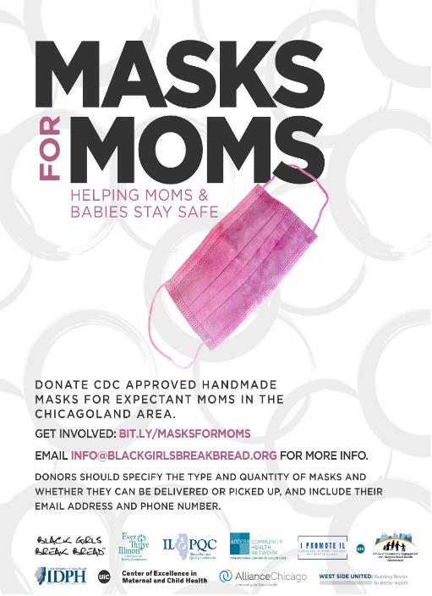
Masks for MOMs wants to get reusable cloth face masks to the moms and moms-to-be who need them in the Chicago-land area.
The aim is to ensure that pregnant moms from vulnerable communities have access to face masks at their prenatal visits and when they arrive at hospitals for delivery.
Find out more & sign-up to volunteer at https://bit.ly/masksforMOMs.

Slide 19

http://www.cvent.com/events/supportive-pregnancy-virtual-groups-/event-summary-973b69bfc5dc46ff93a407f4417fb609.aspx

Slide 20
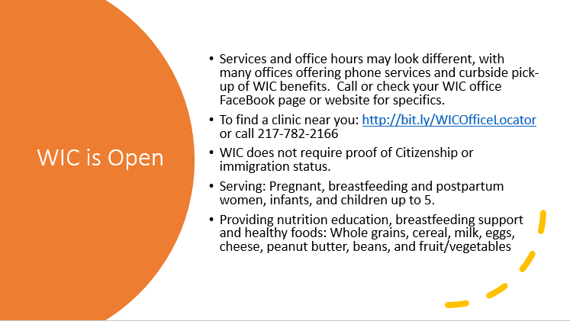
IL WIC: Here for You During COVID-19 Fact Sheet (4.3.2020)

Slide 21
Restore Illinois
Chicago moving to Phase 3 on June 3rd
Other parts of the state moving to phase 3 on May 29th
Earliest timeframe to move to Stage 4 is June 26th
Key elements
  social distancing and wearing of facemasks important to continue to educate patients and staff
Key Areas of Focus for Safety
  Hand Hygiene
  Social Distancing
  PPE / face masks
  Screening and self-awareness of symptoms

Slide 22
Discussion of OB Unit Strategies

Slide 23





MORRIS HOSPITAL
& HEALTHCARE CENTERS
Presented by Leticia Setrini-Best, M.D.
Obstetrician & Gynecologist
89 bed rural hospital in Morris, IL
Morris Hospital is the only hospital in Grundy County
Level II Perinatal services provided
Loyola University Medical Center network
498 births in 2019
8 LDRP beds
4 Antepartum/triage beds
1 surgical suite

Slide 24

Case Presentation
35 year old G1P0 at 37 4/7 weeks admitted to L&D on 3/19/2020 for IOL due to CHTN on Procardia with A1GDM, s/p BMTZ per MFM recommendation. GBS+
SROM with Foley, Pitocin for IOL, PNC for GBS
  Progress to second stage, pushed 2 hours, temp 104, failed forceps
  Delivered by CS on 3/20 female infant, Apgars 8 & 9, 6lbs. 8oz., placed on droplet and contact precautions, COVID PCR obtained
  Amp and Gent for suspected chorioamnionitis, 2 units PRBC, BPs stable on Procardia
  COVID positive 3/23, d/c home to self isolate
  Infant made PUI and placed in nursery, COVID testing negative, d/c home with Aunt
  Infant returned to ER on 4/3 with hypothermia, no etiology, d/c home with parents, education provided

Slide 25
Lessons Learned
Universal PPE or Universal testing (5 office visits, all OB, half the staff)
Unit divided into COVID, non-COVID wings with 2 negative pressure rooms and negative pressure Special Care Nursery
OR could not be made negative pressure, CS done with TOGA, N95, newborn resuscitation in sub sterile area
Newborn care education for mothers isolated from newborn

Slide 26
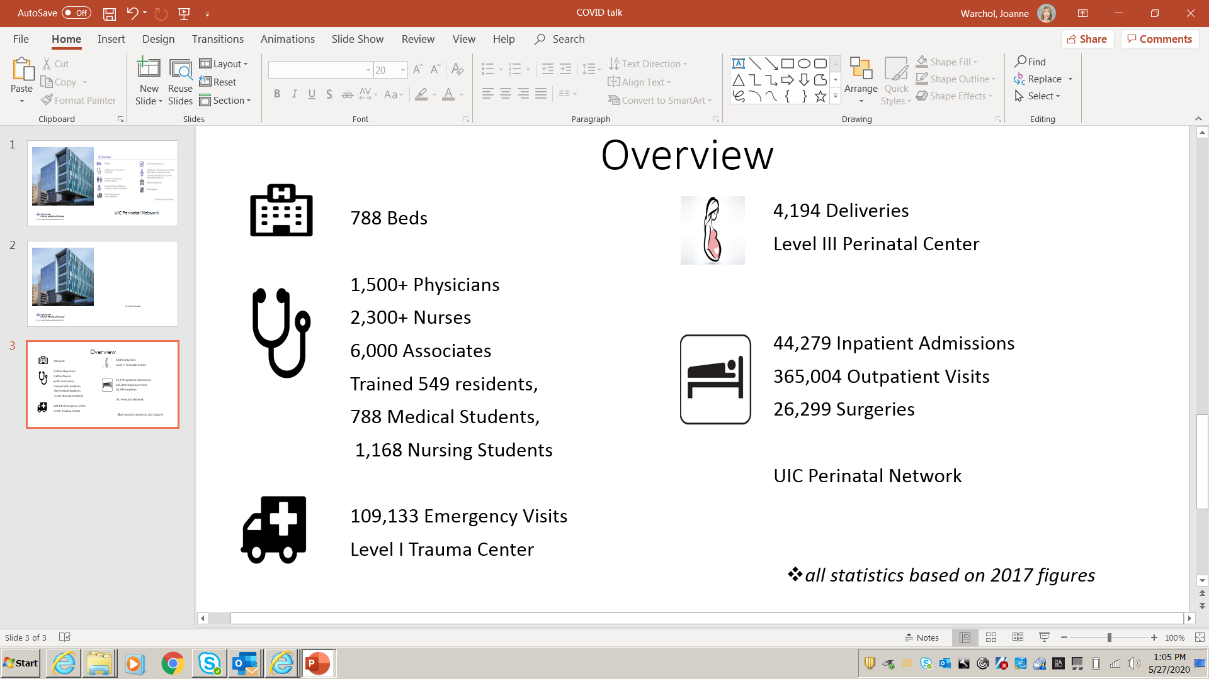

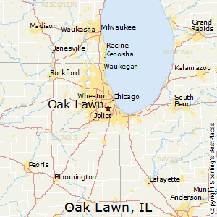

Slide 27

Creating a Negative Pressure OR in L&D
Concern arose in L&D during a morning safety huddle about how to control spread of Covid-19 as there were no negative pressure OR’s
Universal screening demonstrated + results in asymptomatic patients and need for a negative pressure OR
LDR negative pressure room was evaluated as a possibility-team approach with building services, epidemiology, pharmacy, main OR team, anesthesia, IT, surgeons/obstetricians, RN’s, and surgical techs
It was determined that air exchange was adequate, biomed evaluated for vacuum system for anesthesia gas waste
Drills were conducted and infection prevention consulted to evaluate and approve use as an OR
This all occurred in the time of about 24 hours!

Slide 28

Lessons Learned
Supply issues and conservation/COVID cart
All COVID positive postpartum patients are admitted to a COVID unit and staffed with OB RN.
Virtual visits set up via telehealth for isolated newborns in NICU
Mother is given at least one children’s book that she keeps and can read during her virtual visit to promote bonding and allows mother to nurture baby remotely
Pictures of newborn are also provided to mother.
Mother is given handout that has names, pictures, roles, and contact info of the supportive service team members in NICU (care management, child life, social services, music therapy, therapeutic listening RN, chaplaincy)
Retesting scheduled prior to discharge if applicable
Discharge follow-up phone calls

Slide 29

HSHS St. Anthony’s Memorial Hospital is a133 bed hospital in South Central IL. The Women and Infants Center has 5 LDR rooms, 2 Triage beds, 10 PP rooms, a Level II nursery with 24/7 NNP coverage and averages 750 deliveries annually.

Slide 30
Patient G2P1 delivered via Repeat Cesarean Section at 39 3/7 weeks gestation.
Hx: Patient presented to her Obstetricians office on April 7th for a routine prenatal visit, patient is asymptomatic
Patient developed a runny nose and symptoms of what was believed to be sinusitis on April 9th. Patient was treated with antibiotics.
Patient lost sense of smell and taste, tested for COVID-19 on April 20th, results came back positive.

Slide 31
Patient presented to hospital on April 24th for a repeat Cesarean section.
C-Section scheduled for 1230 with a 1030 patient arrival.
All staff that would provide care to the patient were notified and reported the day before the schedule procedure date to complete a walk through of the procedure.
Patient was also contacted by myself to complete a walk through of what to expect and to answer any questions her or her family may have.
Patient was asymptomatic on the date of her procedure and was 14+ days since symptom onset.

Slide 32
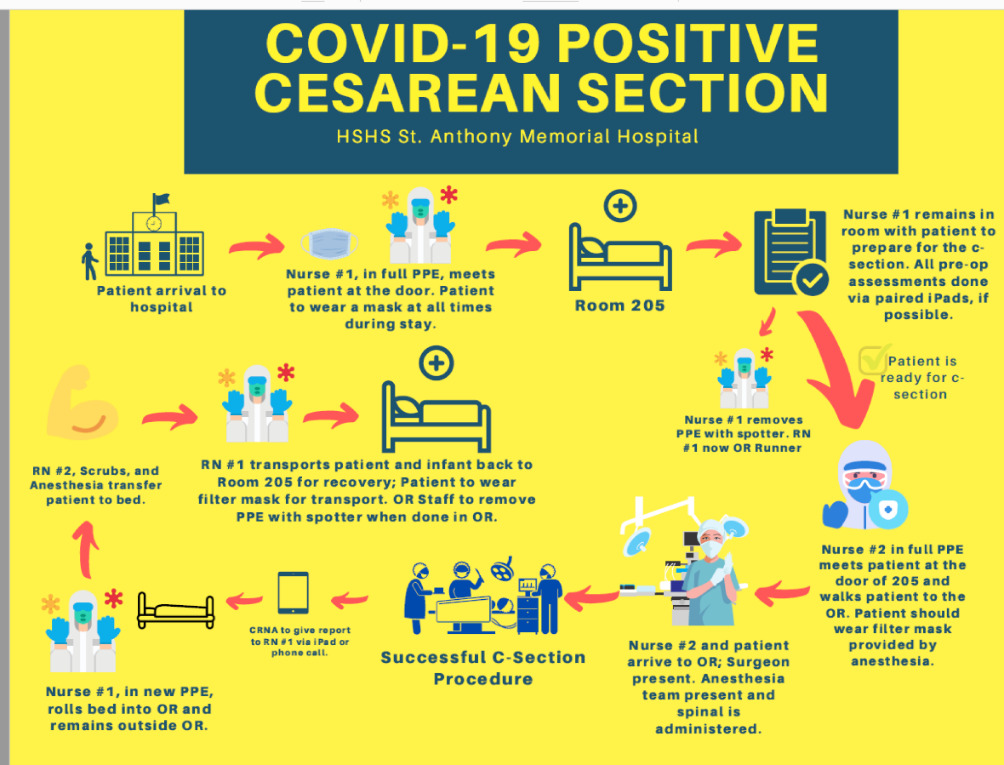

Slide 33
Patient’s support person was not allowed in the OR, iPad provided.
Patient delivered healthy baby boy via repeat cesarean section no complications during entire stay- Mother and baby roomed together in a negative pressure room
Negative pressure nursery on stand by
Parents refused COVID-19 testing for newborn
Formula fed and discharged on Postpartum day 2.

Slide 34
Lessons Learned
Our plan focused on the mother
No specific newborn plan
Staffing concerns
Level II care

Slide 35
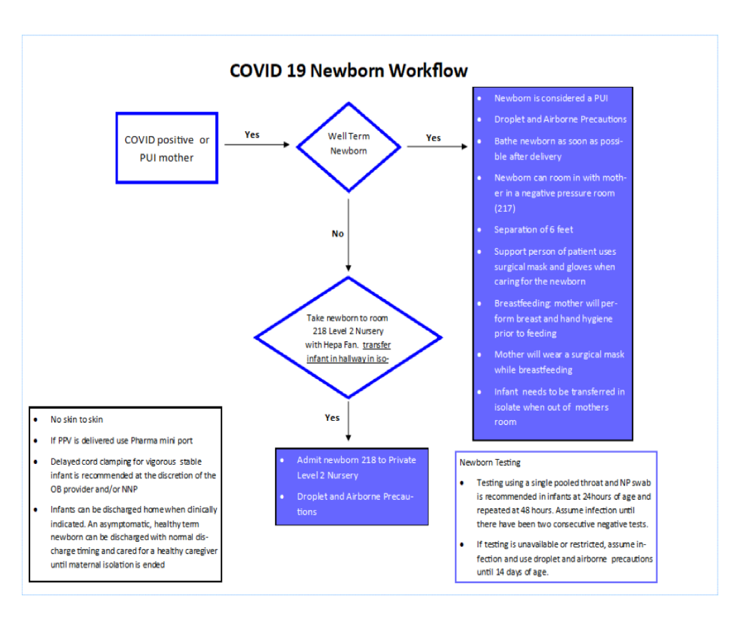

Slide 36
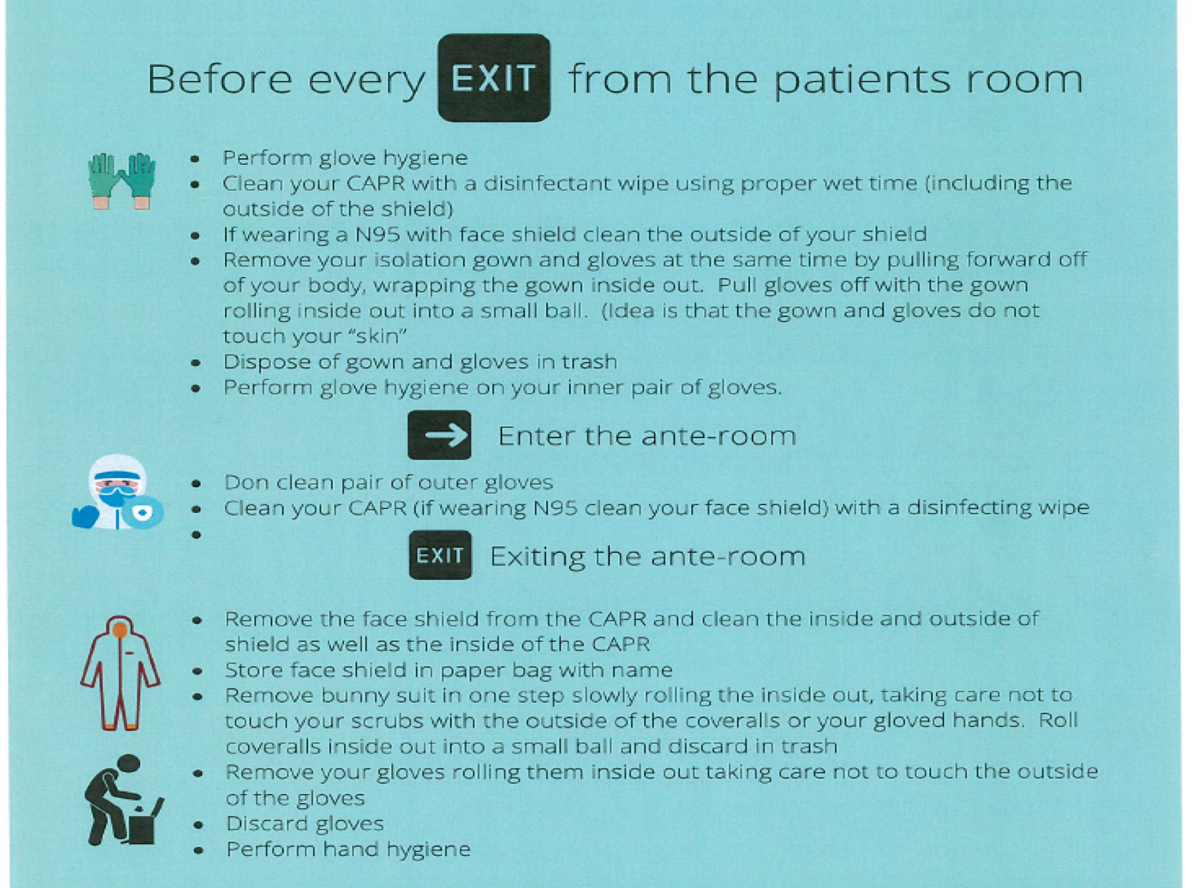

Slide 37
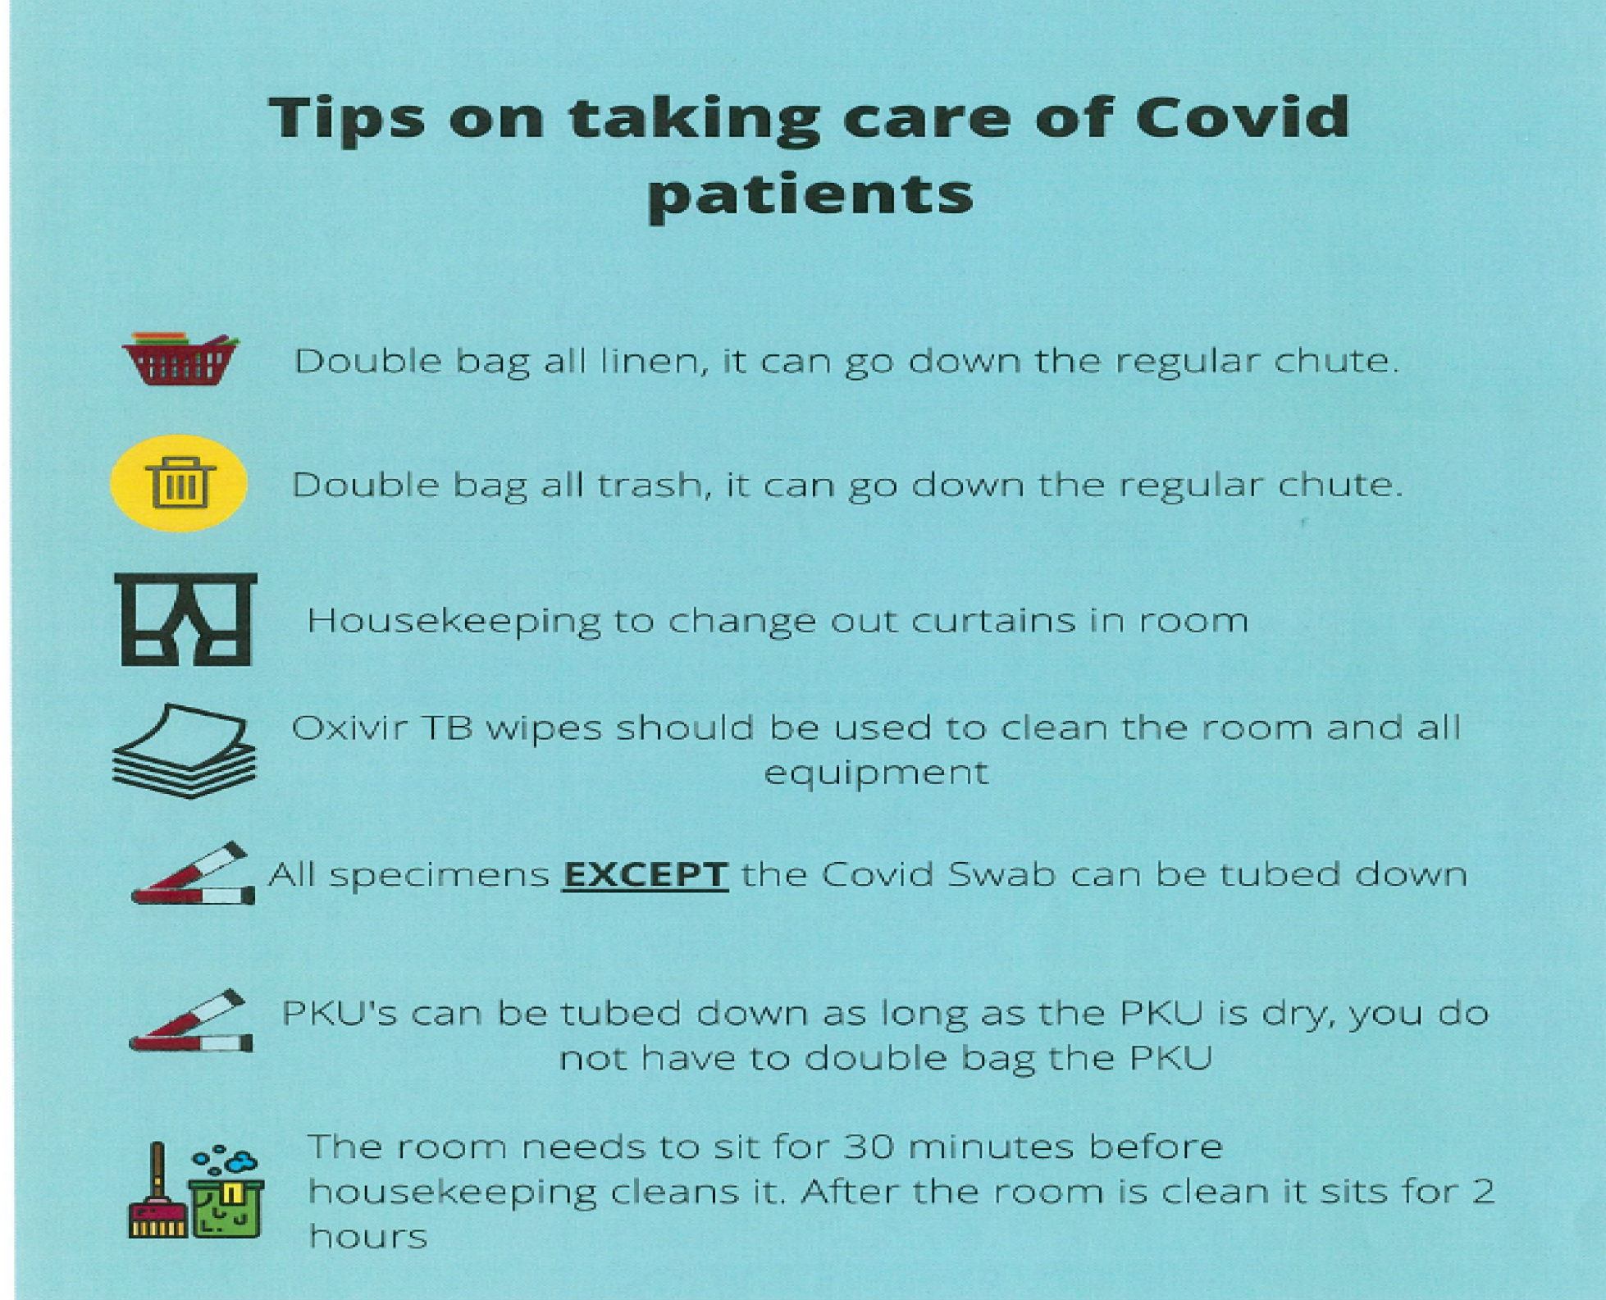

Slide 38
OB Discussion Panel
Leticia Setrini-Best, MD – Obstetrics & Gynecology, Morris Hospital, Morris, IL
Ashley Vincent, BSN, RNC-OB, HSHS - Manager, Women and Infant Services/Pediatrics, St. Anthony’s Memorial Hospital, Effingham, IL
Kim Kocur, MSN, RNC-OB, CNS-APN - Perinatal Outreach Coordinator, Women and Infant's Services, Advocate Christ Medical Center, Oak Lawn, IL
Fidel Abrego, MD, MBA – Obstetrics & Gynecology, John H. Stroger, Jr. Hospital, Chicago, IL
Emily Miller, MD – Maternal-Fetal Medicine, Northwestern University, Chicago, IL
Rob Abrams, MD, Executive Director - SIU Center for Maternal - Fetal Medicine, HSHS St. John's Hospital, Springfield

Slide 39
OB Questions/Discussion
Questions from chat box
Questions from registration
OB Q&A from 5.15.20 webinar
Q/A from 5.8.2020 webinar (OB answers)
Q/A from 5.01.2020 – questions answered webcast
Q/A from 4.24.2020 webinar (OB answers)
Q/A from 4.17.2020 webinar
Q/A from 4.10.2020 webinar
Q/A from 4.3.2020 webinar

Slide 40
Discussion of Neonatal Unit Strategies

Slide 41
Considering Patient Centered
Decision Making for mom/babies
SSM Health: Perinatal Isolation & breastfeeding decision information (4.8.2020)
SSM Health: Patient education resource to support patient centered decision making for COVID+ moms/baby separation (Word version 5.23.20)
· SSM Health: Patient education resource to support patient centered decision making for COVID+ moms/baby (pdf version 5.23.20)
Notes:
Share Justin example resource from SSM Health

Slide 42
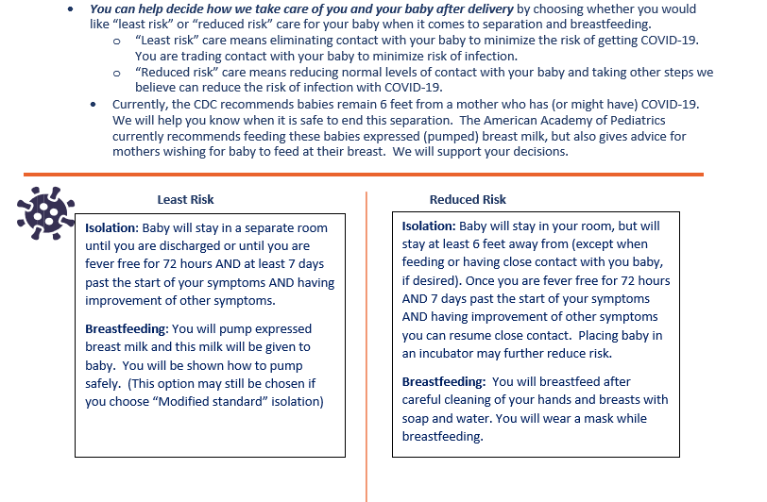
Patient-Centered Decision
Making for Moms/Newborns

Slide 43
Discussion Panel
Leslie Caldarelli, MD, NICU Director, Prentice Women's Hospital, Chicago
Justin Josephsen, MD, Medical Director – St. Mary’s Hospital NICU, Neonatologist Cardinal Glennon Children’s Hospital, St. Louis
Notes:
UPDATE

Slide 44
Neonatal Questions/Discussion
Questions from chat box
Questions from meeting registration
Neonatal Q&A from 5.15.20 webinar
Q/A from 5.8.2020
Q/A from 5.01.2020 – questions answered webcast
Q/A from 4.24.2020 webinar (Neonatal Answers)
Q/A from 4.17.2020 webinar
Q/A from 4.10.2020 webinar
Q/A from 4.3.2020 webinar

Slide 45
Thank You
We continue to give thanks to the nurses, doctors, health care workers, public health teams and others across our state at work confronting the COVID-19 pandemic.
Please send questions, comments and recommendations, cases / willingness to share for future COVID-19 OB/Neo discussion webinars to info@ilpqc.org
Recording of this webinar will be available at www.ilpqc.org

Slide 46



THANKS TO OUR
FUNDERS
Email info@ilpqc.org or visit us at www.ilpqc.org
Notes:
Updated 10/22/19

