Slide 1

Immediate Postpartum LARC (IPLARC)
Grand Rounds
Presented by:

Slide 2
Acknowledgments
This slide set was created with support from the following individuals/groups:
Kai Tao, ND, MPH, CNM
  Director/Founder, Alliance Chicago – Juno4Me and Certified Nurse Midwife, Erie Family Health Center/Prentice Women’s Hospital
Shelly Tien, MD, MPH
  Maternal Fetal Medicine Specialist, NorthShore University HealthSystem
Eve Espey, MD, MPH
  Chairperson, New Mexico Perinatal Collaborative
American College of Obstetricians and Gynecologists LARC Program
Florida Perinatal Quality Collaborative

Slide 3
ILPQC Immediate Postpartum Long-Acting Reversible Contraception (IPLARC) Initiative

Slide 4
IPLARC
Definitions
IPLARC Definitions
Immediate Post-Placental Insertion: IUD within 10 minutes of placental extraction
Immediate Postpartum Implant: Implant anytime after delivery before discharge from the hospital
Immediate Postpartum LARC (IPLARC): Long-acting reversible contraception (IUDs, implants) placed prior to discharge following labor and delivery
Immediate Postpartum Insertion: IUD within 48 hours of delivery
Transcesarean Insertion: IUD though uterine incision at time of C-section
Notes:
Kai

Slide 5
Background – why larc immediate postpartum?

Slide 6
Consequences of Unplanned Pregnancies & Short Interpregnancy Intervals
Consequences of Unplanned Pregnancies
Poor pregnancy outcomes
Delayed initiation of prenatal care
Lower breastfeeding rates
Intended
Unintended
Consequences of Short Interpregnancy Interval
Higher risk of poor maternal and infant outcomes: preterm birth, low birthweight, preeclampsia
50% of IL births covered by Medicaid
Notes:
Chicago Metropolitan Agency for Planning definition of Cook and the counties immediately surrounding it: DuPage, Kane, Kendall, Lake, McHenry, and Will counties
In 2014 there were 158,522 births in Illinois with 69,526 (44%) in Cook county and 106,204 (67%) in the Chicago Metro area (Chicago Metropolitan Agency for Planning definition of Cook and the counties immediately surrounding it: DuPage, Kane, Kendall, Lake, McHenry, and Will counties).^{4a} Approximately 66,579 (42%) of Illinois births resulted from unintended pregnancies.^{4b} Approximately 9,684 births in Illinois are to teens 19 and under.^{4a} For babies with moms 21 years old or younger, it was at least the 2nd birth for 29% and at least the 2nd pregnancy for 39% (Personal Conversation with A. Bennett, 8/2017).
Intrauterine Devices (IUDs) and contraceptive implants, known as long acting reversible contraception (LARC) are safe and effective for most women and adolescents.⁵ They are demonstrated effective in reducing unintended pregnancies.⁶ LARC effectiveness could be increased when placed in the immediate postpartum (IPLARC) before hospital discharge after delivery given that approximately 40 to 60% of women have unprotected intercourse prior to the 6 week postpartum visit and fewer than half of women return to the doctor for their 6 week postpartum visit^{7,8,9}. Women counselled on all contraceptive methods and provided their choice of contraception for free chose LARC at a rate of 75%. Additionally, 86% of women were using LARC 12 months later – higher than the continuation rate for other short-acting reversible contraception – and reported high satisfaction with LARC.¹⁰
IPLARC is a strategy to empower women of childbearing age with information and services to optimize the timing and spacing of their pregnancies in order to reduce unintended pregnancies linked with adverse maternal and child health outcomes.¹¹ In 2014, 79,261 (50%) of Illinois births were covered by Medicaid.¹² In July 2015, the IL Department of HealthCare and Family Services (HFS) allowed hospitals to reimburse for LARC devices provided immediately postpartum before discharge from the hospital, in addition to the Diagnostic Related Group (DRG) reimbursement for labor and delivery.¹⁴ In addition, the American College of Obstetricians and Gynecologists (ACOG) released national guidelines in their Committee Opinion #670, authored by Ann Borders and Alison Stuebe, in August 2016.

Slide 7
Why LARC?
LARC is safe and cost effective
LARC can be removed any time with restored fertility
Women choose LARC and report high satisfaction with LARC
Reduces adverse maternal and infant outcomes associated with unplanned pregnancy
Support for LARC from ACOG, AAP, AAFP, AWHONN, CDC, CMS, ASTHO
Notes:
In 2014 there were 158,522 births in Illinois with 69,526 (44%) in Cook county and 106,204 (67%) in the Chicago Metro area (Chicago Metropolitan Agency for Planning definition of Cook and the counties immediately surrounding it: DuPage, Kane, Kendall, Lake, McHenry, and Will counties).^{4a} Approximately 66,579 (42%) of Illinois births resulted from unintended pregnancies.^{4b} Approximately 9,684 births in Illinois are to teens 19 and under.^{4a} For babies with moms 21 years old or younger, it was at least the 2nd birth for 29% and at least the 2nd pregnancy for 39% (Personal Conversation with A. Bennett, 8/2017).
Intrauterine Devices (IUDs) and contraceptive implants, known as long acting reversible contraception (LARC) are safe and effective for most women and adolescents.⁵ They are demonstrated effective in reducing unintended pregnancies.⁶ LARC effectiveness could be increased when placed in the immediate postpartum (IPLARC) before hospital discharge after delivery given that approximately 40 to 60% of women have unprotected intercourse prior to the 6 week postpartum visit and fewer than half of women return to the doctor for their 6 week postpartum visit^{7,8,9}. Women counselled on all contraceptive methods and provided their choice of contraception for free chose LARC at a rate of 75%. Additionally, 86% of women were using LARC 12 months later – higher than the continuation rate for other short-acting reversible contraception – and reported high satisfaction with LARC.¹⁰
IPLARC is a strategy to empower women of childbearing age with information and services to optimize the timing and spacing of their pregnancies in order to reduce unintended pregnancies linked with adverse maternal and child health outcomes.¹¹ In 2014, 79,261 (50%) of Illinois births were covered by Medicaid.¹² In July 2015, the IL Department of HealthCare and Family Services (HFS) allowed hospitals to reimburse for LARC devices provided immediately postpartum before discharge from the hospital, in addition to the Diagnostic Related Group (DRG) reimbursement for labor and delivery.¹⁴ In addition, the American College of Obstetricians and Gynecologists (ACOG) released national guidelines in their Committee Opinion #670, authored by Ann Borders and Alison Stuebe, in August 2016.

Slide 8
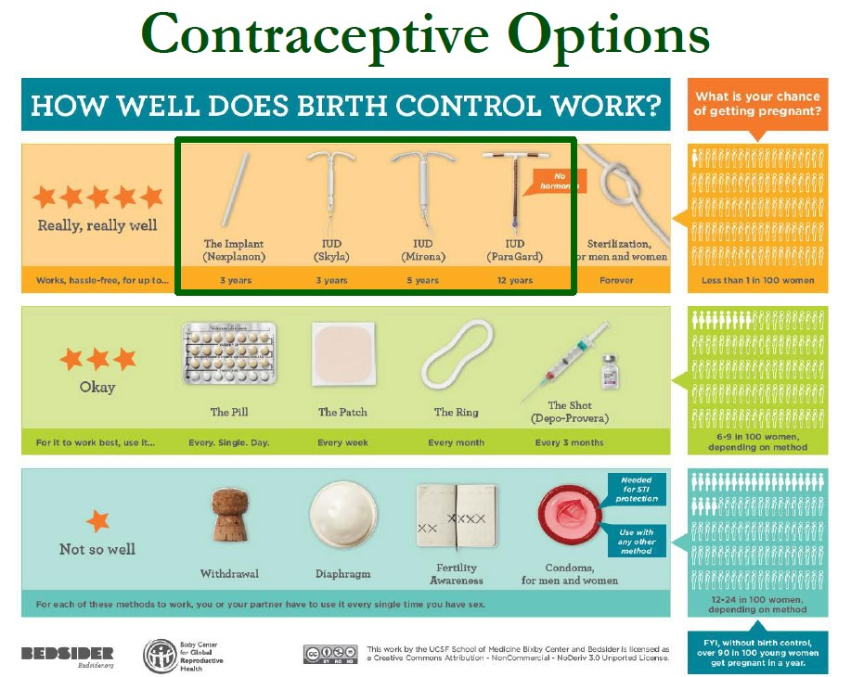
LARC is the Most Effective of

Slide 9


LARC Options

Slide 10
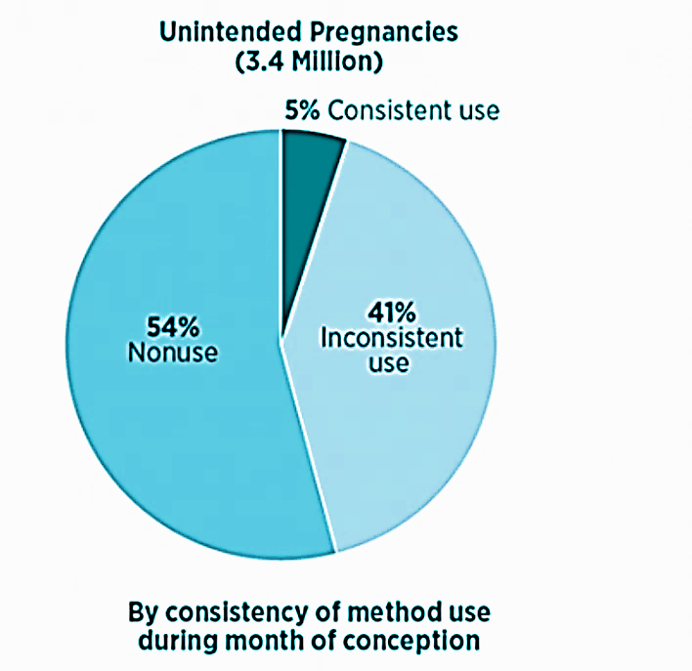
Importance of Highly Effective Contraception
Increasing access to highly reliable contraception helps women plan pregnancy
41% of women were inconsistently using contraception and 54% not using contraception the month of conception
guttmacher.org

Slide 11
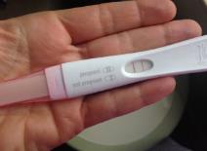
Why immediately after delivery? Can’t it wait?
High interest in LARC exists among postpartum women, particularly among women with a recent unintended pregnancy and women who do no not desire pregnancy for at least two years. (Tang t al., 2013)
Over half of unintended pregnancies among women in the US occur within two years following delivery. (In Potter et al., 2013)
About 40 to 60% of women have unprotected intercourse prior to the 6-week postpartum visit
Fewer than half of women will return to their up at 6-week visit.
Dmgaz.org

Slide 12
IPLARC has many advantages
Convenience
Motivation
Time limits on some postpartum insurance coverage
Not pregnant
High rate of satisfaction
  74% IPP IUD continue at a year
  84% IPP implant continue at a year
Cost-effective
Effectiveness
Cohen, 2016
Crockett, 2017
Woo, 2015
Notes:
Eve Espey

Slide 13
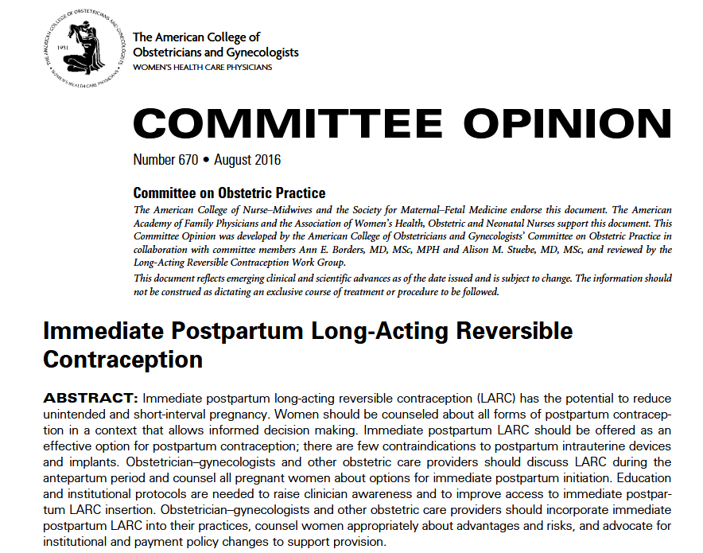

Slide 14
“The American College of Obstetricians and Gynecologists supports immediate postpartum LARC insertion as a best practice, recognizing its role in preventing rapid repeat and unintended pregnancy.”

Slide 15
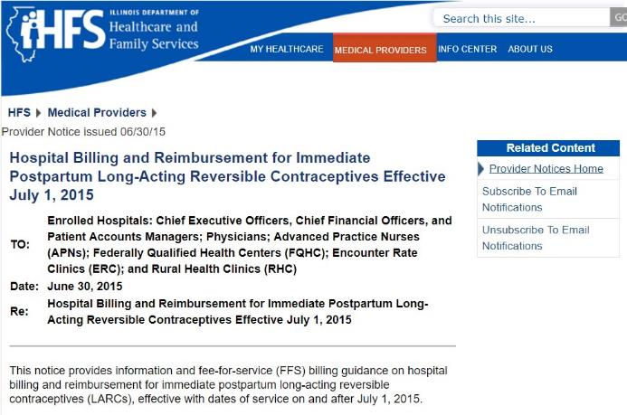
IHFS Allows Hospitals to
Reimburse
A July 2015 IHFS provider notice allowed hospitals to reimburse for inpatient LARC separate from OB Bundle
About a year after this notice, LARC utilization increased from <10/quarter to 35-57/quarter
A statewide quality improvement collaborative can help hospitals facilitate increased access to IPLARC
Key Resource:
IL IPLARC Billing Guidance
An informational tool that provides detailed responses about billing from HSF, Medicaid, MCOs and general guidance from private payers in IL.

Slide 16
Benefits of increasing larc access from other states

Slide 17

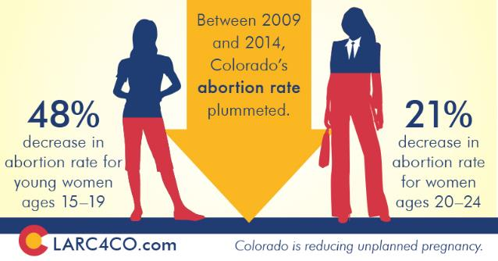
Colorado Family Planning Initiative
Training, education
no cost/reduced cost LARCs
5 years, over 70 clinics,
$2.5 M in GRF budget
https://www.colorado.gov/pacific/sites/default/files/PSD_TitleX3_CFPI-Report.pdf
Notes:
Kai

Slide 18

CHOICE Project
> 9K women aged 14-45 were provided standardized comprehensive contraceptive counseling
No-cost for all methods
75% of women chose a LARC method
86% of women who chose a LARC method were still using that method one year later, compared to 55% of women who chose a non-LARC method
https://contraceptivechoice.wustl.edu/
Notes:
KAI

Slide 19

CHOICE Project
Rates of unintended pregnancy were 20Xs higher among women using a non-LARC method.
Abortion rate in the region receiving free access to LARC was less than half the national and regional rates.
LARC users had highest rates of satisfaction with their method one year later.
https://contraceptivechoice.wustl.edu/
Notes:
Kai

Slide 20
Important facts for providers to know

Slide 21

IPLARC Contraindications
Hemorrhage
Severe perineal laceration
Infection
  Chorioamnionitis
  Sepsis
Notes:
Eve Espey
21

Slide 22
Expulsion
Expulsion rates for immediate postpartum IUD insertion are higher than for interval or post-abortion insertion
  Reported at 10% within 10 minutes of placental delivery
  Up to 29.7% from 10 minutes to 4 weeks after delivery
Benefits of immediate insertion have been shown to outweigh the risk of expulsion
Nearly half of women do not return for their postpartum visit and may not received desired contraception due to multiple barriers to care postpartum
ACOG Practice Bulletin 186
Jatlaoui et. al. IUD expulsion after postpartum placement: systematic review. Obstet-Gynecol. 2018
Notes:
Shelly
Add slides 10 & 11 from Eve Espey
ON slide 10 from Espey, remove sentence in red

Slide 23

Benefits of IPLARC outweigh risk of expulsion
Randomized trial comparing IUD use at 6 months postpartum among women who received IPLARC in the setting of cesarean delivery vs. women planned interval IUD placement 6 or more weeks postpartum
2012-2014: 112 women randomized
A larger proportion of the women with IPLARC placed at cesarean were using an IUD at 6 months postpartum
  IPLARC group (40/48 [83%]) v.
  Interval group (32/50 [64%]
  RR 1.3, 95% CI 1.02-1.66)
Among the 56 women randomized to interval IUD insertion
  22 (39%) of them never received an IUD
  14 (25%) never returned for IUD placement
  5 (9%) women declined an IUD
  3 (5%) had a failed IUD placement
Notes:
Shelly

Slide 24
Bottom line
“Despite the higher expulsion rate of immediate postpartum IUD placement, evidence strongly suggests the superiority of immediate placement in reduction of unintended pregnancy especially for those at greatest risk of not having recommended postpartum follow-up visit.”
ACOG Committee Opinion #670

Slide 25
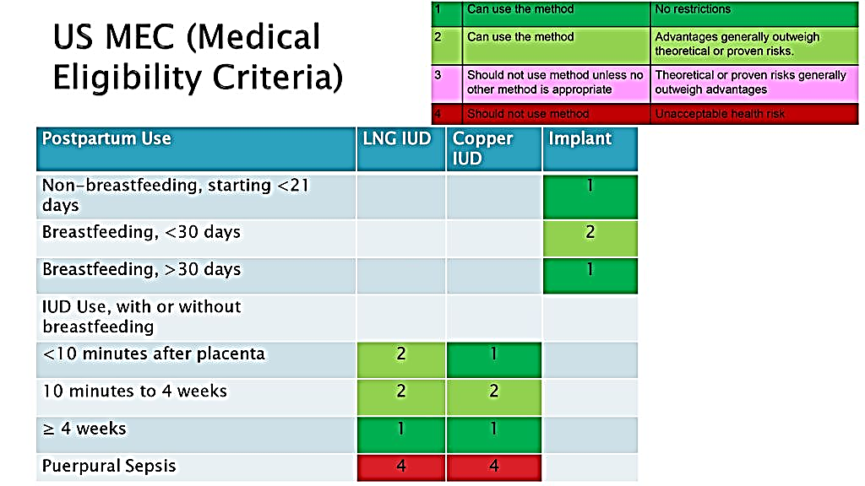
CDC Supports IPLARC for Breastfeeding and Non-breastfeeding moms
“Given available evidence, women considering IPP hormonal LARC should be counseled about the theoretical risks of reduced duration of breastfeeding, but the preponderance of evidence has not shown a negative effect on actual breastfeeding outcomes”
--ACOG Practice Bulletin 186
CDC. U.S. medical eligibility criteria for contraceptive use, 2010: adapted from the World Health Organization medical eligibility criteria for contraceptive use, 4th edition. MMWR 2010;59(No. RR-4).
Notes:
Kai

Slide 26
No significant differences in breastfeeding outcomes were shown in RCT
Notes:
Shelly Tien

Slide 27
No significant difference found in time to lactogenesis (milk coming in) were shown in RCT
Notes:
Shelly Tien

Slide 28
Comprehensive contraceptive counseling including Iplarc
Empower all pregnant women to make informed decisions regarding what they want for future childbearing and what they want for birth control after delivery

Slide 29
No wrong door for birth control!
LARC methods should be included as one of many family planning options available to postpartum women. All women should be counseled on a full range of contraception options following delivery, including immediate postpartum LARC, free from coercion.
Contraceptive choice is grounded in Reproductive Justice

Slide 30
LARC Statement of Principles
“We acknowledge the complex history of the provision of LARCs and seek to ensure that counseling is provided in a consistent and respectful manner that neither denies access nor coerces anyone into using a specific method.”
“We commit to ensuring that people are provided comprehensive, scientifically accurate information about the full range of contraceptive options in a medically ethical and culturally competent manner in order to ensure that each person is supported in identifying the method that best meets their needs.”
Notes:
People should know this document exists, and they should read it. These are just the first 2 principles.
Eve Espey

Slide 31
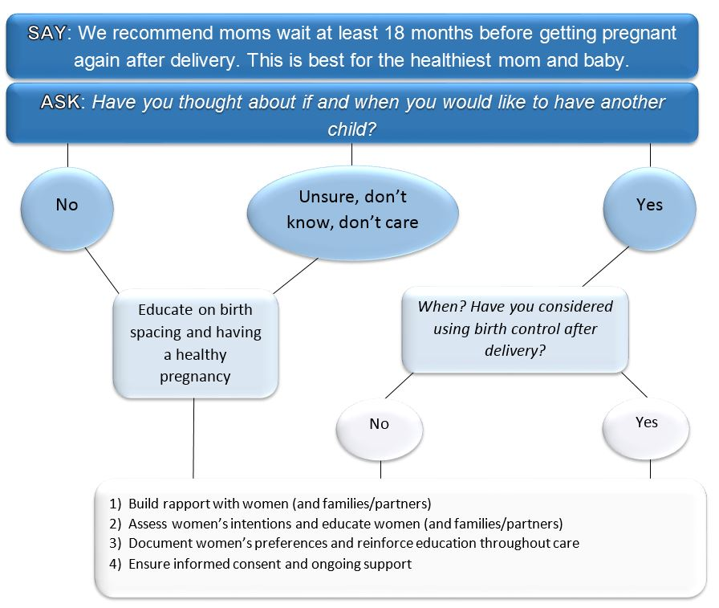

Notes:
The FPQC advisory board use One Key Question as a model for how to broach immediate postpartum contraception with women. We suggest that providers say…and then ask…You can read through the steps, but they all funnel to the same four points:
The comprehensive contraceptive counseling session which include women, their families and partners should be conversations
That put women at ease
Assess their intentions and provide tailored and specific information based on women’s needs and preferences
Documentation is stressed and so is ensuring informed consent and ongoing support
I am sharing the same information in different configurations to help hospitals think through how they would like to structure the initiative in their facility.

Slide 32
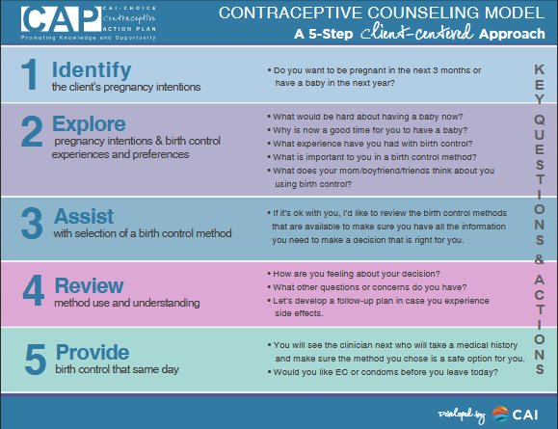

Slide 33
Counseling & Consent
Patient-centered counseling approach: Shared decision-making
Discussion timing
Shared Decision Making
Do you want to have more children?
How many more children would you like to have and when?
Reproductive Life Planning and Comprehensive Contraceptive Options counseling
What have you heard about the benefits of pregnancy spacing?
Neri, 2016
ACOG Committee Opinion #490, Partnering With Patients to Improve Safety
Notes:
https://www.cdc.gov/preconception/documents/rlphealthproviders.pdf
Resources, research and commentary at Bedsider: https://providers.bedsider.org/
Change “do you have any children now” to “how many children do you have?”

Slide 34
IPLARC insertion training for all providers
IUD and Nexplanon Training available

Slide 35

IPLARC Insertion of IUDs Training
ACOG LARC Program online videos
Planning for additional ACOG/ILPQC IPLARC Hands-On training opportunities in 2019
Grand Rounds with possible training opportunities

Slide 36
Nexplanon placement training
The FDA requires health care providers who perform implant insertions and removals receive training from the manufacturer of Nexplanon.®
Request a Nexplanon® training:
Website: http://www.nexplanon-usa.com/en/hcp/services-and-support/request-training/
Phone number: 1-877-467-5266
Email info@ilpqc.org for contact information for your hospital Nexplanon rep to schedule this training!
Notes:
Merck & Co., Inc. Nexplanon (etonogestrel implant) 68 mg radiopaque: request training. Whitehouse Station (NJ): Merck; 2015. Available at: http://www.nexplanon-usa.com/en/hcp/services-and-support/request-training/. Retrieved September 21, 2017.
Staff Comment: Phone number 1-877-467-5266 is correct.
Eve espey

Slide 37
ILPQC Structure and supports for teams

Slide 38
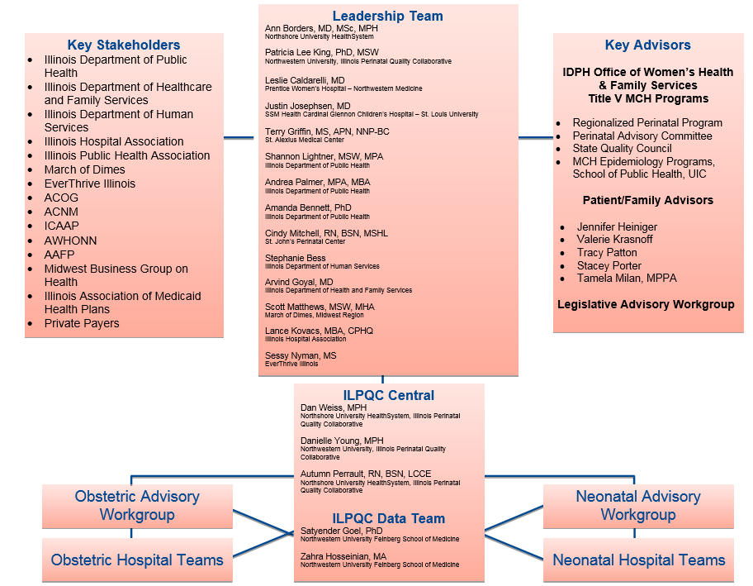
ILPQC Infrastructure
Notes:
UPDATED_DW_10.22.2018

Slide 39
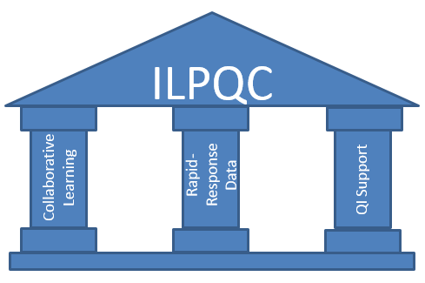
ILPQC: Three Pillars Support Quality Improvement Success
Leadership, Advisors, Stakeholders, Patients/Families

Slide 40
What is Quality Improvement?
Hospital QI Work: What changes can you make to your process/system and test with a PDSA cycle to reach initiative goals?

Slide 41
ILPQC Quality Improvement Strategy
Multidisciplinary hospital-based QI teams
Collaborative learning
Rapid-response data system
Regular communication
QI support
Notes:
ILPQC facilitated the following QI strategies:
We supported the creation of multidisciplinary hospital-based QI teams,
Provided opportunities for collaborative learning across hospitals through in person events, and monthly web-based meetings
created a rapid response data system that allowed teams to track and compare their data
And maintained regular communication via newsletters and updated website
Importantly, we provided QI support to hospital teams through a toolkit, regional network meetings and QI coaching calls.

Slide 42
Illinois Perinatal Quality Collaborative (ILPQC)
Multi-disciplinary, multi-stakeholder Perinatal Quality Collaborative with 119 Illinois hospitals
Support participating hospitals’ implementation of evidenced-based practices using quality improvement science, collaborative learning and rapid response data
>99% of IL births
Notes:
The Illinois Perinatal Quality Collaborative is a multi-disciplinary, multi-stakeholder perinatal quality collaborative started in 2013 with over 100 Illinois hospitals representing greater than 95% of Illinois births.
ILPQC supports participating hospitals’ implementation of evidenced-based practices using quality improvement science, collaborative learning and rapid response data

Slide 43
Initiative OVERview
Immediate Postpartum Long-Acting Reversible Contraception (IPLARC)

Slide 44

Immediate Postpartum LARC (IPLARC)
Grant from Pritzker Family Foundation
Empower women with information and services to optimize the timing and spacing of their pregnancies to reduce unintended pregnancies linked with adverse MCH outcomes
Support birthing hospitals that provide contraception at the hospital level to implement best practice protocols
Hospitals that do not provide contraception can participate with post-delivery outpatient alternative strategies
Opportunities for ACOG LARC Initiative training

Slide 45
IPLARC Initiative Goals
Increase access to IPLARC
Educate Patients on contraceptive options
Educate Providers counseling and placement
Simplify IPLARC Billing
Stock LARC in Pharmacy
Implement IPLARC Protocol
Systems Changes to OB Care Process Flow

Slide 46
Aims and Measures
“Go Live” date by May 2020 for Wave 2 teams!
Overall Initiative Aim
Within 11 months of initiative start, ≥75% of participating hospitals will be providing immediate postpartum LARCs.
Structure Measures
IT/EMR systems that allow for documentation of IPLARC placement for tracking, and documentation
Coding / billing strategies in place for reimbursement for IPLARC
IPLARC devices stocked in the inpatient pharmacy
IPLARC protocols in place for labor and delivery and postpartum units
Communicated launch of IPLARC availability during delivery admission with affiliated prenatal care site and provided sites with provider/staff and patient education materials for contraceptive options counseling, including IPLARC
Implemented standardized education materials and counseling protocols* for patients during delivery admission regarding contraceptive options including IPLARC
Process Measure
Educated all participating providers/nurses on benefits of IPLARC, protocols, counseling & IPLARC placement
Outcome Measure, among participating hospitals
Provide and document comprehensive contraceptive counseling, including IPLARC, during prenatal care and delivery admission
By increasing access to IPLARC, increase in utilization of IPLARC

Slide 47

Expert Advisors
Expert Panel
  Melissa Gilliam
  Lee Hasselbacher
  Sadia Haider
  Shannon Lightner
  Kai Tao
  Amber Truehart
Clinical leads:
  Stephen Locher, Advocate Illinois Masonic Medical Center
  Shelly Tien, NorthShore University HealthSystem Evanston Hospital

Slide 48
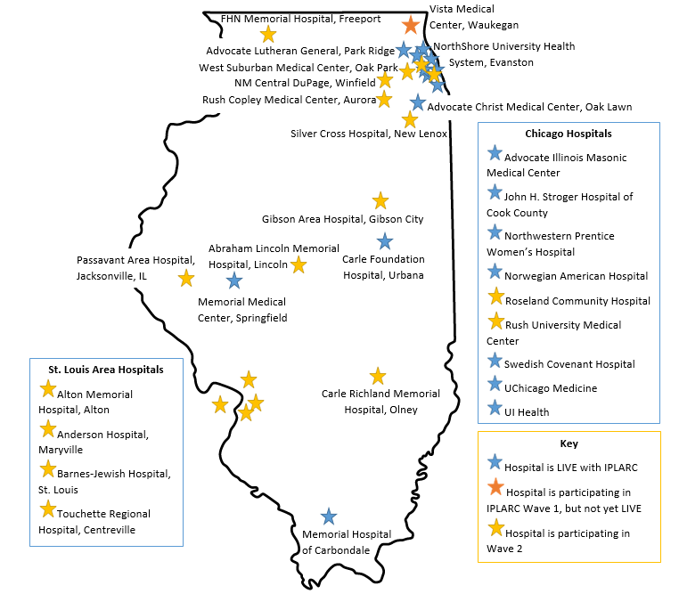
IPLARC Teams

Slide 49
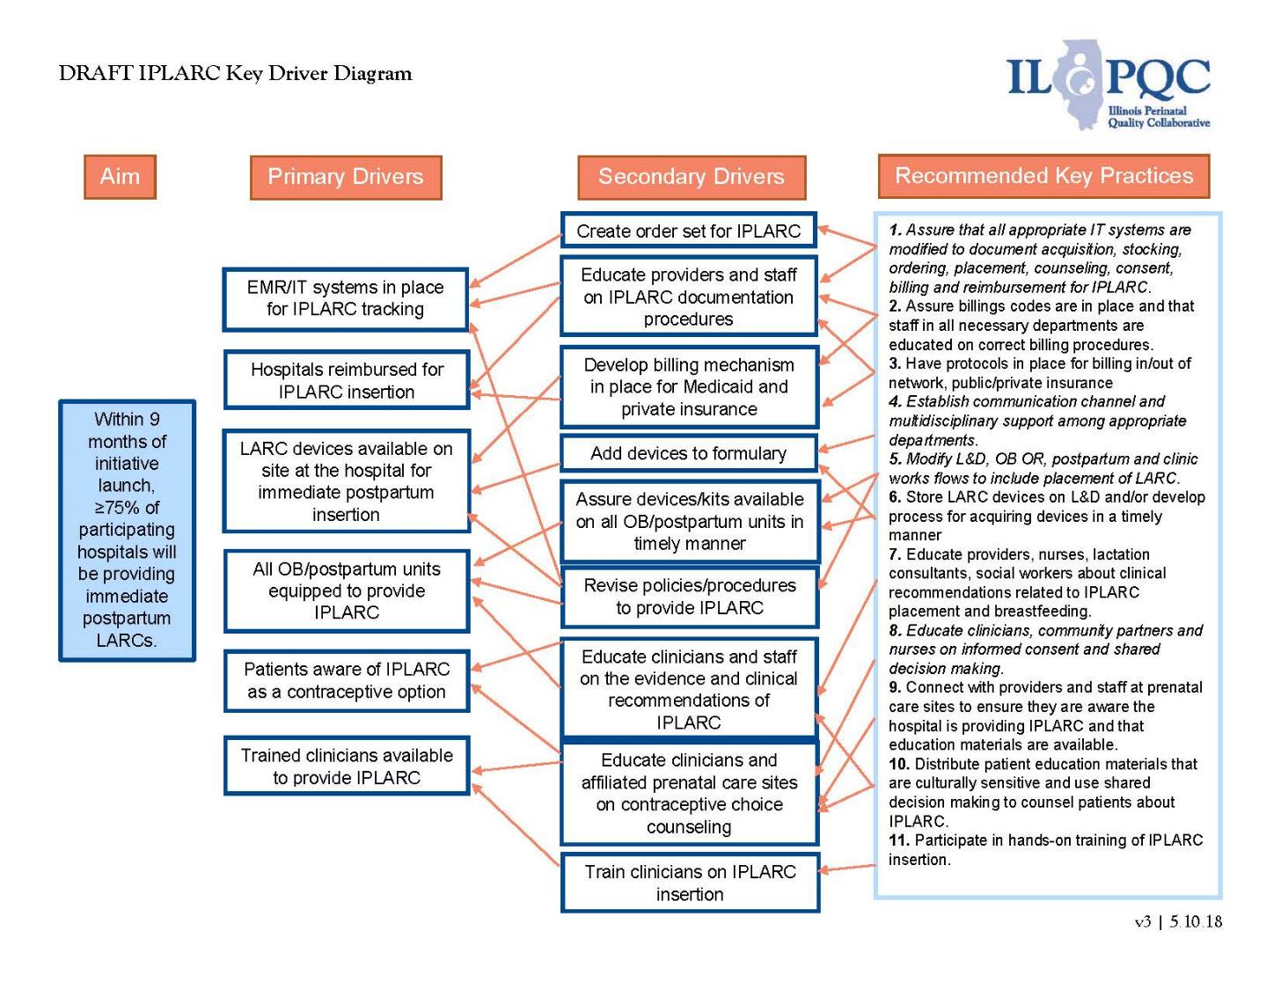
IPLARC Key Driver Diagram

Slide 50
Practice Changes for
IPLARC Success – Pre-implementation
Assure early multidisciplinary support by educating and identifying key champions in all pertinent departments for your IPLARC QI team.
Establish scheduled meetings for your team at least monthly, assuring that all necessary departments are represented, develop 30/60/90 day plan, establish timeline to accomplish key steps.
Establish and test billing codes and processes to assure adequate and timely reimbursement (see toolkit).
Expand pharmacy/ inpatient inventory capacity and device distribution to assure timely placement on labor and delivery and postpartum units.
Educate clinicians, nurses, pharmacy, and lactation consultants about benefits and clinical recommendations related to IPLARCs (see toolkit for e-modules, slide decks, materials).
Assure that all appropriate IT/EMR systems are modified to document acquisition, stocking, ordering, placement, counseling, consent, billing and reimbursement for IPLARCs (dot phrases to document counseling and placement, consent forms, order set, billing framework see toolkit examples).
Modify L&D, OB OR, postpartum, and clinic work flows (protocols/process flow/ checklists) to include counseling, consent, and placement of IPLARC (see toolkit for example).

Slide 51
Practice Changes for
IPLARC Success – Implementation
Establish consent processes for IPLARC that allows for transfer of consent from prenatal clinic as well as obtaining inpatient consent (see toolkit for examples).
Develop educational materials and shared decision making counseling practices to educate patients about the availability of IPLARC as a contraception option (outpatient prenatal care locations, L&D, postpartum) (see toolkit for examples).
Educate clinicians, and nurses on informed consent and shared decision making related to IPLARC as well as IPLARC placement and documentation (see toolkit for ILPQC/ACOG training, e-modules, slide decks, education materials).
Standardize system / protocol / process flow to assure all patients receive comprehensive contraception choice counseling including IPLARC in affiliated prenatal care sites and during delivery admission.
Communicate launch date of hospital’s IPLARC capability to all providers, nurses and affiliated prenatal care sites: communicate protocols, documentation and billing strategies.
Track and review IPLARC data, collected monthly through ILPQC REDcap data system with real-time data reports, share data with providers and nurses and review standardized counseling for prenatal sites and labor and delivery and IPLARC uptake, to evaluate program success and sustainability.

Slide 52
Implementation of IPLARC
Implementation of IPLARC
CLINICAL:
Training for nurses and providers for insertion/troubleshooting
Various techniques- experience matters
Training for LC, SW, Neo, Peds, Pharm
T
REVENUE CYCLE:
Ordering & stocking supply
Proper billing & coding outside of DRG
Timely and full reimbursement
E
COUNSELING & ED
Shared Decision Making Counseling and standardized consent with risks
Aligned with outpatient
Routine discussion embedded in admission workflow and E M R
A
POLICY:
Hospital policy, Provider Credentialing
Departmental protocols
Checklist
HFS & Commercial Coverage
M
Notes:
Kai

Slide 53
All teams collect data for monthly data reports to drive QI
Structure Measures:
  Track hospital progress on key QI steps
  Red/yellow/green (not started, started, completed)
    IPLARC devices stocked
    Protocols in place
    Coding/billing
    Documentation
    Standardized patient education
    System-wide communication
MNO-OB Quarterly Structure Measures

Slide 54
All teams collect data for monthly data reports to drive QI
Process Measures:
  % of Physician and midwife educated on IPLARC
  % of Nurse, lactation consultant, and social worker educated on IPLARC
Outcome Measures:
  # of deliveries for the month
  # of IUDs and # of implants placed for the month
  Random sample of 10 deliveries report
    # with comprehensive contraceptive counseling documented prenatal
    # with comprehensive contraceptive counseling documented delivery admission

Slide 55
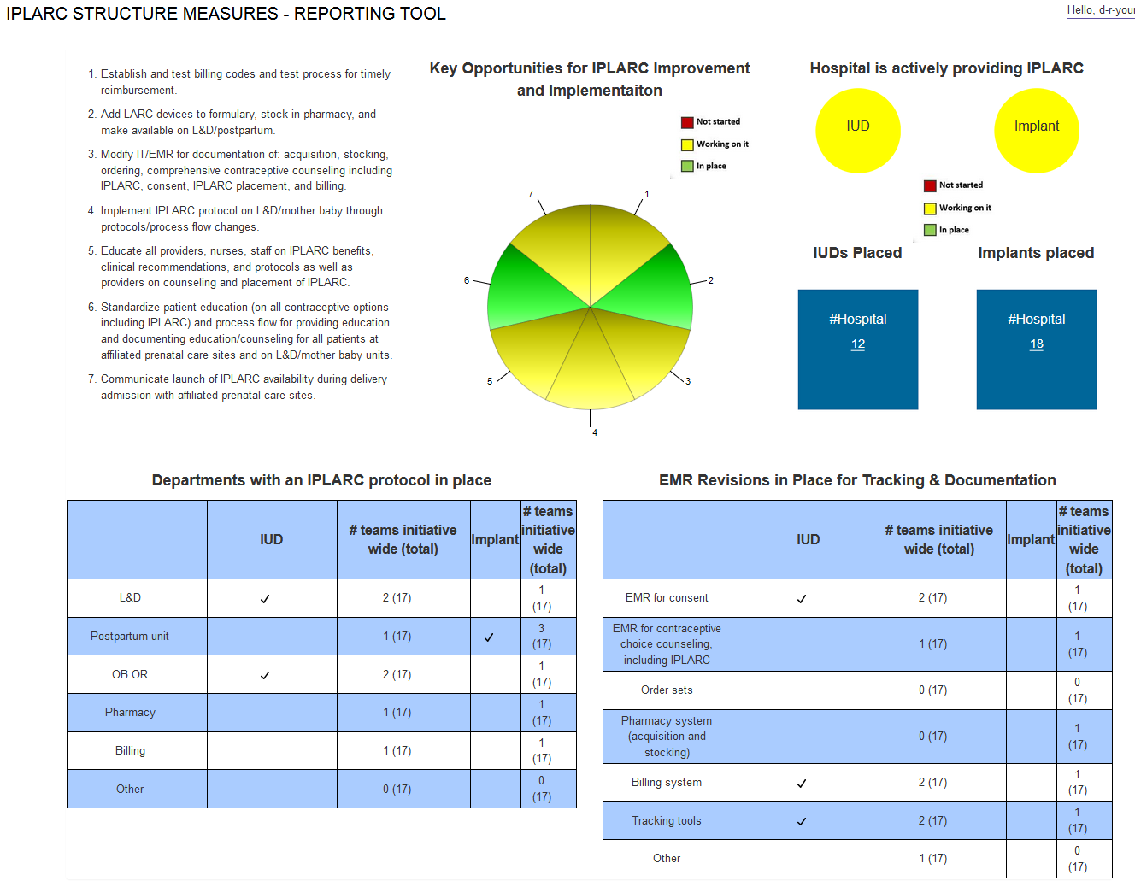
Tab 1
Default displays the last month of data entered by your hospital
Use this dashboard to drive your team’s QI work!

Slide 56
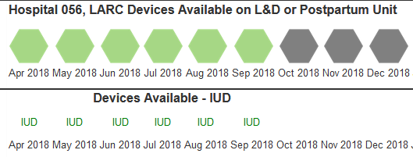
Structure Measure Reports
Hexagons are colored to indicate team progress on the structure measure from month-to-month

Slide 57
Wave 1: IPLARC on Inpatient Formulary
Notes:
Updated 7/2/19

Slide 58
Wave 1: IPLARC Protocols in Place
Notes:
Updated 7/2/19

Slide 59
Wave 1: IPLARC Billing Codes
Notes:
Updated 7/2/19

Slide 60
Wave 1: IT/EMR Revisions In Place
Notes:
Updated 7/2/19

Slide 61
IPLARC Provider Education
Notes:
Updated 7/2/19

Slide 62
Comprehensive Contraceptive Counseling
Notes:
Updated 7/2/19

Slide 63
Completing key QI steps and Achieving go live by march 2019

Slide 64
ILPQC is here to help teams succeed!
ILPQC IPLARC toolkit: www.ilpqc.org/iplarc providing materials to make each step easier to complete
Key Players Meetings are a free consultation to help teams celebrate success, problem solve, overcome challenges, and move implementation forward to help achieve the GO LIVE Goal
Monthly IPLARC teams calls (3rd Monday of the month from 12-1pm) for help with key steps
Assistance with provider trainings
Detailed billing/coding advice and consultation

Slide 65
Goals for Teams: Prior to GO LIVE
Providers know how to bill/code and document for IPLARC placement
Providers are trained for immediate postpartum IUD and Nexplanon placement
Standardized contraceptive counseling and materials including IPLARC are available
Dot phrases are developed to document counseling and patient plan
Providers are trained to offer Comprehensive Contraceptive Counseling free from coercion
Patient education materials are available in inpatient and outpatient settings
Providers are aware of IPLARC protocols and how to access all needed materials
Standard plan is established to provide patients with post-procedure instructions and follow-up, make sure nurses are aware of this process flow
Communication between hospital team and prenatal care sites prior to GO LIVE date so that prenatal sites know when to start counseling patients that IPLARC is an option
ILPQC can help organize provider trainings!

Slide 66
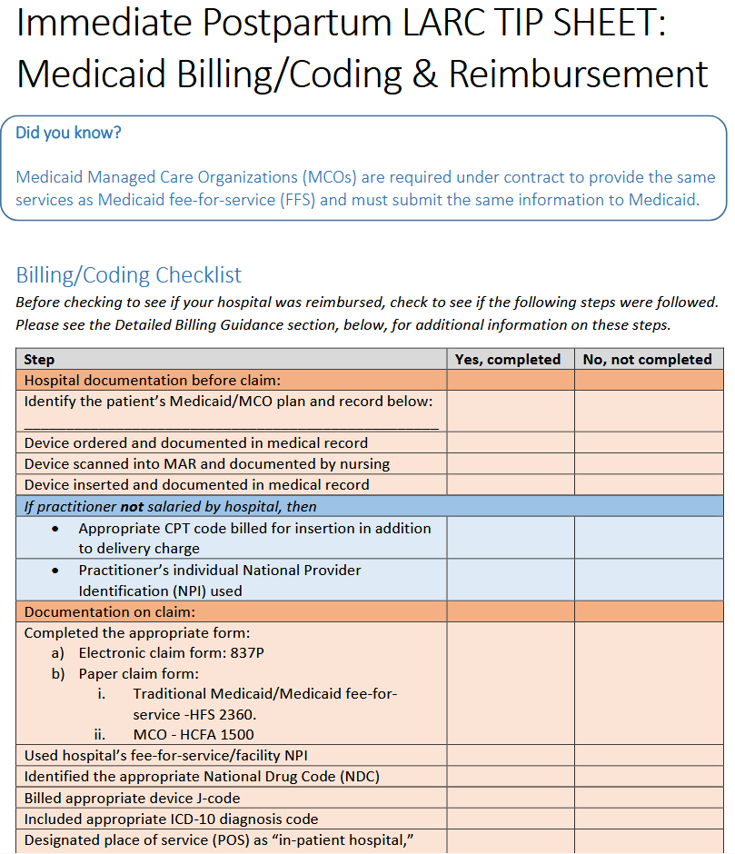
Providers must know how to bill/code and document for IPLARC placement
Do you have a specific billing question to troubleshoot? Send an email to info@ilpqc.org!

Slide 67
Gather IPLARC team including pharmacist to begin investigation.
Sample Process Flow Map
for Stocking LARC on inpatient units
need to have access to LARC on L&D/postpartum
Determine which devices are appropriate for your institution.
Obtain and fill out “Physician Application” for adding medication to the formulary.
Present at the hospital’s Pharmacy & Therapeutics Committee Meeting.
Address any barriers noted during investigation.
Administration approval granted?
No
Begin investigation on why approval was not granted.
Yes
Initiate IPLARC insertion
Protocol.
Notes:
This is right after Shelly’s talk and reflects the process she taking currently.

Slide 68
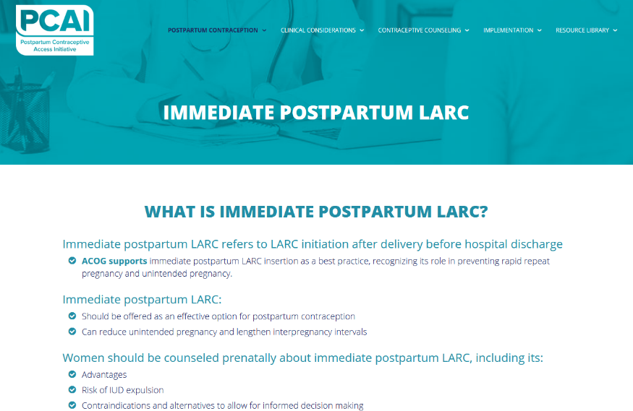
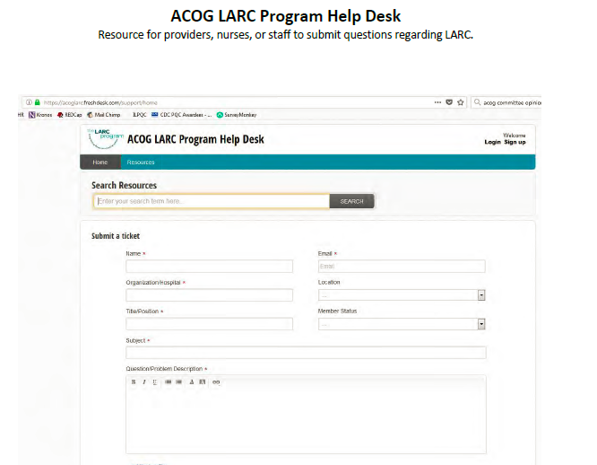
Providers are trained for immediate postpartum IUD and Nexplanon placement

Slide 69
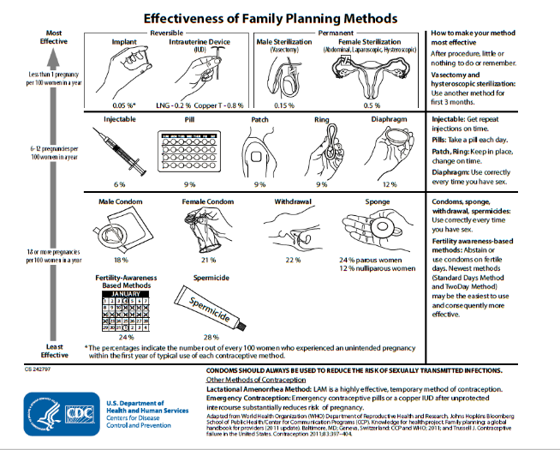
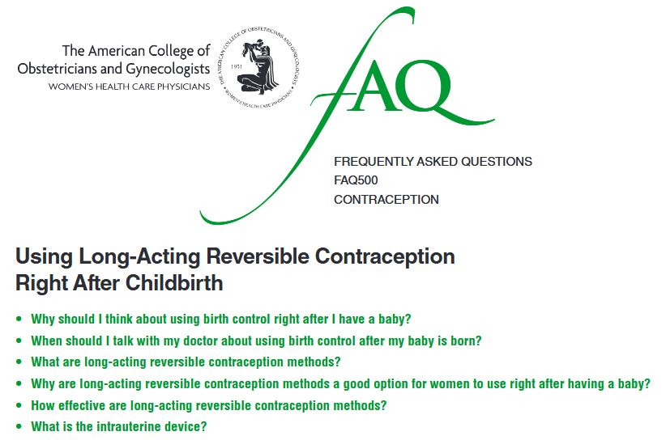
Standardized contraceptive counseling and materials including IPLARC are available to patients

Slide 70
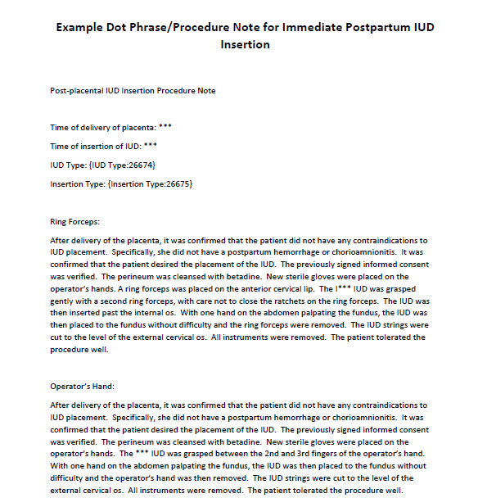
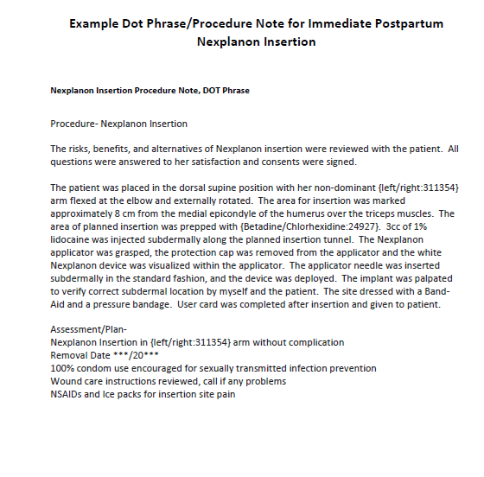
Dot phrases are developed to document counseling and patient plan

Slide 71
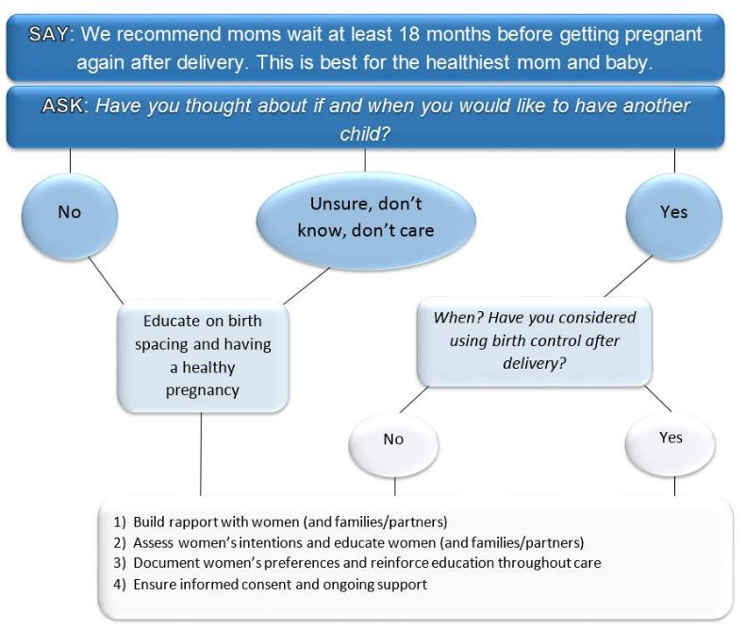
Providers are trained to offer Comprehensive Contraceptive Counseling free from coercion

Slide 72
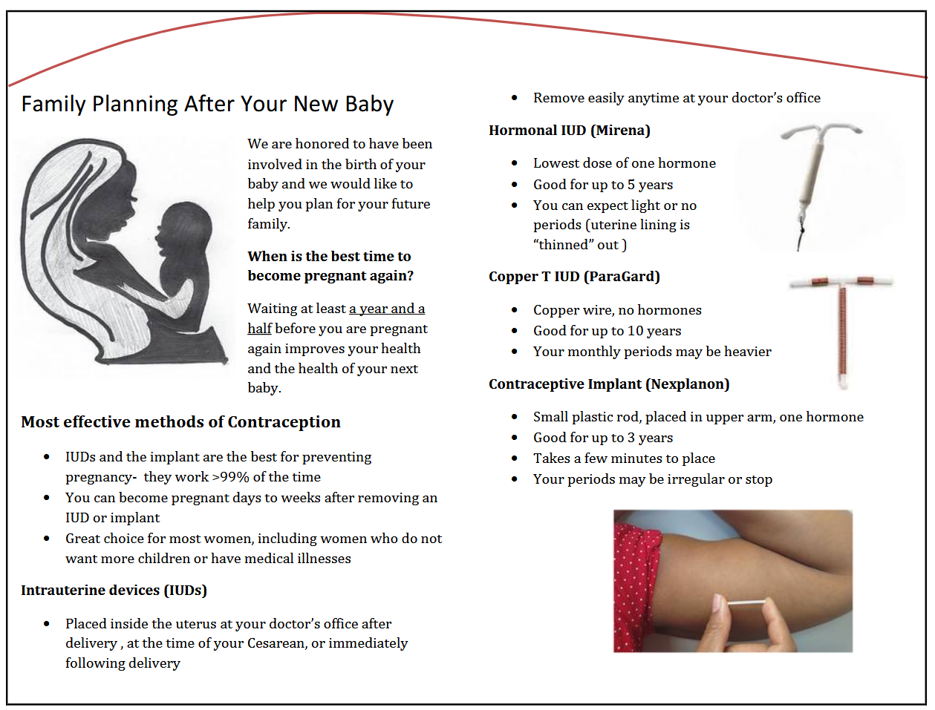
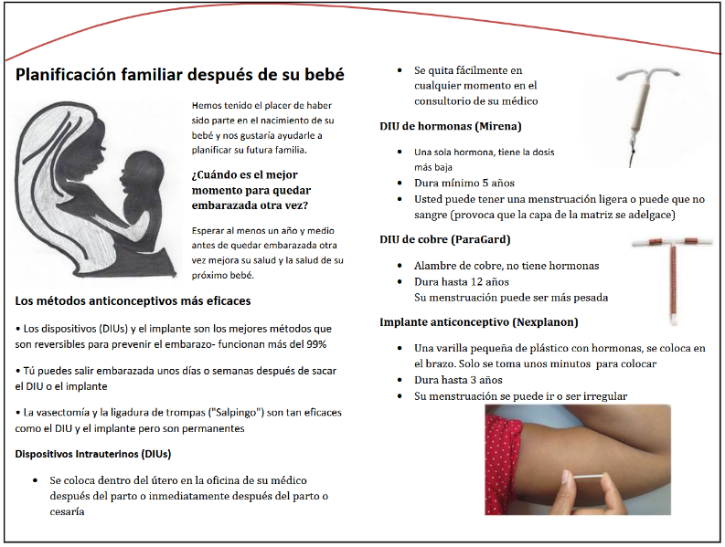
Standardized approach to provide patient education in inpatient & outpatient settings

Slide 73
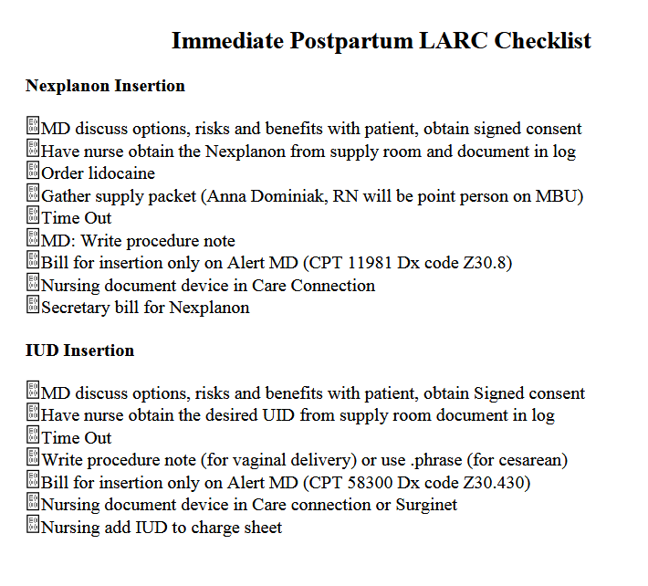
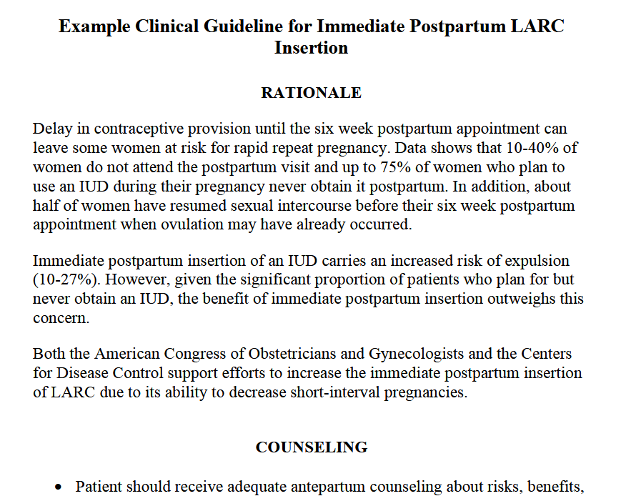
Providers are aware of IPLARC protocols and how to access all needed materials
A number of example protocols are available in the IPLARC toolkit
  Example protocols, policies
  Example checklists
  Example consents

Slide 74
Sample Process Flow
LARC Consent & Documentation
Admission history and physical (H&P) obtained by provider and options for LARC risks and benefits discussed.
LARC desired?
No
Follow routine delivery process for anticipated delivery method.
Yes
Provider obtains signed consent and has it scanned into medical record.
Provider orders LARC device under admission order set and proper documentation completed in H&P.
Planned Cesarean Section (c/s)?
No
Initiate c/s LARC Process Flow.
Yes
Initiate Anticipated Vaginal Delivery LARC Process Flow.

Slide 75
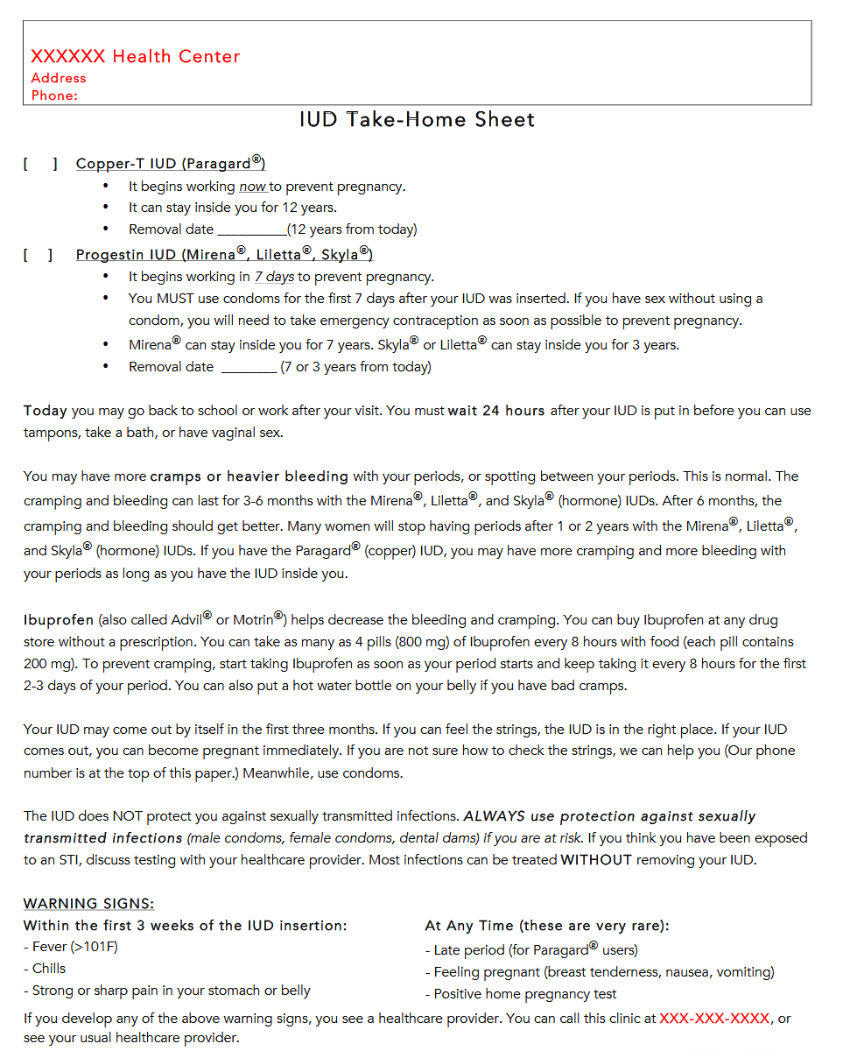
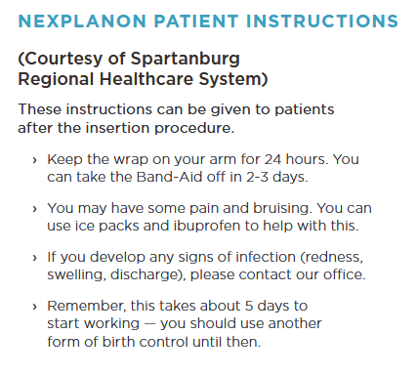
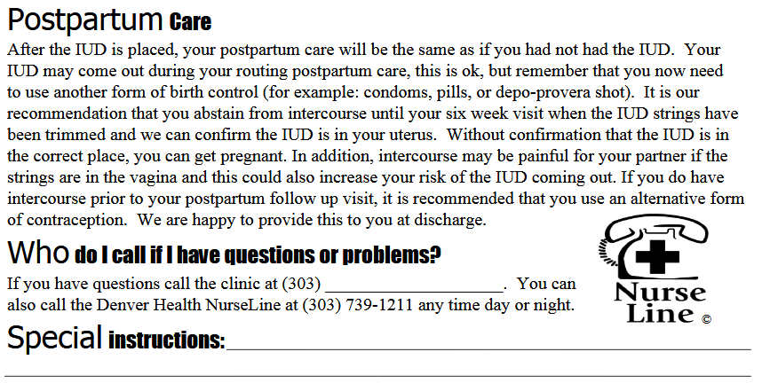
Standard plan is established to provide patients with post-procedure instructions & follow-up, make sure nurses are aware of this process flow
Notes:
We are aware that there are many steps to offering and inserting PP LARC but do not want to forget about the steps that should be apart of a hospital’s process once LARC is inserted. When women are preparing to leave the hospital they should be given information about what to expect and where they can go. This may look different depending on the what hospital a woman is delivering at but it should include information about the risk of IUD expulsion and checking for strings once they have healed. For IUD expulsions, we are suggesting that women use back up methods but see their OB provider if they want another device inserted. For women who would like removal they can go to their OB provider, an federally qualified health center or the local health department to have the device removed at little to no cost. I think satisfaction and contraceptive continuation is important for seeing the impact in short interval and unintended pregnancy so it may require that providers work with community partners to assess how women are managing their contraception – we work closely with the FL Healthy Start Coalitions across the state, many of which have home visitation programs for moms and babies. These community-based services can fill gaps when women are not returning to care but still are in need of information and services.

Slide 76

Communication between hospital team and prenatal care sites prior to GO LIVE date so that prenatal sites know when to start counseling patients that IPLARC is an option

Slide 77
Role of OB Providers and Care Teams: After GO LIVE
Monitor data reports on counseling/documentation to confirm that patients are offered postpartum contraception including IPLARC with standard documentation of counseling
Ensure that LARC devices are available for same day placement during postpartum visits for patients interested in LARC but who do not want immediate postpartum insertion
Consider early Universal Postpartum Visit – schedule this visit prior to patient discharge from hospital with a goal of increased uptake of patient follow-up

Slide 78
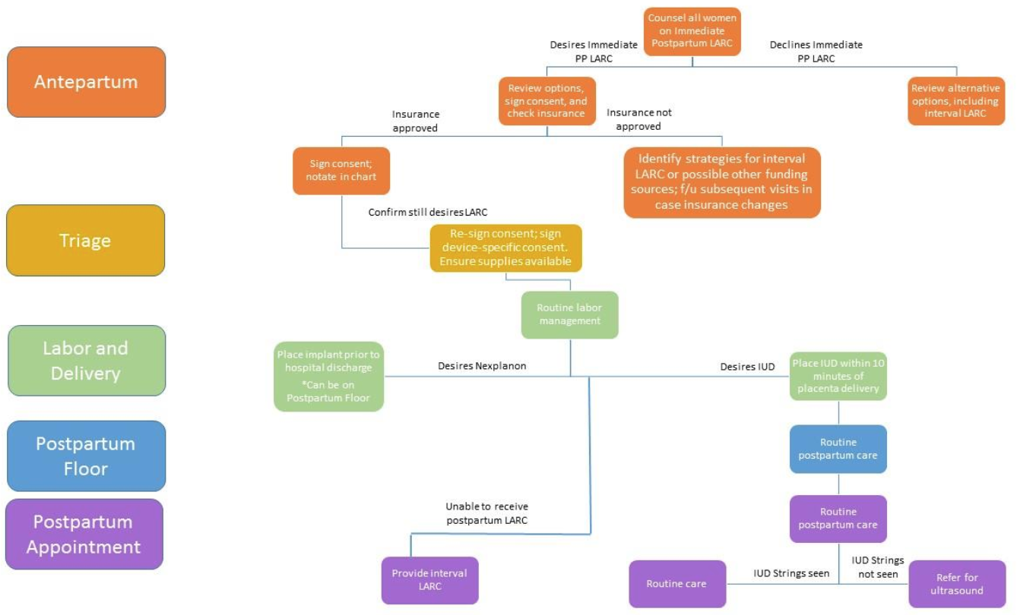
IPLARC Work Flow Diagram
Notes:
Earlier I mentioned workflow and this diagram Illustrates the anticipated way in which Access LARC could function at a hospital. We expect each institution to modify their workflow to accommodate the initiative in a way that works best for them so this is not prescriptive in any way.
There is one small modification that I would like to make here, we are asking that providers check women’s insurance prior to having an in-depth conversation about IPP LARC. We don’t want to counsel women on a method that they cannot receive. After that is done, then the patient receives counseling on IPP LARC during the prenatal period, if possible (we recommend having the conversation earlier, probably a brief introduction in trimester one and a comprehensive conversation in trimester two). For a patient that chooses IPP LARC, they would be asked to sign the consent document and receive approval from their insurance. This should be documented in the patient chart and during triage the patient should re-sign consent and sign device-specific consent. A nurse would ensure that the supplies are available for the insertion in L&D or on the postpartum floor if Nexplanon was selected. LARC is placed, then the patient is directed through routine postpartum care. We hope women will return for their postpartum appointment but if not they should have some anticipatory guidance about what to expect and where to go.

Slide 79
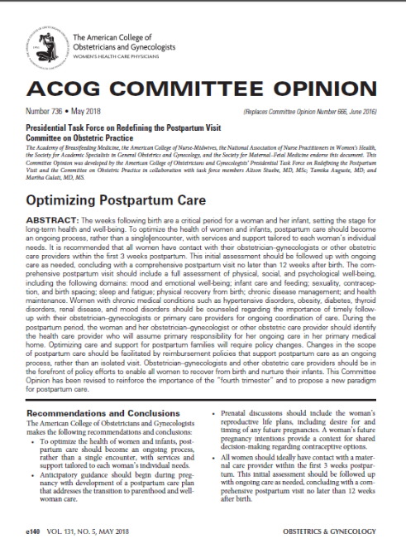
Redefining Postpartum Care
ACOG Committee Opinion #736:
To optimize the health of women and infants, postpartum care should become an ongoing process, rather than a single encounter
All women should ideally have contact with maternal care provider within the first 3 weeks postpartum (ideally within 2 weeks)
  Blood pressure checks
  Breastfeeding support
  Mental health well-being
  Contraception
Initial assessment should be followed up with ongoing care as needed
Conclude with a comprehensive postpartum visit NO LATER than 12 weeks after birth

Slide 80
Conclusion
Immediate postpartum LARC is one option for patients to consider when choosing postpartum contraception
IPLARC is safe, effective, and endorsed by national partners
Goal to reduce barriers to effective post-delivery contraception at all Illinois hospitals
ILPQC is here to help you:
  With resources/ materials through the IPLARC Toolkit
  Work through detailed billing and coding challenges
  Conduct Key Players Meeting at your hospital to brainstorm challenges and move implementation forward
  Achieve the March 2019 GO LIVE Goal

Slide 81
Contact
Email info@ilpqc.org
Visit us at www.ilpqc.org

Slide 82

IDPH

