Slide 1

Improving Postpartum Access to Care (IPAC)

Slide 2
Why IPAC Matters?

Slide 3
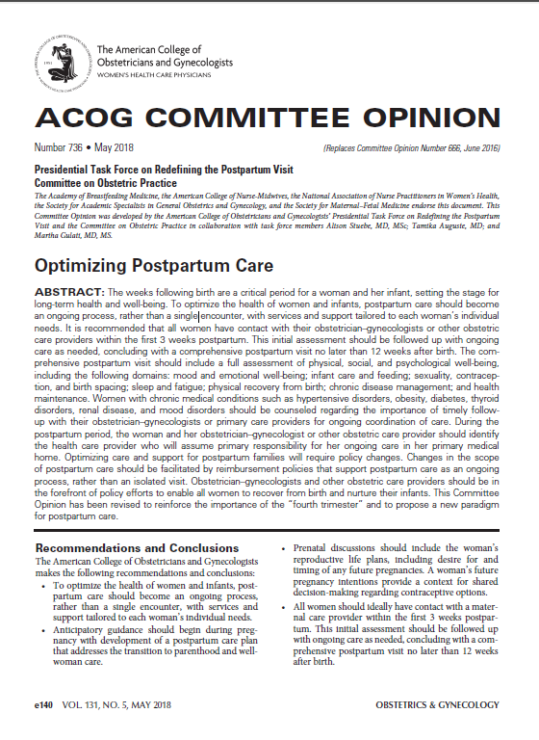
Redefining Postpartum Care
ACOG Committee Opinion #736:
To optimize the health of women and infants, postpartum care should become an ongoing process, rather than a single encounter
All women should have an early postpartum visit
  Blood pressure checks
  Breastfeeding support
  Mental health well-being
  Contraception
Initial assessment should be followed up with ongoing care as needed
Followed a comprehensive postpartum visit between 6-12 weeks

Slide 4
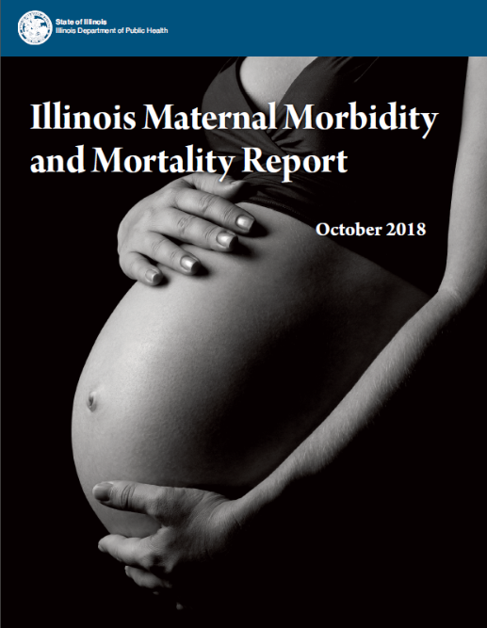
Review of mmrc report

Slide 5
Key Recommendations from the MMRC report
For Providers:
  Providers should adopt the recent recommendation from the American College of Obstetricians and Gynecologists (ACOG) for early postpartum visit in addition to traditional 6 week visit
For Hospitals:
  Birthing hospitals should ensure that women are connected with a primary care or obstetrical provider and scheduled for a postpartum visit prior to hospital discharge
For Health Plans:
  Illinois should expand Medicaid eligibility for the postpartum period from 60 days to one year after delivery and health insurance plans should cover case management and outreach for postpartum high-risk women for up to one year after delivery
  Health insurance plans should separate payment for visits in the postpartum period from labor and delivery (unbundle postpartum visit services from labor and delivery)
http://dph.illinois.gov/sites/default/files/publications/publicationsowhmaternalmorbiditymortalityreport112018.pdf
Notes:
https://www.riverbender.com/articles/details/illinois-releases-first-maternal-morbidity-and-mortality-report-31421.cfm
CAN WE ADD THE % OF PREVENTABLE DEATHS FOR OB CAUSES
Also can we add a slide on top causes of death? If there is a slide.

Slide 6
MMRC Report Overview
IL is first state to release a statewide maternal morbidity and mortality report
Identified statewide trends in maternal mortality and provided recommendations to prevent maternal mortality
Key Findings:
  Avg of 73 women per year died within one year of pregnancy 2008-2016 (Total of 655 women)
  Non-Hispanic Black women are 6x as likely to die of a as non-Hispanic White women
  72% of pregnancy-related deaths and 93% of violent pregnant-associated deaths (includes overdoses) were deemed preventable
http://dph.illinois.gov/sites/default/files/publications/publicationsowhmaternalmorbiditymortalityreport112018.pdf

Slide 7
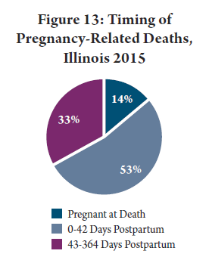
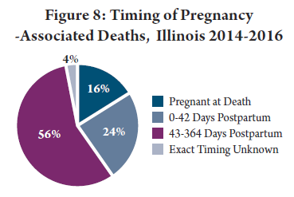
Key Findings Regarding Maternal Mortality in the Early Postpartum Period
24% of pregnancy associated deaths 0-42 days
53% of pregnancy related deaths 0-42 days
Before the 6 week visit
http://dph.illinois.gov/sites/default/files/publications/publicationsowhmaternalmorbiditymortalityreport112018.pdf

Slide 8
Maternal Morbidity in the Early Postpartum Period
50% of postpartum strokes occur within 10 days of discharge
20% of women discontinue breastfeeding before the first 6-weeks
Up to 40% of women do not attend the 6-week postpartum visit
As many as 1 in 5 women experience a postpartum mental health disorder
Notes:
Suzanne to add citations

Slide 9
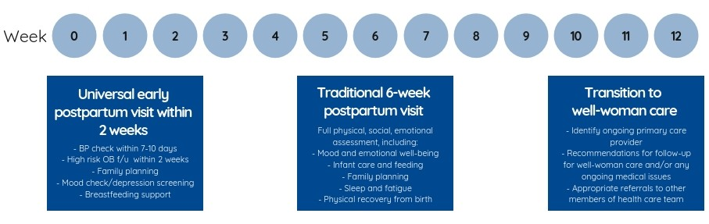
New Postpartum Care Continuum
An early postpartum visit (within 2 weeks of delivery) provides women with essential maternal safety checks such as blood pressure evaluation, wound/perineum evaluation, breastfeeding support, mental health well-being, and family planning, among other essential health services.

Slide 10

Components of the 2 week Early
Postpartum Visit
Maternal Health
Safety Check
Blood pressure / preeclampsia symptoms check
Wound/ perineum check
Assess appropriate postpartum bleeding
Mood check/depression screening
Breastfeeding support
Family planning/contraception options
Linkage to health / community services
(ie. WIC, breastfeeding support, home visits)
Assess medical / pregnancy complications, including
SUD/OUD risks and link to needed follow up care
Review risk reduction strategies for future
pregnancies

Slide 11
Ilpqc structure and supports

Slide 12
Illinois Perinatal Quality Collaborative (ILPQC)
Multi-disciplinary, multi-stakeholder Perinatal Quality Collaborative with 119 Illinois hospitals participating in 1 or more initiative
Support participating hospitals’ implementation of evidenced-based practices using quality improvement science, collaborative learning and rapid response data
>99% of IL births

Slide 13



ILPQC Provides Responsive
QI Services to Hospital Teams
Webinars/ Calls
Monthly collaborative learning calls
Quarterly QI support calls to individual teams
Face to Face
Spring Face-to-Face Meeting breakouts
Annual Conference breakouts
ILPQC Resources
Paper/online QI toolkits
Patient-education materials
Monthly e-newsletters
Webinar recordings
ILPQC Data
Rapid response data system
Real-time reports for teams to compare data across time & hospitals
Key Player site visits
Grand Rounds presentations
Small group QI topic calls as needed
Data system training calls
Quality Improvement Support Services
Notes:
Make less “list-like” and coordinate with the graphics more… connect better. Make shorted words in boxes with what the main points are. Done AP
DAN UPDATE
Toolkits, patient-education materials, face-to-face meetings (breakouts), data training calls, key players meeting, support for team development
Buprenorphine and IPLARC trainings
36 monthly OB & Neonatal team calls with Team Talks for collaborative learning over course of initiatives
15 QI topic calls with about 80 hospitals and topic champions sharing strategies
20 QI support calls per quarter with hospital teams working towards goals and perinatal network administrators providing additional support
Facilitated monthly e-newsletters per initiative to teams
Monthly updates of key resources on ilpqc.org
ILPQC rapid-response data system has real-time reports for teams to compare data across time and other hospitals

Slide 14
Initiative Overview
Improving Postpartum Access to Care (IPAC)

Slide 15

ILPQC Improving Postpartum
Access to Care (IPAC) Initiative
Aim: Within 11 months of initiative start, ≥80% of participating hospitals will implement universal early postpartum visits (within 2 weeks) and be able to facilitate scheduling prior to hospital discharge
To optimize the health of women by increasing access to early postpartum care within the first two weeks postpartum to facilitate follow-up as an ongoing process, rather than a single 6-week encounter and provide an opportunity for a maternal health safety check and link women to appropriate services.
Key Goals:
Increase % of women with an early postpartum visit scheduled with an OB provider within the first two weeks after delivery
Increase % of women receiving focused postpartum education prior to discharge after delivery
Increase % of providers / staff receiving education on optimizing early postpartum care
Achieve GO LIVE goal to provide IPAC for ≥80% participating hospitals by May 2020

Slide 16
How do we track progress to make sure we are making change happen
Track progress with system changes, process and outcomes across time and compare to other participating hospitals

Slide 17
Aims & Measures
Overall Initiative Aim
Within 11 months of initiative start, ≥80% of participating hospitals will implement universal early postpartum visits (within 2 weeks) and be able to facilitate scheduling prior to hospital discharge
Structure Measures
IPAC protocol/process flow in place for facilitating scheduling of early postpartum visits with affiliated outpatient care sites and OB providers prior to discharge
Communicate recommendation/strategy for early postpartum visit and obtain buy-in with OB providers/ outpatient care sites (ie, share ILPQC OB provider/outpatient care site packet)
Implement standard postpartum education prior to discharge after delivery regarding: benefits of early postpartum care postpartum early warning signs and how to seek care benefits of pregnancy spacing and options for (outpatient) family planning
Process Measures
Educate all providers and staff on optimizing early postpartum care including: maternal safety risks in the postpartum period benefits of early postpartum care/maternal health safety check protocol for facilitating scheduling early postpartum visit prior to discharge documentation and billing for early postpartum visit components of early postpartum visits/maternal health safety check
Outcome Measure
Increase % of women with documentation of an early postpartum visit/maternal health safety check encounter scheduled within the first 2 weeks of delivery
Increase % of patients who receive standardized pp patient education prior to discharge
Notes:
Updated post IPAC clinical leads call on 5/15/19

Slide 18
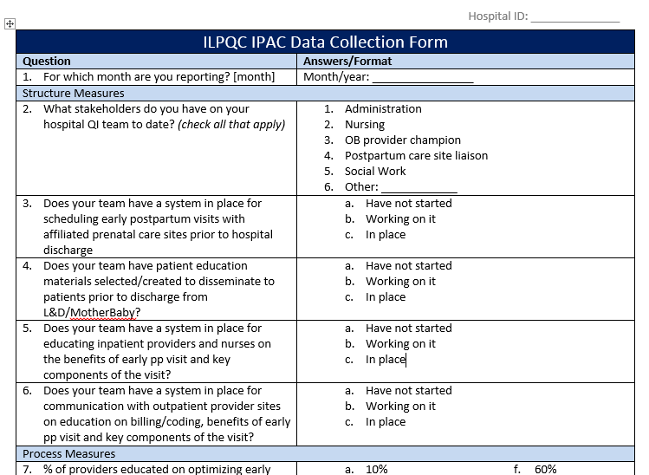
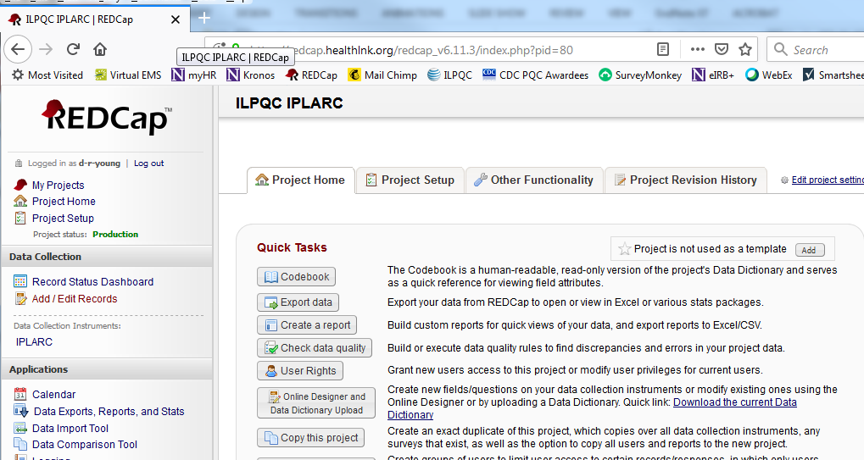
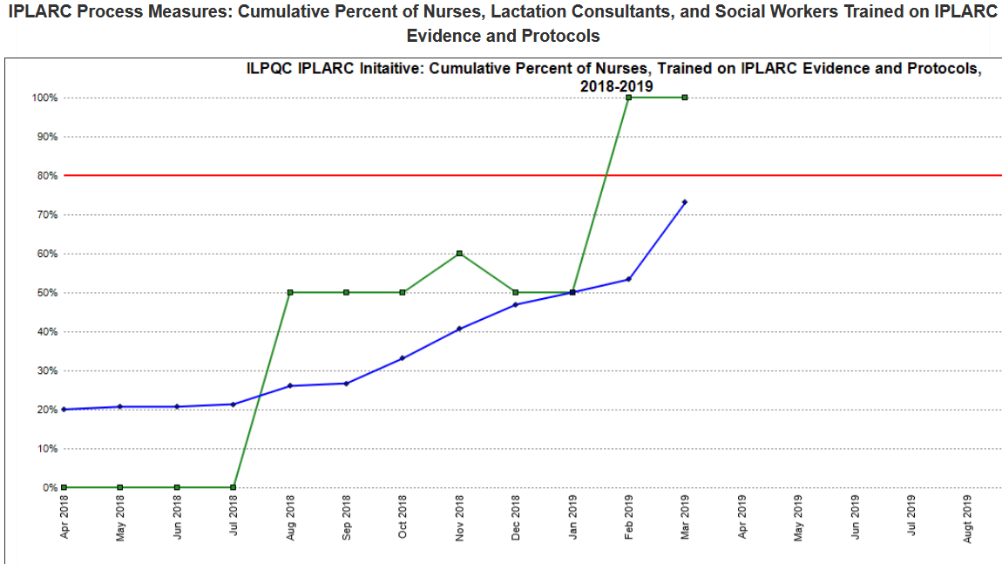
ILPQC Data System
Collect data at your hospital
Enter data into data system
Review your progress in web-based reports to compare across time and across participating hospitals
Notes:
Insert pics of IPAC data forms if available- edited to remove IPLARC on the data grapg- 5.14

Slide 19
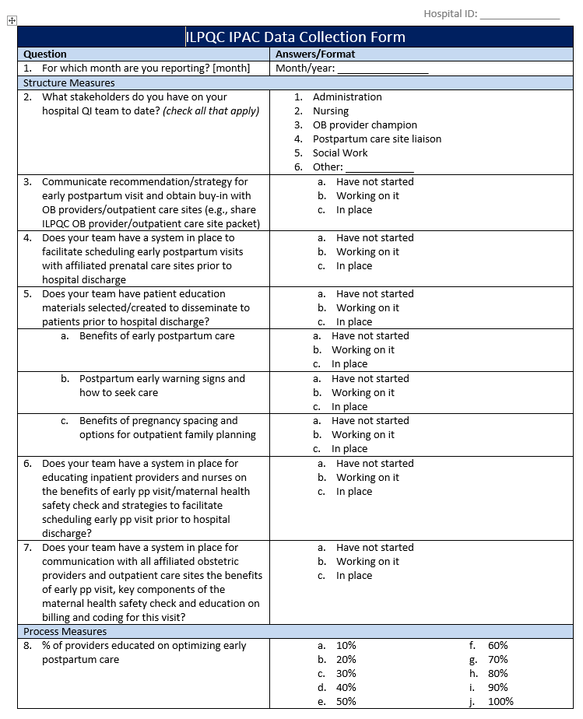
The QI team at your hospital will be collecting and sharing data for this initiative
Paper form
Notes:
Danielle, please add in the new data form here once finalized- AP

Slide 20
Timeline for IPAC
Go LIVE goal by May 2020
Initiative Development and Pilot with St. Anthony Hospital
Recruitment for IPAC Teams
IPAC Kick-Off Call
Wave 2 Launch Face-to-Face Meeting
Monthly Team Webinars / Active QI Period
April – December 2018
Winter/ Spring 2019
May 20, 2019
May 29, 2019
3rd Monday of month, 11-12pm
2019-2020

Slide 21

IPAC Clinical Leads
Clinical Leads:
  Michelle Bucciero, St. Anthony Hospital
  Jeanne Goodman, Loyola University Medical Center
  Kelli Lewis, Franciscan Health Olympia Fields
  Lisa Masinter, Erie Health Center
Clinical leads work with ILPQC to develop and refine data project aims/measures, data collection, scope, etc.

Slide 22

IPAC
Key Driver
Diagram
Key Drivers
Strategies
Obtain buy-in from OB providers and outpatient care sites on national recommendations and benefits for an early pp visit within 2 weeks.
Utilize provider outpatient packet to engage OB providers and outpatient care sites to help plan for early pp visit scheduling, obtain buy-in from providers, and share options for billing and coding.
Provide billing and coding information to OB providers and outpatient care sites for the early pp visit within 2 weeks.
AIM
Within 11 months of initiative start, ≥80% of participating hospitals will implement universal early postpartum visits (within 2 weeks) and be able to facilitate scheduling prior to hospital discharge
Create a hospital specific process flow to help facilitate scheduling of an early pp visit within 2 weeks prior to discharge
Implement process flow to facilitate universal scheduling of early pp visits prior to delivery discharge
Revise policies and procedures to ensure scheduling for an early pp visit within 2 weeks
Implement provider and nurse education on risks of the postpartum period, benefits of early pp visit, and key components of maternal health safety check
Develop strategy to educate inpatient and outpatient providers and staff using IPAC slide set, OB Provider Packet, and/or didactic education
Plan in place for ongoing and new hire education
Standardize system to provide patient education prior to hospital discharge on the benefits of early pp visit, early pp warning signs, and benefits of pregnancy spacing and options for (outpatient) family planning
Patient education materials selected: benefits of early pp visit/ components of maternal health safety check, early pp warning signs and how to seek care (AWHONN), benefits of healthy pregnancy spacing/(outpatient) family planning options
Implement system to provide and review IPAC patient education prior to hospital discharge

Slide 23

Process Flow for Scheduling
Early Postpartum Visit
Patient meets all discharge criteria
Patient counseled on need for early postpartum visit at 2 weeks and will help make appointment before discharge
Provide patient education materials on the benefit of early postpartum visit, warning signs/symptoms to seek care (ie. AWHONN hand out), and information on benefits of pregnancy spacing/family planning options.)
Able to schedule early postpartum appointment before discharge
Arrange follow up with patient to schedule 2 week postpartum visit after discharge
No
Yes
Confirm patient has early pp visit scheduled and document in record
Appointment scheduled and appointment date and time added to patient’s discharge paperwork
Document counseling, education and postpartum care plan in discharge summary / instructions and ensure patient has follow up plan

Slide 24
Your OB Provider Packet
What’s included in your packet
Initiative introductory letter signed by your OB Chair
Your hospitals discharge process flow
IPAC Fact Sheet
National and State Guidance documents
  ACOG CO #736
  AIM Postpartum Care Safety Bundle
  IDPH Maternal Morbidity and Mortality Report
Billing and coding resources
Provider education resources
Office Flyer

Slide 25
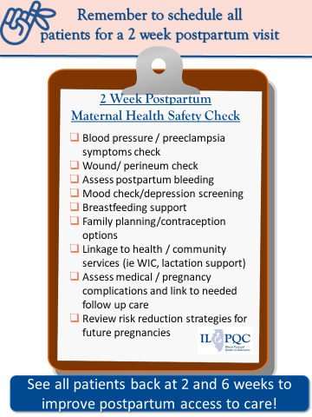
Early Postpartum
Visit/Maternal Health Safety Office Flyer

Slide 26
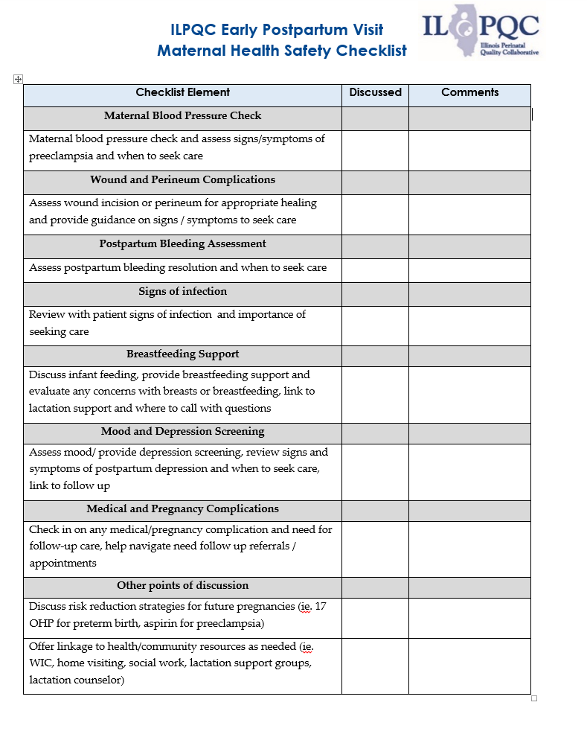
Early Postpartum
Visit/Maternal Health Safety Checklist

Slide 27
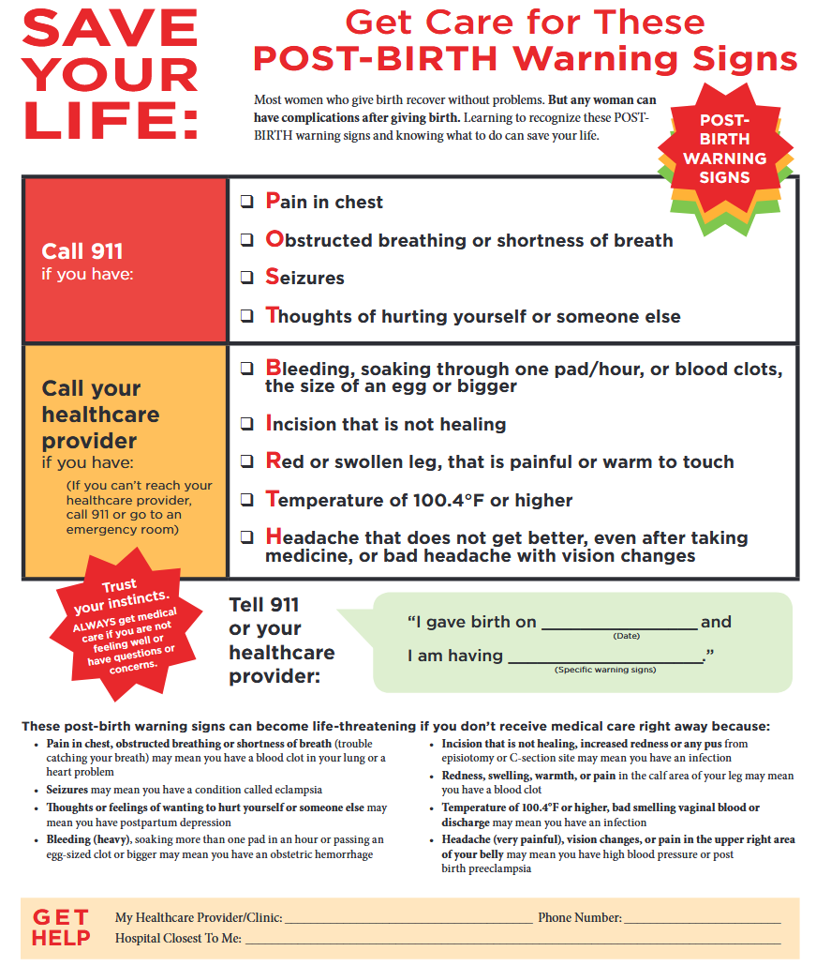
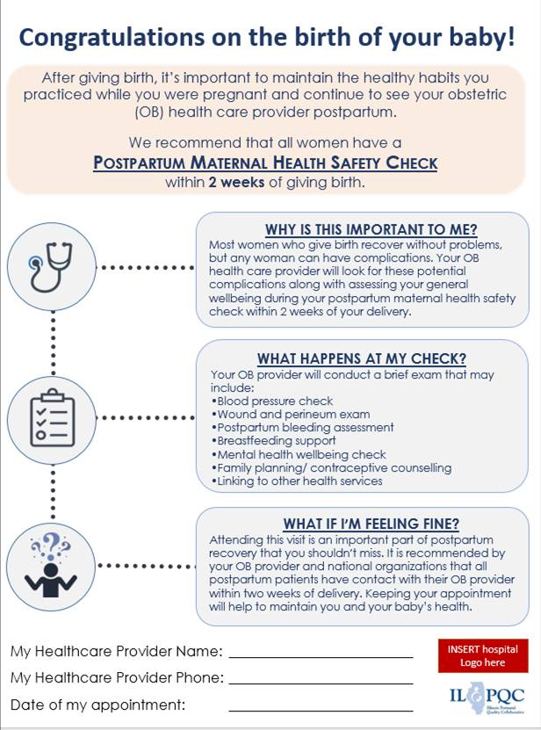
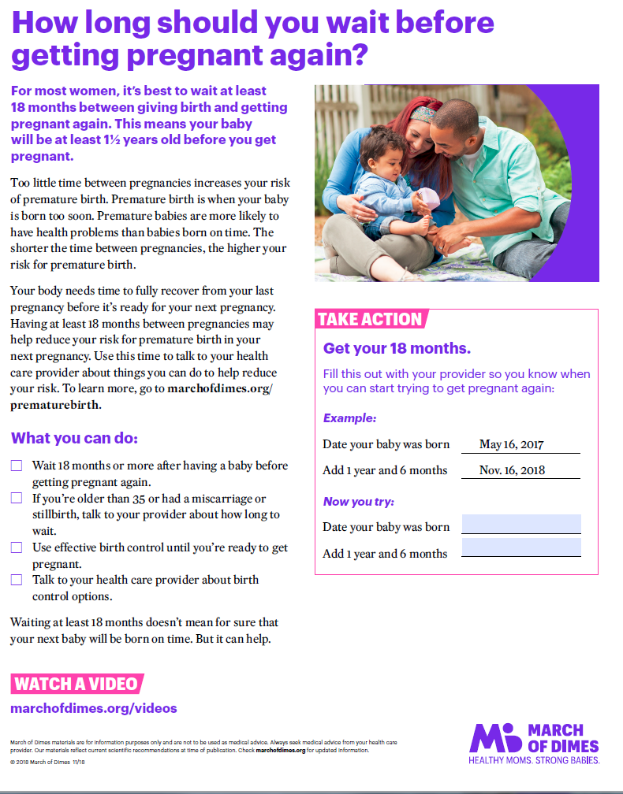
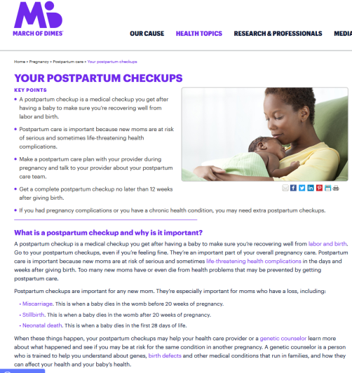
Example Postpartum Patient
Education Material

Slide 28
What is the role of the
OB provider for IPAC success?
Council all patients on the plan for early postpartum visit and why a maternal health safety check within 2 weeks is important (discuss key components of visit), document plan/discussion
Make sure patient receives pp education material before discharge:
  Benefit of early postpartum visit
  Postpartum early warning signs and how to seek care
  Benefits of pregnancy spacing, family planning options
Facilitate scheduling early postpartum visit (within 2 weeks) for all patients, document in chart
Confirm patients receive early pp visit within 2 weeks/ maternal health safety check and use check list for key components
Document and bill for early postpartum visit

Slide 29
What is the role of the OB Nurse for IPAC success?
Understand maternal risks in the postpartum period and benefits of early postpartum visit / maternal health safety check
Make sure patient receives pp education material before discharge:
  Benefit of early postpartum visit
  Postpartum early warning signs and how to seek care
  Benefits of pregnancy spacing, (outpatient) family planning options
Facilitate and help ensure scheduling early postpartum visit (within 2 weeks) for all patients before hospital discharge, confirm documented in chart and discharge instructions
Discharge conversation ensure patient understands key pp education materials, understands plan for early postpartum visit, and has appointment scheduled.

Slide 30
Contact
Email info@ilpqc.org
Visit us at www.ilpqc.org

Slide 31

IDPH

