Slide 1

Mother and Neonates Affected by Opioids
Initiative
Inset Name and date

Slide 2
Objectives
Discuss the opioid epidemic as the backdrop for the Mothers and Neonates Affected by Opioids (MNO) initiative
Review the goals/components of the initiative
Collaborative learning & ILPQC Resources
Start the dialogue about what the implementation process at our hospital will entail

Slide 3
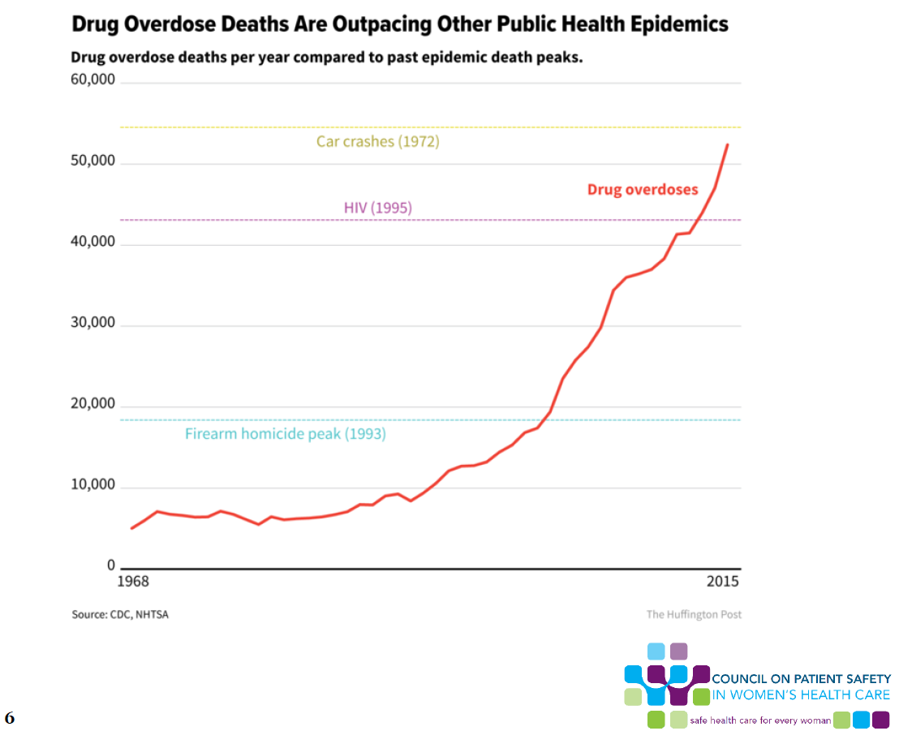
Notes:
There are any number of epidemiologic slides that demonstrate the magnitude of the opioid epidemic in the US. This data from the Huffington post demonstrates, alarmingly, that death from drug overdose has exceeded peak deaths from firearm homicides (1993), HIV (1995), and is on pace to exceed peak car crashes deaths (1972).

Slide 4
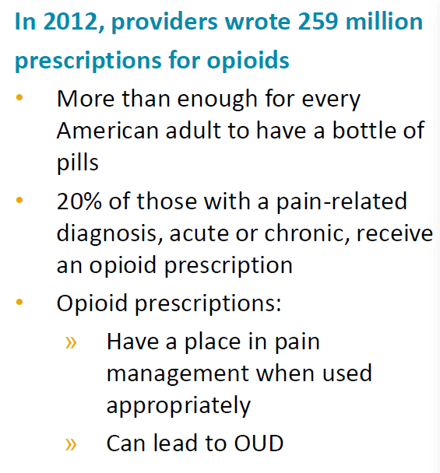

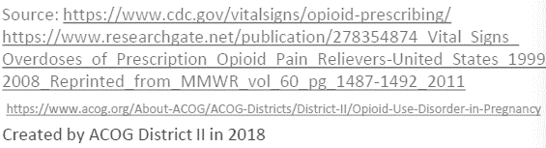
Prescribing Practices
Notes:
We as prescribing providers have unfortunately contributed to the magnitude of this problem…

Slide 5
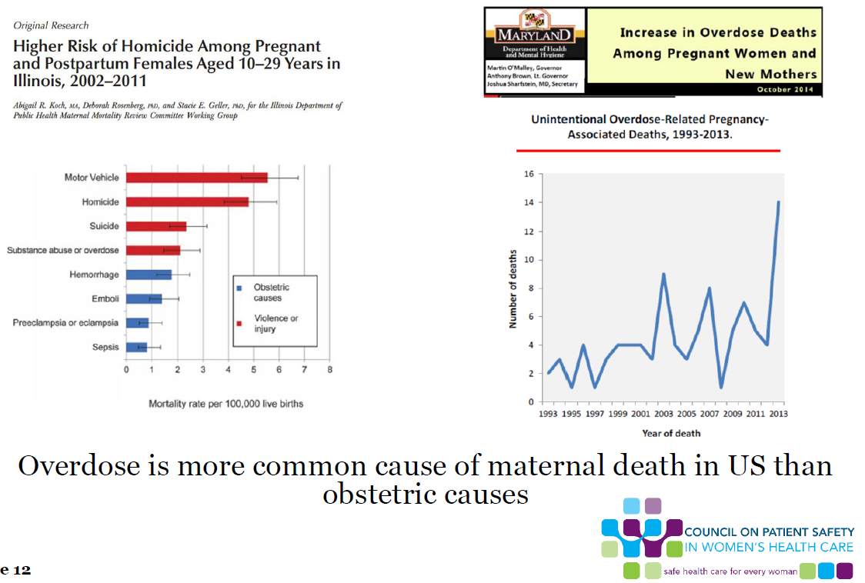
The Opioid Crisis and
Maternal Mortality
Notes:
Most relevant to all of us here in this room is the impact of opioid use in pregnancy. This chart to the left demonstrates maternal mortality in IL between 2002 and 2011. The blue bars represent obstetric causes and the red non-obstetric causes. Here, we see, that substance abuse overdose exceeds all obstetric-related causes of death below. We see to the right here the rise in maternal mortality related to overdose in Maryland. The risk to our mothers reflects the risk we see nationally.

Slide 6
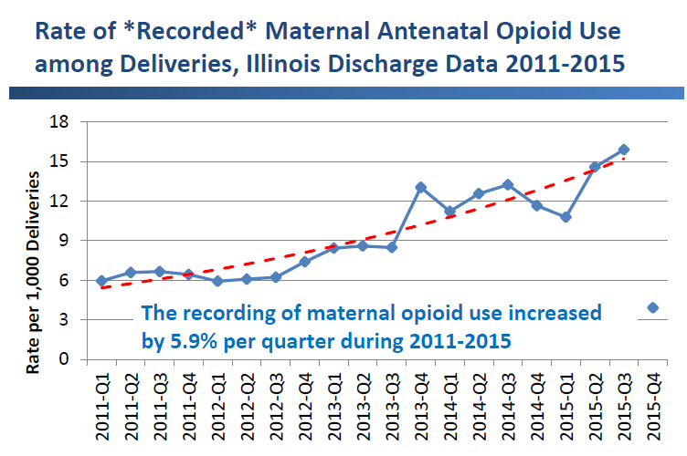
Mothers Affected by Opioids
in IL: Scope of the Problem
116% increase in recorded maternal opioid use between 2011 and 2015
Pregnancy is a window of opportunity to identify women with OUD and link to treatment as well as begin to develop a plan for optimizing her baby’s care
Notes:
Also:
Women have higher rates of hospitalizations for opioid overdoses⁷
Women are more likely than men to:
be prescribed opioids⁸
use opioids chronically⁸
receive prescriptions for higher doses⁸
engage in “doctor-shopping” ⁹
be prescribed opiates in combination with sedatives¹⁰
face barriers in access to substance abuse treatment¹¹

Slide 7
Rate of Drug Poisoning Deaths among IL
Women of Reproductive Age (WRA; 15-44 years), 2008-2017
The rate of drug poisoning deaths for WRA increased 101% between 2008 and 2017.
The rate of opioid-related poisoning deaths for WRA increased 175% from 2008 to 2017.
Data Source: Illinois death certificates, 2008-2017. 2017 data are provisional
Notes:
There were 207 drug poisoning deaths among women of reproductive age in 2008 and 400 in 2017, a 101% increase.
There were 122 opioid-related poisoning deaths among women of reproductive age in 2008 and 323 in 2017, a 175% increase.

Slide 8
Rate of Opioid-Related Poisoning Deaths
Among IL Women of Reproductive Age
(WRA), By Opioid Type
The rate of heroin-related deaths for WRA increased more than 10-fold in ten years
The rate of synthetic-opioid-related deaths for WRA increased by 9-fold in only four years
Data Source: Illinois death certificates, 2008-2017. 2017 data are provisional
Notes:
Heroin was involved in approximately 50% of opioid-related poisoning deaths in 2017
Synthetic opioids were involved in approximately 55% of opioid-related poisoning deaths in 2017.

Slide 9
Rate of Opioid-Related Poisoning Deaths
Among IL Women of Reproductive Age
(WRA), By Race/Ethnicity
The rate of opioid-related deaths is highest among non-Hispanic white WRA
White, Black and Hispanic WRA have all experienced increases in opioid-related deaths over the last 10 years
Data Source: Illinois death certificates, 2008-2017. 2017 data are provisional
Notes:
Rates of overdose are highest among non-Hispanic white women, however, all race/ethnicity groups have experienced significant increases in overdose rates for women.

Slide 10
Rate of Pregnancy-Associated Deaths
Due to Drug Poisoning, IL Residents, 2008-2016
Between 2008 and 2016:
Pregnancy-associated deaths related to any drug poisoning nearly tripled.
Pregnancy-associated deaths specifically related to opioid poisoning increased almost 6-fold.
Data Source: Illinois death certificates, 2008-2016.
Notes:
There were 10 pregnancy-associated deaths related to opioid poisoning in 2016. Pregnancy-associated deaths related to any drug overdose nearly tripled. Pregnancy-associated deaths specifically related to opioid overdose increased almost 6-fold across the last 10 years.

Slide 11
Number of Pregnancy-Associated Deaths
Due to Drug Poisoning, IL Residents, 2008-2016
The number of drug poisoning and opioid-related deaths has increased over time.
Opioids were involved in 83% of pregnancy-associated drug poisoning deaths during 2014-2016.
Data Source: Illinois death certificates, 2008-2016.
Notes:
Opioids were involved in 83% of pregnancy-associated drug overdose deaths during 2014-2016

Slide 12
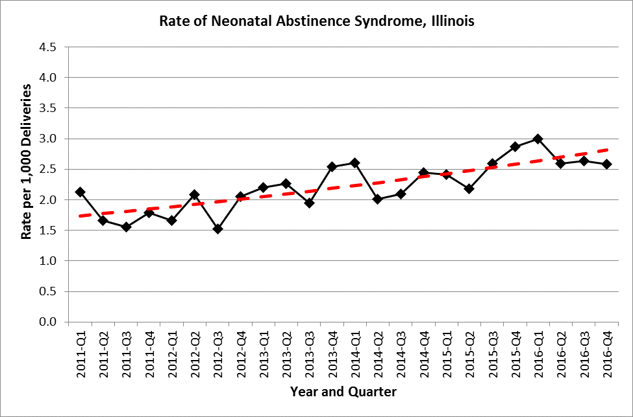
Neonatal Abstinence Syndrome
in IL: scope of the problem
53% increase in rate of NAS from 2011 – 2016
NAS rate increased 2.1% per quarter from 2011-2016
Notes:
53% increase in rate of NAS from 2011 – 2016
NAS rate increased 2.1% per quarter from 2011-2016

Slide 13
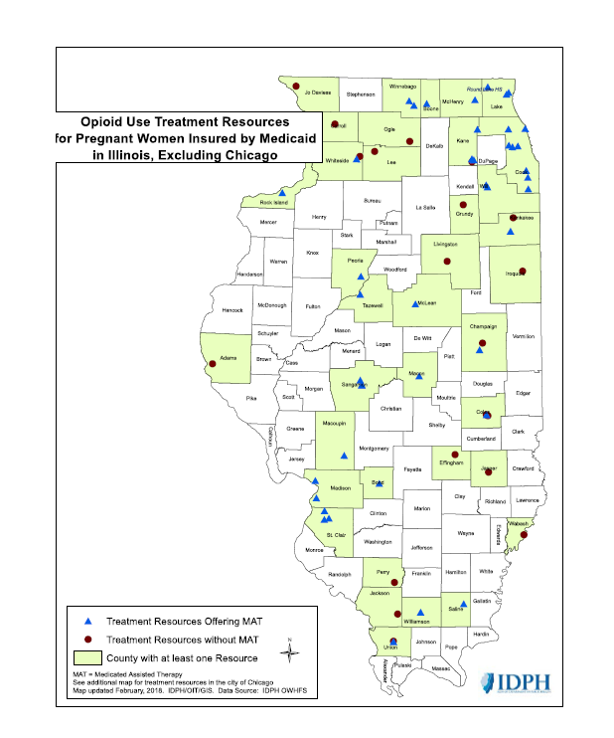
Opioid Use Treatment Resources for Pregnant Women Insured by Medicaid in IL, excluding Chicago
Notes:
So, this map displays resources in IL by county. The county’s in green are those that have at least 1 treatment resource available for our underserved/Medicaid population. We have the fewest resources available for our women in greatest need.

Slide 14
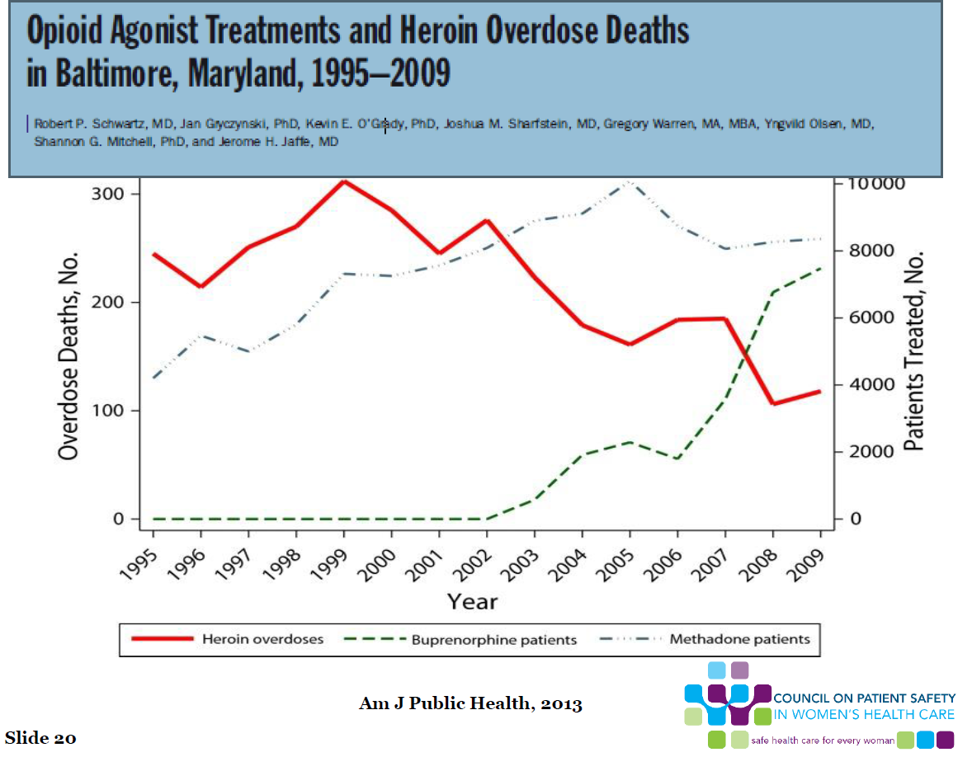
Notes:
I bring this issue up because treatment resources are important to survival. This figure here demonstrates the inverse relationship between a rise in MAT treatment and a decline in heroin overdose deaths in Baltimore, MD.

Slide 15
The Backdrop
Rise in opioid use
Rise in opioid death
Over-prescription of opioids
Rise in maternal opioid-related death
Rise in neonatal abstinence syndrome
Improved outcome with treatment
Limited treatment providers
Notes:
To summarize….

Slide 16
The MNO Initiative
ILPQC implementation of statewide initiative for obstetric and neonatal teams
Support of IDPH, the NAS Advisory Committee, the Regionalized Perinatal Health Program and other stakeholders
All Illinois birthing/newborn hospitals
To improve the quality of care provided to Mothers and Newborns affected by Opioids (MNO).

Slide 17
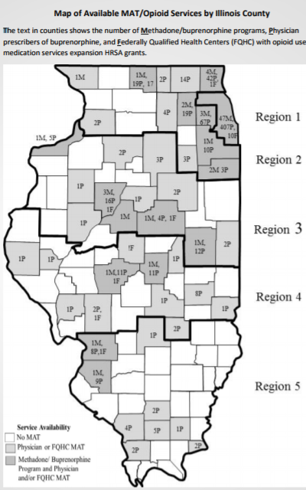
Mothers Affected by Opioids:
How do We Improve Care?
Increase moms on Medication Assisted Therapy by delivery
Hospitals implement and share with affiliated prenatal care sites a validated screening tool, implement SBIRT protocol, map local resources and create a process flow to link moms with OUD to MAT and needed services.
Provide education to providers/care team on stigma reduction and key protocols (screening, SBIRT, linkage to care, optimal care protocols)
Engaging moms in the non pharmacologic care of babies with NAS (breastfeeding, eat sleep console, rooming in)
Care checklist prenatally and at L&D
Patient education (consult and standardized education materials) empowering moms their participation matters!
Hospital level process flow / protocol changes to increase maternal participation (rooming in, breast feeding, eat-sleep-console)

Slide 18
The MNO Initiative Aims
Improve identification of pregnant women with opioid use disorder (OUD) through standardized screening and assessment for OUD on: admission to labor and delivery, emergency rooms, affiliated outpatient prenatal sites; and implementation of Screening, Brief Intervention, Referral to Treatment (SBIRT) protocol.
Improve linkage to addiction care for moms with OUD through standardized mapping of local resources to link moms to addiction services/MAT/behavioral health services in your area. Share completed local linkage to care resources document and process flow for linking moms with OUD to MAT and needed services, with inpatient OB units, ER and affiliated prenatal care sites.
Optimize clinical care of pregnant women with OUD through patient and provider education, implementation of care protocols/checklists and consultations to be completed prior to or during delivery admission.

Slide 19
MNO Initiative Aims
4. Improve outcomes for opioid exposed newborns (OENs) through key interventions: standardized identification and assessment of OENs, increased maternal participation in OENs newborn care, optimize non-pharmacologic newborn care, standardize pharmacologic treatment, and develop standard safe discharge plans.
5. Optimize prevention of OUD through provider and patient education, provider compliance with PMP lookup state law when prescribing any narcotic, and implementation of clinical guidelines for strategies to reduce opioid over-prescribing after delivery.

Slide 20


MNO Key Elements Link to our Improvement Goals
Screening and Linkage to Care
Optimizing Care for Moms/Babies
Prevention

Slide 21
Our Goals for MNO
1. Increase validated screening and linkage to MAT for mothers with opioid use disorder
Implementation of validated screening tools with SRIRT protocol on Labor/Delivery, ER, and outpatient prenatal care sites
Mapping of available local resources to link pregnant and postpartum women to MAT/ support services
Protocols / process flow for management of women who screen positive and linking them to care

Slide 22
Our Goals for MNO
2. Optimizing care for mothers and newborns affected by opioids.
Standardized patient education materials
Provider & nurse education on stigma reduction and screening/linkage to care/ care protocols
Implementation of care protocols/checklists for prenatal care, L&D and postpartum
Consultations for behavioral health, neonatology, etc. prior to or during delivery.
Notes:
Autumn – list key steps here based on our measures for this bucket…should be check list, NARCAN, contraception plan, consults, patient and provider education, reduction of stigma / implicit bias training

Slide 23
Our Goals for MNO
3. Prevent opioid use disorder (OUD) - 2019
  Provide a systems-based approach
  Reduce the number of opioids prescribed for routine deliveries
  Increase documentation of PMP look up by providers prior to prescribing opioids
  Provide education on OUD prevention and stigma reduction for providers, staff and pregnant women
Notes:
We should switch to make the order consistent with our buckets…prevention is always listed last.

Slide 24
Opioid Use Disorder
in Pregnancy
FIRST STEPS
Know the Basics

Slide 25
Knowing the basics; Addiction
Primary chronic disease of brain reward, motivation, memory and related circuitry.
Reflected in pathologically pursing reward and/or relief by substance use and other behaviors.
Like other chronic diseases, addiction often involves cycles of relapse and remissions
Without treatment, addiction is progressive and can result in disability of death.
Notes:
Gives a background on addiction. It’s a disease. Often we as providers have stigma and bias, we need to remind ourselves that this is pathological.

Slide 26
Our MNO Team Members
OB Team:
  Team Lead:
  Physician Lead:
  Nurse Lead:
  Outpatient Rep:
Notes:
Fill in who your team members are, add as needed!

Slide 27
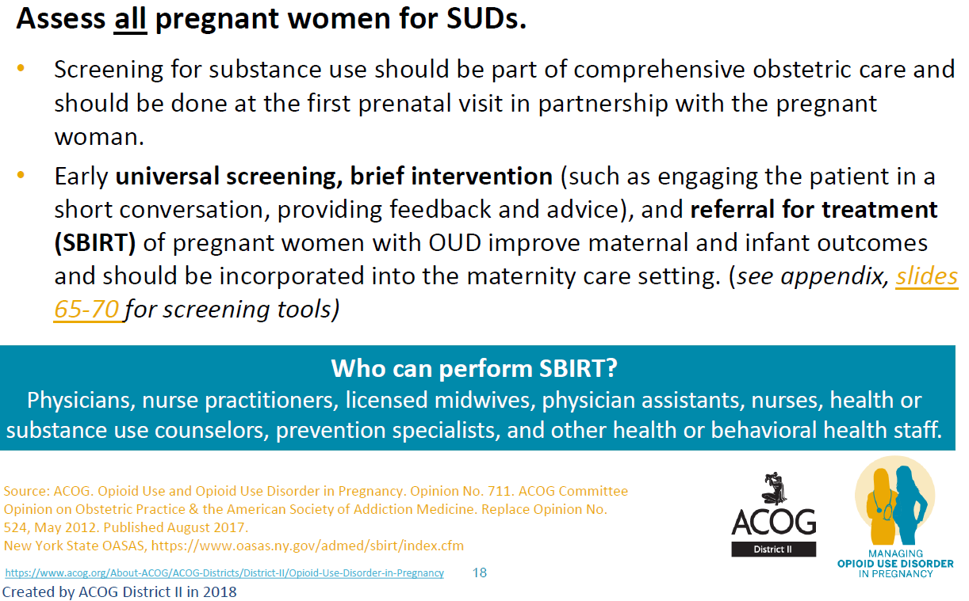
Screening
Notes:
Screening all pregnant woman on all units caring for pregnant women as a part of comprehensive obstetric care.
Early universal screening with a validated tool chosen from the ILPQC toolkit

Slide 28
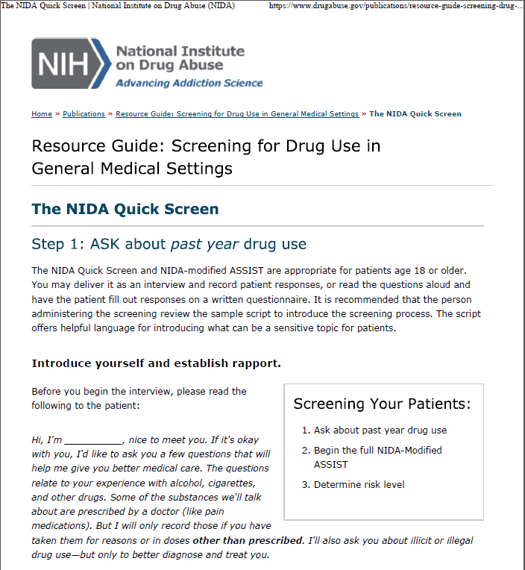
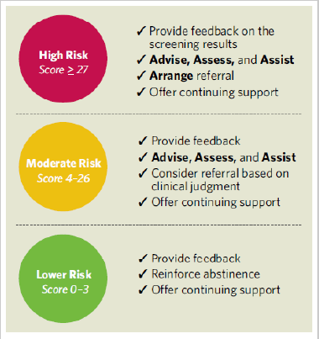
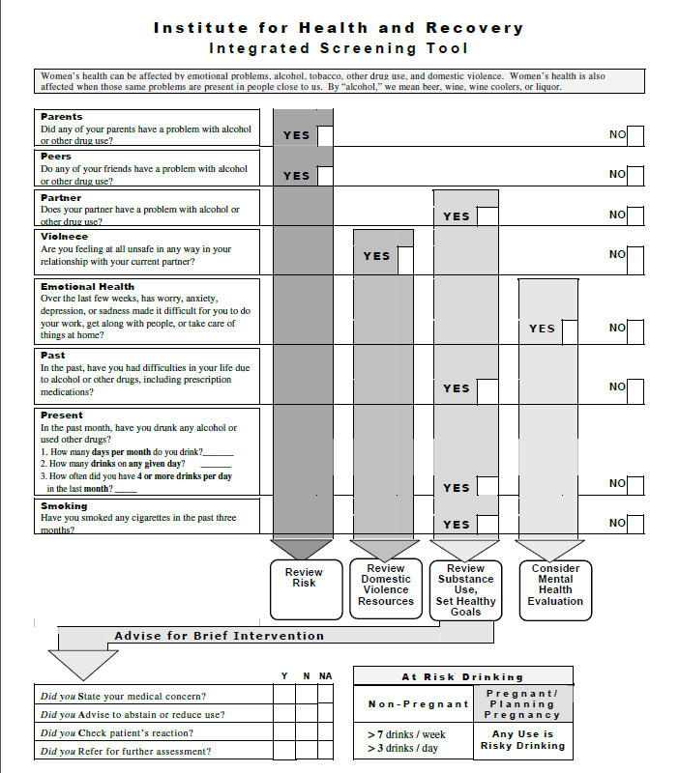
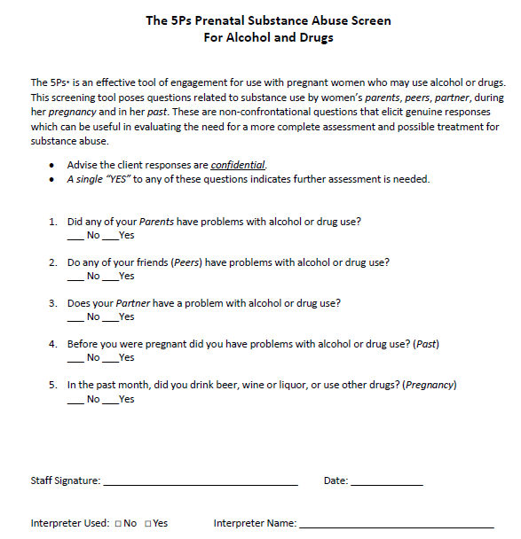
Example Screening Tools
NIDA Quick Screen
5 P’s Screening Tool & Follow-Up Questions*
Institute for Health and Recovery Integrated Screening Tool*
Notes:
Example of tools that are provided in the ILPQC toolkit…need to add info from Daisy’s talks about screening and the tool they used.

Slide 29

Patients who Screen Positive
ALL patients who screen positive for OUD should receive a brief intervention and referral to treatment
Should be administered privately with open-ended discussion and without judgment
Providers can be reimbursed for SBIRT (see ILPQC toolkit for codes)
“Providing written handouts to ALL women can reach those who are afraid to disclose use, but may be at risk/need treatment.”*
*ACOG district II slide set
Notes:
What are we going to do with patient’s who screen positive. Patient’s should be receiving a brief intervention and referral to treatment. Hospitals can be reimbursed for this.

Slide 30
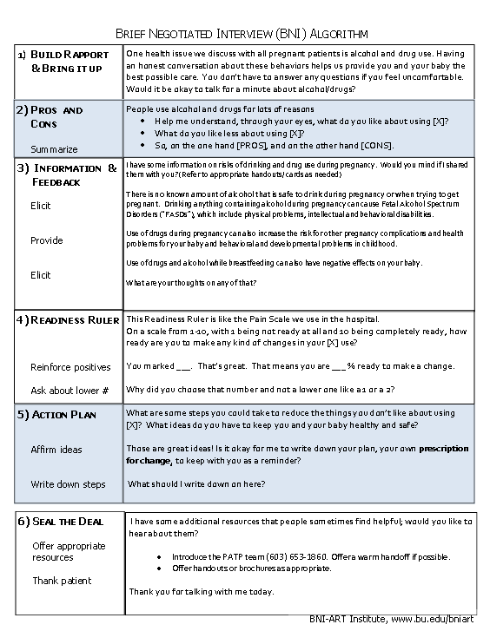
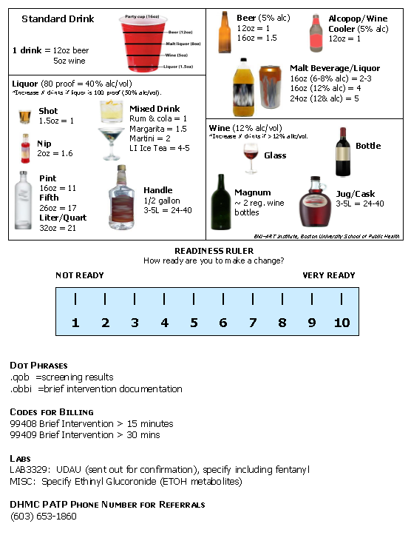
BNI Pocket Card for providers
Courtesy of Caitlin Barthelmes, MPH
Notes:
Pocket care provided by ILPQC (see the toolkit) gives providers a brief script for screen positive patients, also the BILLING CODES to get reimbursed for screening and SBIRT counseling.

Slide 31
Example SBIRT Process
Comprehensive assessment; referral; and linkage to services
Notes:
Sample of the process flow for screening and managing screen positive patients

Slide 32
Notes:
Example of how it might look incorporating screening and brief intervention and referral to treatment.

Slide 33
Outpatient Prenatal Screening
Universal prenatal screening with a brief intervention by a provider requires…
  Selection of screening tool/trauma
  EPIC build to have in EMR
  Training of providers/staff on selected screening tools
Indicate O99.32 Opioid Use Disorder code on problem list
Provision of patient educational materials
Linkage to social work and linkage to MAT / addiction care
  Requires mapping of providers /resources in the area
  Process flow for successfully linking screen positive patients to care
Referral to neonatology for consult/checklist
Delivery plan/checklist with education on pp infant care /engaging mom in care of newborn
Post-partum care plan with a safe discharge
Notes:
These are the key steps

Slide 34
Screening on L&D
Universal L&D screening
  Use of a validated screening tool
  Brief intervention process flow for screen positive
  EPIC build in EMR/Documentation in H&P
  Requires training of providers/staff on screening tool
  Requires training on non-judgmental approach / stigma reduction
  MFM consult for screen positive?
  Neonatology consult/checklist
  Engage social work
  Protocol / checklist for L&D and postpartum care
  Engaging mom in care of newborn: rooming in, breastfeeding, eat-sleep-console
  Safe discharge for babies
  Linkage to care for post-partum
  Provision of patient education information
Notes:
Implementing screening on L&D will take the following key steps – we are making progress on..

Slide 35
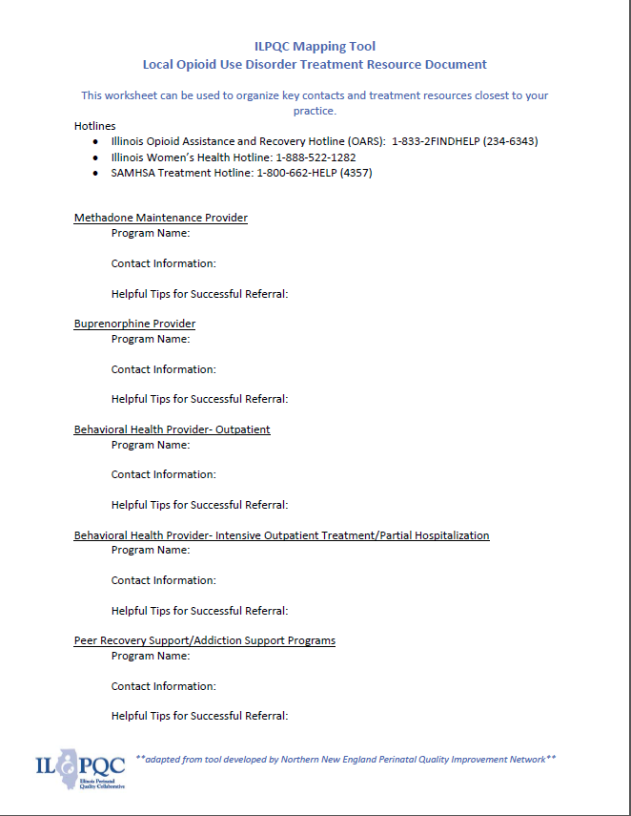

Mapping Local Resources
ILPQC Mapping Tool for local MAT / addiction resources*
IDPH Opioid Use Treatment Resources for Pregnant Women with Medicaid in Illinois
Notes:
We are working on a Mapping Tool to help link screen positive women to needed local resources. We will share the completed Mapping Tool and a process for using it with all outpatient affiliated prenatal clinics / OB offices, the ER and our Labor and Delivery / mom-baby unit.

Slide 36

Helping our Patients
Maintenance
MAT
Map local resources for MAT providers and addiction services.
Establishing process flow to link patients with OUD to care.
Expand the number of Buprenorphine providers
Notes:
Steps to help link screen positive women with OUD to MAT
1) Map local resources for MAT providers and addiction services.
2) Establishing process flow to link patients with OUD to care.
3) Expand the number of Buprenorphine providers

Slide 38


Prenatal-Intrapartum-Postpartum Care for OUD
Example Best Practice Recommendations for Prenatal/Intrapartum/Postpartum Care Complicated by Substance Use Disorders*
Example Checklist for Providers for Prenatal/Intrapartum/Postpartum Care for Pregnant women with substance use disorders*
Example Checklist to optimize prenatal care for women with OUD, Chart template
Notes:
WE need to standardize care with best practice recommendations / protocol and checklist to make sure we provide the optimal care for women with OUD prenatal, labor and delivery and postpartum care settings.

Slide 39
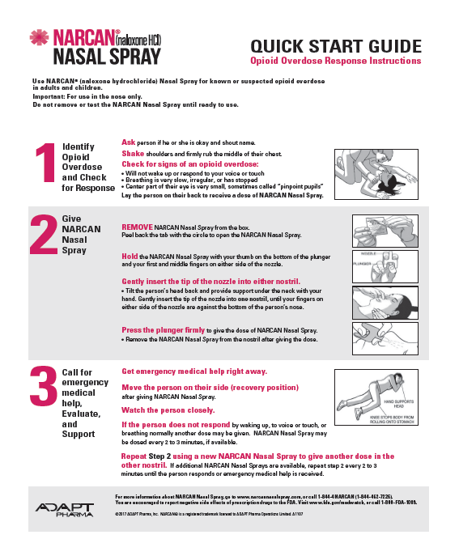
Counseling & Prescribing Naloxone/Narcan
AMA Opioid Task Force Prescribing Naloxone One-Pager*
Naloxone Rescue Kit Consultation Checklist*
Narcan Nasal Spray- Quick Start Guide
Notes:
We will be working on helping providers counsel women with OUD on access to NARCAN as an overdose prevention strategy

Slide 40
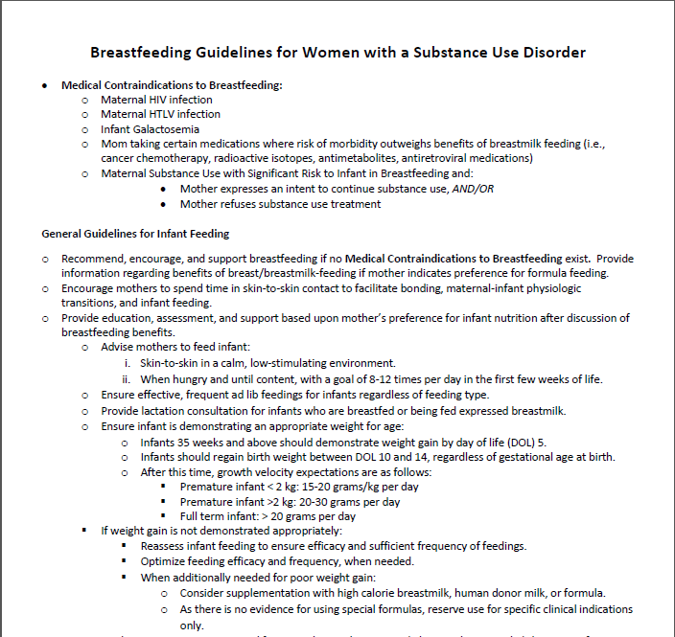

Other Resources to Optimize Care for Women with OUD
Breastfeeding Guidelines for Women with a Substance Use Disorder*
Notes:
The ILPQC toolkit has many patient / provider resources to help take better care of pregnant and postpartum women with OUD

Slide 41

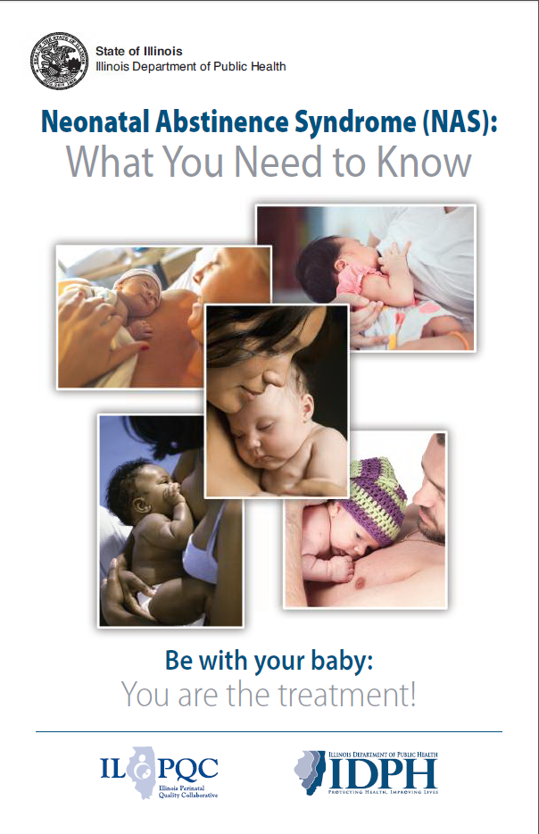
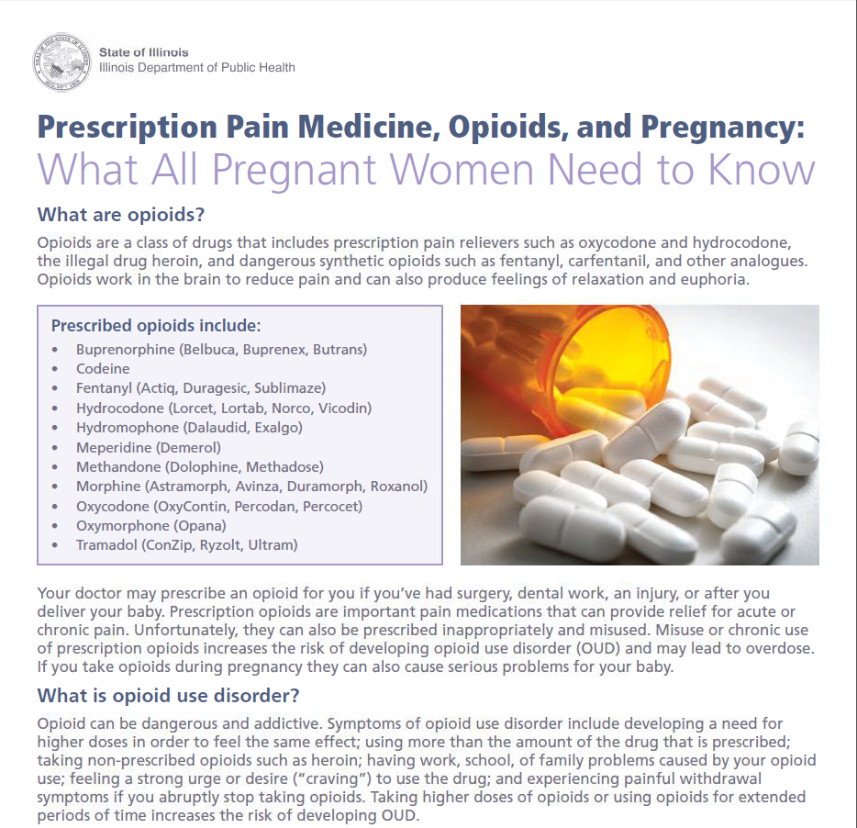
Education Materials for Pregnant Women with OUD
Pregnancy and MAT one-pager
Are you in treatment or recovery
NAS What you need to know one-pager
NAS Booklet
Notes:
We have amazing patient materials that were produced with input from national experts and patients right here in Illinois. Please review these materials and we will be working on a standard plan to make sure all of our pregnant and postpartum patients with OUD have access to these resources. We also have a hand out for all pregnant women to learn about pain medication use in pregnancy / postpartum and risk of NAS and opioid addiction.

Slide 42
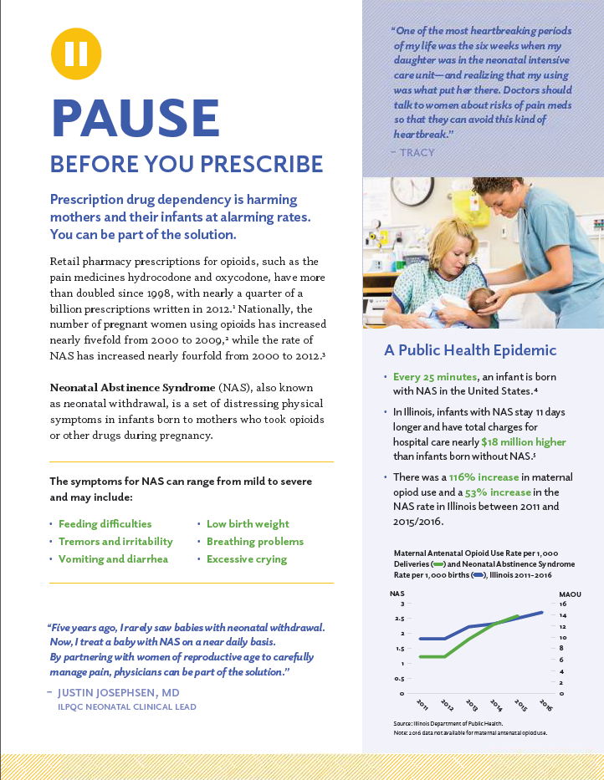
Patient and Provider Education for OUD Prevention
Pain Medication, Opioids and Pregnancy ILPQC Handout*
Pause Before You Prescribe- ILPQC Handout*
Notes:
We have materials to educate providers on risks of prescribing opioids and how they can reduce these risks.

Slide 43
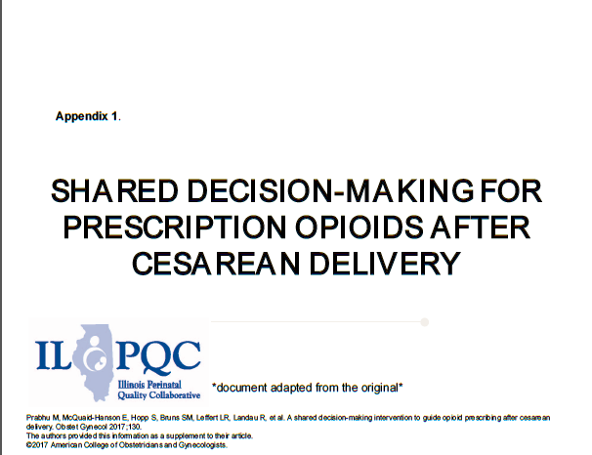
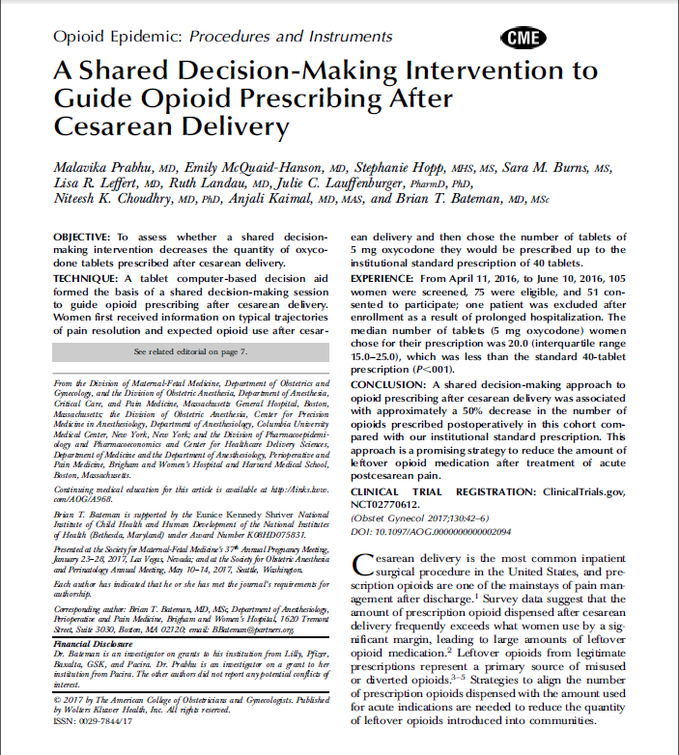
Reduce Opioid Over Prescribing Postpartum
A Shared Decision-Making Intervention to Guide Opioid Prescribing After Cesarean Delivery –article and PowerPoint tool*
Example Enhanced Recovery after Surgery (ERAS) Pathway for Cesarean*
Notes:
In 2019 the initiative will also be focusing on reducing opioid prescribing and prevention of OUD. Resources in the MNO ILPQC toolkit will assist with this process.

Slide 44
Neo Teams: key interventions for Opioid Exposed Newborns
Standardize identification and assessment
Standardize pre-delivery planning with neo/peds consult with mom/family
Increase maternal participation in newborn care
Optimize non-pharmacologic newborn care
Standardize pharmacologic treatment
Develop standard safe discharge plans.
Notes:
Neonatology teams are partnering with MNO –OB teams to standardize and improve care of babies with NAS. An important goal will be increasing maternal / family involvement with non-pharmacologic care of the newborn with NAS (rooming in, Eat-sleep-console, breastfeeding etc)

Slide 45
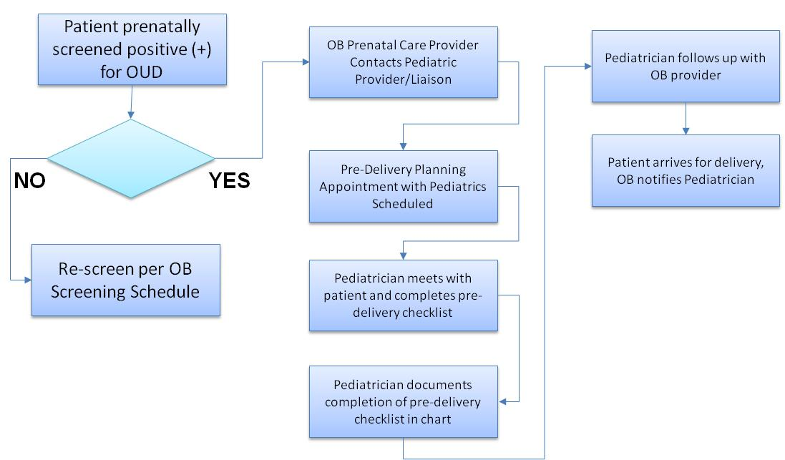
Pre-Delivery Planning
Neo or Pediatric consult Process Flow
Notes:
Here are examples of work the Neo team will be doing around standardizing the Neonatology / pediatric consult for all women with OUD during prenatal care optimally, or on L&D prior to delivery.

Slide 46
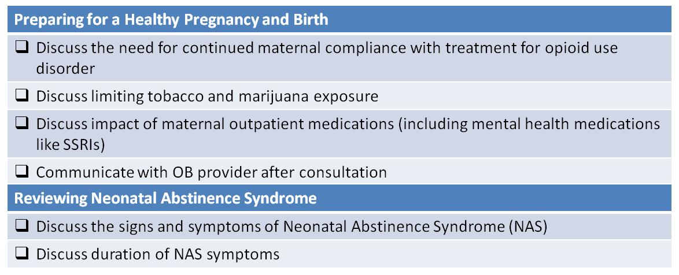
ILPQC MNO Recommended
Prenatal Consultation Guidelines

Slide 47
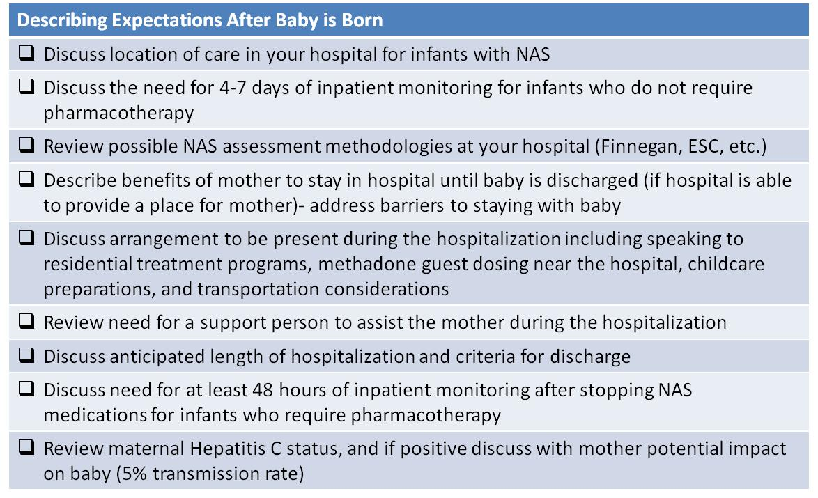
ILPQC MNO Recommended
Prenatal Consultation Guidelines

Slide 48
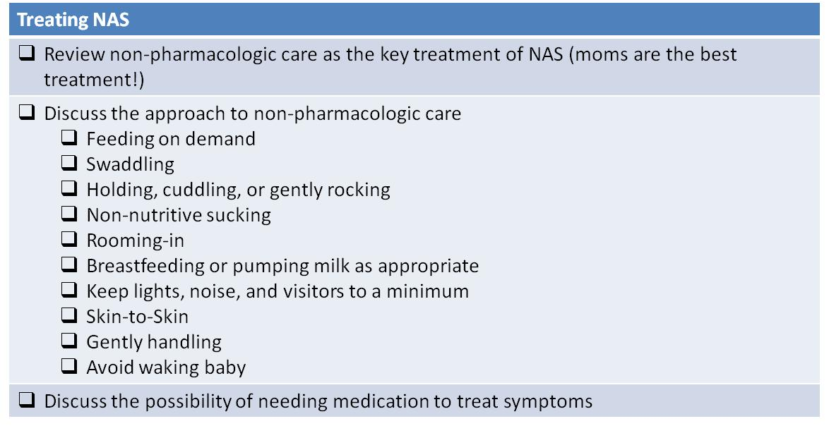
ILPQC MNO Recommended
Prenatal Consultation Guidelines

Slide 49
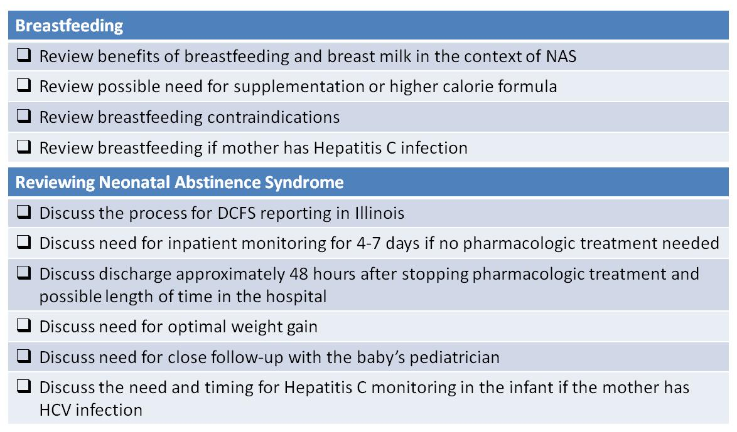
ILPQC MNO Recommended
Prenatal Consultation Guidelines

Slide 50
What data will we be collecting
to track our progress?
Monthly Data tracks improvement across time, can compare to other hospitals
  OB Teams
    All women with OUD collect process outcomes and measures
    Random sample of 10 charts from all deliveries to collect % of patients screened for OUD (prenatal and on L&D)
  Neo Teams
    Collect data on babies with opioid exposure > 36 weeks
  Structure measures to track our QI work: dashboard tracks
    not started OR working on it OR completed implementation
    screening tool and SBIRT implementation, patient and provider education, protocol implementation, mapping resources, process flow, etc.
Notes:
Collecting data will allow us to track progress and compare our progress across time and other hospitals across the state.

Slide 51
Screening and Linkage to Care
Optimizing Care for Moms/Babies
Prevention
OB
PROCESS & OUTCOME MEASURES:
Improve identification of women with OUD and linkage to addiction care
  Percent of mothers with OUD at delivery on medication assisted treatment (MAT) *
  Percent of random sample of women at delivery with documented screening for OUD (% screened prenatal, % screened delivery admission) #
# random sample of 10 charts per month, will submit % with monthly data
* Outcome Measure

Slide 52
Screening and Linkage to Care
Optimizing Care for Moms/Babies
Prevention
OB
STRUCTURE MEASURES (NOW MONTHLY):
Improve identification of women with OUD and linkage to addiction care
  Percent of hospitals / prenatal care sites using validated screening tool and SBIRT protocol for opioid use in pregnancy
  Percent of hospitals and affiliated prenatal care sites with addiction care community resources mapped and linkage to care process flow implemented

Slide 53
Screening and Linkage to Care
Optimizing Care for Moms/Babies
Prevention
OB
PROCESS & OUTCOME MEASURES:
Percent of women with OUD received Narcan counseling / offer documented prenatally or during delivery admission, prior to maternal discharge
Percent of women with OUD received contraception counseling and plan documented prenatally or during delivery admission, prior to maternal discharge?
Percent of women with OUD receiving behavioral health or social work consult documented prenatally or during delivery admission, prior to maternal discharge?
Percent of women with OUD with HIV, Hepatitis B, and Hepatitis C screening completed and documented prenatally or prior to delivery
Percent of women with OUD receiving education on OUD and NAS infant care prenatally or during delivery admission, prior to maternal discharge?
Percent of women with OUD receiving prenatal pediatric consult on OUD/NAS
Percent of mothers with OUD/OEN who roomed together during hospitalization.
Percent of OEN receiving maternal breastmilk at maternal discharge

Slide 54
Screening and Linkage to Care
Optimizing Care for Moms/Babies
Prevention
OB
STRUCTURE MEASURES (NOW MONTHLY):
Percent of hospitals that have implemented standardized protocol and/or checklist for optimal management of patients with OUD during labor and postpartum.
Percent of hospitals that have provided to affiliated prenatal care sites checklist and sample standardized protocols / best practices for optimal prenatal management of women with OUD.
Percent of hospitals that have standardized use of materials for educating pregnant women with OUD regarding: benefits of MAT for OUD, benefits of breastfeeding, and importance of mothers role in NAS newborn care (i.e. pediatric/neonatology consult, patient education materials)
Percent of hospitals that have provided to affiliated prenatal care sites standardized education materials for pregnant women with OUD regarding: benefits of MAT for OUD, benefits of breastfeeding, and importance of mother's role in NAS newborn care (i.e. pediatric/neonatology consult, patient education materials)
Cumulative proportion of providers & nurses educated on OUD care protocols: stigma reduction, screening / SBIRT and process flow for linkage to MAT/ addiction services, importance of mother's role in NAS newborn care, and optimal care for pregnant and postpartum women with OUD.
Percent of hospitals that have established a standardized approach for providing education materials to all pregnant / postpartum patients: pain management expectations and options post- delivery, prescription pain medicine risk of OUD and diversion.

Slide 55
Collaborative Learning & ILPQC Resources

Slide 56
ILPQC helps teams succeed
Opportunities for collaborative learning
  Monthly ILPQC MNO Webinars: learn from other states, learn from other IL hospital teams, share resources
    OB – 4th Monday of each month from 12:30-1:30
    Neonatal – 2nd Monday o f each month from
  Face to Face meetings to share and learn (May / November)
ILPQC REDCap Data System provides real time reports, tracking progress and comparison to other hospitals
Monthly newsletter / website with resources
QI coaching calls to assist in QI strategies
MNO Toolkits for OB teams and for Neo teams
Regional Buprenorphine Trainings for OB providers

Slide 57
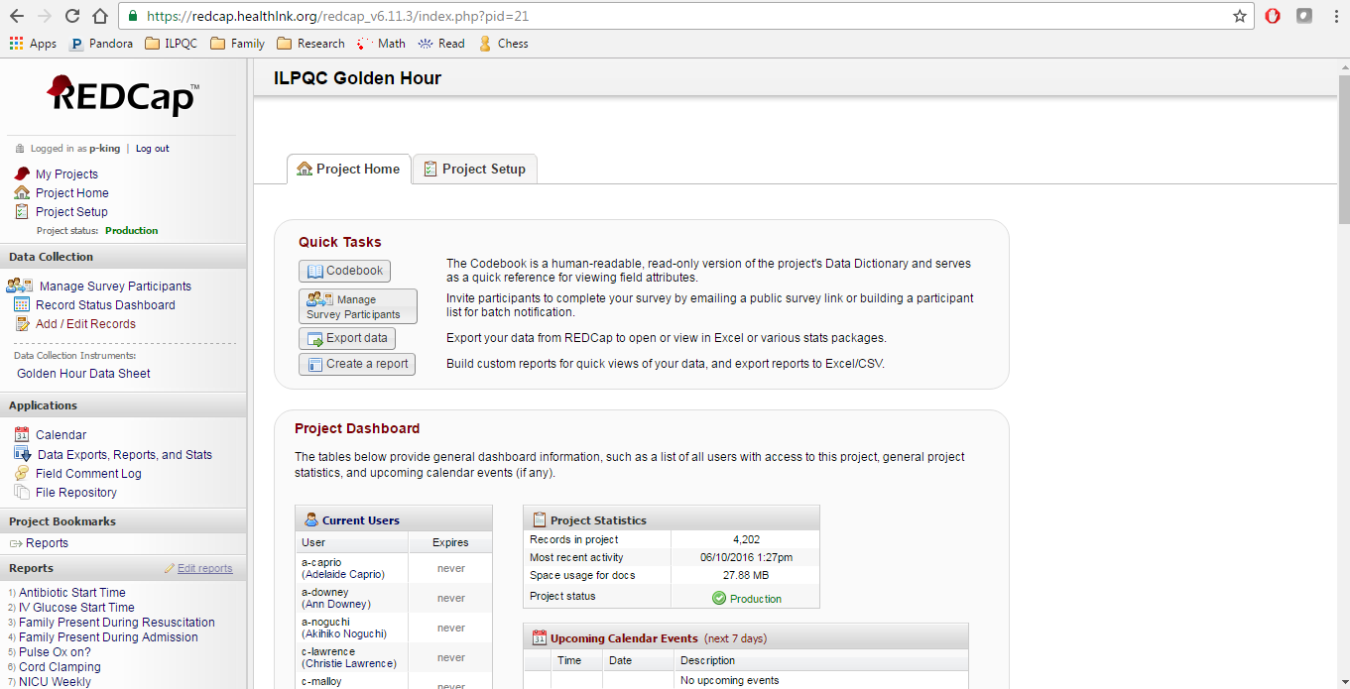
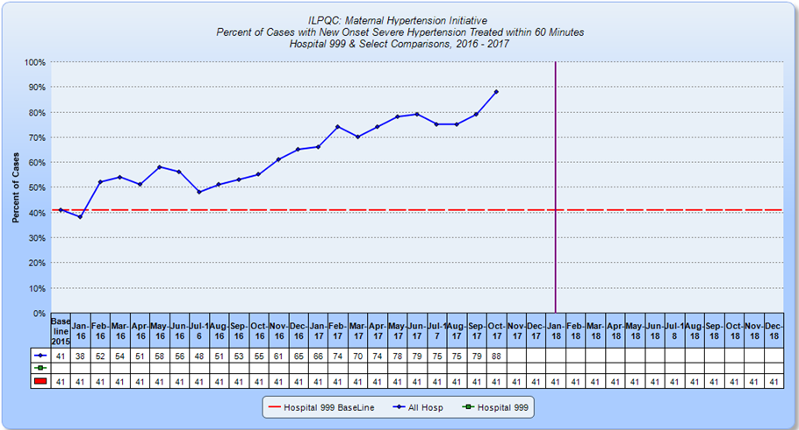
ILPQC Data System
Every team has a secure web portal to access ILPQC REDCap data system
- Teams enter monthly data to receive real time free reports
- Can track progress across time and compare to all participating hospitals
Teams can review their Rapid Response reports on outcome, process and structure measures to compare data across time and across hospitals

Slide 58


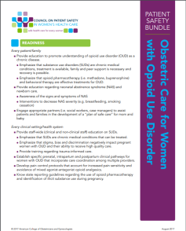
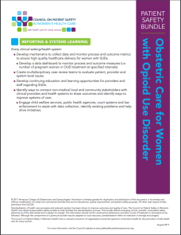
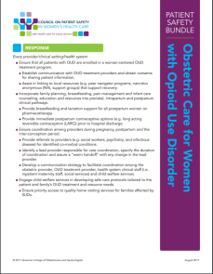
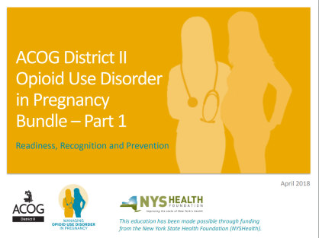
Other Resources:
ILPQC Website: www.ilpqc.org
  MNO Toolkit available online
  Request a Grand Rounds Speaker Presentation
  Monthly MNO Team Calls
Obstetric Care for Women with Opioid Use Disorder AIM Patient Safety Bundle
ACOG District II Opioid Use Disorder in Pregnancy Bundle
https://safehealthcareforeverywoman.org/wp-content/uploads/2017/09/Obstetric-Care-for-OUD_Presentation-9.6.17.pdf
https://www.acog.org/-/media/Districts/District-II/Public/PDFs/ACOG_OpioidUse_Readiness_Recognition_Prevention_FINAL_Updated_POSC_June.pdf?dmc=1&ts=20180619T1807414894

Slide 59



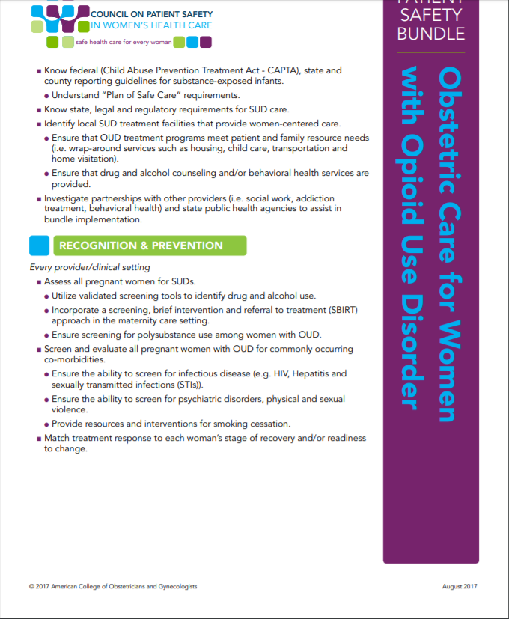
National Guidance:
AIM Bundle
Obstetric Care for Women with Opioid Use Disorder Bundle and Resources Listing*

Slide 60
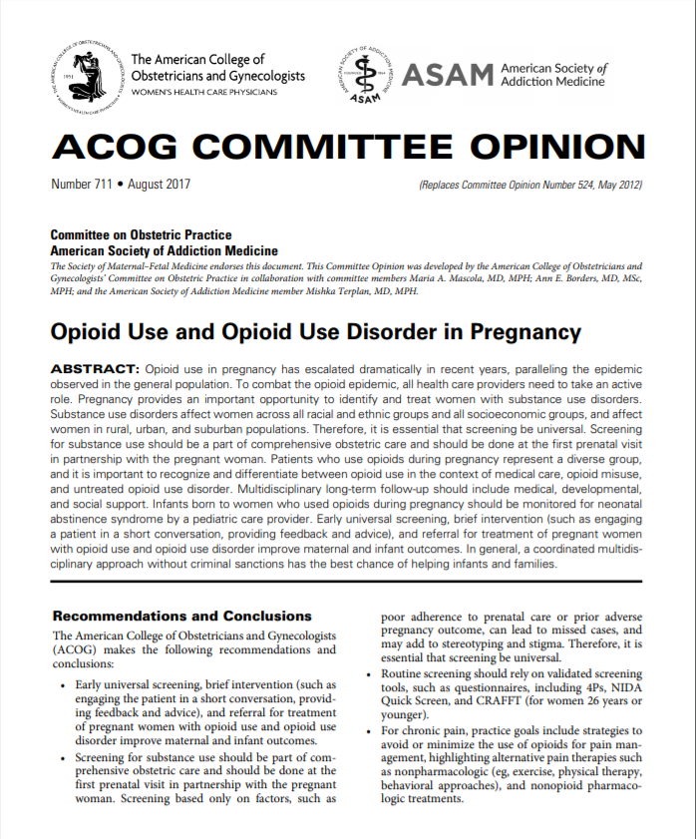
ACOG Committee Opinion
ACOG Committee Opinion #711: Opioid Use and Opioid Use Disorder in Pregnancy*

Slide 61
Conclusion
We have a lot of work ahead,
but we are up for the challenge!
Thank you
Questions/Comments
Email info@ilpqc.org
Visit us at www.ilpqc.org

Slide 62





