Slide 1
ILPQC GOLDEN HOUR
September 29, 2016

Slide 2
Call number
815-348-9071
No pin needed
If you are not speaking please mute

Slide 3
Monthly Topics
Order debrief, admit, family, dr surf
Volunteers – email me
Blog on ILPQC

Slide 4
Agenda
Golden Hour Monthly topic – admission practices
Data quality and timeliness
November meeting

Slide 5
Admission PBP's
Timely glucose
Timely antibiotics

Slide 7
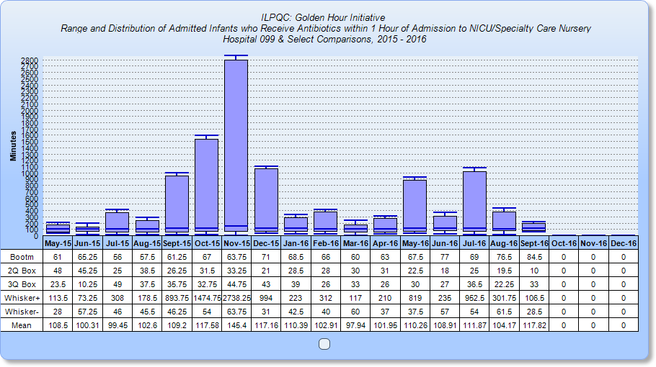

Slide 9
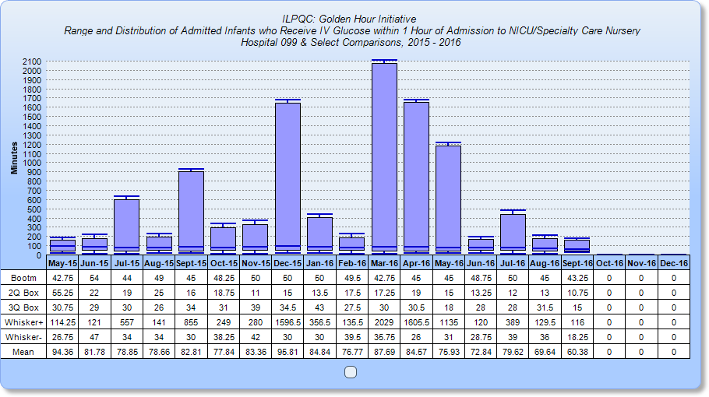

Slide 10
Barriers and Successes
What's the problem
How did you solve

Slide 11
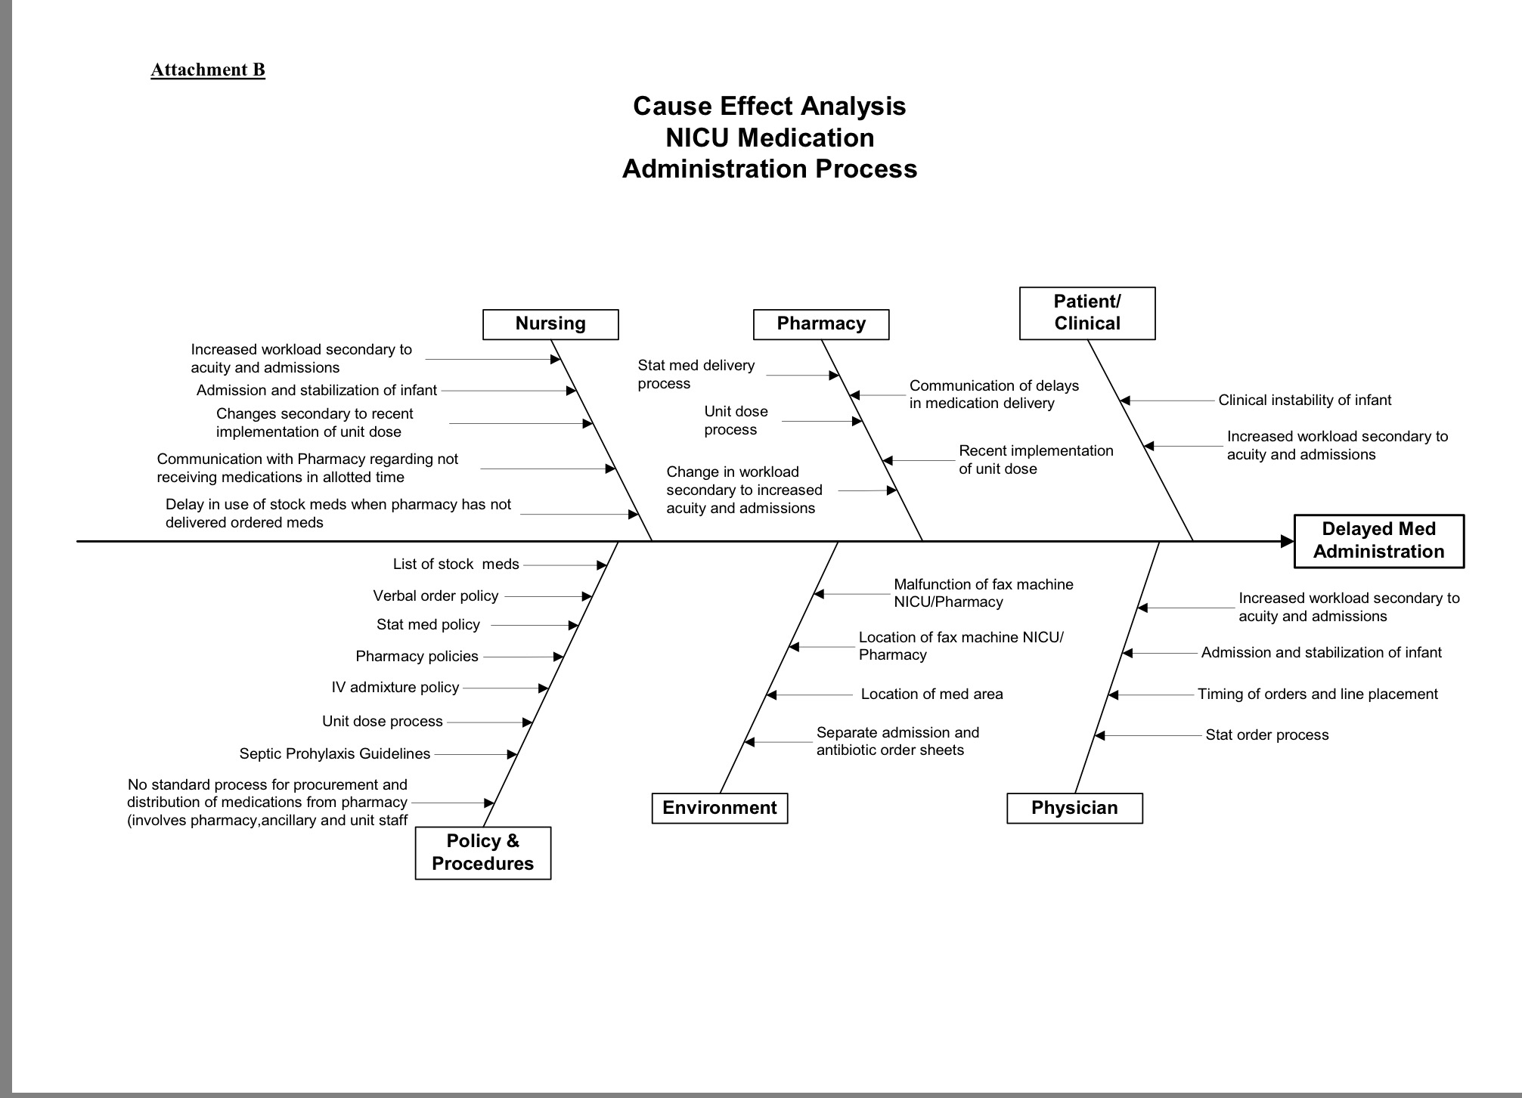

Slide 12
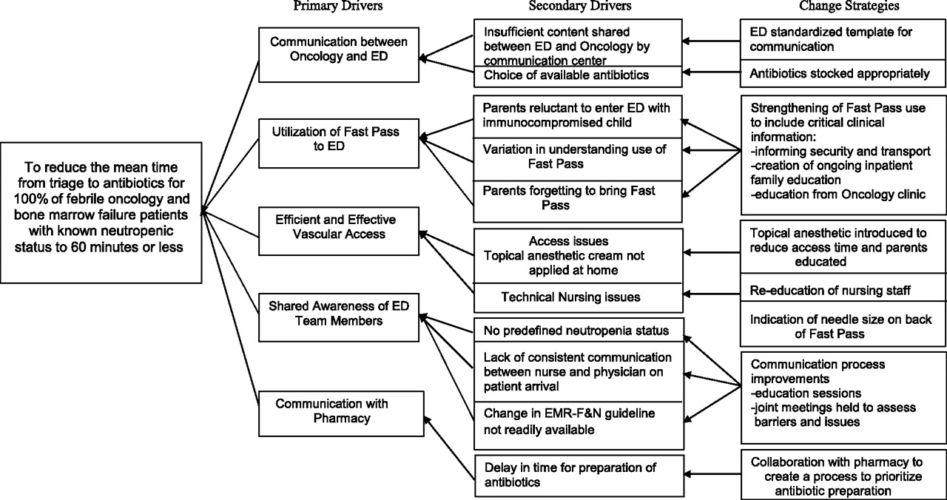

Slide 13
Data
Review your data and share
Check definitions to sure correctly entering
Some centers behind in data entry and some with no data entered

Slide 14
November Meeting
November 3rd
Westin Lombard
All centers expected to bring posters

