Slide 1
ILPQC GOLDEN HOUR
MAY 13 2016

Slide 2
Agenda
Welcome and introductions
Simulation videos
Golden Hour Data review
Golden Hour open forum
Storyboard viewing
Project 2017 discussion
Project 2017 voting

Slide 3
Simulation

Slide 4
November Meeting
Speakers

Slide 5
Golden Hour Data

Slide 6
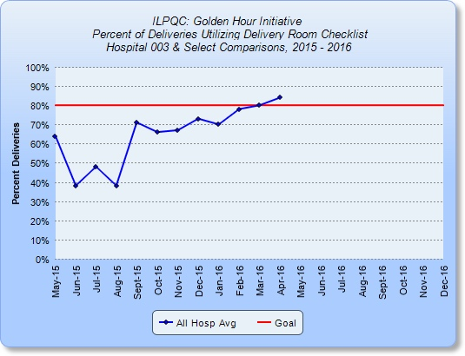
Checklist

Slide 7
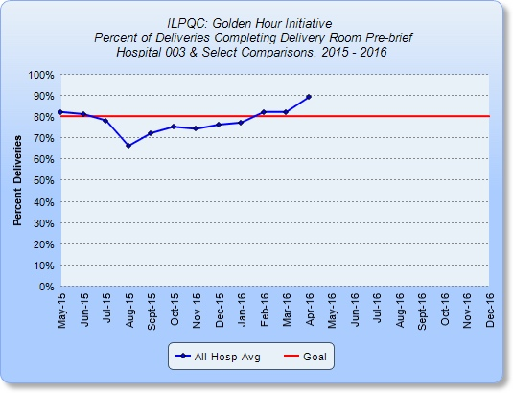
Prebrief

Slide 8
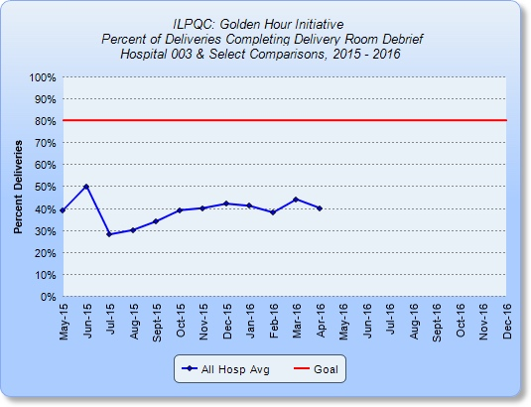
Debrief

Slide 9
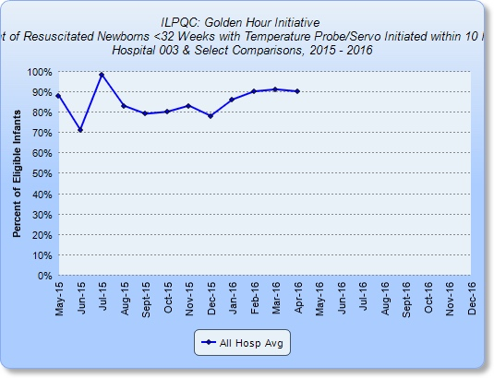
Temp Probe

Slide 10
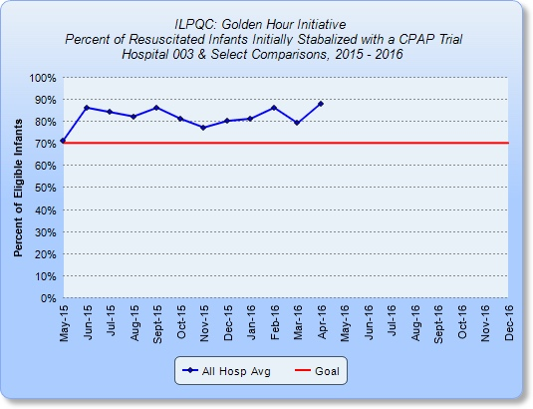
CPAP

Slide 11
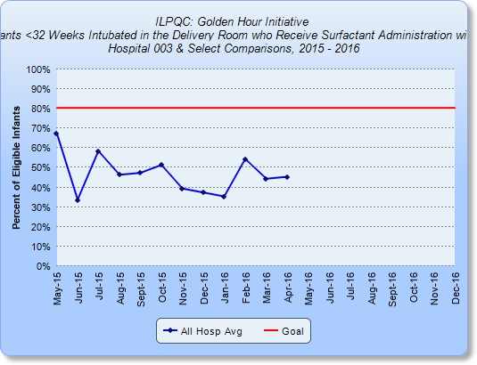
Surfactant

Slide 12
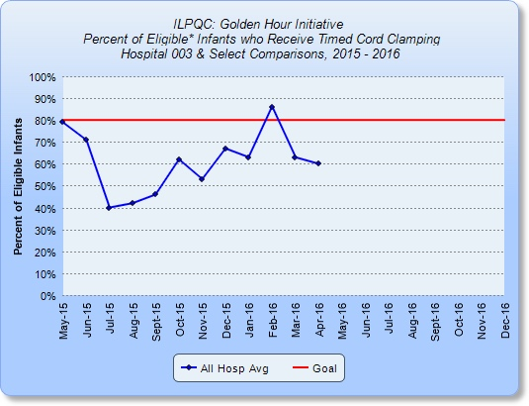
Timed Cord Clamping

Slide 13
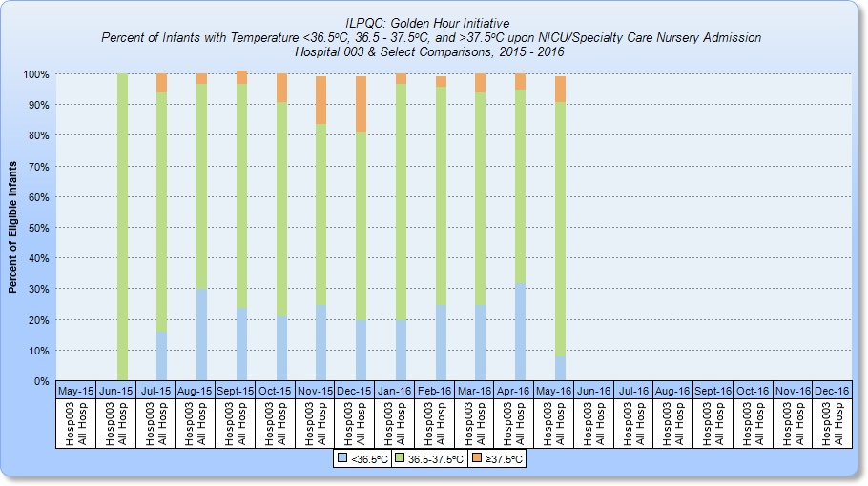
Temperature

Slide 14
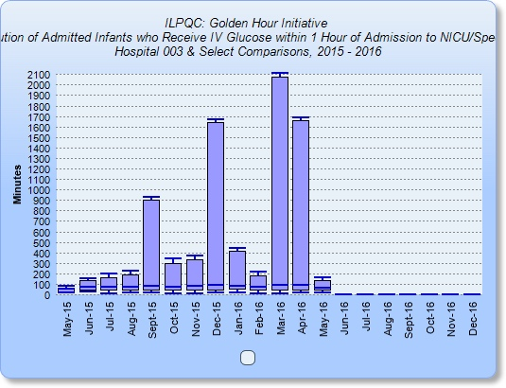
IV glucose

Slide 15
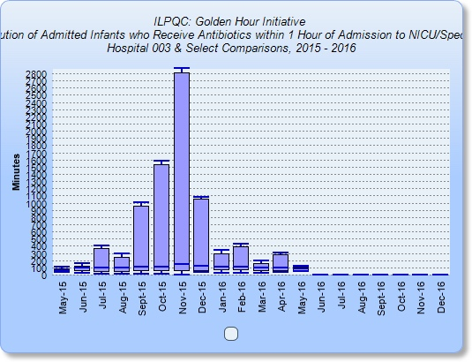
Antibiotics

Slide 16
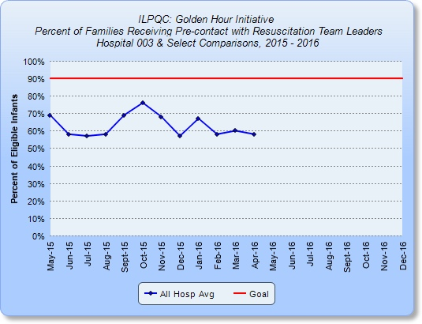
Family pre contact

Slide 17
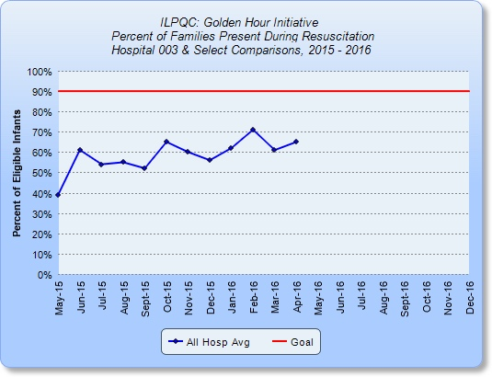
Family at resuscitation

Slide 18
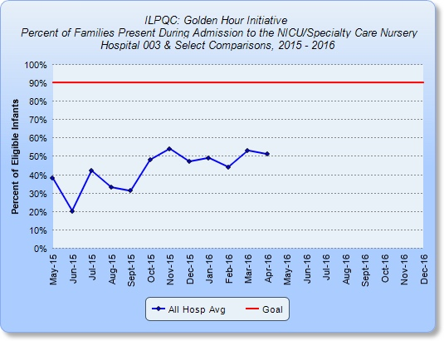
Family admit

Slide 19
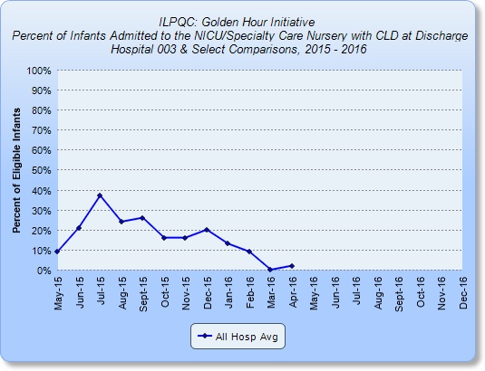
CLD

Slide 20
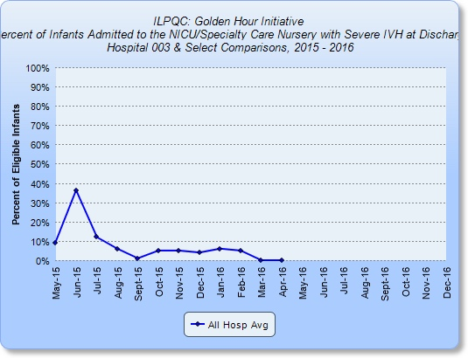
IVH

Slide 21
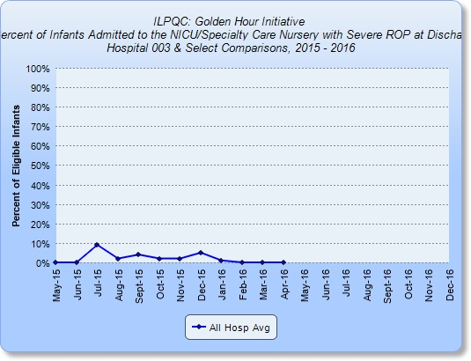
ROP

Slide 22
Discussion and Storyboards

Slide 23
Projects 2017
Family focused Transitions
Survival without Morbidity
NAS
Human Milk
Antibiotic Stewardship

Slide 24
Family Focused Transitions
Peoria

Slide 25
Survival without Morbidity
Northwestern

Slide 26
NAS
Aki

Slide 27
Human Milk
Statewide
Evidence
Builds on Nutrition

Slide 28
Next Steps
Tool kits
Data Sheets

Slide 29
Final Thoughts
VON Posters
November Meeting

