Slide 1
Welcome!
Please use this time before we begin to:
  Set up your storyboard in your level area
  Help yourself to continental breakfast in the corridor
  Restrooms are past the lobby then down the hall to the left
  If you have team members here, please try to sit together

Slide 2

Maternal Hypertension Initiative
Face-to-Face Collaborative Learning Session
May 23, 2016
9:30 am – 3:30 pm

Slide 3
Today’s Participants
293 participants registered
97 hospitals registered
Roll call: physicians, midwives, nurses, quality, public health
Materials check:
  Face to Face Folder
  ILPQC HTN Initiative Toolkit Binder
  Preeclampsia Patient Education tear pads

Slide 4
Agenda
9:30 – 9:45 am ILPQC Maternal Hypertension Initiative: What Are We Trying to Accomplish? (Ann Borders)
9:45 – 10:35 am Improving Healthcare Response to Maternal Hypertension: The CMQCC (California) Preeclampsia Collaborative (Larry Shields)
10:35 – 11:05 am The AIM HTN Bundle 101: Key Steps for Implementation (Nancy Peterson)
11:05 – 11:30 am Understanding QI Strategies for Bundle Implementation (Patti Lee King)
11:30 am – 12:30 pm Team Storyboard and Process Flow Presentations & Viewing (All Participants)
12:00 – 12:45 pm Lunch and Networking (All Participants
12:45 – 1:15 pm Accurate Measurement of Blood Pressure & Other Strategies for Success (Nancy Peterson)
1:15 – 2:35 pm Small Group Implementation Cafés (All Participant)
2:35 – 3:00 pm Strategies for Data Collection & Using Your Data to Drive Quality Improvement (Patti Lee King, Kate Finnegan)
3:00 – 3:30 Next Steps & Wrap-up Panel (Ann Borders, Larry Shields, Patti Lee King)

Slide 5
Today’s Presenters
Ann Borders, ILPQC OB Lead & Executive Director
Larry Shields, Director of Maternal Fetal Medicine, Marian Regional Medical Center, Santa Maria, California
Nancy Peterson, Director of Perinatal Outreach and Clinical Program Manager, California Maternal Quality Care Collaborative
Patti Lee King, ILPQC State Project Director
Kate Finnegan, ILPQC Project Coordinator

Slide 6

ILPQC Vision
A statewide perinatal quality collaborative that involves all perinatal stakeholders; utilizes
data-driven, evidence-based practices; improves perinatal quality resulting in improved birth outcomes, improved health for women and infants, and decreased costs; builds on Illinois’ existing state-mandated Regionalized Perinatal System, and operates with long-term sustainable funding.

Slide 7

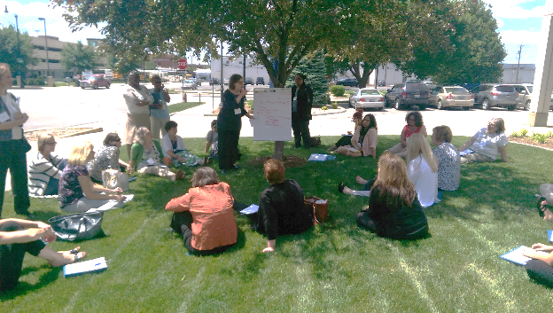


Working Together on
State-wide Initiatives

Slide 8

Hospital Engagement
109 hospitals participating in one or more ILPQC Initiative
107 hospitals in OB Initiatives
  Over 95% of IL births covered by ILPQC
26 hospitals in Neonatal
Initiative
  Over 85% of IL NICU beds covered by ILPQC

Slide 9


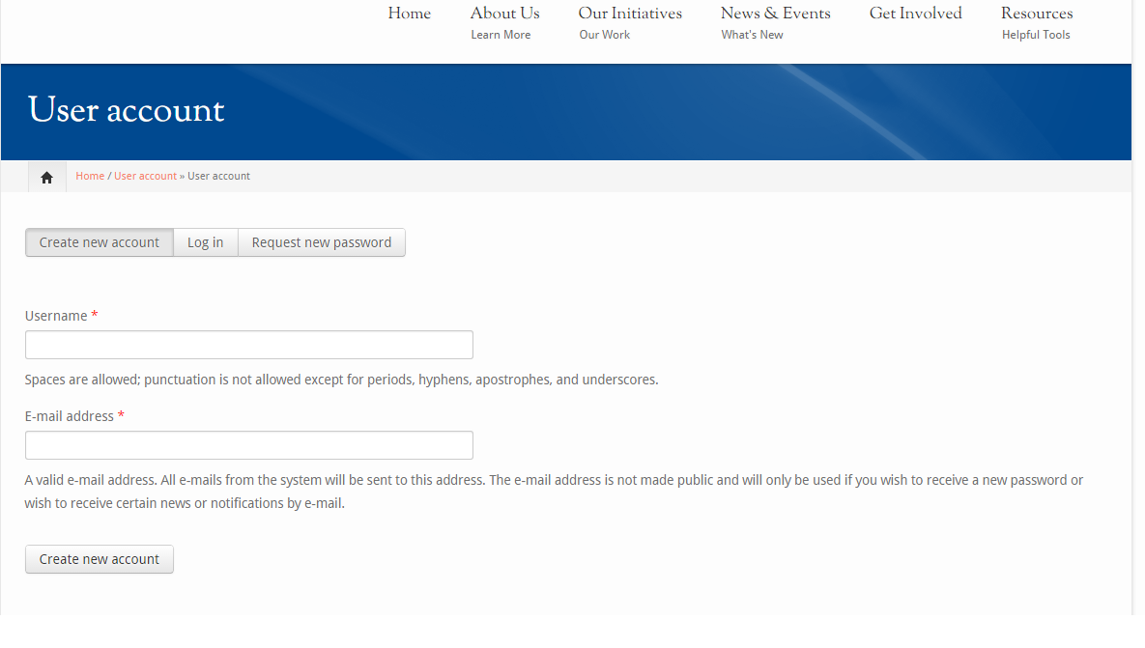
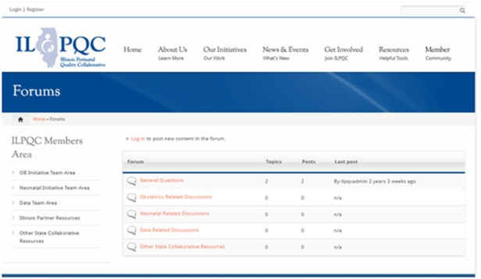
www.ilpqc.org
Includes initiative resources and members-only area to collaborate via discussion boards

Slide 10

ILPQC Maternal
Hypertension Initiative
Aim: Reduce the rate of severe morbidities in women with severe preeclampsia, eclampsia, or preeclampsia superimposed on pre-existing hypertension by 20% by December 2017
Approach: Established workgroup (1/2015), identify hospital teams (5/2016), implement evidence-based practices / protocols / AIM HTN Bundle (6/2016-12/2017)
OB Advisory Workgroup and HTN Clinical Leadership Team developed process/outcome measures, toolkit/education, data form and reports
  Input from IDPH SQC / Perinatal Network Administrators / AIM Initiative / CA, NY, and NC collaboratives
  Launched Wave 1 in January 2016, Wave 2 May 2016 – TODAY!

Slide 11
ILPQC HTN:
Proposed Timeline 2016
 | Activity | 11/15 | 12/15 | 1/16 | 2/16 | 3/16 | 4/16 | 5/16 | 6/16 | 7/16 | 8/16 | 9/16 | 10/16 | 11/16 | 12/16
Wave 1 | Launch initiative at ILPQC annual meeting
 | Wave 1 Teams calls
 | Test data collection process and implementation, collect baseline data
 | Wave 1 feedback
Wave 2 | Enroll Wave 2 teams
 | 2-hour educational webinar for all teams – May 2, 12:30-2:30
 | Face-to-face meeting to launch QI work – May 23, 10am – 3:30
 | Monthly data collection/team calls (June 2016-Dec 2017)

Slide 12
ILPQC HTN Initiative
Goal & Measures
Goal: Reduce preeclampsia maternal morbidity
IL Measure | Type | Goal
Severe Maternal Morbidity No. of women with severe maternal morbidities (e.g. Acute renal failure, ARDS, Pulmonary Edema, Puerperal CNS Disorder such as Seizure, DIC, Ventilation, Abruption) / No. pregnant & postpartum women with new onset severe range HTN | Outcome | 20% reduction
Appropriate Medical Management in under 60 minutes No. of women treated at different time points (< 30,60,90, >90 min) after elevated BP is confirmed / No. of women with new onset severe range HTN | Process | 100%
Debriefs on all new onset severe range HTN* cases | Process | 100%
Discharge education and follow-up within 7-10 days for all women with severe range HTN, 72 hours with all women with severe range HTN on medications | Process | 100%
Severe range HTN: ≥160 systolic / ≥110(105) diastolic per hospital standard
*New onset severe range HTN: first episode of persistent severe range HTN (lasting >15 minutes) in a hospitalization (ER, L&D, or other inpatient setting), can be chronic HTN, gestational HTN, preeclampsia and/or postpartum diagnosis.

Slide 13
What data are we collecting?
Collect data all patients with severe range BP
  Time to treatment, patient outcome, discharge patient education and timely follow up scheduled
Identify all patients with severe range BP
  Bedside data collection to collect data on time to treatment and debrief
  Chart abstraction to confirm all pts identified, outcome and discharge data (education & F/U)
Baseline data due July 15: Oct, Nov, Dec 2015
Monthly data: due by the 15th of the following month

Slide 14
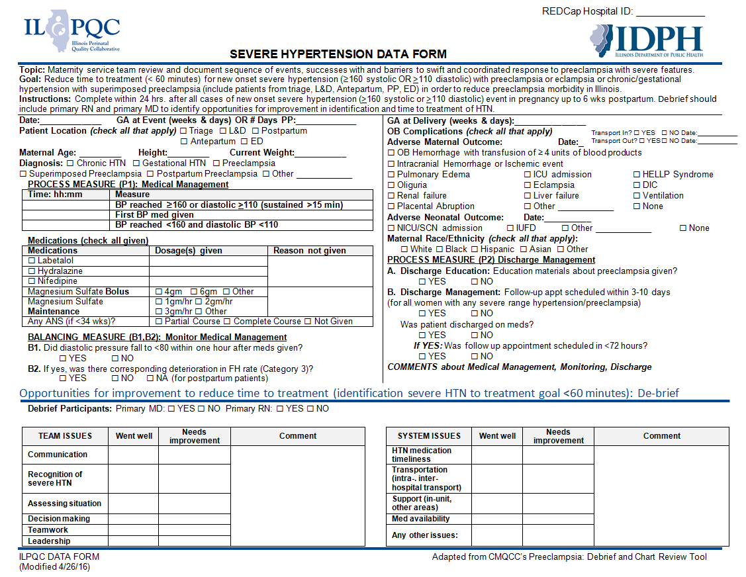

Slide 15
What are we trying to accomplish?
Early recognition of hypertension and correct diagnosis during and after pregnancy
Reduce time to treatment of severe range blood pressure, 160/110(105)
Deliver not too early and not too late
Provide patient education and appropriately timed follow up
Implementation of evidence based protocols
Notes:
First and foremost, early recognition of hypertension in pregnancy is vital to managing the potential impacts. Blood pressure must be treated and guidelines have been established including treating within one hour of confirmed readings. Magnesium sulfate is not a blood pressure medication, it is for seizure control and is recommended for use in preeclampsia with severe features local protocols need to be developed and followed. Women with hypertension in pregnancy require close follow up and the full HIP toolkit provides recommendations for all women postpartum. There is a two-sided one page document in the HIP toolkit that you may find helpful in assuring that you utilize elements of the Patient Safety Bundle developed by ACOG, SMFM, AWHONN, and others for readiness, recognition, response and reporting.

Slide 16


Key Clinical Pearl:
160/110 vs. 160/105
Controlling blood pressure
is the optimal intervention
to prevent deaths due to stroke
in women with preeclampsia.
The critical initial step in decreasing maternal morbidity and mortality is to administer anti-hypertensive medications as soon as possible (< 60 minutes) of documentation of persistent (retested within 15 minutes) BP ≥160 systolic, and/or >105-110 diastolic

Slide 17
Need
To
Treat*
BP ≥
160/110(105)
*BP persistent 15 minutes, activate treatment algorithm with IV therapy ASAP, < 30-60 minutes

Slide 18
Key Driver Diagram: Maternal Hypertension Initiative
GOAL: To reduce preeclampsia maternal morbidity in Illinois hospitals
Interventions
Key Drivers
Implement standard order sets and/or algorithms for early warning signs, diagnostic criteria, timely triage, monitoring and treatment of severe hypertension
Ensure rapid access to medications used for severe hypertension with guide for administration and dosage
Implement system plan for escalation, obtaining appropriate consultation, and maternal transport
Perform regular simulation drills of severe hypertension protocols with post-drill debriefs
Integrate severe hypertension processes (e.g. order sets, tracking tools) into your EHR
AIM: By December 2017, to reduce the rate of severe morbidities in women with preeclampsia, eclampsia, or preeclampsia superimposed on pre-existing hypertension by 20%
Readiness: Implementation of standard processes for optimal care of severe maternal hypertension in pregnancy
Recognition: Screening and early diagnosis of severe maternal hypertension in pregnancy
Standardize protocol for measurement and assessment of blood pressure and urine protein for all pregnant and postpartum women
Standardize response to early warning signs including listening to and investigating symptoms and assessment of labs
Implement facility-wide standards for patient-centered education of women and their families on signs and symptoms of severe hypertension
Educate OB, ED, and anesthesiology physicians, midwives, and nurses on recognition and diagnosis of severe hypertension that includes utilizing resources such as the AIM hypertension bundle and/or unit standard protocol
Response: Care management for every pregnant or postpartum woman with new onset severe hypertension
Execute facility-wide standard protocols for appropriate medical management in under 60 minutes
Create and ensure understanding of communication and escalation procedures (e.g. implementing a rapid response team through the use of TeamSTEPPS)
Develop OB-specific resources and protocols to support patients, families, staff through major complications
Provide patient-centered discharge education materials on preeclampsia and postpartum preeclampsia
Implement patient protocols to ensure follow-up within 7-10 days for all women with severe hypertension and 72 hours for all women on medications
Reporting/Systems Learning: Foster a culture of safety and improvement for care of women with new onset severe hypertension
Establish a system to perform regular debriefs after all new onset severe hypertension cases
Establish a process in your hospital to perform multidisciplinary systems-level reviews on all severe hypertension cases admitted to ICU
Continuously monitor, disseminate, and discuss your monthly data in ILPQC REDCap system at staff/administrative meetings
Add maternal hypertension assessment and treatment protocols and education to provider and staff orientations, and annual competency assessments

Slide 19
Where to start?
Staff education and standardized BP measurement
Rapid access to medications
IV treatment of BP’s ≥ 160mmHg systolic or ≥ 110(105) mmHg diastolic within 1 hour
Uniform policy for magnesium sulfate
Early postpartum follow-up
Standardized postpartum patient educational materials.

Slide 20
What should your team do?
Monthly Team Call (all teams members)
  We will discuss data & QI strategies for HTN bundle implementation, review HTN education topic and share Team Talks (teams across IL share progress, barriers and successes)
Submit baseline, then monthly data into RedCap
  You will be able to track your progress across time and compare to over 100 hospitals in initiative on reducing time to treatment for severe range BP
Schedule regular meetings with your HTN Team
  Review your data, identify opportunities for improvement, use ILPQC resources and drive QI

Slide 21
ILPQC Maternal Hypertension:
Toolkit Binders
Each team participating in ILPQC Maternal Hypertension Initiative will receive a Toolkit Binder and CD
Binders contain materials to assist in implementation of the AIM Bundles
  IDPH letter, ACOG HTN in Pregnancy Executive Summary, ILPQC HTN in Pregnancy Comprehensive Slide Set
  Sample protocols, order sets, check lists, treatment algorithms, drills, simulations, debriefs, patient education

Slide 22
HTN Preeclampsia Tear Pad
Distribution
English / Spanish on back
Preeclampsia Foundation
Enough tear pads for a years supply for each participating hospital
See your Perinatal Network Administrator for plan to get your hospitals tear pads

Slide 23
MOC Credits
The ABOG MOC standards now allow participation in ABOG-approved Quality Improvement Projects to meet the annual Improvement in Medical Practice (Part IV) MOC requirements.
The “Illinois Perinatal Quality Collaborative (ILPQC) Maternal Hypertension Quality Improvement Initiative” has been approved to meet ABOG Part IV Improvement in Medial Practice MOC Requirements for 2016 and 2017.
  The activity has been approved from February 19, 2016 through December 31, 2017, or the length of the activity, whichever is shorter.
For further information, review the 2015 MOC Bulletin at http://www.abog.org/bulletins/MOC2016.pdf.

Slide 24
Improving Healthcare Response to Maternal Hypertension: The CMQCC (California) Preeclampsia Collaborative
Larry Shields, MD
Director of Maternal Fetal Medicine, Marian Regional Medical Center,
Santa Maria, California

Slide 25
The AIM HTN Bundle 101: Key Steps for Implementation
Nancy Peterson, MSN, RNC-OB, PNNP, IBCLC
Director of Perinatal Outreach and Clinical Program Manager, California Maternal Quality Collaborative

Slide 26
Understanding QI Strategies for Bundle Implementation
Patti Lee King, PhD, MSW
State Project Director, Illinois Perinatal Quality Collaborative

Slide 27
11 Steps to getting started with the
ILPQC Maternal HTN Initiative
Initiate monthly team meetings & make plans to be on ILPQC monthly team calls
Develop ILPQC data collection strategies (baseline/ongoing)
Complete the Data Use Agreement
Submit the AIM Baseline Survey and Implementation Checklist
Diagram your process flow for severe HTN management
Identify opportunities for improvement
Review Toolkit Binder for resources
Develop your first PDSA with your team
Outline 30, 60, 90 day implementation plan
Identify strategies for implementing debriefs
Ask for help and celebrate small successes

Slide 28
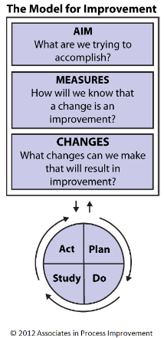
Institute for Healthcare Improvement (IHI)
Model for Improvement
Langley GL, Moen R, Nolan KM, Nolan TW, Norman CL, Provost LP. The Improvement Guide: A Practical Approach to Enhancing Organizational Performance (2nd edition). San Francisco: Jossey-Bass Publishers; 2009.
Notes:
The model of improvement is three questions.

Slide 29
AIM: What are we trying to accomplish?
By December 2017, to reduce the rate of severe morbidities in women with preeclampsia, eclampsia, or preeclampsia superimposed on pre-existing hypertension by 20%
Notes:
SMART AIMS
Specific, Measureable, Actionable, Relevant, Time bound
Initiative Aim, It’s smart because:
Specific: focusing on women with preeclampsia, eclampsia, or preeclampsia superimposed on pre-existing hypertension
Measureable: 20% reduction, we can measure over the course of the initiative through our outcome measure and retrospectively with state hospital discharge data
Achievable – CMQCC Preeclampsia Collaborative achieved at 40-50% reduction
Relevant – Per Ann and Larry’s talks at the start of the meeting we can see that reducing severe morbidities associated with severe hypertension is of local and national importance
Timebound: want to do this by December 2017
The question for your improvement work is how can you get your hospital’s severe maternal morbidies associated with severe hypertension down 20%?

Slide 30
MEASURES: How will we know that a change is an improvement?
Outcome
What are your results towards your aim?
Process
How do you achieve your aim?
Balancing
Are there unintended consequences?
Severe maternal morbidity
Time to treatment
Patient discharge education and follow up
Debrief
Hypotension
Fetal heart rate deterioration
Notes:
3 types of measures, outcome, process, and balancing.
Measures tell your team whether the changes you make lead to improvement

Slide 31
CHANGES: What changes can we make that will result in improvement?
  How can you get your hospital’s severe maternal morbidities associated with severe hypertension down 20%?
  Early recognition of hypertension and correct diagnosis during and after pregnancy
  Reduce time to treatment of severe range blood pressure, 160/110(105)
  Deliver not too early and not too late
  Provide patient education and appropriate follow up
  Implement evidence based protocols

Slide 32
Tools to Identify Opportunities for Change
Process Flow Diagram
Implementation Checklist

Slide 33

Identify Possible Changes
  Think Creatively
  Brainstorm with your QI team
  Collect ideas from all providers and staff who are a part of the identification and treatment of severe hypertension
  Adapt known good ideas
  Read the toolkit binder and professional literature
  Network with other hospitals
  Look at the Key Driver Diagram
  Look at your process flow map again
  Identify opportunities within the gaps

Slide 35
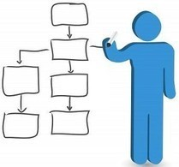
Use Your Process Flow Diagram to Identify
What is the current process for blood pressure measurement and recording?
When and how is the provider contacted when severe range blood pressure is identified?
How is severe range blood pressure treated?
How is care coordinated between
Units (L&D, PP, ED, ICU)
What steps are missing?
Where repetition is occurring?
Are the right people performing the right tasks?
Adapted from OPQC.

Slide 36
Implementation Checklist
14 item assessment of what bundle components you do or don’t have in place at your hospital
Complete at:
  May 2016 (Implementation Baseline)
  Quarterly for the duration of the initiative
Responses highlight opportunities:
  For change at the hospital level
  For QI support and resources at the collaborative level
Implementation checklist adapted from the tool developed by
IHI for implementation of the AIM bundles in Louisiana.

Slide 37
Tool to Test Changes
Plan Do Study Act (PDSA Cycles)

Slide 38
Institute for Healthcare Improvement (IHI)
Model for Improvement
Notes:
The model of improvement is three questions.

Slide 39
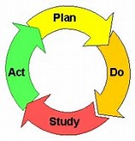
Plan...Do...Study...Act
Plan the test
  What is the objective of the test? population?
  What tasks are necessary in order to conduct the test?
  Develop the action plan of tasks – who, when, what, when where?
  How will you measure the impact of the test?
  What do you predict will happen?
Do--test the change
  Carry out the plan
  Document problems and unexpected observations
Study the results of the test
  What were the results from the test?
  Were there any unexpected observations?
  Was your prediction correct?
  What do you need to do next?
Act on your results
  Adapt – do you need to make revisions & re-test?
  Adopt – do you need to scale up a successful test?
  Abandon – did your test fail but you were able to learn from it?

Slide 40


What is a PDSA?
Sequential small test of change
A small change put into effect on a temporary basis and to learn about its impact
It is NOT:
Data collection
Implementing a solution
Rolling out an educational program
Getting a form, policy, procedure approved by the official committees

Slide 41

Key Points for PDSAs
  Power of 1: Do initial PDSAs on smallest scale possible
  Test under as many conditions as possible as you move to implementation, anticipating naysayers
  Always identify the hypothesis before testing the change to refine prediction and learn from failure
  Use a “study measure” specific to the PDSA, not one of initiative measures, including qualitative measures
Notes:
Conduct the test with
one day
one physician
one patient
Narrative: Did we mention to start small? The “big” part of your thinking will go into the 3 questions for the Model for Improvement. Think long and hard about your aim, measures and change idea. Be as specific as you can be. Then, start a small PDSA.

Slide 42
Possible opportunities for change from CMQCC experience
  Lack of knowledge of BP parameters
  Magnesium Sulfate given instead
  MD Disagrees with BP Parameters
  MD Preference for oral medications instead of IV
  Competing priorities (i.e. ultrasounds, labs, magnesium sulfate administration)
  RN reluctant to give IV meds
  Unable to access meds within 60 minutes
  Fear of hypotension
  MD not available
Notes:
Completed based on PDSA example, reference availability of worksheet as tool for teams developing their own PDSA Cycles

Slide 43

PDSA example: Improving access to IV HTN education on unit
After completing their process flow diagram and reviewing their responses to the Implementation Checklist, Hospital A learns that their units didn’t have IV hypertension medications (e.g. IV labetalol) available on their L&D unit.
Photo Credit: Creative Commons
Notes:
Issue set up

Slide 44
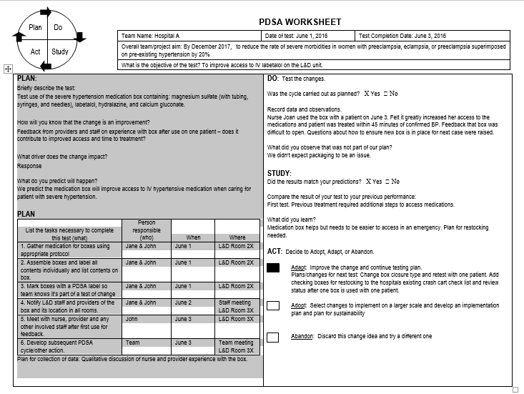

Slide 45

Photo Credit: Creative Commons
After completing several incremental PDSA cycles, a decision was made to implement the severe hypertension medication boxes with clearly labeled listed contents in the unit with an easy to open seal and add restocking of used boxes on the crash cart checklist. Education on the medication box occurred during interdisciplinary staff meeting.

Slide 46
Tools to Identify Interventions and Resources
MAP-IT
Key Driver Diagram
Toolkit Binder

Slide 47
MAP-IT
Mobilize Team
Assess Situation
Plan Change Tactics
Implement
Track Progress
United States Department of Health and Human Services. (2014). Healthy people in healthy communities: A
community planning guide using Healthy People 2020. Retrieved from http://www.healthypeople.gov/2020/implement/MapIt.aspx

Slide 48
Strategies and Change Tactics
Education
Audit with feedback
Discourse
Meetings
Public release of data
Reminders
Rewards
Grand rounds
Data
Classes or conferences
Simulation training
Tests
Newsletters or posters
  Identify barriers to change
  Select implementation strategies and tactics to eliminate specific barriers
  Clinicians in similar settings working on similar QI projects encounter similar barriers
  Collaborative learning provides opportunity to share
Bingham & Main (2010). Effective implementation strategies and tactics for leading change in maternity units. J Perinat Neonat Nurs, 24(1):32-42.
Notes:
Blue Strategies
Bullets Tactics

Slide 49
Key Driver Diagram: Maternal Hypertension Initiative
GOAL: To reduce preeclampsia maternal morbidity in Illinois hospitals
Interventions
Key Drivers
Implement standard order sets and/or algorithms for early warning signs, diagnostic criteria, timely triage, monitoring and treatment of severe hypertension
Ensure rapid access to medications used for severe hypertension with guide for administration and dosage
Implement system plan for escalation, obtaining appropriate consultation, and maternal transport
Perform regular simulation drills of severe hypertension protocols with post-drill debriefs
Integrate severe hypertension processes (e.g. order sets, tracking tools) into your EHR
AIM: By December 2017, to reduce the rate of severe morbidities in women with preeclampsia, eclampsia, or preeclampsia superimposed on pre-existing hypertension by 20%
Readiness: Implementation of standard processes for optimal care of severe maternal hypertension in pregnancy
Recognition: Screening and early diagnosis of severe maternal hypertension in pregnancy
Standardize protocol for measurement and assessment of blood pressure and urine protein for all pregnant and postpartum women
Standardize response to early warning signs including listening to and investigating symptoms and assessment of labs
Implement facility-wide standards for patient-centered education of women and their families on signs and symptoms of severe hypertension
Educate OB, ED, and anesthesiology physicians, midwives, and nurses on recognition and diagnosis of severe hypertension that includes utilizing resources such as the AIM hypertension bundle and/or unit standard protocol
Response: Care management for every pregnant or postpartum woman with new onset severe hypertension
Execute facility-wide standard protocols for appropriate medical management in under 60 minutes
Create and ensure understanding of communication and escalation procedures (e.g. implementing a rapid response team through the use of TeamSTEPPS)
Develop OB-specific resources and protocols to support patients, families, staff through major complications
Provide patient-centered discharge education materials on preeclampsia and postpartum preeclampsia
Implement patient protocols to ensure follow-up within 7-10 days for all women with severe hypertension and 72 hours for all women on medications
Reporting/Systems Learning: Foster a culture of safety and improvement for care of women with new onset severe hypertension
Establish a system to perform regular debriefs after all new onset severe hypertension cases
Establish a process in your hospital to perform multidisciplinary systems-level reviews on all severe hypertension cases admitted to ICU
Continuously monitor, disseminate, and discuss your monthly data in ILPQC REDCap system at staff/administrative meetings
Add maternal hypertension assessment and treatment protocols and education to provider and staff orientations, and annual competency assessments

Slide 50
ILPQC Maternal Hypertension:
Toolkit Binders
Each team participating in ILPQC Maternal Hypertension Initiative will receive a Toolkit Binder
Binders contain materials to assist in implementation of the AIM Bundles
  Using your QI data from REDCap and your Implementation Checklist, identify areas for improvement
  Identify resources in the binder to facilitate QI work on areas for improvement
    Example:
      Area for improvement: Low percent of debriefs being completed at your hospital
      Binder: Locate resources for debriefs (Tab 8, sections on Briefs, Debriefs, and Huddles and Team Communication)

Slide 51
Summary
Tools to Identify Opportunities for Change
  Process Flow Diagram
  Implementation Checklist
  Tool to test change
  PDSA Cycle
  Tools to identify interventions and resources
  MAP-IT
  Key Driver Diagram
  Toolkit Binder

Slide 52
Team Storyboard Viewing
Tell your team’s story from 11:30 – 12:30 pm
Learn what other teams are doing
Understand other teams’ process flow for identification and treatment of severe range blood pressure
Share your ideas and thought with others
  Opportunities for improvement
  Change ideas
  Strengths
  Support needed
  Different challenges across hospital units

Slide 53
Lunch and Networking
Pick up box lunch in corridor and return to your table
Discuss storyboards and complete worksheet during lunch from 12:00 – 12:45 pm
  “Steal Shamelessly Share Seamlessly, Storyboard Worksheet” in folders
  Use worksheet to discuss storyboards and record ideas from other teams
HOSPITAL IDS!
Please find Kate Finnegan at the registration table during lunch to get your ILPQC 3-digit Hospital ID.

Slide 54
Accurate Measurement of Blood Pressure & Other Strategies for Success
Nancy Peterson, MSN, RNC-OB, PNNP, IBCLC
Director of Perinatal Outreach and Clinical Program Manager, California Maternal Quality Collaborative

Slide 55
Implementation Cafés:
Timeline
Implementation Cafés led by network administrators, educators, and OB physicians (1:15 – 2:35 pm)
  1:15-1:25pm: Move to your assigned café area in the Dove Conference Center. Assignments can be found in the upper right hand corner of your agenda.
  1:25-1:30pm: Café objectives and introductions.
  1:30-1:55pm: Discussion of barriers and opportunities for improvement.
  1:55-2:05pm: Return to the Dove Conference Center main room.
  2:05-2:35pm: Facilitator teams report out the top 3 takeaways from smaller group café discussion.

Slide 56
Implementation Cafés:
Topics and Locations
Group topics and room locations
  Reduce time to treatment severe HTN: L&D, antepartum
    Section 1A (Dove)
    Section 2A (Dove)
  Reduce time to treatment severe HTN: ER, postpartum
    Section 1B (3rd Fl, Rms 1&2)*
    Section 2B (3rd Fl, Rms 3&4)*
  Improve management of patients with severe HTN at discharge: timely follow up, discharge education
    Section 1C (3rd Fl, Rms 5&6)*
    Section 2C (3rd Fl, Rms 7&8)*
  Strategies for implementation of debriefs/huddles, simulations, drills
    Section 1D (Dove)
    Section 2D (3rd Fl, Rms 9&10)*
  Strategies to standardize severe HTN treatment/management
    Section 1E (Dove)
    Section 2E (Dove)
*For cafés meeting on the 3rd Floor above Dove, the co-facilitators will split participants evenly across two smaller rooms and facilitate sub-groups.

Slide 57
Debrief with Large Group
Debrief from small groups to large group 2:05 – 2:35 pm
Facilitator share top 3 take-aways from group discussion

Slide 58
Strategies for Data Collection & Using Your Data to Drive Quality Improvement
Patti Lee King, PhD, MSW
State Project Director, Illinois Perinatal Quality Collaborative
Kate Finnegan, MPH
Project Coordinator, Illinois Perinatal Quality Collaborative

Slide 59
What data are we collecting?
Collect data all patients with severe range BP
  Time to treatment, patient outcome, discharge patient education and timely follow up scheduled
Identify all patients with severe range BP
  Bedside data collection to collect data on time to treatment and debrief
  Chart abstraction to confirm all pts identified, outcome and discharge data (education & F/U)
Baseline data due July 15: Oct, Nov, Dec 2015
Monthly data: due by the 15th of the following month

Slide 60
How will we measure improvement?
You will measure your progress towards process and outcome measures using the “Severe Hypertension Data Form”
You will compare your monthly data (May 2016 – Dec. 2017) to your baseline data (Oct., Nov., Dec, 2015) using reports accessed via REDCap
Baseline data should be entered in REDCap by July 15 and web-based reports for viewing will be available at that time

Slide 61
Severe HTN Data Form:
2 Options
Single data form to be used both at the bedside and for chart abstraction
Separate data forms
  Bedside data form
  Chart abstraction tool
Both options gather the same information
Use whatever works for your hospital team!

Slide 62
Option 1 – Single Form

Slide 63
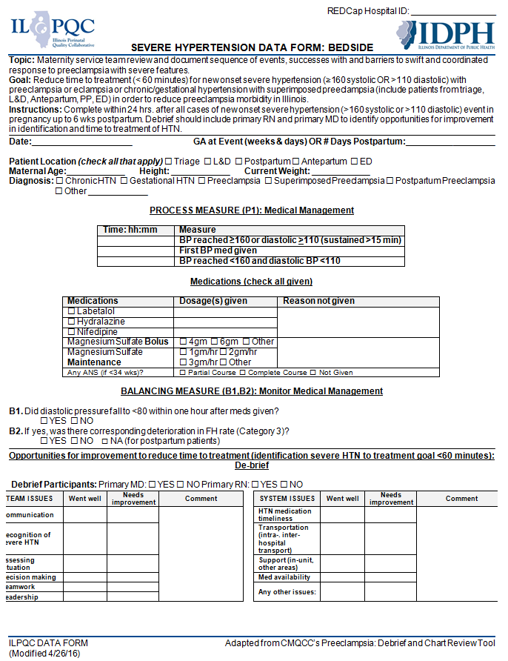
Option 2 – Two Forms
Bedside Form

Slide 64
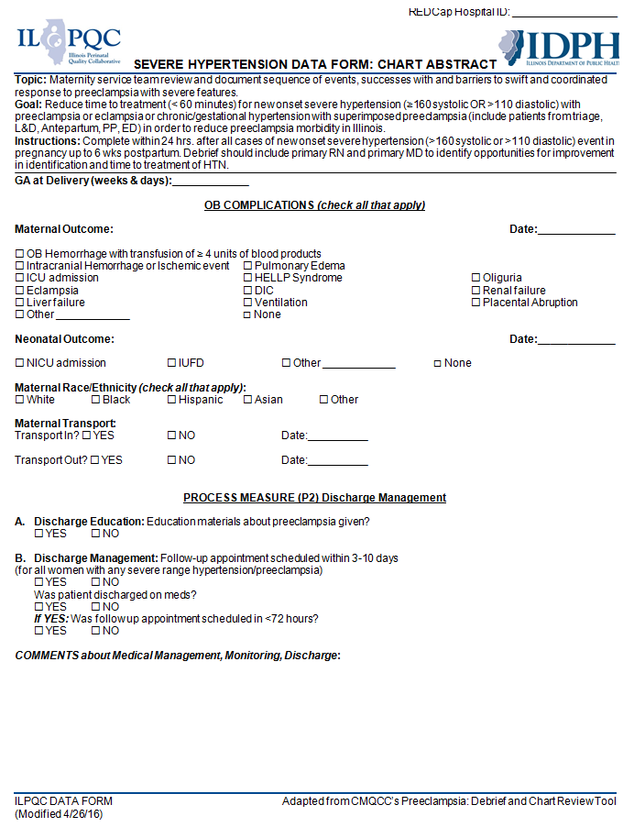
Option 2 – Two Forms
Chart Abstract Form

Slide 65
Steps for Data Form
Implementation
Implement the Severe HTN Data Form at the bedside for all women who have been identified with new onset severe HTN
Use chart review to collect discharge and outcome data on all women identified with new onset severe HTN
Use your EMR to identify all patients with new onset severe HTN to insure you’ve captured all cases through the bedside implementation of the Severe HTN Data Form, can use chart review to collect data on missed patients.
Enter data in REDCap by the 15th of the month for the previous month (i.e. May 15th for April data)

Slide 66
Lessons Learned from Wave 1
23 Wave 1 teams completed survey (100%) – Thank you!
  73.9% of teams meeting at least monthly (17)
    19 teams with physicians /2 teams with midwife participating
    13 teams with quality participating
    11 teams with ED participating
  87.0% have implemented the data form (20)
    75% of teams implementing form at bedside (15 of 20)
    78.3% of teams using chart abstraction to collect data (18 of 23) including:
      10 teams using EMR keyword searches
      1 team using dashboards
      9 teams using ICD-10 codes
      11 teams using delivery logs
      8 teams using pharmacy records

Slide 67
Wave 1 Survey: Data
Collection Strategies
  “Some of the patient data was collected in real time and for other patient's it was via chart review. We had training sessions for the nurses to explain the data form and what to do when a patient presents for care.”
  “RNs have been selected to be champions, several have filled out bedside collection forms.”
  “Had to make it a quality project on our Lean Daily Management Board.”
  “RNs fill out a log book with the patient label and brief data, team then researches chart and logs in RedCap.”

Slide 68
Wave 1 Survey: Lessons learned
  “We have included Pharmacy in our team to address any barriers to access of meds and review order sets.”
  “We implemented a new triage log to get the people who are new diagnosis for severe range hypertension.”
  “Added HTN meds to all pyxis on floor for easier access.”
  “Great to have ER engaged.”

Slide 69
Wave 1 Survey – Strategies
Going Forward
  “We had a great debriefing today with our monthly drills, we need to get better about debriefing these types of cases as well.”
  “I can't get our quality department to run ICD 10 reports: they are "too busy"... that would help. More commitment; a truly engaged physician champion.”
  “Need to engage staff at the bedside.”

Slide 70
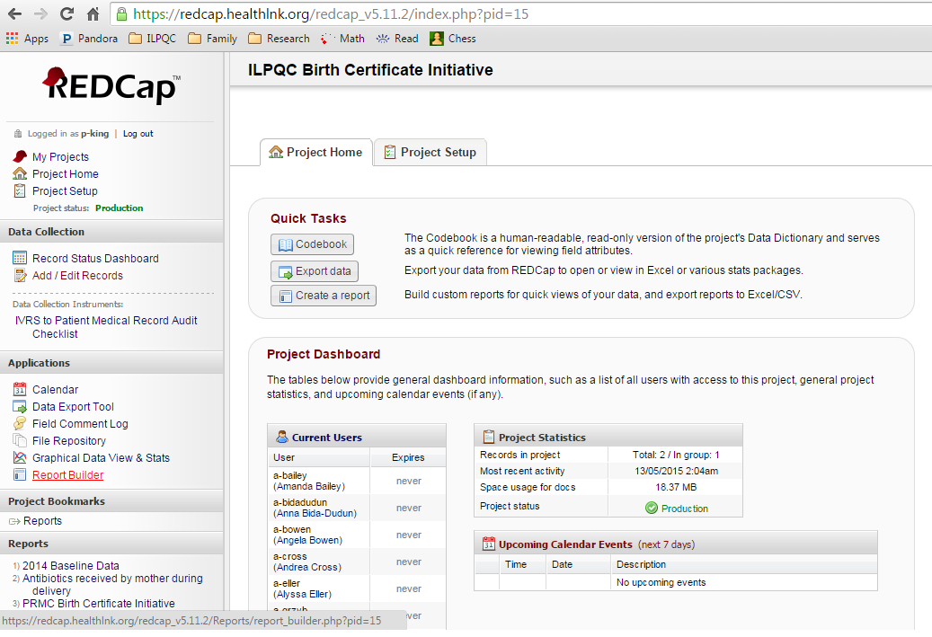
REDCap Data System
Secure web-based data portal to enter your data and to view your reports
Notes:
Kate Finnegan

Slide 71
How to Access Reports
https://redcap.healthlnk.org/
Login to REDCap with user name and password
Click “My Projects” Tab
Click “ILPQC Severe Hypertension Data Form” Link
Click “Reports” Link Under “Project Bookmarks” in left sidebar
A new window will launch, Enter your three digit hospital ID, “009”, “055” or “101”

Slide 72
Understanding Your
REDCap Reports
Monthly Reports show data during your quality improvement work (Jan./May – Dec. 2017) on key process and outcome measures
Coming soon in July: Baseline data (Oct., Nov., Dec., 2015) will show on your monthly reports as the initial dot in the line graph and as a straight line across the length of the line graph
Notes:
Explain REDCap reports/graphs – aggregate and each variable
Baseline
Monthly

Slide 73
Understanding Your
REDCap Reports
Focus on your hospital’s line graph to see improvement in your data
Depending on the graph, you’ll look for
  Upward trend (time to treatment, patient education and follow up, debrief)
  Downward trend (SMM)
  Grown in blue and green segments of stacked bar chart (time to treatment breakdown)

Slide 74
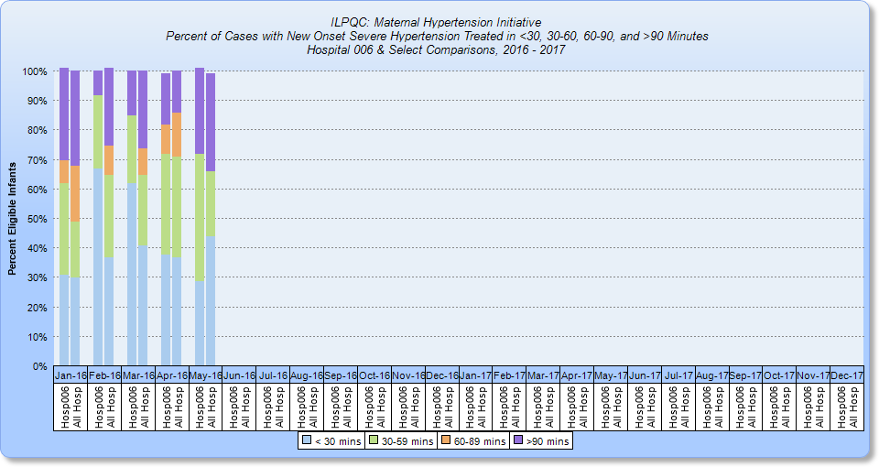
Understanding Your
REDCap Reports: Time to Treatment
All Hosp
Your Hosp
Notes:
Bar graph of % of women falling into each time to treatment category (<30, 30-60, 60-90, >90) – excludes women whose BP came down with medication and women where no action was taken (missed opportunity)
For time to treatment, we want to see all women in <30 or 30-60 treatment categories! Overall process goal is for 100% of women with new onset severe range HTN (sustained for 15 minutes) to receive medication withing 60 minutes.
Light blue (bottom section): <30 minutes
Green (second from bottom): 30-60 minutes
Want 100% of women to fall into one of these two categories (improvement will be seen by increasing % of women falling into bottom two sections of bars)

Slide 75
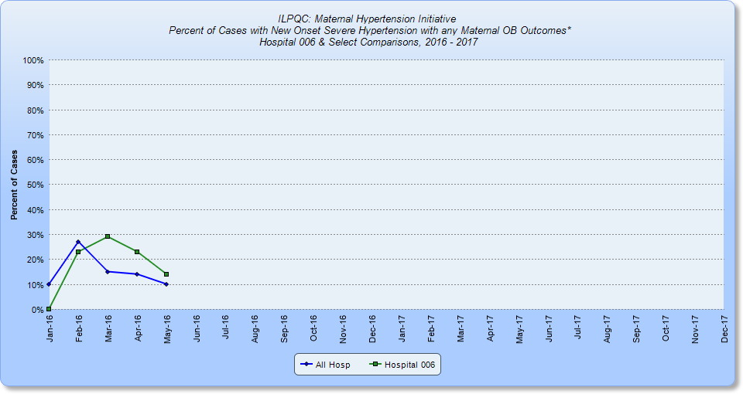
Understanding Your REDCap
Reports: SMM Including Hemorrhage
Your Hosp
All Hosp
*OB Hemorrhage with transfusion of ≥ 4 units, Intracranial Hemorrhage or Ischemic event,
Pulmonary Edema, ICU admission, HELLP Syndrome , Oliguria, Eclampsia, DIC, Renal failure,
Liver failure, Ventilation, Placental Abruption
Notes:
Line graph is the way to see improvement in their data
For SMM, we want to see the line trending down! Overall outcome goal of initiative is to decrease SMM by 20%. Once baseline is graphed, can track progress towards goal.
Green line with squares – your monthly % of SMM – line decreasing will show improvement
Blue line with diamonds – all participating hospitals overall % SMM per month
Can also compare to hospitals of same level and you are able to view
Graph 5 (this graph) and 6 in REDCap are similar – this graph shows all SMM, graph 6 shows SMM excluding hemorrhage

Slide 76
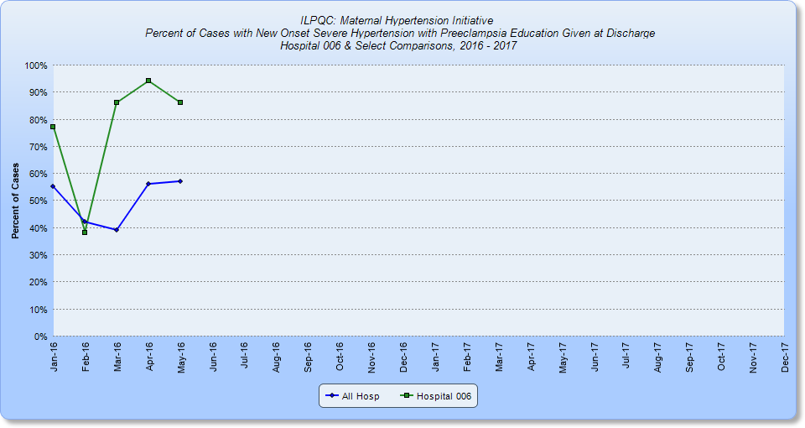
Understanding Your REDCap
Reports: Patient Education at Discharge
Your Hosp
All Hosp
Notes:
Line graph is the way to see improvement in their data
For patient education, line going up shows improvement! Process measure is 100% of cases will receive education at discharge
Green line with squares – your monthly % of patients receiving patient education at discharge – line increasing will show improvement
Blue line with diamonds – all participating hospitals overall % of patients receiving patient education at discharge

Slide 77
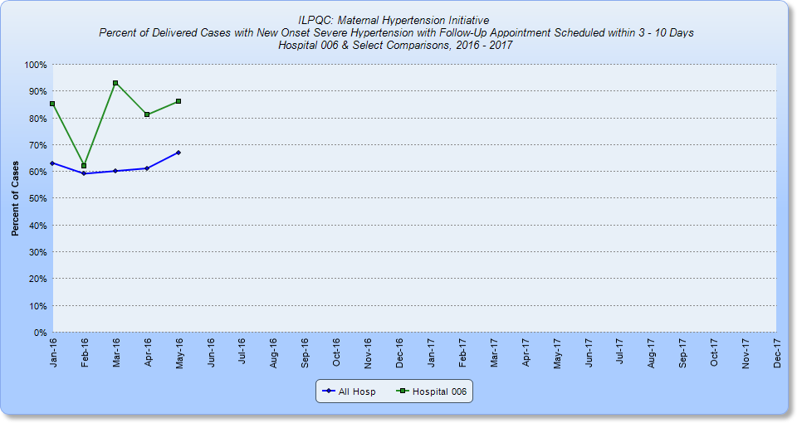
Understanding Your
REDCap Reports: Patient Follow-up
Your Hosp
All Hosp
Notes:
Line graph is the way to see improvement in their data
For patient follow-up appointments, line going up shows improvement! Process measure is 100% of cases will have follow-up appointment scheduled within 3-10 days of discharge
Green line with squares – your monthly % of patients with follow-up appointment scheduled within 3-10 days of discharge – line increasing will show improvement
Blue line with diamonds – all participating hospitals overall % of patients with follow-up appointment scheduled within 3-10 days of discharge

Slide 78
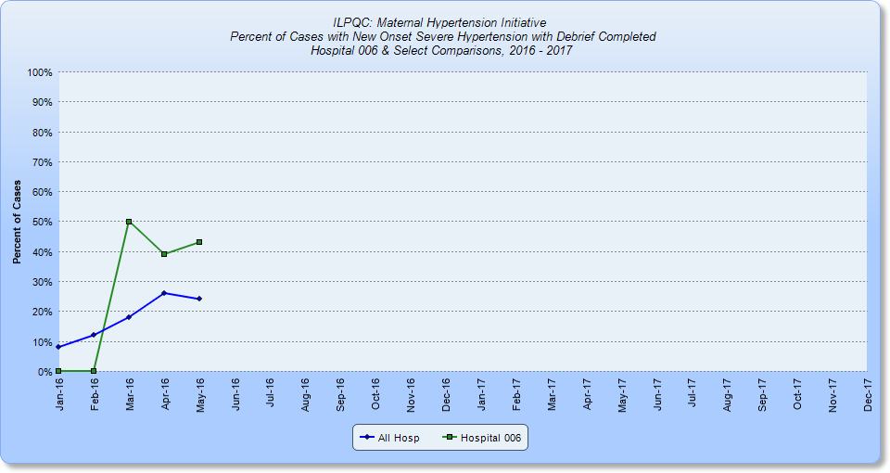
Understanding Your
REDCap Reports: Debriefs
Your Hosp
All Hosp
Notes:
Line graph is the way to see improvement in their data
For debriefs, line going up shows improvement! Process measure is 100% of cases will be debriefed by primary physician and nurse
Green line with squares – your monthly % of cases that were debriefed by primary physician and nurse – line increasing will show improvement
Blue line with diamonds – all participating hospitals overall % of cases debriefed by primary physician and nurse

Slide 79
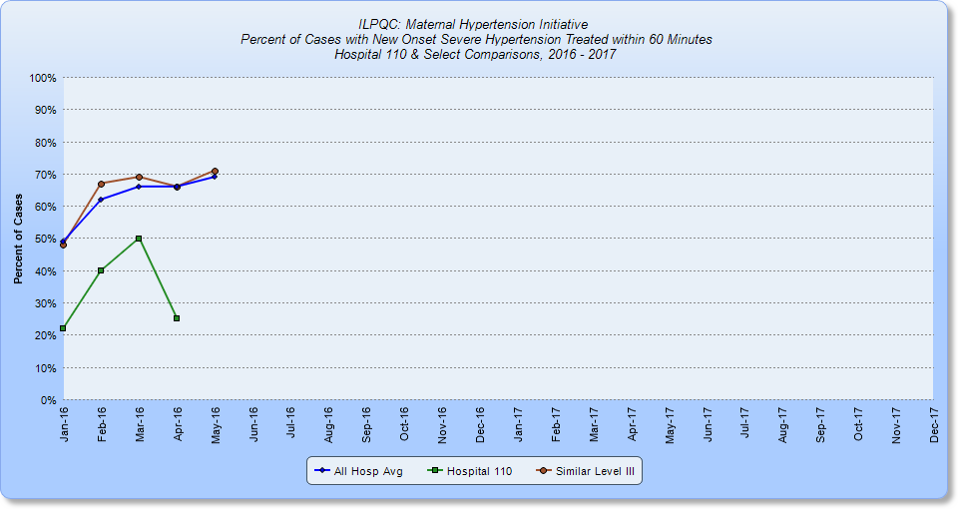
Example: Lower than average
% treated within 60 min
Your Hosp

Slide 80
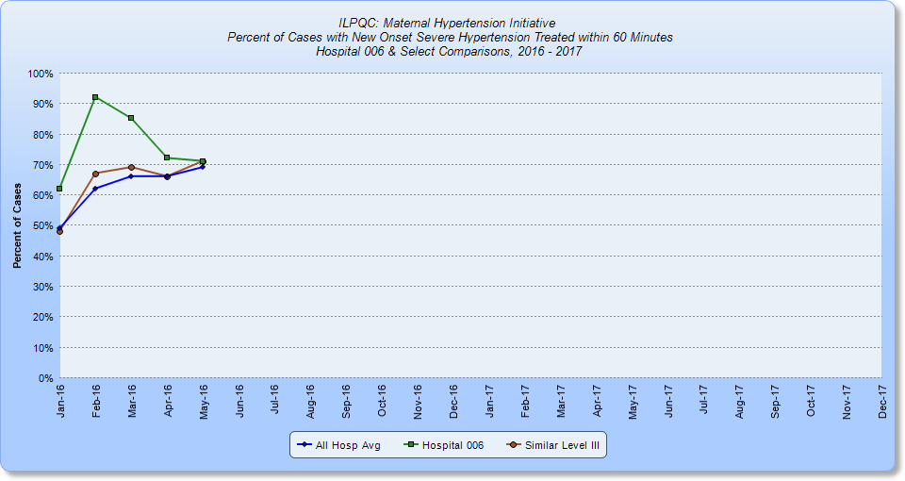
Example: Higher than average
% treated within 60 min
Your Hosp

Slide 81
Understanding Your Baseline
Reports: Time to Tx Example
Your Hosp

Slide 82
Baseline Implementation Checklist
Results
14 item assessment of what bundle components you do or don’t have in place at your hospital
Complete at:
  May 2016 (Implementation Baseline)
  Quarterly for the duration of the initiative
  Responses highlight opportunities:
  For change at the hospital level
  For QI support and resources at the collaborative level
  Baseline results are in with 86 hospitals reporting!
Implementation checklist adapted from the tool developed by
IHI for implementation of the AIM bundles in Louisiana.
Notes:
Patti Lee King

Slide 83
Readiness Components Needed
  Standard protocols for ID and tx of severe HTN are needed in
  Over 50% of L&D and AP/PP units
  Over 80% of Triage/ED units
  Unit education on protocols are needed in
  20% of L&D and AP/PP units
  Over 60% of Triage/ED units
  Process for timely id, triage, and eval in all hospital areas are needed in 65% of participating hospitals
Notes:
Patti Lee King

Slide 84
Readiness Components Needed
Cont.
  Rapid access to IV meds is needed in
  6% of L&D units
  15% of AP/PP and Triage/ED units
  System plan for escalation is needed in
  16% of L&D units
  21% of AP/PP units
  30% of Triage/ED units
  KEY READINESS OPPORTUNITIES
  Develop and implement in all units:
  Standard protocols
  Process for timely ID, triage, and evaluation
  Focus especially on all Readiness components in Triage/ED units

Slide 85
Recognition Components Needed
Notes:
Standard protocols for measure and assessment of BP needed in 45% of participating hospitals
Standard response to maternal early warning signs needed in 34% of participating hospitals
Facility-wide standards for education of women needed in 78% of participating hospitals

Slide 86
Response Components Needed
Notes:
Min Reqs of protocols
Notification of physician or primary care provider if systolic BP =/>160 or diastolic BP =/>110(105) for two measurements within 15 minutes;
After the second elevated reading, treatment should be initiated ASAP (preferably within 60 minutes of verification);
Includes onset and duration of magnesium sulfate therapy when indicated;
Includes escalation measures for those unresponsive to standard treatment;
Describes manner and verification of timely follow-up for blood pressure check and evaluation within 7 to 14 days postpartum;
Describes postpartum patient education for women with hypertension / preeclampsia describing postpartum preeclampsia

Slide 87
Reporting Components Needed
  Culture of huddles and debriefs to identify opportunities for improvement are needed in
  35% of L&D and AP/PP units
  56% of Triage/ED units
  Multidisciplinary reviews of all cases admitted to ICU are needed in
  40% of L&D and AP/PP units
  50% Triage/ED units
  Monitoring of quality outcomes and process metrics are needed in
  65% in L&D and AP/PP units
  78% of Triage/ED units

Slide 88
Summary
  Monthly Severe Hypertension Data Form collection when entered in REDCap show your monthly progress towards you goals to:
  Reduce severe maternal morbidity
  Reduce time to treatment
  Increase use of debriefs
  Increase patient discharge education and timely follow up
  Quarterly Implementation Checklist provides insight on your progress toward implementation of bundle components
  Use these resources to drive the agenda of your monthly team meetings and PDSA cycles!

Slide 89
Next Steps
Submit 3 months of retrospective baseline data (Oct-Dec 2015) by July 15
Collect monthly data and enter May data into REDCap by June 15
Review your reports immediately in REDCap
  Data team will review data for errors within 48 hrs
Data Use Agreement – get sign off
Baseline Implementation Checklist - submit
Contact ILPQC or your PNA with any questions

Slide 90
HTN Monthly Team Calls
June 27, 12:30-2:30pm
July 25, 12:30-1:30pm
August 22, 12:30-1:30pm
September 26, 12:30-1:30pm
October 24, 12:30-1:30pm

Slide 91
HTN Monthly Calls:
Education Topics
Call Date | Slides Due to ILPQC | Topic | Team Members
June 27 12:30 – 2:30 pm | June 6 | Readiness and Reporting - Drills, Simulation, and Debriefs | Sherry Jones, Melissa Claudio, Nicole Ury, Sam Schoenfelder
July 25 12:30 – 1:30 pm | July 6 | Recognition - Accurate BP Measurement & Diagnosis | Heather Stanley Christian, Soti Markuly, Debbie Schy, Mona LaGrand, Sam Schoenfelder, Robbin Uchison
August 22 12:30 – 1:30 pm | August 1 | Response - BP Medication and Treatment Algorithms | Jim Keller, Angelique Rettig, Felicia Fitzgerals, Deena Layton, Roma Allen
September 26 12:30 – 1:30 pm | September 7 | Response - Timing of Delivery | Jim Keller, Deena Layton, Sue Fulara
October 24 12:30 – 1:30 pm | October 3 | Response - Patient Education/Engagement and Postpartum Follow-up | Angelique Rettig, Debbie Schy, Roma Allen

Slide 92
Save the Date – 4th Annual ILPQC Conference!
Thursday, November 3rd
Westin in Lombard
Tentative time: 8 am – 5 pm

Slide 93

Questions & Wrap-up Panel

Slide 94
Thank You!
ILPQC HTN Leadership Team
ILPQC OB Advisory Workgroup
Face to Face Planning Subcommittee
Cindy Mitchell and HSHS St. John’s Hospital
Perinatal Network Administrators and Educators and State Quality Committee
All Implementation Café Facilitators
All volunteers who made today possible!!

Slide 95

ILPQC Administrative Team
Ann Borders
ILPQC Executive Director, OB Lead
Aki Noguchi and Pat Ittmann
Neonatal Leads
Patricia Lee King
State Project Director
Kate Finnegan
Project Coordinator
Email us at info@ilpqc.org
Website: www.ilpqc.org

Slide 96

IDPH

