Slide 1
Accurate Blood Pressure Measurement: Strategies for Success
Nancy Peterson MSN, RNC-OB, PNNP
Director of Perinatal Outreach
Clinical Program Manager of CMQCC
Stanford University

Slide 2

Blood Pressure Basics
BP measurement is one of the most important basic clinical assessments that we do, yet it is often one of the most inaccurately performed assessments, leading to delays in diagnosis and treatment

Slide 3
Recognition
Acute onset, severe hypertension that is accurately measured using standard technique and is
persistent for 15 minutes or more
is considered a
hypertensive emergency.

Slide 4

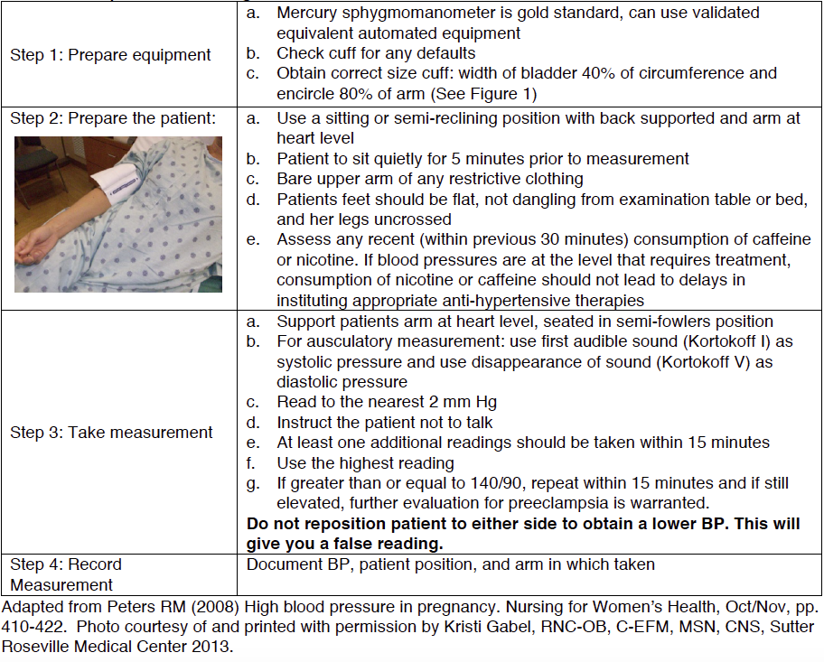
Steps for Obtaining Accurate Blood Pressure Measurements

Slide 5
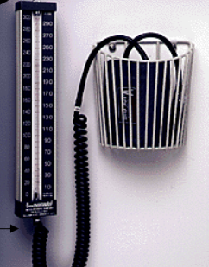
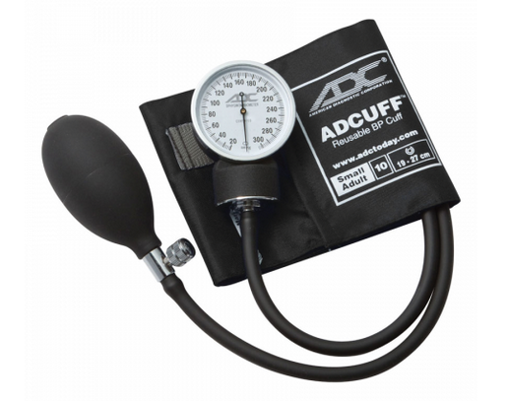
Prepare Equipment
Ausculatory (Manual)
  Mercury Sphygmomanometer
    Gold Standard
  Aneroid (clock face)
    Needs to be calibrated with a mercury sphygmomanometer every 6 months
Oscillometric (automated devices)
  AHA recommends that these devices be validated with mercury sphygmomanometer readings with every patient

Slide 6
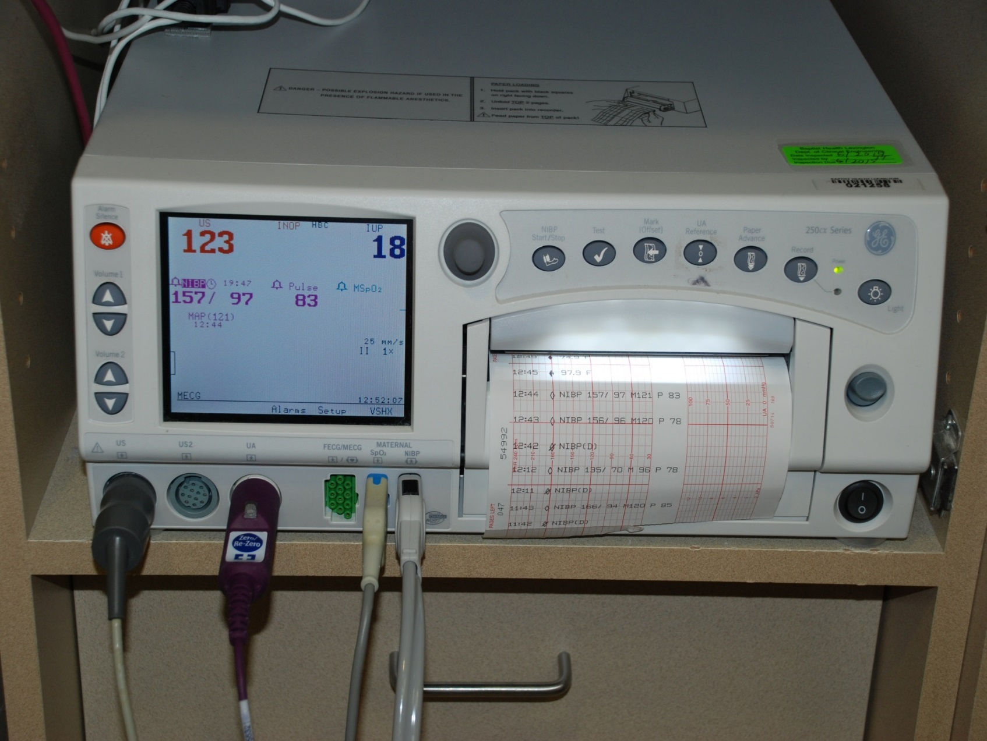
Automated BP Measurements

Slide 7
What variance is clinically acceptable?
The International Standards Organization ISO 81060-2:2009 is used by manufacturers of noninvasive blood pressure devices to test against mercury sphygmomanometers.
This standard calls for a difference of ±5 mm Hg with a standard deviation of no more than 8 mm Hg.
Notes:
The accuracy of automatic devices is validated for BP measurement in the upper arm only thus decreasing the validity of the findings

Slide 8
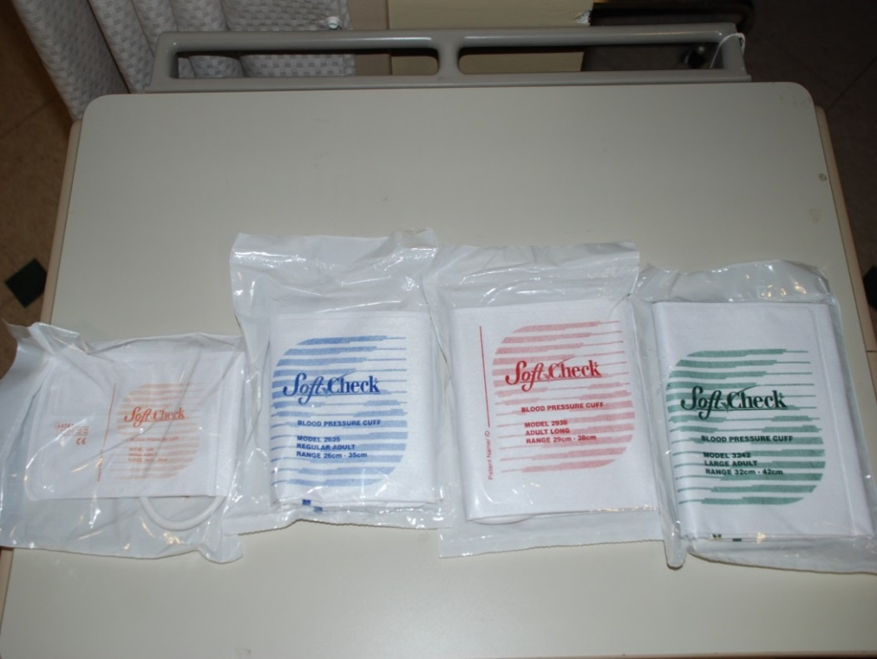
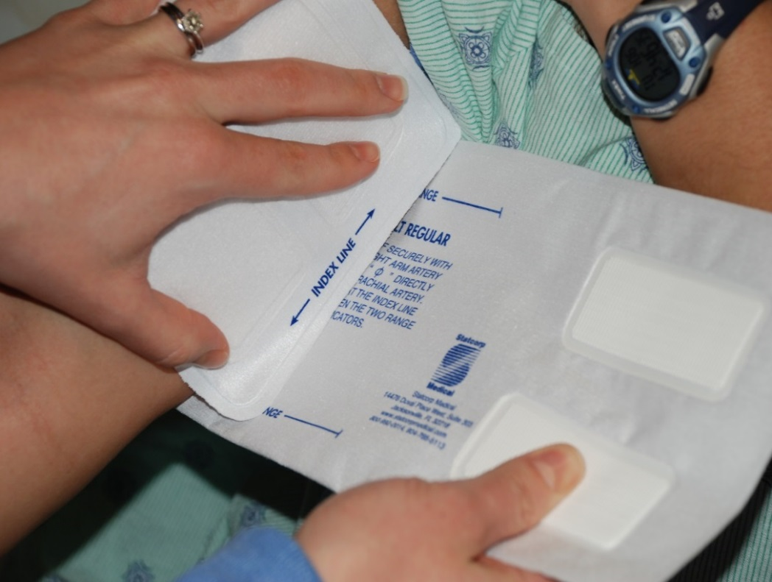
Appropriately Sized BP Cuff

Slide 9
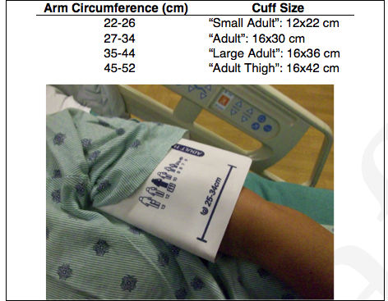
Cuff size and placement
Correct cuff size (width of bladder 40% of circumference and encircle 80% of arm.
Measure at the midpoint of the upper arm.
Place cuff directly on skin with bladder over brachial artery and lower end of cuff 2-3 cm above the antecubital fossa
Notes:
If you are not sure which cuff to use, measure the arm “If in doubt, measure it out”!!! If it is borderline between two sized you should error on the side of the larger cuff. The bladder should be placed midline over the brachial artery. No restrictive clothing should be on the patients arm that can act as a tourniquet and cause an inaccurate measurement
3rd point: If cuff is too low, you can get artifact noise r/t the stethoscope touching the cuff.

Slide 10
Consequences of Mis-Cuffing
Overestimation of BP | Underestimation of BP
Cuff too small (Systolic ⬆ by as much as 15 mm Hg) | Cuff too large
Cuff not placed over brachial artery | Brachial artery above heart level
Cuff applied over clothing or too loose
Arm positioned below heart level and not supported
Deflation of cuff too slow | Deflation of cuff too fast
Notes:
Most frequent BP measurement error with undercuffing accounting for 84% of miscuffing in large arms.. A recent study found that 80% of very slim pregnant women had their BP underestimated with a standard cuff. Other factors that decrease the accuracy of BP measurements include: Air in the cuff before it is placed on the pt’s arm, kinks or loose connections, any arm motion during measurement (passive or active), If repeated BP are needed, fully deflate the cuff and wait at least 15 sec between measurements.

Slide 11
Patient Preparation & Positioning
Use a sitting or semi-reclining position with arm at heart level, legs uncrossed and feet flat, not dangling.
The back should be supported.
Patient should sit quietly for five minutes before BP is taken.
Assess any recent (within 30 min) consumption of caffeine or nicotine.
Background noise and talking can all affect BP accuracy.
Notes:
While the patient is sitting quietly for at least 5 min, they should be comfortable with their back supported , legs uncrossed and feel resting on the floor.

Slide 12
Consequences of Improper Positioning
If back is unsupported: Diastolic may be higher by 6 mmHg (Pickering TG et al; Circulation 2005)
If the legs are crossed: Systolic may be higher by 2-8 mmHg (Pickering TG et al; Circulation 2005)
If the arm is allowed to hang down, unsupported: the BP will be elevated by 10-12 mm Hg (O’Brien E. J Hypertension, 2003)
If patient is talking: BP may increase by 8-15 mm HG
Pickering TG, Hall JE, Appel LJ, et al. Recommendations for blood pressure measurement in humans and experimental animals: part 1: blood pressure measurement in humans: a statement for professionals from the Subcommittee of Professional and Public Education of the American Heart Association Council on High Blood Pressure Research. Circulation 2005; 111:697.
O'Brien, E. Ambulatory blood pressure measurement is indispensible to good clinical practice. J Hypertens 2003; 21(suppl 2):S11.
Notes:
Pain and anxiety can also increase BP

Slide 13

Take Blood Pressure Measurement
Support patients arm at heart level
For ausculatory measurement: use first audible sound (Kortokoff I) as systolic pressure and use disappearance of sound (Kortokoff V) as diastolic pressure
Deflate cuff slowly, 2-3 mm Hg per heartbeat
Read to the nearest 2 mm Hg
Notes:
Place the stethoscope lightly over the brachial artery. If it is pressed too firmly against the artery, it may cause turbulance and the disappearance of sound thus artificially reducing the diastolic pressure.

Slide 14
Take Blood Pressure Measurement
Retake in other arm, use the highest reading
If ≥ 140/90, repeat within 15 minutes
Auto BP cuffs overestimate systolic by 4-6 mmHg and underestimates diastolic by up to 10 mmHg
DO NOT reposition patient to either side to obtain a lower BP

Slide 15
Record Measurement
Document blood pressure
Patient position
Location BP taken (Arm, forearm, right or left)
Cuff size

Slide 16
Key Points
Be Consistent
  Same arm
  Same position
  Same cuff size
Evaluate BP trends vs. isolated values
If using automatic BP monitors, do not “auto-cycle”. Be present to confirm appropriate BP technique criteria have been met

Slide 17
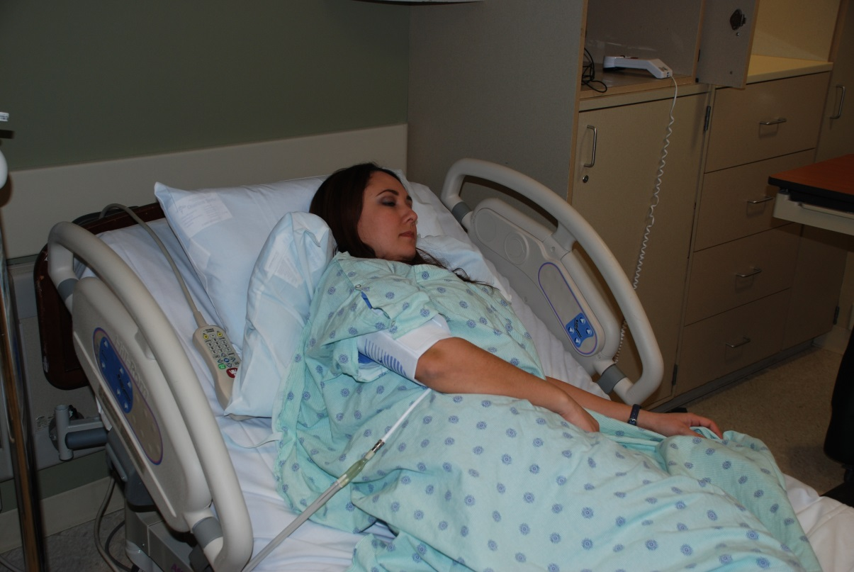
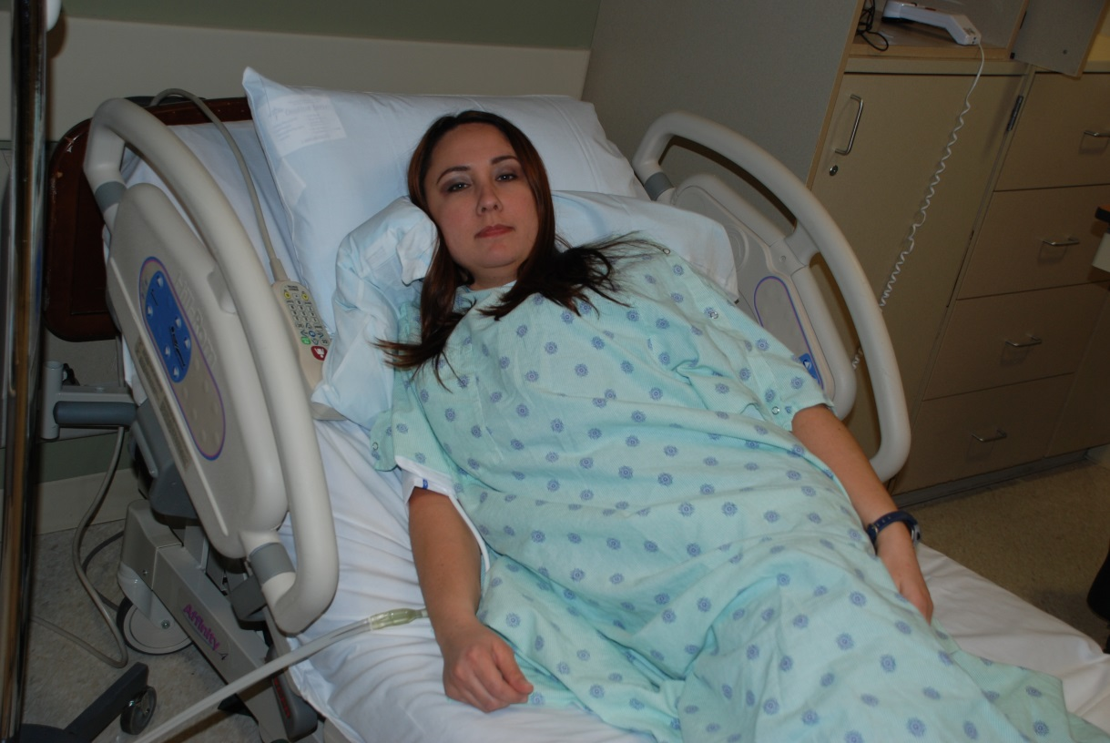
Arm Position Matters!
Upper arm = lower BP
Lower arm = higher BP

Slide 18
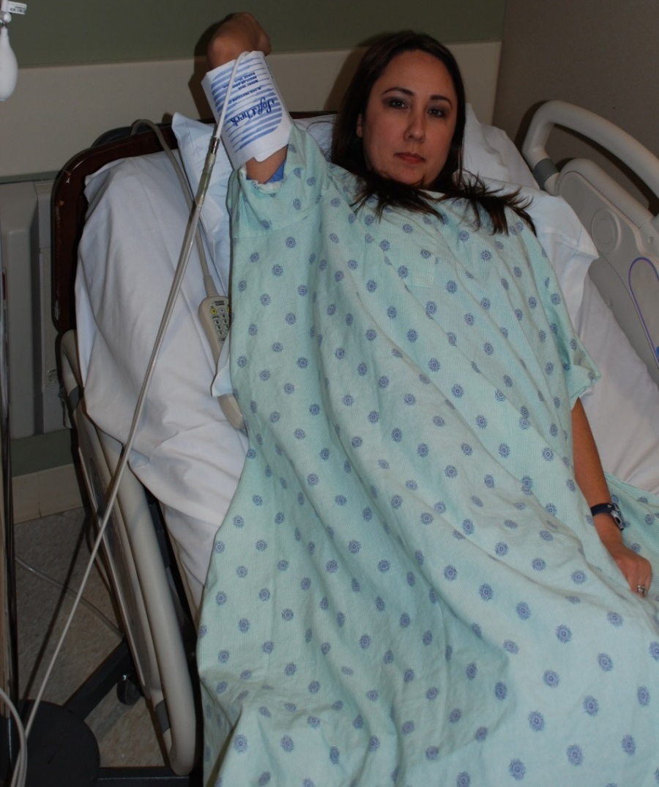
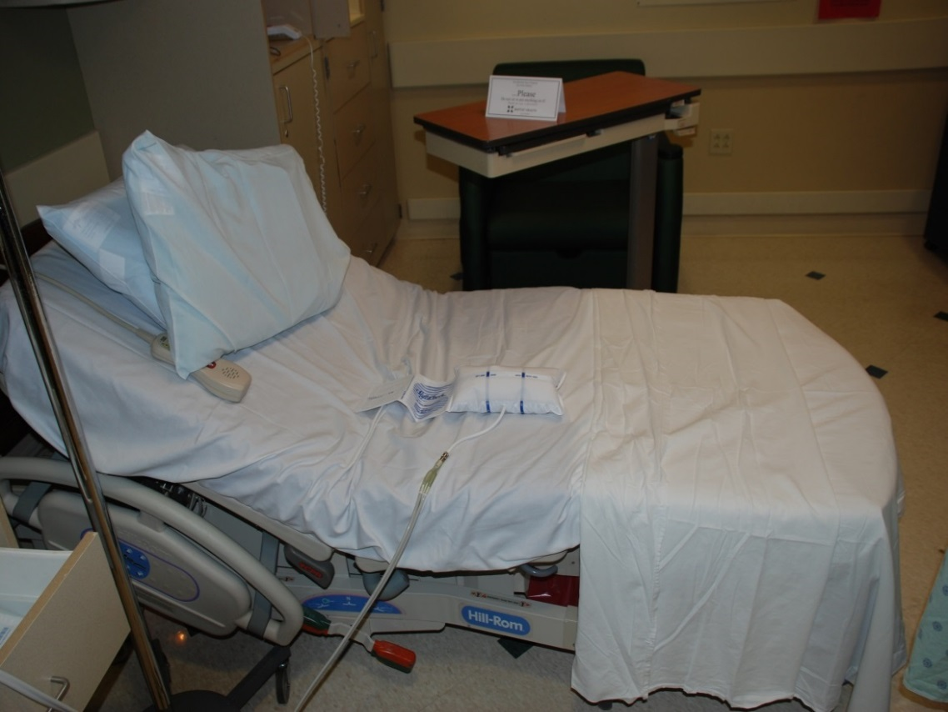
BP recording without a patient
Arm above the heart:
Even lower BP

Slide 19
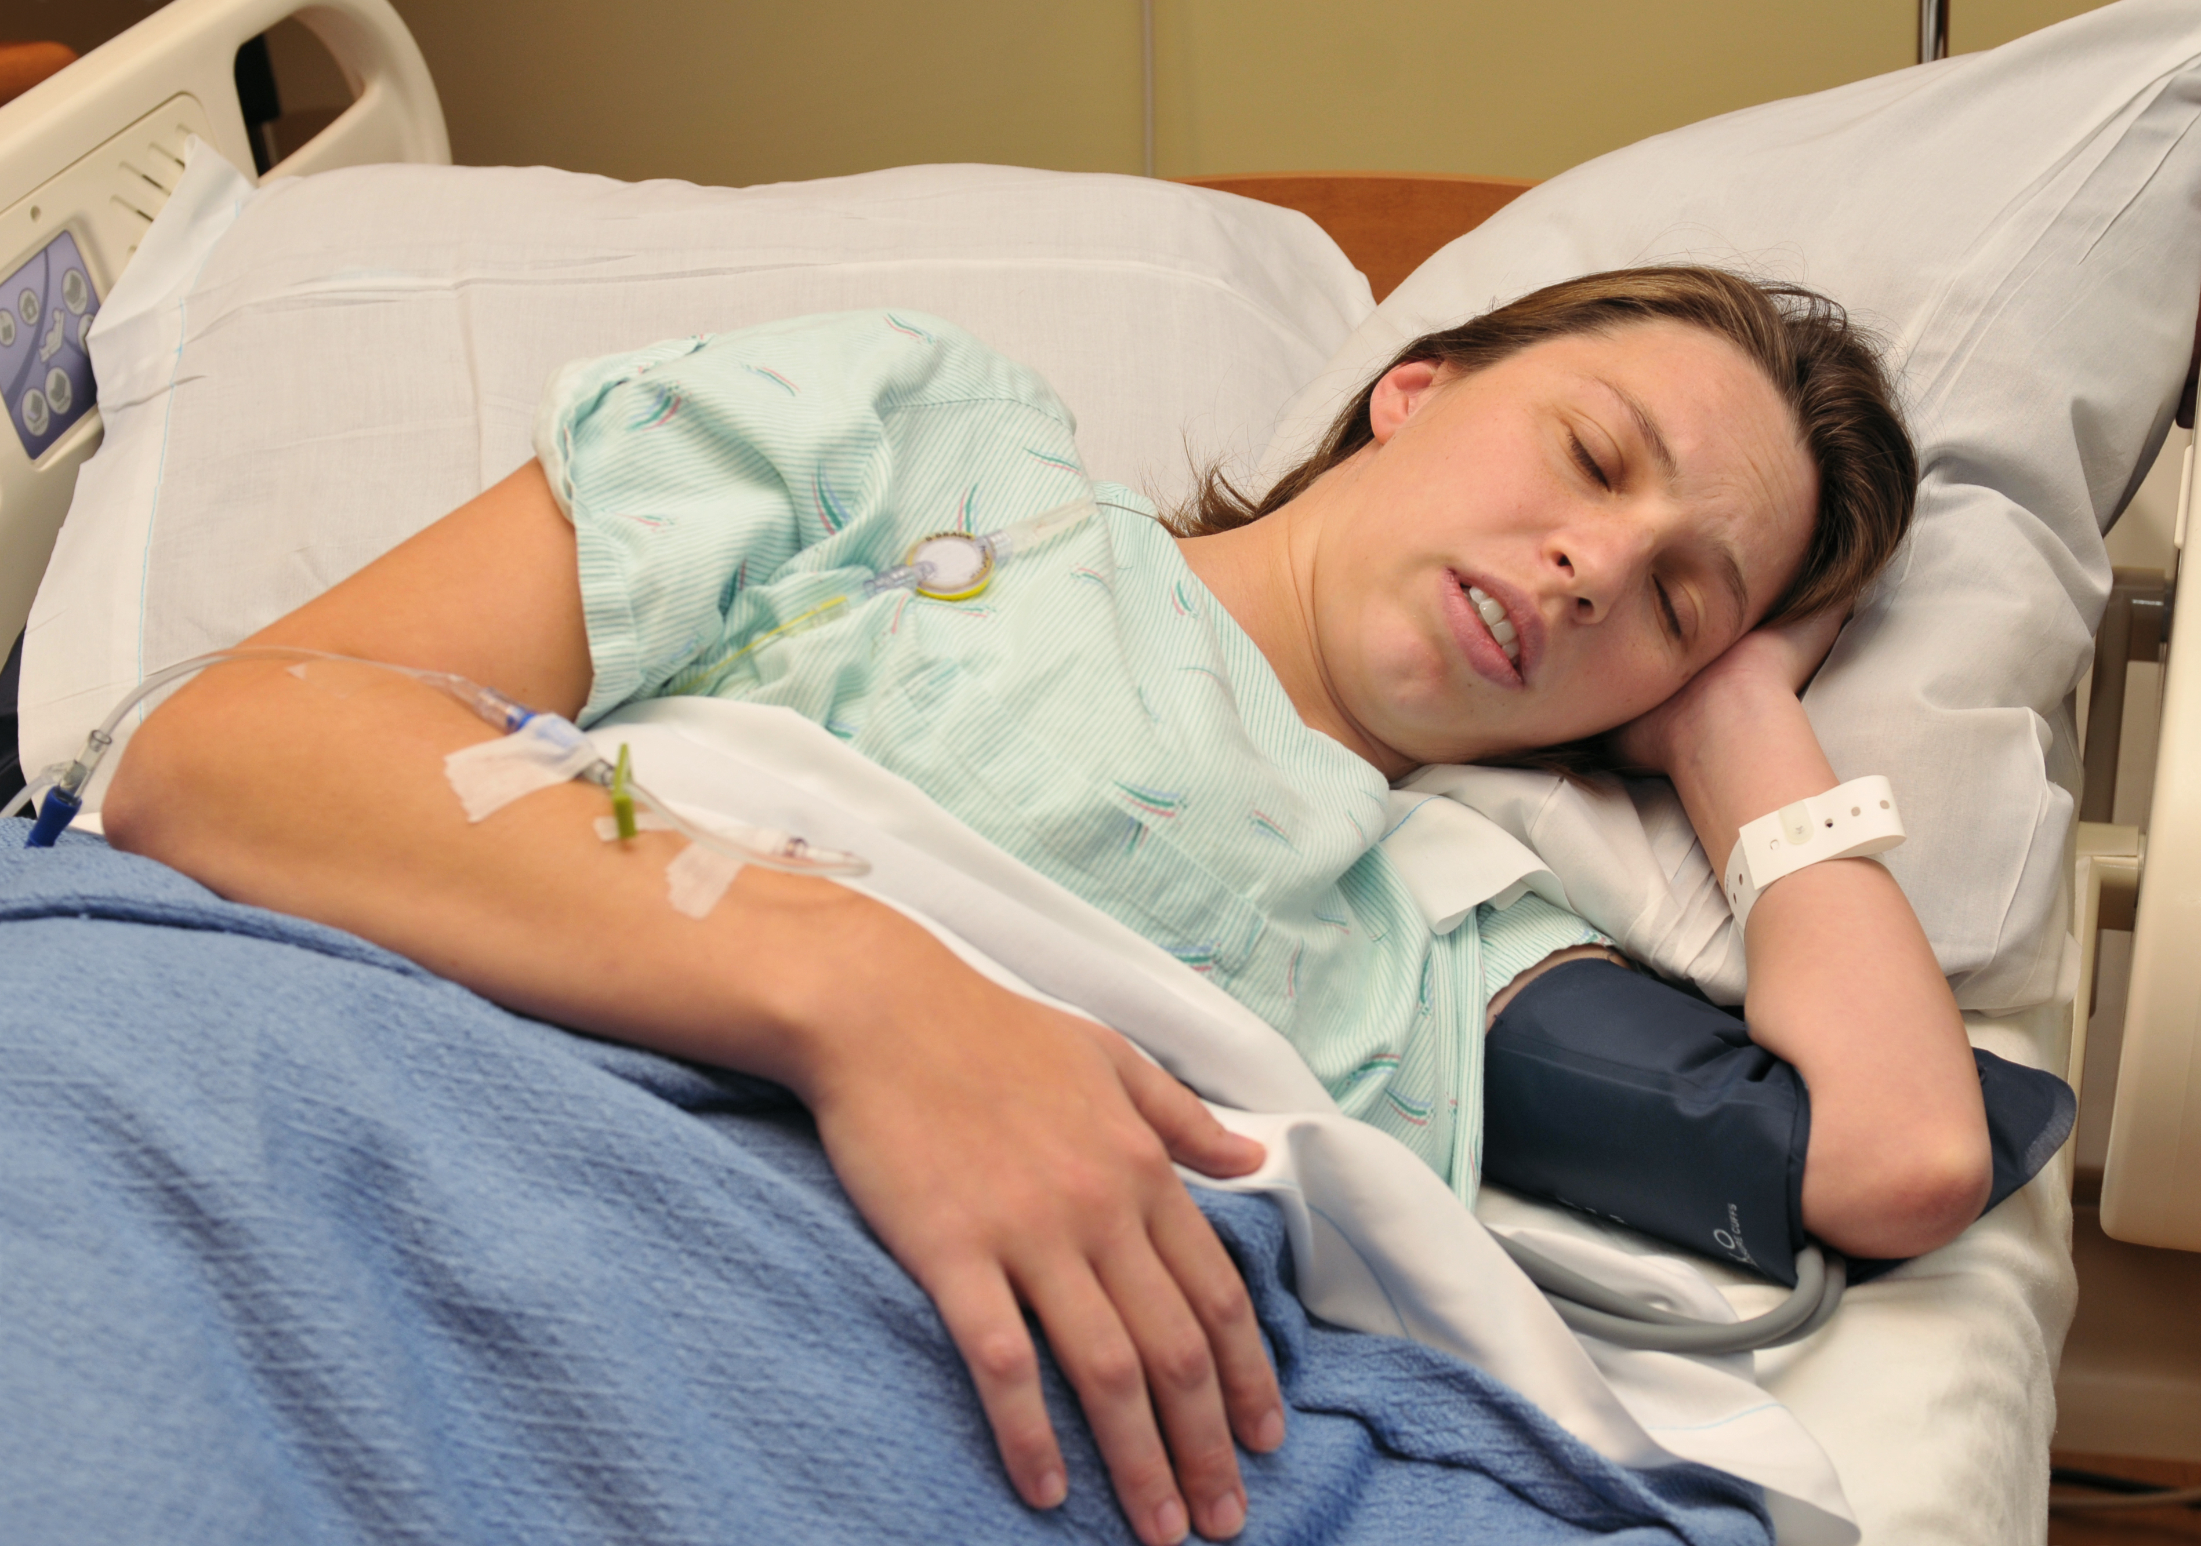
Automated BP measurements irrespective of:
  Position
    Maternal
    Cuff
  Contractions
  Epidural
  Pushing

Slide 20
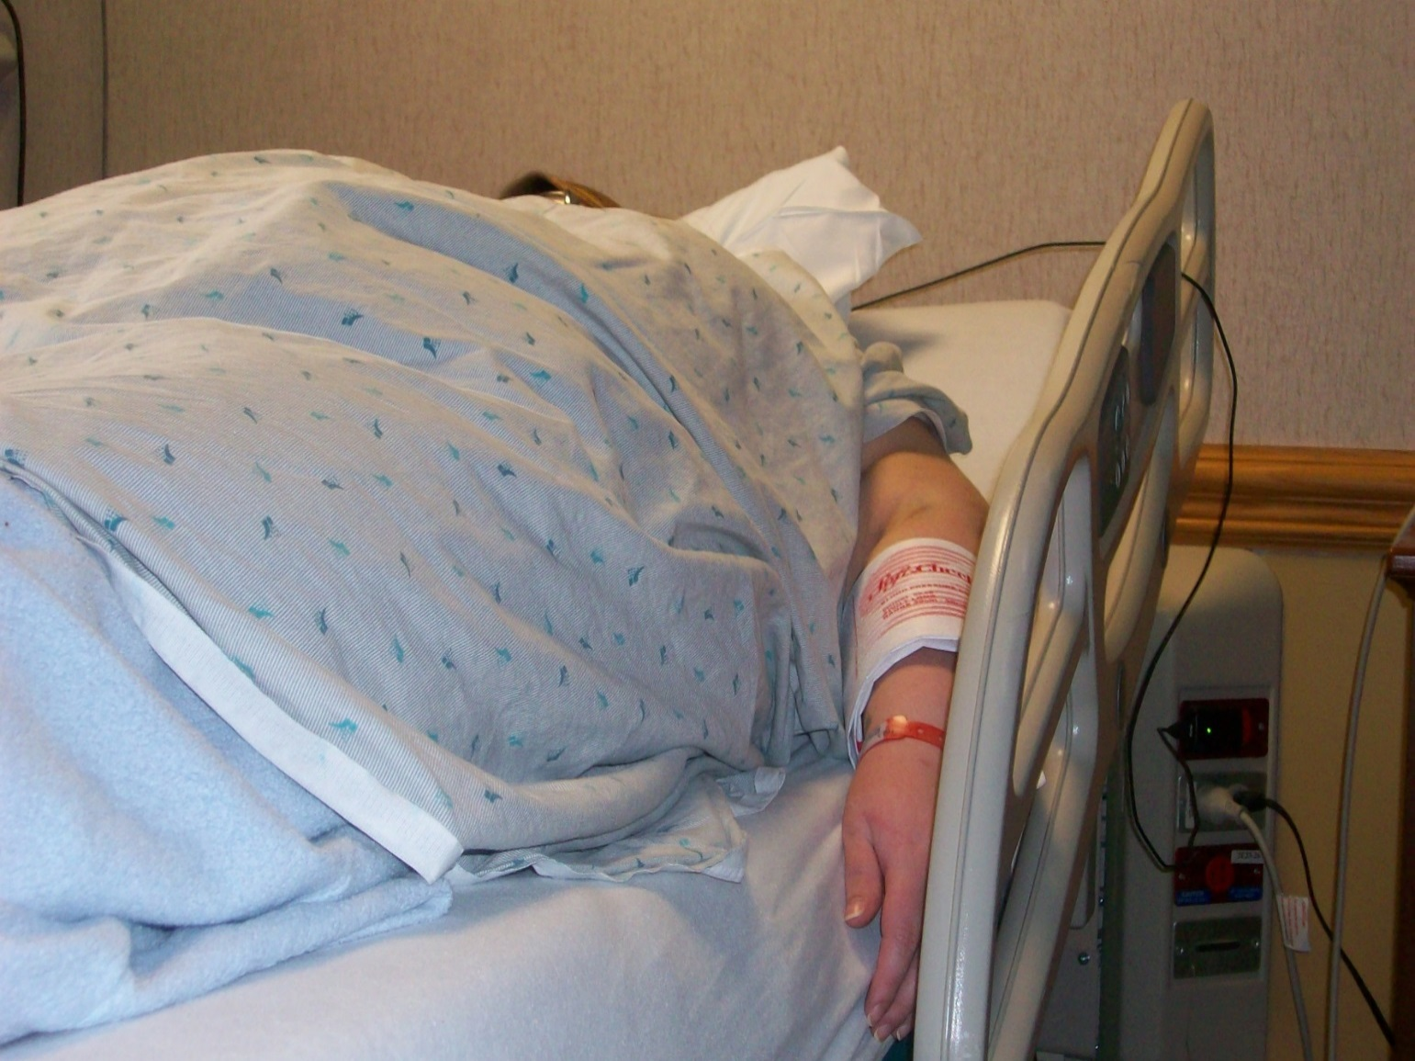
What if the BMI = 70 kg/m² ?

Slide 21
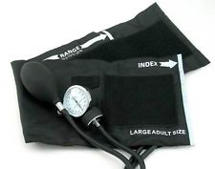
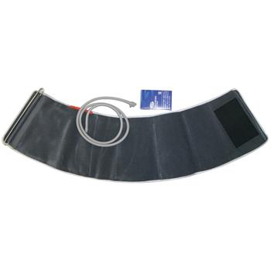
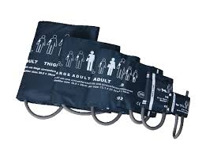
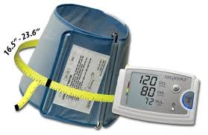
Challenges in BP Measurement in Obese Women
Size of arm
Shape of arm
Length of arm
Cuff sizes and shapes

Slide 22
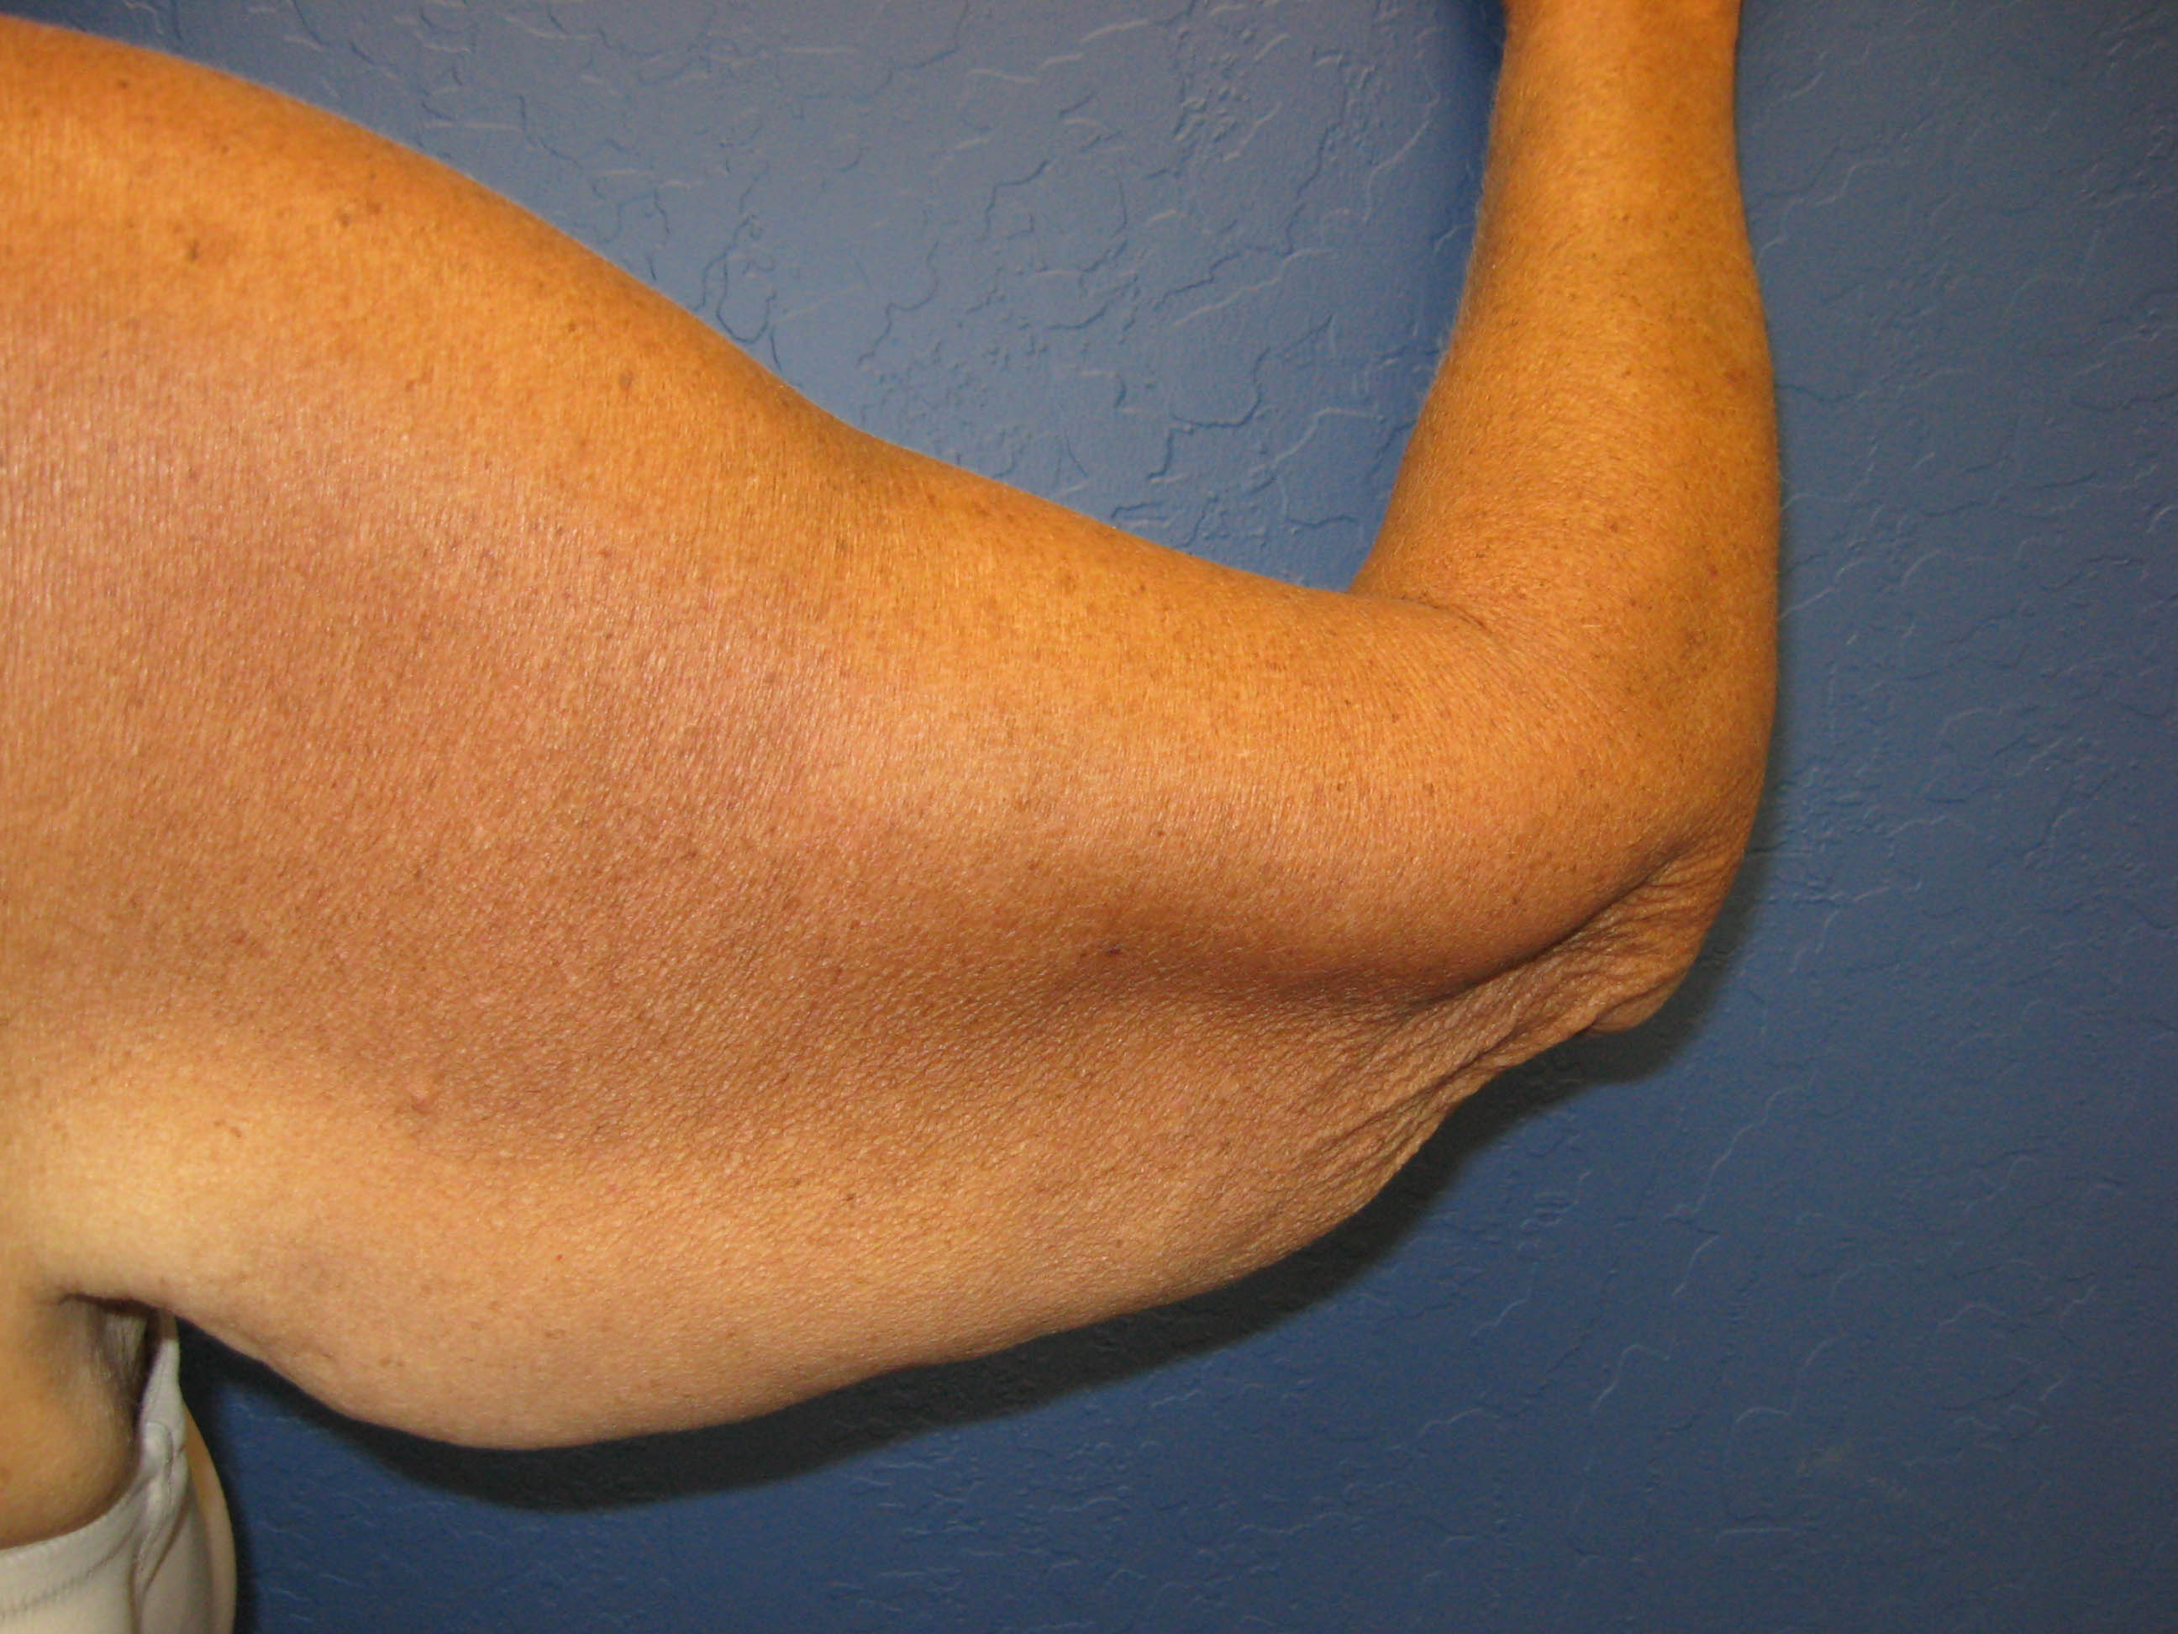
For Example
When the arm circumference near the shoulder is much > the arm circumference near the elbow=poor cuff fit=inaccurate BP
A large arm circumference + a short humeral length = an inaccurate BP utilizing a cylindrical thigh cuff due to cuff extension past the elbow

Slide 23
Mis-cuffing in an Obese Patient
Using a cuff that is too small can overestimate blood pressure by up to 30 mm Hg whereas using a cuff that is too large can underestimate blood pressure by 10-30 mm Hg
      Palatini P, Parati G. Blood pressure measurement in very obese patients: a challenging problem. Journal of Hypertension 2011, 29 (3) 425-429.

Slide 24
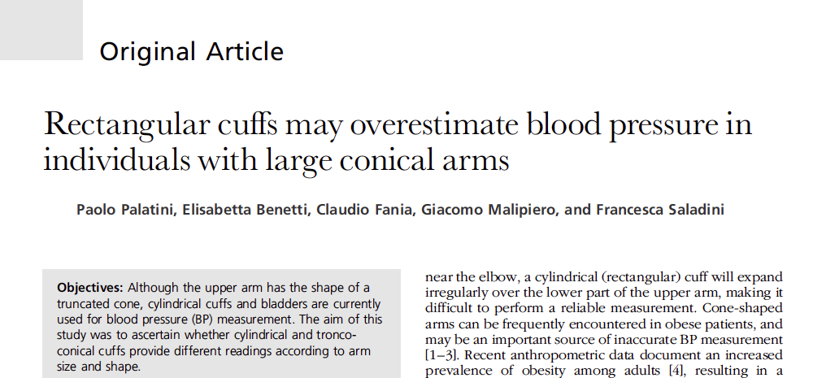
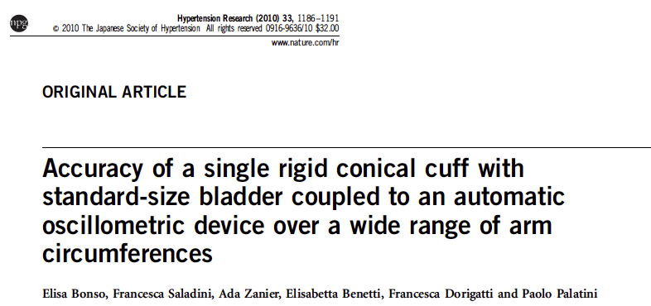
Conclusion: In obese people, the upper arm may have a pronounced tronco-conical shape and cylindrical cuffs may overestimate BP. Troco-conical cuffs should be used for BP measurement in individuals with large arms
Journal of Hypertension 2012, 30:530-536
Conclusion: Use of cylindrical cuff in combination with an oscillometric automatic device, overestimated SBP in patient with arm circumference > 30 cm, but when a conical cuff was used, the device provided accurate readings
Notes:
There is more and more evidence in the literature that conical shaped cuffs give the most accurate measrements but very few hospitals have them.

Slide 25
AHA BP Measurement Recommendations
If upper-arm circumference is more than 34 cm, large adult cuffs or thigh cuffs can be used.
For upper-arm measurements greater than 50cm, the AHA recommends using a cuff on the forearm and feeling for the appearance of the radial pulse at the wrist to estimate systolic BP. The accuracy however is not as reliable.
Notes:
Most of the evidence discourages a forearm measurement as an alternative to upper arm using an automated device.

Slide 26

So What Can We Do to Improve BP Measurement Accuracy?

Slide 27
Education Strategies
Ensure proper training of staff:
  Incorporate accurate BP measurements in annual “skills day”
  Develop a facility specific module
  NEJM BP Training: http://www.nejm.org/doi/full/10.1056/NEJMvcm0800157
  Poster Boards
  Laminate “Steps to Obtain Accurate Blood Pressure” and post on units

Slide 28

BP Kit
Selection of cuff sizes
Sphygmomanometer
Measuring tape
Stethoscope
Laminated instructions for cuff measurements and key actions
Optional: Reflex hammer, debrief tool
Notes:
One hospital implemented disposible automated cuffs in L&D. Benefits: Better fit for more accurate readings, Follows patient wherever she is to ensure accurate size cuff is used for subsequent BP readings, improved infection control, latex free and disposible.

Slide 29
Strategies for Implementation of Accurate BP Measurements
Create your “Burning Platform”
Inventory your equipment to and make sure that it is regularly inspected, calibrated and validated
Ensure that all staff are trained in standardized BP measurement technique
Update protocol to reflect current recommendations and guidelines
Notes:
In order to engage people you need to convince them there is a problem. Use hard data, show the evidence, and use stories to evoke emotional engagement by the team.

Slide 30

Thank You

