Slide 1

MNO OB Toolkit Committee
April 18, 2018
11:00AM – 12:00 PM

Slide 2
Overview
Toolkit Outline
What did you like
What needs to be fixed
New items
Next Steps

Slide 3


Slide 4
Toolkit Organization

Slide 5
OB Toolkit Sections
Toolkit Section
ILPQC Materials
General Resources & National Guidance ACOG committee opinions Presentations Miscellaneous
Prevention Patient Education Provider Education Bias and Stigma
Screening and Linkage to Care Screening Tools Screening Protocols and Clinical Guidelines
Optimizing Care for Moms Guidelines Contraceptive Counseling Breastfeeding
Example Protocols

Slide 6
Summary of feedback

Slide 7
Process for Including Documents in Final Version of Toolkit
Items ranked 4+ were included
Items with a ranking of 3 were included if they:
  Aligned with a structure measure without a resource ranked with a 4 or 5
Items ranked below 3 were not included

Slide 8
Prevention Measures
Reduce opioids prescription for routine deliveries
  Number of opioids prescribed for routine vaginal and cesarean deliveries
Hospital has established a protocol for providing education materials to pregnant and postpartum patients on OUD and pain management strategies during pregnancy and postpartum
Hospital has provided affiliated prenatal care sites with education materials for pregnant and postpartum patients on OUD and pain management strategies during pregnancy and postpartum
Hospital has implemented protocol and any necessary system changes for OB providers to document use of the Prescription Monitoring Program (PMP) look up prior to prescribing opioids to pregnant and postpartum patients in accordance with Illinois state law
At the end of this quarter, percentage of opioid prescriptions at delivery discharge with PMP lookup documented
Hospital has implemented protocol for practice guidelines for pain management to reduce postpartum opioid use after routine vaginal and cesarean deliveries

Slide 9
Prevention: What did you find?
Robbin Uchison & Kate Aliaga
What was most valuable?
What is missing, what needs to be improved?
Discussion Topics (on upcoming slides):
  What are the top patient education materials?
  Focus group patient materials
  PMP Lookup
  Measures with one resource

Slide 10
Patient Education Materials
Item # | Org | Resource | Measure | Comments
1 | ACOG | ACOG_OUD_Patient Ed Fact Sheet | 1
5 | CDC | CDC_pregnancy_opioid_pain_factsheet | 1 | Good for triage handout?
12 | MOD | MOD_Opioids-health-action-sheet- 10-13-17 | 1 | Can be used in clinic or at hospital – like that it has Spanish version
2 | ACOG | ACOG_OUD_Tobacco, Alcohol, Drugs, Pregnancy FAQ | 2 | Like #1 better but both good Q&A format for patient use
4 | NNEPQIN | Barbara Bush Hospital_Care for You and Your Baby_Patient Letter | 2 | Could be used in prenatal clinics/offices or given at the hospital – very informative
9 | MOD | MOD_Alcohol during pregnancy | 2 | Short and to the point, easy for patients to understand
10 | MOD | MOD_Heroin and pregnancy | 2 | Short and to the point, easy for patients to understand
11 | MOD | MOD_Marijuana and pregnancy | 2 | Short and to the point, easy for patients to understand
14 | MOD | MOD_Prescription opioids during pregnancy | 2 | Mother to baby fact sheets are helpful and include breastfeeding info
17 | OTIS | MotherToBaby_Benzodiazepines Fact Sheet | 2
18 | OTIS | MotherToBaby_Buprenorphine Fact Sheet | 2
19 | OTIS | MotherToBaby_Codeine Fact Sheet | 2
20 | OTIS | MotherToBaby_Fentanyl Fact Sheet | 2
21 | OTIS | MotherToBaby_Oxycodone Fact Sheet | 2
23 | OPQC | OPQC_NAS_parent_guide_092914 | 2 | Can be used both in clinics and at the hospital – great information and visuals – definitely include somewhere in toolkit – not focused on prevention but good explanation of what happens during LDR when patient is taking medications
30 | WAG | WAG_Brochure-Opioid-Pregnancy_Final | 2
27 | SAMHSA | SAMHSA_Methadone Treatment for Pregnant Women | None
Notes:
Highlighted items are what I am suggesting we keep

Slide 11
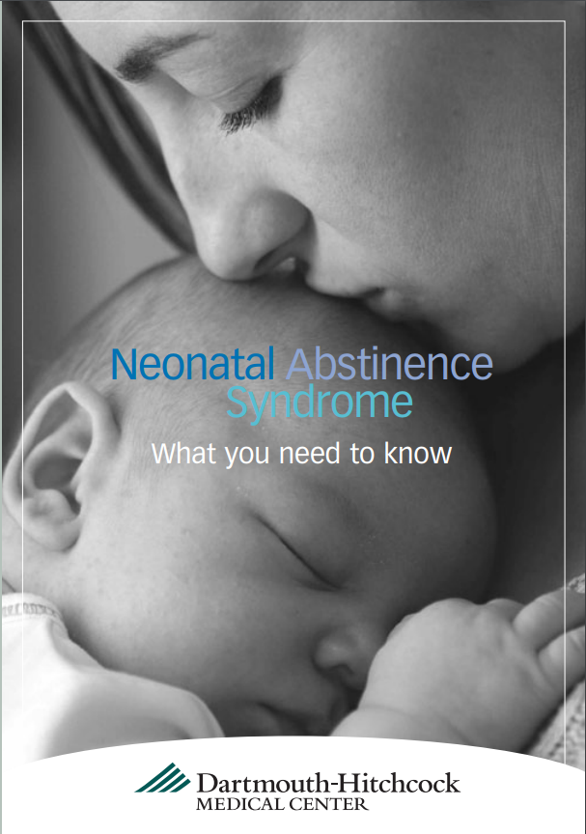

Patient Education
Materials Review
DECISION POINT: input on patient education resources for infant care receiving top marks from 2 patient focus groups (St. Louis and Rockford) and ILPQC Patient Advisors, pending results from Stroger (Chicago).
http://docs.wixstatic.com/ugd/55ea1e_284695f28e0a412895d471e299cd9787.pdf
http://www.overdosepreventionstrategies.org/wp-content/uploads/2016/09/Neonatal-Abstinence-Syndrome-%E2%80%93-What-you-need-to-know-Dartmouth-Hitchcock-Medical-Center.pdf

Slide 12
Prevention: PMP Look-Up Resources
Item # | Item Name | Org | How useful was this item (1 = not useful at all, 5 = very useful) | Structure measure(s) that this material aligns with (circle all that apply) | Comments
34 | DHS_42 CFR Part 8_MAT for Opioids Use Disorders | DHS | 1 2 3 4 5 | 1 2 3 4 5 None | Goes through law about PMP but very long
35 | IL_PMP_NewLaw | State of Illinois | 1 2 3 4 5 | 1 2 3 4 5 None | Gives important points about PMP law for providers
Is the Federal Guidance useful? Do we only want to include the IL law? Do we need to develop anything else for this measure?

Slide 13
Prevention
One recommended resource specifically for structure measures 5
One recommended resource for stigma/bias
  New resources – volunteer to review?
Do we need any others?
Item # | Organization | Resource | Measure(s) | Comments
33 | CDC | CDC_Guidelines for Prescribing Opioids for Chronic Pain | 5
46 | SAMHSA | SAMHSA_Words Matter_How Language Choice can Reduce Stigma | None
45 | SAMHSA | SAMHSA_Clinical-guidance-for-treating-pregnant-and-parenting-women-with-opioid-use-disorder-and-their-infants | 1, 2, 3, 4, 5 | Applies to ALL structure measures - great resource – very comprehensive
Notes:
New stigma resources: “NICU Experiences of Mothers of SEN’s”, The Mothering Experiences of Women with Substance Use” and “Try Not to Judge”

Slide 14
Screening & Linkage to Care Measures
Improve identification of women with OUD and linkage to addiction care
  Percent of mothers with OUD at delivery in medication assisted treatment (MAT)*
  Percent of mothers with OUD at delivery screened for OUD in pregnancy
Hospital has completed Local OUD Treatment Resources Document to map local community resources (MAT/addiction treatment services/behavioral health support) for pregnant and postpartum women with OUD
Hospital has provided affiliated prenatal care sites completed Local OUD Treatment Resources Document of local community resources mapped (MAT/addiction treatment services/behavioral health support) for pregnant and postpartum women with OUD
Hospital has implemented a validated screening tool and protocol for screening of pregnant and postpartum women for OUD
Hospital has provided to affiliated prenatal care sites options for validated screening tools and sample protocols for screening pregnant and postpartum women for OUD
Hospital has implemented a protocol for women who endorse or screen positive for OUD to assess and link to MAT/addiction care/support services
Hospital has provided to affiliated prenatal care sites sample protocols for women who endorse or screen positive for OUD to assess and link to MAT/addiction care/support services

Slide 15
Screening & Linkage to Care: What did you find?
Elizabeth Unal & Deb Kamradt
What was most valuable?
What is missing, what needs to be improved?
Discussion topics (on upcoming slides):
  What screening tools to include?
  Opioid resource guide

Slide 16
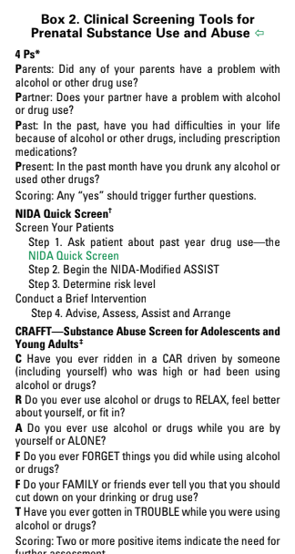
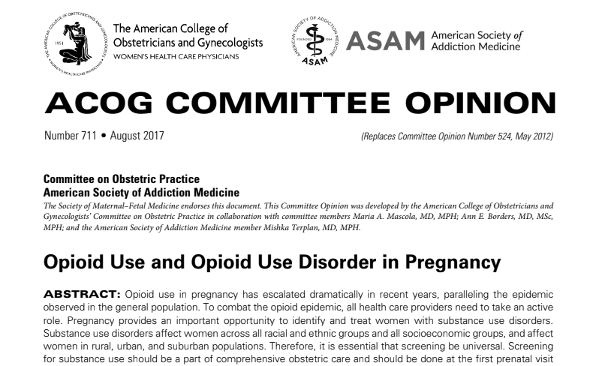
Screening & Linkage to Care
Structure this section after ACOG Committee Opinion #711
Should we include only these screeners in the toolkit?

Slide 17
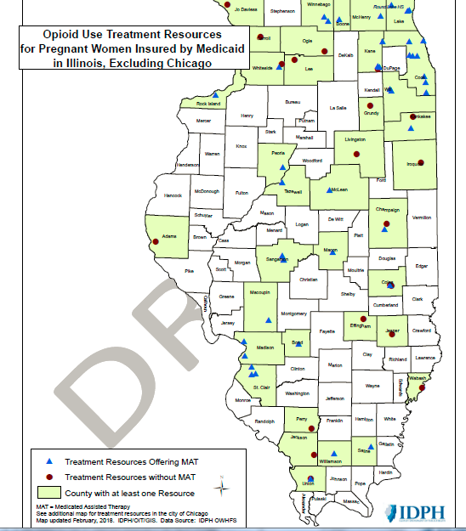
Opioid Resource Guide
More specific feedback about the Opioid Resource Guide?

Slide 19
Optimizing Care Measures
Improve care of women with OUD with standardized protocol / checklists for clinical care and support services during prenatal care, delivery, and postpartum
  Percent of women with OUD received Narcan counseling / offer documented prenatally or prior to maternal discharge
  Percent of women with OUD received contraception counseling / plan documented prenatally or prior to maternal discharge
  Percent of women with OUD receiving behavioral health / social work consult documented prenatally or prior to maternal discharge
Hospital has implemented standardized protocol and/or checklist for optimal management of patients with OUD during labor and postpartum
Hospital has provided to affiliated prenatal care sites sample standardized protocols and/or checklists for optimal prenatal management of women with OUD
Hospital has standardized use of materials for educating women with OUD, regarding OUD and pregnancy and mothers role in NAS newborn care (i.e. pediatric consult, patient education materials)
Hospital has provide to affiliated prenatal care sites standardized education materials for women with OUD, regarding OUD and pregnancy and mothers role in NAS newborn care (i.e. pediatric consult, patient education materials) with sample processes
At the end of this quarter, cumulative proportion of providers educated on OUD care protocols (Stigma reduction, Screening, assessment, community resources, linkage to care and optimal care during prenatal, intrapartum, and postpartum)
At the end of this quarter, cumulative proportion of nurses educated on OUD care protocols (Stigma reduction, Screening, assessment, community resources, linkage to care and optimal care during prenatal, intrapartum, and postpartum)

Slide 20
Optimizing Care: What did you find?
Anne Martin & Jessica Smith
What was most valuable?
What is missing, what needs to be improved?
Discussion topics (on upcoming slides):
  Pennsylvania opioid guidelines – Need to check if Toradol is safe for breastfeeding.
  Suggestions for development of checklists (next slide)
  Item #87 (NNEPQIN_10c.-HIV-Resources-for-Providers_v01.23.18) - Is this appropriate during pregnancy? Good resources listed.

Slide 21
Resources to Use for Checklist Development
Item # | Item Name | Organization | How useful was this item (1 = not useful at all, 5 = very useful) | Structure measure(s) that this material aligns with (circle all that apply) | Comments
74 | NNEPQIN_08a.-NNEPQIN-Breastfeeding-Guidelines-2.21.17-final | NNEPQIN | 1 2 3 4 5 | 1 2 3 4 5 6 None | Could be used to develop a protocol.
76 | PA_Opioid Guidelines OBGYN | State of Pennsylvania | 1 2 3 4 5 | 1 2 3 4 5 6 None | Pg. 5- Toradol and breastfeeding? Clarify with Pedi? Great point about prescribing opiates with acetaminophen. Could assist with developing unit protocols.
77 | PA_Use of Addiction Treatment Medications in Treatment of Pregnant Patients with Opioid Use Disorder | State of Pennsylvania | 1 2 3 4 5 | 1 2 3 4 5 6 None | Excellent provider and nurse education. Could assist with developing unit protocols. Great for inpatient induction and PP info. Could use to develop outpatient checklist?
81 | NNEPQIN_04.-Strategies-for-treating-concurrent-tobacco-use-disorder-01.23.18 | NNEPQIN | 1 2 3 4 5 | 1 2 3 4 5 6 None | Great info/facts in here. Great for providers or nurses to discuss with patients. Could be used to develop a checklist or protocol.
86 | NNEPQIN_10b.-Hepatitis-B-Screening-and-Diagnosis_v01.23.18 | NNEPQIN | 1 2 3 4 5 | 1 2 3 4 5 6 None | Could develop a checklist and use to educate nurses or providers.

Slide 22
Essential edits

Slide 23
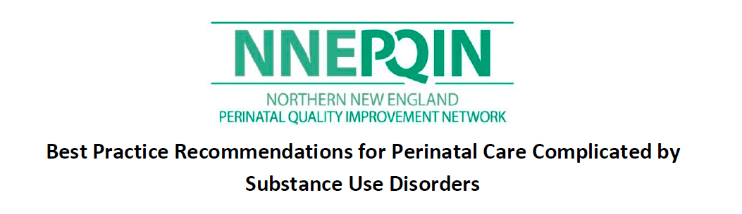
Sample Protocol
Feedback from Barb Parilla:
  Any protocol used should strongly encourage smoking cessation counseling/treatment as tobacco use is significantly associated with higher rates of NAS.
  Should not "consider" using the PDMP but absolutely need to look up patient's history.
  3 post partum visits (1-2, 4 and 6 weeks) seem like a lot for a general OB

Slide 24
Toolkit gaps

Slide 25
More Information Needed
Need more information about PMP lookup
General contraceptive counseling resource (will pull this from IPLARC toolkit)
NAS Parent Education guide to be reviewed by neonatology (item #84, NNEPQIN_09c.-NAS-parent-education-guide)

Slide 26
Next steps

Slide 27
Additional Materials to Review
ACOG District II Opioid Bundle Slide Deck
AIM toolkit resources – do we need permission to use these?
Infant Feeding Decisions
Parental Duse Use as Child Abuse (childwelfare.gov)
Reports of Child Abuse and Neglect (Illinois.gov)

Slide 28
Next Steps

