Slide 1
Storyboard Instructions Adapted from the New York State Perinatal Quality Collaborative (NYSPQC)
This is a Storyboard template. Feel free to change font size, color, add slides, or use your own pages, but please provide as much information as possible that is requested in this template.
At the Face-to-Face Learning Session, use the Storyboard to tell your team’s story descriptively, clearly and creatively – photos, collages and illustrations are welcome.
There is no wrong way to create a Storyboard so don’t be afraid to be creative. Additionally, be sure to keep it simple; the Storyboard is not meant to be an extremely time-consuming project.
Storyboards must fit into a space approximately 28 x 40 inches. It may be created from a collection of letter-sized sheets (print outs of your power point slides or word documents) that are convenient for carrying while traveling. Seven to eight pages fit easily in the available space – depending on arrangement - but more can be accommodated by overlapping pages (see Slide 11 for sample layouts). Boards for posting and pushpins will be provided at the Face-to-Face.
Display Tips
Fewer words: More pictures and graphics
Real people pictures… At least of your teams
Font size as big as possible
Fancy not necessary
Color to highlight key messages (If you don’t have a color printer, use bright highlighters)
Clear titles and labels if you use graphs (X and Y axes, dates, brief explanation of what it shows)

Slide 2
Storyboard Template for Illinois Teams
Adapted from the New York State Perinatal Quality Collaborative (NYSPQC)

Slide 3
Hospital and Team Description
Describe your Hospital and your improvement team
List team members and their roles
Brief description of your hospital demographics
Other additional information about cultural groups or important demographics others should know about you

Slide 4
Process Flow Diagram
Share process flow diagram for severe maternal hypertension (can be from any unit)

Slide 5
Time to Treatment
Share time to treatment data and strategies

Slide 6
Patient Education
Share patient education data and strategies

Slide 7
Discharge Follow-up
Share discharge follow-up data and strategies

Slide 8
Debrief
Share data on debriefing and strategies

Slide 9
Successes
Identify key successes in working towards goals on process measures for HTN initiative

Slide 10
Opportunities for Improvement and Sustainability
Identify opportunities for improvement for last 6 months of HTN initiative
Start thinking about sustainability planning and sharing ideas

Slide 11
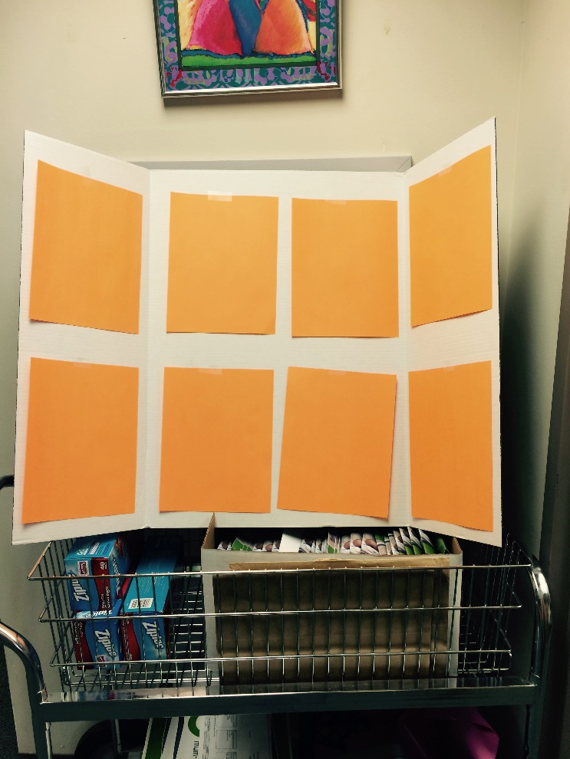
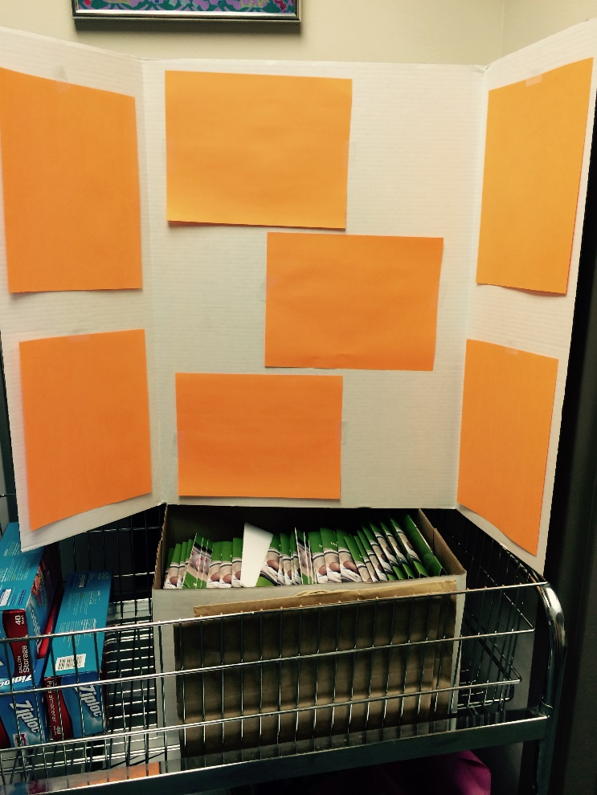
Sample Layouts
With 4 portrait oriented sheets in the middle panel
With 3 landscape oriented sheets in the middle panel

