Slide 1

Illinois Maternal Hypertension Initiative: Improving Outcomes through Evidenced Based Practice
Presented by:

Slide 2
Acknowledgments
This slide set was adapted from materials created by the following groups:
FPQC Hypertension in Pregnancy Initiative
  http://health.usf.edu/publichealth/chiles/fpqc/hip
CMQCC Preeclampsia Collaborative
  https://www.cmqcc.org/projects/past-projects/cmqcc-preeclampsia-collaborative
ACOG DII (New York) Safe Motherhood Initiative
  https://www.acog.org/About-ACOG/ACOG-Districts/District-II/Safe-Motherhood-Initiative
AIM Severe Hypertension in Pregnancy Bundle
  http://www.safehealthcareforeverywoman.org/secure/hypertension-bundle.php

Slide 3
ILPQC Severe Maternal Hypertension Initiative

Slide 4
Background
Worldwide and in the United States, hypertension is one leading cause of pregnancy-related deaths (PRDs) before, during, or after delivery.
Reports from North Carolina and California state that maternal deaths due to hypertension had significant prevention opportunities. (Berg, C. et al., 2005 & California Department of Public Health, 2011)

Slide 5
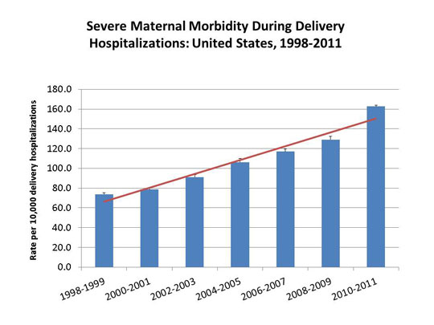
Maternal Morbidity

Slide 6
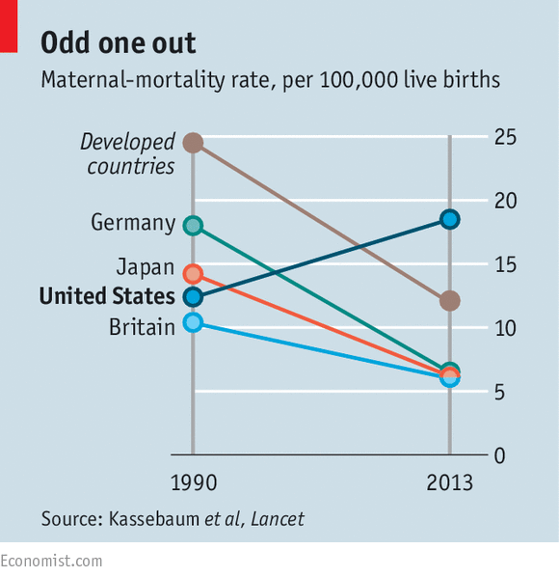
Maternal Mortality

Slide 7


Maternal Mortality Rate, California Residents: 1970-2010
15.5
PreE
Taskforce
14.0
PreE
Toolkit
Hemorrhage
Taskforce
Hemorrhage
Toolkit
Notes:
Maternal mortality in California is increasing and is as high as it was in the 1970’s. Why is maternal mortality increasing?
Changes in the coding of maternal deaths on death certificates may account for some (i.e., 30%) of the increase (Hoyert, 2007)
In addition, more pregnant women have chronic health conditions that contribute to worse outcomes
Numerous social factors (poverty, reduced education, exposure to chronic stress)
Hospital quality of care and health care provider issues also contribute to some degree
CA maternal deaths are decreasing after state wide initiatives of the CA Maternal Quality Collaborative for Hemorrhage and Hypertension

Slide 8
Prevalence – ACOG 2013
Incidence of preeclampsia has increased by 25% in the past 20 years
Preeclampsia causes an estimated 60,000 maternal deaths yearly worldwide
There are 50 –100 near misses for every maternal death
Preeclampsia is a risk for future cardiovascular disease
Notes:
This slide provides some background on the importance of addressing Hypertension in Pregnancy.
Read slide. For more detail, please see the FPQC Slide Set “HIP Mortality Data Background”

Slide 9
Only 5 things
Classification Maternal Hypertension:
1) GHTN
2) PE
3) PE with severe features
4) CHTN
5) CHTN+PE

Slide 10

Management Maternal Hypertension
1) Recognize Symptoms
2) BP control
3) Seizure prevention
4) Delivery- 34 wks, 37wks.
5) Postpartum surveillance
Only 5 things

Slide 11

Where are the gaps?
Contributing Factors to Maternal Death | Preeclampsia | TOTAL
HEALTHCARE PROFESSIONALS | 96% | 79%
Delay in Diagnosis | 92% 1.7x | 54%
Use of Ineffective Treatment | 79% 1.6x | 42%
Misdiagnosis | 54% 1.7x | 31%
HEALTHCARE FACILITY | 12 (48%) | 72 (50%)
CA-PAMR 2002-2004

Slide 12
Where are the gaps?
Contributing Factors to Maternal Death | Preeclampsia | TOTAL
PATIENT FACTORS | 64% | 72%
Delay or Failure to Seek Care | 63% 2.4x | 26%
Lack of Understanding of the Importance of Health Event | 56% 3.7x | 15%
CA-PAMR 2002-2004

Slide 13

Maternal Recognition Improves
Outcomes
Symptoms of Preeclampsia
Patient seeks care
Escalate level of care
MgS04
Antihypertensives
Steroids for Baby
Delivery
Improved Outcome
“The best way to diagnose preeclampsia is to listen to your patients.”
~ Dr. Baha Sibai
(c) 2015 Preeclampsia Foundation
Notes:
Patient education of course does not prevent preeclampsia (or hemmorage or AFE), but of the thousands of women in our database, an alarmingly high number of them have lost babies or had adverse outcomes that could have been mitigated by getting to care earlier in the process. “If only I knew...” is a common refrain.
In short, patient education improves recognition of symptoms, leading women to seek care and advocate for themselves, allowing for some interventions, leading to improved outcomes.
And this applies to the postpartum period as well.
As illustrated by Joan’s story, preeclampsia symptoms education MUST be included in discharge instructions, as well. The post-partum period is a particularly vulnerable time, exacerbated by hormonal changes, a natural rise in blood pressure, sleep deprivation, and everybody’s focused on the new baby, not so much mom.
Evidence supporting the need for more preeclampsia information for patients is clear when you look at the California data, for instance.

Slide 14
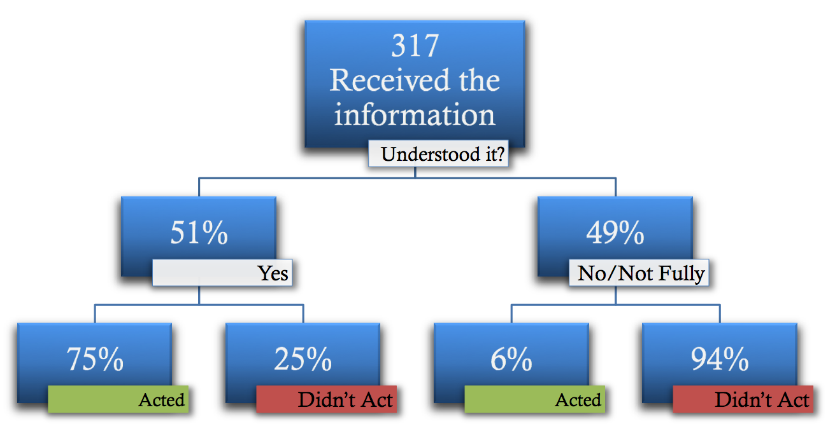
Did Comprehension Lead to Action?
1:5 recalled information and understood it!
75% v.6% acted if they had symptoms
J Mat-Fet Neo Medicine 2013
Notes:
And of THOSE 317 women, about half reported fully understanding the explanation. The education bias in our sample doesn’t bode well for the rest of the population that is not as well-educated.
But here’s the most interesting part, I think. Of THOSE women, who got it and understood it, 75% acted upon this knowledge by promptly reporting symptoms, going to the hospital, monitoring their own blood pressure, or complying with an order of bedrest.
Of those who did NOT understand their providers’ explanations, only 6% acted upon their symptoms.
14

Slide 15
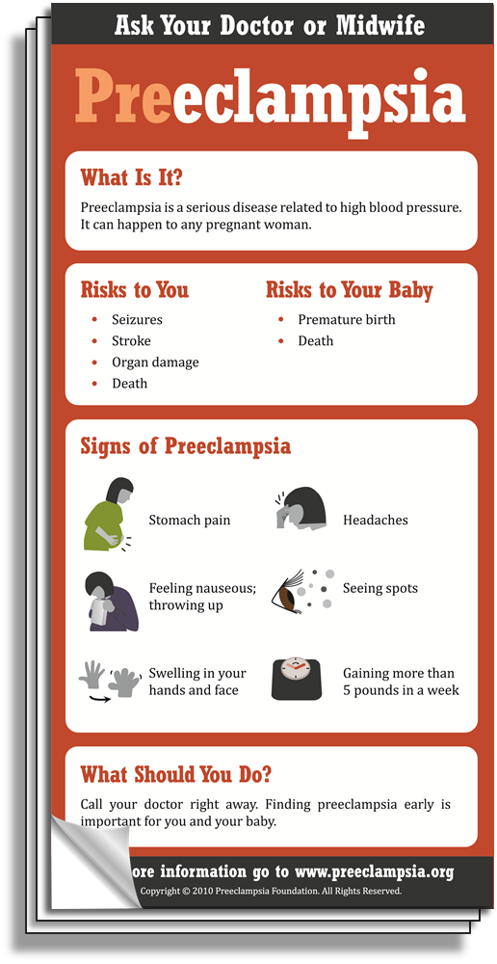
What is it?
Why should
you care?
What should you
pay attention to?
What should you do if you
have any of the signs?
Am J Obstet Gynecol 2012
Notes:
[TEAR PAD]
Our illustrated tear pad uses many of these same principles, chunking up information into bite sized pieces, reinforcing simple simple messages with pictorial representations. This btw is available in English and Spanish for just the cost of shipping via our website. preeclampsia.org/store

Slide 16
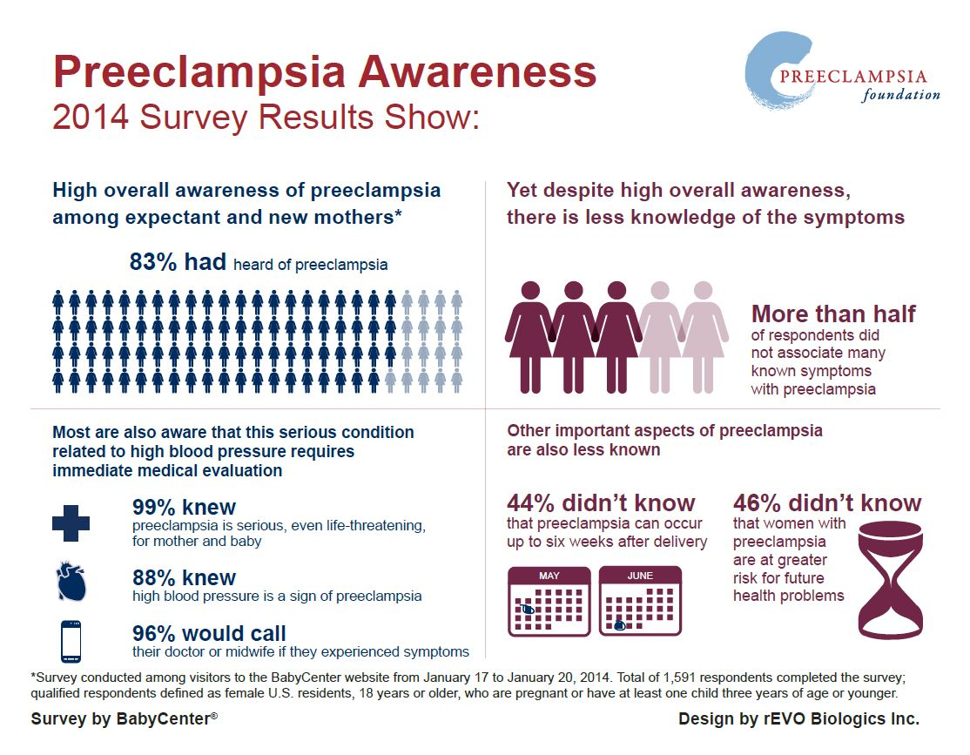
Notes:
We think we’re doing something right because more recently, in 2014, we partnered with BabyCenter.com (a site that is regularly used by 80% of all pregnant women) to conduct a market survey and found that awareness of preeclampsia has gone up considerably with 83% of expectant and new mothers having heard of preeclampsia.

Slide 17
Key Clinical Pearl
Patients with vague symptoms of:
  headache
  abdominal pain (possibly “referred” pain to neck, shoulder, back)
  shortness of breath
  generalized swelling, extreme weight gain
  complaints of “I just don’t feel right”
  Visual disturbances
Need to be evaluated for atypical presentations of preeclampsia with “severe features”
Am J Obstet Gynecol. May 2009;200(5):481 e481-487.

Slide 18
Historically How Well
Do We Treat Maternal BP?
Common Mistakes:
Treating only if diastolic pressure >110
Treating BP with magnesium
Not treating if there is no proteinuria
Waiting for 6 hours

Slide 19
Reaffirmed 2012

Slide 20
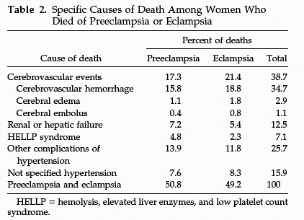
Cause of U.S. Maternal Mortality
CDC Review of 14 years of coded data: 1979-1992
4024 maternal deaths 790 (19.6%) from preeclampsia
90%
of CVA were from hemorrhage
MacKay AP, Berg CJ, Atrash HK. Obstetrics and Gynecology 2001;97:533-538
Notes:
Deaths from Preeclampsia
We have made no progress with regard to preventing maternal death from hemorrhagic cerebral vascular accidents.

Slide 21
BP Associated Major Morbidity
Stroke
Placental Abruption
Eclampsia
Cerebral Edema/PRES
Retinal Detachment
Liver Hematoma/Rupture
Renal Failure
Hemorrhage/DIC
Pulmonary Edema
Ascites/pleural effusion

Slide 22
Blood Pressure Control and Stroke
antihypertensive
  23/24 (95.8%) women with systolic BP > 160mm Hg
  24/24 (100%) had a BP ≥ 155 mm Hg
  3/24 (12.5%) women with diastolic BP > 110mm Hg
  5/28 (20.8%) women with diastolic BP > 105mm Hg
Martin JN et al. Stroke and Severe Preeclampsia and Eclampsia:
A Paradigm Shift Focusing on Systolic Blood Pressure, Obstet Gynecol 2005;105-246.

Slide 23
Preeclampsia Treatment Recommendations
Systolic ≥ 160 | Diastolic ≥ 110 | Repeat BP and Treat Within 30-60 minutes (ideally ASAP)
≥155 | ≥105-110 | Alternative triggers*
Recommendations apply to all forms of hypertension:
Gestational HTN = Preeclampsia = chronic HTN
Notes:
Treatment should be initiated for blood pressures that are ≥160 mm Hg systolic or 105-110 mm Hg diastolic.
Alternative triggers that have been discussed in Martin’s study (2005), suggest that treatment should be initiated at a lower threshold of 155/105 if the primary goal is to reduce maternal intracranial hemorrhage, which remains the leading cause of death from preeclampsia.⁴

Slide 24

ILPQC Maternal
Hypertension Initiative
Aim: Reduce the rate of severe morbidities in women with severe preeclampsia, eclampsia, or preeclampsia superimposed on pre-existing hypertension by 20% by December 2017
Approach: Established workgroup (1/2015), identify hospital teams (5/2016), implement evidence-based practices / protocols / AIM HTN Bundle (6/2016-12/2017)
OB Advisory Workgroup and HTN Clinical Leadership Team developed process/outcome measures, toolkit/education, data form and reports
  Input from IDPH SQC / PNAs / AIM Initiative / CA, NY, and NC
  Launched Wave 1 in January 2016 with 24 teams
  Launched Wave 2 on May 2, 2016 with 110 teams

Slide 25
What are we trying to accomplish?
Early recognition of hypertension and correct diagnosis during and after pregnancy
Reduce time to treatment of severe range blood pressure, 160/110(105)
Deliver not too early and not too late
Provide patient education and appropriately timed follow up
Implementation of evidence based protocols for treatment and management of severe HTN / preeclampsia / eclampsia
Notes:
First and foremost, early recognition of hypertension in pregnancy is vital to managing the potential impacts. Blood pressure must be treated and guidelines have been established including treating within one hour of confirmed readings. Magnesium sulfate is not a blood pressure medication, it is for seizure control and is recommended for use in preeclampsia with severe features local protocols need to be developed and followed. Women with hypertension in pregnancy require close follow up and the full HIP toolkit provides recommendations for all women postpartum. There is a two-sided one page document in the HIP toolkit that you may find helpful in assuring that you utilize elements of the Patient Safety Bundle developed by ACOG, SMFM, AWHONN, and others for readiness, recognition, response and reporting.

Slide 26

Key Clinical Pearl:
160/110 vs. 160/105
Controlling blood pressure
is the optimal intervention
to prevent deaths due to stroke
in women with preeclampsia.
The critical initial step in decreasing maternal morbidity and mortality is to administer anti-hypertensive medications as soon as possible (< 60 minutes) of documentation of persistent (retested within 15 minutes) BP ≥160 systolic, and/or >105-110 diastolic
Clark SL, Hankins GD. Preventing maternal death: 10 clinical diamonds. Obstet Gynecol 2012;119:360–4.

Slide 27
Need
To
Treat*
BP ≥
160/110(105)
*BP persistent 15 minutes, activate treatment algorithm with IV therapy ASAP, < 30-60 minutes

Slide 28
ILPQC HTN Initiative
Goal & Measures
Goal: Reduce preeclampsia maternal morbidity
IL Measure | Type | Goal
Severe Maternal Morbidity No. of women with severe maternal morbidities (e.g. Acute renal failure, ARDS, Pulmonary Edema, Puerperal CNS Disorder such as Seizure, DIC, Ventilation, Abruption) / No. pregnant & postpartum women with new onset severe range HTN | Outcome | 20% reduction
Appropriate Medical Management in under 60 minutes No. of women treated at different time points (30,60,90, >90 min) after elevated BP is confirmed / No. of women with new onset severe range HTN | Process | 100%
Debriefs on all new onset severe range HTN* cases | Process | 100%
Discharge education and follow-up within 10 days for all women with severe range HTN, 72 hours with all women with severe range HTN on medications | Process | 100%
Severe range HTN: ≥160 systolic / ≥110(105) diastolic per hospital standard
*New onset severe range HTN: first episode of persistent severe range HTN (lasting >15 minutes) in a hospitalization (ER, L&D, or other inpatient setting), can be chronic HTN, gestational HTN, preeclampsia and/or postpartum diagnosis.

Slide 29
Opportunities for Quality Improvement
Early recognition of hypertension and response to clinical triggers of preeclampsia (pregnant and pp)
Importance of accurate BP measurement and identify severe range BP across all units.
Reduce time to treatment for BP >160/110(105)
Implement standardized use of ACOG protocols for acute treatment of severe range BP
Coordination of care (L&D, PP, ED, ICU) and timely evaluations and consultations
Postpartum follow-up and patient education

Slide 30
Where to start?
Staff education and standardized BP measurement
Rapid access to medications
IV treatment of BP’s ≥ 160mmHg systolic or ≥ 110(105) mmHg diastolic within 30-60 min
Standardize treatment algorithms / order sets
Early postpartum follow-up
Standardized postpartum patient educational materials.

Slide 31

Importance of
Obtaining Accurate
Blood Pressure
Failing to accurately measure blood pressure in a consistent manner can lead to misdiagnosis, delays in treatment, worsening disease, increased morbidity and even death.
Accurate blood pressure measurement is essential for clinical decision making
  Correct positioning of the woman
  Proper equipment (cuff sizes and shapes; calibrated readings)
Notes:
Hypertension in pregnancy is one of the leading causes of maternal mortality and morbidity. Having a standardized assessment of blood pressure is important to the early recognition and management of hypertension in pregnancy. Preeclampsia had the possibility of quickly becoming severe and resulting in seizures, strokes and other associated syndromes. In order to make good clinical decisions it is necessary to have accurate consistent assessments. To do this equipment must be appropriate in size and shapes of cuffs and well maintained.

Slide 32
Clinical Pearls
Take time to use correct equipment and measure her arm
Position the woman correctly
Initial blood pressure should be assessed after the woman has been resting with minimal distraction for 5 minutes.
BP ≥160/110(105) lasting for 15 minutes should be treated in under 30-60 minutes
Initial BP is ≥
140 systolic OR
≥ 90 diastolic
Repeat blood pressure in 15 minutes
Take in the same arm
Initial BP is ≥
160 systolic or
≥ 110(105) diastolic
Notify provider after first elevated BP
Reassess after 15 minutes
Do not reposition to side-lying
Activate treatment algorithms if remains ≥160/110(105)
Evaluate for preeclampsia
Activate Severe HTN Treatment Algorithm
Notes:
There are several key elements to accurate blood pressure. (read slide)

Slide 33
Hypertensive Medication
Administration Oral versus IV
First line therapy recommendations for acute treatment of critically elevated BP [>160/110(105)] are with either IV labetalol or hydralazine.
In a patient without IV access oral immediate release nifedipine may be used (10 mg) and may be repeated in 30 minutes.
PO (oral not sublingual) nifedipine appears equally as efficacious as IV labetalol in correcting severe BP elevations.
PO labetalol would be expected to be less effective in acutely lowering the BP due to its slower onset to peak and thus should be used only if nifedipine is not available in a patient without IV access.
ACOG Practice Bulletin #33, Reaffirmed 2012; ACOG Committee Opinion #514, 2012; Tuffnell D, Jankowitcz D, Lindow S, et al. BJOG 2005;112:875-880.

Slide 34
Hypertensive Medication Administration: Oral v. IV
IV Labetalol
  Onset: 2-5 min
  Peak: 5 min
PO Labetalol:
  Onset: 20 min-2 hrs
  Peak: 1-4 hrs
IV Hydralazine
  Onset: 5-20 min
  Peak: 15-30 min
PO Nifedipine
  Onset: 5-20 min*
  Peak: 30-60 min
*PO, (oral) not sublingual nifedipine, onset of action is 15-30 minutes depending on the reference source.
Am J Emerg Med. 1985 (6):524-30
BJOG 2012;119:78-85.
http://www.uspharmacist.com/content/d/feature/i/1444/c/27112/

Slide 35
Severe Hypertension Treatment
Algorithm
SBP > 155 and/or DBP > 105
Provider Notified
Blood Pressure Triggers
SBP ≥ 160 and/or DBP ≥ 110
Repeat in 15 minutes.
Notify Provider and Proceed
IV Access
FHR monitoring
Labs per PIH Order Set Pulse Oximeter
IV Anti-Hypertension Meds
First Line Medications
Seizure Prophylaxis
IV Labetalol
20 mg (over 2 min)
IV Hydralazine
5 or 10mg (over 1-2 min)
Per physician’s order
Magnesium Sulfate
Repeat BP in 10 min
If elevated, administer
IV Labetalol 40 mg
Repeat BP in 20 min
If elevated, administer
IV Hydralazine 10 mg
Bolus Dose: 4gm over 20 minutes
Maintenance Dose: 2gm per hour
Repeat BP in 10-15 min If elevated, administer
IV Labetalol 80 mg
Repeat BP in 20 min
If elevated, administer
IV Hydralazine 10 mg
PO Nifedipine If no IV access Initial Dose: 10 mg
May repeat dose at 20 minute intervals for a maximum of
5 doses.
Repeat BP in 20 min
If elevated,
IV Hydralazine
pre algorithm
anesthesia consult
Repeat BP in 20 min
If elevated, IV Labetalol 20 mg
pre algorithm
anesthesia consult

Slide 36
Key Clinical Pearl
Algorithms for acute treatment hypertension and eclampsia should be readily available or preferably posted in all clinical areas that may encounter pregnant women.
Notes:
SEGUE: One bundle that the Council on Patient Safety is still working on and hopes to deploy before the year is out is a Patient, Family and Staff support bundle. Eleni is going to talk a bit about that and what you can do even before it comes out.

Slide 37
ACOG protocol
Standing Order (Labetalol)
Labetalol 20 mg IV over 2 minutes
If still elevated, labetalol 40 mg IV over 2 min
If still elevated, labetalol 80 mg IV over 2 min
Recheck in 10 min
Recheck in 10 min
Recheck in 10 min
If still elevated, Repeat labetalol 80mg over 10 minutes to achieve total dosage of 220mg (includes all previous administrations)
Recheck in 20 min
Switch to hydralazine 10 mg IV over 2 min
Seek consultation MFM, Critical Care, Anesthesia, Internal medicine
Target B/P
140 to <160 or 90-100
Notes:
1. Notify physician if systolic BP measurement is greater than or equal to 160 mm Hg or if diastolic BP measurement is greater than or equal to 110 mm Hg.
2. Institute fetal surveillance if undelivered and fetus is viable.
3. Administer labetalol (20 mg IV over 2 minutes).
4. Repeat BP measurement in 10 minutes and record results.
5. If either BP threshold is still exceeded, administer labetalol (40 mg IV over 2 minutes). If BP is below threshold, continue to monitor BP closely.
6. Repeat BP measurement in 10 minutes and record results.
7. If either BP threshold is still exceeded, administer labetalol (80 mg IV over 2 minutes). If BP is below threshold, continue to monitor BP closely.
8. Repeat BP measurement in 10 minutes and record results.
9. If either BP threshold is still exceeded, administer hydralazine (10 mg IV over 2 minutes). If BP is below threshold, continue to monitor BP closely.
10. Repeat BP measurement in 20 minutes and record results.
11. If either BP threshold is still exceeded, obtain emergency consultation from maternal–fetal medicine, internal medicine, anesthesia, or critical care specialists.
12. Give additional antihypertensive medication per specific order.

Slide 38
ACOG protocol
Standing Order (Hydralazine)
Hydralazine 5 or 10 mg IV over 2 minutes
Recheck in 20 min
If still elevated, hydralazine 10 mg IV over 2 min
Recheck 20 min
If still elevated, labetalol 20 mg IV over 2 min
Recheck in 10 min
If still elevated, labetalol 40 mg IV over 2 min
Emergency consults: MFM and anesthesia
Target B/P
140 to <160 or 90-100
Notes:
1. Notify physician if systolic BP is greater than or equal to 160 mm Hg or if diastolic BP is greater than or equal to 110 mm Hg.
2. Institute fetal surveillance if undelivered and fetus is viable.
3. Administer hydralazine (5 mg or 10 mg IV over 2 minutes).
4. Repeat BP measurement in 20 minutes and record results.
5. If either BP threshold is still exceeded, administer hydralazine (10 mg IV over 2 minutes). If BP is below threshold, continue to monitor BP closely.
6. Repeat BP measurement in 20 minutes and record results.
7. If either BP threshold is still exceeded, administer labetalol (20 mg IV over 2 minutes). If BP is below threshold, continue to monitor BP closely.
8. Repeat BP measurement in 10 minutes and record results.
9. If either BP threshold is still exceeded, administer labetalol (40 mg IV over 2 minutes) and obtain emergency consultation from maternal–fetal medicine, internal medicine, anesthesia, or critical care specialists.
10. Give additional antihypertensive medication per specific order.

Slide 39
ACOG protocol
Standing Order (Oral Nifedipine)
Nifedipine 10 mg PO (never crush or give SL)
Recheck in 20 min
If still elevated, nifedipine 20 mg PO
Recheck 20 min
If still elevated, nifedipine 20 mg PO
Recheck in 20 min
If still elevated, switch to labetalol or hydralazine protocol
Emergency consults: MFM and anesthesia, critical care or internal medicine
Notes:
1. Notify physician if systolic BP is greater than or equal to 160 mm Hg or if diastolic BP is greater than or equal to 110 mm Hg.
2. Institute fetal surveillance if undelivered and fetus is viable.
3. Administer nifedipine 10 mg PO
4. Repeat BP measurement in 20 minutes and record results.
5. If either BP threshold is still exceeded, administer nifedipine 20 mg PO. If BP is below threshold, continue to monitor BP closely.
6. Repeat BP measurement in 20 minutes and record results.
7. If either BP threshold is still exceeded, administer nifedipine 20 mg PO. If BP is below threshold, continue to monitor BP closely.
8. Repeat BP measurement in 20 minutes and record results.
9. If either BP threshold is still exceeded, administer labetalol (40 mg IV over 2 minutes) and obtain emergency consultation from maternal–fetal medicine, internal medicine, anesthesia, or critical care specialists.
10. Give additional antihypertensive medication per specific order.

Slide 40
Magnesium Sulfate & Nifedipine
3029 received Nifedipine for BP treatment
1469
1560
Magnesium
No Magnesium
Hypotension
0.4%
Hypotension
0.3%
Magpie Trial: Lancet 2002; 359:1877
Notes:
Hypotension not defined.

Slide 41
ACOG Sample Order Sets
Labetalol
Hydralazine
Nifedipine
Emergent therapy for acute onset, severe hypertension during pregnancy and the postpartum period. Committee Opinion No. 623. American College of Obstetrics and Gynecologists. Obstet Gynecol 2015; 125:521-5.

Slide 42
Timely Treatment of BP
CMQCC
Dignity Health
*
Notes:
Calculation not the same:
Pre-ACOG guidelines of 11/2013.

Slide 43
Magnesium Therapy:
Key Clinical Pearl
Magnesium sulfate therapy for seizure prophylaxis (DOES NOT TREAT HTN) should be administered to any patients with:
  Preeclampsia with “severe features” i.e., subjective neurological symptoms (headache or blurry vision), abdominal pain, epigastric pain, OR BP > 160/110
  Eclampsia
  Should be considered in patients with preeclampsia without severe features

Slide 44
Who Should Get Magnesium?
 | Mild Preeclampsia | Severe Preeclampsia | Eclampsia
ACOG | NU# | X | X
NICE |  | X | X
SOGC | X* | X | X
CMQCC | X* | X | X
WHO | X | X | X
* Should be considered: NNT = 109 for mild, 63 for severe
(NNT = number needed to treat)
# Not Universally”
Notes:
Rationale for ACOG for the lack of a recommendation in the case of mild preeclampsia was the need to treat 109 patients to prevent 1 case of eclampsia and the number to treat with severe preclampsia was 63.

Slide 45
Magpie Trial Collaboration Group
Do women with pre-eclampsia, and their babies, benefit from magnesium sulfate?
58% reduction in seizures
45% reduction in maternal death*
33% reduction in placental abruption
Magpie Trial: Lancet 2002; 359:1877
Notes:
The 45% reduction in maternal death is not statistically significant but clinically important.

Slide 46
CMQCC Collaborative:
Barriers to BP Treatment

Slide 47
BP Normalized
BP taken in sitting or semi-fowlers
Cuff size correct
Nurse verifies cuff placed correctly
Automated cuff calibrated
Verification occurs within 15 min of abnormal value

Slide 48
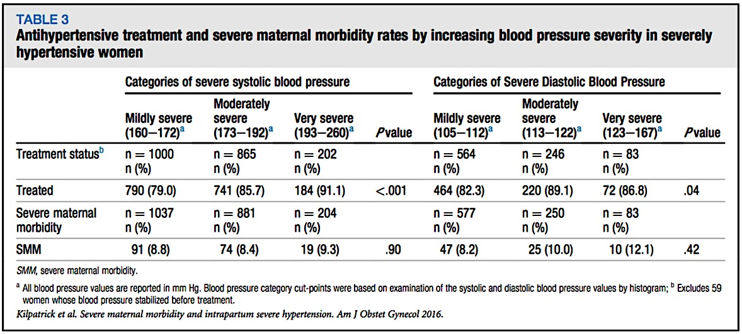
Blood Pressure and Severe Maternal Morbidity
Kilpatrick SJ, AJOG, 2016
“Did Not like The BP Parameters”
 | Mild | Moderate | Severe
Systolic BP | 160-172 | 173-192 | >192
Diastolic BP | 105-112 | 113-122 | >123
Notes:
Kilpatrick SJ, Abreo A, Greene N, et al. Severe maternal morbidity in a large cohort of women with acute severe intrapartum hypertension. Am J Obstet Gynecol 2016;215:91.e1-7.

Slide 49
Magnesium Sulfate
is not an antihypertensive
Primary effect is via CNS depression
Improves blood flow to CNS via small vessel vasodilation
Blood pressure after magnesium infusion:
  6 gm loading then 2 gm/hr.
 | sBP | sBP 30 min | sBP 120 min | dBP | dBP 30 min | dBP 120 min
Mild Group | 145 ±10 | 143 ±13 | 141 ±14 | 87 ±10 | 79 ±9 | 82 ±9
Hypertens Pregnancy. 2008;27(4):315-27.

Slide 50
“Prefer Oral Medication”
Meeting treatment goal of <155/105
NS

Slide 51
“Can Not Get Medication <30-60 min”
Work with pharmacy
Stock on labor and delivery with emergency override
Get Pharmacy and Therapeutics Committee to approve IV labetalol for use on OB floor
Nursing and OB education for use
Have emergency medication box

Slide 52
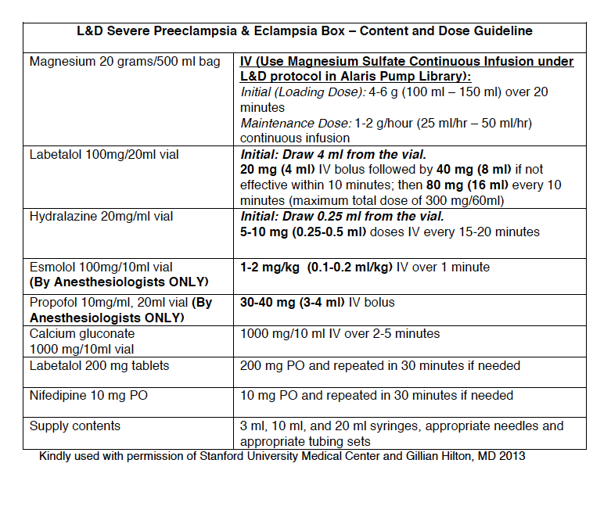
Emergency Medication Box for
Severe Preeclampsia and Eclampsia
Notes:
This is a sample Box from Stanford University. Each facility can customize their own box based on their hospital formulary.

Slide 53
“Competing Priorities”
Verify BP
IV access
Labs collected
Physician notified → chain of command
Antihypertensive medication
Magnesium sulfate started
Labs sent
Imaging or other diagnostics

Slide 54
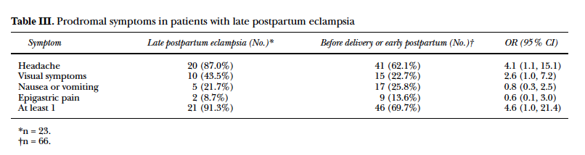
Postpartum Care –
Delivery is The Cure (except when it’s not)
91% had at least 1 prodromal symptom
52% had more than one prodromal symptom
100% had headache or visual symptoms
Only 33% (7/21) sought care for their symptoms
AUTHOR’S CONCLUSION: “...efforts should be directed to the education of the health care providers and patients regarding the importance of prompt reporting and evaluation of symptoms of preeclampsia during the postpartum period.”

Slide 55
Late Postpartum Eclampsia
>48 hours following delivery, up to 6 weeks PP
Accounts for approximately 15% of cases of eclampsia
63% had no antepartum hypertensive diagnosis
The magnitude of blood pressure elevation does not appear to be predictive of eclampsia
The most common presenting symptom was headache, which occurred in about 70% of patients; other prodromal symptoms included shortness of breath, blurry vision, nausea or vomiting, edema, neurological deficit, and epigastric pain
Al-Safi Z, Imudia A, Filetti L, et al. Delayed Postpartum Preeclampsia and Eclampsia. Obstet Gynecol. 2011;118(5):1102-1107.

Slide 56
Patient Discharge / Education
Postpartum/ discharge protocols should include:
  Management and verification of postpartum follow-up & BP check within 7 to 10 days post-discharge
  Standardize discharge patient education for women with preeclampsia and/or severe range HTN
  Discharge instructions to include warning signs of preeclampsia for ALL postpartum patients

Slide 57
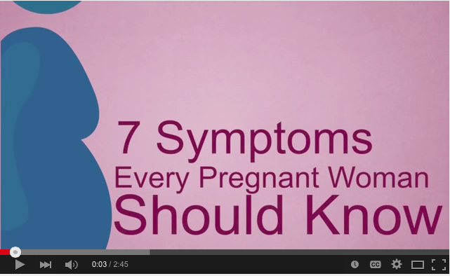


Materials for Prenatal &
Postpartum Patient Education
“7 Symptoms Every Pregnant Woman Should Know” video available in English and Spanish on YouTube™
You W, et al. Improving patient understanding of preeclampsia: a randomized controlled trial. Am J Obstet Gynecol 2012.
Notes:
Other patient education materials include:
Brochures
Magnets
Videos
Poster (avail. early 2016)
Providers can order at:
preeclampsia.org/store

Slide 58
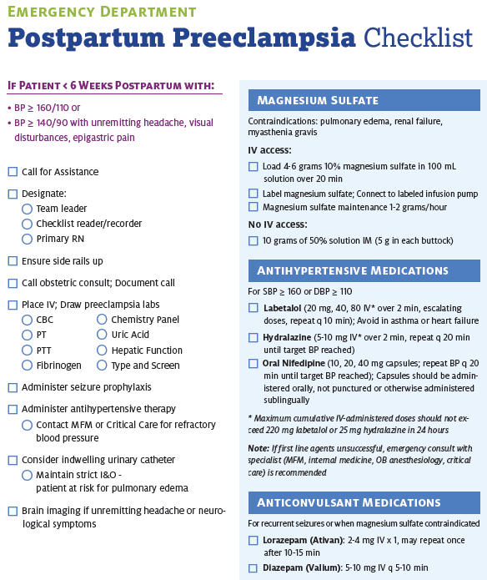

Slide 59
Timely Response Matters!
Process for timely triage and evaluation of pregnant and postpartum women with hypertension, reduce time to treatment for severe range BP.
Include emergency department and outpatient
Rapid access to medications used for severe hypertension: medications should be stocked and immediately available. Include brief guide for administration & dosage.
System plan for escalation, obtaining appropriate consultation, and maternal transport, as needed
Emergency protocols – Eclampsia management, HTN treatment algorithms

Slide 60
Key Elements of Bundles for Hypertensive Patients
  Staff education and correct BP measurement
  Notify the physician if BP >155/105 mmHg*
  Standardized treatment of BP within 1 hr if >160/110 mmHg
  Uniform policy for use of MgSO₄ for Severe Preeclampsia and should be consider in patients with preeclampsia
  Early postpartum follow-up (3-14 days) if diagnosis of hypertension
  Standardized patient educational materials

Slide 61
Appropriate Preeclampsia Evaluation

Slide 62
Key Clinical Pearl
Patients presenting with vague symptoms of:
  headache
  abdominal pain
  shortness of breath
  generalized swelling
  complaints of “I just don’t feel right”
should be evaluated for atypical presentations of preeclampsia or “severe features”
Sibai BM, Stella CL. Diagnosis and management of atypical preeclampsia-eclampsia. Am J Obstet Gynecol. May 2009;200(5):481 e481-487.

Slide 63
ACOG Executive Summary on Hypertension In Pregnancy, Nov 2013
1. The term “mild” preeclampsia is discouraged for clinical classification. The recommended terminology is:
  a. “preeclampsia without severe features” (mild)
  b. “preeclampsia with severe features” (severe)
2. Proteinuria is not a requirement to diagnose preeclampsia with new onset hypertension.
3. The total amount of proteinuria > 5g in 24 hours has been eliminated from the diagnosis of severe preeclampsia.
4. Early treatment of severe hypertension is mandatory at the threshold levels of 160 mm Hg systolic or 110 mm Hg diastolic.
5. Magnesium sulfate for seizure prophylaxis is indicated for preeclampsia with severe features and should not be administered universally for preeclampsia without severe features (mild).

Slide 64
ACOG Executive Summary on Hypertension In Pregnancy, Nov 2013
6. Preeclampsia with onset prior to 34 weeks is most often severe and should be managed at a facility with appropriate resources for management of serious maternal and neonatal complications.
7. Induction of labor at 37 weeks is indicated for preeclampsia and gestational hypertension.
8. The postpartum period is potentially dangerous. Patient education for early detection during and after pregnancy is important.
9. Long-term health effects should be discussed.
Notes:
It should be noted however that the CMQCC Preeclampsia task force recommends that magnesium sulfate be considered for preeclampsia without severe features.

Slide 65
Proteinuria
300 mg in a 24 hour period or
Protein/creatinine ratio 0.3 (mg/dL/mg/dL)
1+ or more proteinuria by dipstick if above are not available
The old 5 grams of protein has gone away . The amount of proteinuria does not correlate with outcome, or guide therapy

Slide 66
Delivery Management
Induction of labor at 37 weeks is indicated for preeclampsia and gestational hypertension.

Slide 67
When to Deliver
Chronic Hypertension
  With no additional maternal or fetal complications, delivery before 38 0/7 weeks not recommended
  With superimposed preeclampsia, follow preeclampsia recommendations
Preeclampsia/Gestational Hypertension
  Without severe features:
    May expectantly manage until severe features present or 37 0/7 weeks
  With Severe Features
    Prior to viability- deliver
    May expectantly manage in appropriate setting until 34 weeks gestation, if maternal and fetal status stable
American College of Obstetricians and Gynecologists, Task Force on Hypertension in Pregnancy. Hypertension in pregnancy. Report of the American College of Obstetricians and Gynecologists' Task Force on Hypertension in Pregnancy. Obstet Gynecol. 2013 Nov;122(5):1122-31.

Slide 68
Key Clinical Pearl
In patients with preterm preeclampsia with severe features,
the disease can rapidly progress to significant maternal morbidity and/or mortality.
*Transfer to appropriate level of care if possible
Notes:
We must emphasize the fact that in patients with preterm preeclampsia the progression of disease is highly unpredictable and therefore the level of surveillance in these patients must be increased. We strongly recommend that all patients with new onset hypertension, new onset proteinuria or new onset symptoms under 34 weeks gestation, be admitted for a minimum 24 hour observation period. Serial blood pressure measurements and serial laboratory studies should be initiated to detect progression of disease and allow for ongoing fetal assessment.

Slide 69
Indications for Delivery
34 weeks gestation if severe features OR
Any of the following:
  Uncontrolled hypertension despite therapy
  Recurrent symptoms such as headache, visual changes, RUQ pain
  Pulmonary edema
  Significant renal or hepatic dysfunction
  HELLP Syndrome or Disseminated Intravascular Coagulation
  Eclampsia
  Abruptio placenta
  Non reassuring fetal status: growth restriction, oligohydramnios, or abnormal fetal testing

Slide 70
Postpartum Attention
Patient education for early detection of signs and symptoms of preeclampsia during and after pregnancy is important.
Standard follow up of all hypertension patients in the first 7-10 days postpartum for BP check.
Long-term health effects of preeclampsia, including increased risks of cardiovascular disorders, should be discussed.

Slide 71
Hospital Protocols,
Algorithms, Order sets
Facility-wide standard protocols with checklists and escalation policies for management and treatment of:
Severe range hypertension (ACOG treatment algorithms for IV therapy as soon as possible)
Eclampsia, seizure prophylaxis, and mag over-dosage
Postpartum presentation of severe hypertension/preeclampsia

Slide 72
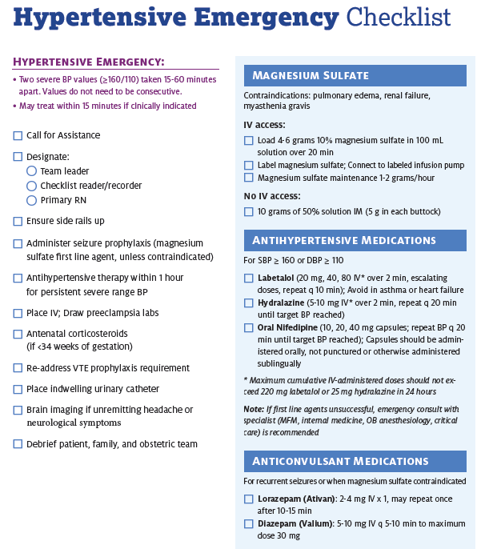

Slide 73
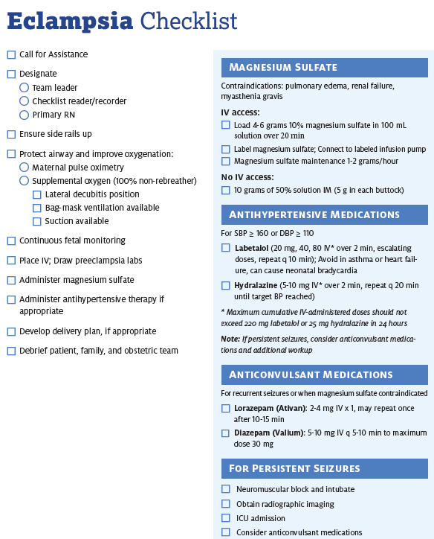

Slide 75
Key Clinical Pearl
Use of preeclampsia-specific checklists, team training and communication strategies, and continuous process improvement strategies will likely reduce hypertensive related morbidity.
Use of patient education strategies, targeted to the educational level of the patients, is essential for increasing patient awareness of signs and symptoms of preeclampsia.
Notes:
Education strategies include a clear and simply written list of patient symptoms to share with patients and their families during prenatal visits and upon discharge from the hospital. Written instructions should help patients to recognize preeclampsia symptoms and seek care.

Slide 76
ILPQC Maternal HTN Initiative
Jan 2016-Dec 2017

Slide 77
ILPQC HTN Initiative
Goal & Measures
Goal: Reduce preeclampsia maternal morbidity
IL Measure | Type | Goal
Severe Maternal Morbidity No. of women with severe maternal morbidities (e.g. Acute renal failure, ARDS, Pulmonary Edema, Puerperal CNS Disorder such as Seizure, DIC, Ventilation, Abruption) / No. pregnant & postpartum women with new onset severe range HTN | Outcome | 20% reduction
Appropriate Medical Management in under 60 minutes No. of women treated at different time points (30,60,90, >90 min) after elevated BP is confirmed / No. of women with new onset severe range HTN | Process | 100%
Debriefs on all new onset severe range HTN* cases | Process | 100%
Discharge education and follow-up within 10 days for all women with severe range HTN, 72 hours with all women with severe range HTN on medications | Process | 100%
Severe range HTN: ≥160 systolic / ≥110(105) diastolic per hospital standard
*New onset severe range HTN: first episode of persistent severe range HTN (lasting >15 minutes) in a hospitalization (ER, L&D, or other inpatient setting), can be chronic HTN, gestational HTN, preeclampsia and/or postpartum diagnosis.

Slide 78
Key components for success
Early recognition of hypertension / preeclampsia triggers during pregnancy and postpartum period
Reduce time to treatment of severe range blood pressure, 160/110(105)
Provide patient education and appropriate discharge follow up
Implementation of evidence based protocols
  Management of severe HTN, preeclampsia triggers, magnesium, expectant management vs delivery, postpartum management, eclampsia
Notes:
First and foremost, early recognition of hypertension in pregnancy is vital to managing the potential impacts. Blood pressure must be treated and guidelines have been established including treating within one hour of confirmed readings. Magnesium sulfate is not a blood pressure medication, it is for seizure control and is recommended for use in preeclampsia with severe features local protocols need to be developed and followed. Women with hypertension in pregnancy require close follow up and the full HIP toolkit provides recommendations for all women postpartum. There is a two-sided one page document in the HIP toolkit that you may find helpful in assuring that you utilize elements of the Patient Safety Bundle developed by ACOG, SMFM, AWHONN, and others for readiness, recognition, response and reporting.

Slide 79
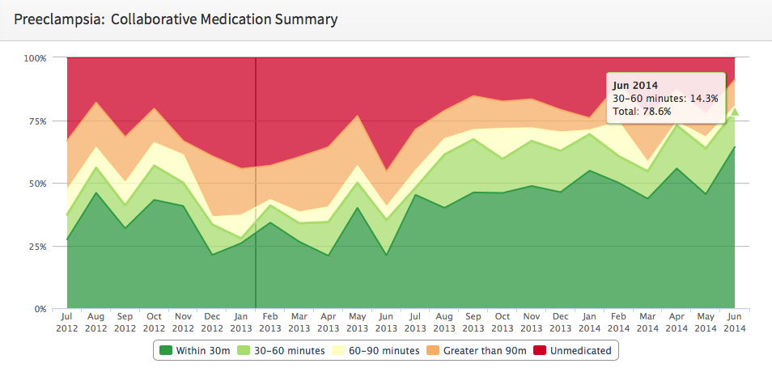
CMQCC Results
Baseline was Retrospective
Notes:
This graph only shows monthly totals, not quarterly!!! This number(78.6%) is only for the month of June! The 2nd quarter total % is 72.4%.
Last month: 30-60 min: 17.8%, Total was 66.7%

Slide 80
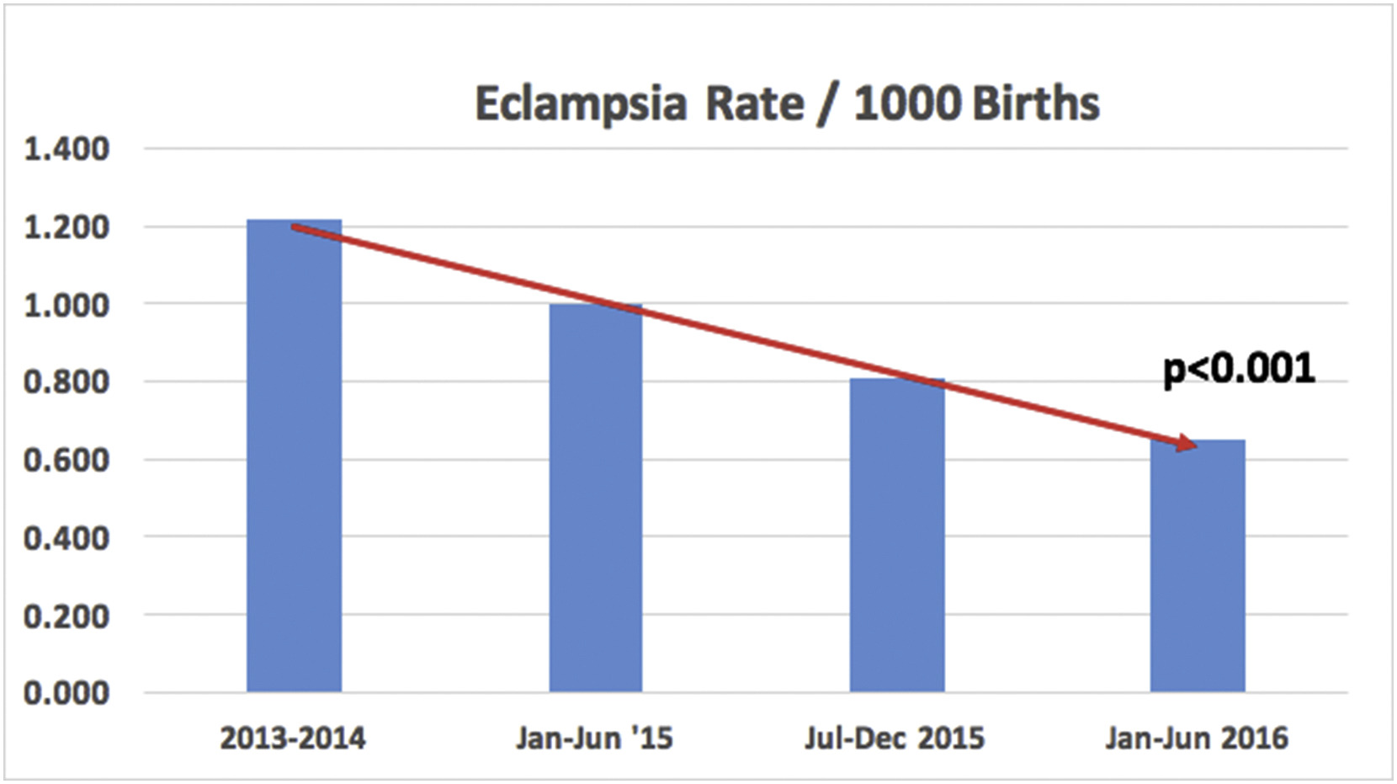

CMQCC Reduction
Eclampsia Rate
The rate of eclampsia decreased from 1.21/1000 at baseline to 0.65/1000 during 2016, p<0.001.
American Journal of Obstetrics & Gynecology 2017 216, DOI: (10.1016/j.ajog.2016.11.937)
Copyright © 2016 Terms and Conditions

Slide 81
Maternal HTN:
Time to Treatment

Slide 82
Maternal Hypertension Data:
Time to Treatment

Slide 83
Maternal Hypertension Data:
Patient Education

Slide 84
Maternal Hypertension Data:
Patient Follow-up

Slide 85
Maternal Hypertension Data:
Debrief

Slide 86
Role of Nurses and Staff
Know best practices for accurate blood pressure management
Identify severe range BP >160/105-110, notify provider and repeat with in 15 minutes.
If repeat BP remains elevated, notify provider of BP and need to activate severe range BP treatment protocol for IV therapy
Have easy access to protocol / order set to ensure correct intervals for repeating BP and redose medications.
Systems in place for easy rapid access to medications
Follow protocols for Magnesium.
Ensure all patients with hypertension have appropriate follow up with in 7-10 days, if home on meds f/u 72 hours for BP.
Ensure all patients are given standard education on postpartum preeclampsia
Remember to Debrief

Slide 87
Role of OB providers
If notified of severe range BP
  Follow ACOG treatment guidelines for IV therapy and BP reassessment and escalation of therapy
  Goal is therapy ASAP within 30-60 minutes of confirmed elevated BP
  Determine need for immediate evaluation
  Participate in Debrief with nurse (what went well, any barriers to reducing time to treatment)

Slide 88
Role of OB Providers
Discharge Management
  All postpartum patients with gest HTN / preeclampsia need early postpartum follow up within 7-10 days to evaluate BP
  Standardize preeclampsia education for prenatal and postpartum patients

Slide 89
Conclusion
Systolic BP ≥160 or diastolic BP ≥110(105) warrant:
  Prompt evaluation at bedside
  Treatment to decrease maternal morbidity and mortality
Risk reduction and successful clinical outcomes require avoidance/management of severe systolic and diastolic hypertension in pregnant and postpartum women.
Increasing evidence indicates that standardization of care improves patient outcomes

Slide 90
Additional Resources
Preeclampsia Foundation tools and materials
  www.preeclampsia.org
California Maternal Quality Care Collaborative
  www.CMQCC.org
Patient safety bundles and AIM program information
  www.safehealthcareforeverywoman.org
ACOG DII (New York) Safe Motherhood Initiative
  https://www.acog.org/About-ACOG/ACOG-Districts/District-II/Safe-Motherhood-Initiative
Illinois Perinatal Quality Collaborative (ILPQC)
  www.ilpqc.org
Notes:
There are other resources available for HIP that include:….

Slide 92
Contact
Email info@ilpqc.org
Visit us at www.ilpqc.org

Slide 93

IDPH

