Slide 1

Illinois Maternal Hypertension Initiative Comprehensive Slide Set
Presented by:

Slide 2
Acknowledgments
This slide set was adapted from materials created by the following groups:
FPQC Hypertension in Pregnancy Initiative
  http://health.usf.edu/publichealth/chiles/fpqc/hip
CMQCC Preeclampsia Collaborative
  https://www.cmqcc.org/projects/past-projects/cmqcc-preeclampsia-collaborative
ACOG DII (New York) Safe Motherhood Initiative
  https://www.acog.org/About-ACOG/ACOG-Districts/District-II/Safe-Motherhood-Initiative
AIM Severe Hypertension in Pregnancy Bundle
  http://www.safehealthcareforeverywoman.org/secure/hypertension-bundle.php

Slide 3
Overview
Background – HTN and QI
AIM HTN Bundle: Readiness
AIM HTN Bundle: Recognition & Prevention
AIM HTN Bundle: Response
AIM HTN Bundle: Reporting & Systems Learning
ILPQC Maternal Hypertension Initiative

Slide 4
Background
Worldwide and in the United States, hypertension is one leading cause of pregnancy-related deaths (PRDs) before, during, or after delivery.
Reports from North Carolina and California state that maternal deaths due to hypertension had significant prevention opportunities. (Berg, C. et al., 2005 & California Department of Public Health, 2011)

Slide 5


Maternal Morbidity and Mortality: Preeclampsia
About 8 Preeclampsia Related Mortalities/2007 in CA
400-500x
Near Misses: 380/year (ICU admissions)
40-50x
Serious
Morbidity: 3400/year (prolonged postpartum length of stay)
Source: 2007 All-California Rapid Cycle Maternal/Infant Database for CA Births: CMQCC
Notes:
Based on analysis of data in the All-California Rapid Cycle Maternal/Infant Database for California births in 2007 – the extent of morbidity associated with preeclampsia is shown in this slide.
There are approximately 8 deaths per year related to preeclampsia/eclampsia among CA women, but the rate of “near–miss” defined here as the number of ICU admissions is 380/yr and serious morbidities defined as prolonged postpartum length of stay is 3400/yr.

Slide 6
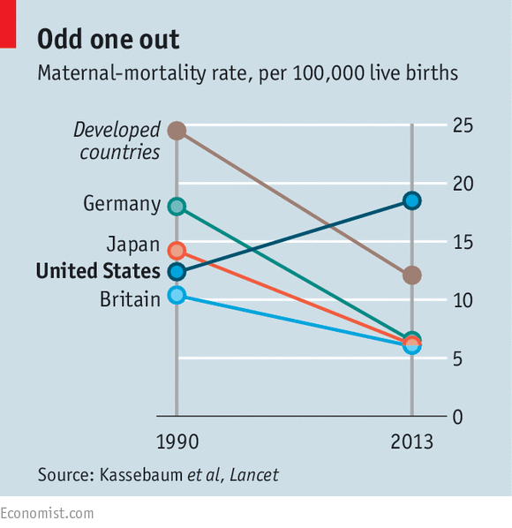
Maternal Mortality

Slide 7
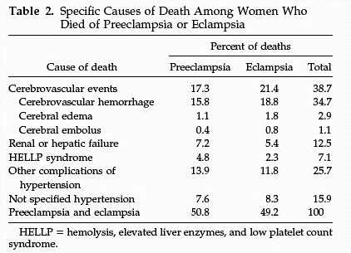

Cause of U.S. Maternal Mortality
CDC Review of 14 years of coded data: 1979-1992
4024 maternal deaths
790 (19.6%) from preeclampsia
90%
of CVA were from hemorrhage
MacKay AP, Berg CJ, Atrash HK. Obstetrics and Gynecology 2001;97:533-538
Notes:
We have made no progress with regard to preventing maternal death from hemorrhagic cerebral vascular accidents.

Slide 8
Prevalence – ACOG 2013
Incidence of preeclampsia has increased by 25% in the past 20 years
Preeclampsia causes an estimated 60,000 maternal deaths yearly worldwide
There are 50 –100 near misses for every maternal death
Preeclampsia is a risk for future cardiovascular disease
Notes:
This slide provides some background on the importance of addressing Hypertension in Pregnancy.
Read slide. For more detail, please see the FPQC Slide Set “HIP Mortality Data Background”

Slide 9
Distribution of Pregnancy-
Related Causes of Deaths in Illinois
Cause of Death | Examples | n | %
Vascular | AFE, PE, cerebrovascular events, chronic HT | 72 | 29.4%
Cardiac | Cardiomyopathy, heart disease, dysrhythmias | 45 | 18.4%
Hemorrhage | Uterine rupture, atony, lacerations | 35 | 14.3%
Pre-eclampsia/ Eclampsia | Pre-eclampsia/ Eclampsia | 18 | 7.3%
Infection | Puerperal, due to spontaneous AB | 14 | 5.7%
Cancer | Breast, leukemia, lymphoma, melanoma | 13 | 5.3%
Pulmonary | Pneumonia, asthma | 13 | 5.3%
Other | Psychiatric, anesthesia, hematologic, hepatic | 35 | 14.3%

Slide 10
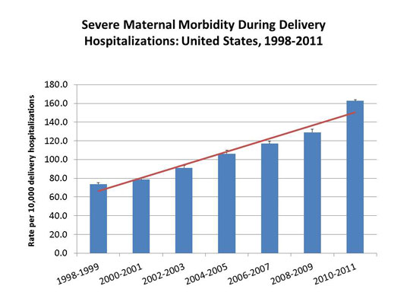
Maternal Morbidity

Slide 11
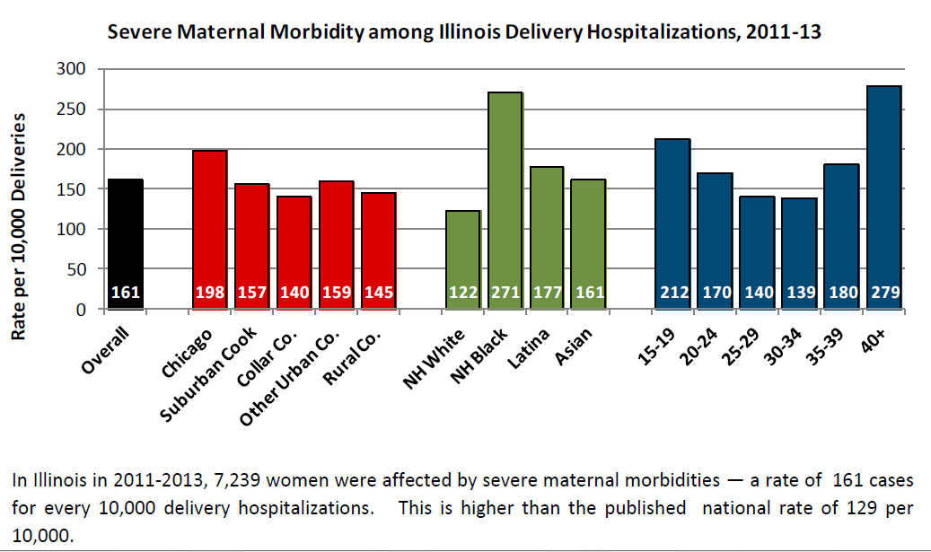
Maternal Morbidity:
Disparities in Illinois

Slide 12

ILPQC Maternal
Hypertension Initiative
Aim: Reduce the rate of severe morbidities in women with severe preeclampsia, eclampsia, or preeclampsia superimposed on pre-existing hypertension by 20% by December 2017
Approach: Established workgroup (1/2015), identify hospital teams (5/2016), implement evidence-based practices / protocols / AIM HTN Bundle (6/2016-12/2017)
OB Advisory Workgroup and HTN Clinical Leadership Team developed process/outcome measures, toolkit/education, data form and reports
  Input from IDPH SQC / PNAs / AIM Initiative / CA, NY, and NC
  Launched Wave 1 in January 2016 with 24 teams
  Launched Wave 2 on May 2, 2016 with 108 teams with over 200 participants on webinar!

Slide 13
Initiative Goals
Early recognition of hypertension / preeclampsia triggers during pregnancy and postpartum period
Reduce time to treatment of severe range blood pressure, >160/110(105)
Provide patient education and appropriate discharge follow up
Implementation of evidence based protocols
  Management of severe HTN, preeclampsia triggers, magnesium, expectant management vs delivery, postpartum management, eclampsia
Notes:
First and foremost, early recognition of hypertension in pregnancy is vital to managing the potential impacts. Blood pressure must be treated and guidelines have been established including treating within one hour of confirmed readings. Magnesium sulfate is not a blood pressure medication, it is for seizure control and is recommended for use in preeclampsia with severe features local protocols need to be developed and followed. Women with hypertension in pregnancy require close follow up and the full HIP toolkit provides recommendations for all women postpartum. There is a two-sided one page document in the HIP toolkit that you may find helpful in assuring that you utilize elements of the Patient Safety Bundle developed by ACOG, SMFM, AWHONN, and others for readiness, recognition, response and reporting.

Slide 14
ILPQC HTN Initiative
Goal & Measures
Goal: Reduce preeclampsia maternal morbidity
IL Measure | Type | Goal
Severe Maternal Morbidity No. of women with severe maternal morbidities (e.g. Acute renal failure, ARDS, Pulmonary Edema, Puerperal CNS Disorder such as Seizure, DIC, Ventilation, Abruption) / No. pregnant & postpartum women with new onset severe range HTN | Outcome | 20% reduction
Appropriate Medical Management in under 60 minutes No. of women treated at different time points (30,60,90, >90 min) after elevated BP is confirmed / No. of women with new onset severe range HTN | Process | 100%
Debriefs on all new onset severe range HTN* cases | Process | 100%
Discharge education and follow-up within 7-10 days for all women with severe range HTN, 72 hours with all women with severe range HTN on medications | Process | 100%
Severe range HTN: ≥160 systolic / ≥110(105) diastolic per hospital standard
*New onset severe range HTN: first episode of persistent severe range HTN (lasting >15 minutes) in a hospitalization (ER, L&D, or other inpatient setting), can be chronic HTN, gestational HTN, preeclampsia and/or postpartum diagnosis.

Slide 15
Opportunities for Quality Improvement
Early recognition of hypertension and response to clinical triggers of preeclampsia (pregnant and pp)
Importance of accurate blood pressure measurement
Initiating antihypertensive medications early and aggressively for BP >160/110(105)
Coordination of care (L&D, PP, ED, ICU) and timely evaluations and consultations
Postpartum follow-up and patient education

Slide 16
Where to start?
Staff education and standardized BP measurement
Rapid access to medications
IV treatment of BP’s ≥ 160mmHg systolic or ≥ 110(105) mmHg diastolic within 30-60 min
Uniform policy for magnesium sulfate
Early postpartum follow-up
Standardized postpartum patient educational materials.

Slide 17
Implementation of
AIM Hypertension Bundle
ILPQC Maternal Hypertension Initiative roll out will focus on implementation of the AIM Hypertension Patient Safety Bundle
Drive quality improvement through the 4 domains/key drivers
  Readiness (every Provider and unit)
  Recognition & Prevention (every case of HIP)
  Response (every patient)
  Reporting & Systems Learning (every multidisciplinary team)
Implementation of resources linked to bundle
  Visual aids, checklists, algorithm’s, protocols, etc.
  Education for physicians and nurses
  Key education topics and use of resources
ILPQC Maternal HTN Quality Improvement Initiative has been approved to meet ABOG Part IV Improvement in Medical Practice MOC requirements for 2016 and 2017 for participating OB/GYN physicians

Slide 18

AIM Hypertension Safety
Patient Bundle
Readiness (every Provider and Unit)
Recognition & Prevention (every patient)
Response (every case of HIP)
Reporting/Systems Learning (every multidisciplinary team)

Slide 19
Hypertension Safety
Patient Bundle
Readiness (every Provider and Unit)
Standards for diagnostic criteria, early warning signs, monitoring and management/ treatment of preeclampsia w/ and w/o features (include policies, procedures, order sets and algorithms)

Slide 20
Readiness at Your Hospital
Standardize preeclampsia diagnostic criteria
Process flow
Look at antepartum/postpartum, ED, and Triage
Protocols reflect current standards / evidence
  Samples available
Implementation Checklist
Order sets
AIM baseline survey

Slide 21
Updated Terminology and New Standards for Diagnostic Criteria

Slide 22
ACOG Executive Summary on Hypertension In Pregnancy, Nov 2013
1. The term “mild” preeclampsia is discouraged for clinical classification. The recommended terminology is:
  a. “preeclampsia without severe features” (mild)
  b. “preeclampsia with severe features” (severe)
2. Proteinuria is not a requirement to diagnose preeclampsia with new onset hypertension.
3. The total amount of proteinuria > 5g in 24 hours has been eliminated from the diagnosis of severe preeclampsia.
4. Early treatment of severe hypertension is mandatory at the threshold levels of 160 mm Hg systolic or 110 mm Hg diastolic.
5. Magnesium sulfate for seizure prophylaxis is indicated for severe preeclampsia and should not be administered universally for preeclampsia without severe features (mild).

Slide 23
ACOG Executive Summary on Hypertension In Pregnancy, Nov 2013
6. Preeclampsia with onset prior to 34 weeks is most often severe and should be managed at a facility with appropriate resources for management of serious maternal and neonatal complications.
7. Induction of labor at 37 weeks is indicated for preeclampsia and gestational hypertension.
8. The postpartum period is potentially dangerous. Patient education for early detection during and after pregnancy is important.
9. Long-term health effects should be discussed.
Notes:
It should be noted however that the CMQCC Preeclampsia task force recommends that magnesium sulfate be considered for preeclampsia without severe features.

Slide 24
Terminology
Previous
Present
Pregnancy Induced Hypertension (PIH)
Mild and Severe Preeclampsia
Hypertension in Pregnancy (HIP)
Preeclampsia with or without severe features
Preeclampsia with onset prior to 34 weeks is most often severe and should be managed at a facility with appropriate resources for management of serious maternal and neonatal complications.

Slide 25
Proteinuria
300 mg in a 24 hour period or
Protein/creatinine ratio 0.3 (mg/dL/mg/dL)
1+ or more proteinuria by dipstick if above are not available
The old 5 grams of protein has gone away . The amount of proteinuria does not correlate with outcome, or guide therapy

Slide 26
Delivery Management
Induction of labor at 37 weeks is indicated for preeclampsia and gestational hypertension.

Slide 27
Postpartum Attention
The postpartum period is potentially dangerous. Patient education for early detection of signs and symptoms of preeclampsia during and after pregnancy is important.
Long-term health effects of preeclampsia should be discussed.

Slide 28
Updated Classification of Hypertension in Pregnancy
Chronic (Preexisting) Hypertension
Abnormal blood pressure predating pregnancy or before 20 weeks gestation | Hypertension that predated the pregnancy Hypertension that develops before 20 weeks gestation and first trimester blood pressures are not known
Gestational Hypertension
Abnormal blood pressure first developing in pregnancy | Hypertension that develops after 20 weeks gestation in a woman with previously normal blood pressure At least two measurements taken 4 or more hours apart If hypertension occurs before 20 weeks gestation and first trimester blood pressure measurements are normal, then consider early onset gestational hypertension Rule out preeclampsia

Slide 29
Updated Classification of
Hypertension in Pregnancy
Preeclampsia
Abnormal blood pressure as described in gestational hypertension plus proteinuria | Greater than 300 mg total protein in a 24 hour collection Random urine protein (mg/dL) to creatinine (mg/dL) ratio of 0.3 1+ protein on urine dipstick if above quantifiable measures not available
Severe features for gestational hypertension and preeclampsia* | Systolic blood pressure greater than 160 mm Hg or diastolic blood pressure greater than 110 mm Hg (check blood pressure within 15 minutes to confirm since persistent elevation greater than 160 mm Hg or 110 mm Hg is a hypertensive emergency) CNS symptoms (generalized tonic clonic seizure, headache or visual disturbances) Pulmonary edema Platelet count less than 100,000/microliter Elevation serum transaminases more than 2 times over baseline or ALT greater than 70 Serum creatinine level greater than 1.1 mg/dL or doubling of serum creatinine HELLP syndrome

Slide 30
Updated Classification of
Hypertension in Pregnancy
Superimposed preeclampsia
Chronic hypertension with the development of preeclampsia | Sudden increase in blood pressure that was previously controlled requiring escalation of blood pressure medication New onset proteinuria or sudden increase in proteinuria Development of any of the criteria listed under “severe features”
Postpartum Hypertension
New onset condition OR Secondary to persistent hypertension | BP increases again 3-6 days postpartum Symptoms of preeclampsia or eclampsia, including stroke Can develop up to 4-6 weeks postpartum

Slide 31

Hospital Protocols,
Algorithms, Order sets
Facility-wide standard protocols with checklists and escalation policies for management and treatment of:
severe hypertension
eclampsia, seizure prophylaxis, and mag over-dosage
postpartum presentation of severe hypertension/preeclampsia

Slide 32
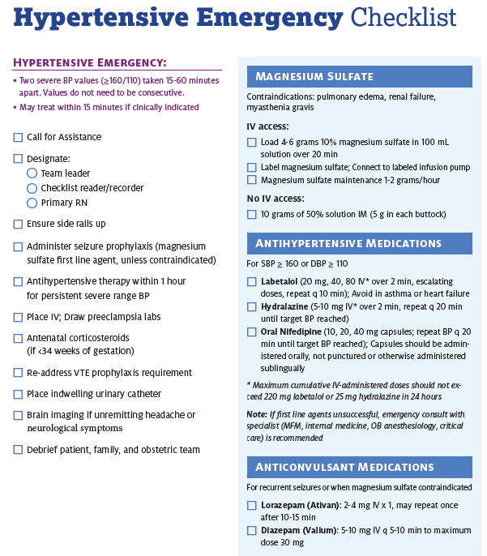

Slide 33
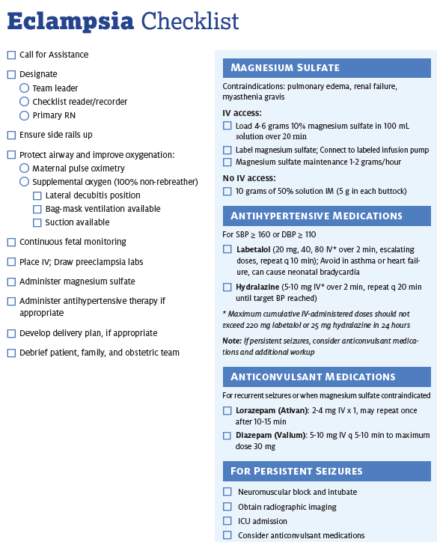

Slide 34
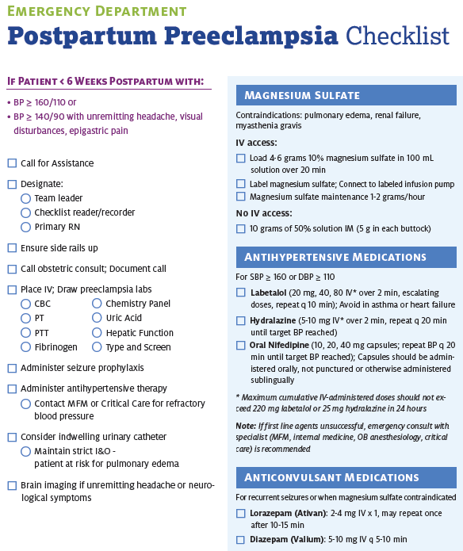

Slide 35
Readiness (every Provider and Unit)
Recognition & Prevention (every patient)
Standard protocol for measurement and assessment of BP, labs and urine protein for all pregnant and postpartum women
Standard and timely response to maternal early warning (danger) signs including listening to and investigating patient’s symptoms, fetal condition and assessment of labs
“The best way to diagnose preeclampsia is to listen to your patients.”
~ Dr. Baha Sibai

Slide 36

Importance of
Obtaining Accurate
Blood Pressure
Preeclampsia and preeclampsia with severe features are characterized by elevated blood pressure.
Failing to accurately measure blood pressure in a consistent manner can lead to misdiagnosis, delays in treatment, worsening disease, increased morbidity and even death.
Accurate blood pressure measurement is essential for clinical decision making
  Correct positioning of the woman
  Proper equipment (cuff sizes and shapes; calibrated readings)
Notes:
Hypertension in pregnancy is one of the leading causes of maternal mortality and morbidity. Having a standardized assessment of blood pressure is important to the early recognition and management of hypertension in pregnancy. Preeclampsia had the possibility of quickly becoming severe and resulting in seizures, strokes and other associated syndromes. In order to make good clinical decisions it is necessary to have accurate consistent assessments. To do this equipment must be appropriate in size and shapes of cuffs and well maintained.

Slide 37
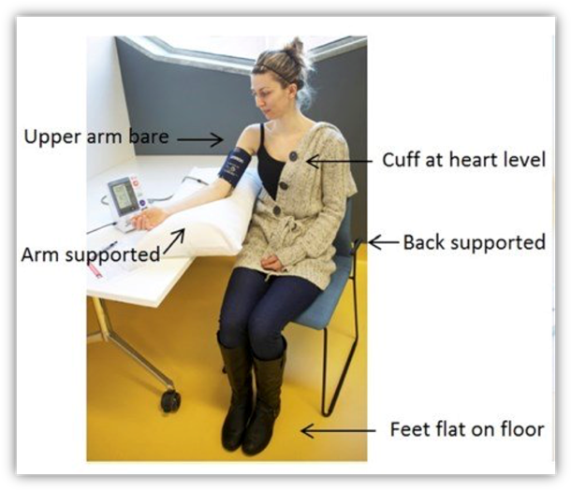
Challenge #1:
Proper positioning of the woman
Position:
  If in bed: Semi-fowlers with the head of the bed elevated 30-40 degrees; arm supported; legs uncrossed
  If sitting in chair: feet resting on the floor (not dangling)
  At least 5 minutes of rest before assessment
Arm:
  Right arm preferred but either arm may be used and should be supported
  Cuff at heart level
No talking : Systolic and diastolic BPs of hypertensive and normotensive patients increase with talking
***NOT lying down in bed***
Notes:
The first challenge in determining accurate blood pressure is appropriate cuff size. 40 to 50% of the arm should be covered with the cuff. If too small the pressure measured is higher than actual pressure. If too large the measure is artificially lower. Both result in the potential for inaccurate diagnosis and possible poor outcomes for patients.

Slide 38
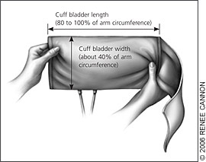
Challenge #2:
Choose the Right Cuff Size
The cuff bladder width should cover between 40-50% of the circumference of the arm.
The lower cuff edge should be about 1 inch above the antecubital space
Center the bladder over the brachial artery
If the cuff is too small the blood pressure will be falsely higher
if the cuff is too large the reading will be artificially lowered
Notes:
The first challenge in determining accurate blood pressure is appropriate cuff size. 40 to 50% of the arm should be covered with the cuff. If too small the pressure measured is higher than actual pressure. If too large the measure is artificially lower. Both result in the potential for inaccurate diagnosis and possible poor outcomes for patients.

Slide 39

Challenge #3:
Choose the Right Cuff Shape
Not every woman has an upper arm shape that works with a rectangular cuff.
Some women have an upper arm shape the is conical rather than cylindrical.
Notes:
Arm shapes vary greatly and an appropriate shape cuff must be used or again, the measures will not be accurate. There are rectangular and conical cuffs and these should be available for use on every unit.

Slide 40

Challenge #4:
The Obese Patient
Upper arm circumference > 50 cm
Can use a thigh cuff if upper arm is long enough
Measure forearm
Choose cuff that covers 40% of circumference
Inflate cuff and feel for radial pulse
  This method is not considered as accurate and should be used in circumstances when a proper cuff can’t be obtained.
Notes:
Obesity is a big challenge in clinical obstetric practice brining a variety of complications and concerns. Hypertension is one of the complications of obesity therefore accurate measures of blood pressure for obese women is essential. Depending on the length of the upper arm, a thigh cuff may be used, for upper arm circumference greater than 50 cm. The forearm may also be used with a cuff that covers 40% of the arm. Newer cuffs for radial measures are coming available but if they are not used and a cylindrical cuff is used instead it may not be as accurate.

Slide 41
Clinical Pearls
Take time to use correct equipment and measure her arm
Position the woman correctly
Initial blood pressure should be assessed after the woman has been resting with minimal distraction for 5 minutes.
BP ≥160/110(105) lasting for 15 minutes must be should in under 30-60 minutes
Initial BP is ≥
140 systolic OR
≥ 90 diastolic
Repeat blood pressure in 15 minutes
Take in the same arm
Initial BP is ≥
160 systolic or
≥ 110(105) diastolic
Notify provider after first elevated BP
Reassess after 15 minutes
Do not reposition to side-lying
Activate treatment algorithms if remains ≥160/110(105)
Evaluate for preeclampsia
Activate Severe HTN Treatment Algorithm
Notes:
There are several key elements to accurate blood pressure. (read slide)

Slide 42
Appropriate Preeclampsia Evaluation

Slide 43
Key Clinical Pearl
Patients presenting with vague symptoms of:
  headache
  abdominal pain
  shortness of breath
  generalized swelling
  complaints of “I just don’t feel right”
should be evaluated for atypical presentations of preeclampsia or “severe features”
Sibai BM, Stella CL. Diagnosis and management of atypical preeclampsia-eclampsia. Am J Obstet Gynecol. May 2009;200(5):481 e481-487.

Slide 44
Laboratory Evaluation of Preeclampsia
Initial lab studies should include:
  CBC with platelet count
  AST, ALT, LDH
  Creatinine, Bilirubin, Uric acid, Glucose
For women with acute abdominal pain, add:
  Serum amylase, lipase and ammonia
Notes:
Bilirubin comes on most liver function lab panels and is helpful in cases of severe HELLP syndrome and Acute fatty liver disease.

Slide 45
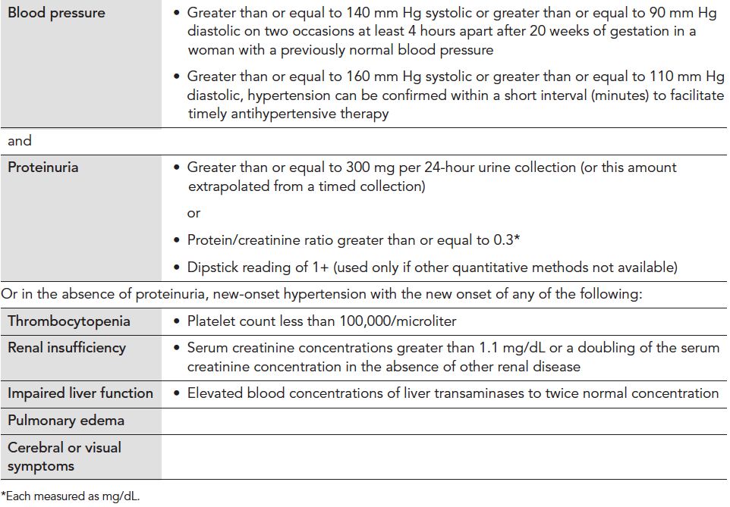
Diagnosis Criteria for
Preeclampsia
Executive Summary: Hypertension in Pregnancy, American College of Obstetricians and Gynecologist, Obstet Gynecol 2013;122:1122-31. Copyright permission received.
Notes:
The new ACOG guidelines which will be published in Fall 2013, may eliminate proteinuria as a criterion for diagnosis of preeclampsia.

Slide 46
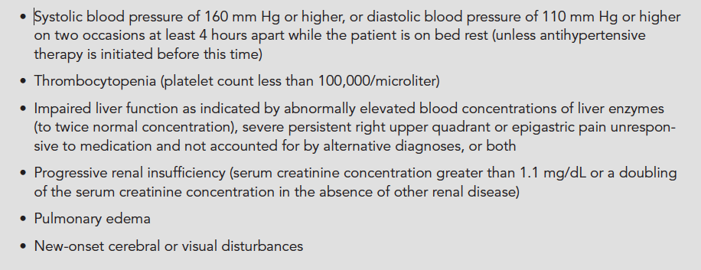
Diagnosis of Preeclampsia with
Severe Features
Executive Summary: Hypertension in Pregnancy, American College of Obstetricians and Gynecologist, Obstet Gynecol 2013;122:1122-31. Copyright permission received.
Notes:
To make the diagnosis of severe PE, you need to have documented SBP of 160 or greater on two occasions 4 hrs apart. However in the acute onset of HTN above threshold 160/105-110 it is unadvisable to wait 4 hrs for treatment. A BP should be repeated in 15 min and if still elevated above threshold, treat with antihypertensive medication within 30-60 min.

Slide 47
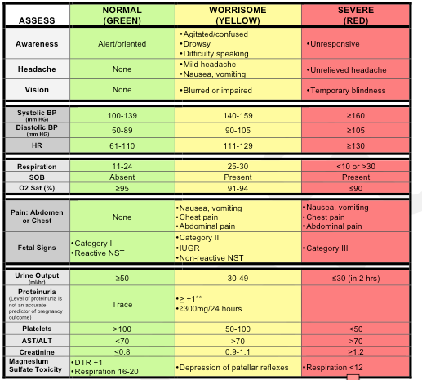
Preeclampsia Early Recognition Tool
Notes:
This is a tool that is designed to aid in the early recognition and response to a patient’s deteriorating condition as the disease process progresses in severity. The next slide is a continuation of this form with interventions based on the number of triggers.

Slide 48
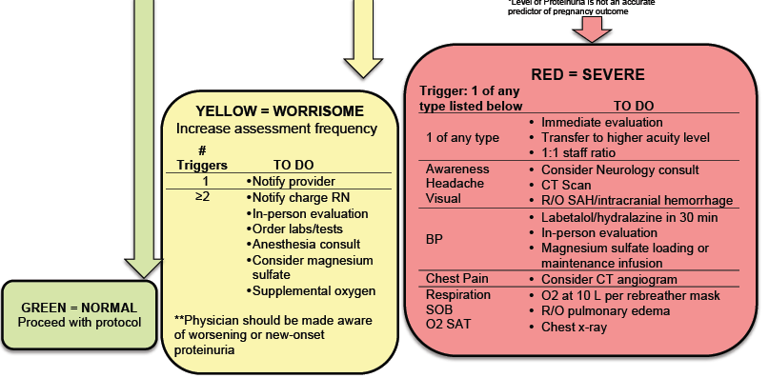
Clinical Signs to Watch for:
Notes:
The hope is that this Early Recognition Tool can be incorporated into the maternal notes and can be initiated in prenatal clinics and utilized as vital sign documentation until discharge. The chart stays with the patient until discharge creating a visual trend of individual physiology and allows assessment and treatment based on what is abnormal for the patient.

Slide 49
Timing of Delivery
Hypertension in Pregnancy
Not To Early….Not Too Late

Slide 50


Preeclamptic Balancing Act
Stroke
Hemorrhage
Renal Failure
Hepatic Failure
Subcapsular Hepatic Hematoma
Pulmonary Edema
Retinal detachment
Placental Abruption
Fetal and Maternal Death
Etc…
Prematurity
  ROP
  Sepsis
  NEC
  IVH
  CP
  RDS
  Etc…
CMOP

Slide 51
When to Deliver
Chronic Hypertension
  With no additional maternal or fetal complications, delivery before 38 0/7 weeks not recommended
  With superimposed preeclampsia, follow preeclampsia recommendations
Preeclampsia/Gestational Hypertension
  Without severe features:
    May expectantly manage until severe features present or 37 0/7 weeks
  With Severe Features
    Prior to viability- deliver
    May expectantly manage in appropriate setting until 34 weeks gestation, if maternal and fetal status stable
American College of Obstetricians and Gynecologists, Task Force on Hypertension in Pregnancy. Hypertension in pregnancy. Report of the American College of Obstetricians and Gynecologists' Task Force on Hypertension in Pregnancy. Obstet Gynecol. 2013 Nov;122(5):1122-31.

Slide 52
Key Clinical Pearl
In patients with preterm preeclampsia with severe features,
the disease can rapidly progress to significant maternal morbidity and/or mortality.
*Transfer to appropriate level of care if possible
Notes:
We must emphasize the fact that in patients with preterm preeclampsia the progression of disease is highly unpredictable and therefore the level of surveillance in these patients must be increased. We strongly recommend that all patients with new onset hypertension, new onset proteinuria or new onset symptoms under 34 weeks gestation, be admitted for a minimum 24 hour observation period. Serial blood pressure measurements and serial laboratory studies should be initiated to detect progression of disease and allow for ongoing fetal assessment.

Slide 53
Expectant Management of
Pregnancies < 34 Weeks Gestation
(From CMQCC Preeclampsia Toolkit, 2013)
Notes:
These tables describe the approach to preeclampsia with severe features < 34 wks.
*Patients with eclampsia and visual disturbances should be evaluated in consultation with critical care medicine/neurology for the presence of Posterior Reversible Encephalopathy Syndrome (PRES).
**Mental status changes in the presence of severe thrombocytopenia should be evaluated in consultation with hematology for Thrombotic Thrombocytopenic Purpura (TTP) and consideration for treatment or transfer to a center with treatment capacity should be given.

Slide 54
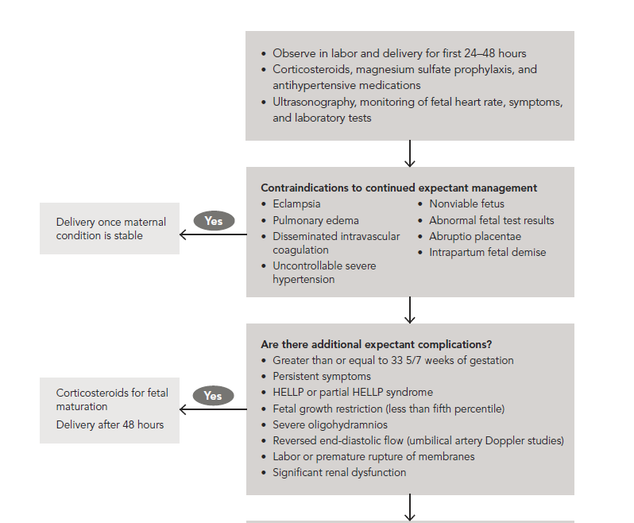

Management of Preeclampsia with Severe Features
at Less Than 34 Weeks Gestation After Viability
American College of Obstetricians and Gynecologists, Task Force on Hypertension in Pregnancy. Hypertension in pregnancy. Report of the American College of Obstetricians and Gynecologists' Task Force on Hypertension in Pregnancy. Obstet Gynecol. 2013 Nov;122(5):1122-31
NO
EXPECTANT MANAGEMENT

Slide 55
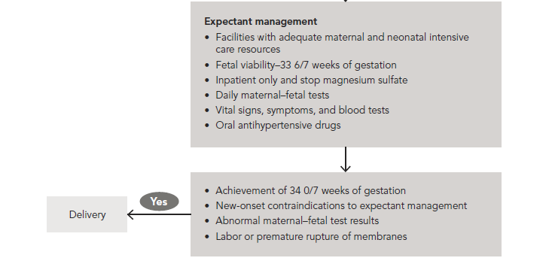
Expectant Management of Preeclampsia with
Severe Features at Less Than 34 Weeks Gestation
American College of Obstetricians and Gynecologists, Task Force on Hypertension in Pregnancy. Hypertension in pregnancy. Report of the American College of Obstetricians and Gynecologists' Task Force on Hypertension in Pregnancy. Obstet Gynecol. 2013 Nov;122(5):1122-31.

Slide 56
Management of Suspected Severe Preeclampsia < 34 Weeks Gestation
No contraindications to expectant management – Short Term
Initial 24-48 hours observation
Initiate antenatal corticosteroids if not previously administered
Initiate 24 hour urine monitoring as appropriate
Ongoing assessment of maternal symptoms, BP, urine output
Daily lab evaluation (minimum) for HELLP and renal function
May observe on an antepartum ward after initial evaluation
Proceed to delivery for:
Recurrent severe hypertension despite therapy
Other contraindications to expectant management
Antenatal corticosteroid treatment completed:
Expectant management not contraindicated
Consider ongoing in-patient expectant management
Adapted from Sibai BM. Evaluation and management of severe preeclampsia before 34 weeks’ gestation. American Journal of Obstetrics & Gynecology, September 2011, pg. 191-198.

Slide 57
Expectant Management in Pregnancies with Severe Preeclampsia < 34 Weeks Gestation
Expectant management recommendations:
With stable maternal/fetal conditions, continued pregnancy should be undertaken only at facilities with adequate maternal and neonatal intensive care resources
Administer corticosteroids for fetal lung maturity benefit
ACOG Executive Summary: Hypertension in Pregnancy. Obstet Gynecol 2013;122:1122-31

Slide 58
Management of Suspected Severe Preeclampsia < 34 Weeks Gestation
Long Term Management
Consider ongoing, inpatient expectant management until 34 weeks or indication for delivery:
Monitor vital signs frequently (at least each shift)
At least daily maternal assessment for subjective symptoms of severe preeclampsia
At least daily assessment of fetal well-being
Serial evaluation for HELLP syndrome and of renal function
Serial estimation of fetal growth and amniotic fluid volume
Adapted from Sibai BM. Evaluation and management of severe preeclampsia before 34 weeks’ gestation. American Journal of Obstetrics & Gynecology, September 2011, pg. 191-198.

Slide 59
Indications for Delivery
34 weeks gestation OR
Any of the following:
  Uncontrolled hypertension despite therapy
  Recurrent symptoms such as headache, visual changes, RUQ pain
  Pulmonary edema
  Significant renal or hepatic dysfunction
  HELLP Syndrome or Disseminated Intravascular Coagulation
  Eclampsia
  Abruptio placenta
  Non reassuring fetal status: growth restriction, oligohydramnios, or abnormal fetal testing

Slide 60
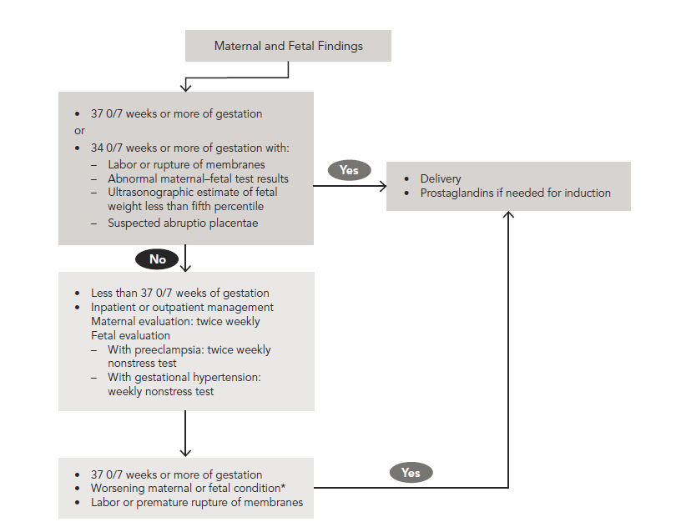
Management of Gestational Hypertension or
Preeclampsia without Severe Features

Slide 61
Preeclampsia: Outpatient
Management
Maternal stability
BP in the non-severe range
Gestational age < 37 weeks (At 37 weeks delivery should be considered)
No indicators of severe features of preeclampsia
None of the following maternal symptoms: Headache, visual disturbances, abdominal pain, gastrointestinal symptoms
No evidence of hemolysis
In essence a near normal laboratory assessment

Slide 62
Preeclampsia: Outpatient Management
Fetal stability
Appropriate fetal growth
Reassuring antenatal fetal testing
Normal amniotic fluid volume
Ability to be followed as an outpatient
Communicative and reliable patient
  Patient can check BP at home
Twice weekly assessment in office:
  Maternal blood pressure
  Laboratory assessment for indicators of worsening disease (creatinine, liver function, platelets)
  Fetal testing including amniotic fluid assessment
  Periodic ultrasound assessment of fetal growth

Slide 63
Readiness (every Provider and Unit)
Recognition & Prevention (every patient)
Response (every case of HIP)
Process for timely triage and evaluation of pregnant and postpartum women with hypertension including emergency department and outpatient

Slide 64
Key Clinical Pearl
Controlling blood pressure
is the optimal intervention
to prevent deaths due to stroke
in women with preeclampsia.
Over the last decade, the UK has focused QI efforts on aggressive timely treatment of both systolic and diastolic blood pressure and has demonstrated a significant reduction in deaths.

Slide 65
Key Clinical Pearl
The critical initial step in decreasing maternal morbidity and mortality is to administer anti-hypertensive medications within 60 minutes of documentation of persistent (retested within 15 minutes) BP ≥160 systolic, and/or >105-110 diastolic.
Ideally, antihypertensive medications should be administered as soon as possible, and availability of a “preeclampsia box” will facilitate rapid treatment.
In Martin et al., stroke occurred in:
  23/24 (95.8%) women with systolic BP > 160mm Hg
  24/24 (100%) had a BP ≥ 155 mm Hg
  3/24 (12.5%) women with diastolic BP > 110mm Hg
  5/28 (20.8%) women with diastolic BP > 105mm Hg
Martin JN, Thigpen BD, Moore RC, Rose CH, Cushman J, May. Stroke and Severe Preeclampsia and Eclampsia: A Paradigm Shift Focusing on Systolic Blood Pressure, Obstet Gynecol 2005;105-246.

Slide 66
Need
To
Treat*
BP ≥
160/110(105)
*BP persistent 15 minutes, activate treatment algorithm with IV therapy ASAP, < 30-60 minutes

Slide 67
Hypertensive Medication
Administration Oral versus IV
First line therapy recommendations for acute treatment of critically elevated BP in pregnant women [>160/110(105)] are with either IV labetalol or hydralazine.
In the event that acute treatment is needed in a patient without IV access oral nifedipine may be used (10 mg) and may be repeated in 30 minutes.
PO (oral) nifedipine appears equally as efficacious as IV labetalol in correcting severe BP elevations.
Oral labetalol would be expected to be less effective in acutely lowering the BP due to its slower onset to peak and thus should be used only if nifedipine is not available in a patient without IV access.
ACOG Practice Bulletin #33, Reaffirmed 2012; ACOG Committee Opinion #514, 2012; Tuffnell D, Jankowitcz D, Lindow S, et al. BJOG 2005;112:875-880.

Slide 68
Antihypertensive Therapy
First line agents
IV Labetalol
(Normadyne)
Beta blocker (some alpha)
IV Apresoline
(Hydralazine)
PO Nifedipine*
(Procardia)
Calcium channel blocker
Caution with heart rate > 100, severe aortic stenosis, recent MI, cardiogenic shock.
Vasodilator
Caution with heart rate < 60, congenital heart failure, AV heart block or asthma
Can repeat after 10 minutes
Watch for rebound tachycardia or hypotension
Caution with Heart rate > 100, recent stroke, severe mitral valve disease
Can repeat after 20 minutes
Can repeat after 30 minutes
*If IV access unavailable

Slide 69
ACOG protocol
Standing Order (Labetalol)
Labetalol 20 mg IV over 2 minutes
If still elevated, labetalol 40 mg IV over 2 min
If still elevated, labetalol 80 mg IV over 2 min
Recheck in 10 min
Recheck in 10 min
Recheck in 10 min
If still elevated, Repeat labetalol 80mg over 10 minutes to achieve total dosage of 220mg (includes all previous administrations)
Recheck in 20 min
Switch to hydralazine 10 mg IV over 2 min
Seek consultation MFM, Critical Care, Anesthesia, Internal medicine
Target B/P
140 to <160 or 90-100
Notes:
1. Notify physician if systolic BP measurement is greater than or equal to 160 mm Hg or if diastolic BP measurement is greater than or equal to 110 mm Hg.
2. Institute fetal surveillance if undelivered and fetus is viable.
3. Administer labetalol (20 mg IV over 2 minutes).
4. Repeat BP measurement in 10 minutes and record results.
5. If either BP threshold is still exceeded, administer labetalol (40 mg IV over 2 minutes). If BP is below threshold, continue to monitor BP closely.
6. Repeat BP measurement in 10 minutes and record results.
7. If either BP threshold is still exceeded, administer labetalol (80 mg IV over 2 minutes). If BP is below threshold, continue to monitor BP closely.
8. Repeat BP measurement in 10 minutes and record results.
9. If either BP threshold is still exceeded, administer hydralazine (10 mg IV over 2 minutes). If BP is below threshold, continue to monitor BP closely.
10. Repeat BP measurement in 20 minutes and record results.
11. If either BP threshold is still exceeded, obtain emergency consultation from maternal–fetal medicine, internal medicine, anesthesia, or critical care specialists.
12. Give additional antihypertensive medication per specific order.

Slide 70
ACOG Protocol (Labetalol)
Notify physician if systolic BP measurement is greater than or equal to 160 mm Hg or if diastolic BP measurement is greater than or equal to 110 (105) mm Hg.
Institute fetal surveillance if undelivered and fetus is viable.
Administer labetalol (20 mg IV over 2 minutes).
Repeat BP measurement in 10 minutes and record results.
If either BP threshold is still exceeded, administer labetalol (40 mg IV over 2 minutes). If BP is below threshold, continue to monitor BP closely.
Repeat BP measurement in 10 minutes and record results.
If either BP threshold is still exceeded, administer labetalol (80 mg IV over 2 minutes). If BP is below threshold, continue to monitor BP closely.
Repeat BP measurement in 10 minutes and record results.
If either BP threshold is still exceeded, administer hydralazine (10 mg IV over 2 minutes). If BP is below threshold, continue to monitor BP closely.
Repeat BP measurement in 20 minutes and record results.
If either BP threshold is still exceeded, obtain emergency consultation from maternal–fetal medicine, internal medicine, anesthesia, or critical care specialists.
Give additional antihypertensive medication per specific order.

Slide 71
ACOG protocol
Standing Order (Hydralazine)
Hydralazine 5 or 10 mg IV over 2 minutes
Recheck in 20 min
If still elevated, hydralazine 10 mg IV over 2 min
Recheck 20 min
If still elevated, labetalol 20 mg IV over 2 min
Recheck in 10 min
If still elevated, labetalol 40 mg IV over 2 min
Emergency consults: MFM and anesthesia
Target B/P
140 to <160 or 90-100
Notes:
1. Notify physician if systolic BP is greater than or equal to 160 mm Hg or if diastolic BP is greater than or equal to 110 mm Hg.
2. Institute fetal surveillance if undelivered and fetus is viable.
3. Administer hydralazine (5 mg or 10 mg IV over 2 minutes).
4. Repeat BP measurement in 20 minutes and record results.
5. If either BP threshold is still exceeded, administer hydralazine (10 mg IV over 2 minutes). If BP is below threshold, continue to monitor BP closely.
6. Repeat BP measurement in 20 minutes and record results.
7. If either BP threshold is still exceeded, administer labetalol (20 mg IV over 2 minutes). If BP is below threshold, continue to monitor BP closely.
8. Repeat BP measurement in 10 minutes and record results.
9. If either BP threshold is still exceeded, administer labetalol (40 mg IV over 2 minutes) and obtain emergency consultation from maternal–fetal medicine, internal medicine, anesthesia, or critical care specialists.
10. Give additional antihypertensive medication per specific order.

Slide 72
ACOG Protocol (Hydralazine)
Notify physician if systolic BP is greater than or equal to 160 mm Hg or if diastolic BP is greater than or equal to 110 (105) mm Hg.
Institute fetal surveillance if undelivered and fetus is viable.
Administer hydralazine (5 mg or 10 mg IV over 2 minutes).
Repeat BP measurement in 20 minutes and record results.
If either BP threshold is still exceeded, administer hydralazine (10 mg IV over 2 minutes). If BP is below threshold, continue to monitor BP closely.
Repeat BP measurement in 20 minutes and record results.
If either BP threshold is still exceeded, administer labetalol (20 mg IV over 2 minutes). If BP is below threshold, continue to monitor BP closely.
Repeat BP measurement in 10 minutes and record results.
If either BP threshold is still exceeded, administer labetalol (40 mg IV over 2 minutes) and obtain emergency consultation from maternal–fetal medicine, internal medicine, anesthesia, or critical care specialists.
Give additional antihypertensive medication per specific order.

Slide 73
ACOG protocol
Standing Order (Oral Nifedipine)
Nifedipine 10 mg PO (never crush or give SL)
Recheck in 20 min
If still elevated, nifedipine 20 mg PO
Recheck 20 min
If still elevated, nifedipine 40 mg PO
Recheck in 20 min
If still elevated, switch to labetalol or hydralazine protocol
Emergency consults: MFM and anesthesia, critical care or internal medicine
Notes:
1. Notify physician if systolic BP is greater than or equal to 160 mm Hg or if diastolic BP is greater than or equal to 110 mm Hg.
2. Institute fetal surveillance if undelivered and fetus is viable.
3. Administer nifedipine 10 mg PO
4. Repeat BP measurement in 20 minutes and record results.
5. If either BP threshold is still exceeded, administer nifedipine 20 mg PO. If BP is below threshold, continue to monitor BP closely.
6. Repeat BP measurement in 20 minutes and record results.
7. If either BP threshold is still exceeded, administer nifedipine 20 mg PO. If BP is below threshold, continue to monitor BP closely.
8. Repeat BP measurement in 20 minutes and record results.
9. If either BP threshold is still exceeded, administer labetalol (40 mg IV over 2 minutes) and obtain emergency consultation from maternal–fetal medicine, internal medicine, anesthesia, or critical care specialists.
10. Give additional antihypertensive medication per specific order.

Slide 74
ACOG Protocol (PO Nifedipine)
Notify physician if systolic BP is greater than or equal to 160 mm Hg or if diastolic BP is greater than or equal to 110 (105) mm Hg.
Institute fetal surveillance if undelivered and fetus is viable.
Administer nifedipine 10 mg PO
Repeat BP measurement in 20 minutes and record results.
If either BP threshold is still exceeded, administer nifedipine 20 mg PO. If BP is below threshold, continue to monitor BP closely.
Repeat BP measurement in 20 minutes and record results.
If either BP threshold is still exceeded, administer nifedipine 20 mg PO. If BP is below threshold, continue to monitor BP closely.
Repeat BP measurement in 20 minutes and record results.
If either BP threshold is still exceeded, administer labetalol (40 mg IV over 2 minutes) and obtain emergency consultation from maternal–fetal medicine, internal medicine, anesthesia, or critical care specialists.
Give additional antihypertensive medication per specific order.

Slide 75
Anti-Hypertensive Medications for Chronic Hypertension
Agent | Initial dosing | Frequency | Total maximal daily dose
Labetalol* | 200 mg bid | Q 12 hours to Q 8 hours | 2400 mg
Nifedipine long acting | 30 mg daily | Daily | 120 mg
Methyldopa** | 250 mg bid | Q 12 hours to Q 6 hours | 3000 mg
Notes:
In the HIP toolkit we provide several tables of medication for you to utilize in planning for first and second line treatment, this is a sampling of the meds used for chronic hypertension.

Slide 80
Magnesium Therapy:
Key Clinical Pearl
Magnesium sulfate therapy for seizure prophylaxis should be administered to any patients with:
  Preeclampsia with “severe features” i.e., subjective neurological symptoms (headache or blurry vision), abdominal pain, epigastric pain, OR BP > 160/110
  Eclampsia
  Should be considered in patients with preeclampsia without severe features

Slide 81
Recommendations for Women
Who Should Be Treated With Magnesium
 | Preeclampsia without severe features | Preeclampsia with Severe Features | Eclampsia
ACOG | ** | X | X
NICE |  | X | X
SOGC | X* | X | X
CMQCC | X* | X | X
WHO | X | X | X
**ACOG Executive Summary, 2013: for preeclampsia without severe features, it is suggested that magnesium sulfate not be administered universally for the prevention of eclampsia.
* Should be considered: Numbers needed to treat (NNT) = 109 for “mild”, 63 for “severe”
Notes:
ACOG did not recommend the use of magnesium sulfate in the case of mild preeclampsia because 109 patients had to be treated to prevent one case of eclampsia.
In the case of severe preeclampsia, 63 patients needed to be treated to prevent eclampsia, and the use of magnesium sulfate was recommended.

Slide 82
Late Postpartum Eclampsia
>48 hours following delivery, up to 4 weeks PP
Accounts for approximately 15% of cases of eclampsia
63% had no antepartum hypertensive diagnosis
The magnitude of blood pressure elevation does not appear to be predictive of eclampsia
The most common presenting symptom was headache, which occurred in about 70% of patients; other prodromal symptoms included shortness of breath, blurry vision, nausea or vomiting, edema, neurological deficit, and epigastric pain
Al-Safi Z, Imudia A, Filetti L, et al. Delayed Postpartum Preeclampsia and Eclampsia. Obstet Gynecol. 2011;118(5):1102-1107.

Slide 85
Patient Education
Postpartum/ discharge protocols should include:
  Management and verification of postpartum follow-up & BP check within 7 to 10 days post-discharge
  Standardize discharge patient education for women with preeclampsia and/or severe range HTN
  Discharge instructions to include warning signs of preeclampsia for ALL postpartum patients
  Support/communication plan for patients, families, and staff for ICU admissions and serious complications of severe hypertension

Slide 86
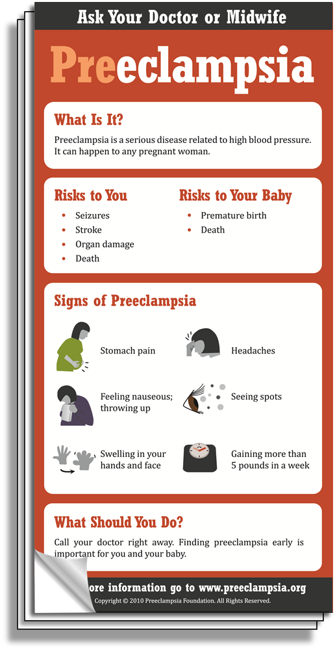
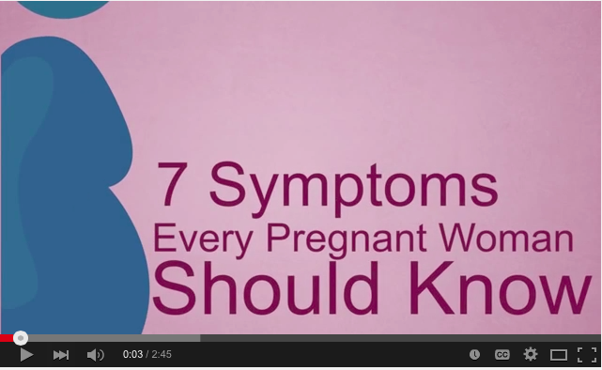

Materials for Prenatal &
Postpartum Patient Education
“7 Symptoms Every Pregnant Woman Should Know” video available in English and Spanish on YouTube™
You W, et al. Improving patient understanding of preeclampsia: a randomized controlled trial. Am J Obstet Gynecol 2012.
Notes:
Other patient education materials include:
Brochures
Magnets
Videos
Poster (avail. early 2016)
Providers can order at:
preeclampsia.org/store

Slide 89
Key Strategies to Improve Response

Slide 90

Rapid access to medications used for severe hypertension:
  medications should be stocked and immediately available
  Include brief guide for administration & dosage.
System plan for escalation for maternal hypertension, obtaining appropriate consultation, and maternal transport, as needed

Slide 91
Facility-wide standard protocols with checklists and escalation policies for management and treatment of:
severe hypertension
eclampsia, seizure prophylaxis, and mag over-dosage
postpartum presentation of severe hypertension/preeclampsia

Slide 92
Minimum requirements for protocol:
Notification of primary physician or primary care provider if systolic BP ≥160 or diastolic ≥110 for 2 measurements within 15 min
After second elevated reading, treatment should be initiated ASAP (within 60 min of verification)
Includes onset and duration of magnesium sulfate therapy
Appropriate labs sent and fetal assessment

Slide 93
Minimum requirements for protocol (cont):
Includes escalation measures for those unresponsive to standard treatment
Describes management and verification of follow-up within 7 to 14 days postpartum
Describe postpartum patient education for women with preeclampsia
Discharge instructions to include warning signs of HTN for ALL postpartum patients

Slide 94
Postpartum patients presenting to the ED with hypertension, preeclampsia or eclampsia should either be assessed by or admitted to an obstetrical service
Systems should be in place to screen all women for pregnancy AND postpartum status in the ER

Slide 95
Support and communication plan for patients, families, and staff for ICU admissions and serious complications of severe hypertension

Slide 96
Timely Response Matters!
Process for timely triage and evaluation of pregnant and postpartum women with hypertension, reduce time to treatment for severe range BP.
Include emergency department and outpatient
Rapid access to medications used for severe hypertension: medications should be stocked and immediately available. Include brief guide for administration & dosage.
System plan for escalation, obtaining appropriate consultation, and maternal transport, as needed
Emergency protocols – Eclampsia management, HTN treatment algorithms

Slide 97
Key Clinical Pearl
Use of preeclampsia-specific checklists, team training and communication strategies, and continuous process improvement strategies will likely reduce hypertensive related morbidity.
Use of patient education strategies, targeted to the educational level of the patients, is essential for increasing patient awareness of signs and symptoms of preeclampsia.
Notes:
Education strategies include a clear and simply written list of patient symptoms to share with patients and their families during prenatal visits and upon discharge from the hospital. Written instructions should help patients to recognize preeclampsia symptoms and seek care.

Slide 98
Readiness (every Provider and Unit)
Recognition & Prevention (every patient)
Response (every case of HIP)
Reporting/Systems Learning (every multidisciplinary team)
Unit Education on protocols, unit-based drills & simulations
Establish a culture of huddles for high risk patients and post-event debriefs to identify successes and opportunities
Establish a process for multi-disciplinary case reviews

Slide 99
California Pregnancy-Associated Mortality Review (CA-PAMR) Quality Improvement Review Cycle
1. Identification of cases
2. Information collection, review by multidisciplinary committee
3. Cause of Death, Contributing Factors and Quality Improvement (QI) Opportunities identified
4. Strategies to improve care and reduce morbidity and mortality
5. Evaluation and Implementation of QI strategies and tools

Slide 100
Common Errors/Problems in Managing Hypertension
Failure to diagnose and recognize severity of the disease
Failure to initiate timely antihypertensive medication
Failure to initiate appropriate Magnesium Sulfate prophylaxis
Failure to initiate early transfer to higher level of care when necessary
Failure to organize safe care and management plans: Moving to delivery without adequate assessments and maternal stabilization
Notes:
There are a number of common errors, omissions and challenges that may be used in developing the scenarios for the drills. Some of these include:….

Slide 101

Potential Clinical Scenarios for Hypertension Drills
Preeclampsia
Eclampsia
Hypertensive Urgency – BP ≥ 160/110(105)
Stroke
Notes:
Hypertension in pregnancy lends itself to simulation drills because there are a number of components to recognition and prevention, that include:….

Slide 102
Goal Examples
Teams will improve their response to BP > 160/110(105) hypertensive events and reduce time to treatment
Teams will communicate better during hypertensive events
Teams will respond in a timely fashion to signs of preeclampsia
Teams will be able to efficiently evaluate a patient who presents with seizures
Teams will effectively manage a patient who is actively seizing
Notes:
It is important to think about the reasons and goals that you have in developing the scenario. Some examples include:…

Slide 103
Huddles / Debriefs
Multidisciplinary review of all severe hypertension/eclampsia, complex cases, and those admitted to ICU for systems issues, lessons learned and outcome improvement opportunities (and include patient input)
Debrief (nurse / provider) all hypertensive events (BP >160/110 (105)
  discuss time to treatment: what went well, opportunities for improvement, team and patient communication, systems issues

Slide 104
ILPQC Maternal HTN Initiative

Slide 105
ILPQC HTN Initiative
Goal & Measures
Goal: Reduce preeclampsia maternal morbidity
IL Measure | Type | Goal
Severe Maternal Morbidity No. of women with severe maternal morbidities (e.g. Acute renal failure, ARDS, Pulmonary Edema, Puerperal CNS Disorder such as Seizure, DIC, Ventilation, Abruption) / No. pregnant & postpartum women with new onset severe range HTN | Outcome | 20% reduction
Appropriate Medical Management in under 60 minutes No. of women treated at different time points (30,60,90, >90 min) after elevated BP is confirmed / No. of women with new onset severe range HTN | Process | 100%
Debriefs on all new onset severe range HTN* cases | Process | 100%
Discharge education and follow-up within 7-10 days for all women with severe range HTN, 72 hours with all women with severe range HTN on medications | Process | 100%
Severe range HTN: ≥160 systolic / ≥110(105) diastolic per hospital standard
*New onset severe range HTN: first episode of persistent severe range HTN (lasting >15 minutes) in a hospitalization (ER, L&D, or other inpatient setting), can be chronic HTN, gestational HTN, preeclampsia and/or postpartum diagnosis.

Slide 106
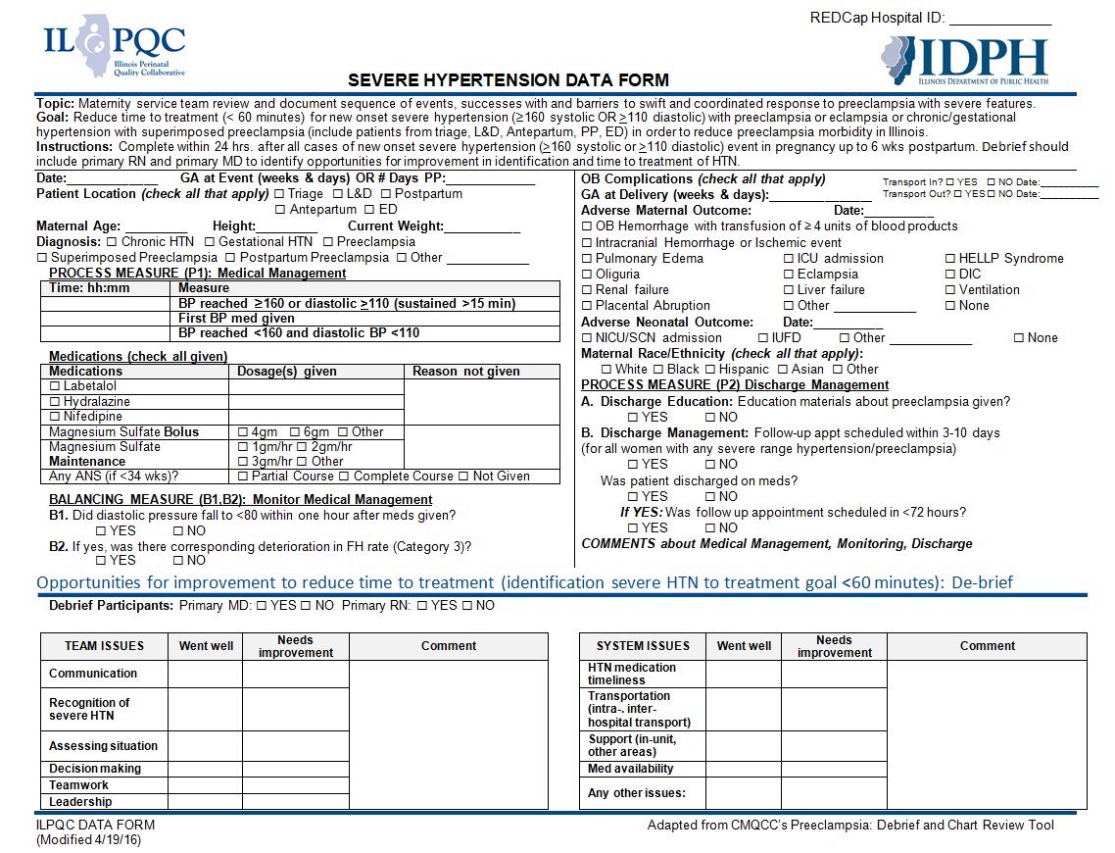
IL Maternal Hypertension:
Data Form

Slide 107
Keys to Success
Team Participates on Monthly Team Call
  4th Monday of each month 12:30-1:30
  Review data, discuss QI strategies for HTN bundle implementation, education topic and Team Talks (hear from teams across IL sharing progress)
Submit monthly data in RedCap
  Teams can track progress across time and compare to over 100 hospitals in initiative on reducing time to treatment for all patients with severe range BP
Hold regular HTN Team meetings to review data, identify opportunities for improvement and drive QI work

Slide 108
Initiative Goals
Early recognition of hypertension / preeclampsia triggers during pregnancy and postpartum period
Reduce time to treatment of severe range blood pressure, 160/110(105)
Provide patient education and appropriate discharge follow up
Implementation of evidence based protocols
  Management of severe HTN, preeclampsia triggers, magnesium, expectant management vs delivery, postpartum management, eclampsia
Notes:
First and foremost, early recognition of hypertension in pregnancy is vital to managing the potential impacts. Blood pressure must be treated and guidelines have been established including treating within one hour of confirmed readings. Magnesium sulfate is not a blood pressure medication, it is for seizure control and is recommended for use in preeclampsia with severe features local protocols need to be developed and followed. Women with hypertension in pregnancy require close follow up and the full HIP toolkit provides recommendations for all women postpartum. There is a two-sided one page document in the HIP toolkit that you may find helpful in assuring that you utilize elements of the Patient Safety Bundle developed by ACOG, SMFM, AWHONN, and others for readiness, recognition, response and reporting.

Slide 109
Key Driver Diagram: Maternal Hypertension Initiative
GOAL: To reduce preeclampsia maternal morbidity in Illinois hospitals
Interventions
Key Drivers
Implement standard order sets and/or algorithms for early warning signs, diagnostic criteria, timely triage, monitoring and treatment of severe hypertension
Ensure rapid access to medications used for severe hypertension with guide for administration and dosage
Implement system plan for escalation, obtaining appropriate consultation, and maternal transport
Perform regular simulation drills of severe hypertension protocols with post-drill debriefs
Integrate severe hypertension processes (e.g. order sets, tracking tools) into your EHR
AIM: By December 2017, to reduce the rate of severe morbidities in women with preeclampsia, eclampsia, or preeclampsia superimposed on pre-existing hypertension by 20%
Readiness: Implementation of standard processes for optimal care of severe maternal hypertension in pregnancy
Recognition: Screening and early diagnosis of severe maternal hypertension in pregnancy
Standardize protocol for measurement and assessment of blood pressure and urine protein for all pregnant and postpartum women
Standardize response to early warning signs including listening to and investigating symptoms and assessment of labs
Implement facility-wide standards for patient-centered education of women and their families on signs and symptoms of severe hypertension
Educate OB, ED, and anesthesiology physicians, midwives, and nurses on recognition and diagnosis of severe hypertension that includes utilizing resources such as the AIM hypertension bundle and/or unit standard protocol
Response: Care management for every pregnant or postpartum woman with new onset severe hypertension
Execute facility-wide standard protocols for appropriate medical management in under 60 minutes
Create and ensure understanding of communication and escalation procedures (e.g. implementing a rapid response team through the use of TeamSTEPPS)
Develop OB-specific resources and protocols to support patients, families, staff through major complications
Provide patient-centered discharge education materials on preeclampsia and postpartum preeclampsia
Implement patient protocols to ensure follow-up within 7-10 days for all women with severe hypertension and 72 hours for all women on medications
Reporting/Systems Learning: Foster a culture of safety and improvement for care of women with new onset severe hypertension
Establish a system to perform regular debriefs after all new onset severe hypertension cases
Establish a process in your hospital to perform multidisciplinary systems-level reviews on all severe hypertension cases admitted to ICU
Continuously monitor, disseminate, and discuss your monthly data in ILPQC REDCap system at staff/administrative meetings
Add maternal hypertension assessment and treatment protocols and education to provider and staff orientations, and annual competency assessments

Slide 110
CMQCC: 4-Step Program to
Improve Preeclampsia Outcomes
Make the Right Diagnosis (new criteria)
Treat the BP!
Deliver not too early, and not too late
Patient education and early postpartum F/U

Slide 111
Need
To
Treat*
BP ≥
160/110(105)
*BP persistent 15 minutes, activate treatment algorithm with IV therapy ASAP, < 30-60 minutes

Slide 112
Sample Process Flow Diagram for
Management of Severe Range BP:
Kaiser Permanente, Roseville, CA

Slide 113
AIM Baseline Survey
Bundle Implementation Questions
Readiness - For every unit in your hospital do you have (Yes/No):
Standard protocols for early warning signs, diagnostic criteria, monitoring and treatment of severe preeclampsia/eclampsia (include order sets and algorithms).
  L&D
  Antepartum/Postpartum
  Triage/ED
Unit education on protocols, unit-based drills (with post-drill debriefs).
  L&D
  Antepartum/Postpartum
  Triage/ED
Process for timely identification, triage, and evaluation of pregnant and postpartum women with hypertension including ED and outpatient areas.
Rapid access to IV medications used for severe hypertension/eclampsia: Medications should be stocked and immediately available on L&D and in other areas where patients may be treated. Include brief guide for administration and dosage.
  L&D
  Antepartum/Postpartum
  Triage/ED
System plan for escalation, obtaining appropriate consultation and maternal transport, as needed for severe maternal hypertension, preeclampsia, and eclampsia.
  L&D
  Antepartum/Postpartum
  Triage/ED

Slide 114
AIM Baseline Survey
Bundle Implementation Questions
Recognition - For every OB/postpartum patient in your hospital do you have (Yes/No):
6. Standard protocol for the measurement and assessment of BP and urine protein for all pregnant and postpartum women.
7. Standard response to maternal early warning signs including listening to and appropriately investigating patient symptoms and assessment of labs (i.e. CBC with platelets, AST and ALT)
8. Facility-wide standards for educating prenatal and postpartum women on signs and symptoms of preeclampsia and severe hypertension.

Slide 115
AIM Baseline Survey
Bundle Implementation Questions
Response - For every case of severe hypertension/preeclampsia in your hospital do you have (Yes/No):
9. Facility-wide standard protocols with checklists and escalation policies for management and treatment of: Severe hypertension; Eclampsia, seizure prophylaxis, and magnesium over-dosage; and Postpartum, emergency department and outpatient presentations of severe hypertension/preeclampsia.
10. Minimum requirements for protocol: Notification of physician or primary care provider if systolic BP =/>160 or diastolic BP =/>110 for two measurements within 15 minutes; After the second elevated reading, treatment should be initiated ASAP (preferably within 60 minutes of verification); Includes onset and duration of magnesium sulfate therapy when indicated; Includes escalation measures for those unresponsive to standard treatment; Describes manner and verification of timely follow-up for blood pressure check and evaluation within 7 to 14 days postpartum; Describes postpartum patient education for women with hypertension / preeclampsia describing postpartum preeclampsia.
11. Support plan for patients, families, and staff for ICU admissions and serious complications of severe hypertension.

Slide 116
AIM Baseline Survey
Bundle Implementation Questions
Reporting - In every unit of your hospital, do you (Yes/No):
11. Establish a culture of huddles for high-risk patients and post-event debriefs to identify successes and opportunities for improvement.
  L&D
  Antepartum/Postpartum
  Triage/ED
12. Multidisciplinary review of all severe hypertension/eclampsia cases admitted to ICU for systems issues.
  L&D
  Antepartum/Postpartum
  Triage/ED
13. Monitor quality outcomes and process metrics involving severe hypertension in pregnancy.
  L&D
  Antepartum/Postpartum
  Triage/ED

Slide 117
HTN Initiative Monthly
Team Calls: Schedule
Call Date | Topic
June 27 12:30 – 2:30 pm | Readiness and Reporting - Bundle / Toolkit Overview AND Drills, Simulation, and Debriefs
July 25 12:30 – 1:30 pm | Recognition - Accurate BP Measurement & Diagnosis
August 22 12:30 – 1:30 pm | Response - BP Medication and Treatment Algorithms
September 26 12:30 – 1:30 pm | Response - Timing of Delivery
October 24 12:30 – 1:30 pm | Response - Patient Education/Engagement and Postpartum Follow-up

Slide 119
Additional Resources
Preeclampsia Foundation tools and materials
  www.preeclampsia.org
California Maternal Quality Care Collaborative
  www.CMQCC.org
Patient safety bundles and AIM program information
  www.safehealthcareforeverywoman.org
ACOG DII (New York) Safe Motherhood Initiative
  https://www.acog.org/About-ACOG/ACOG-Districts/District-II/Safe-Motherhood-Initiative
Illinois Perinatal Quality Collaborative (ILPQC)
  www.ilpqc.org
Notes:
There are other resources available for HIP that include:….

Slide 121
Contact
Email info@ilpqc.org
Visit us at www.ilpqc.org

Slide 122

IDPH

