Slide 1
Maternal Hypertension Initiative Teams Call Implementing Debriefs
December 19, 2016
12:30 – 1:30 pm

Slide 2
Overview
4th Annual Conference Recap (5 mins.)
HTN Initiative: Collaborative Tools and Updates (20 mins.)
CMQCC Team Debrief Experience (20 mins.)
Jamie Vincent, MSN, RNC-OB, C-EFM, Perinatal CNS - John Muir Hospital
Team Talks (10 mins.)
Marilyn Paolella BSN, RNC, E-EFM, Silver Cross Hospital
Patient and Family Advisors
Next Steps & Questions

Slide 3
Annual Conference

Slide 4
Annual Conference 2016
Conference held on November 3, 2016 at the Westin in Lombard, IL
396 participants (largest ever)!
54 physicians (most ever)
313 nurses including perinatal administrators and educators
Representatives from state legislature, Medicaid, Public Health (most ever)
5 sponsors (most ever)

Slide 5
Annual Conference 2016: Debrief
Debrief on event
Feedback on what went well and what we can improve on?
Debrief on OB Breakout
Discussion of key takeaways
Moving forward with QI focused calls in 2017 for HTN
Interest across many potential future initiatives:
Implementation of LARC at Delivery
Supporting Vaginal Birth / Reducing Primary Cesarean
Optimizing Management of Maternal Opioid Use (partnership with neonatal NAS initiative

Slide 6
HTN Initiative: Collaborative Tools and Updates QI Support Plan Collaborative Data Review A QI Story: Doubling Debriefs

Slide 7
Collaborative Call Schedule: Focus on System Changes
Call Date | Topics –Top 5 system level changes/interventions to decrease the time to treatment and improve discharge education and follow-up:
December 19, 2016 12:30 – 1:30 pm | Establish a system to perform regular debriefs after all new onset severe maternal hypertension cases
January 23, 2017 12:30 – 1:30 pm | Develop and implement standard order sets, protocols, and checklists for recognition and response to severe maternal hypertension and integrate into EHR
February 27, 2017 12:30 – 1:30 pm | Implement a system to identify pregnant and postpartum women in all hospital departments and execute protocol for measurement, assessment, and monitoring of blood pressure and urine protein for all pregnant and postpartum women
March 27*, 2017 12:30 – 1:30 pm | Ensure rapid access to IV and PO anti-hypertensive medications with guide for administration and dosage (e.g. standing orders, medication kits, rapid response team)
April 24, 2017 12:30 – 1:30 pm | Implement a system to provide patient-centered discharge education materials on severe maternal hypertension and implement protocols to ensure patient follow-up within 10 days for all women with severe hypertension and 72 hours for all women on medications
May | Anticipate Face –to – face meeting

Slide 8
Focused QI Support Starting in January 2017
ILPQC Central reviews data on key process measures by hospital, starting with time to treatment in January 2017
ILPQC identifies hospitals and provided targeted support
Treating 75-100% (28 teams as of 9/16) of women in under 60 minutes – Hospitals will be contacted with mentorship opportunities
Treating 25-74% (12 teams as of 9/16) of women in under 60 minutes – Hospitals will be invited to focused QI support calls
Treating 0-24% (24 teams as of 9/16) of women in under 60 minutes – Hospitals will be contacted for individual QI support calls
Stay tuned for upcoming QI Support Calls in email newsletters

Slide 9
Focused QI Support Starting in January 2017
ILPQC Central working with perinatal network administrators and provides resources to support teams to achieve goals on reducing time to treatment by December 2017
Instructions for hospitals to provide reports to PNAs
Discussion questions for network meetings and encourage teams share data / progress / challenges / successes
Follow up with hospitals needing additional support
QI support calls link high performers with teams needing support

Slide 10
Severe Hypertension Data Entry Status
 | Total Records | # Teams with Data
Baseline (2015) | 1501 | 86
July | 550 | 74
August | 632 | 80
September | 542 | 80
October | 411 | 66
November | 348 | 57
Overall | 3984 | 98

Slide 11
Maternal HTN: Time to Treatment
Note: June 2016 data omitted as missed opportunities not reported consistently.

Slide 12
CMQCC Results
Baseline was Retrospective
Notes:
This graph only shows monthly totals, not quarterly!!! This number(78.6%) is only for the month of June! The 2nd quarter total % is 72.4%.
Last month: 30-60 min: 17.8%, Total was 66.7%

Slide 13
REVISED - Key Driver Diagram: Maternal Hypertension Initiative
GOAL: To reduce preeclampsia maternal morbidity in Illinois hospitals
Key Drivers
Interventions
AIM: By December 2017, to reduce the rate of severe morbidities in women with preeclampsia, eclampsia, or preeclampsia superimposed on pre-existing hypertension by 20%
GET READY
IMPLEMENT STANDARD PROCESSES for optimal care of severe maternal hypertension in pregnancy
Develop standard order sets, protocols, and checklists for recognition and response to severe maternal hypertension and integrate into EHR
Ensure rapid access to IV and PO anti-hypertensive medications with guide for administration and dosage (e.g. standing orders, medication kits, rapid response team)
Educate OB, ED, and anesthesiology physicians, midwives, and nurses on recognition and response to severe maternal hypertension and apply in regular simulation drills
RECOGNIZE
IDENTIFY pregnant and postpartum women and ASSESS for severe maternal hypertension in pregnancy
Implement a system to identify pregnant and postpartum women in all hospital departments
Execute protocol for measurement, assessment, and monitoring of blood pressure and urine protein for all pregnant and postpartum women
Implement protocol for patient-centered education of women and their families on signs and symptoms of severe hypertension
RESPOND
TREAT in 30 to 60 minutes every pregnant or postpartum woman with new onset severe hypertension
Execute protocols for appropriate medical management in 30 to 60 minutes
Provide patient-centered discharge education materials on severe maternal hypertension
Implement protocols to ensure patient follow-up within 10 days for all women with severe hypertension and 72 hours for all women on medications
CHANGE SYSTEMS
FOSTER A CULTURE OF SAFETY and improvement for care of women with new onset severe hypertension
Establish a system to perform regular debriefs after all new onset severe maternal hypertension cases
Establish a process in your hospital to perform multidisciplinary systems-level reviews on all severe maternal hypertension cases admitted to ICU
Incorporate severe maternal hypertension recognition and response protocols into ongoing education (e.g. orientations, annual competency assessments)

Slide 14
Maternal HTN: Debriefs

Slide 15
Maternal HTN: Debriefs

Slide 16
QI Methods Example: Linking data review to PDSA cycle
Review your team data in your next team meeting
How are you doing over time?
Consistent? Improving?
How do you compare to other teams?
Have you tried any system changes to improve debriefs?
If yes, could they be improved?
If no, why not try now?

Slide 17
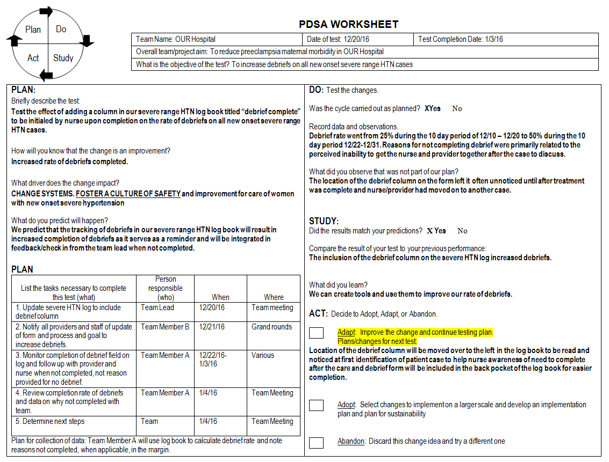
A QI Story: Doubling Debriefs

Slide 18
CMQCC Team Debrief Experience Jamie Vincent, MSN, RNC-OB, C-EFM, Perinatal CNS - John Muir Hospital

Slide 19
Preeclampsia: Postpartum Case Review
Jamie Vincent, RNC, MSN
Perinatal Clinical Nurse Specialist

Slide 20
Case Review:
45 y.o., G5 P5, s/p repeat C/S for breech presentation on 1/20/2016
Admitted to ED with c/o bleeding from incision
States BP fairly well controlled, but elevated lately
History of preeclampsia with two prior pregnancies

Slide 21
Case Review:
175/90 @ 0930
164/99 @ 1330

Slide 22
Case Review:

Slide 23
Preeclampsia Care Guidelines: ED

Slide 24
Preeclampsia Care Guidelines: ED

Slide 25
Preeclampsia Care Guidelines: ED

Slide 26
Preeclampsia Care Guidelines: ED

Slide 27
CMQCC Debrief Form:

Slide 32
Questions?

Slide 33
Team Talks
Silver Cross Hospital
Marilyn Paolella BSN, RNC, E-EFM

Slide 34
Silver Cross Hospital
Cerner Hospital for Documentation
New Debrief Documentation

Slide 35
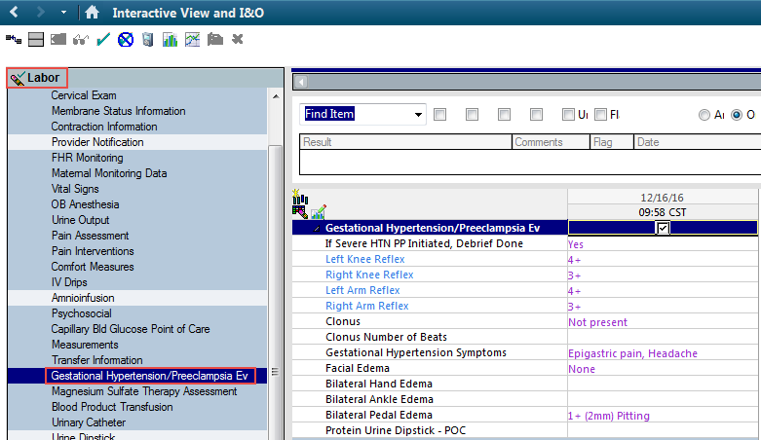
Debrief Documentation
Gestational Hypertension/Preeclampsia and Magnesium Sulfate Therapy Assessment
iView Labor band – Gestational Hypertension section:
New field for If Severe HTN PP Initiated, Debrief Done within Gestational Hypertension section:

Slide 36
Other hypertension documentation

Slide 37
Also have Magnesium Sulfate band

Slide 38
Coming January 2017
New alert will fire in Cerner in order to make sure the patient is seen after discharge in the appropriate time frame, if patient had severe hypertension powerplan. (Fires with a pharmacy link)
It should display to physicians and RNs upon opening the patient’s chart.
It should fire starting 18 hours after Date, Time of Birth. If the mother had multiples, it should go off of Baby A.
It should fire every 4 hours.
It should STOP firing when the Discharge Patient order has been placed.
It will remind the physician and nursing staff about the discharge visit criteria for patients with severe hypertension, and those discharged on meds.

Slide 39
Patient & Family Advisors

Slide 40
Patient/Family Advisors
ILPQC patient/family advisors
ILPQC having conversations with 4 potential moms to serve on advisory boards
Discussing specific roles of patient/family advisors at the state level
Hospital patient/family advisors
ILPQC developed tool to help staff/providers engage patient/family members in discussion about working in QI
Draft for review and feedback in download box
Available on website and sent to all team members
One Pager on the value of patient/family engagement posted to front page of ILPQC website!

Slide 41
Team Talks – HTN Initiative
Teams assigned an OB Teams Call – look for email from Kate
January -
Alexian Brothers Women’s and Children’s Hospital
Memorial Hospital East/Belleville
February
Northwest Community Hospital
Rush-Copley
March
Elmhurst Memorial
Unitypoint Health Trinity
Alexian Brothers Women’s and Children’s
April
SwedishAmerican
Palos Community Hospital
Generate discussion and learning through sharing
Good foundation for storyboard/poster presentations!
Present 5-10 mins. on current QI work based on monthly call topic:
January – implementing standard order sets, protocols, and checklists
February – standardizing identification, BP measurement, assessment, and monitoring for pregnant/postpartum women
March – rapid access to IV and PO anti-hypertensive medications
April – implement system for standardized patient discharge education and follow-up

Slide 42
HTN Initiative Next Steps
Focus on QI strategies to reduce time to treatment across all hospitals
Identify a patient/family advisor for their HTN Initiative Team and participate in monthly team meetings!
Data past and upcoming due dates:
Severe HTN Data Form
November data was due December 15th
December data is due January 15th
AIM Quarterly Measures
2016 Q3 (July - September) was due October 15th
2016 Q4 (October – December) is due January 15th
Quarterly Implementation Checklist
2016 Q3 (July - September) was due October 15th
2016 Q4 (October – December) is due January 15th
Next teams call will be January 23, 2017 from 12:30 – 1:20 pm
Email info@ilpqc.org with any questions!

Slide 43
Q&A
Ways to ask questions:
Raise your hand on Adobe Connect to ask your question by phone
Post a question in the Adobe Connect chat box

Slide 44
Contact
Email info@ilpqc.org
Visit us at www.ilpqc.org

Slide 45
IDPH

