Slide 1

Birth Certificate Accuracy Initiative
Monthly OB Teams Call
August 24, 2015
12:30 pm – 1:30 pm

Slide 2

Variables of the Month:
Audience Response
Go to respond.cc
Enter the code 10585
Answer the questions for the variables of the month discussion

Slide 3
Overview
Birth Certificate Accuracy Initiative update
QI topics of interest
  Review data and identify opportunities for change
  Demo reports and website resources
Variables of the month
  Antibiotics
  Infant Feeding
  LMP
Team Talks
  Evanston Hospital, NorthShore University HealthSystem – Ann Newkirk
Next Steps

Slide 4
BC Accuracy July Data
107 team rosters submitted for initiative (44 wave 1, 63 wave 2)
July audit data due 8/15 in REDCap https://redcap.healthlnk.org/
    As of 8/20, 80 teams have entered data (74.8% of teams)!
QI Process Feedback Forms
    51 completed for May as of 8/20
    34 completed for June as of 8/20
    22 completed for July as of 8/20
    Report your QI process monthly:
  https://www.surveymonkey.com/s/MonthlyProcessSurveyMay2015

Slide 5
BC Accuracy July Data:
All Variables
Goal = 95.0% (red dashed line)
Baseline = 87.0% (blue dash dot line)
Overall accuracy for all 17 variables for July = 94% (black dotted line)
Total Hospitals Reporting July Data = 80

Slide 6
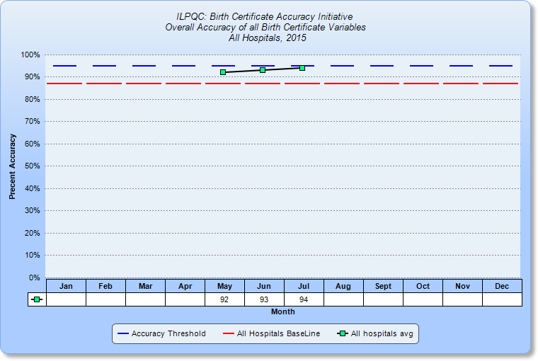
BC Accuracy: Overall Accuracy of All Variables
2014 Baseline = 87.3%

Slide 7
QI Cycle Support Recap
Monthly QI cycle process
  OB Teams webinar on the 4th Monday of each month, 12:30-1:30
  Data reporting via REDCap and QI process feedback reporting via SurveyMonkey
  QI coaching calls with Perinatal Network Administrators and ILPQC as needed
  Encourage each hospital team to meet to discuss data report, QI process feedback form and plan next PDSA.

Slide 8
Opportunities for Change
Let’s take a closer look at variables under 95% accuracy & identified on PDSA workshop calls
Variable | Baseline Accuracy | May Accuracy | June Accuracy | July Accuracy
Augmentation | 88.7 | 91 | 91 | 95
Antibiotics | 86.0 | 90 | 92 | 94
Gestation | 88.0 | 91 | 91 | 93
Infant Feeding | 83.7 | 87 | 91 | 89
SSN | 85.7 | 92 | 92 | 93
Prenatal Care | 78.3 | 84 | 84 | 89
WIC | 76.0 | 81 | 86 | 87
LMP | 81.0 | 83 | 87 | 88

Slide 9
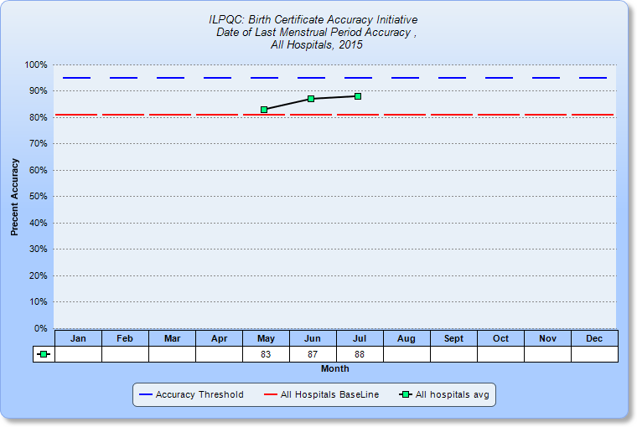
Opportunities for Change:
LMP
2014 Baseline = 81.0%

Slide 10
Accuracy of LMP
What is your current source document for LMP? Is it accurate?
Opportunity for Change | Possible PDSA
If you don’t already, could you use the prenatal record as your source document? | Work with 1 prenatal provider to test including this information on the prenatal record. See notes from July call for more ideas on accessing current and accurate prenatal records with the information you need for the birth certificate ready to abstract.
If you use mom’s worksheet, is the data often missing? | Do you administer mom’s worksheet via interview? If not, work with 1 nurse or other staff to test interviewing mom to see if this helps reduce the frequency of missing LMP data. If you do interview, work with 1 nurse or other staff to test follow-up questions or probes that encourage mom to provide this information.
What are barriers to LMP accuracy at your hospital? Share in the chat box.

Slide 11
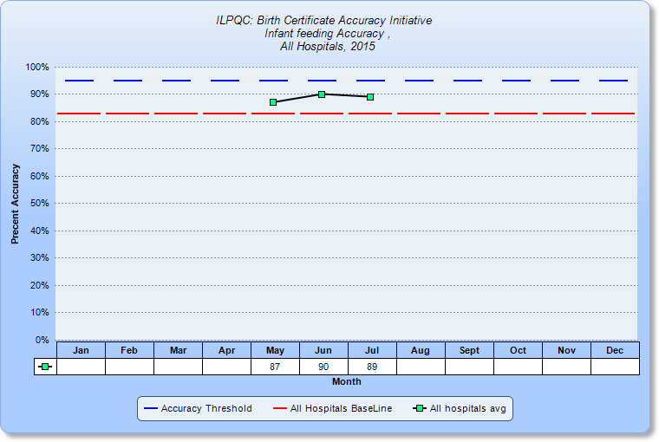
Opportunities for Change:
Infant Feeding
2014 Baseline = 83.7%

Slide 12
Accuracy of Infant Feeding
Opportunity for Change | Possible PDSA
Provider understanding and use of IVRS definition of infant feeding | Do all providers know, understand and use the IVRS infant feeding definition consistently and record it clearly on the medical record? If providers don’t know the definition, identify 1 provider to educate on the definitions (with key variables guide or other source) and test accuracy of medical record. If providers don’t record infant feeding clearly on the medical record, identify 1 provider to work with you to recording it differently for 1 day and see how these records are abstracted in IVRS.
Birth Certificate abstractor’s identification of infant feeding data from the medical record | Do all abstractors know how to identify infant feeding on the medical record and distinguish different types of feeding? If abstractors don’t know definition, identify 1 abstractor to educate on the definitions (e.g. with key variables guide). If abstractors don’t know where to find infant feeding clearly on the medical record, identify 1 provider to record infant feeding in a different way for 1 day and see how these records are abstracted in IVRS.
What are barriers to Infant Feeding accuracy at your hospital? Share in the chat box.

Slide 13
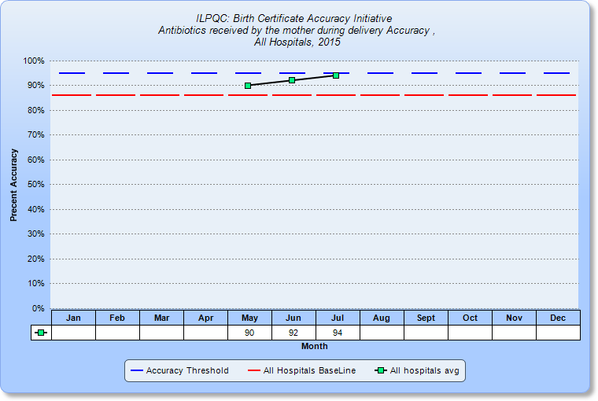
Opportunities for Change:
Antibiotics
2014 Baseline = 86.0%

Slide 14
Accuracy of Antibiotics
Opportunity for Change | Possible PDSA
Provider understanding and use of IVRS definition of antibiotics | Do all providers know, understand and use the IVRS antibiotics definition consistently and record it clearly on the medical record? If providers don’t know the definition or distinguish antibiotics during labor, identify 1 provider to educate on the definitions (with key variables guide or other source) and test accuracy of medical record. If providers don’t record antibiotics – and distinguish during labor - clearly on the medical record, identify 1 provider to work with you to recording it differently for 1 day and see how these records are abstracted in IVRS.
Birth Certificate abstractor’s identification of antibiotics administered during labor from the medical record | Do all abstractors know how to identify antibiotics during labor from antibiotics outside of labor on the medical record and? If abstractors don’t know definition, or how to differentiate antibiotic during labor, identify 1 abstractor to educate on the definitions (e.g. with key variables guide). If abstractors don’t know where to find antibiotics clearly on the medical record, or hot to identify if they were administered during labor, identify 1 provider to record infant feeding in a different way for 1 day and see how these records are abstracted in IVRS.
What are barriers to Antibiotic accuracy at your hospital? Share in the chat box.

Slide 15
QI Support: Connecting Hospitals on Variables of Interest
5 QI Topic Workshops to be held
Opportunity to connect and workshop with other hospitals focused on similar PDSA cycles
  Monday, August 31
    9 am: Augmentation
    10am: WIC
    11 am: Gestational Age
  Tuesday, September 1
    10am: Antibiotics
    11am: Prenatal Care and Last Menstrual Period
Discussion boards are available on each variable on the ILPQC member’s only section of the website

Slide 16
Demo: BC Reports & Website Resources
How to access and download your Birth Certificate reports
Website resources
  Where to find Birth Certificate materials and resources
  Members only area
    QI Topic Workshop Discussion Boards
    Information on insurance definitions

Slide 17
OB Teams Call
Birth Certificate optimization initiative
August 24, 2015
Cindy Mitchell

Slide 18
Variables for Discussion
LMP
Antibiotics
Infant Feeding
Mom’s pre-pregnancy weight

Slide 19
Audience response
Go to respond.cc
Enter the code 10585
Answer the following questions

Slide 20
Date of last normal menses
Mom delivers at 39w 6d. When completing the BC the clerk notices that the LMP section is blank on moms prenatal record. Mom isn’t sure when her last period was. How would you answer this question on the birth certificate?
a) 99/99/9999
b) Calculate what mom’s LMP should have been based on the gestational age at delivery.

Slide 21
Date of last normal menses
Mom comes in and delivers with no PNC. When completing the birth certificate mom states that her last period was October last year. How would you answer this variable on the birth certificate?
a) 10/99/2014
b) 99/99/9999

Slide 22
Date of last normal menses
Definition: The date the mother’s last normal menstrual cycle began.
Enter the date the mother’s last normal menstrual period began.
Enter unknown portions as “99”
Sources: Prenatal Care Record (1st choice)
Admission H&P
Date last normal menses began
Guidebook #40; pg 27
Key Variable Document variable #5

Slide 23
Antibiotics received by mom during labor
Mom comes in contracting; not ruptured; was a scheduled repeat C/S in 2 days. Mom is offered to attempt a VBAC but declines so c/s was performed. Antibiotics are hung in the OR.
On the birth certificate would you check the box for Antibiotics received by the mother during labor?
A) Yes
B) No

Slide 24
Antibiotics received by mom during labor
Mom arrives in labor. She progresses to 7cm. At that time she starts running a fever. Antibiotics are ordered and administered. However, the baby becomes tachycardic and over the next few hours no cervical change is made; mom agrees to a c/s delivery. Would you check the box for Antibiotics received by the mother during labor?
A) Yes
B) No

Slide 25
Antibiotics received by mom during labor
Definition: Antibiotic medications received by the mother during labor.
Check the box only if the mother received any antibiotic medicines after labor began but before delivery. Do not check box if mother did not labor, such as scheduled cesarean section. Antibiotics are usually given to women in labor for these and other medical conditions (which should appear in the chart)
  Chorioamnionitis
  + GBS
  SBE prophylais
  Maternal Fever
Do not check box if Antibiotics are only given for C/S
Characteristics of labor and delivery
Guidebook #46; pg 46
Key Variable Document variable #11

Slide 26
Infant feeding
Mom delivers at 37w 4d. She has stated her intent is to exclusively breastfeed. Baby nurses frequently and by 24 hours mom is exhausted and states that she needs the baby out of her room for the night so she can sleep. Baby gets fussy in the nursery about 45 min after mom got to sleep. Staff supplement baby with 20 ml of formula so they don’t have to wake mom right away. Baby sleeps for 2 ½ hours and is then taken to moms room to breastfeed. All other feedings till discharge are breastmilk. How would you answer the birth certificate question regarding how is infant being fed?
A) Breast milk only
B) Formula only
C) Both breast milk and formula
D) Neither breast milk or formula
E) Unknown

Slide 27
Infant feeding
Same Scenario as previous question ~ however for this one the formula was provided at 36 hours of age and the birth certificate has already been completed and filed. What would the answer be to how is infant being fed:
A) Breast milk only
B) Formula only
C) Both breastmilk and formula
D) Neither breast milk or formula
E) Unknown

Slide 28
Infant Feeding
Definition: How is infant being fed?
Breastmilk only
Formula only
Both breastmilk and formula
Neither breast milk or formula
Unknown
This field notes the feeding method at the time the record is created.
If the submission changes after submission of the birth certificate but before discharge, this information does not change.
If a baby has only received breast milk from delivery until the birth certificate record is created (including babies fed at the breast and babies given breast milk in a bottle) then answer: Brest milk only.
Do NOT answer based on mom’s intent to breast of bottle feed.
The Answer to this question auto-populates the next field. “is the Infant Being Breastfed at ANY time between Birth and Discharge?
How is Infant being Fed
Guidebook #58; pg 69
Key Variable Document variable #17

Slide 29
Mother’s pre-pregnancy weight
Mom delivers at 40w 1d. While completing the birth certificate you notice the pre-pregnancy weight on the prenatal record is not filled out. They did record a weight at her first prenatal care visit of 145#. You also notice that on the paperwork you have mom complete she has left this question blank and states she doesn’t remember.
On the birth certificate what would you put for Mother’s pre-pregnancy weight.
A) 145
B) unknown

Slide 30
Mother’s pre-pregnancy weight
Same scenario as previous question. However this time mom puts a pre-pregnancy weight on her forms as 140#. What would you put on the birth certificate for mother’s pre-pregnancy weight?
A) 145
B) 140
C) Unknown

Slide 31
Mother’s pre-pregnancy weight
Definition: Mother’s weight prior to pregnancy
Enter the mother’s weight before pregnancy diagnosed.
If mother’s pre-pregnant weight is unknown, enter unknown
1st choice for information is prenatal record
Mother’s pre-pregnancy weight
Guidebook #33; pg 22
Key Variable Document variable: not included

Slide 32

Questions

Slide 33
Team Talks
NorthShore Evanston
  Ann Newkirk

Slide 34
ILPQC 3rd Annual Meeting:
Poster Abstract Submission!
ILPQC 3rd Annual Meeting to be held at UIC Forum on Wednesday, November 18
Now accepting poster abstract submissions!
  Opportunity for ALL hospitals across the state to share a perinatal quality improvement projects!
  Posters detailing ANY quality improvement projects in development, current projects, or recently completed projects (not limited to ILPQC initiatives) are welcome!
  Instructions for submissions found here:
  http://bit.ly/1DPWBLe
  Abstracts to be submitted to Survey Monkey here:
  https://www.surveymonkey.com/s/ILPQCposters2015

Slide 35
Next Steps
Conduct monthly audit for August and enter data into REDCap by September 15
Submit monthly QI process feedback form for August via SurveyMonkey by September 15
Review your reports immediately in REDCap to evaluate your progress towards improved accuracy and identify opportunities for change
Encourage your team to meet: discuss progress, complete QI feedback form and plan next PDSA.
Contact ILPQC or your PNA with any questions

Slide 36
Next OB Teams Meeting
September 28, 12:30-1:30pm
Need 2 teams to sign up for “Team Talks” for September – December meetings
Remember to register for the www.ilpqc.org
ILPQC website member’s only section
Send your Process Flow Diagram and PDSA worksheets to info@ilpqc.org to share with other teams in the ILPQC members section.

Slide 37

ILPQC Administrative Team
Ann Borders
ILPQC Executive Director, OB Lead
Aki Noguchi and Pat Ittmann
Neonatal Leads
Patricia Lee King
State Project Director
Kate Finnegan
Project Coordinator
Email us at info@ilpqc.org
Website: www.ilpqc.org

Slide 38


