Slide 1

Neonatal Breakout Session
December 19, 2017

Slide 2
Annual Conference
Neonatology Breakout
GH Achievements and Sustainability Plan
  Review of Golden Hour Data
  Golden Hour Survey Review
  Sustainability Plans
MNO Initiative Overview
Creation of Driver Diagram for MNO Initiative
Panel Discussion

Slide 3
Neonatal Golden Hour:
Communication Practices
91%
77%
88%
77
51%
77
79%
29%

Slide 4
Neonatal Golden Hour:
Delivery Room Practices
94%
78%
91%
56%
Notes:
Dan Updated 12.17
Prepare graphs
JJ Updated 12.16
Take out of graphs:
Father at delivery
Administration of surfactant
Administration of antibiotics
IV fluids?

Slide 5
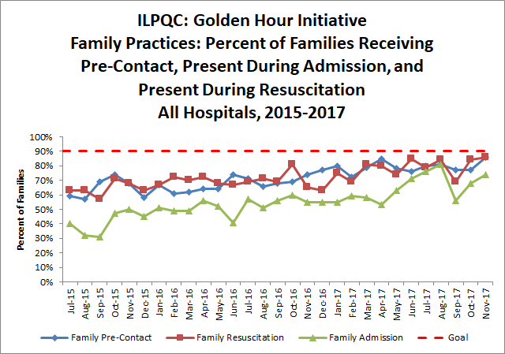
Neonatal Golden Hour:
Family Engagement
86%
63%

Slide 6
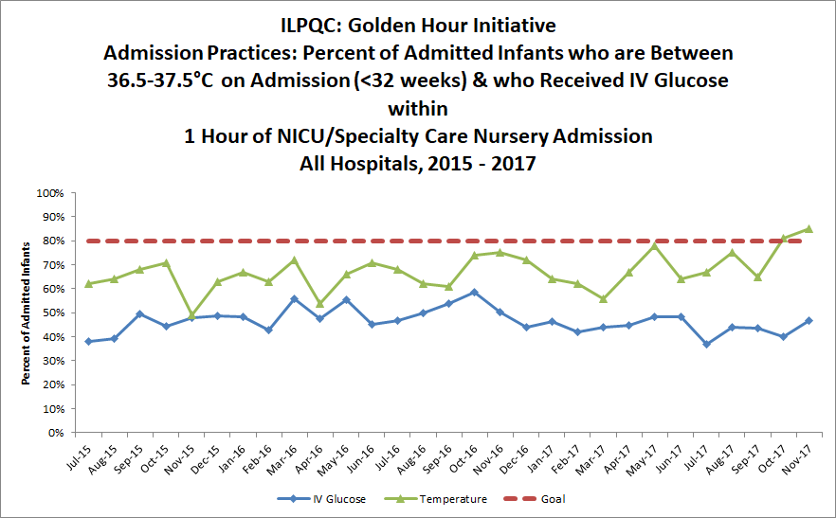
Neonatal Golden Hour: Admission
Practices – Temperature and IV Glucose
83%
61%

Slide 7
ILPQC Neonatal Survey Analysis Data
Thank you to Cecilia Lopez from Carle Foundation Hospital for her assistance in developing these slides!

Slide 8
Survey Results
17 hospitals responded to the survey - Thank You!
Golden Hour
  Focal measures
  Successes
  Barriers
  Lessons Learned
  Sustainability
MNO Initiative
Areas for Improvement in ILPQC

Slide 9
Survey Findings:
GH Measures as a Primary Focus
Temperature between 36.5-37.5 °C (97.7-99.5 °F) upon NICU admission
Delayed cord clamping
Post-resuscitation debrief
Pre-brief
Pulse-oximetry
Non-invasive respiratory support
Checklist
Family Engagement prior to delivery
Antibiotics and IV access within 1 hour of NICU admission
Family engagement in delivery room and during NICU admission
Surfactant
75% or more of teams
60-74% of teams
under 60% of teams

Slide 10

What worked well for the GH Initiative?
“The data site was easy to navigate. Reviewing the data monthly with our entire NICU team at our Quality meeting was most helpful in achieving our goals.”
“Sharing of documents to educate staff on new initiative. Sharing of information on what's going well and what we struggle with. Prescheduled meetings.”
“I liked how detailed the description of the outcomes were. I liked having multiple things to focus on as not every hospital needs work on the same outcomes.”
“Monthly calls with details from teams who were succeeding on certain measures, giving ideas to teams who were struggling with the same measure.”

Slide 11

Biggest Barriers for Data Collection and
Entry

Slide 12
Biggest Barriers to Data
Collection and Entry
Resources
  Having staff that submit information that is needed to collect the data is challenge.
  Repeated reminders to staff regarding definitions for data collection.
Buy in
  Lack of investment after an extensive attempt to go through all of the channels to get the project started.
  Inconsistent completion by providers and nurses
Data system
  Identify opportunities to improve usability of data forms/entry
  Incorporate dash board for improved reporting

Slide 13
Lessons Learned from the GH Initiative
Communication
  Develop strategies for communication within hospital teams during changes in membership
  Ensure effective communication from the start of the initiative
  Ensuring all team leads are getting ILPQC communications
Data
  Clear variable definitions/analysis plans up front to avoid ambiguity
  Incorporating early input from teams on data collection/system
Tools
  Providing templates (e.g. checklists) to jump start teams
  Communicate collaborative team call topics in advance to facilitate team preparation
  Identify strategies to increase physician engagement

Slide 14
ILPQC Collaborative Learning and
Communication Preferences
Over half (55%) of teams found the hospital teams calls to be moderately to extremely useful
  11% not at all useful
  33% slightly useful
  44% moderately useful
  11% extremely useful
Teams recommended every other month (44%) or monthly (40%) team calls for MNO
Teams valued regular email communications and preferred monthly email updates (72% of respondents) over twice monthly or quarterly

Slide 15
Plans for 2018 and Beyond
High interest in 2018 initiatives
  89% of responding teams plan to participate in MNO
    Opportunities for expansion to Level I and Level II hospitals
  94% plan to participate in GH Sustainability
Initiatives of interest for consideration for 2020 and beyond (20% or more of teams expressing interest)
  Antibiotic stewardship (35% of teams)
  Survival without morbidity
  Supporting optimal breastfeeding/Breastmilk in the NICU

Slide 16
Exploring Additional Resources for Teams
Most teams (88%) interested in ILPQC offering didactic via live webinars
Top Topics of interest for QI include:
  Teamwork for Quality Improvement/TeamSTEPPS (78%)
  Fishbone and Pareto Diagrams (67%)
  SMART Aims (61%)
  Model for Improvement and PDSAs (56%)

Slide 17
Suggestions for Improved Collaborative
Learning and Information Sharing between Hospitals and ILPQC
  Continue to facilitate sharing through the hospital teams call format
    Share how other hospitals completed the implementation process for the project
    Call focused on REDCap
      Refresher before MNO
      How to run and interpret different reports
  Communication processes
    Distribute power points – power points are distributed to teams with a reminder for the call
    Maybe a blog/suggestion page that can be used to submit questions/concerns that all hospitals can respond to – offered discussion boards through the ILPQC website and could revisit
Support team play and supportive atmosphere

Slide 18
Preferred Golden Hour Sustainability
Measures for 2018

Slide 19
Sustainability Measures
Temperature
  >80% of infants <32 weeks will have a temperature between 36.5-37.5 ℃
Debrief
  Will debrief after high-risk deliveries
Delayed Cord Clamping
  >80% of infants < 32 weeks will receive delayed cord clamping

Slide 20

Achieving and Sustaining
GH Goals for ALL TEAMS
Compliance monitoring of key measures to sustain the gains
Teams focus on key measures to complete goals
ILPQC QI support to teams in need of additional assistance and will hold quarterly GH team calls

Slide 21

ILPQC Mothers and Newborns affected by Opioids (MNO)
Proposed Aims:
Increase pregnant women affected by opioids linked to care prenatally and receiving Medication Assisted Treatment (MAT) for opioid disorder at delivery
Decrease pharmacological therapy in substance exposed neonates
Increase mothers and newborns affected by opioids breastfeeding at neonatal discharge
Increase neonates exposed to chronic maternal opioid use who can be discharged to maternal care
Approach: Establish workgroup, identify hospital teams, implement neonatal change package (in collaboration with OB) using QI strategies, data, & collaboration.
First ever ILPQC “dyad” initiative with OB and Neonatal teams partnering to prepare providers, nurses, and families to improve outcomes for mothers and infants affected by opioids.

Slide 22
MNO Alignment with
State of Illinois Opioid Action Plan
Prevention: Preventing the further Spread of the Opioid Crisis
Priority | Strategy | ILPQC
Priority A: Safer prescribing and dispensing | Strategy 1: Increase PMP use by providers | Increase the % of prenatal providers using the Illinois Prescription Monitoring Program
 | Strategy 2: Reduce high-risk opioid prescribing through provider education and guidelines | Increase % of hospitals with protocols for safe prescribing practices for routine cesarean section and vaginal birth
Priority B: Education and stigma reduction | Strategy 3: Increase accessibility of information and resources | Increase % of hospitals providing primary prevention materials to their outpatient OB clinics
Priority C: Monitoring and communication | Strategy 5: Strengthen data collection, sharing, and analysis to better identify opportunities for intervention | Increase % of participating birthing hospitals having entered any opioid process and outcome measure data into the ILPQC Data & Reporting System to monitor their improvement over time and in comparison to birthing hospitals

Slide 23
MNO Alignment with
State of Illinois Opioid Action Plan
Treatment and Recovery: Providing evidence-based treatment and recovery services to Illinois residents with opioid use disorder (OUD)
Priority | Strategy | ILPQC
Priority D: Access to Care | Strategy 6: Increase access to care for individuals with opioid use disorder | Increase % of prenatal providers with validated screening protocols for OUD in pregnancy
 |  | Increase % of birthing hospitals who have identified community resources for outpatient medical management of OUD for pregnant/postpartum women and have created a referral protocol
 |  | Increase % of birthing hospitals who have trained providers and staff on protocols for referring pregnant and postpartum women for outpatient medical management of OUDs
 |  | Increase % of buprenorphine prescribers for pregnant/postpartum women

Slide 24
MNO Alignment with
State of Illinois Opioid Action Plan
Response: Averting Overdose Deaths
Priority | ILPQC
Priority F: Rescue | Increase % of mothers, of newborns with known exposure to opioids, screened in pregnancy
 | Decrease pharmacological therapy in substance exposed neonates
 | Increase % of newborns with known exposure to opioids receiving reliable newborn screening
 | Increase % of newborns with known exposure to opioids receiving consistent, non-pharmacological treatment
 | Increase % of hospitals using evidence-based NAS pharmacological treatment guidelines

Slide 25
ILPQC NAS Workgroup
To develop and implement a NAS quality improvement initiative based on successful work in other states and adapted for Illinois, including development of:
    Smart AIM, Process, Outcome, and Balancing Measures
    Data Forms and Reports
    Toolkits/ Resources
    Hospital Recruitment Procedures
    Collaborative Learning Content
    QI Support Models
Work in collaboration with the IDPH NAS Advisory Committee
Notes:
Model state PQC programs in OH, TN, Massachusetts, FL

Slide 26
ILPQC Mothers and Newborns affected by Opioids (MNO)
Proposed Aims:
Increase pregnant women affected by opioids linked to care prenatally and receiving Medication Assisted Treatment (MAT) for opioid disorder at delivery
Decrease pharmacological therapy in substance exposed neonates
Increase mothers and newborns affected by opioids breastfeeding at neonatal discharge
Increase neonates exposed to chronic maternal opioid use who can be discharged to maternal care
Approach: Establish workgroup, identify hospital teams, implement neonatal change package (in collaboration with OB) using QI strategies, data, & collaboration.
First ever ILPQC “dyad” initiative with OB and Neonatal teams partnering to prepare providers, nurses, and families to improve outcomes for mothers and infants affected by opioids.

Slide 27
ILPQC NAS Workgroup
35 Members Representing:
Stroger (3)
Memorial Hospital Of Carbondale (2)
Advocate Lutheran
UIC
St. Louis University of Medicine (2)
Barnes Jewish Memorial
Lurie Children’s (4)
HSHS St. John’s Hospital (2)
University of Chicago
Central Dupage
McDonough Medical Group
OSF St. Francis Medical Center
Southern Illinois University Healthcare
Northwestern Medicine Lake Forest
Swedish American
AMITA Adventist Medical-Hinsdale
Loyola University
Advocate Condell Medical
SSM Cardinal Glennon
UIC
St. Alexis Medical Center

Slide 28
ILPQC NAS Workgroup:
Membership
Amy Jolly
Barbara Parilla
Carol Rosenbusch
Christine Emmons
Debra Warndahl
Derrick Rollo
Donna Lemmenes
Elaine Shafer
Ginger Darling
Heather Stanley-Christian
Jane Shyken
Tamara Smith
Jennifer Hamilton-Gilpin
Jenny Brandenburg
Jill Alden
Jodi Hoskins
Kenny Kronfrost
Kim Luckey
Kimberly Spence
Leslie Caldarelli
Lisa Davis
Lisa Maloney
Malihaha Shareef
Sue Horner
Venkata Majiga
Marcella McDonald
Margaret Behm
Mary Hope
Mary Puchalski
Omar LeBlanc
Patricia Ittmann
Phyllis Burnes
Rita Brennan
Roshena Lindsey
Sherry Jones
Stephanie Loiacuro
Terry Griffin

Slide 29
MNO Timeline
Tasks | Oct-17 | Nov-17 | Dec-17 | Jan-18 | Feb-18 | Mar-18 | Apr-18 | May-18
Develop QI Initiative (AIMS, Measures, Data Form)
Recruit and Launch Wave 1 with OB & Neonatal Teams
Launch Wave 2 with all hospital teams

Slide 30

Building your MNO Team
Required
  Pediatric provider
  Pediatric/newborn nurse champions
  OB team representative
  Prenatal clinic/outpatient representative for prenatal consultation
Recommended
  Patient/family member
  QI professional
  Social worker
  Lactation consultant

Slide 31
Creating a Driver Diagram for the MNO Initiative
Ann Downey, MD, MS

Slide 32
Objectives
Review the IHI Model for Improvement
Review the MNO Initiative
Review the anatomy of a driver diagram
Review the role of a driver diagram as a quality improvement tool
Create a Driver Diagram for the MNO Initiative

Slide 33
Goals
  Develop more familiarity with IHI MFI
  Establish familiarity with driver diagram (DD)
  By the end of this session, we will have a sample driver diagram to use as a template for the development of a local DD

Slide 34
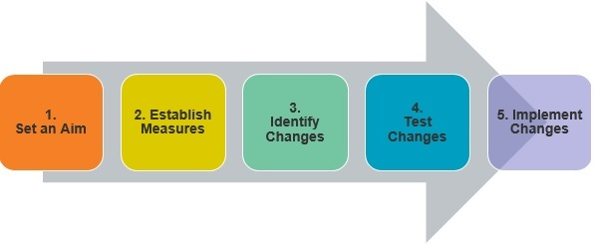
Using the Model for Improvement to Improve Care

Slide 35
MNO AIM Statement Draft**
Participating ILPQC NICUs will decrease the use of pharmacologic therapy by 30% for patients effected by NAS and improve discharge preparedness by December, 2019.
Notes:
This aim statement is an example that is specific, establishes stretch, is measurable, achievable, relevant and timely.

Slide 36
Possible** MNO Metrics
Process:
  Compliance with a nonpharmacologic management and discharge bundle
Balancing:
  Readmission rates for infants with NAS
  Nursing satisfaction
Outcome:
  Number of infants treated with pharmacotherapy for NAS
  Family survey results regarding discharge preparedness
Notes:
Our process metrics measure our steps in the system and help establish whether changes can be attributed to the interventions or other effects within the system.
Our balancing measures establish whether the interventions cause new problems within the system.
Our outcome measure seek to define health or wellbeing of the infants and/or families as a whole.

Slide 37
Now we must identify changes!

Slide 38
What is a Driver Diagram?
The visual representation of a shared theory of knowledge
A broad prediction of the changes required to accomplish the given aim
It is built by a team of stakeholders
Each theory can be tested in a systematic way→ PDSA

Slide 39
Why Use a Driver Diagram?
Simple
Visual
Keeps the team on track
Provides administration/management/etc. with a one page synopsis of your plan
Alligns your change ideas to the bigger goal

Slide 40
Anatomy of a Driver Diagram

Slide 41
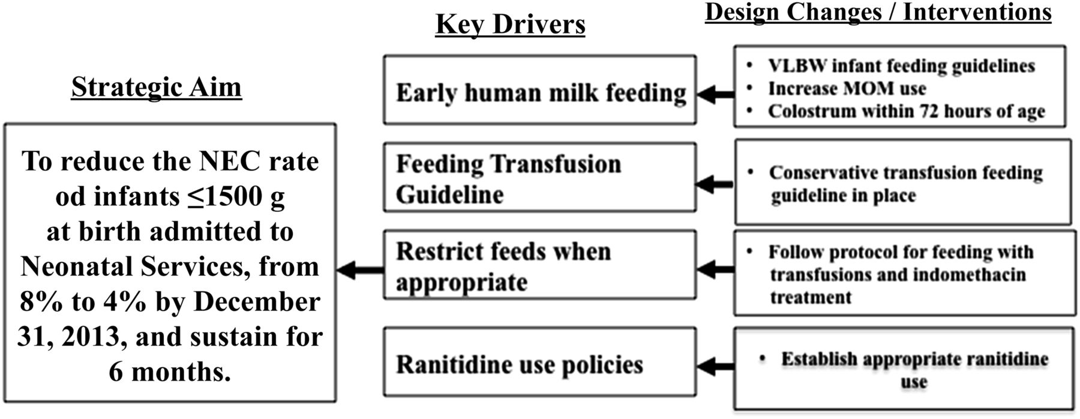

Key driver diagram summarizing specific interventions driving key baseline changes aimed at achieving the specific aim of NEC rate reduction by 50%.
Maria M. Talavera et al. Pediatrics 2016;137:e20151119
©2016 by American Academy of Pediatrics
Notes:
Key driver diagram summarizing specific interventions driving key baseline changes aimed at achieving the specific aim of NEC rate reduction by 50%. Key driver diagram based on Institute for Healthcare Improvement model of improvement.

Slide 42
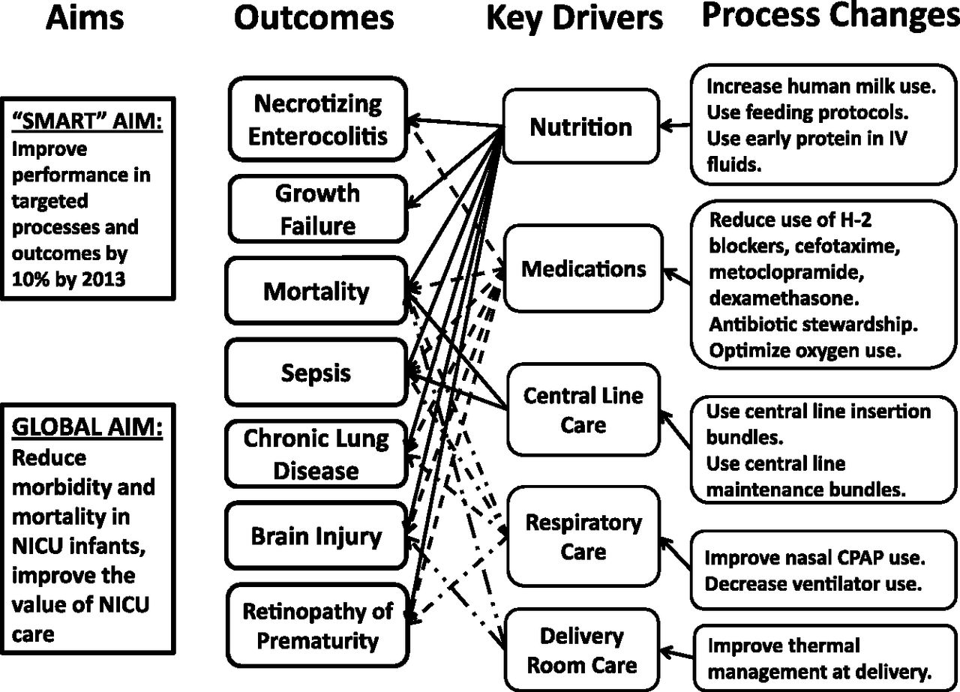
Driver diagram of the 100 000 Babies Campaign identifying the aims, outcomes, key drivers, and process changes targeted in the program.
Dan L. Ellsbury et al. Pediatrics 2016;137:e20150389
©2016 by American Academy of Pediatrics
Notes:
Driver diagram of the 100 000 Babies Campaign identifying the aims, outcomes, key drivers, and process changes targeted in the program. CPAP, continuous positive airway pressure; IV, intravenous.

Slide 43
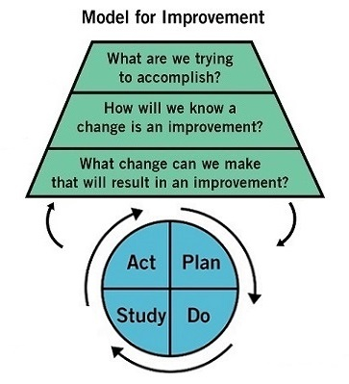

Slide 44

Let’s Create a Driver Diagram…

Slide 45
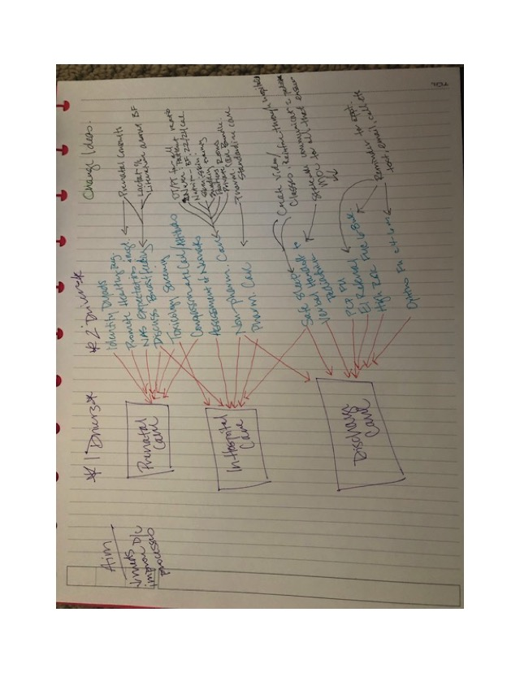
Now It’s Your Turn…

Slide 46
Panel Discussion

Slide 47
MNO Timeline
Tasks | Oct-17 | Nov-17 | Dec-17 | Jan-18 | Feb-18 | Mar-18 | Apr-18 | May-18
Develop QI Initiative (AIMS, Measures, Data Form)
Recruit and Launch Wave 1 with OB & Neonatal Teams
Launch Wave 2 with all hospital teams

Slide 48
Next Steps for ILPQC NAS Workgroup
Finalize Aims
Finalize Measures
Develop Data Form
Develop Change Packages
Provide Hospital Support and Education

Slide 49
Next Steps for You
Assemble MNO Teams
Engage hospital leadership now
Identify potential barriers
Prepare for kick-off in late Spring

Slide 50
Contact
Email info@ilpqc.org
Visit us at www.ilpqc.org

