Slide 1

Hot Topics in Obstetric QI:
Discussion of Sustaining Current Severe Maternal Hypertension Initiative and Launching 2018 Initiatives: Mothers and Newborns affected by Opioids and Immediate Postpartum LARC
ILPQC Fifth Annual Conference
December 19, 2017

Slide 2
Overview
Panel:
  Ann Borders, MD, MSc, MPH
  Julie Zemaitis DeCesare, MD
  Ron Iverson, MD
  Amy Crockett, MD, MSPH
Sustaining Severe Maternal Hypertension Initiative (45m.)
  Finishing strong
  Sustaining the gains
Launching 2018 Initiatives
  Mothers and Newborns affected by Opioids (40m.)
  Immediate Postpartum LARC (20m.)
Next steps (30m.)

Slide 3
Discussion of Severe Maternal Hypertension Initiative
ILPQC Fifth Annual Conference
December 19, 2017

Slide 4

CONGRATULATIONS
QUALITY IMPROVEMENT
RECOGNITION AWARD WINNERS
ILPQC Severe Maternal Hypertension Initiative

Slide 5
Severe Maternal Hypertension
Initiative
  Review initiative goals and team survey results
  Julie DeCesear’s deeper dive into FPQC’s HTN work
  Next Steps
“I truly believe this was a great initiative that brought awareness and management of this disease starting from the clinic visits until 6 weeks postpartum. Time of treatment is crucial and this initiative has brought attention to all the staff managing these patients.”

Slide 6
Where are our Teams in their
Maternal HTN Initiative Journey?

Slide 7
Goal 1: Finishing Strong
All ILPQC Teams Achieve Time to Treatment and Overall Initiative Goals

Slide 8
Maternal Hypertension Data:
Time to Treatment

Slide 9
Reducing Time To Treatment
Elements of Maternal Hypertensive Bundle Most Effective in Reducing Time to Treatment
ILPQC Team Survey, 2017

Slide 10
Maternal Hypertension Data:
Time to Treatment

Slide 11
Maternal Hypertension Data:
Patient Education

Slide 12
Maternal Hypertension Data:
Patient Follow-up

Slide 13
Maternal Hypertension Data:
Debrief

Slide 14
AIM Quarterly Measures:
Provider & Nurse Education
Wow!
Providers
Nurses

Slide 15
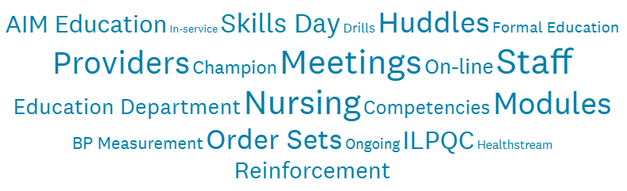
Effective Steps to Implement
Education Program
ILPQC Team Survey, 2017
We have included the education into our computer modules and have made it an annual requirement. We have also included maternal hypertension simulations
We used consistent reminders after education in huddles and unit meetings and audited charts.
We identified RN and MD champions for the whole hospital along with unit champions and have the support of nursing administration
We incorporated HTN education as part of nursing skills day yearly. All new staff and physicians will be educated using the comprehensive slide set.
Notes:
Summary Notes:
Protocols and Order Sets
Education
Annual competencies, new employee training
Sources: AIM bundles, ACOG
Simulation
Sharing of Data
OB Department meetings
Staff meetings
Simulation Drills

Slide 16
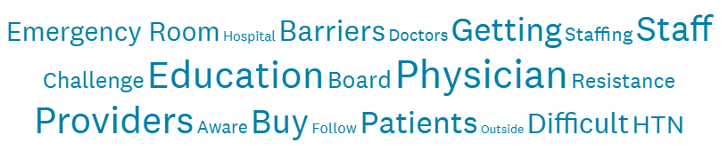
Barriers to Implementing
Education Program
ILPQC Team Survey, 2017
Provider buy in has been the biggest barrier. Many providers are still not on board with the protocol despite education and policy changes.
ED participation and buy in
It’s hard to engage private practice physicians and get buy in from them to attend education
Time to accomplish simulations and ongoing time for educational offerings is a barrier
Our initial roll out was very successful but sometimes it’s difficult to keep up with new hires
Notes:
Provider pushback and lack of urgency
Nursing Staff buy in
Time to provide education and follow-up
Lack of Staff
Volume of Providers and Nurses
Physicians inconsistent with treatment of all HTN patients
Resistance to participate in debriefs

Slide 17
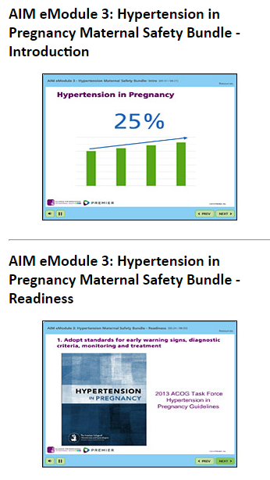
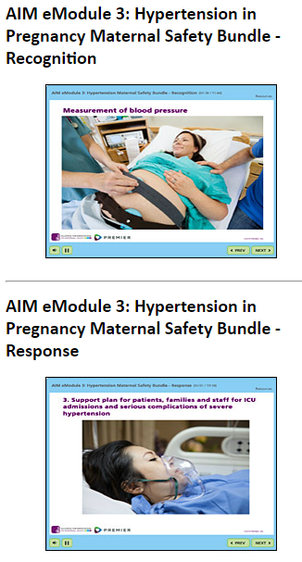

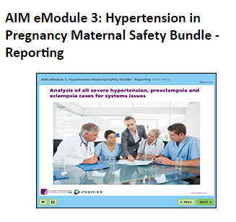
Education Tools to Implement ACOG
Algorithms & Order Sets – Physician Buy In
AIM eModules | Severe Maternal HTN Grand Rounds
Available on AIM website. Quiz at end with certificate - can ask providers/staff to submit certificate. View eModules here. | Available to download from ILPQC website (or click here). Speakers group available to provide Grand Rounds across the state. Email info@ilpqc.org for more information.

Slide 18
Implementation Checklist:
Standard Policies / Protocols Across Units
Way to go!

Slide 19
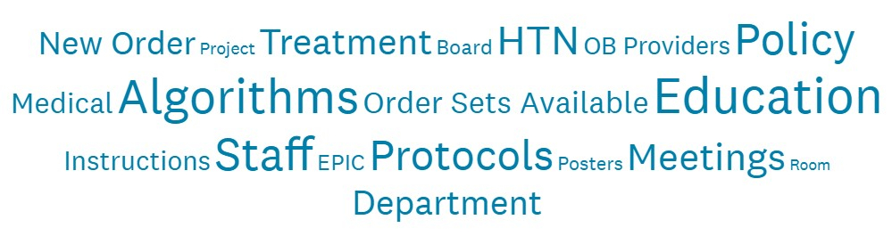
Effective Steps to Implement
Standard Protocols
ILPQC Team Survey, 2017
We reiterate what the goal is at physician OB department meetings and work closely with OB chair to promote an overall culture of safety where the chain of command is used and event reporting is done to determine trends.
We have updated policies and created a protocol for management of severe HTN that is posted in all rooms with other visual aides.
We use common order set for all units. ED knows that they have the full support of the OB unit and can call at anytime for us to facilitate the treatment of possible patient
Notes:
Order sets and protocols
Signage for staff – posters in bathrooms, near time clocks and break rooms
Get Administration on board
Multidisciplinary monthly meetings and education.
Simulations
Physician Champion
California Tool Kit Algorithm

Slide 20
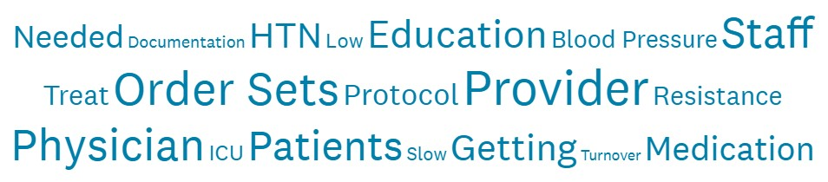
Barriers to Implementing
Standard Protocols
ILPQC Team Survey, 2017
We had a delay in making order sets available because we needed various committee approvals and the IT build.
We have lack of support/buy in from private physicians. Resistance from some who do not want to follow protocol-want to do things their own way
It’s hard to develop mechanisms to trigger the memory of providers and staff for a condition they are rarely exposed to in practice.
We experience high turnover in the ED and face resistance to treat BPs in the ED.
Notes:
Provider compliance with protocols
Concern for hypotension
Lack of staff involvement
Data collection
ED Engagement
Provider buy in
Low volume

Slide 21

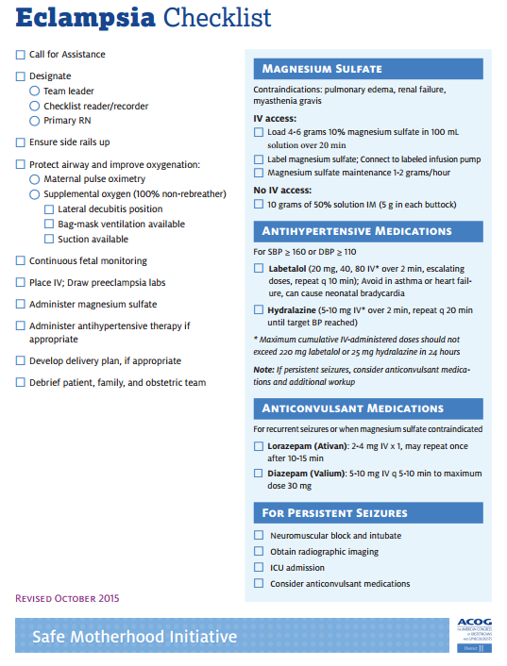
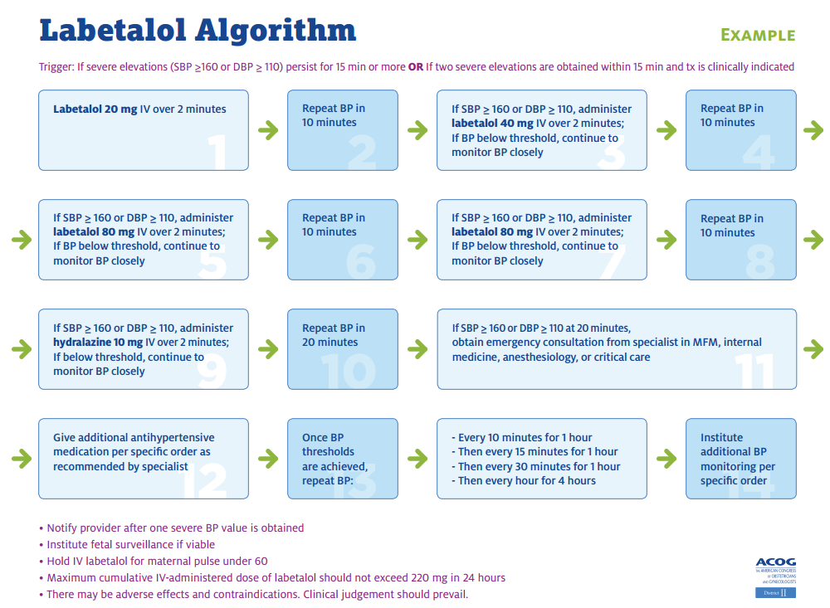
Tools to Implement ACOG
Algorithms & Order Sets
ACOG Pocket Order Sets | ACOG DII Checklists | ACOG DII Algorithms
Available to pick up at the table to the left of the stage! | Available on website or under Tab 5 in your binder | Available on website or under Tab 7 in your binder
All tools can be implemented in to EHR!

Slide 22

Achieving Time to Treatment
For ALL TEAMS
Perinatal Network Administrators outreach to teams not yet at 80%
All teams complete provider/staff education using AIM e-modules, share data & goals
ILPQC QI support calls to teams in need of additional support

Slide 23
Goal 2: Sustaining the Gains
All ILPQC Teams Develop and Implement Sustainability Plans

Slide 24

Meet with Your Team to
Develop Your Sustainability Plan
Sustainability Plan
Compliance Monitoring
New Hire Education
Ongoing Staff/Provider Education
Notes:
All teams should meet and develop Maternal HTN Sustainability Plan:
HTN compliance monitoring – 4 key questions
HTN education for new hires – AIM e-modules
Incorporate HTN education into ongoing unit education for providers and staff: drills / simulations / e-modules and continue to protocols, active “debrief” = “how did we do on Time to Treatment?”

Slide 25

ILPQC Support Strategies
Hospital Teams Report Most Helpful
ILPQC Hypertension Toolkit Binder
Reviewing ILPQC Data Reports with Team
AIM/ACOG Online E-Module Education
May 2017 Face to Face Meeting
Team Talks on monthly webinar
Additional QI Training Requested
Teamwork for Quality Improvement/TeamSTEPPS
IHA’s Model for Improvement
ILPQC Team Survey, 2017

Slide 26

Compliance Monitoring in
REDCap
  Time to treatment severe HTN < 60 minutes
  Magnesium provided
  Early follow up for BP check within 7-10 days
  Patient discharge education

Slide 27
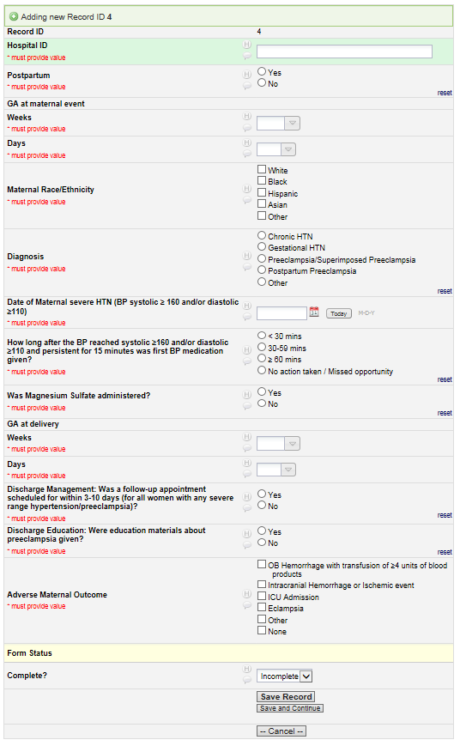
Continue monthly reporting on 4 key process measures in short form with access to graphs
HTN Compliance Data Form in REDCap:

Slide 28
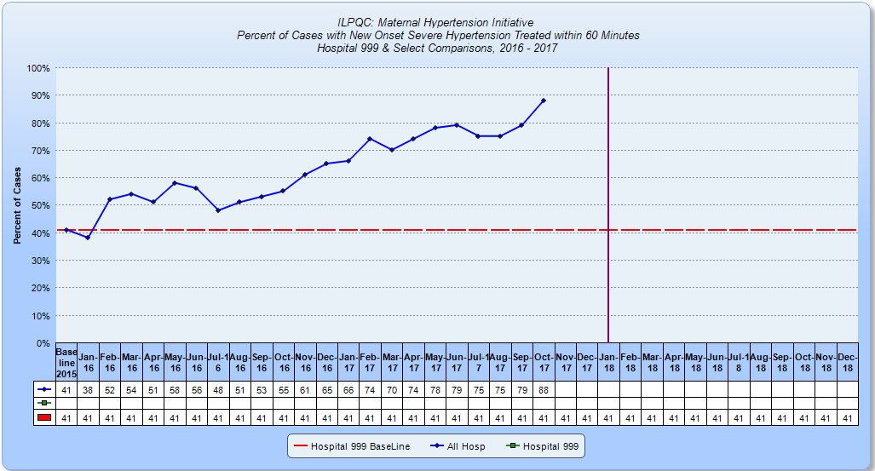
Compliance Data Run Chart in REDCap:

Slide 29

Strategies for Sustaining Success
Know Your Champions – nursing leaders, providers, quality Transparency and Accountability – monthly calls/meetings, distribute outcomes/metrics by facility Physician Collaboration – system and facility level engagement Standardized Education – new hire orientation, annual review Standardized High Risk Scenario – simulation/drills Share Learnings – case reviews, “good catches” and near misses Utilize Tools and Technology – laminated algorithms, electronic health record alerts and reminders
Slides courtesy of Suzanne Weisner, Dignity Health

Slide 30
Compliance Monitoring
Hospital Teams
Monthly Meetings
ILPQC
QI Support and Quarterly Team Check in Calls
Perinatal Network Administrators
Outreach
Mentorship Model
Sustained Improvements

Slide 31
Goal 3: Review Magnesium Sulfate Data and Develop PDSA cycle(s)

Slide 32

Magnesium Compliance Monitoring
Review your magnesium compliance data and missed opportunities
Run a PDSA cycle if not at goal
ACOG Executive Summary on Hypertension In Pregnancy, Nov 2013: “Proteinuria is not a requirement to diagnose preeclampsia with new onset severe hypertension and sign/symptom of end organ dysfunction.”

Slide 34
Preeclampsia Bundle Compliance:
Treat elevated BP
Give magnesium sulfate
Early PP follow-up
PREECLAMPSIA
Jul14-Mar15

Slide 35
Treatment Changes
92%
96%
85%
90%
79%
Delta 10.8%
p<0.01
Delta 33.2%
p<0.01
57%
Percent (%) Appropriately Treated
AJOG. 2017 216:415.e1-5

Slide 36
Rate of Eclampsia/1000 births and SMM/100 births
Delta 20.1%
p<0.01
Delta 46.5%
P=0.02
23 Hospitals, N=69,449
AJOG. 2017 216:415.e1-5

Slide 37
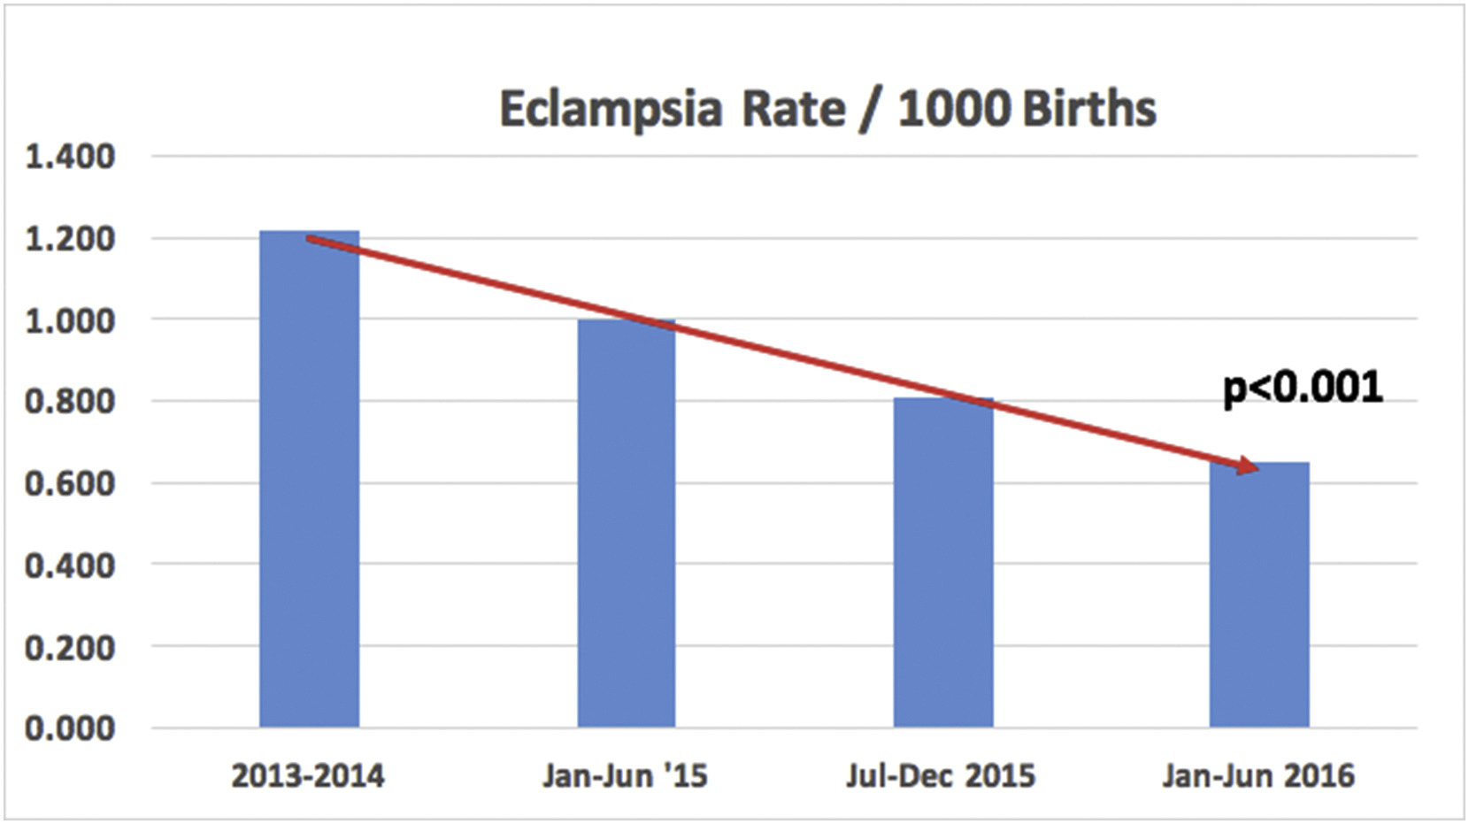

CMQCC Reduction
Eclampsia Rate
The rate of eclampsia decreased from 1.21/1000 at baseline to 0.65/1000 during 2016, p<0.001.
American Journal of Obstetrics & Gynecology 2017 216, DOI: (10.1016/j.ajog.2016.11.937)
Copyright © 2016 Terms and Conditions

Slide 38
Maternal Hypertension Data:
Magnesium Sulfate Administered

Slide 39

Next Steps for HTN Teams
Review your data for missed opportunities
Identify what you need to do to accomplish goals
Draft HTN Sustainability Plan for 2018
Share your data and goals and what needs to be accomplished with your providers and staff

Slide 40
Discussion: Supporting a
Strong Finish
All teams submit a HTN Sustainability Plan using ILPQC sustainability plan template
Transition to HTN Compliance Data Form after final December 2017 data is submitted (January 30, 2018)
  Teams can continue to track additional data on their internal forms if they choose
Facilitating collaborative team calls for HTN sustainability – Every other month for first quarter then move to quarterly (January, March, Q2, Q3, Q4)
Leveraging Perinatal Network Meetings for ongoing sustainability discussions

Slide 41

Florida Perinatal Quality Collaborative: HIP
Julie Z. DeCesare, MD
Clinical Co-Lead for PROVIDE
Florida Perinatal Quality Collaborative
Associate Professor
University of Florida College of Medicine

Slide 42

Hypertension in Pregnancy (HIP) Initiative

Slide 43


Hypertension Safety Patient Bundle
Readiness
  Every unit
Recognition / Prevention
  Every patient
Response
  Every case of severe hypertension/preeclampsia
Reporting / Systems Learning
  Every unit

Slide 44
Percent of Hospitals meeting
HIP Structural Measures
June 2017 (n=32)

Slide 45
HIP Sustainability
HIP hospitals should audit the first 10 severe new-onset hypertensive cases per quarter and plan to submit for a Quarterly Sustainability Data Check-in
Physicians can get MOC credit for the HIP Initiative in 2016 and 2017
Notes:
Quarterly times 2
Semiannually times 2

Slide 46
HIP Sustainability Sheets

Slide 47
HIP Goals
Reduction of short and long-term morbidity and mortality related to pregnancy hypertension.
Proper screening, diagnosis and management of hypertensive disorders.
Timely recognition and quick, organized response to preeclampsia.
Proper discharge screening and planning, including patient education

Slide 48




Questions?
Facebook.com/TheFPQC/
@TheFPQC
Join our mailing list at FPQC.org
E-mail: FPQC@health.usf.edu
Notes:
At FPQC.org you can find information about current and past projects and join our mailing list. We have a facebook page and twitter account as well. You can also email us at FPQC@health.usf.edu
http://health.usf.edu/publichealth/chiles/fpqc/provide is the specific site for PROVIDE

Slide 49
Launching 2018 Initiatives
ILPQC Fifth Annual Conference
December 19, 2017

Slide 50

Launch 2018 Initiatives
Mothers and Newborns affected by Opioids Initiative
  OB and Neonatal Teams making a difference together for opioid exposed moms and babies
Immediate Postpartum LARC Initiative
  OB Teams improving moms access to LARC

Slide 51
Overview of Statewide
Quality Initiatives
Statewide QI Initiative | Now | Jan 2018 | Feb | Mar | Apr | May
MNO | Recruit Wave 1 teams | Monthly calls start for Wave 1 | Letter of support from IDPH | Recruit Wave 2 teams | Initiative Launch Webinar with all teams | Face to Face Meeting 5/30, 5/31
IPLARC |  | Recruit Wave 1 teams |  | Monthly calls start for IP LARC

Slide 52
Suggestions from Team Survey for next initiatives
  More support for developing physician champions
  Continued coordination with IDPH and Perinatal Networks for statewide initiatives
  More education / training – grow QI capacity

Slide 53
Discussion of 2018 Mothers and Newborns affected by Opioids (MNO) Initiative
ILPQC Fifth Annual Conference
December 19, 2017

Slide 54
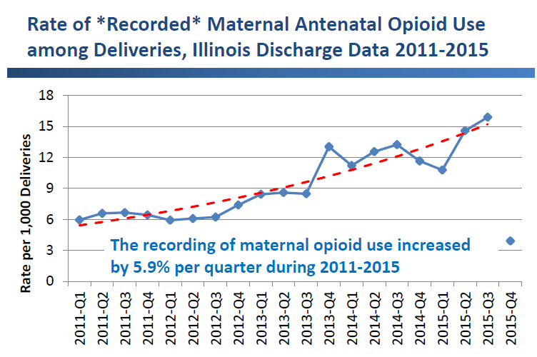
Mothers Affected by Opioids
in IL: scope of the problem
Pregnancy is a window of opportunity to identify women with OUD and link to treatment
Notes:
Locher slides ---- 2016 data?
Also:
Women have higher rates of hospitalizations for opioid overdoses⁷
Women are more likely than men to:
be prescribed opioids⁸
use opioids chronically⁸
receive prescriptions for higher doses⁸
engage in “doctor-shopping” ⁹
be prescribed opiates in combination with sedatives¹⁰
face barriers in access to substance abuse treatment¹¹

Slide 55
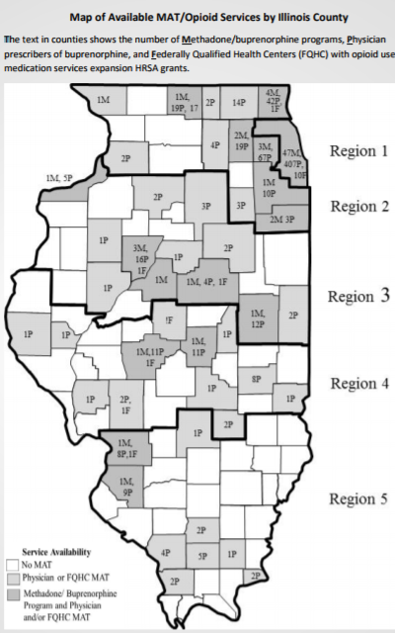
Mothers Affected by Opioids: Opportunities for Improvement
Increase moms Medication Assisted Therapy
Only a third to a half of pregnant women with OUD were receiving MAT in 2012
Consistent MAT reduces risk of relapse, HIV infection, overdose, and adverse pregnancy outcomes
Access to treatment varies widely across IL counties
Engaging moms in the non pharmacologic care of their newborns with NAS
About 50% of mothers with chronic opioid use breastfeed at discharge compared to 81% for all mothers
About 60% of NAS babies go home with their birth mothers
Notes:
(1a) Figure of care access from: http://www.dhs.state.il.us/OneNetLibrary/27896/documents/OpioidCrisisInIllinois_051617.pdf
(1b) http://www.dph.illinois.gov/data-statistics/vital-statistics/death-statistics/more-statistics
________________
(2) Stat about use of substance abuse treatment: http://www.pewtrusts.org/en/research-and-analysis/analysis/2017/05/17/opioid-misuse-in-pregnant-and-postpartum-women-is-on-the-rise, citation Substance Abuse and Mental Health Services Administration, Center for Behavioral Health Statistics and Quality, “National Survey on Drug Use and Health (NSDUH)” (2015), https://www.samhsa.gov/data/sites/default/files/NSDUH-FFR1-2015Rev1/NSDUH-FFR1-2015Rev1/NSDUH-FFR1-2015Rev1/NSDUH-National%20Findings-REVISED-2015.pdf
________________
(3) Breastfeeding at discharge with SA:
Breastfeeding at Hospital Discharge among High Risk Obstetrical Patients (2016)
Leandro Cordero1*, Amneet Bajwa2, Mona R Prasad3, Reena Oza-Frank2, Mark B Landon3 and Craig A Nankervis2
“Our study population consisted of 308 women with HROB conditions who were consecutively enrolled in prenatal subspecialty clinics and delivered infants during 2012-2014. In our institution, prenatal care to HROB women is provided at subspecialty clinics: diabetes mellitus (DM), antepartum treatment for substance abuse (SA), miscellaneous (MISC) high risk conditions and women with a history of preterm labor or preterm delivery (PTL).”
Breastfeeding at discharge was 50% among SA patients
https://www.clinmedjournals.org/articles/ijwhw/international-journal-of-womens-health-and-wellness-ijwhw-2-031.php?jid=ijwhw
https://www.clinmedjournals.org/articles/ijwhw/ijwhw-2-031table2.html
______________
(4) Discharged to mothers: http://chfs.ky.gov/NR/rdonlyres/40B04792-10AC-490C-89D0-881ED920BAD6/0/2016AnnualMeetingPreliminaryProgram.pdf
_________
(5) From Ohio MOMS Fullerton 2013 and Thomas 2013 review papers on MAT
Also: https://www.ncbi.nlm.nih.gov/pmc/articles/PMC4981621/
_______________________
(6) https://www.samhsa.gov/data/sites/default/files/report_2724/ShortReport-2724.html

Slide 56

Mothers and Newborns
Affected by Opioids (MNO)
Grant from CDC and IDPH
Ongoing input from IDPH and NAS Advisory Committee
Participation in national ACOG AIM OB Care for Women with Opioid Use Disorder Bundle Implementation Collaborative
Partnership with ILPQC Neonatal Teams to prepare providers, nurses, and moms to support infants at risk for with non-pharmacologic care
OB Clinical Leads
  Barbara Parilla, MD, Advocate Lutheran General Hospital
  Jaye Shyken, MD, SMM Health St. Mary’s Hospital

Slide 57

Hospital Identified Unmet Needs to Optimize Care for Mothers and Newborns Affected by Opioids
ILPQC Team Survey, 2017
Education
Management Protocols
Treatment Facilities
Support Systems
Access and Transportation
Education
Resources
Follow-Up Care
Standardized Assessment Tools
OB and Neonatal teams partnering to prepare providers, nurses, and families to improve outcomes for mothers and infants affected by opioids.

Slide 58

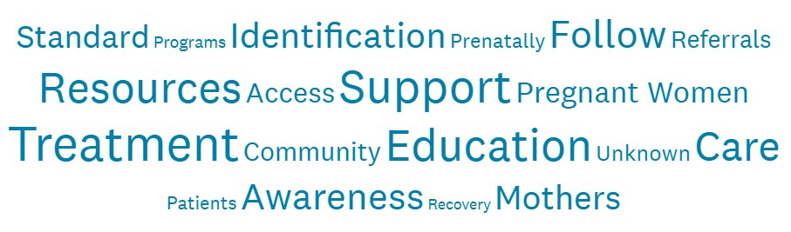
Current Unmet Needs in
Hospital and Community for Mothers
Support of treatment during pregnancy and after pregnancy in the local community
Access to treatment
Resources
Standards
We need info on the best way to keep moms and babies together in the face of space limitations in the hospital and education on how to help these moms and educate them.
ILPQC Team Survey, 2017

Slide 59

Current Unmet Needs in
Hospital and Community for Newborns
Collaboration with and identification of community resources
Staff
Providers
Mothers
Standard of care
Follow up care upon discharge
Mother’s education on how to best care for newborn
ILPQC Team Survey, 2017

Slide 60
Proposed Smart Aims by 12/2019
Increase pregnant women affected by opioids linked to care prenatally and receiving Medication Assisted Treatment (MAT) for opioid disorder delivery
Increase mothers and newborns affected by opioids breastfeeding at neonatal discharge
Decrease pharmacological therapy in substance exposed neonates
Increase neonates identified to be exposed to chronic maternal opioid use who can be discharged to maternal care

Slide 61
MNO Timeline
Tasks | Oct-17 | Nov-17 | Dec-17 | Jan-18 | Feb-18 | Mar-18 | Apr-18 | May-18
Develop QI Initiative (AIMS, Measures, Data Form)
Recruit and Launch Wave 1 with OB & Neonatal Teams
Launch Wave 2 with all hospital teams

Slide 62
MNO Proposed Measures link to our Improvement Goals
Prevention
Screening and Linkage to Care
Optimizing Care for Moms/Babies

Slide 63

Prevention
Increase the use of safe prescribing protocols for opioids use during routine vaginal and cesarean delivery
Increase the provision of primary prevention education materials on OUD and NAS infant care for pregnant and postpartum patients
Increase providers / staff educated on key initiative components

Slide 64

Screening and Linkage to Care
  Increase the percent of women screened for OUD
  Increase the percent of mothers of infants at risk for NAS who are linked to treatment
  Increase the percent of providers utilizing the Prescription Monitoring Program (PMP) look up prior to prescribing opioids

Slide 65
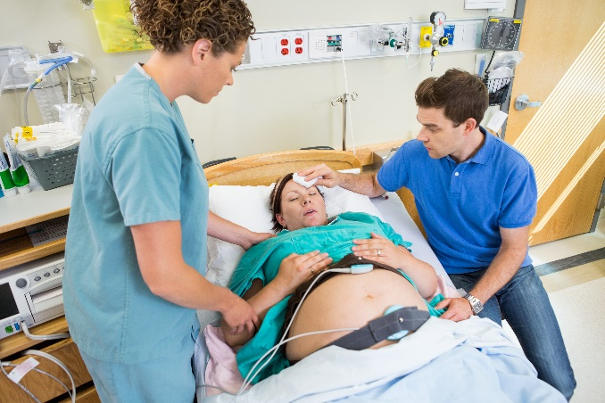
Optimizing Care for Moms/Babies
  Conduct mapping of community resources for perinatal opioid use treatment and support
  Increase the percent of mothers of infants at risk for NAS who are on MAT at time of delivery
  Improve and standardize care of women with OUD during prenatal, intrapartum, postpartum (protocols)
  Improve patient / family engagement in care of infant at risk for NAS

Slide 66
OB Data Elements
Quarterly Structure
Community Resources Mapped
Monthly Process
Received Prenatal Screening
Linked to Treatment Prenatally
Monthly Outcome
In Treatment at Discharge
Breastfeeding at Discharge
Standard Screening
Protocols* Implemented
Received Education
Newborn Discharged to Mother
Provider/Staff Education
*Protocols for safe prescribing, patient education, linking women who screen positive to care, PMP lookup, optimal management during labor and postpartum

Slide 67
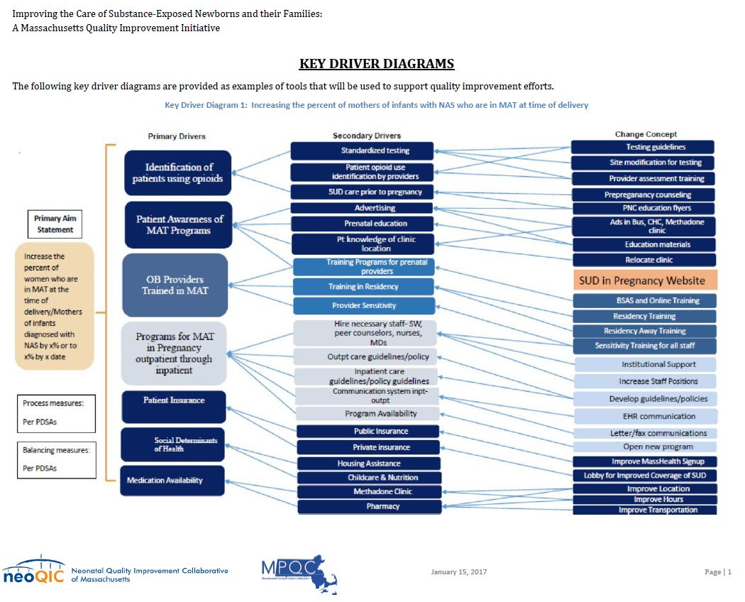
Sample KDD for Connecting
Mothers with OUD to Tx

Slide 68

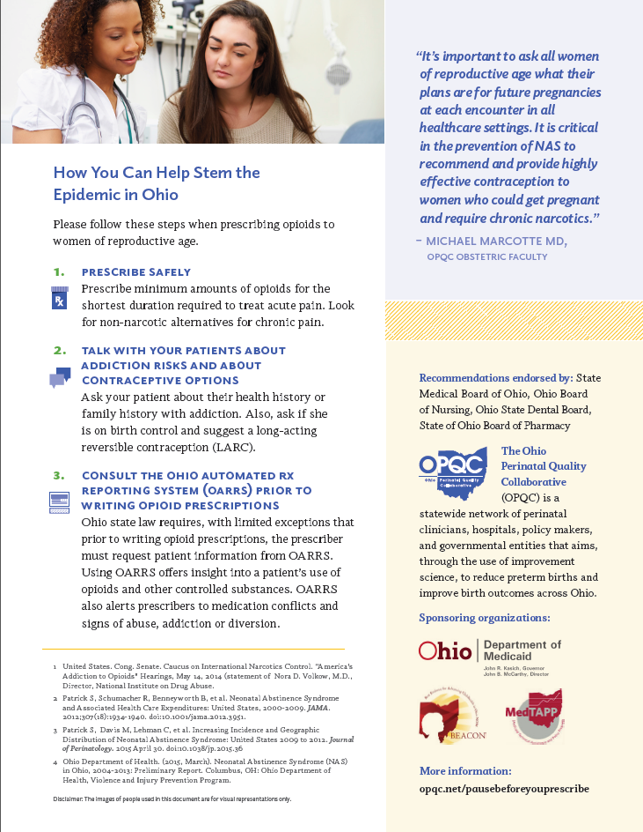
Sample Provider Prevention Education Materials

Slide 69
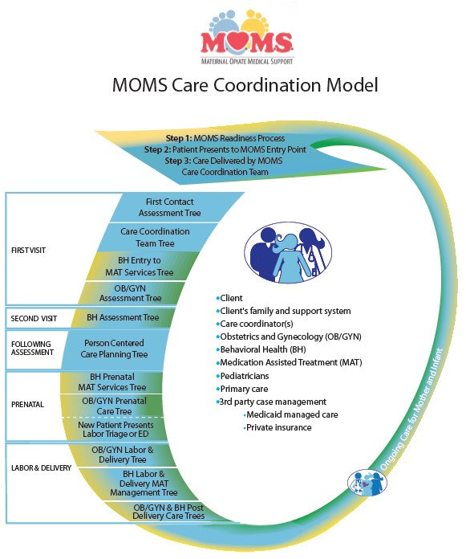
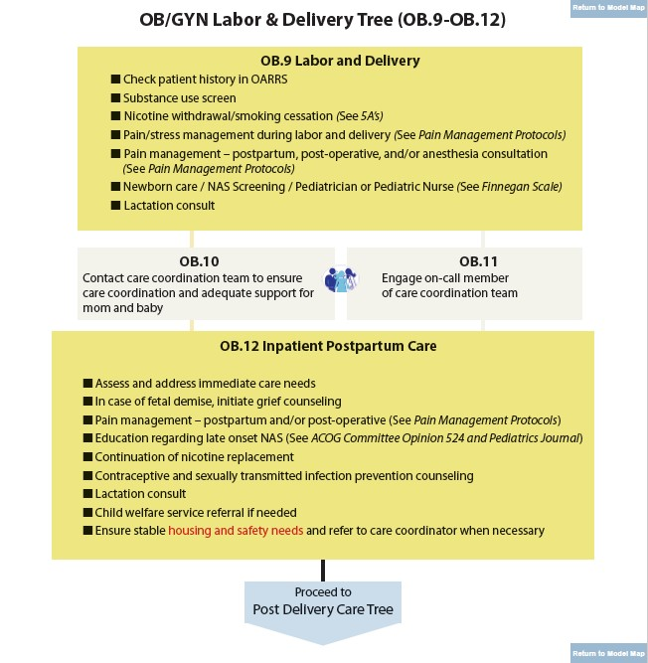
Sample Care Coordination Algorithm

Slide 70
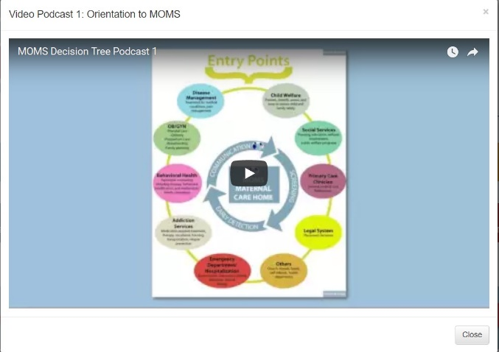

Education Opportunities
Working with AIM to develop eModules
MOMS project podcasts
Buprenorphine trainings
  Interest
  How many
  Locations

Slide 71

MNO Wave 1 Recruitment
Recruiting MNO Wave 1 teams now by mid January 2018
Working with perinatal network administrators to reach out to Wave 1 teams based on survey respondents
Wave 1 teams will
  Participate in monthly team calls
  Test data collection processes and forms
  Provide feedback before rolling out to Wave 2 in April/May

Slide 72

Building your MNO Team
Required
  OB provider
  OB nurse champions
  Neonatal / pediatric team representative
  Prenatal clinic/outpatient representative*
Recommended
  Patient/family member
  QI professional
  social worker
  Lactation consultant

Slide 73
The PNQIN Experience Approaching OUD in Pregnancy and Substance Exposed Newborns
Ronald E Iverson, Jr, MD, MPH
Co-Chair, MA PNQIN
ILPQC 5th Annual Conference
December 19, 2017
Lombard, IL

Slide 74
Leadership Team for this project
PNQIN
Munish Gupta (BIDMC)
Ron Iverson (BMC)
Mary Houghton (BIDMC)
Neonatal Folks
Elisha Wachman (BMC)
Larry Rhein (UMass)
Rachana Singh (Baystate)
Davida Schiff (MGH)
Maternal Folks
Katherine Callaghan (UMass)
Leena Mittal (MCPAP for Moms)
Laura Sternberger (Moms Do Care)
QI Experts
Connie Cowley
Patrice Melvin (BCH)
State Partners
Katherine Record (HPC)
Hannak Klookmok (HPC)
Fifi Diop (DPH)
Michael Kelleher (OHHS)
Debra Bercuvitz (DPH)
Abby Taylor (AGO)
Karen Pressman (BSAS)
Mary Lutz (DCF)

Slide 75
Who’s involved in PNQIN?
Department of Public Health
Health Policy Commission
Health and Human Services
Attorney General’s Office
Bureau of Substance Abuse Services
Bureau of Family Health and Nutrition
Department of Children and Families
Early Intervention
March of Dimes
Centers for Disease Control and Prevention
AdCare Educational Institute
MCPAP for Moms
Moms Do Care
NICHQ
Boston Children’s Hospital PPSQ
Massachusetts Hospital Association
And others…

Slide 76
What has been done already on this project?
Past and ongoing state efforts
More treatment programs (BSAS), particularly for women
Mandatory insurance coverage for treatment
Increasing trainings for MAT providers
Improving DCF screening and monitoring protocols
Increasing Early Intervention enrollment for SENs
Peer mentor moms through Moms Do Care
HPC innovation investments around NAS
Governor’s task force, state legislation
Many efforts to reduce opioid burden, including PMP
Widespread availability of Naloxone

Slide 77
What has been done already?
NeoQIC and MPQC
Collaborative project since 2013
Hospital-based improvement teams
Practice surveys and data audits
Online maternal and neonatal toolkits
Partnerships with many state agencies and groups
CDC grant!

Slide 78

Commonwealth of Massachusetts
Interagency Task Force on
Newborns with Neonatal Abstinence Syndrome
State plan for the coordination of care and services for newborns with neonatal abstinence syndrome and substance-exposed newborns
March 17, 2017

Slide 79







Slide 80
2017 OUD in Pregnancy and SEN Improvement Initiative

Slide 81
Driver diagram: Increasing MAT in Pregnancy with OUD
Primary Drivers
Secondary Drivers
Change Concept
Identification of patients using opioids
Patient opioid use screening
SUD screening tool
Primary Aim Statement
Patient opioid biologic testing
Screening/testing guidelines
Mapped response to + test
Site modifications
Increase the percent of women who are in MAT at the time of delivery/Mothers of infants diagnosed with NAS by x% or to x% by x date
Patient Awareness of SUD in Pregnancy Programs
SUD care prior to pregnancy
Lab tests
Advertising
Prepreganancy counseling
Prenatal education
PNC education flyers
Pt knowledge of clinic location
Ads in Bus, CHC, Methadone clinic
Training Programs for prenatal providers
Education materials
OB Providers Trained in MAT
Training in Residency
Relocate clinic
BSAS and Online Training
Provider Sensitivity
Residency Training
Programs for SUD treatment in Pregnancy
Hire necessary staff- SW, peer counselors, nurses, MDs
Residency Away Training
Sensitivity Training
Outpt care guidelines/policy
Institutional Support
Inpatient care guidelines/policy guidelines
Increase Staff Positions
Patient Insurance
Program Availability
Develop guidelines/policies
Process measures:
Per PDSAs
Open new program
Social Determinants of Health
Public Insurance
Improve MassHealth Signup
Private insurance
Lobby for Improved Coverage of SUD
Balancing measures:
Per PDSAs
Housing Assistance
Improve Location
Medication Availability
Childcare & Nutrition
Improve Hours
Methadone Clinic
Improve Transportation
Pharmacy

Slide 82
Driver diagram: Increase screening for OUD in Pregnancy
Primary Drivers
Secondary Drivers
Change concept
Standardized screening across CWC clinics
Selection of single validated screening tool
Awareness and understanding of SUD screening
Front desk staff to give screening tool at initial PNV
Patients given standardized screening tool in CWC
Copies of screening tool at CWC front desk (could remove this as it is part of above)
Screen easy to administer
Lunchtime talk to staff explaining screen
Primary Aim Statement
Increase to 75% the percent of obstetrical CWC patients screened for SUD using an evidence-based screening tool.
Screening incorporated into CWC workflow
Posters in workspace explaining screening tool
Check for screening at 30 week review
Staff comfort with screening tool
Staff ed. session on scoring of screening tool
Scoring & documentation of standardized screen results
Posters in clinic illustrating scoring system
Scoring responsibilities clear and consistent
Screening scored & documented while patient still in clinic
Screening score documented at same time as urine dip results
Identify space in EMR for score to be recorded
Provider awareness of standardized SUD screening
CORE lecture on SBIRT & new screening tool (resident education)
Interpretation of screening score, and interventions and referrals as needed
Division meeting introducing new screening tool & process (attending education)
Provider motivation to perform standardized SUD screening
Provider able to perform brief intervention in clinic
Develop/distribute recommendations on “brief intervention” and “referral to treatment” for medium and high-risk patients
Provider able to refer high-risk patients to treatment
Pamphlet on substance use in pregnancy & resources for patients

Slide 83
Driver diagram: Breastfeeding in NAS babies
Overall Goal:
Improve breastfeeding for infants with NAS
Primary Drivers
Secondary Drivers
Potential Change Concepts
Current eligibility criteria too restrictive
Change eligibility criteria / guideline modifications
Primary AIM:
Among opioid exposed newborns, increase any breastfeeding in the 24 hrs prior to discharge by ___% by ___(date).
Secondary AIMs:
Increase exclusive breastfeeding during the entire hospitalization by ____%
Improve rate of maternal presence at the bedside during the hospitalization by _____%
Not all mothers eligible to breastfeed
Mothers not on MAT early in pregnancy
Increase # of mothers on MAT early in pregnancy
Mothers not aware of benefits
Education to mothers starting prenatally
Mothers don’t initiate breastfeeding
Mothers don’t get enough technical support
LC visits prenatally
Mothers don’t want to breastfeed or unknown reasons
LC visits postnatally (mother-baby and pediatrics)
Interview mothers to ask about barriers
Mothers don’t have enough technical support
Lactation peer counselor
Outcome Measures:
% mothers eligible to breastfeed
% mothers who initiated breastfeeding
% any/exclusive breastfeeding in the 24 hours prior to discharge
% exclusive breastfeeding during the entire hospitalization
% maternal presence at the bedside over the hospitalization
Mothers don’t continue breastfeeding
Process measures:
Guidelines adherence
# of LC and peer counselor visits
Time (hrs) to initiate breastfeeding or pumping
Mothers loose motivation
Engage with residential treatment programs to enable mothers to stay at the bedside
Mothers not at the bedside due to competing priorities
Methadone guest dosing close to the hospital
Providers readily offer formula
Balancing measures:
Max % weight loss
Days to regain birth weight
Need for phototherapy
Provide meals for mothers on pediatrics
Excessive weight loss related to withdrawal
Encourage pumping and fortification with 24kcal/oz starting on Mother-Baby

Slide 84
2017 OUD in Pregnancy Improvement Initiative Goals
Improve the care of women with perinatal opioid use | Increase the percent of mothers of infants at risk for NAS who are on MAT at time of delivery
Increase family engagement in care of infant at risk for NAS | Increase the percent of infants at risk for NAS who are receiving mother’s milk at time of hospital discharge
Improve follow-up of newborns and families impacted by perinatal opioid use | Increase the percent of infants with NAS enrolled in EI at 1 year of age

Slide 85
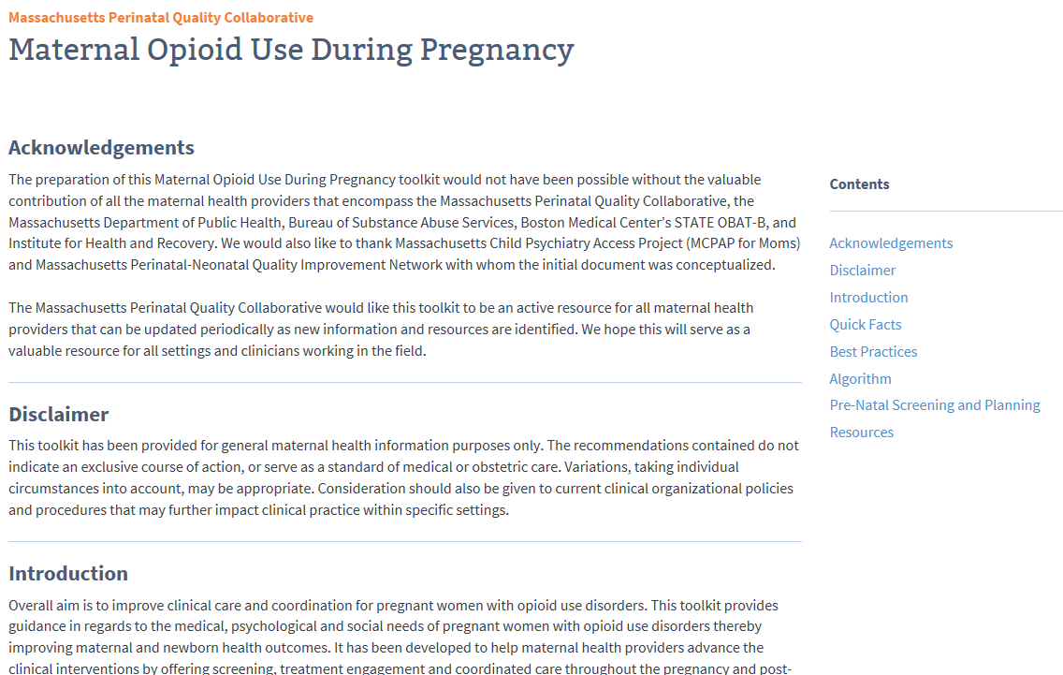
Website: Link to OB Toolkit
www.neoqicma.org

Slide 86
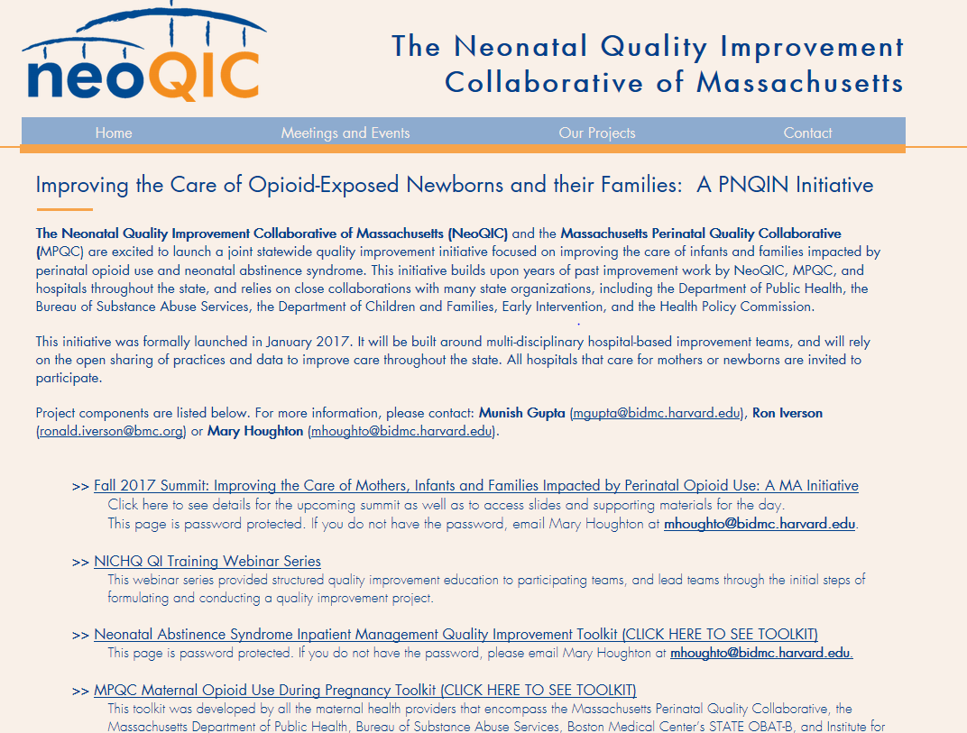
Website
www.neoqicma.org

Slide 87

Website: Neonatal Toolkits
www.neoqicma.org

Slide 88

Website: Project documents
www.neoqicma.org

Slide 89
PNQIN Practice Survey
Distributed August 2017
Asked questions about outpatient OB practices, inpatient OB practices, and neonatal care

Slide 90
Data!

Slide 91
Some Data from our database
Launched for 2017, 2016 also encouraged
Denominator: infants monitored for NAS for
possible or known in-utero opiate exposure
Full report, including hospital-specific performance, to be distributed quarterly
600 births collected

Slide 92
Data Snapshot: 600 Dyads Entered to Date
Ethnicity of Mother | Count | Race of Mother | Count
Hispanic | 38 | White | 498
Not Hispanic | 448 | Black/African American | 28
Unknown or unable to obtain | 71 | Asian | 3
 |  | Other | 10
 |  | Unknown/Unable to obtain | 17
Location of Birth | Count
Inborn | 557
Outborn | 41
What was the eventual discharge disposition from your hospital?
Home with biologic parent | 74.8%
Home with guardian or foster parent | 20.3%
Other | 2.7%
Unable to determine | 2.2%

Slide 93
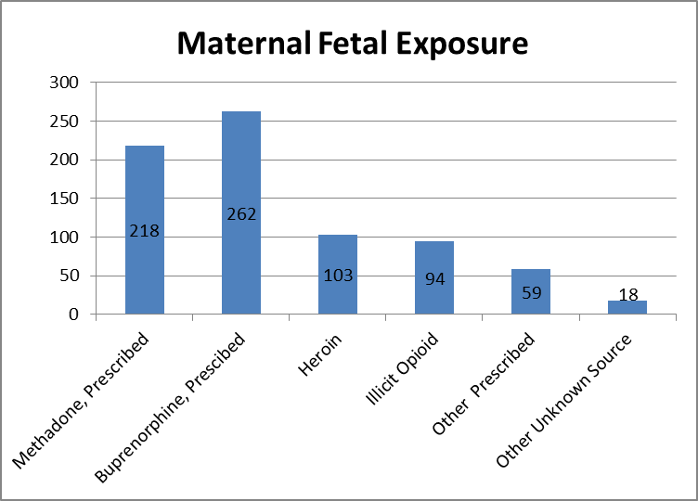
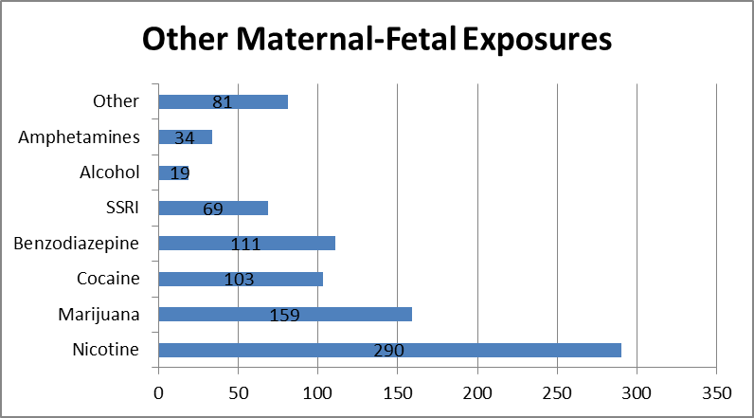
Data Snapshot: 600 Dyads Entered to Date
% of Any Illicit Maternal – Fetal Exposures: 44.7%

Slide 94
Data Snapshot: 600 Dyads Entered to Date
Was the infant eligible to receive his/her mother’s own milk per your hospital’s guidelines?
Yes | 64.7%
No | 31.3%
Unknown | 3.9%
Did infant ‘room-in’ with birth mother for at least 1 night prior to discharge?
Yes | 73.9%
No | 23.3%
Unknown | 2.8%
Did infant receive Pharmacologic treatment for NAS?
Yes | 49.4%
No | 50.3%
Did infant receive any of his/her mother’s own milk at any time during hospitalization?
Yes | 54.6%
No | 42.0%
Unknown | 1.3%
What type of feeding was infant receiving at discharge/transfer from your hospital?
Breast milk and formula | 27.2%
Breast milk only | 19.0%
Formula only | 53.4%

Slide 95
Data Snapshot: 600 Dyads Entered to Date

Slide 96
Data Snapshot: 600 Dyads Entered to Date

Slide 97
Data Snapshot: 600 Dyads Entered to Date

Slide 98

Questions?

Slide 99
Discussion of 2018 Immediate Postpartum LARC Initiative
ILPQC Fifth Annual Conference
December 19, 2017

Slide 100
Consequences of Unplanned Births and Short Interpregnancy Intervals
Consequences of Unplanned Pregnancies
Poor pregnancy outcomes
Delayed initiation of prenatal care
Lower breastfeeding rates
Higher risk of maternal depression and potential future child maltreatment
Unintended
Intended
Consequences of Short Interpregnancy Interval
Higher risk of poor maternal and infant outcomes: Preterm birth, low birthweight, preeclampsia
50% of IL births covered by Medicaid
Notes:
Chicago Metropolitan Agency for Planning definition of Cook and the counties immediately surrounding it: DuPage, Kane, Kendall, Lake, McHenry, and Will counties
In 2014 there were 158,522 births in Illinois with 69,526 (44%) in Cook county and 106,204 (67%) in the Chicago Metro area (Chicago Metropolitan Agency for Planning definition of Cook and the counties immediately surrounding it: DuPage, Kane, Kendall, Lake, McHenry, and Will counties).^{4a} Approximately 66,579 (42%) of Illinois births resulted from unintended pregnancies.^{4b} Approximately 9,684 births in Illinois are to teens 19 and under.^{4a} For babies with moms 21 years old or younger, it was at least the 2nd birth for 29% and at least the 2nd pregnancy for 39% (Personal Conversation with A. Bennett, 8/2017).
Intrauterine Devices (IUDs) and contraceptive implants, known as long acting reversible contraception (LARC) are safe and effective for most women and adolescents.⁵ They are demonstrated effective in reducing unintended pregnancies.⁶ LARC effectiveness could be increased when placed in the immediate postpartum (IPLARC) before hospital discharge after delivery given that approximately 40 to 60% of women have unprotected intercourse prior to the 6 week postpartum visit and fewer than half of women return to the doctor for their 6 week postpartum visit^{7,8,9}. Women counselled on all contraceptive methods and provided their choice of contraception for free chose LARC at a rate of 75%. Additionally, 86% of women were using LARC 12 months later – higher than the continuation rate for other short-acting reversible contraception – and reported high satisfaction with LARC.¹⁰
IPLARC is a strategy to empower women of childbearing age with information and services to optimize the timing and spacing of their pregnancies in order to reduce unintended pregnancies linked with adverse maternal and child health outcomes.¹¹ In 2014, 79,261 (50%) of Illinois births were covered by Medicaid.¹² In July 2015, the IL Department of HealthCare and Family Services (HFS) allowed hospitals to reimburse for LARC devices provided immediately postpartum before discharge from the hospital, in addition to the Diagnostic Related Group (DRG) reimbursement for labor and delivery.¹⁴ In addition, the American College of Obstetricians and Gynecologists (ACOG) released national guidelines in their Committee Opinion #670, authored by Ann Borders and Alison Stuebe, in August 2016.

Slide 101
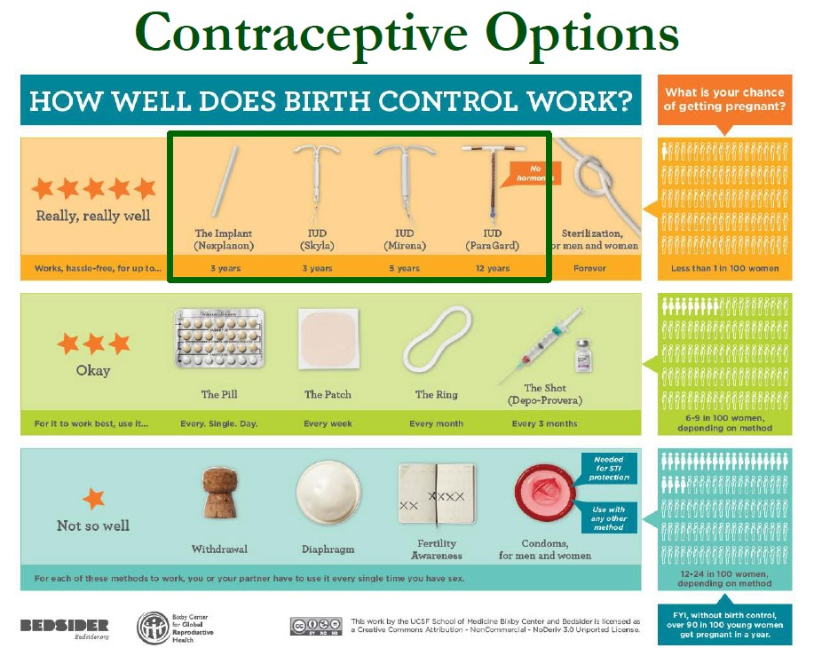
LARC is the Most Effective of

Slide 102


Why LARC?
LARC is safe and cost effective
LARC can be removed any time with restored fertility
Women choose LARC and report high satisfaction with LARC
Reduces adverse maternal and infant outcomes associated with unplanned pregnancy
Support for LARC from ACOG, AAP, AAFP, AWHONN, CDC, CMS, ASTHO
Notes:
In 2014 there were 158,522 births in Illinois with 69,526 (44%) in Cook county and 106,204 (67%) in the Chicago Metro area (Chicago Metropolitan Agency for Planning definition of Cook and the counties immediately surrounding it: DuPage, Kane, Kendall, Lake, McHenry, and Will counties).^{4a} Approximately 66,579 (42%) of Illinois births resulted from unintended pregnancies.^{4b} Approximately 9,684 births in Illinois are to teens 19 and under.^{4a} For babies with moms 21 years old or younger, it was at least the 2nd birth for 29% and at least the 2nd pregnancy for 39% (Personal Conversation with A. Bennett, 8/2017).
Intrauterine Devices (IUDs) and contraceptive implants, known as long acting reversible contraception (LARC) are safe and effective for most women and adolescents.⁵ They are demonstrated effective in reducing unintended pregnancies.⁶ LARC effectiveness could be increased when placed in the immediate postpartum (IPLARC) before hospital discharge after delivery given that approximately 40 to 60% of women have unprotected intercourse prior to the 6 week postpartum visit and fewer than half of women return to the doctor for their 6 week postpartum visit^{7,8,9}. Women counselled on all contraceptive methods and provided their choice of contraception for free chose LARC at a rate of 75%. Additionally, 86% of women were using LARC 12 months later – higher than the continuation rate for other short-acting reversible contraception – and reported high satisfaction with LARC.¹⁰
IPLARC is a strategy to empower women of childbearing age with information and services to optimize the timing and spacing of their pregnancies in order to reduce unintended pregnancies linked with adverse maternal and child health outcomes.¹¹ In 2014, 79,261 (50%) of Illinois births were covered by Medicaid.¹² In July 2015, the IL Department of HealthCare and Family Services (HFS) allowed hospitals to reimburse for LARC devices provided immediately postpartum before discharge from the hospital, in addition to the Diagnostic Related Group (DRG) reimbursement for labor and delivery.¹⁴ In addition, the American College of Obstetricians and Gynecologists (ACOG) released national guidelines in their Committee Opinion #670, authored by Ann Borders and Alison Stuebe, in August 2016.

Slide 103
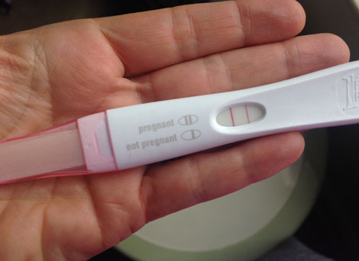
Why Immediate Postpartum
LARC for Unplanned Pregnancy?
About 40 to 60% of women have unprotected intercourse prior to the 6 week postpartum visit
Fewer than half of women return to the doctor for their 6 week postpartum visit

Slide 104

Immediate Postpartum LARC
(IPLARC)
Grant from J.B. and M.K. Pritzker Foundation
Empower women with information and services to optimize the timing and spacing of their pregnancies to reduce unintended pregnancies linked with adverse MCH outcomes
Support birthing hospitals that provide contraception at the hospital level to implement best practice protocols
Opportunities for ACOG LARC Initiative training
Expert Panel (in development) & Clinical leads:
  Stephen Locher, Advocate Illinois Masonic Medical Center
  Shelly Tien, NorthShore University HealthSystem Evanston Hospital

Slide 105
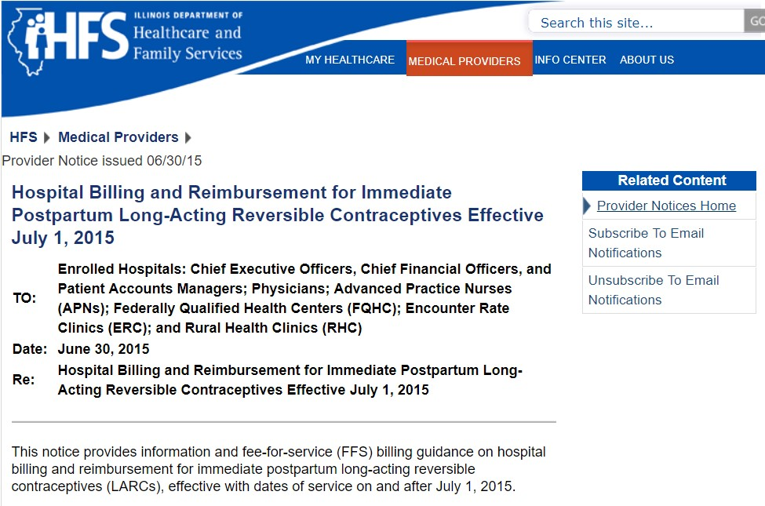
IHFS Allows Hospitals to
Reimburse
In July 2015, the IL Department of HealthCare and Family Services allowed hospitals to reimburse for LARC devices provided immediately postpartum before discharge from the hospital separate from OB Bundle

Slide 106

Early Challenges to
Implementation
Identifying champions in each department
Adding LARC devices to hospital formulary
Make LARCs and ancillary equipment available at delivery and postpartum
Create, review, and/or modify polices to support IPLARC placement
Establish and test billing codes
Modify IT systems to assure adequate data collection

Slide 107
ILPQC IP LARC Initiative
Goals
Increase access to IP LARC
Educate Patients on contraceptive options
Educate Providers counseling and placement
Simplify IPLARC Billing
Stock LARC in Pharmacy
Implement IP LARC Protocol
Systems Changes to OB Care Process Flow

Slide 108

IPLARC Wave 1 Recruitment
Recruiting MNO Wave 1 teams through March 2018
Working with perinatal network administrators to reach out to Wave 1 teams based on survey respondents (at least 1 per network)
Wave 1 teams will
  Participate in monthly team calls
  Implement QI Initiative at their hospital and
  collaborate to support success across Wave 1 Teams
  Provide feedback and mentorship to Wave 2 teams
Wave 2 Teams join in late 2018 or early 2019

Slide 109
IP LARC Timeline
Tasks | Jan-18 | Feb-18 | Mar-18 | Apr-18 | May-18 | Sep-18 | Oct-18 | Nov-18 | Dec-18
Develop QI Initiative
Recruit Wave 1
Launch Wave 1 Implements LARC
Recruit Wave 2
Launch Wave 2 with Mentorship Model

Slide 110
Building your IP LARC Team
Required
  OB provider champion
  OB nurse champion
Recommended
  Patient/family member
  Outpatient representative
  billing/collections
  Contracts/MCO liaison
  IT/EMR
  Pharmacy
  Lactation consultant
  QI professional

Slide 111
Florida Perinatal Quality Collaborative: Access LARC
Julie Z. DeCesare, MD
Clinical Co-Lead for PROVIDE
Florida Perinatal Quality Collaborative
Associate Professor
University of Florida College of Medicine

Slide 112
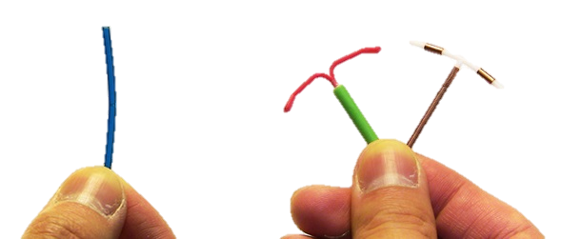
Access LARC
Immediate Postpartum Long-Acting Reversible Contraceptives (LARC)

Slide 113
Access LARC Initiative
Two Phases
Pre-Implementation Phase:
  Focuses on getting structural changes in place to allow for acquisition and billing of LARCs
Implementation Phase:
  Focuses on provision of new service
Notes:
Because this initiative is expected to take significant effort for hospital teams to get all the pieces in place for successful implementation, the initiative is divided into two phases: Pre-implementation and Implementation.
The Pre-implementation Phase focuses on creating and modifying hospital systems to enable acquisition and availability of and reimbursement for immediate postpartum LARC placement. Initial decisions regarding which LARC method (IUD or implant) as well as which hospital sites (L&D, postpartum, outpatient clinic) will be included in the initiative will guide the implementation process. The pharmacy will need to address formulary revisions, determine pharmacy costs (device, local anesthetic, stocking charge), inventory levels, stocking locations and order system revisions. Billing and collections department may need to create new billing codes (device, facility, provider), initiate contract amendments with managed care organizations, customize the claims process, and test billing revisions to assure reimbursement. Policies and procedures, guidelines and work flows for labor and delivery, obstetric operating rooms, and postpartum floors will also require creation or revision. Administration support at the highest level will be critical during this phase to assure the various departments work together and that, the initiative continues to make timely progress given other hospital priorities.
The Implementation Phase focuses on the delivery of this new service. It includes assuring that credentialed providers are available for immediate postpartum LARC insertion and that providers are trained in contraception choice counseling that includes the option of postpartum LARCs. This is the phase during which providers will actually begin offering and providing immediate postpartum LARC.This initiative will take some time for planning for successful implementation.

Slide 114
Access LARC
Practice at a Catholic Facility
Creating a series of work arounds to enhance pp contraception
Same day discharge and nexplanon insertion
Protocol for IUD insertions 2 weeks pp

Slide 115
Questions?
Facebook.com/TheFPQC/
@TheFPQC
Join our mailing list at FPQC.org
E-mail: FPQC@health.usf.edu
Notes:
At FPQC.org you can find information about current and past projects and join our mailing list. We have a facebook page and twitter account as well. You can also email us at FPQC@health.usf.edu
http://health.usf.edu/publichealth/chiles/fpqc/provide is the specific site for PROVIDE

Slide 116
Amy Crockett, MD, MPH
Clinical Lead, South Carolina Birth Outcomes Initiative

Slide 117
Teams Survey Says:
Future Interest in OB Improvement Areas
Initiative to Support Vaginal Birth and Reduce Primary Cesareans
Maternal Morbidity Reduction/Hemorrhage
Maternal Morbidity Reduction/Prevention of Venous Thromboembolism

Slide 118
Other Areas of Interest in OB Improvement
Diabetes in Pregnancy
Ob Sepsis/Reduction in SSI rates
Baby Friendly/Lactation
Perinatal Loss Bereavement Care
Nitrous Oxide for Labor
Safe Sleep

Slide 119

Discussion
Questions
Barriers and opportunities to implement these initiatives in Illinois
Next steps for consideration

Slide 120
Process improvement:
A brief introduction

Slide 121
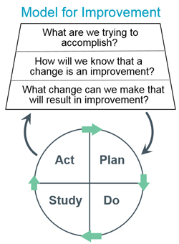
IHI: Model for Improvement

Slide 122
Assemble Stakeholder
Patients
Nurses
Providers
Medical Assistants
Clinic staff
Outside agencies

Slide 123
Create an AIM Statement
What do you want to change?
By how much?
By when?

Slide 124
Describe your problem
Process map
Fishbone
Driver diagram

Slide 125
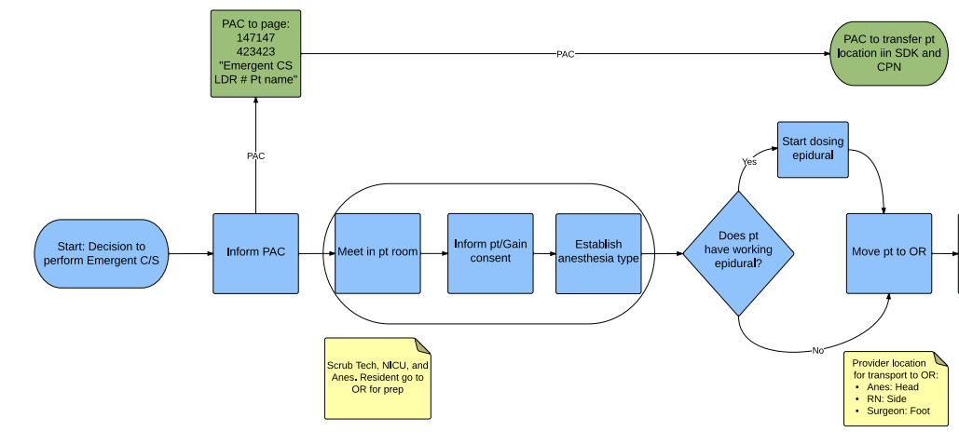
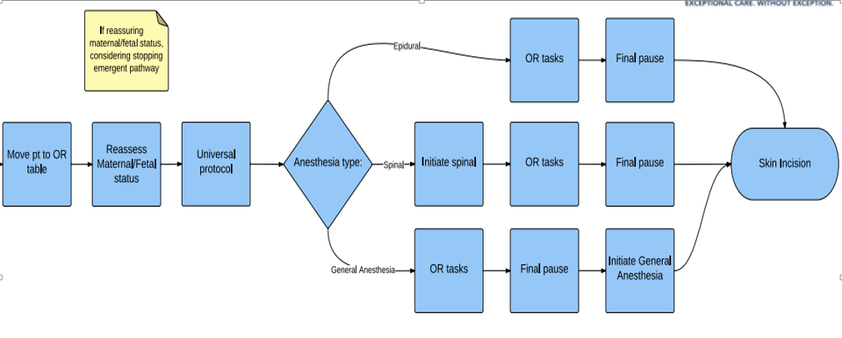
Process map

Slide 126
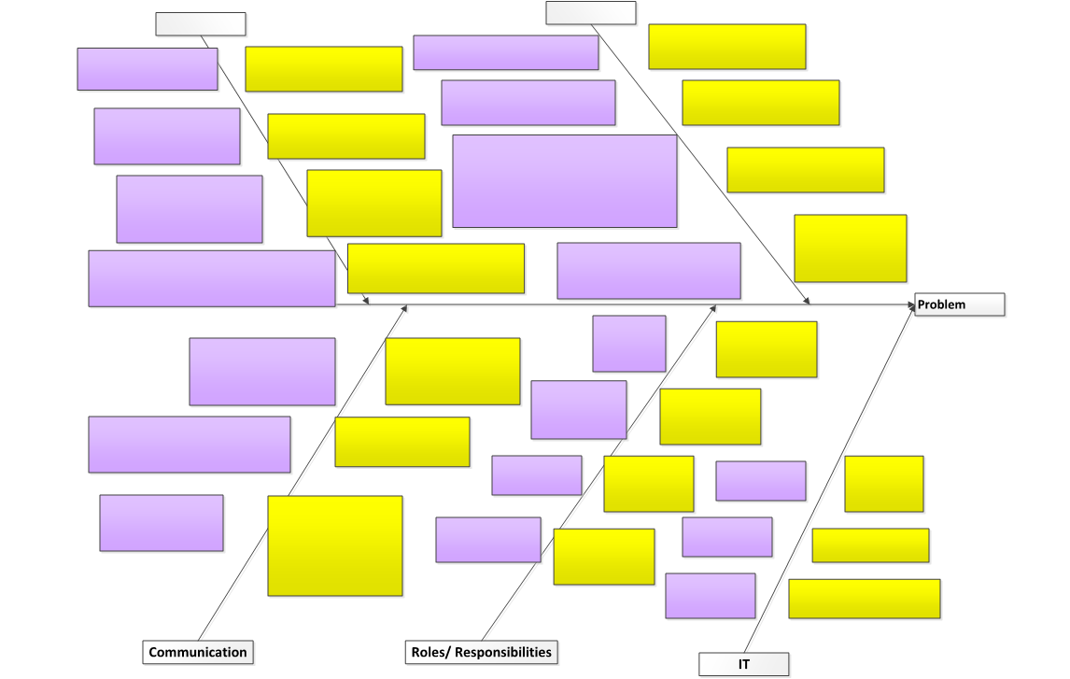
Fishbone
Equipment
Environment
Outcom
Patient factors
Teamwork
Technology

Slide 127
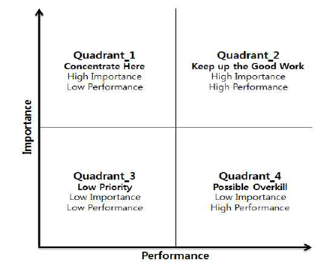
Change concept prioritization

Slide 128
Measurement
Outcome measures: what you are trying to change?
Process measures: what are the components of care?
Balancing measures: what could this process affect negatively?

Slide 129
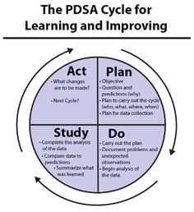
Address the Change Concepts

Slide 130
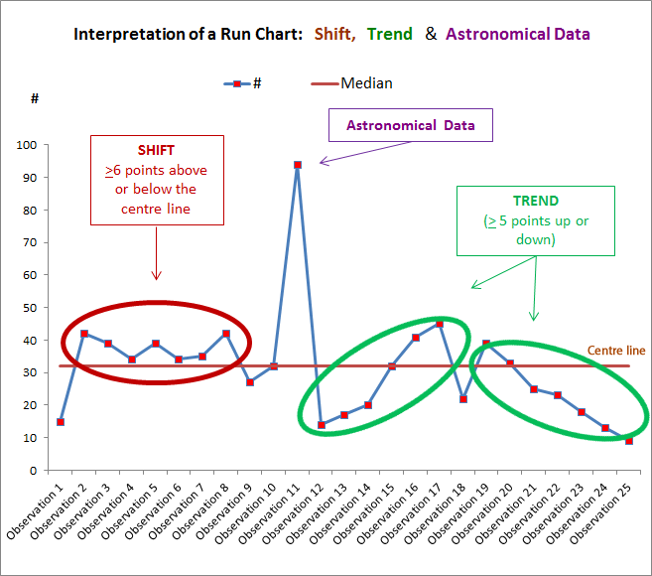
On time data evaluation: Run charts

Slide 131
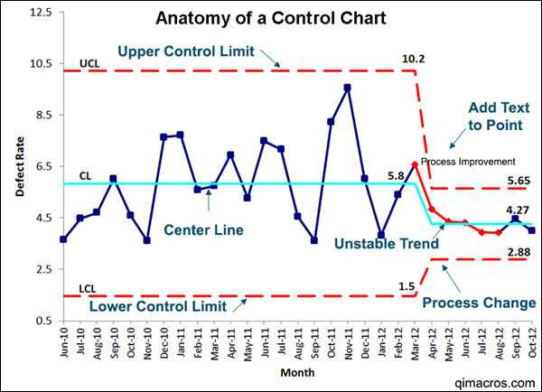
On time data evaluation: Control charts

Slide 132
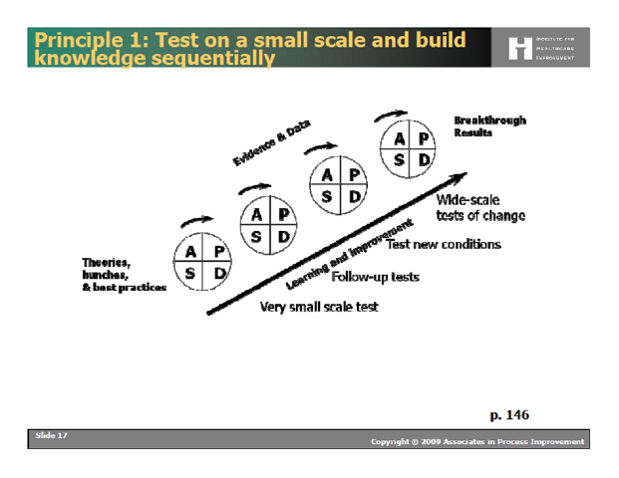
An Overall Picture
Scale of PDSA/Test
Degree of Belief
Principle 1: Test on a Small Scale and Build Knowledge Sequentially. Cambridge, Massachusetts: Institute for Healthcare Improvement; 2009. (Available on www.IHI.org)

Slide 133
Spread Change!
Share and learn from others
Stay descriptive, not prescriptive
Follow data
Know when to move on to sustainment

